Slide 1

感恩遇见，相互成就，本课件资料仅供您个人参考、教学使用，严禁自行在网络传播，违者依知识产权法追究法律责任。
更多教学资源请关注
公众号：溯恩高中英语
知识产权声明

Slide 2


Slide 3







Brainstorm
Listen to the song, and guess the theme of the song.
Describe an achievement or a person that you're proud of.
What is it ?/Who is he or she ?
Why are you proud of it?

Slide 4

Listening and Filling
1、Love in your eyes,
Sitting by my side,
Going on hands,
Walking through the .
2、Hold me up hold me ,
Lift me up to the sky,
Teaching me to love with ,
Helping me my mind.
3、I can fly,
I'm proud that I can fly,
To give the best of ,
Till the end of the .
4、Believe me I can fly,
I'm proud that I can fly,
To give the best of mine,
The in the sky.
5、Stars in the sky,
Wishing once upon a time,
Give me love make me ,
Till the end .
silent
holding
nights
heaven
tight
touch
heart
smile
open
life
mine
1
time
5
4
3
2

Slide 5
Finding and Tasting-- Rhyme
5、Stars in the sky
Wishing once upon a time
Give me love make me smile
Till the end of life
（Repeat 2--5）
6、Can't you believe that you light up my way
No matter how that is my path
I'll never lose my faith
7、See me fly
I'm proud to fly up high
Show you the best of mine
Till the end of the time
8、Believe me I can fly
I'm singing in the sky
Show you the best of mine
The heaven in the sky
9、Nothing can stop me
Spread my wings so wide
1、Love in your eyes
Sitting silent by my side
Going on holding hands
Walking through the nights
2、Hold me up hold me tight
Lift me up to touch the sky
Teaching me to love with heart
Helping me open my mind
3、I can fly
I'm proud that I can fly
To give the best of mine
Till the end of the time
4、Believe me I can fly
I'm proud that I can fly
To give the best of mine
The heaven in the sky

Slide 6
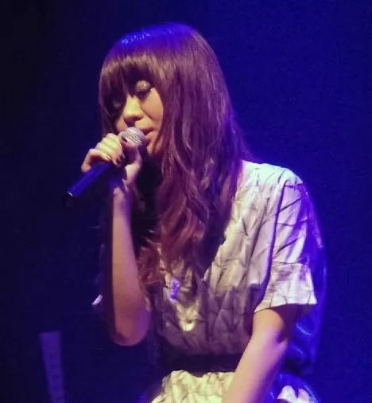
Background Introduction
冯曦妤(Féng Xīyú)，香港歌手兼作词人，以歌声清脆而著名。
1999年，16岁的冯曦妤加入陈光荣的音乐室。Proud Of You是冯曦妤自创的一首歌，也是《挥着翅膀的女孩》的原曲，是冯曦妤在人生最低潮时作给制作人兼她的领路人陈光荣的，谢谢他对自己的鼓励和支持。

Slide 7

Background Introduction
一个成功者需要歌颂和感恩背后默默奉献的辛勤教导者。我 -- 会飞的人，你--教导者。
我之所以能取得成就，是因为有你，一直以来，我以有你而感到骄傲。
proud of .... 以....为骄傲。不是为成功者而感到骄傲
而是为每一个在成功者背后默默付出的指路人······
Thank you, teachers!

Slide 8
Reading and Translating
1、Love in your eyes
Sitting silent by my side
Going on holding hands
Walking through the nights
2、Hold me up hold me tight
Lift me up to touch the sky
Teaching me to love with heart
Helping me open my mind
3、I can fly
I'm proud that I can fly
To give the best of mine
Till the end of the time
你眼中充满爱意
静静地坐在我身边
一直牵着手
走过夜晚
抱起我 抱紧我
高高举起让我摸到天
教我用心去爱
助我把心窗打开
我能飞翔……
我为自己能飞而骄傲
奉献自己最珍贵的
直到生命的最后一刻

Slide 9
Reading and Translating
4、Believe me I can fly
I'm proud that I can fly
To give the best of mine
The heaven in the sky
5、Stars in the sky
Wishing once upon a time
Give me love make me smile
Till the end of life
（Repeat 2--5）
6、Can't you believe that you light up my way
No matter how that is my path
I'll never lose my faith
相信我，我能飞翔
我为自己能飞而骄傲
奉献自己最珍贵的
空中的天堂
天上繁星
希望有一天
爱的降临让我欢笑
直至我的一生
你可相信，你已照亮我的前路
不论前方有多艰难
我决不失去信心

Slide 10
Reading and Translating
7、See me fly
I'm proud to fly up high
Show you the best of mine
Till the end of the time
8、Believe me I can fly
I'm singing in the sky
Show you the best of mine
The heaven in the sky
9、Nothing can stop me
Spread my wings so wide
看我飞翔
我骄傲的高高地向上飞
将我最好的展示给你看
直到最后一刻
相信我能飞
我在空中歌唱
将我最好的展示给你
空中的天堂
没有什么能阻挡我
展翅高飞

Slide 11
感恩遇见，相互成就，本课件资料仅供您个人参考、教学使用，严禁自行在网络传播，违者依知识产权法追究法律责任。
更多教学资源请关注
公众号：溯恩高中英语
知识产权声明

Slide 12
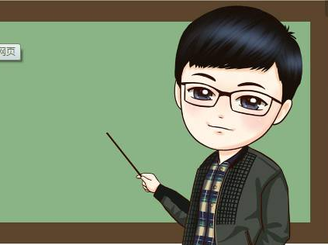
Enjoying and Imitating
1、Love in your eyes
love里面有一个短音 /ʌ/ ，要短促有力收小腹。your与eyes 之间需要连读，唱起来更顺口。
Sitting silen_{t} by my side
sitting双t要浊化。silent by my side四个单词里面都有 /aɪ/ 音，要把它们发的很饱满，会更具魅力。
Going on holding hands
going 和hold 这两个单词里都有一个 /əʊ/ 音，同样要将它发的饱满圆滑，唱出来会更好听。
Walking through the nights
2、Hol_{d} me u_{p} hol_{d} me tight
hold me up这句中的hold中的 “d” 可以省略不读的。
Lif_{t} me u_{p} to touch the sky
Lift me up to touch the sky 这句中 lift 与me 需要连读，所以 “t”也可以省略。
Teaching me to love with heart
Helping me open my mind

Slide 13
Enjoying and Imitating
3、I can fly
I'm proud tha_{t} I can fly
To give the bes_{t} of mine
that I 和 best of这两个地方注意点是相同的，都需要连读加浊化。
Till the end of the time
注意此处的连读。the end 中的“the”发音 /ði:/
4、Believe me I can fly
I'm proud tha_{t} I can fly
To give the best of mine
The heaven in the sky

Slide 14
Notes to the lyrics
tight/taɪt/ adj. 紧的；密封的；绷紧的；严厉的adv. 紧紧地；彻底地
1. held or fixed in position firmly; difficult to move or undo 牢固的；紧的；解开的
•He kept a tight grip on her arm. 他紧紧握住她的胳膊。
•The screw was so tight that it wouldn't move. 螺丝钉太紧，拧不开。
2. fitting closely to your body and sometimes uncomfortable 紧身的；紧贴的
•The new sweater was a tight fit . 这件新毛衣很贴身。
3. very strict and firm 严密的；严格的；严厉的
•We need tighter security at the airport. 我们需要在机场实行更加严密的安全措施。
4. difficult to manage with because there is not enough 紧的；拮据的；不宽裕的
•We have a very tight budget /a tight schedule. 我们的预算很紧/日程安排很紧凑。
拓展： Ode to the Oak—Shu Ting 致橡树——舒婷
I must be a kapok beside you, 我必须是你近旁的一株木棉，
As an image of tree I stand with you. 做为树的形象和你站在一起。
Our roots hold tightly in the earth, 根，紧握在地下，
Our leaves touch gently in the clouds. 叶，相触在云里。
拓展：Now it's time to say good night. Sleep tight.现在该说晚安了，晚安，睡个好觉。

Slide 15
Notes to the lyrics
proud /praʊd/ adj. 自豪的；得意的；自负的
be proud of = take pride of 以...为自豪
• Your achievements are something to be proud of .
你的成就是值得骄傲的。
• Knowledge makes humble, and ignorance makes proud.
博学使人谦逊，无知使人骄傲。
• What would children do to make their parents proud?
孩子怎样做才能让家长骄傲？
• You did a great job，we are so proud of you.
你做得很好，我们为你感到自豪。
• He is a proud, arrogant man. His pride will be his downfall.
他是一个骄傲自大的人。他的骄傲必使他垮台。
• It's time to swallow your pride and ask for your job back.
这时候你应该收起自尊，讨回那份工作。

Slide 16
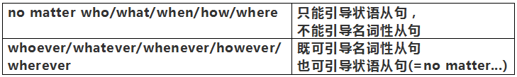
Notes to the lyrics
once upon a time 从前
• Once upon a time there lived in a country a do-gooder.
从前，在一个国家里，有一位做了无数善事的善心者。
No matter how that is my path
• No matter how difficult it is = However difficult it is, life must be eyebrows.
不管多难熬，人生都要眉眼带笑。
• Wherever you are, no matter how far, I promise that I won't give up on you.
无论你在哪里，不管有多远，我保证绝不会离开你。

Slide 17

Showing and Performing
5、Stars in the sky
Wishing once upon a time
Give me love make me smile
Till the end of life
（Repeat 2--5）
6、Can't you believe that you light up my way
No matter how that is my path
I'll never lose my faith
7、See me fly
I'm proud to fly up high
Show you the best of mine
Till the end of the time
8、Believe me I can fly
I'm singing in the sky
Show you the best of mine
The heaven in the sky
9、Nothing can stop me
Spread my wings so wide
1、Love in your eyes
Sitting silent by my side
Going on holding hands
Walking through the nights
2、Hold me up hold me tight
Lift me up to touch the sky
Teaching me to love with heart
Helping me open my mind
3、I can fly
I'm proud that I can fly
To give the best of mine
Till the end of the time
4、Believe me I can fly
I'm proud that I can fly
To give the best of mine
The heaven in the sky

Slide 18
Describing and Appreciating
A Teacher for All Seasons
A teacher is like Spring,
Who nurtures new green sprouts,
Encourages and leads them,
Whenever they have doubts.
A teacher is like Summer,
Whose sunny temperament
Makes studying a pleasure,
Preventing discontent.
A teacher is like Fall,
With methods crisp and clear,
Lessons of bright colors
And a happy atmosphere.
A teacher is like Winter,
While it's snowing hard outside,
Keeping students comfortable,
As a warm and helpful guide.
sprout /spraʊt/ v. 发芽；长芽n. 芽；萌芽；苗芽
discontent /dɪskən'tent/ n. 不满 adj. 不满的 vt. 使不满
crisp /krɪsp/ adj. 脆的；新鲜的

Slide 19
Describing and Appreciating
A speech from a student
Good afternoon, everyone,
It is a great honor to have the opportunity to be with you today. The topic of my speech is “Thank you. My Dear teacher”.
Whenever I think of my dear teacher, memories of the past crowd into my mind. I can well remember that there was a time when I failed in the final exam. I was not a best student, but he didn't look down upon me because of my low scores.
I was such a person as hadn't been paid attention to , you were the only one of the teachers who persuaded me that I was better than I suspected. Only then did I realize that I was also a good student. You are always finding methods to improve our English. I am grateful for all you have done I can't thank you enough for illuminating my life voyage with your light of life.
Thank you for listening
illuminate /ɪ'l(j)uːmɪneɪt/ v. 阐明，说明；照亮；使灿烂

Slide 20
感恩遇见，相互成就，本课件资料仅供您个人参考、教学使用，严禁自行在网络传播，违者依知识产权法追究法律责任。
更多教学资源请关注
公众号：溯恩高中英语
知识产权声明

Slide 21


