Slide 1

感恩遇见，相互成就，本课件资料仅供您个人参考、教学使用，严禁自行在网络传播，违者依知识产权法追究法律责任。
更多教学资源请关注
公众号：溯恩高中英语
知识产权声明

Slide 2
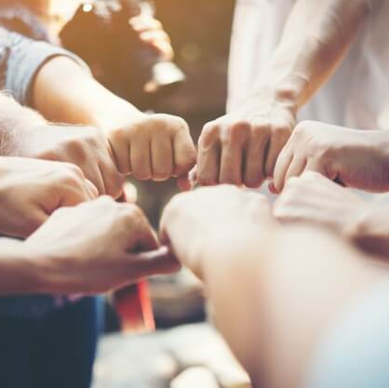
词汇Unit 2 导案
词汇Unit 2 学案
词汇Unit 2 练案
人教版新教材 词汇导学练
Unit2 Book1
淮北市实验高中
张钊

Slide 3
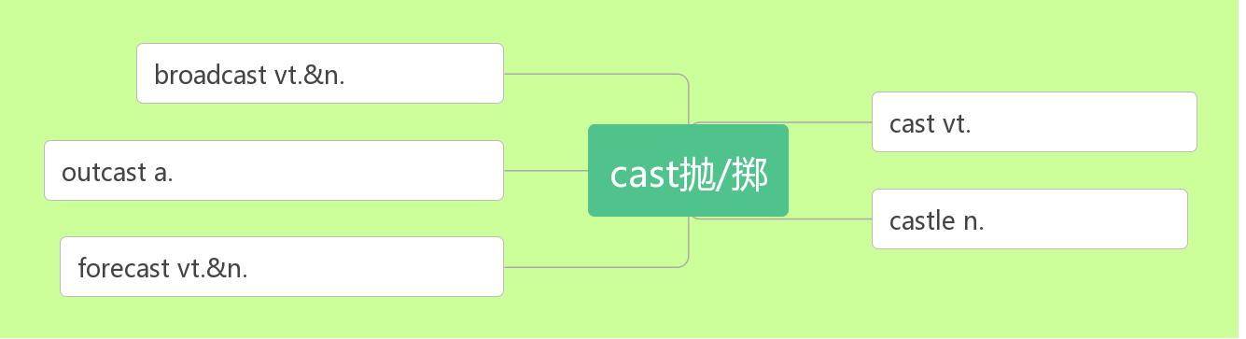
1. castle [ˈkɑ:sl] n.
城堡;堡垒
破拆法：cast(抛掷)+le(了)
助记：抛掷了的武器都被城堡挡了下来。
广播
投,掷,抛
无家可归的
城堡,堡垒
预测,预报

Slide 4
e.g.
Visitors to the castle are asked not to take photographs.
来城堡参观者不得拍照。
Most castles were built on hilltops.
多数城堡建在山顶上。
Every year a large number of tourists come to visit Windsor Castle, which is beautiful.
每年都有大量的游客来参观美丽的温莎城堡。
My hut is my castle. Wind comes in, rain comes in, kings don't come in.
我的茅屋就是我的城堡，风能进，雨能进，国王不能进。

Slide 5
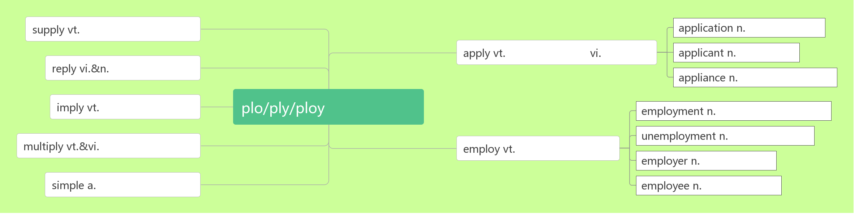
2. apply [əˈplaɪ] vi. vt.
申请
应用;涂抹
供应;提供
申请;应用
应用;涂
申请
申请人
回答;回复
用具;器皿
暗示
应用/折叠
雇用;就业
失业
增加;繁殖
雇用;利用
雇主
简单的
雇员
apply to sb. for sth.
apply sth to sth
向某人申请...
把某物应用于/涂抹在...上

Slide 6
练：
You should ______ in person. 你应该当面申请。
They may apply ______(join) the organization.他们可以申请加入该组织。
To study abroad, you should _________ a visa first.要出国留学，你应该先申请签证。
She only __________ one university and was accepted. 她只向一所大学提出申请并被录取了。
Don't forget ________(apply) sun cream. 不要忘记涂上防晒霜。
You can apply theory ___ practice. 你可以把理论用于实践。
The new technology ___________________________(apply) to farming. 这项新技术已应用于农业。
apply
to join
apply for
applied to
to apply
to
was applied/has been applied

Slide 7
She applied the cream____ her face and neck.
她把乳霜抹在脸和脖子上。
If you don't take charge of shaping your own destiny, others will apply their agenda(计划,日程表) ___you.
你若不主动建构自己的命运，别人将会把他们的计划加诸在你身上。
Send a full CV with your job ___________.
寄上求职申请书和详尽的个人履历。
Since the 1970s many new ____________ have been found for me. 从二十世纪七十年代起，我又被开发出了很多新的用途。
We have learned the ___________ of new technology to teaching. 我们学会了将新技术应用于教学上。
There were over 500 __________ for the job.
对这份工作有超过500名申请人。
to
to
application
applications
application
applicants

Slide 8
3.visa [ˈvi:zə] n.
a visa 申请签证
tourist/entry/exit visa
To travel abroad, you 'll have to get a passport, and you'll also need a visa. 要出国旅游,你必须申办护照, 同时还需要有签证。
4.rent [ rent] vt. vi. n.
练：
She ________(rent) a house with three other girls. 她和其她三个女孩合租一套房子。
We ________(rent) a car for the week and explored the area.
我们租了一个星期的车游历这个地区。
She rented rooms ______ university students.她把房间租给了大学生。
The apartment rents ______ $500 a month. 这套房间每月租金为500 元。
She worked to pay the _______ while I went to college.
在我读大学期间，她打工挣钱来付租金。
签证
词根词缀：vis(看)+a(去)：去给别人看的东西——签证
apply for
旅游/入境/出境签证
租用;出租
出租
租金
rents
rented
to
for
rent

Slide 9
5.pack [pæk]vt. (行李) n.
一包；一盒；一群；一堆
pack (sth.) 将(东西)打包装箱
练：
When I was 17, I _________ my bags and left home. 17岁时, 我背起行囊离开了家。
I should _______ for the trip. 我该打包上路了。
You either pack ____ and go home, or keep fighting!
要不你就打包回家，要不就继续奋斗！
I need to _______________ my things into the suitcase very quickly.
我需要快速把这些东西放到手提箱里。
The tea ______________ and sent to many different countries.
茶叶被打包运往不同的国家。
He put too many things into his _______. 他放太多的东西在他的包里。
He told you____________ lies. 他对你说了一堆谎言。
We were first greeted with the barking by ___________ dogs, seven to be exact.
包装;收拾
纸包;一包
a pack of
up
packed
pack
up
pack/pack up
was packed
pack
a pack of
a pack of

Slide 10
令人惊奇的;令人惊喜的
6. amazing [əˈmeɪzɪŋ ] adj.
(现在分词表示 ，意为“ ”)
amazed [əˈmeɪzd ] adj.
(过去分词表示 ，意为“ ”)
练：
an _________ discovery/success/performance 惊人的发现/成功/表演
It was one of the most _________ films I've ever seen.
这是我看过的最精彩的电影之一。
I saw her ________ look. 我看到了她惊愕的神情。
I was amazed ______ his speed of working. 他办事之麻利让我深感叹服。
The teacher was amazed __________(find) that a lazy student had gained a mark of100 in the test.
老师惊奇地发现一个懒惰的学生在这次考试中得了100 分。
主动内涵
令人……的
感到惊奇的; 感到惊喜的
被动内涵
感到……的
amazing
amazing
amazed
at
to find

Slide 11
While there are_________ stories of instant transformation, for most of us the changes are gradual and require a lot of effort and work, like cleaning up a polluted river.
I'm sure the boy's rich knowledge will _______ you.
我相信那个男孩渊博的知识会使你们吃惊。
The child ________ us with his ability in art, math and other areas.
这个有天赋的孩子在艺术、数学和其他领域的能力使我们吃惊。
It amazed everyone _____ Yang Chenyu gained a mark of 730 in the 2019 Entrance Examination.
杨晨煜在 2019 年高考中获得 730 分的成绩使大家很惊讶。
amazing
amaze
amazed
that

Slide 12
安排；筹备
7.arrangement [əˈreɪndʒmənt]n.
练：
Actually, I've just finished the travel ______________(arrange)!
实际上,我刚刚完成了旅行安排！
Please tell him the arrangements _____ his trip in Italy.
请告诉他在意大利旅行的安排。
I'll make arrangements for you __________(meet) at the airport.
我会安排人到机场接你。
Her teacher made a special arrangement ____________(discuss) her progress at school once a month.
她的老师作了特别安排，每月讨论一次她在学业上的进展情况。
The party _______________(arrange) quickly. 聚会很快就安排好了。
词根词缀：ar(去)+range(排列)+ment(名词后缀):去排列好——安排
arrangement
for
to meet
to discuss
was arranged

Slide 13
They had no time _____________(arrange) their own wedding. 他们没有时间筹备自己的婚礼。
We will arrange ____ a car to pick you up.我们将安排一辆车来接你.
Would you like ____________(arrange) for a personal interview? 你是否想安排一次亲自会见?
8.extremely [ ɪkˈstri:mli ] adv.
练：
The earth will experience __________ weather. 地球将会遭受极端天气。
She found it ___________ difficult to get a job. 她发觉找工作极其困难。
The suffering of the people was _________.人们遭受的痛苦极为深重。
Everything is going on ___________ well.一切进展得非常顺利。
to arrange
for
to arrange
极其
ex(强调)+trem(发抖)+e+ly(副词后缀): 极端到令人发抖的——极其
extreme
extremely
extreme
extremely

Slide 14
extremely
My mobile phone is ____________ useful. 我的手机非常有用。
They sold their land at the ___________ low prices.
他们以极低的价格卖掉土地。
Jiuzhaigou is an ___________ beautiful place.
九寨沟是一个非常美丽的地方。
We are working under _________ pressure at the moment.
目前我们正在极大的压力下工作。
9.source[sɔ:s]n.
e.g.
extremely
extremely
extreme
来源;出处;源头
拆破法：s(水)+our(我们的)+ce(测) 助记：要测出我们的河水的源头。

Slide 15
What other sources of information can you find about Peru?
关于秘鲁，你能找到其他信息来源吗？
The library is a useful source of information.图书馆就是很好的资料来源。
What is their main source of income?他们的主要收入来源是什么？
The source of the Mekong is in Qinghai Province.湄公河的源头在青海省。
For me, music is a great source of enjoyment.
对于我来说，音乐是我快乐的源泉。
10.narrow [ˈnærəʊ]adj. vi.& vt.
e.g.
狭窄的
(使)变窄
拆破法：na(那)+r(让)+row(一排) 助记：路太窄了,那就让大家排成一排。

Slide 16
They were climbing up a ________ mountain road.
他们正沿一条狭窄的山路向上爬。
This is where the river _________. 这条河就是在这里变窄的。
She slowed the car and began driving through the town's _________ streets. 她放慢车速，开始穿过该镇狭窄的街道。
We need to ________ the gap between the rich and poor.
我们需要缩小贫富差距。
The gap between the two main parties has ___________.
两大主要政党之间的差距已经缩小了。
narrow
narrows
narrow
narrow
narrowed

Slide 17
11.flat [ flæt ]adj. n.
e.g.
The driver stops the car on a flat platform and gets out.
司机把车停在一个平坦的平台上，然后出来了。
People used to think the earth was flat. 人们曾经认为地球是平的。
Do you live in a flat or a house? 你住的是公寓还是独立住宅？
Before they got married, they had the flat decorated.
他们结婚前把公寓装修了一遍。
平坦的; 扁平的
公寓; 单元房
拆破法：fl(fly)+at(在) 助记：飞机要在平坦的地方起飞

Slide 18
强有力的；有权势的；有影响力的
12.powerful [ˈpaʊəfl ]adj.
power[pa ʊə]n.
come to/into power
beyond one's power
nuclear/wind/solar power
power cut/failure
His speech was a ___________ attack against the enemy.
他的演说是对敌人强有力的抨击。
As is known to us, knowledge is _________.众所周知，知识就是力量。
His grandfather once was a rich and __________ man.
他的爷爷曾经是一个有钱有势的人。
The Republican Party came _______ power in 2016.
美国共和党是在2016 年上台执政的。
China is wealthier and more __________ than ever before.
中国比以往任何时候都更加富有和强大。
力量；能力；政权；能源；动力
上台执政
超出某人的能力
核能/ 风能/ 太阳能
断电/ 停电
powerful
power
powerful
to/into
powerful

Slide 19
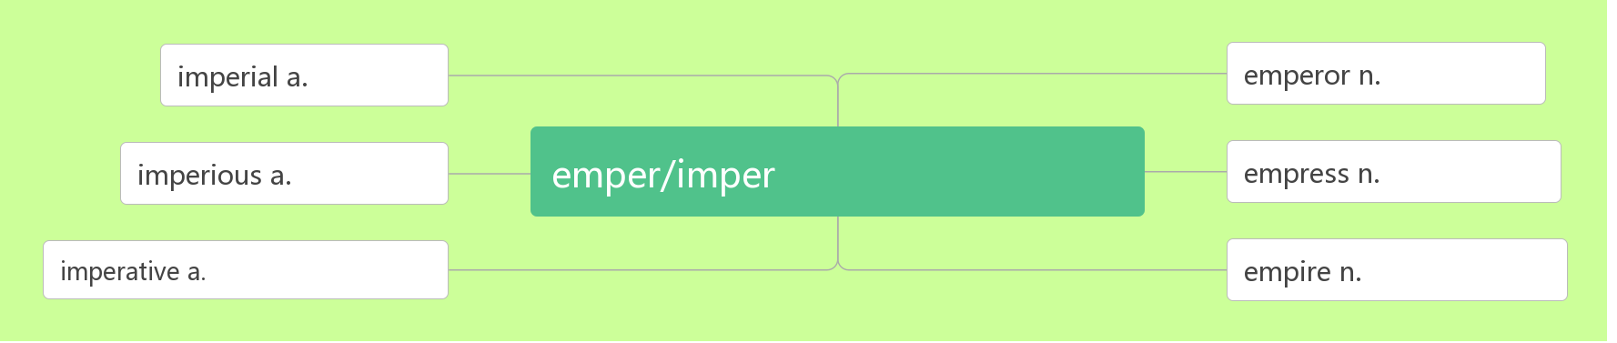
帝国
13.empire[ˈempa ɪə(r)]n.
emperor[ˈempərə(r)]n.
The Thirty Year's War caused the end of the empire. 30 年的战争导致帝国的灭亡。
The Inca emperor lived in the now-famous site Machu Picchu.
印加皇帝曾住在现在著名的遗址马丘比丘。
Qinshihuang was the first emperor of China in history. 秦始皇是中国历史上第一位皇帝。
When the emperor died, his three sons shared the empire.
当皇帝去世后, 他的三个儿子共同分享帝国。
皇帝
帝国的
皇帝
专横的
统治/命令
女皇
强制的
帝国

Slide 20
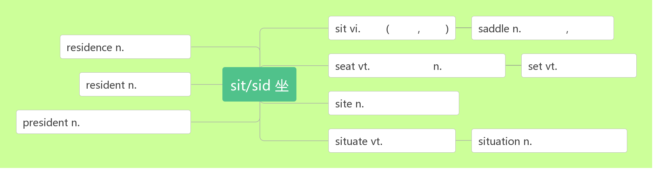
地点；位置；现场
14.site [saɪt ]n.
A good site has been chosen for the new school.已为新学校选好了校址。
The bar is built on the site of an ancient castle . 这家酒吧建在一个古代城堡的遗址上。
They put up their tent at the camping site.他们在营地上搭起了帐篷。
He was a worker on a building site. 他在工地做过建筑工人。
web site 网站
坐
sat, sat
马鞍,鞍部
住所
使就坐
座位
设置, 设定
居民
位置,地点
总统, 总裁
使位于
形势, 情况

Slide 21
控制；管理；抑制
15.control [kən'trəʊl]vt.&. n.
智美例句：
Instead of letting circumstances control and defeat you, use them to push you into action so that you can change your present situation.
不要让生活控制或打败你，你要把压力变成动力去改变目前的处境
You can do anything you decide to do. You can act to change and control your life; and the procedure, the process, is its own reward.
你可以做任何你决定的事，你可以采取行动改变或控制你的人生；而这程序、过程，本身就是报偿。
To get a thorough understanding of oneself is to get a full control of one's life. Then one will find one's life full of color and flavor.
悟透了自己，才能把握住自己，你生活才会有滋有味！
词根词缀：contr(相反)+rol(滚轮)：从反方向使滚轮停下来——控制

Slide 22
控制; 接管
take control of
Spain took control of Peru in the 16th century and ruled until 1821.
16世纪西班牙控制了秘鲁并统治到1821年。
In the night, they successfully take control of the city.
在夜里他们成功控制了那座城镇。
I can't take control of the boat.这船我控制不了。
I decided to take control of my life. 我决定控制自己的人生。
After his father died, he took control of the company.
他父亲死后，他接管了公司。
16.official [ə'fɪʃl] adj. n.
officially adv.
官方的；正式的; 公务的
政府官员
官方地；正式地

Slide 23
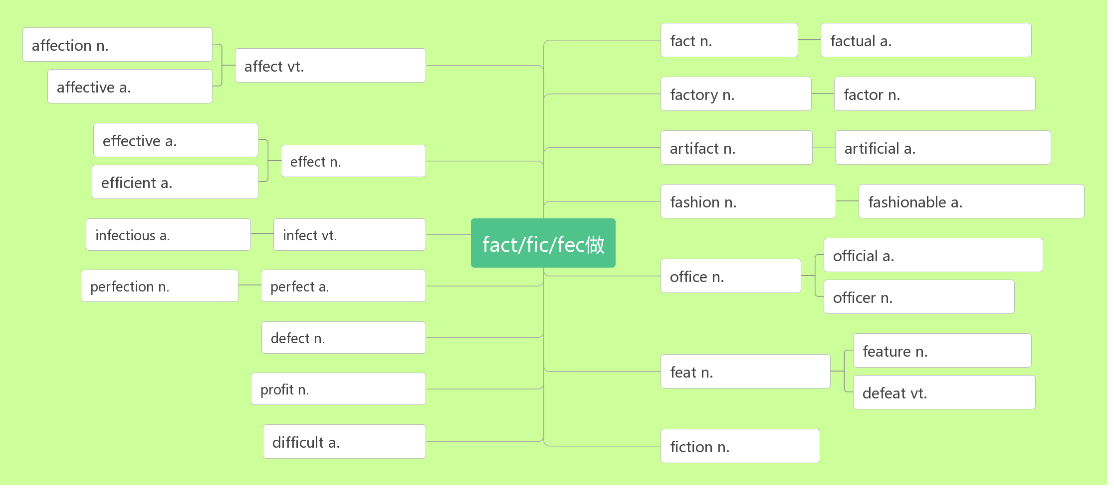

情感;爱
事实
事实的
影响;感动
感人的
工厂
因素
有效的
人造品
人造的
效果;影响
高效的
时尚
时尚的
传染的
传染
官方的n.官员
完美
完美的
办公室
军官;警官
缺陷
特征
功绩
利润
打败
困难的
小说

Slide 24
练：
English is used as an _______ language in many countries.
英语是许多国家的官方语言。
The college is not an ________ recognized English language school.
那所学院不是官方认可的英语学校。
The President made a four-day_______ visit to Mexico.
总统到墨西哥进行了为期四天的正式访问。
The title will be ________ given to me at a ceremony in London. (2016全国卷I）在伦敦举行的一个仪式上，这个头衔将正式授予给我。
His grandfather is an ______ in the army while his father is an _______ in the government. 他的爷爷是部队军官，而他的爸爸是政府官员。
official
officially
official
officially
officer
official

Slide 25
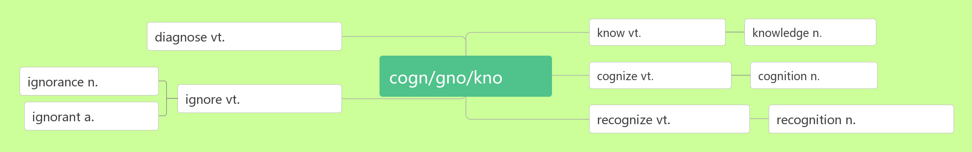
辨别出; 承认; 认可
17. recognise[ ˈrekəgnaɪz] vt.
recognition[rekəgˈnɪʃn] n.
recognise …________ 把……当做；承认…… 为
练：
I___________ him as soon as he came into the room.
他一进屋我就认出了他。
承认;认可
诊断
知道,认识
知识
知
知道,认识
知道,认识
无知
忽视,忽略
无知的
认出;认可
承认;认可
as/to be
recognised

Slide 26
感恩遇见，相互成就，本课件资料仅供您个人参考、教学使用，严禁自行在网络传播，违者依知识产权法追究法律责任。
更多教学资源请关注
公众号：溯恩高中英语
知识产权声明

Slide 27
She passed close by me without a sign of ____________.
她与我擦肩而过,却没认出我.
Though they hadn’t met for many years, they ___________ each other at the first sight.
虽然他们多年没见面，他们第一眼就认出了对方。
The doctor tried to get his work____________ in the medical circles.
这个医生试图让他的工作在医学圈内得到认可。
At last, her father's work has received popular __________.
最后，她父亲的工作得到了大众的认可。
We recognise Xi Jinping ________ a great leader.
我们认为习近平是一位伟大的领袖。
recognition
recognized
recognized
recognition
as/to be

Slide 28
类型; 种类
打字
18. type [taɪp]n. vi. & vt.
typist [taɪpist]n.
练：
How fast can you _____? 你打字有多快？
There are various______of the disease. 该疾病有各种类型。
Have you done this____ of work before?你以前做过这种活儿吗？
I love these______of books.我喜欢这些种类的书籍。
Many women applied for the post of ______.
许多妇女应征这个打字员的职位。
打字员
type
types
type
types
typist

Slide 29
19.flight [flaɪt]n.
e.g.
A short flight from Cusco takes you from the Andes into the Amazon rainforest.
从库斯科出发的短程航班带你从安第斯山脉到亚马逊雨林。
The flight will take four hours.这次航行要飞 4 个小时。
I arrived just in time for my flight to London.我及时赶上了飞往伦敦的航班。
British Airlines is putting on an extra flight to London tomorrow.
英国航空公司明天将增加一班到伦敦的航班。
Flight BA 4793 is now boarding at Gate 17.
BA 4793航班现在正在17号登机口登机。
This flight was more comfortable than I had expected.
这次飞行比我预想的更舒服。
航班;航程

Slide 30
20.accommodation[əˌkɒməˈdeɪʃn]n.
e.g.
From there, you'll spend one day travelling by boat to your accommodation in the middle of the forest.
从那里，你将花一天的时间乘船前往森林中央的住处。
Hotel accommodation is included in the price of your holiday.
你度假的价款包括旅馆住宿在内。
First-class accommodation is available on all flights.
所有班机都备有一等舱位。
More and more travelers are looking for accommodations in private homes.
愈来愈多的旅行者在寻找由私人住户提供的膳宿服务。
膳宿；住宿；住处
词根词缀：ac(去)+com(共同)+mod(模式)+ation(名词后缀)：去用共同的模式招待——膳宿，住宿

Slide 31
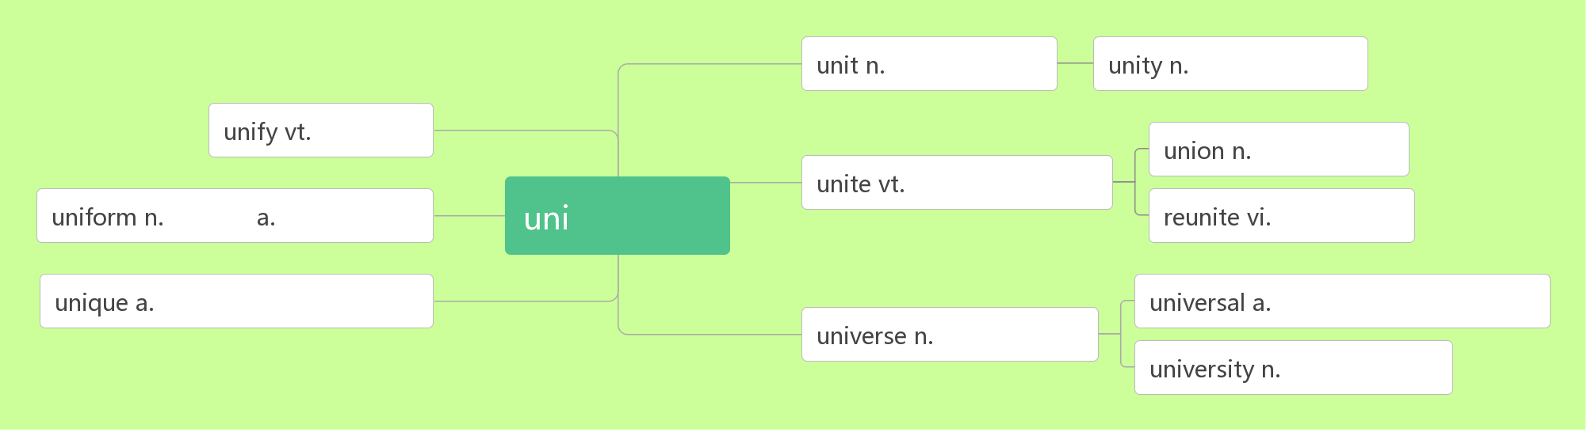
21.unique [juˈni:k]adj.
e.g.
You can then spend three days exploring the rainforest with a local guide and enjoying the plants and animals unique to the rainforest.然后,你可以花三天时间和当地导游一起探索热带雨林, 欣赏热带雨林独有的植物和动物。
Everyone's fingerprints are unique. 每个人的指纹都是独一无二的。
Dollywood is one of the most unique theme parks in the world.
多莱坞是世界上最独特的主题公园之一。
唯一的; 独特的; 特有的
单元;小节
单一;一致
统一
联合;联盟
联合;团结
制服
一致的
单一
团聚;重聚
唯一的;独特的
普遍的;通用的
宇宙
大学

Slide 32
是某人/ 某地特有的
e.g.
This flower is unique to the area. 这种花儿是这一地区特有的。
The koala is unique to Australia. 树袋熊是澳大利亚特有的。
22.path [pɑ:θ ] n.
e.g.
They followed the path to the village.
他们顺着小路来到那个村子。
We walked along the path, enjoying the natural scenery.
我们沿着小路行走，欣赏着自然风光。
I saw our flight path would be over this famous mountain.
我看到我们的飞行路线要经过这座著名山峰。
Our country is on the path to economic recovery.
我们的国家正走上经济复兴之路。
unique to sb. /sp.
小路; 路线; 道路

Slide 33
23.destination[destɪˈne ɪʃn] n.
e.g.
After reaching your destination, you will have a day to explore and be amazed by this ancient city.
到达目的地后，您将有一天的时间去探索，并对这座古城感到惊叹。
Spain is still our most popular holiday destination. 西班牙仍是我们最喜爱的度假去处。
Life is a journey with an unknown destination. 生活是一次不知目的的旅行.
You can check your baggage all the way through to its final destination.你可以把行李直接托运到终点。
After many difficulties and dangers, we finally reached our destination.
经过了许多艰难险阻之后, 我们终于到达了目的地.
目的地；终点
词根词缀：de(下)+stin(站=stand)+ation(名词后缀):下一个要站的地方
——目的地

Slide 34
24.other than
e.g.
Inca builders cut stones to exact size so that nothing was needed to hold walls together other than the perfect fit of the stones.
印加建筑工人把石头切割成精确的尺寸，这样，除了石头的完美贴合之外，不需要任何东西来将墙壁固定在一起。
There is nobody here other than the teacher.
这里除老师外再无别人。
I have not studied foreign languages other than English.
除了英语外，我没学过其他外语。
You can't get there other than by boat.
除了坐船,你无法去那里。
I cannot do anything other than say sorry to you.
我除了向你说声对不起，已经不知道该做些什么了。
除…以外

Slide 35
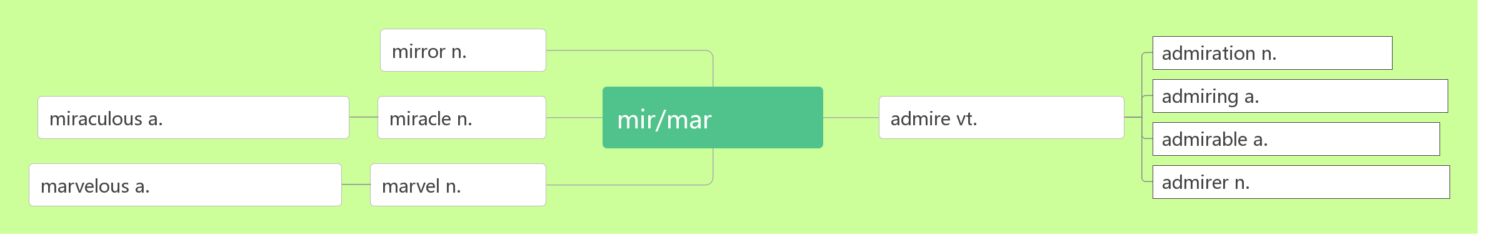
25.admire [ədˈmaɪə(r)]vt.
admiring [əd'ma ɪərɪŋ] adj.
admirable[ ˈædmərəbl] adj.
admiration [ˌædməˈreɪʃ n]n.
练：
欣赏；赞赏；钦佩
音意互通：我的妈呀 助记：我的妈呀，你做的事太令人钦佩了。
镜子
钦佩;欣赏
钦佩的
奇迹般的
奇迹
惊叹
钦佩;欣赏
钦佩的
令人惊叹的
奇迹
爱慕者;崇拜者
赞赏的；钦佩的
令人钦佩的; 值得赞扬的
欣赏；赞赏；钦佩

Slide 36
China and Japan have mid-autumn festivals, when people ________ the moon and in China, enjoy mooncakes.
中国和日本都有中秋节，这时，人们会赏月。在中国，人们还品尝月饼。
He walked along the river, __________ the beautiful scenery.
他沿河边走欣赏美丽的景色。
Honesty is a quality that everyone ________. 诚实是人人都赞赏的品德。
All those who knew him admired him ____ his work.
所有认识他的人都敬佩他所做的工作。
The school is widely ________ for its excellent teaching.
这所学校教学优秀，远近称誉。
He gave her an _________ glance. 他向她投以钦慕的目光。
He was an __________ chairman. 他是一位令人钦佩的主席。
Her devotion to her work was __________. 她对工作的奉献精神可钦可佩。
I have great ___________ for her as a writer. 我十分钦佩她这位作家。
admire
admiring
admires
for
admired
admiring
admirable
admirable
admiration

Slide 37
26.architect [ˈɑ:kɪtekt ] n.
e.g.
Lin Huiyin was not only a professor of Qinghua University but also a famous architect.
林徽因不但是清华大学的教授，而且还是一位著名的建筑设计师。
The new building was built from the design of a famous architect.
这座新楼是根据一位著名建筑师的设计建成的。
architecture [ˈɑ:kɪtekt ʃə(r) ]n.
The house is a textbook example of modern architecture.
这所房子是现代建筑设计典范。
I'm interested in Roman architecture. 我对古罗马建筑风格感兴趣。
At first he studied architecture in college. 起先，他在大学里学习建筑学。
建筑师，建筑设计师
词根词缀：archi(大师)+tect(铸造; 织造)：建筑的大师——建筑师
建筑设计；建筑学

Slide 38
27.brochure [ˈbrəʊʃə(r)] n.
a travel brochure 旅游手册
For more brochures about other package tours around Peru, contact us at tourinfo@travelperu.org. 想获得关于秘鲁其他包价旅游的更多资料手册，请与我们联系：tourinfo@travelperu.org。
Do you have a sightseeing brochure for this town?
在这个镇上有观光手册吗 ?
This hotel looked wonderful from the brochure.
这家旅馆从广告手册上看很棒。
Our company culture is introduced in the brochure.
在这个宣传册介绍了我们的公司文化。
资料手册
音意相通：布鲁塞尔 助记：在布鲁塞尔旅游，你需要一本旅行手册。

Slide 39
28.package[ˈpækɪdʒ]n. vt.
一包/ 盒/ 袋
练：
Fast-food robots will probably cook and________ food.
快餐机器人很可能会烹煮和包装食物。
Foods were already __________ and ready to be sent.
食物已包装好待运。
He sat with the __________ on his knees
他坐着，将包裹放在腿上。
This kind of _________ is very green.
这种包装盒很环保。
We're planning to go ___ a package tour to Japan.
我们计划参加包价旅游去日本。
包裹;包装盒
将…包装好
词根词缀：pack(包装)+age(名词后缀)：包裹，包装盒。
a package of
package
packaged
package
package
on

Slide 40
29.contact [ˈkɒntæ kt ]vt. n.
For more brochures about other package tours around Peru, _______ us at tourinfo@travelperu.org. 想获得关于秘鲁其他包价旅游的更多资料手册，请与我们联系：tourinfo@travelperu.org。
For more information , please _______ John Smith.
了解更多信息，请与约翰史密斯联系。
He never _________ his children after he went to Australia.
他去了澳大利亚以后没联系他的孩子。
I don't have much contact _____ my uncle. 我和叔叔很少联系。
There is little contact ________ the two organizations.
这两个机构相互之间没有什么联系。
Have you kept ___ contact with your friends from college?
你和你大学里的朋友还保持联系吗？
She's _____ contact with her son. 她和儿子失去了联系。
I finally _______ contact with her in Paris. 我最终在巴黎与她取得了联系。
联络；联系
联系；接触
词根词缀：con(一起)+tact(接触)：接触到一起——联系。
contact
contact
contacted
with
between
in
lost
made

Slide 41
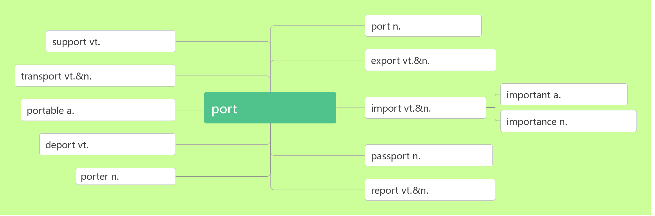
30.transport [ˈtræ nspɔ:t]n. vt. [trænˈspɔ :t]
air/road transport
public transport
transport goods/passengers
交通；运输
运输；运送
港口;口岸
支持
出口
运输
重要的
便携的
港口/搬运
进口
重要性
驱逐
护照
搬运工
报告
空运/ 路运
公共交通；公交车辆
运送货物/旅客

Slide 42
e.g.
Most of us use public transport to go to work.
我们大多数人都乘公交车辆上班。
The extra money could be spent on improving public transport system.
多余的资金可以用于改善公共交通系统。
Mr Black was made transport minister.
布莱克先生被任命为交通部长。
They transport oil to other countries.
他们把石油运到别的国家。
Blood transports oxygen around the body.
血把氧气输送到全身。

Slide 43
31. hike [haɪk ]vi. vt. n.
go 远足；徒步旅行
hiker [ˈhaɪkə(r) ] n.
e.g.
They ate a quick lunch, drank some water, and began to hike.
他们匆匆地吃过午饭，喝了点水，然后就开始徒步旅行。
They are going to hike to the top of a mountain.
他们打算徒步旅行到一座大山的顶端。
The students planned to hike the Rockies. 学生们计划去落基山脉远足。
They went on a ten-mile hike through the forest.
他们做了一次穿越森林的十英里徒步旅行。
We'll go on a hike next week. 我们下个星期会出去徒步旅行。
If the weather's fine, we'll go hiking this weekend.
如果天气好，我们这个周末就去远足。
Early in the morning, hikers pack everything that they will need for the day's hike.一大早，徒步旅行者们把当天旅行所需的一切都装进包里。
徒步旅行
去……远足
远足;徒步旅行
hiking
远足者；徒步旅行者

Slide 44
32. make up
be made up of
make up for
Eleven players make up a football team. 11 个队员_______一个足球队。
Women make up 30 percent of the teachers of our school.
我们学校女教师____30%。
He isn’t telling the truth. He is just making the story.
他没说实话，他只是在____故事。
She spent too much time making herself up. 她在______上花去了太多时间。
She came back and they made up. 她回来了，他们______了。
A football team is made up of eleven players.
一个足球队____ 11 个成员______。
We should work harder to make up for the lost time.
我们应当更加努力工作，以______损失的的时间。
组成；编造；占比；化妆；和好
由……组成
弥补
组成
占
编
化妆
和好
由
组成
弥补

Slide 45
33. soldier /ˈsəʊldʒə (r)/ n.
My brother is a brave soldier. 我的哥哥是一名勇敢的士兵。
智美例句：
Difficult only exists before the weak, but can not prevent the experienced soldier. 困难只存在于弱者面前，挡不住久经考验的士兵。
34. economy[ ɪˈkɒnəmi] n.
economy class
a market economy
economic growth/cooperation/development/reform
士兵; 军人
破拆法：sold(sold)+i(我)+er(人) 助记：士兵就是把自己卖给国家的人
经济; 节约
词根词缀：eco(家)+nom(管理)+y(名词后缀)：对家的管理——经济
（客机）经济舱
市场经济
经济增长/合作/发展/改革

Slide 46
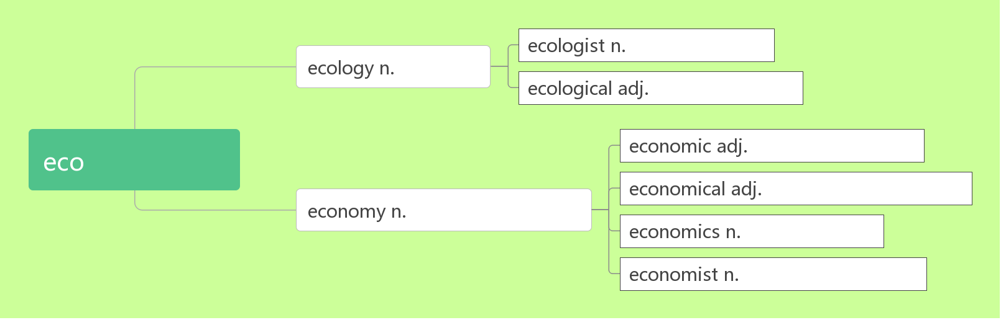
生态学家
生态学
生态学的
经济/生态
经济上的
节约的;经济的
经济；节约
经济学
经济学家
e.g.
The Chinese economy grows at a rate of 10 percent every year. 中国经济每年增长10%。
It was a small economy to walk to work every day每天步行上班是一种小节约。
Coffee is the economic plants of this country. 咖啡是这个国家的经济作物。
The signs of the economic recovery are only just beginning. 经济复苏的迹象刚刚开始显现。

Slide 47
35. credit [ˈkredɪt] n.
to one’s credit
credit card
by credit card
练：
This factory keeps up its good credit, so its products sell very well.
这家工厂保持着良好的______，所以产品销售很好。
Small companies can't get the credit they need. 小公司不能获得他们想要的_____了。
The family was forced to live on credit from local merchants.
这家人不得不靠向当地商人______生活。
We did the work well and got all the credit. 我们工作做得很好，得到了_____。
Students attend "short terms" in May and June to earn the credits required for graduation.学生在 5月和 6月参加“短期”课程，以获得毕业所需的______。
It is very convenient to pay ____ credit card. 用信用卡付款非常方便
信用;借款; 称赞; 学分
词根词缀：cred(相信)+it(去)：去信任——信用
有了信用才能借款上学，要获得老师的称赞就要拿到学分。
值得赞扬
信用卡
用信用卡支付
信用
贷款
赊账
称赞
学分
by

Slide 48
36.detail /ˈdi:te ɪl / n. vt.
detail 详细地
e.g.
Contact the Tourist Information Bureau for more details.
了解详情请联系旅游信息处。
Don’t ignore small details while reading. 阅读过程中不要忽视了小的细节。
Please mark the main ideas and important details with a pen.
请用钢笔标出要点和重要细节。
The man detailed to us all the wonders he had seen in his travels.
那人向我们详述了他旅途所见之奇事。
Happiness hides in life’s small details. If you are not looking, it becomes in- visible.
快乐隐藏在生活的细节里，不留意就难以察觉。
She described the accident in detail. 她详细地叙述了那次事故。
细节；详情；细微之处
详述
破拆法：de(得)+tail(尾巴)：得到秋毫之末——细节。
in

Slide 49
37.check in
check out
e.g.
I'll ring the hotel. I'll tell them we'll check in tomorrow.
我来给旅馆打电话，通知他们我们明天入住。
If you want to stay at a hotel, you have to check in.
你想住旅馆，就得办理登记手续。
Passengers must check in at the airport an hour before the plane leaves.
旅客们必须在飞机起飞前一小时到机场办理登机手续.
He checked in at the Capital International Airport for a flight to America.
他在首都国际机场办好了登机手续，准备飞往美国。
When I got to the hotel, he had just checked out.
当我到达旅馆时，他刚退房走了。
They packed and checked out of the hotel.
他们收拾好东西，办理了退房手续。
Guests must check out before noon, or they will be charged for the day.
旅客必须于中午前办清手续离开, 否则将收取全日费用
(在旅馆、机场等) 登记
结账离开（旅馆等）

Slide 50
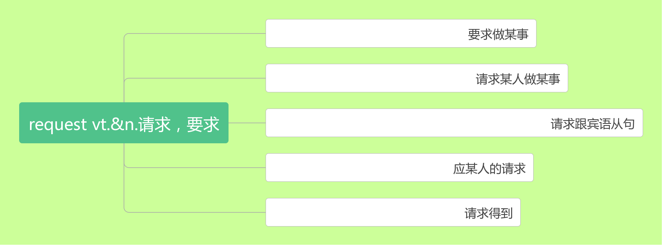
38.request[rɪ'kwest]n.&vt.
练：
If you have any special __________ about your room, please contact the reception.
如果您对您的房间有特殊的要求，清联系接待处。
Finally they had to make a ________ for help. 最后他们只好请求帮助。
He went there _____ their request. 他应邀前往。
(正式或礼貌的) 要求；请求
request to do sth.
request sb. to do sth.
request (that) sb. (should) do sth.
at one's quest
make a request for
request(s)
request
at

Slide 51
The woman came to the party _____ her friend's request.
应朋友的请求，这个妇女参加了聚会。
They requested him ___________. 他们要求他离开。
Visitors are requested not ___________ here. 参观者请勿在此吸烟。
They requested that help _________________(send) at once. 他们请求立即施以援助。
39. view [vju:]n. vt.
in one's view
a sea/ mountain view
e.g.
I'd like a room with a view. 我想要一个可以观看风景的房间。
The view from the top of the hill was more beautiful. 从山顶远眺景色更美丽。
The lake soon came into view . 那湖很快映入眼帘。
The sun disappeared from view . 太阳看不见了。
You should make your views known to your friend.你应该让你的朋友了解你的观点。
In my view it was a waste of time. 依我看, 这是浪费时间。
In my view, the greatest happiness lies in one's satisfaction with one's life.
在我看来, 最大的幸福在于人们对生活的满意程度。
at
to leave
to smoke
(should) be sent
视野;景色;看法
看;看待
在某人看来
海/山景

Slide 52
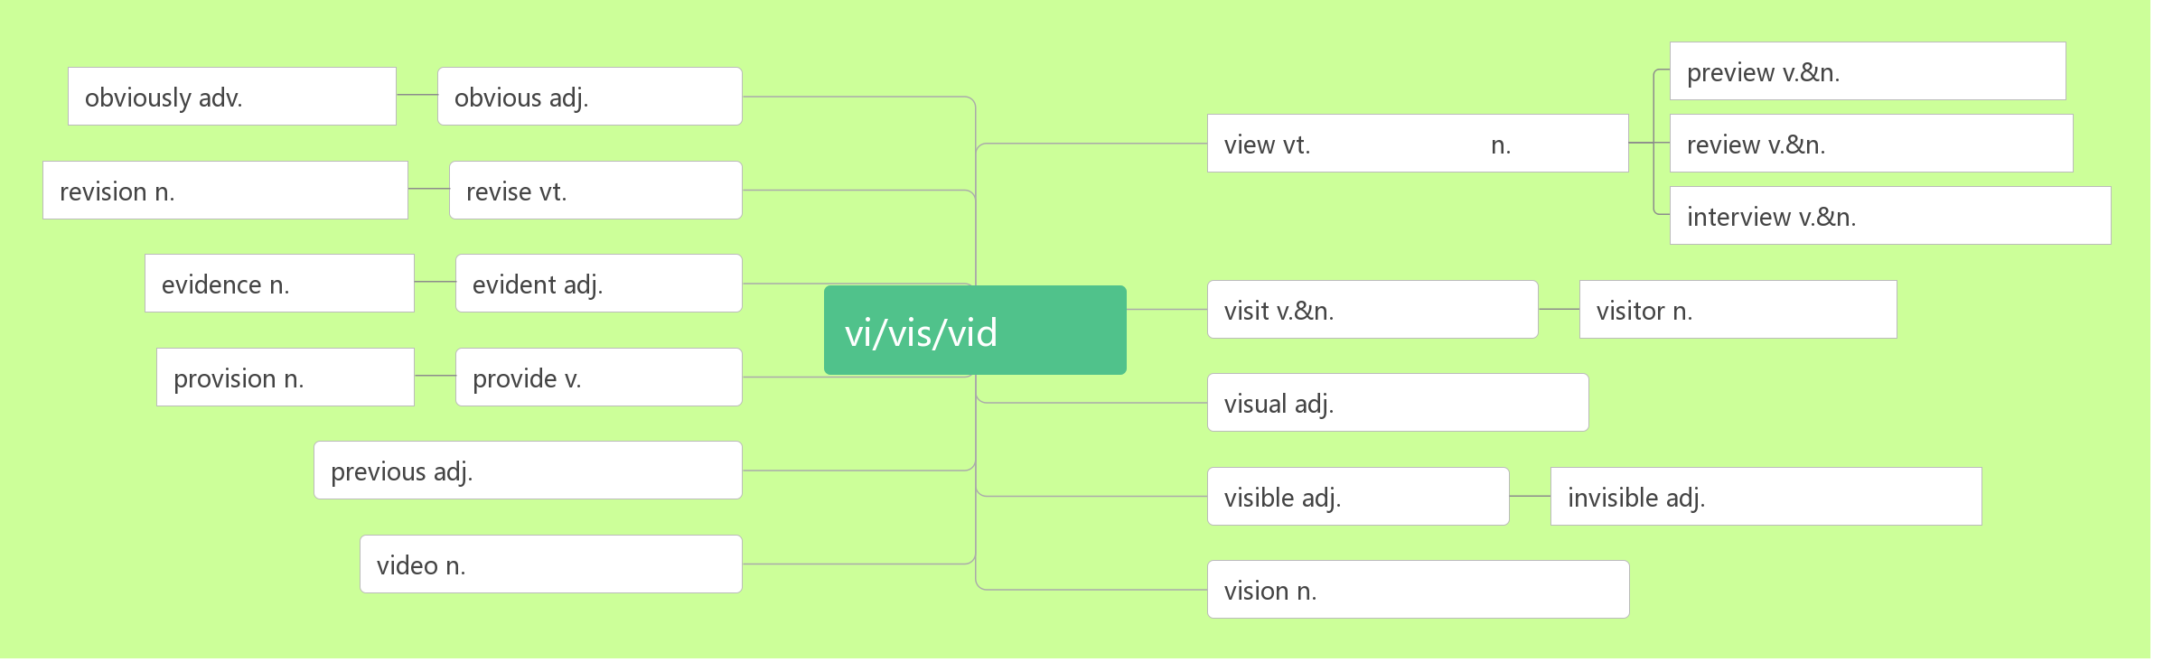
预习
明显地
明显的
看,看待
景象
复习;评论
修订;复习
修订
采访;面试
证据
明显的
参观;访问
游客;访客
看
供应
提供
视觉的
先前的,前面的
可见的
看不见的
视频, 录像
视力；幻像

Slide 53
40.sight [saɪt] n.
The sunset was a very beautiful ________. 那次落日真是一幅美景。
The Great Wall is one of the most amazing _______ in the world.
长城是世界上最惊奇的景象之一。
She went out to see the _______ of Paris. 她去巴黎观光了。
A bicycle came ______ sight on the road. 路上出现了一辆自行车。
We waved until the car was _____ of sight.
我们一直挥着手，直到汽车驶出了我们的视野。
He has very little sight ____ his right eye. 他右眼视力极弱。
My sight is ________(fail), and I can't read any more.
我的视力在下降，看不了书了。
景象; 视野; 视力
sight
sights
sights
into
out
in
failing

Slide 54
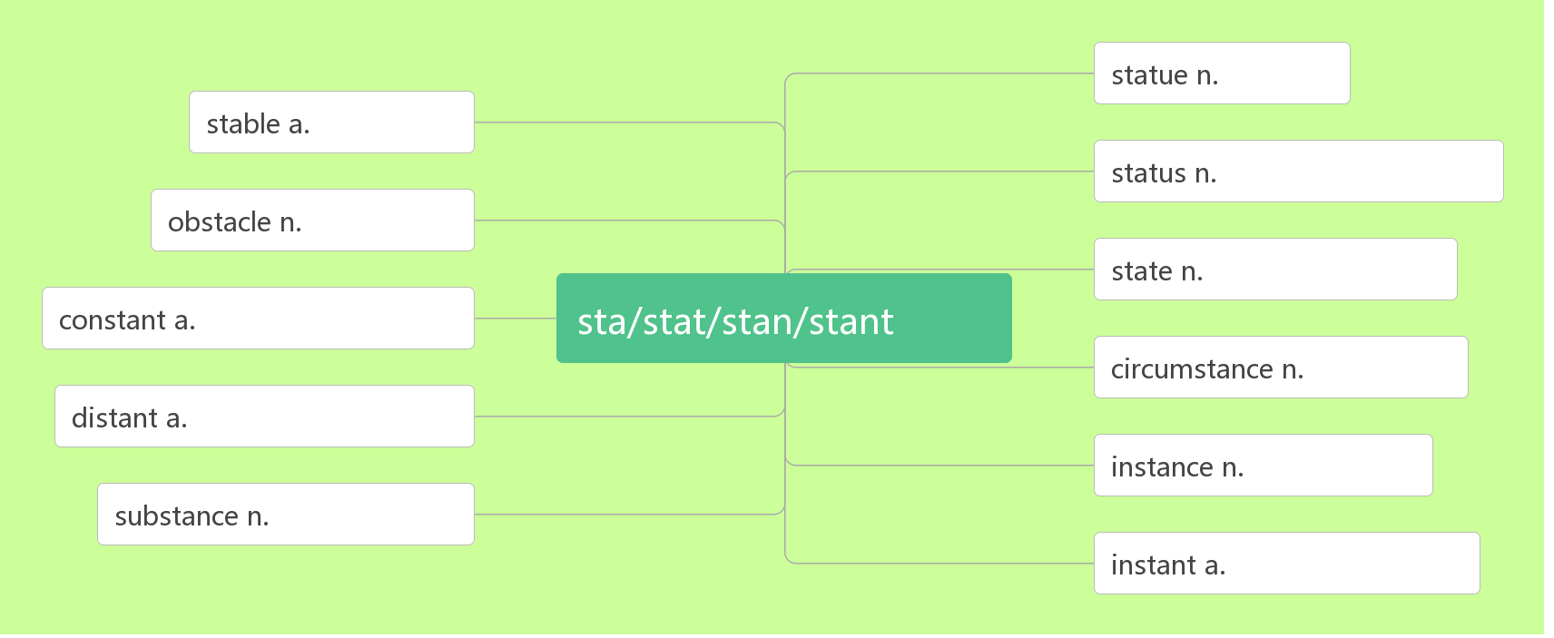
雕塑；雕像
41.statue [ ˈstæ tʃu:] n.
雕像
稳定的
地位;状态;情况
障碍
状态；州
不断的, 稳定的
站
环境
遥远的,有距离的
例子;情况
物质;本质
立即的;紧急的
Each statue has a different face, leading researchers to believe that each one is a copy of a real soldier. 每尊雕像都有一张不同的面孔，使得研究人员认为每尊雕像都是一个真实的士兵的复制品。
They set up a statue in memory of him. 他们立了一座雕塑纪念他。
There is a bronze statue in the central park. 在中心花园有一座青铜像。

Slide 55
42.tomb [tu:m ] n.
More than 700,000 people worked for nearly 40 years to build this tomb.
超过七十万人为建造这座坟墓工作了将近40年。
There are more than 8,000 terracotta statues in the tomb of the Chinese Emperor Qinshihuang.
在中国皇帝秦始皇的陵墓里有8000 多个陶俑。
A group of students placed a wreath at the tomb of the national hero.
一群学生在那位民族英雄墓前献上花圈。
43.unearth [ʌnˈɜ:θ] vt.
e.g.
The statues fill only one part of the emperor's huge tomb, which still has not been completely unearthed.
这些雕像只占巨大的秦始皇坟墓的一部分，坟墓还没有完全被挖掘出来
坟墓
音意相通：土墓 助记：平原地区的坟墓基本上都是土墓。
挖掘；发掘
词根词缀：un(不)+earth(土壤)：不留在土壤中——挖掘。

Slide 56
They have unearthed the bones of an elephant which was 500,000 years old.
他们发掘出了一具大象骨骼，距今已有50 万年。
Red diamonds have been unearthed here. 在这儿发掘了红钻石。
44.comment / ˈkɒ ment /n. vi.& vt.
no comment
comment/make comments on/upon sth.
e.g.
Revise your draft according to your partner's comments.
根据同伴的评论修改你的草稿。
Swap summaries with your partner and give each other comments.
与同伴交换一下概述，并且互相作出评论。
She made helpful comments on my work. 她对我的工作提出了有益的意见。
He made comments on the economic reform.他对经济改革作出了评论。
议论;评论
发表意见；评论
词根词缀：com(一起)+ment(mind)：把想法拿到一起——评论
无可奉告
对……发表意见/作出评论

Slide 57
No comment. I don't know anything.无可奉告。我什么都不知道。
You really can't comment till you know the facts.
知道真相之前，不要发表任何意见。
How does the author comment on Peter Smith's new book?
作者对皮特史密斯的新书有何评论？
So far, he has not made comments on these reports.
到目前为止，他仍未就这些报道发表评论。
I don't really know so I can hardly comment on it.
我不了解实情，所以我不能就此发表意见。

Slide 58
感恩遇见，相互成就，本课件资料仅供您个人参考、教学使用，严禁自行在网络传播，违者依知识产权法追究法律责任。
更多教学资源请关注
公众号：溯恩高中英语
知识产权声明

