Slide 1

感恩遇见，相互成就，本课件资料仅供您个人参考、教学使用，严禁自行在网络传播，违者依知识产权法追究法律责任。
更多教学资源请关注
公众号：溯恩高中英语
知识产权声明

Slide 2
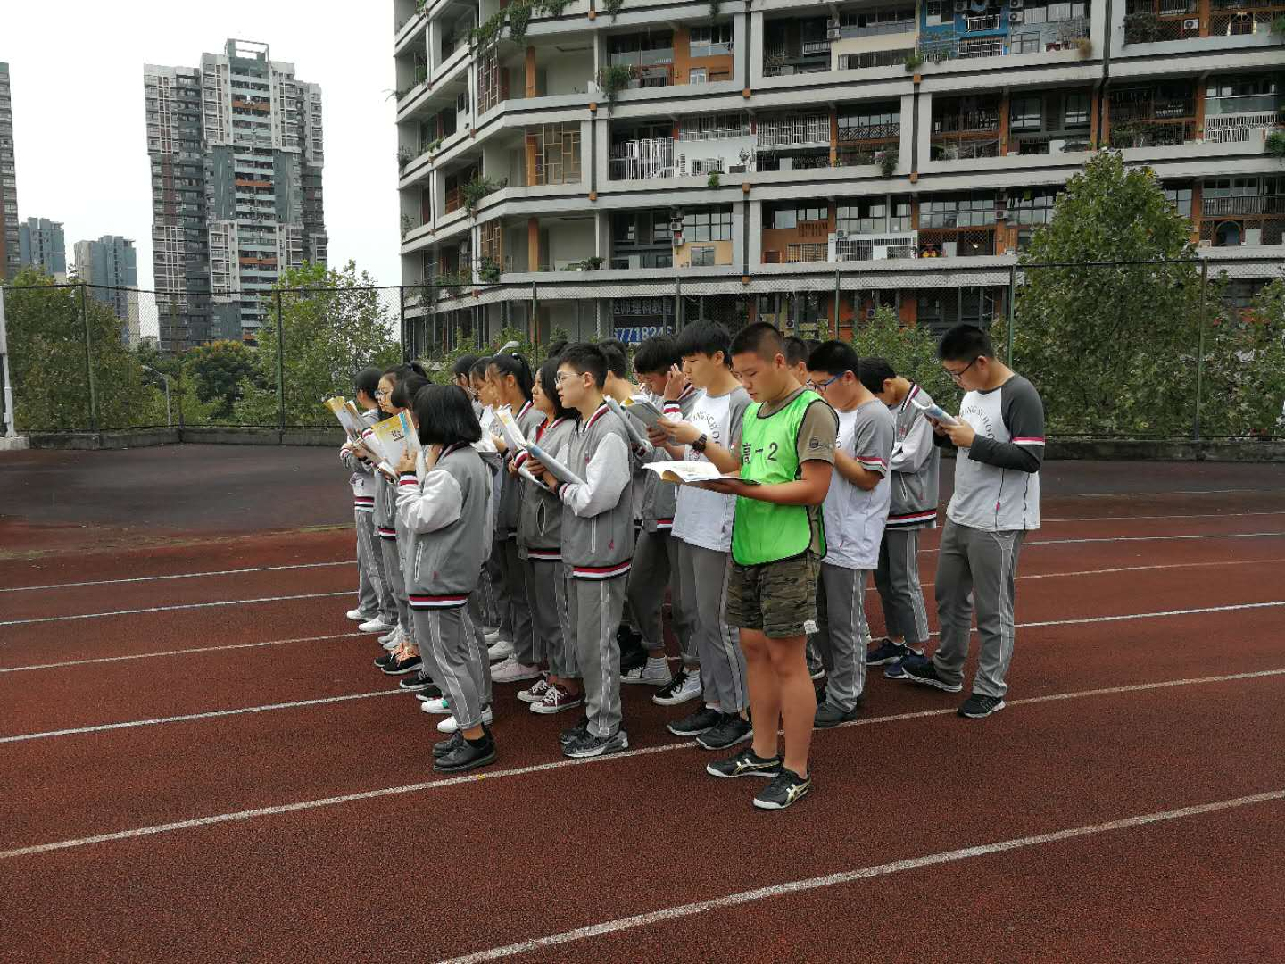
Welcome to our class!

Slide 3

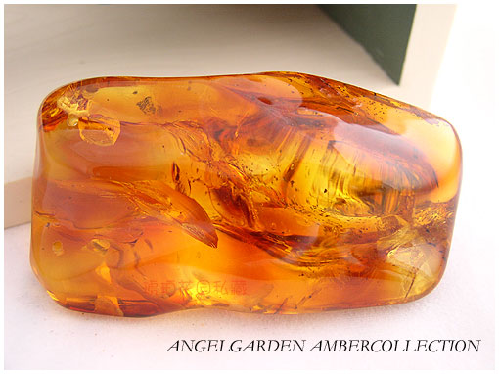
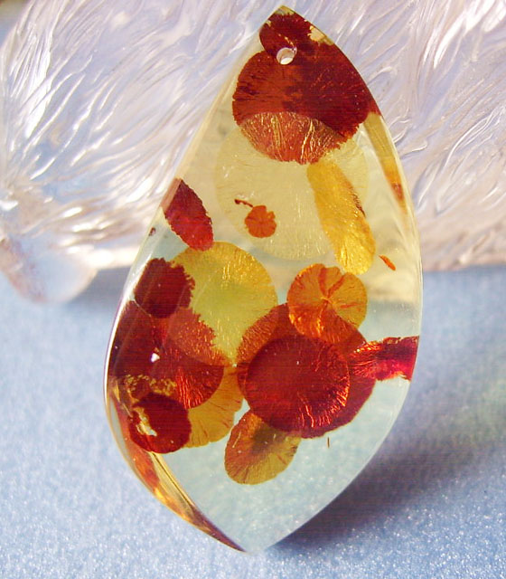
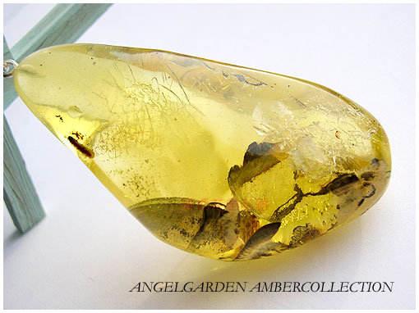
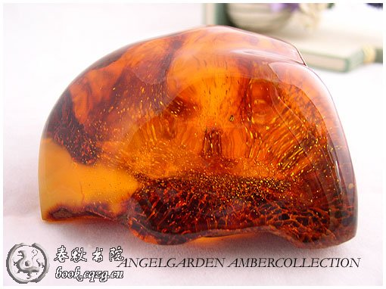
Step1 Lead-in
Have you ever seen amber?

Slide 4
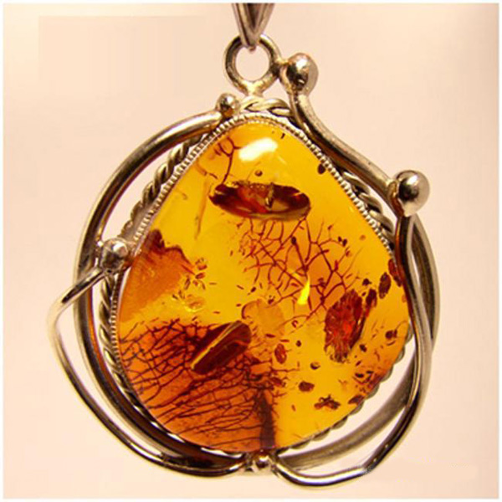
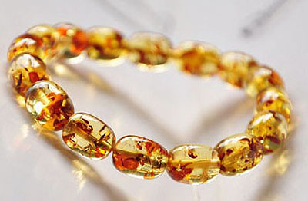
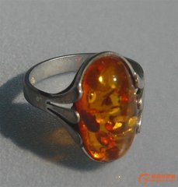
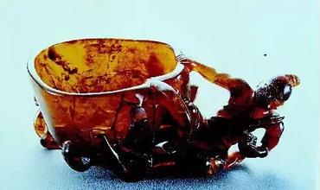
bracelet
necklace
What do you think amber can be made into?
cup
ring

Slide 5
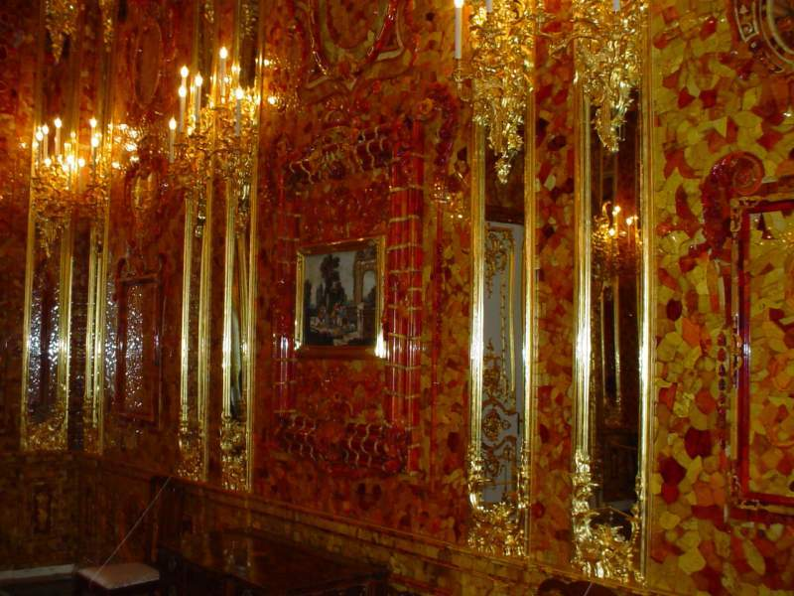
From the video ,what else can amber be made into?

Slide 6
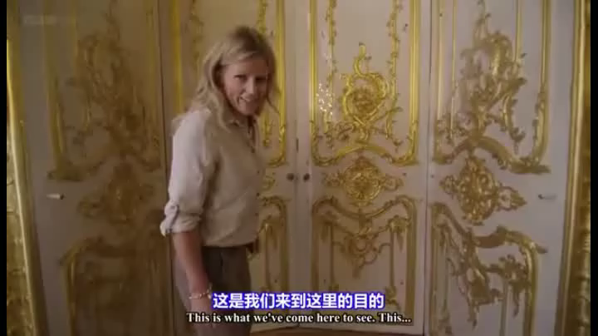

Slide 7
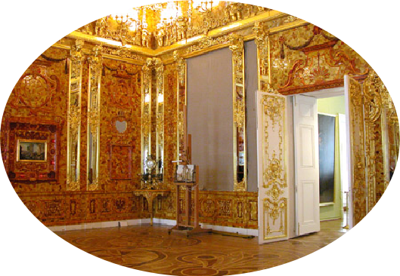
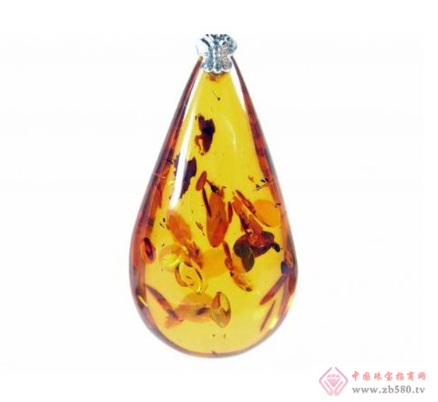
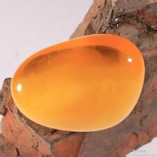
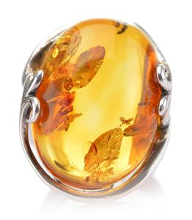
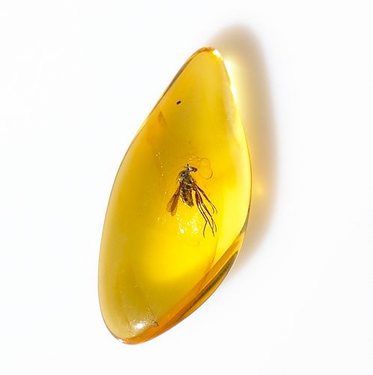
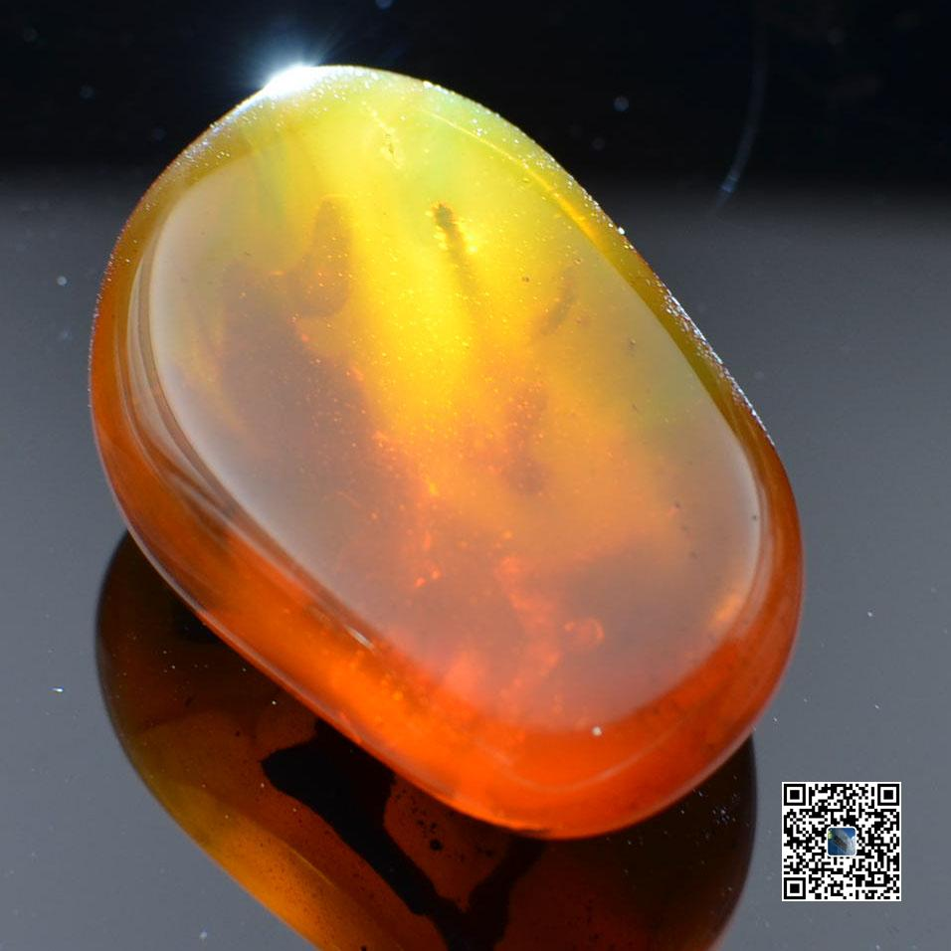
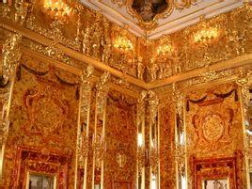
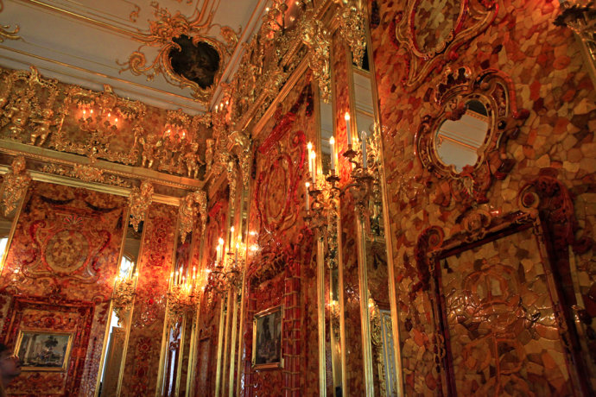
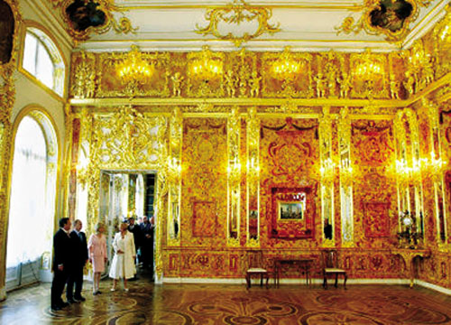
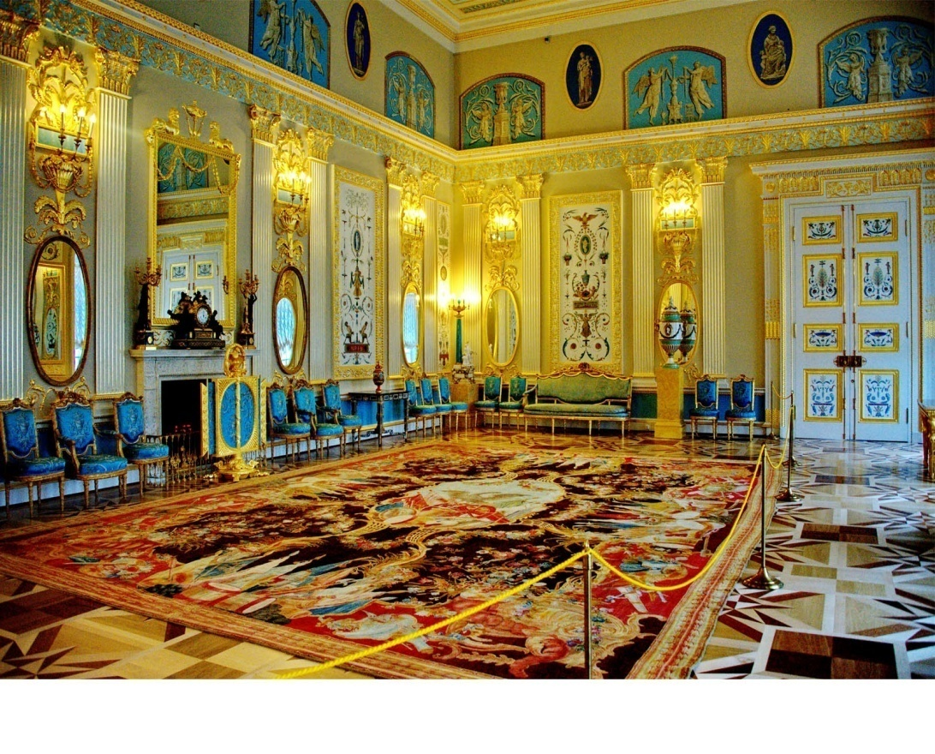
Unit 1 Cultural Relics
In Search of the Amber Room

Slide 8
Reading
(What can we predict from the title?)
Maybe it was missing/lost.
In Search of the Amber Room
How?

Slide 9

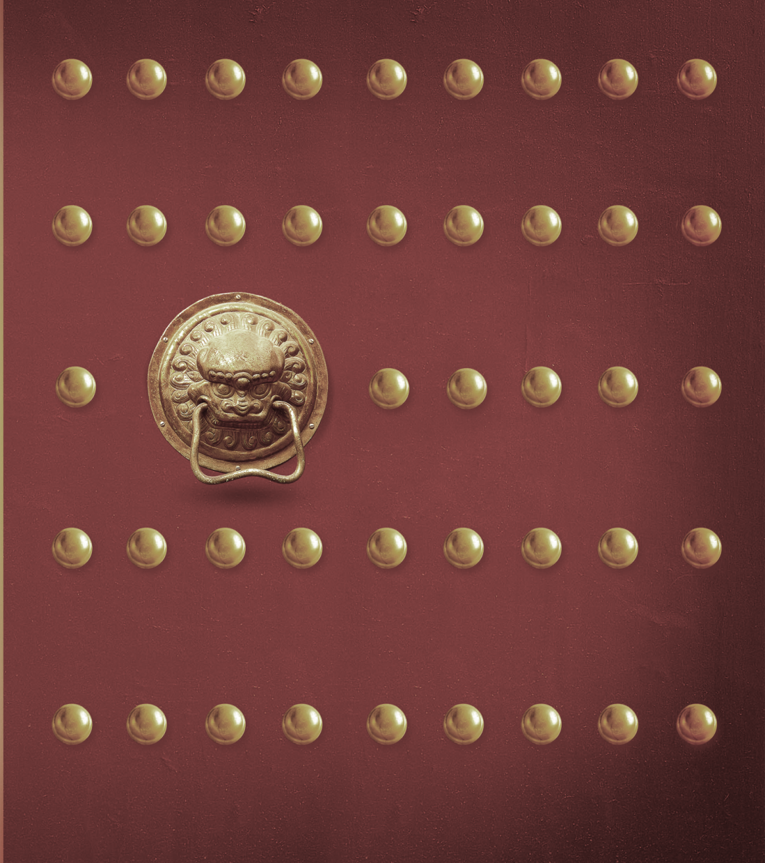
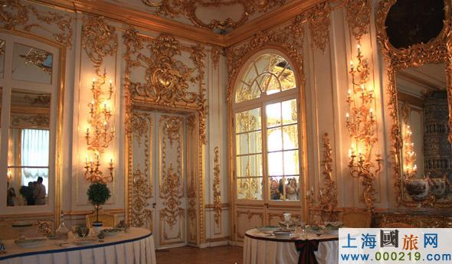


In Search of the Amber Room
Let’s walk into
the Amber Room!
A new look

Slide 10



Part A
A.The Amber Room became a
wonder of the world.
B. The Amber Room got lost.
C. The Amber Room was rebuilt.
D. The Amber Room was built.
E. The Amber Room was given to the
Czar as a gift.
Skim and Match the main idea of each paragraph.
Para. 1
Para. 2
Para. 3
Para. 4
Para. 5

Slide 11

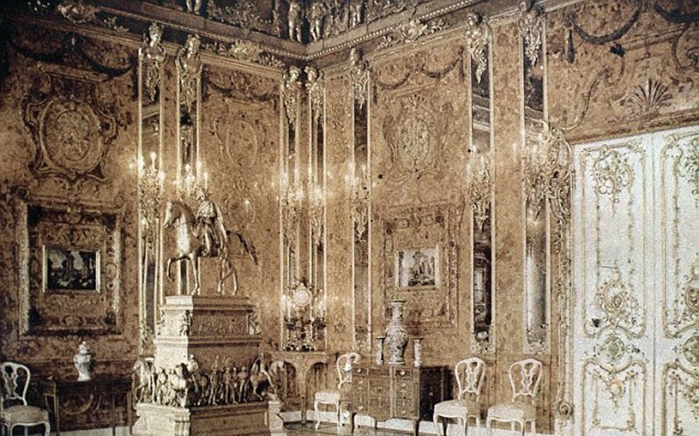

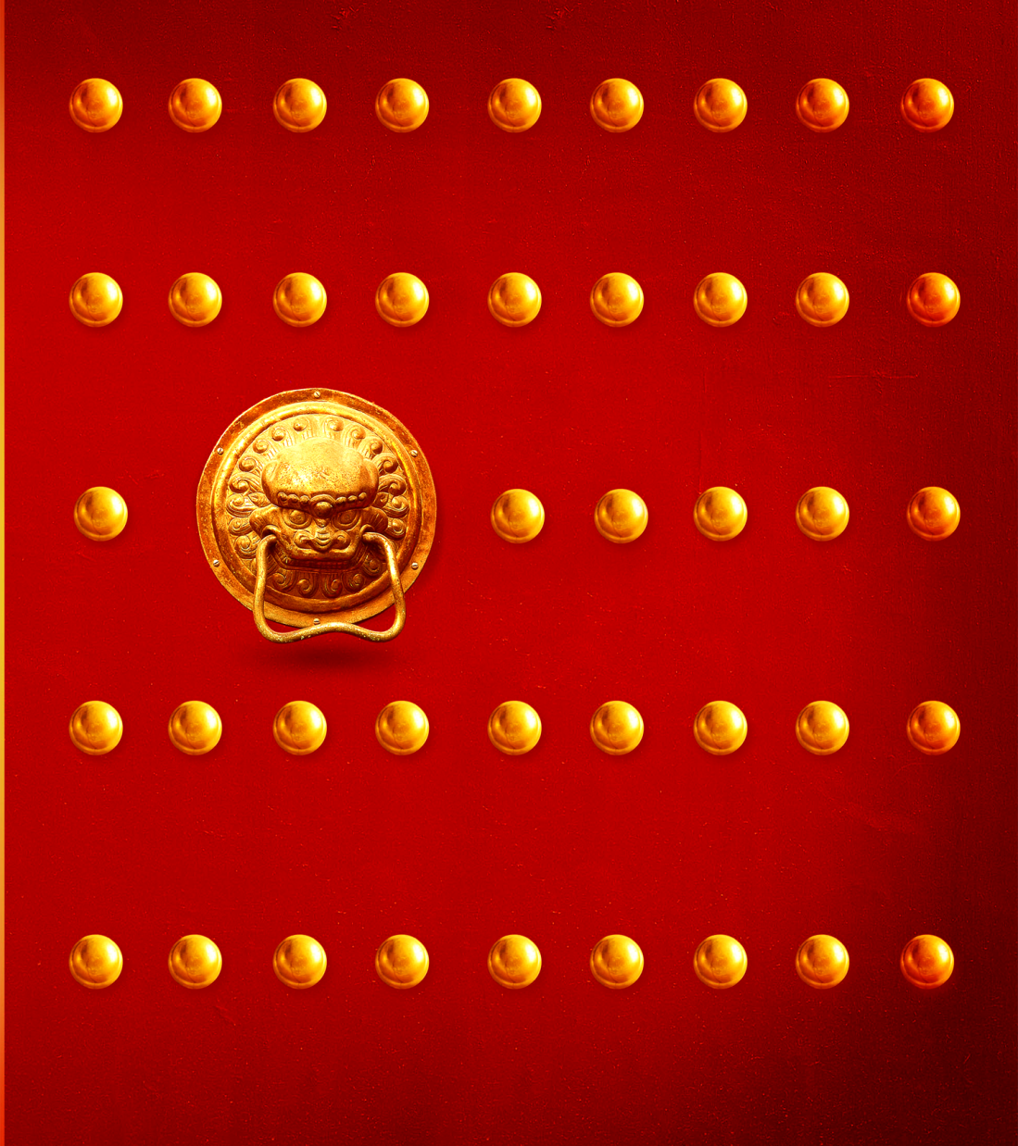
The Amber Room was built. (Para.1)

Slide 12
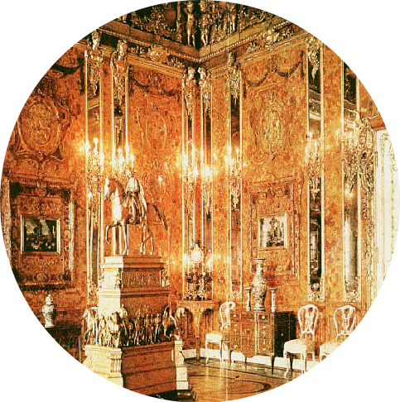
ID card
Name : The Amber Room
Birthplace (出生地): ________________
Material (材料): ________________
Color : ________________
Style : ________________
Decoration : ________________
Builders : ________________
Time of building : ________________
History: ________________
Prussia
several tons of amber
yellow and brown
fancy style
gold and jewels
the country’s best artists
about 10 years
an amazing history

Slide 13
感恩遇见，相互成就，本课件资料仅供您个人参考、教学使用，严禁自行在网络传播，违者依知识产权法追究法律责任。
更多教学资源请关注
公众号：溯恩高中英语
知识产权声明

Slide 14
The amazing history(scan Para.2、3、4)：
The Amber Room was given to the Czar as a gift. (Para.2)
The Amber Room became a wonder of the world. (Para.3)
The Amber Room got lost. (Para.4)

Slide 15
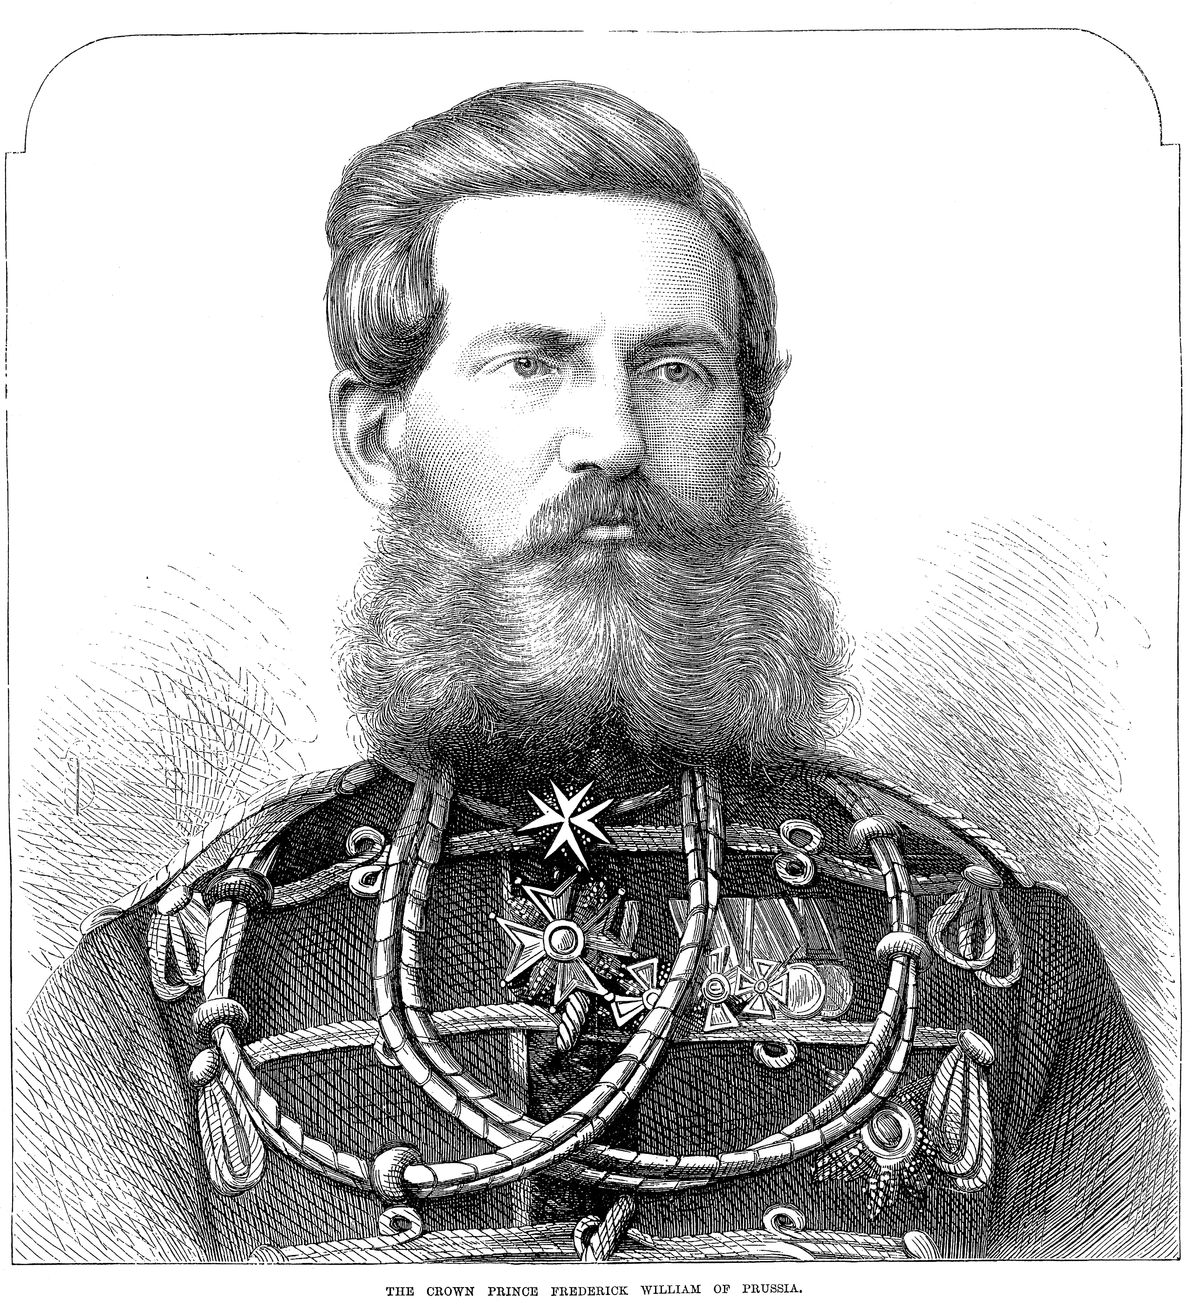
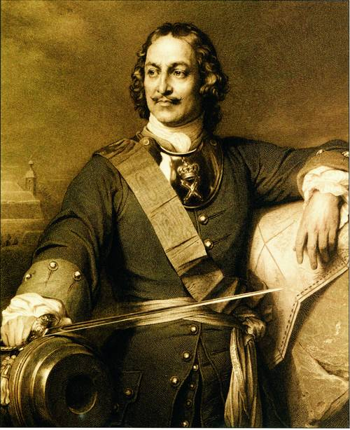
Part B
Scan para.2 and finish the exercises.
the Amber Room
give ?
in return ?
_
Frederick WilliamⅠ
Peter the Great
a troop of his best soldiers
Relation(Prussia &Russia)?
Good.
the former Germany

Slide 16
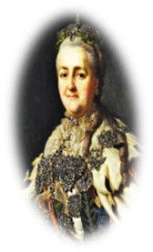
Scan para.3and fill in the blanks.
Part B
1. What did Catherine II do to make the room shine?
A. lighting 60 candles and gold
B. lighting up the lights
C. adding almost 600 candles
D. adding 6000 candles and gold
2. We can infer that Catherine II was a person who ______.
A. was cruel B. ignored the Amber Room
C. acted like a man D. loved beautiful things
2 points
CatherineⅡ

Slide 17

Scan para.4and answer the question.
Part B
What did Nazi army do to the Amber Room?
Relation(Germany &Russia)?
Some of the Nazis secretly stole the Amber Room, and put it inside 27 wooden boxes for Konigsberg.
Bad.

Slide 18
The Amber Room was rebuilt. (Para.5)

Slide 19
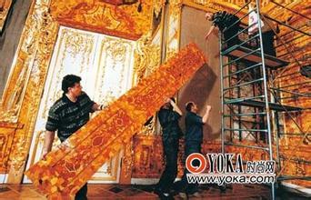
Read para.5
Part B
Who rebuild an Amber Room?
______________________________________.
Relation(Gemany &Russia)?why?
_________________________________________
The Russians and Germans have rebuilt an Amber Room.
Good. Because the two countries cooperated to rebuild the Amber Room.

Slide 20

Read para.5
Part C
Group discussion: Do you think the amber room is
worth rebuilding or not?
Take the following reasons into consideration :
1.the cost 2.historical reason
3.difficulty 4.economy
……
“For”
“Against”

Slide 21

Part C
Show time

Slide 22
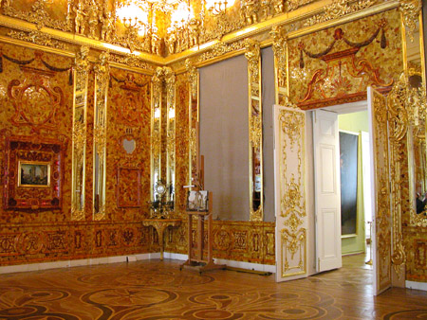

Which group is the winner?

Slide 23
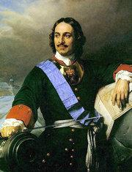
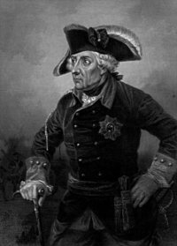
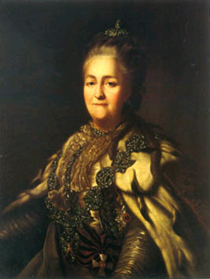

Part D
Frederick WilliamⅠ
FrederickⅠ
an amazing history
an amazing friendship
Peter the Great
CatherineⅡ
Nazi

Slide 24
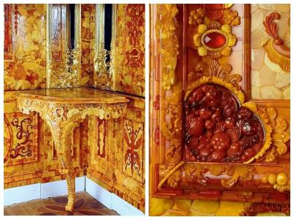
Part D
Quiz—Summary
belonged
At first, the Amber Room __________ to Fredrick I. In 1716 Frederick William I gave it to Peter the Great as a __________ of friendship. In ___________, the czar sent him a troop of his best _______.
Later, Catherine II had it moved to the palace outside St Petersburg and told her artists to ________ more ________ to its design. Thus, the room was completed the way she wanted.
Sadly, in 1941 some of the Nazis secretly _________ it. This was a time when Russia and Germany were ____ ________. After that, what happened to the Amber Room remains a _________.
Recently, the Russians and Germans have _________a new Amber Room. an amazing history.
gift
return
soldiers
add
details
stole
at war
mystery
rebuilt

Slide 25
Homework :
1.Finish the quiz & time-limited training after class.
2.Review the text and underline the important words, expressions and sentences.

Slide 26
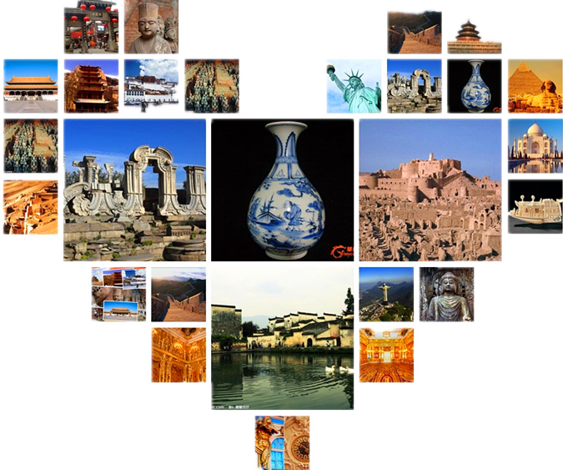
Thank U

Slide 27
感恩遇见，相互成就，本课件资料仅供您个人参考、教学使用，严禁自行在网络传播，违者依知识产权法追究法律责任。
更多教学资源请关注
公众号：溯恩高中英语
知识产权声明

Slide 28
In Search of the Amber Room
Let’s walk out of
the Amber Room!
A new look

