Slide 1
practical writing
Thank-you letter 感谢信
浙江省/常山一中/吴俊峰
金丽衢十二校2019学年高三第一次联考

Slide 2
CONTENTS
1
Play a video
Learn from the native-speaking English teacher
2
Four principles
Character(角色代入)，Content (合理拓展)，
Causality (因果逻辑)，Completeness (要点齐全)
3
Assessment
One possible version and two students' compositions

Slide 3
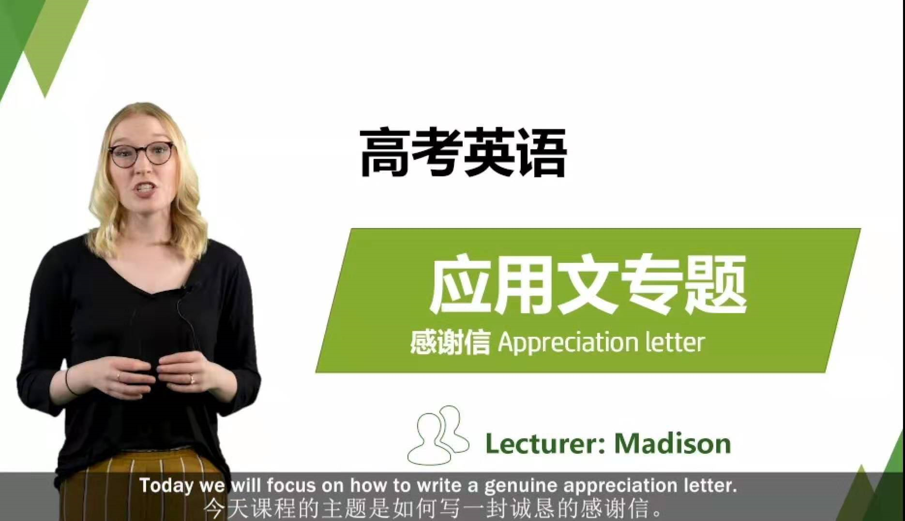
How to write a genuine appreciation letter
Learn from the native-speaking English teacher

Slide 4
How to write a genuine appreciation letter
Three key elements to be genuine
genuine
A
Truthfulness
B
Appropriateness
C
Sincerity

Slide 5

How to write a genuine appreciation letter
Two skills to write an appreciation letter
1
2
The content should be true, and the appraisal be appropriate.
Speak in moderation and in narrative.

Slide 6

A thank-you letter
假定你是李华，暑期在英国旅游时得到当地导游Mr. Smith的悉心照顾，回国后给他写一封邮件表达谢意。主要内容：
1. 回忆旅行中美好时光；
2. 遇到的困难和得到的帮助；
3. 邀请他来中国旅游。
注意：1. 词数80左右；
2. 可适当增加细节，以使行文连贯。

Slide 7

01
Character-the status of identification
1. Who are you?
You're Li Hua, touring in England.
2. What trouble may you meet with when travelling abroad?
not fit in with local condition and customs
lose articles, such as identity card, passport , wallet
language obstacle
feel ill or sick
假定你是李华，暑期在英国旅游时得到当地导游Mr. Smith的悉心照顾，回国后给他写一封邮件表达谢意。主要内容：
1. 回忆旅行中美好时光；
2. 遇到的困难和得到的帮助；
3. 邀请他来中国旅游。
Open-ended point

Slide 8
02
Content-reasonable expansion of details
3. How did Mr. Smith help you as a tour guide?
recommend some can’t-be-missed attractions
thoughtfully arrange suitable travel routes, comfortable accommodation and cuisines of British flavor
4. Why are you writing a letter to express your gratitude?
For Mr. Smith's patience, hospitality, professional attitude
timely help and genuine concern.
假定你是李华，暑期在英国旅游时得到当地导游Mr. Smith的悉心照顾，回国后给他写一封邮件表达谢意。主要内容：
1. 回忆旅行中美好时光；
2. 遇到的困难和得到的帮助；
3. 邀请他来中国旅游。
Open-ended point

Slide 9
03
Causality- make sentences logical
(Effects)
Difficulties | Helps
This is my first trip abroad, I am really at a loss about my tour, | you draw up highly specific plans.
when I don't fit in well with local condition and customs, | you thoughtfully arrange comfortable accommodation and cuisines of British flavor to make my stay smooth and sweet.
What impressed me most was that I lost my passport carelessly, | it was you who made every effort to get it back.
(Causes)

Slide 10

04
Completeness-cover all the key points
How many key points? What are they?
写信目的
回忆旅行中美好时光
Back to China safe and sound, I am writing to extend my sincere gratitude for your timely assistance and support.
1
2
Your genuine help and tender care made sure that my first British trip will forever be a beautiful memory.
遇到的困难和得到的帮助
3
4
邀请来中国旅游
Finally we'd like to invite you to visit China sometime in the near future.
Use causality to describe 2-3 difficulties and helps.

Slide 11

One possible version
Dear Smith,
I'm writing to expres my heartfelt gratitude for your help while I was travelling in England during summer vocation.
It is your detailed and humorous introduction that enables me to have a deeper insight into British culture and have a wondertul time there. I am also deeply impressed by you sincere help to get me some medicine when I caught a cold and your perfect advice in choosing gift for my family.
Thanks again for all your efforts! I do hope someday you'll come to China and let me show you around my hometown.
Yours,
Li Hua

Slide 12
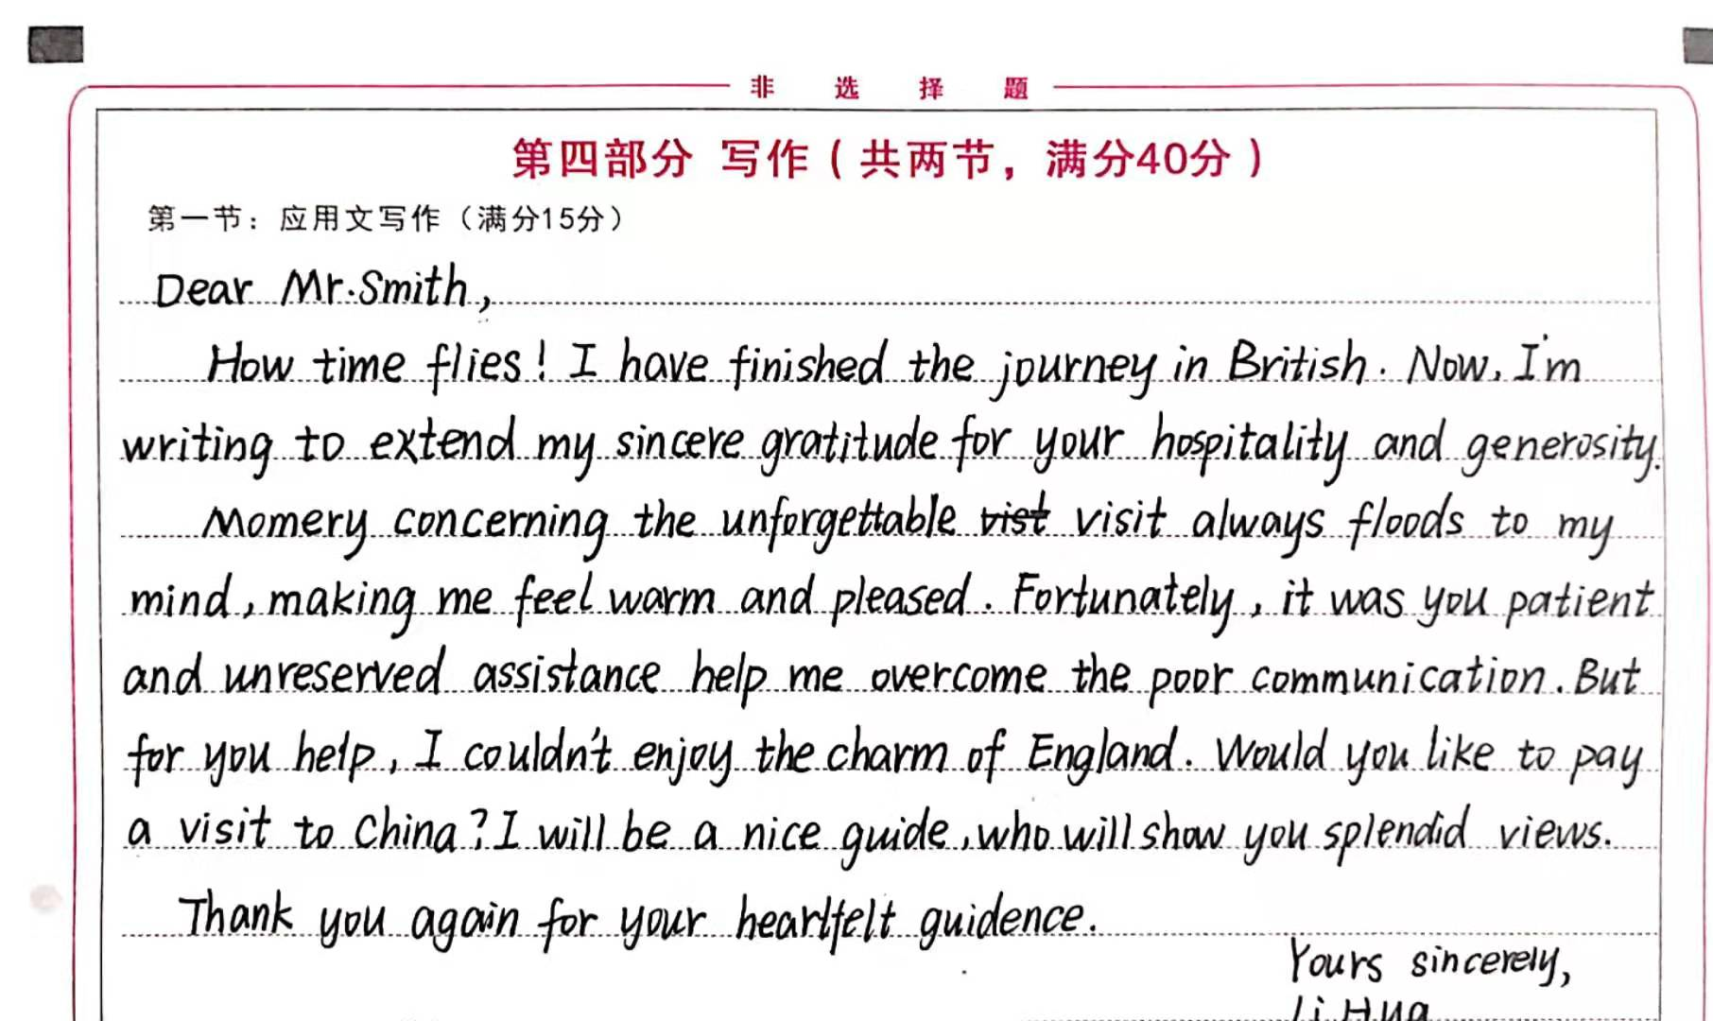
Assessment of student's composition-1
1.完全完成了试题规定的任务;
2.覆盖所有内容要点;
3.应用了较多的语法结构和词汇;
4.语法结构或词汇方面有些许错误,但是因尽力使用较复杂结构或较高级词汇所致;具备较强的语言运用能力;
5.有效地使用了语句间的连接成分,使全文结构紧凑;
6.完全达到了预期的写作目的。

Slide 13
Assessment of student's composition-1
1.完全完成了试题规定的任务;
2.覆盖所有内容要点;
3.应用了较多的语法结构和词汇;
4.语法结构或词汇方面有些许错误,但是因尽力使用较复杂结构或较高级词汇所致;具备较强的语言运用能力;
5.有效地使用了语句间的连接成分,使全文结构紧凑;
6.完全达到了预期的写作目的。

Slide 14
Assessment of student's composition-1
不符合导游的身份和职业描述，把导游混淆成房东。
1.完全完成了试题规定的任务;
2.覆盖所有内容要点;
3.应用了较多的语法结构和词汇;
4.语法结构或词汇方面有些许错误,但是因尽力使用较复杂结构或较高级词汇所致;具备较强的语言运用能力;
5.有效地使用了语句间的连接成分,使全文结构紧凑;
6.完全达到了预期的写作目的。
memory拼写错误
搭配错误，应改为into
强调句型用法错误，掉了that
虚拟语气用法错误，应改为 couldn't have enjoyed

Slide 15
Assessment of student's composition-1
1.完全完成了试题规定的任务;
2.覆盖所有内容要点;
3.应用了较多的语法结构和词汇;
4.语法结构或词汇方面有些许错误,但是因尽力使用较复杂结构或较高级词汇所致;具备较强的语言运用能力;
5.有效地使用了语句间的连接成分,使全文结构紧凑;
6.完全达到了预期的写作目的。
fortunately 作为“起承转合”的衔接词时，通常表明上下文的转折关系，此处作者表达的不是转折关系，所以出现逻辑混乱现象。

Slide 16
Assessment of student's composition-1
角色代入意识不强，对方Mr. Smith导游的身份不明确，导致困难和帮助交代不具体，有些抽象，故难以打动读者。
作者有强烈的表现欲望，有意使用高级词汇和复杂句型，但出现用词不准，句型失误。基本功和熟练程度尚待加强。
逻辑不清，内容缺乏连贯性，结构不紧凑。本习作整体而言，基本达到了预期的写作目的。建议得分第三档高分段9分。
我们在应用文写作的过程中要牢记交际性和得体性，要融入实际生活中，而不是为了写作而写作。

Slide 17
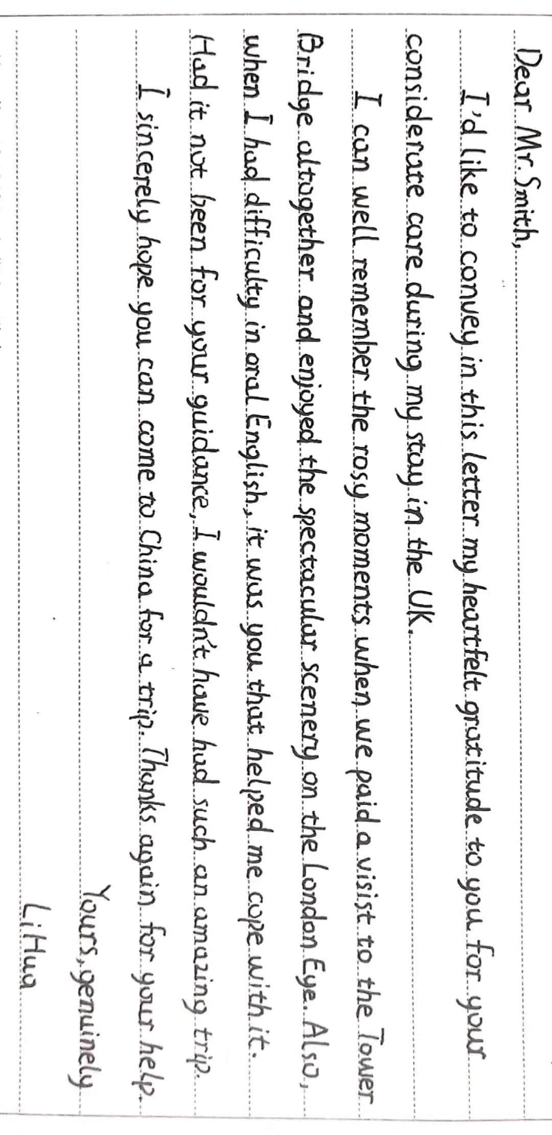
Assessment of student's composition-2
强调句型和虚拟语气，让感激之情溢于言表
强调句型和虚拟语气的合理正确使用，让感激之情溢于言表。
这篇习作格式正确，覆盖所有内容要点，条理清晰，语言优美，行文连贯，结构紧凑，简明扼要，而且应用较多的复杂结构或较高级词汇词组，表现出很强的语言运用能力和严密的逻辑思维能力。尤其是表述具体事实“the Tower Bridge, the London Eye”, 能带着读者游伦敦，真实自然，并融入文化内涵。建议得分第五档13分。

Slide 18
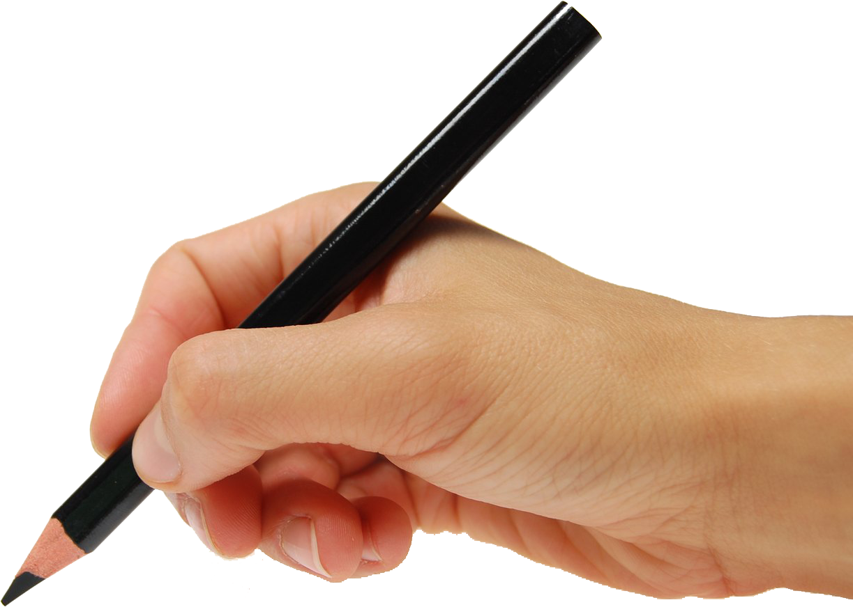
THANK YOU

