Slide 1

感恩遇见，相互成就，本课件资料仅供您个人参考、教学使用，严禁自行在网络传播，违者依知识产权法追究法律责任。
更多教学资源请关注
公众号：溯恩高中英语
知识产权声明

Slide 2
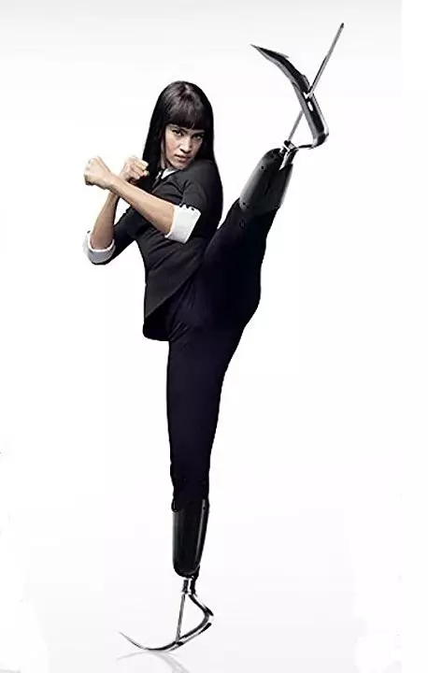
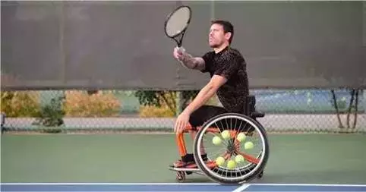
Unit 1
Living Well
Living well means enjoying the same rights and the same opportunities for a good life.

Slide 3

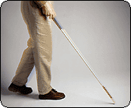
problems
Solutions

Slide 4
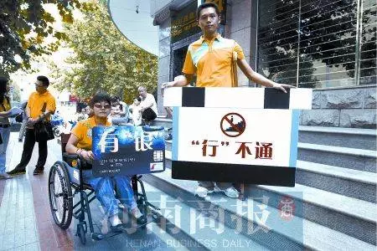
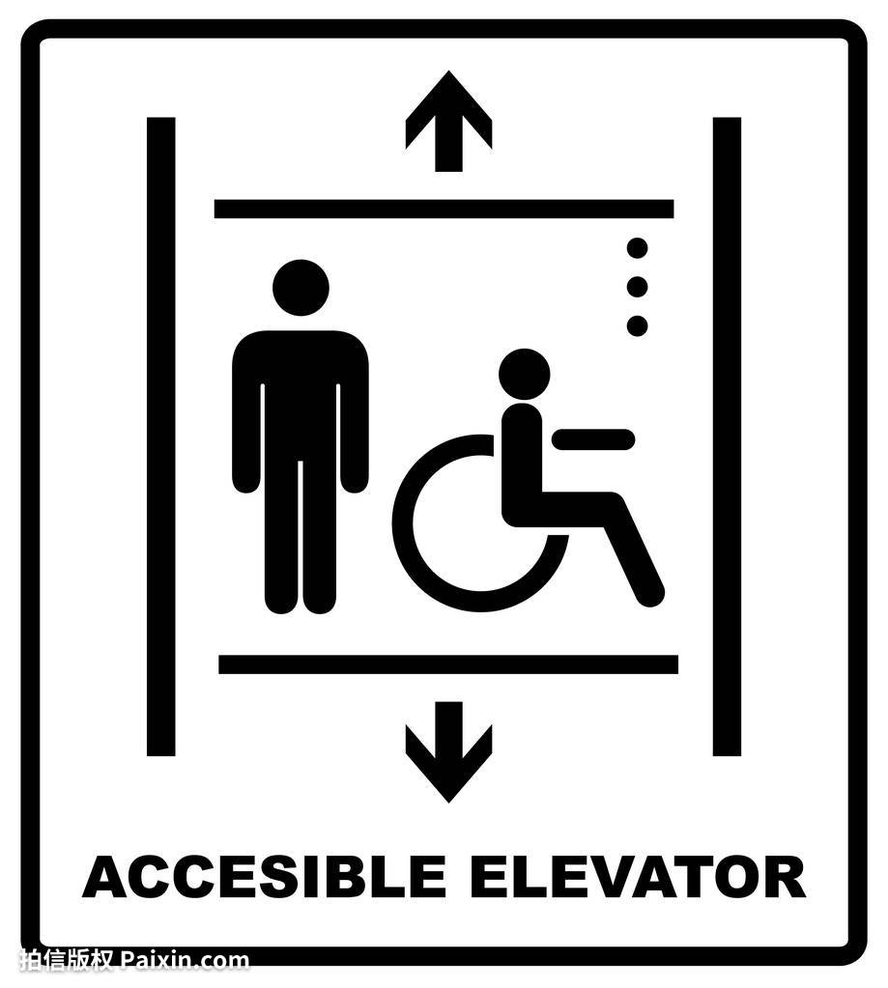
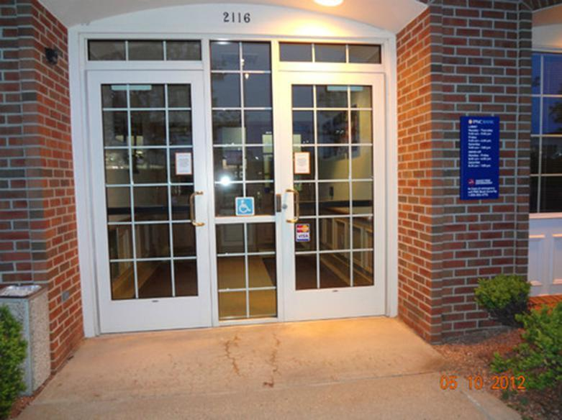
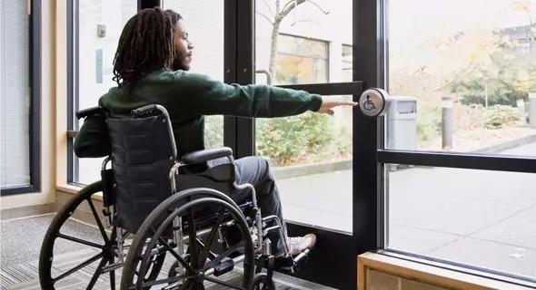
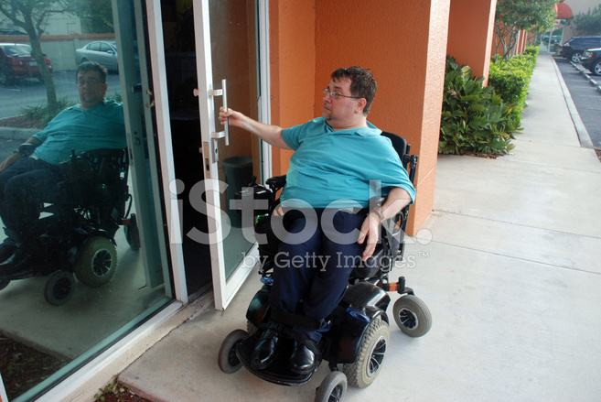
Push To Open Door System
problems
The bank is not accessible.
Solutions!!!
▲Doors wide enough to enter
(adequate access for wheelchairs)
▲ Buttons easy to reach
▲ Doors opened outwards
▲ Lifts(give barrier free access/where?)

Slide 5
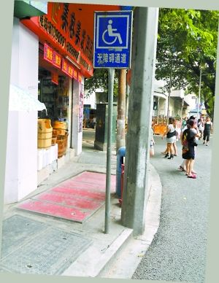
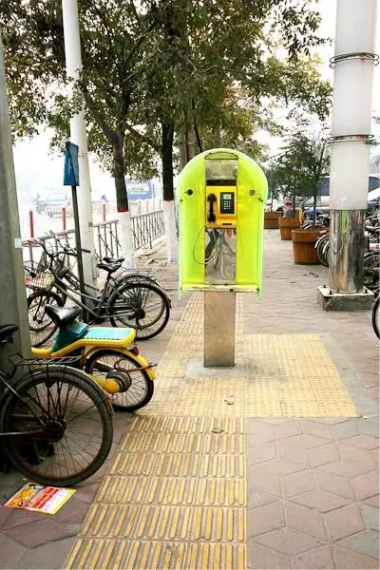
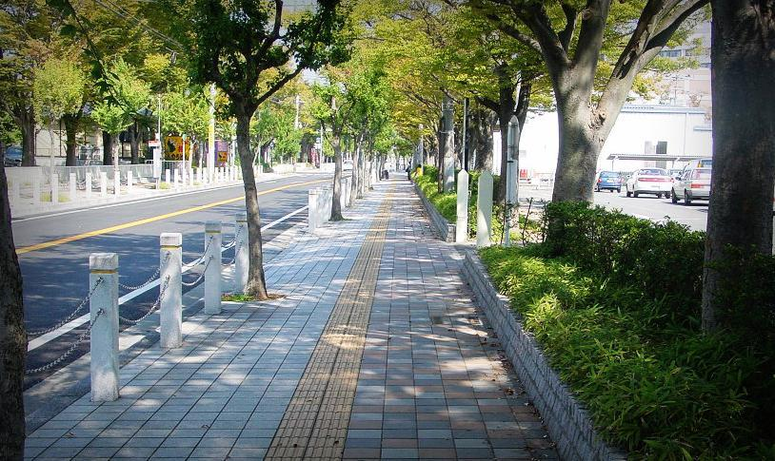
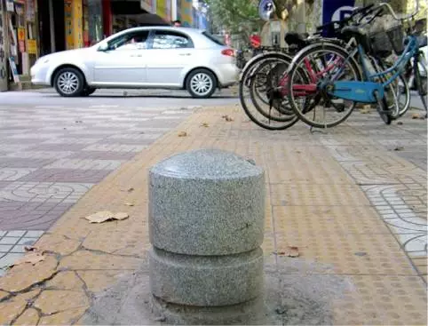
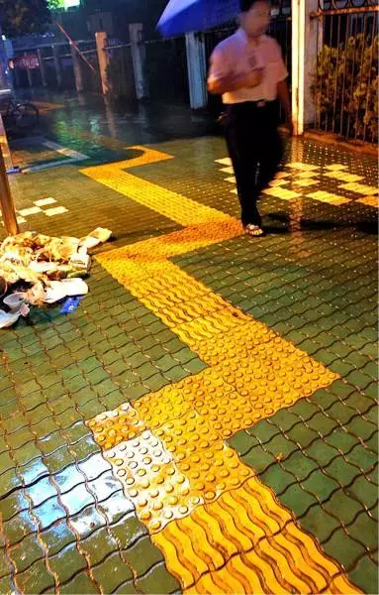
no obstacle facilities—the blind tracks
problems
Roads are blocked and not wide enough
for a wheel to go through
Solutions!!!
▲ barrier-free

Slide 6
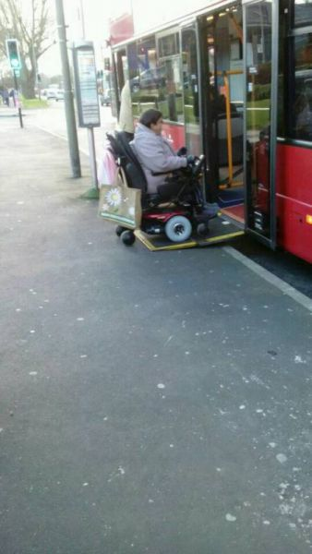
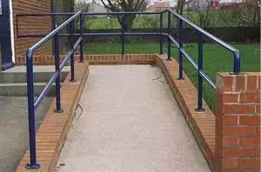
Solutions!!!
Wheelchair Accessible Route System (轮椅通道)
▲ Bridge plate and wheelchair ramps are designed to provide adequate access for wheelchairs users

Slide 7
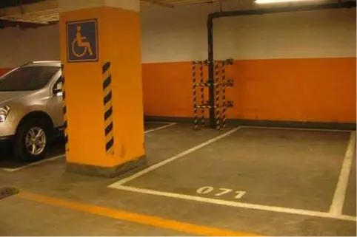
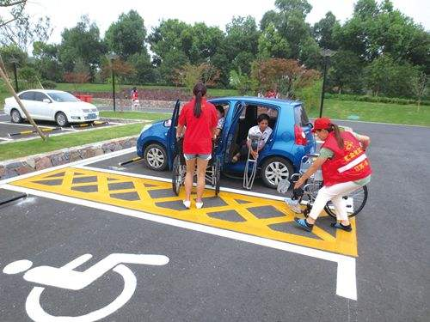
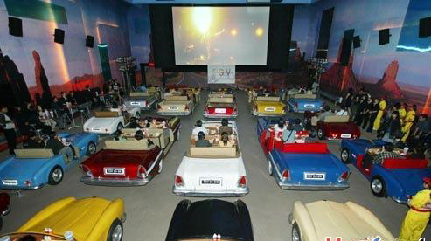
HANDICAPPED parking places
They are kept ONLY for the disabled=They are reserved for people with disabilities in particular
problems
drive-in theatre

Slide 8
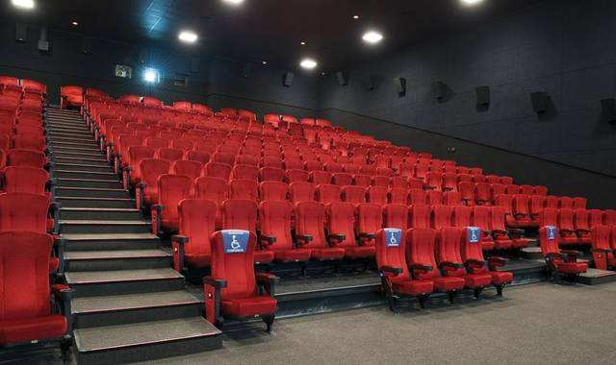
What other problems might people with walking difficulties have in a cinema?

Slide 9
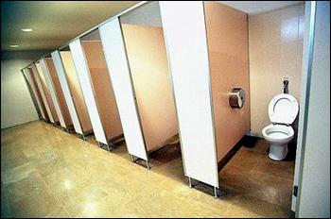
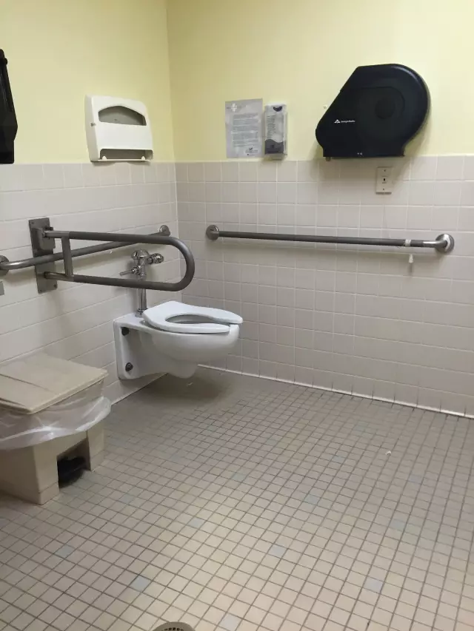
(Restroom for Disabled)
problems
▲ no room for a wheelchair
▲ Doors not opened outwards

Slide 10
感恩遇见，相互成就，本课件资料仅供您个人参考、教学使用，严禁自行在网络传播，违者依知识产权法追究法律责任。
更多教学资源请关注
公众号：溯恩高中英语
知识产权声明

Slide 11
A letter to an architecture
Task 1: Skim the heading of the letter.
Alice Major
__________ wrote the letter.
To _____________ the letter is.
Ms Sanders is a chief _________ of ________ design.
Ms Slanders
architect
cinema
Task 2: Skim the first and last paragraph of the letter to get the main idea.
advice
This is a letter of _______ to the architecture of a new cinema for the benefit of _______customers to enjoy it with dignity.
disabled
Task3：Alice Major advised the architect to consider ____ things.
five

Slide 12
List the suggestions the writer put forward.
1 Adequate access for wheelchairs. …
2 Earphones for people who have trouble hearing. …
3 Raised seating. …
4 Toilets.…
5 Car parking. …
(Look at the words in italics at the beginning of each of the numbered paragraphs and think why the writer numbered her suggestions and used italics)
to organize the ideas and to make it easier for the reader
(architect) to understand and remember the five suggestions.
Tip1: Make your suggestions clear and easy to get by numbering and emphasizing them.

Slide 13
Read for writing strategies:para1
I read in the newspaper today that you are to be the architect for the new Bankstown cinema. I hope you will not mind me writing to ask if you have thought about the needs of disabled customers. In particular
I wonder if you have considered the following things:
I hope you
will not mind me writing to ask if
I wonder if
What is the purpose of the first paragraph of the letter?
purpose
★ To give the ________ of writing the letter
★ ask the architect to consider the needs of
disabled customers
Tip2:use polite forms to encourage the readers to take the ideas seriously.

Slide 14
Skimming for information and writing strategies(para2-6)
1 Adequate access for wheelchairs. It would be handy to have lifts to all parts of the cinema. The buttons in the lifts should be easy for a person in a wheelchair to reach, and the doors be wide enough to enter. In some cinemas, the lifts are at the back of the cinema in cold, unattractive places. As disabled people have to use the lifts, this makes them feel they are not as important as other customers.
Solutions!!!
problem
2 Earphones for people who have trouble hearing. It would help to fit sets of earphones to all seats, not just to some of them. This would allow hearing-impaired customers to enjoy the company of their hearing friends rather than having to sit in a special area.
Solutions!!!
benefit

Slide 15
3 Raised seating. People who are short cannot always see the screen. So I'd like to suggest that the seats at the back be placed higher than those at the front so that everyone can see the screen easily. Perhaps there could be a space at the end of each row for people in wheelchairs to sit next to their friends.
Problem+solution
4 Toilets. For disabled customers it would be more convenient to place the toilets near the entrance to the cinema. It can be difficult if the only disabled toilet is in the basement a long way from where the film is showing. And if the doors could be opened outwards, disabled customers would be very happy.
Solution1+reason+solution2

Slide 16
5 Car parking. Of course, there are usually spaces specially reserved for disabled and elderly drivers. If they are close to the cinema entrance and/or exit, it is easier for disabled people to get to film in comfort.
Solution1+solution2+bebefit
Tip3:to give your suggestions by presenting problems, providing solutions or talking about the benefits.

Slide 17
items | suggestions
__________________for wheelchairs
Earphones for _______ _____________customers
____________seating
Toilets
Car parking
Adequate access
●lifts: It would be handy to …
●the buttons in the lifts: should be easy for… to reach
●the doors: wide enough to enter
●location of the lifts: should not be in cold, unattractive places
It would help to fit sets of earphones to all seats to enjoy the company of their friends.
hearing-impaired
Raised
●seats at the back :be placed higher than those at the front
●a space at the end of each row :to sit next to their friends
●location: to place the toilets near the entrance to the cinema
●the doors :outwards
● spaces: specially reserved
●location: close to the cinema entrance and/or exit

Slide 18
Read for writing strategies:
Read 5 suggestions again and find some more polite forms.
It would be handy to have lifts to all parts of the cinema.
It would help to fit sets of earphones to all seats...
So I’d like to suggest that the seats at the back be placed higher than those at the front …
For disabled customers it would be more convenient to place the toilets near…
And if the doors could be opened outwards, disabled customers would be very happy.
If they are close to the cinema entrance and/or exit, it is easier for disabled people to get to film in comfort.

Slide 19
Read for writing strategies:
Thank you for reading my letter. I hope my suggestions will meet with your approval. Disabled people should have the same opportunities as able-bodied people to enjoy the cinema and to do so with dignity. I am sure many people will praise your cinema if you design it with good access for disabled people. It will also make the cinema owners happy if more people go as they will make higher profits!
Disabled people
praise your cinema
the cinema owners
1.What is the purpose of the last paragraph of the letter?
persuade
To __________ the architect to adopt her suggestions in a polite way and to put forward some reasons why the architect should consider the writer’s suggestions.
2.Besides the disabled, who will also benefit from it?

Slide 20

假设你是高三（1）班李华，就学校校园内垃圾分类的做法用英语给校长写一封建议信。信中应包含以下内容：
1.说明写信目的
2.对校园里垃圾分类现状简要评述
3.提出建议
a letter of advice
How to write
Outline &three tips learnt in this class

Slide 21
Review the form of a suggestion letter.
Greeting: | The greeting ends with a comma.
Body: | 1st part: the purpose of writing 2nd part：suggestions way and put forward reasons for your suggestions 3rd part: finish writing in a polite way
Complimentary close: | begins with a capital letter and ends with a comma. (Yours sincerely/faithfully)
Signature: | your name

Slide 22

Get ready to write!

Slide 23
Dear Mr. Headmaster,
I am Li Hua, a student from Class 1, Senior Ⅲ. I am writing to draw your attention to garbage classification in our school. We produce a large amount of rubbish every day, however, fewer students pay attention to its classification.
I wonder if the school could place more dustbins around and set up specific signs for recyclable or unrecyclable waste. Meanwhile, students should be encouraged to develop good habits to voluntarily differentiate recyclable rubbish from unrecyclable rubbish in a reasonable way, which is vital to create an environmental friendly campus. I believe that, with the joint efforts of both teachers and students, our school will become a more enjoyable place in the near future.
Thank you for reading my letter. I do hope my suggestion will meet with your approval.
Yours faithfully,
Li Hua

Slide 24
感恩遇见，相互成就，本课件资料仅供您个人参考、教学使用，严禁自行在网络传播，违者依知识产权法追究法律责任。
更多教学资源请关注
公众号：溯恩高中英语
知识产权声明

Slide 25
Homework
Review what you have learnt today.
Polish your writing and compare notes with your classmates.

