Slide 1

感恩遇见，相互成就，本课件资料仅供您个人参考、教学使用，严禁自行在网络传播，违者依知识产权法追究法律责任。
更多教学资源请关注
公众号：溯恩高中英语
知识产权声明

Slide 2
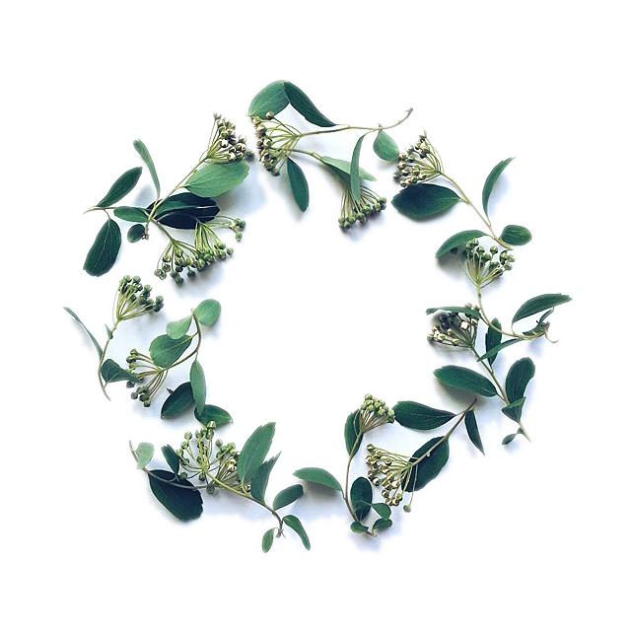
写出有效的句子 创造成熟的风格
Norman King
Sep. 12, 2019

Slide 3
句子宗旨
general concept
从句子的类型、数量、长度、用词等角度精心构思每个句子，让读者理解并欣赏你的作品

Slide 4
01
Introcdution
1.自古以来，世界各地就有各种各样的节目和庆典。
Writing tip1
掌握英语句子的种类，了解英语的表达习惯
从句式结构看，有简单句（主系表，主谓，主谓宾，主谓宾+宾，主谓宾+宾补），并列句，复合句，并列复合句；
从句子功能上看，有陈述句，疑问句，感叹句和祈使句；
从动作发出者的角度看， 有主动句和被动句之分；
从特殊结构看，还有倒装句、强调句、省略句、虚拟句等等。
Since anticent times, there have been various festival and celebrations in all parts of the world .
Festivals and celebrations of all kinds have been held everywhere since ancient times.
2.如果你明天来的话，我就去机场接你。
If you come tomorrow, I will go to the airport to fetch you.
I will go to the airport to fetch you if you come tomorrow.

Slide 5
02
从句subordinating sentences
1.体会下列句子的主要信息：
Melissa was reading a detective story while the national election results were being televised.
2.请比较这两个句子：
(1)When she was thirty years old, she made her first solo
flight across the Atlantic.
(2) When she made her first solo flight across the Atlantic,
she was thirty years old.

Slide 6
Writing tip 2
用主句、强调句和助动词do/does/did强调主要信息
（1）由连词because, as though, while,where，whatever等连接的状语从句和which, where, as等连接的定语从句以及what,whether等连词的名词性从句表示次要信息，相应的主句表示对主要信息的强调；熟练使用复合句是成熟写作风格的标志。
（2）用强调句强调句子的主语、宾语或状语等成分；
（3）用do/does/did加强谓语动词的强调

Slide 7
02
句子翻译
（1）尽管风大雾重，我们还是安全到家了。
Despite heavy winds and nearly impenetrable ground fog, we returned home safe and sound.
（2）正是你毫无保留的帮助我的写作才取得了巨大进步。
It is with your unreserved help that I have made giant progress in Writing.
（3）请所有人务必准时参会。
Do attend the meeting on time/punctually.
Everynone, do attend ...

Slide 8
03
主动句和被动句active and passive sentences
Writing tip3
主动句和被动句active and passive sentences
用主动句强调动作的发出者，使句子更有活力更加生动；如果说话人或当事人不重要则用被动句
1.体会下列句子的不同：
(1) High winds pushed our boat onto the rocks,
where the force of waves tore it to pieces.
(2) Our boat was pushed by high winds onto the rocks, where it was torn to pieces by the force of waves.

Slide 9
03
句子翻译
（1）现如今，人们把骑自行车与慢跑和游泳一起视为最好的全面的运动形式之一。
Nowadays, cycling, along with jogging and swimming, is regarded as one of the all-round forms of exercise.
（2）尽管人们适应了现代社会的快节奏，有专家建议人们过慢一点的生活。
Despite being accustomed to the fast pace in modern society, people are recommended to lead a slower life.
（3）为了增强大家的中国文化意识，学校决定9月20号下周五举行诗歌比赛。
To raise our awareness of Chinese culture, it has been decided that a poetry competion is to be held next Friday, Sep. 20th.

Slide 10
04
并列句coordinating sentences
Writing tip 4
并列句coordinating sentences
用and, but, or, nor, for, so, and yet等并列连词把两个或两个以上的句子并列起来表示对这些事实或者想法同等重视，以避免过多单句的单调性（tedious）
1.比较下列两个句子，分析其特点:
(1) The manager of the coffee shop was waiting for Li Fang to leave. That was very obvious. He wiped the tables. He sat down. He turned on the TV. That was what Li Fang needed.
(2) It was obvious that the manager of the coffee shop was waiting for Li Fang to leave －he wiped the tables, sat down and turned on the TV－just what Li Fang needed.

Slide 11
感恩遇见，相互成就，本课件资料仅供您个人参考、教学使用，严禁自行在网络传播，违者依知识产权法追究法律责任。
更多教学资源请关注
公众号：溯恩高中英语
知识产权声明

Slide 12
04
改进下列两个小片段
(1) The grandmother found that the weaving girl was heart-broken. She decided to let the couple cross the Milky Way to meet once a year.
The grandmother found that the weaving girl was heart-broken and decided to let the couple cross the Milky Way to meet once a year.
Finding that the weaving girl was heart-broken, her grandmother decided to let the couple cross the Milky Way to meet once a year.

Slide 13
04
改进下列两个小片段
(2)A footballer was accused of taking money. He did not score goals deliberately. He wanted to let the other team win. We went to interview him. He denied taking money. We were sceptical. We arranged an interview between the footballer and the man. The man was supposed to bribe him. We saw them together. We guessed from the footballer's body language. He was not telling the truth. We wrote an article. The article suggested he was guilty.
A footballer was accused of taking money for deliberately not scoring goals so as to let the other team win. We went to interview him. He denied taking money but we were sceptical. So we arranged an interview between the footballer and the man supposed to bribe him. When we saw them together we guessed from the footballer's body language that he was not telling the truth. So we wrote an article suggesting he was guilty.

Slide 14
04
完成下列小片段的表达：
半夜里，天空变得清朗了，星星更亮了,（夜晚）非常安静——几乎没有风，只有篝火的火焰和我们做伴。我躺在星空下，想着我们已经走了多远。
At midnight the sky became clearer and the stars grew brighter. It was so quiet.There was almost no wind －only the flames of our fire for company. As I lay beneath the stars I thought about how far we had already travelled.yi
...While lying beneath the stars I thought about how far...

Slide 15
05
排比句parallelism sentences
Persons attempting to find a motive in this narrative will be prosecuted; persons attempting
to find a moral in it will be banished; persons attempting to find a plot in it will be shot.
---Mark Twain， Adventures of Huckleberry Finn
... government of the people, by the people, for the people, shall not perish from the earth.
---Abraham Lincoln, Gettysburg Address

Slide 16
05
排比句parallelism sentences
1.我记得非常清楚，以前，湛蓝的天空、鸟儿的歌唱、月光和鲜花，从未令我心迷神往过。自从我来到这里之后，这一切都变了。
I can well remember that there was a time when a deep blue sky, the song of the birds, moonlight and flowers could never have kept me spellbound. That’s changed since I was here.
2.漆黑的雨夜，刮着大风，电闪雷鸣，乌云滚滚，我完全被这种景象镇住了。
The dark, rainy evening, the wind, the thundering clouds held me entirely in their power.

Slide 17
05
排比句parallelism sentences
3.大多数古老的节日总是庆祝严寒的结束，春季的种植和秋天的收割。
Most ancient festivals would celebrate the end of cold weather,planting in spring and harvest in autumn.
4. 现在的节日有很多由来，一些是宗教上的，一些是季节性的，一些是纪念特殊的人和事件的。
Today’s festivals have many origins, some religious,some seasonal, and some for special people or events.

Slide 18
05
排比句parallelism sentences
Writing tip5: 排比句parallelism
Parallelism is not used merely in speeches. It can make sentences exquisite and powerful.
5.那是最美好的时代，那是最糟糕的时代；那是智慧的年头，那是愚昧的年头；那是信仰的时期，那是怀疑的时期；那是光明的季节，那是黑暗的季节；那是希望的春天，那是失望的冬天。
It was the best of times, it was the worst of times, it was the age of wisdom, it was the age of foolishness, it was the epoch of belief, it was the epoch of incredulity, it was the season of Light, it was the season of darkness, it was the spring of hope, it was the winter of despair.

Slide 19
03
Practice
（1）Water surrounds Vancouver on three sides. The snow-crowned Coast Mountains ring the city on the northeast. Vancouver has a floating quality of natural loveliness.
Surrounded by water on three sides and ringed to the northeast by the snow-crowned Coast Mountains, Vancouver has a floating quality of natural loveliness.
（2）There is a curved beach at English Bay. This beach is in the shape of a half moon. Residential high-rises stand behind the beach. They are in pale tones of beige, blue, and ice-cream pink.
At English Bay, the half-moon curve of beach is backed by high-rises in pale tones of beige, blue, and ice-cream pink.

Slide 20
03
Practice
（3）Any urban glare is softened by folds of green lawns, flowers, fountains, and trees. Such landscaping appears to be unplanned. It links Vancouver to her ultimate treasure of greenness. That treasure is thousand-acre Stanley Park.
Yet any urban glare is quickly softened by folds of green lawns, flowers, fountains, and trees that in a seemingly unplanned fashion link Vancouver to her ultimate treasure of greenness — thousand-acre Stanley Park.
（4）Surrounding stretches of water dominate. They have image-evoking names like False Creek and Lost Lagoon.
And always it is the surrounding stretches of water that dominate, with their image-evoking names like False Creek and Lost Lagoon.

Slide 21
03
Practice
（5）Sailboats and pleasure craft skim blithely across Burrard Inlet. Foreign freighters are out in English Bay. They await their turn to take on cargoes of grain.
Sailboats and pleasure craft skim blithely across Burrard Inlet, while out in English Bay foreign freighters await their turn to take on cargoes of grain.

Slide 22
练习答案
Surrounded by water on three sides and ringed to the northeast by the snow-crowned Coast Mountains, Vancouver has a floating quality of natural loveliness. At English Bay, the half-moon curve of beach is backed by high-rises in pale tones of beige, blue, and ice-cream pink. Turn-of-the-century houses of painted wood frown upward at the glitter of office towers. Yet any urban glare is quickly softened by folds of green lawns, flowers, fountains, and trees that in a seemingly unplanned fashion link Vancouver to her ultimate treasure of greenness — thousand-acre Stanley Park. And always it is the surrounding stretches of water that dominate, with their image-evoking names like False Creek and Lost Lagoon. Sailboats and pleasure craft skim blithely across Burrard Inlet, while out in English Bay foreign freighters await their turn to take on cargoes of grain.

Slide 23
感恩遇见，相互成就，本课件资料仅供您个人参考、教学使用，严禁自行在网络传播，违者依知识产权法追究法律责任。
更多教学资源请关注
公众号：溯恩高中英语
知识产权声明

Slide 24
03
Conclusion
General tip
1. 树立目标成为写作高手，培养兴趣亦是关键；
2. 老师的指导和写作练习必不可少；
3. 词汇是写作的基础，语法要灵活应用；
4. 读写不分家，以读促写、以写验读。
Words and expression are stepping stones.
Reading and writing are two sides on a coin.
Interest is the best teacher.
Target myself at being a writing craftsman.
Instructions are of signifcant importance.
Necessary practice is the key to improvement.
Grammar rules are not stiff.

