Slide 1

感恩遇见，相互成就，本课件资料仅供您个人参考、教学使用，严禁自行在网络传播，违者依知识产权法追究法律责任。
更多教学资源请关注
公众号：溯恩高中英语
知识产权声明

Slide 2

The Road to Modern English

Slide 3
1. Why do you learn English? What's the benefit
of learning a foreign language?
Warming-up
▪ Culture
▪ Education
▪ Social interaction
▪ Personal development
▪ Employment prospect
▪ have deep insight into another culture
▪ reach out to others and form new friendship
▪ communicate with people worldwide
▪ open up a whole new dimension in education
▪ contribute to intellectual growth
▪ increase job opportunities in careers

Slide 4
3. According to Paragraph 2, could native English
speakers understand each other?
2. What does this graph tell you?
English has become a global language.

Slide 5
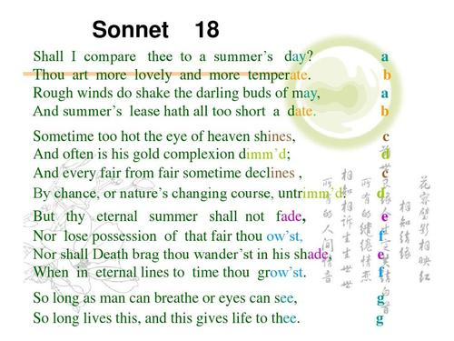
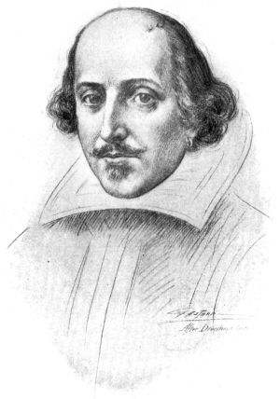
you
You are
have

Slide 6
While-reading
1. Why has English changed over time?
Actually all languages change and develop when cultures meet and communicate with each other
2. Read Paragraph 3-5, figure out how English
changed over time.
(1) When did the changes happen?
(2) What's special about English at that time?
(3) What's the driving factor behind the change?

Slide 7
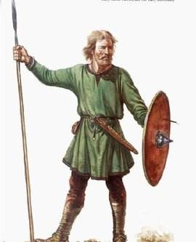
While-reading
Information & Culture
About AD 450 and 1150
The language was based more on German than modern English.
Politics
Germanic tribes started to flooding in like the Angles and the Saxons. They brought about many new vocab into daily life like “woman”, Four days of the week were named in honor of Anglo-Saxon gods.

Slide 8
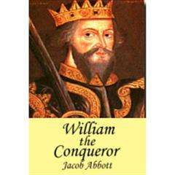
While-reading
Information & Culture
About AD 800 and 1150
The language was greatly enriched, especially its vocabulary.
Politics
About AD 800, Britain was invaded by the Vikings (“die”, “drag”) and later in 1066 William the Conqueror invaded Britain and brought French into the language (“justice”, “beef”) .

Slide 9
感恩遇见，相互成就，本课件资料仅供您个人参考、教学使用，严禁自行在网络传播，违者依知识产权法追究法律责任。
更多教学资源请关注
公众号：溯恩高中英语
知识产权声明

Slide 10
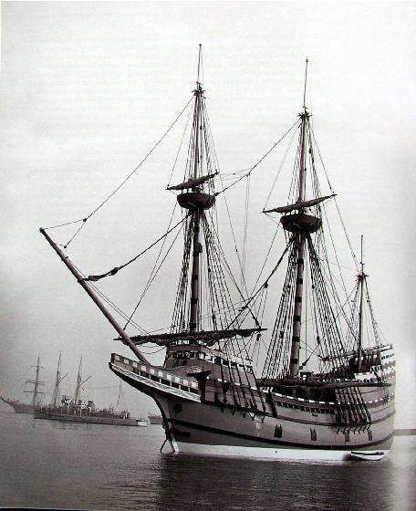
While-reading
Information & Culture
About 17th to 18th century
The language was spoken in America and Australia .
Religion
British Puritans (清教徒) couldn't stand the rule of Catholics (天主教徒), so they took ships to America, the most famous of which is the May Flower.

Slide 11
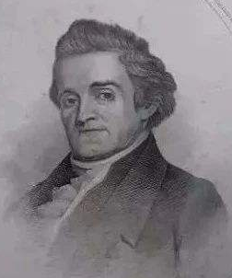
While-reading
Information & Culture
By the 19th century
The language was settled and two big changes in spelling happened.
Scholars
Samuel Jahnson wrote a dictionary and Noah Webster wrote The American Dictionary of the English Language.

Slide 12
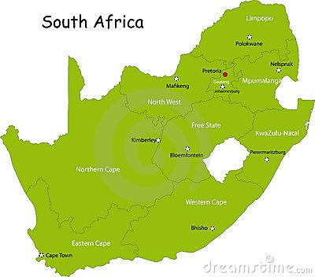
While-reading
Information & Culture
Nowadays
The language spoken as a foreign or second language in South Asia.
Politics & Economy
India and South Africa was governed by Britain and Malaysia as well as Singapore are influenced by the Western World.

Slide 13
Driving Factors
Politics
After the 21th century, other factors, like technology, have great influence on the development of English, especially its vocabulary, which is shown by words such as “telephone”, “Internet”, “computer” and so on.
Religion
The Road to Modern English
Scholars
Economy
…

Slide 14
While-reading
3. How does the writer feel about Chinese English
developing its own identity??
Uncertain/Not sure
4. How do you understand “Only time will tell”?
▪It's hard to know whether Chinese English will
develop its own identity.
▪It remains to be seen whether Chinese English
will develop its own identity.

Slide 15
Structural Analysis
1. What's the text type and what's the purpose?
▪Exposition
▪To inform readers the development of English
2. How does the author clarify the development
of English?
→By listing numbers.
→By giving examples.
→By making contrast.
→By analyzing cause and effect.
...

Slide 16
So why has English changed over time? Actually all languages change and develop when cultures meet and communicate with each other. At fist the English spoken in England between about AD 450 and 1150 was very different from the English spoken today. It was base more on German than the English we speak at present. Then gradually between about AD 500 and 1150, English became less like German because those who ruled England spoke first Danish and later French. These new settlers enriched the English language and especially its vocabulary. So by the 1600’s Shakespeare was able to make use of a wider vocabulary than ever before. In 1620 some British settlers moved to America. Later in the 18th century some British people were taken to Australia to. English began to be spoken in both countries.
Finally by the 19th century the language was settled. At that time two big changes in English spelling happened: first Samuel Johnson wrote his dictionary and later Noah Webster wrote The American Dictionary of the English language. The latter gave a separate identity to American English spelling.
English now is also spoken as a foreign or second language in South Asia. For example, India has a very large number of fluent English speakers because Britain ruled India from 1765 to 1947. During that time English became the language for government and education. English is also spoken in Singapore and Malaysia and countries in Africa such as South Africa. Today the number of people learning English in China is increasing rapidly. In fact, China may have the largest number of English learners. Will Chinese English develop its own identity? Only time will tell.
So why has English changed over time? Actually all languages change and develop when cultures meet and communicate with each other. At fist the English spoken in England between about AD 450 and 1150 was very different from the English spoken today. It was base more on German than the English we speak at present. Then gradually between about AD 500 and 1150, English became less like German because those who ruled England spoke first Danish and later French. These new settlers enriched the English language and especially its vocabulary. So by the 1600’s Shakespeare was able to make use of a wider vocabulary than ever before. In 1620 some British settlers moved to America. Later in the 18th century some British people were taken to Australia to. English began to be spoken in both countries.
Finally by the 19th century the language was settled. At that time two big changes in English spelling happened: first Samuel Johnson wrote his dictionary and later Noah Webster wrote The American Dictionary of the English language. The latter gave a separate identity to American English spelling.
English now is also spoken as a foreign or second language in South Asia. For example, India has a very large number of fluent English speakers because Britain ruled India from 1765 to 1947. During that time English became the language for government and education. English is also spoken in Singapore and Malaysia and countries in Africa such as South Africa. Today the number of people learning English in China is increasing rapidly. In fact, China may have the largest number of English learners. Will Chinese English develop its own identity? Only time will tell.

Slide 17
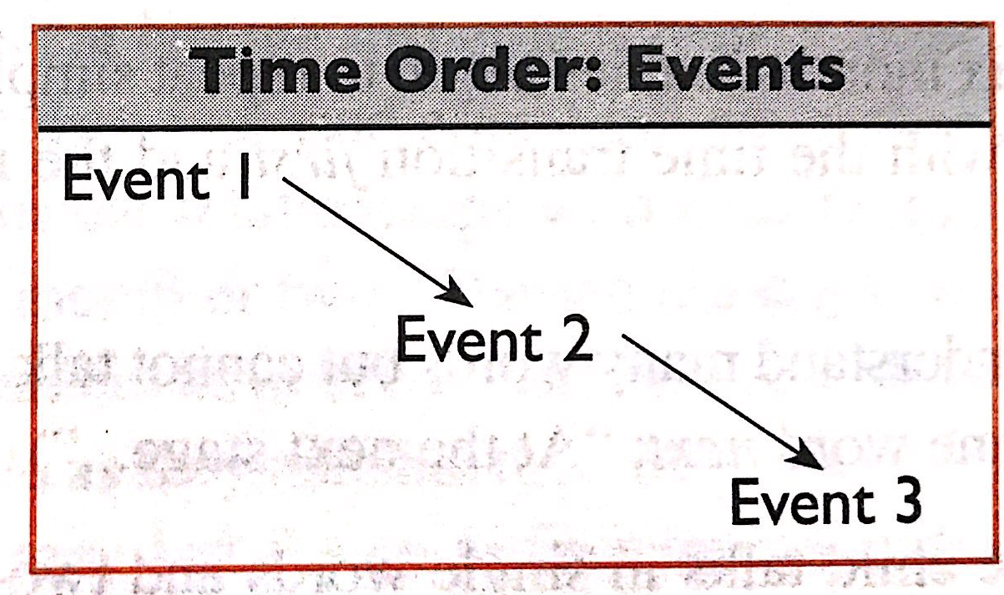
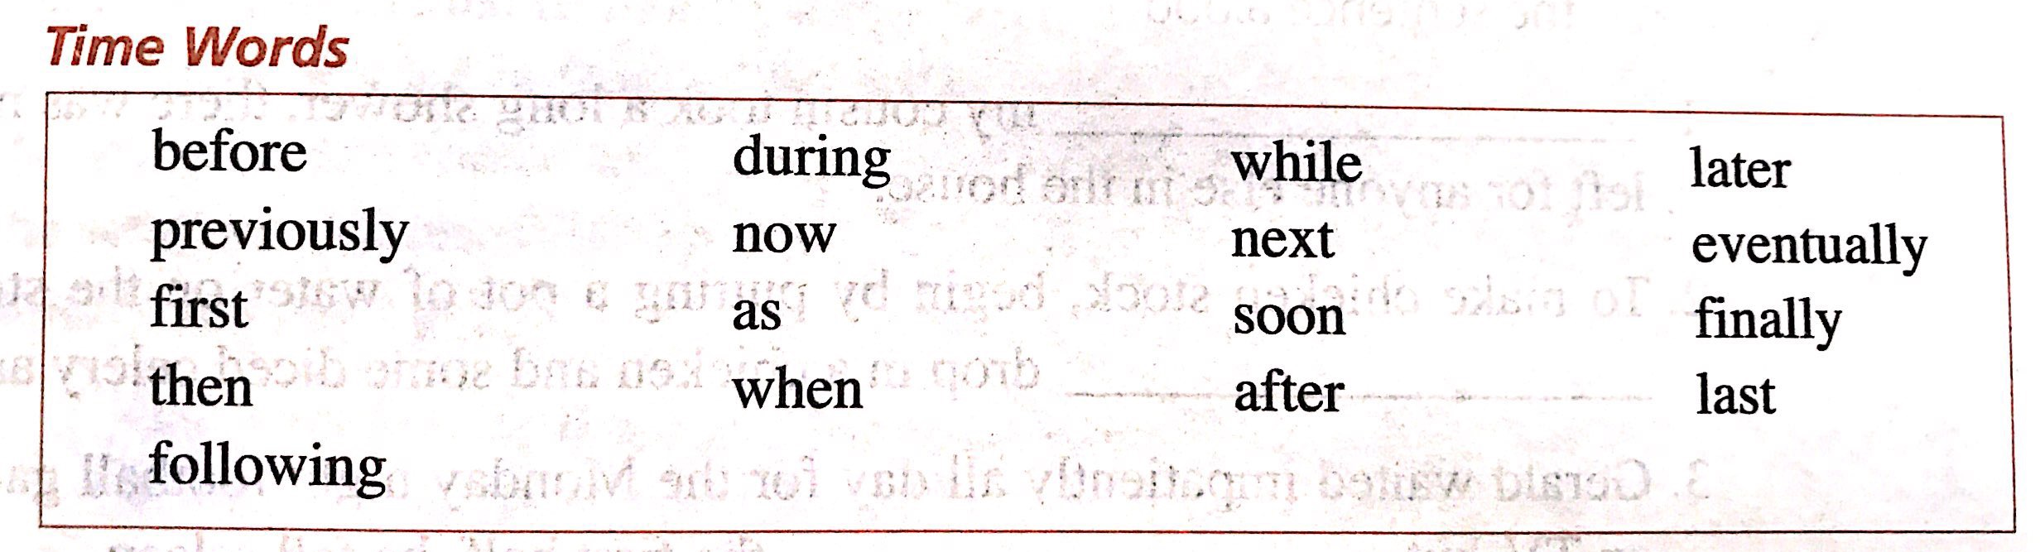
Structural Analysis
2. How does the author clarify the development
of English?
▪By giving a series of events or stages

Slide 18

Post-reading
1. What influence will these global languages
have on other less widely-used languages?
According to linguists, there are about 6500 to 7000 kinds of languages around the world, 10 of which are the most spoken.

Slide 20
感恩遇见，相互成就，本课件资料仅供您个人参考、教学使用，严禁自行在网络传播，违者依知识产权法追究法律责任。
更多教学资源请关注
公众号：溯恩高中英语
知识产权声明

Slide 21
2. How could we protect
the dying languages to
promote language
diversity (多元化)?
▪ set up organizations
▪ teach at an early age
▪ document dying languages
▪ promote public awareness
▪ ...

