Slide 1

感恩遇见，相互成就，本课件资料仅供您个人参考、教学使用，严禁自行在网络传播，违者依知识产权法追究法律责任。
更多教学资源请关注
公众号：溯恩高中英语
知识产权声明

Slide 2

My motherland and me
The 70th anniversary of the founding of
the People’s Republic of China (PRC)
衢州高级中学 毛慧霞

Slide 3


She is not only beautiful but also kind-hearted
她不但美丽而且善良
She is not only strong but also courageous
她不但强壮而且勇敢
She has the largest population in the world.
她拥有世界上最大的人口
She has the most ancient history in the world.
她拥有世界上最古老的历史
She is a star in the east of the world.
她是世界东方的一颗明星
Her land is not only broad but also fertile
她的土地不但广阔而其富饶
Her people are not only hard-working but also courageous
她的人们不但勤劳而其勇敢
She is a great loong growing up in the east of the world.
她是世界东方一条正在崛起的巨龙
She is our beloved motherland
她就是我们亲爱的祖国
China
fertile:肥沃的，富饶的
eg. A chess player must have a fertile imagination and rich sense of fantasy.
loong: 中国龙
eg. Chinese people are proud to call themselves “ the offspring of the loong”.

Slide 4
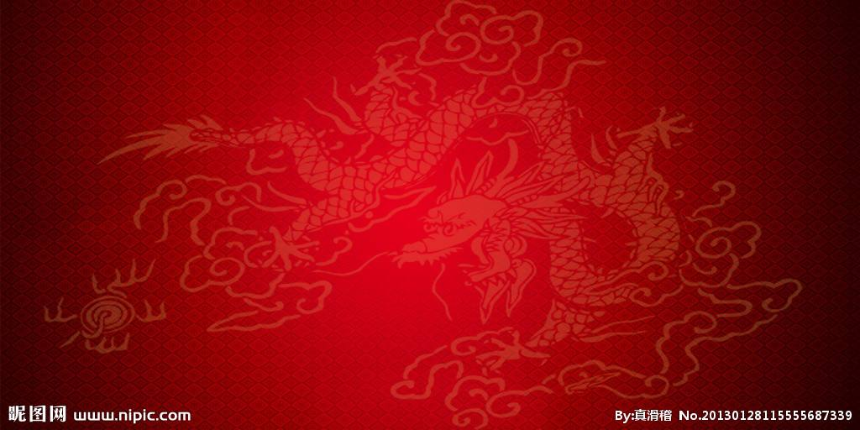
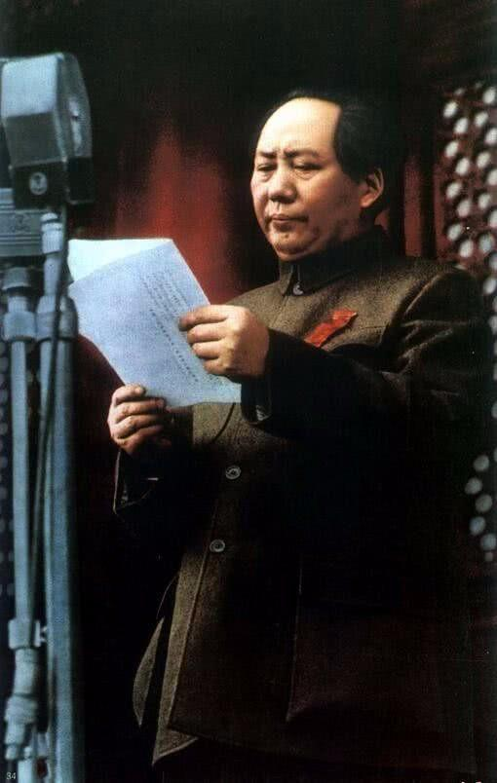
The First of October 1949 is the day that is commemorated by the Chinese people forever. On that day, Beijing’s 30,0000 soldiers and civilians got together in Tiananmen Square and held the founding ceremony of the People’s Republic of China. The crowds, flags, colored silks, fresh flowers and lamps formed a beautiful festive ocean. At 3:00 p.m., cheers resounded like rolls of thunder. Mao Zedong, followed by Zhu De, passed the old tile steps on the west side of the rostrum and stepped on Tiananmen Rostrum first. After Lin Boqu declared the opening of the meeting, within the sound of the national anthem “March of the Volunteers”, the Central People’s Government’s chairman, vice chairmen and members filled their shoes. The people’s leader Mao Zedong solemnly declared: “The Central People’s Government of the People’s Republic of China has been founded!” The resonant voice shook the whole Beijing City, the whole China and the whole world, marking an epoch of the Chinese people of all ethnic groups.
rostrum: 讲台 指挥台
anthem ：圣歌，国歌
Resonant：响亮的，悠扬的
eg. He responded with a resonant smile.
epoch :新时代
eg. The epoch of revolution creates
great figures.
1949年10月1日，这是一个永远为中国人民所纪念的日子。这一天，北京30万军民聚集在天安门广场上举行了开国大典。人群和旗帜、彩绸、鲜花、灯饰，汇成了喜庆的锦秀海洋。下午3时，大地欢声雷动。毛泽东和朱德两位伟人一前一后，沿着城楼西侧的古砖梯道，最先登上了天安门城楼。当林伯渠宣布开会后，在国歌《义勇军进行曲》的乐曲声中，中央人民政府主席、副主席和委员就位。人民领袖毛泽东庄严宣布：“中华人民共和国中央人民政府成立了!”这个洪亮的声音震撼了北京城，震撼了全国，震撼了全世界，开创了中国各民族人民的新世纪。

Slide 5
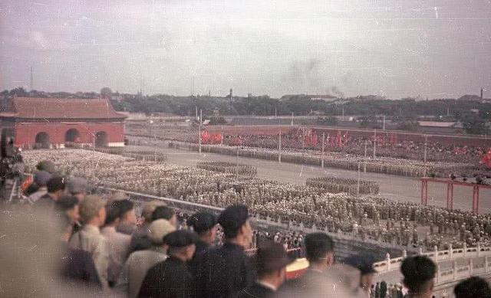
Mao Zedong pushed the button by himself, and then the first five-star red flag was gradually raised in the square. In the mean time, the 54 guns representing the 54 ethnic groups volleyed 28 times, the sounds resounded in the air like shocking thunderclaps foretelling the coming of spring, symbolizing that the Chinese people led by CPC finally gained the victory of the New-Democratic Revolution of China after 28 years of brave struggles.
ethnic :民族的
eg. Ethnic tensions are old problem here.
volley :齐射，截击
eg. It’s still not known how many died in the
volleys of gunfire.
foretell:预言
eg. No one can foretell the future.
毛泽东亲手按动电钮，第一面五星红旗在广场上冉冉升起。与此同时，代表着54个民族的54门礼炮齐鸣28响，如报春惊雷回荡在天地间，它标志着中国共产党领导中国人民英勇奋斗28年，终于取得了中国新民主主义革命的最后胜利。

Slide 6
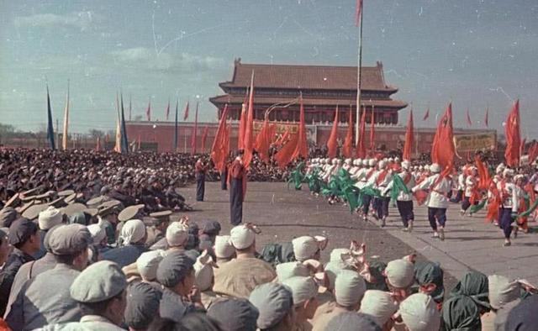
After the flag-raising ceremony, Mao Zedong read out the “Announcement of the Central People’s Government of the People’s Republic of China”, soon afterwards, the large-scale military review and mass parade were held. The celebration was proclaimed to come to an end shortly after 9:00 p.m., but the joyful crowds couldn’t restrain their inner excitements. Numerous masses raised red lanterns and paraded in the city. Late at night, the capital was still immersed in an atmosphere of triumph. The triumphant waves spread to all places of China. From cities to villages, the liberated people cheered and danced. Everybody threw out his or her innermost thought and feeling—The Chinese people have stood up!
升旗之后，毛泽东宣读《中华人民共和国中央人民政府公告》，紧接着举行了规模浩大的阅兵式和群众游行。庆祝活动到晚上9点多钟结束，但欢乐的人群依然抑制不住内心的兴奋。
无数群众举着红灯在城里游行，直到深夜，首都还沉浸在狂欢的气氛中。狂欢的浪潮扩展到全国各地，从城市到乡村，解放了的人们欢呼着、跳跃着，每个人都从心中发出同一个声音——中国人民站起来了！
proclaim: 宣告，表明
restrain: 抑制，阻止，约束
eg. Unable to restrain her desperate anger, she rose and wen to the phone.

Slide 7
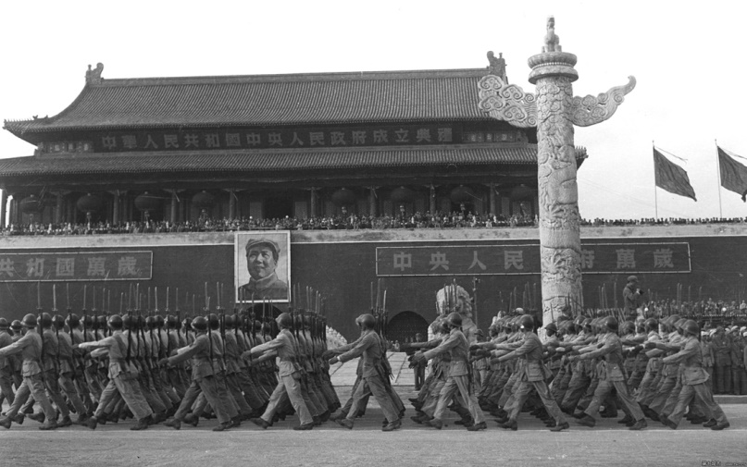
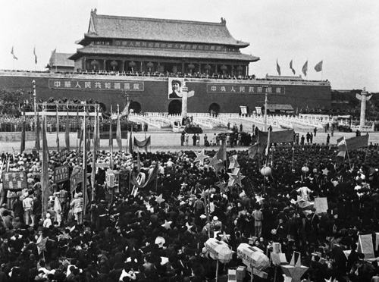
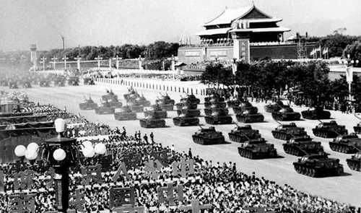
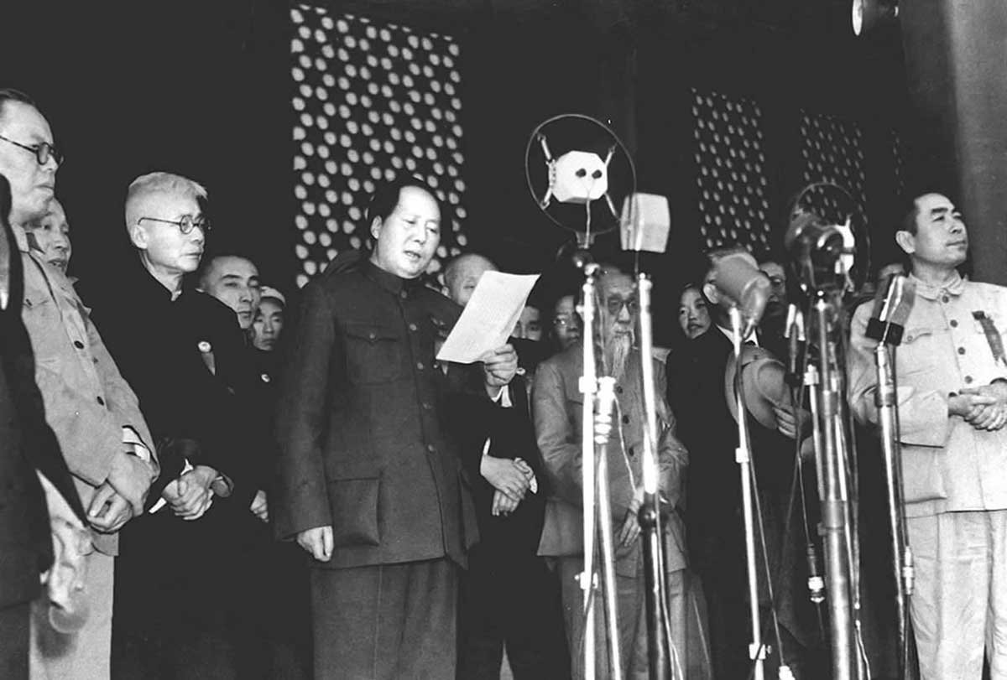

Slide 8
A film revisiting the birth of the People's Republic of China will feature rare color footage of the founding ceremony held in Tian'anmen Square on Oct 1, 1949.
A number of films and TV dramas as well as documentaries feature the historic moment, but all of them are in black and white, as this is the only such remaining old footage in China.
不少影视剧和纪录片都采用过这一历史性时刻的影像资料，但无一例外都是黑白的，因为这是国内现存仅有的旧影像。
footage : 镜头，片段

Slide 9
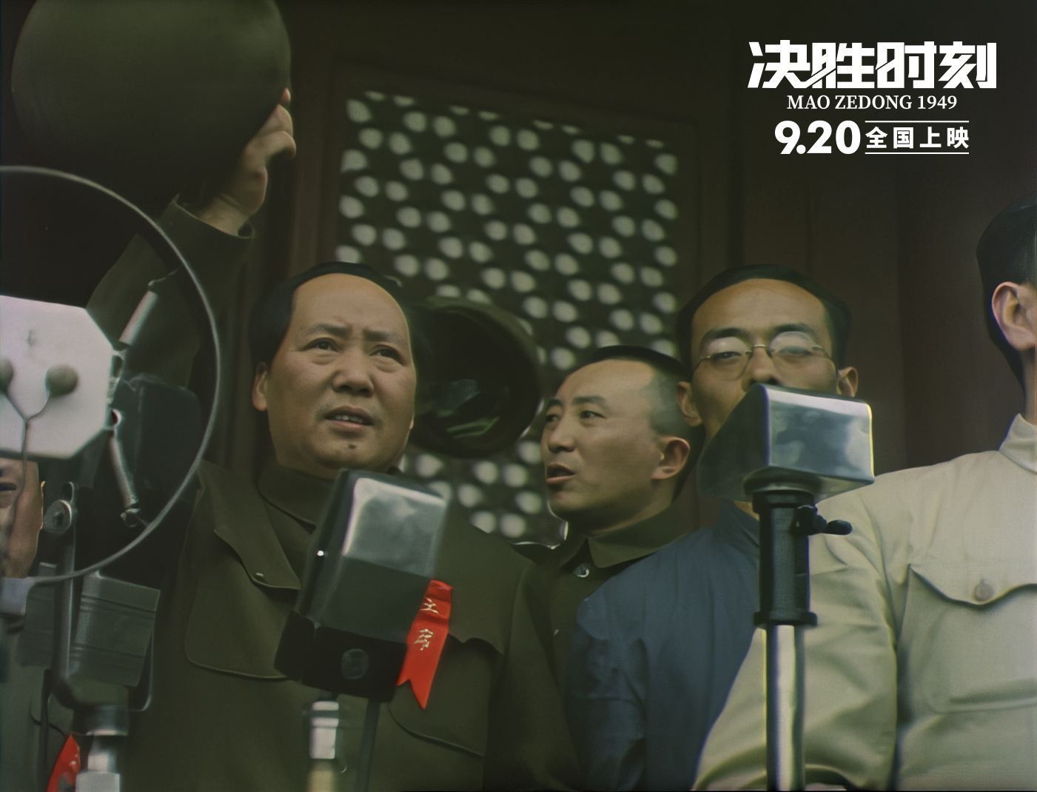

Slide 10
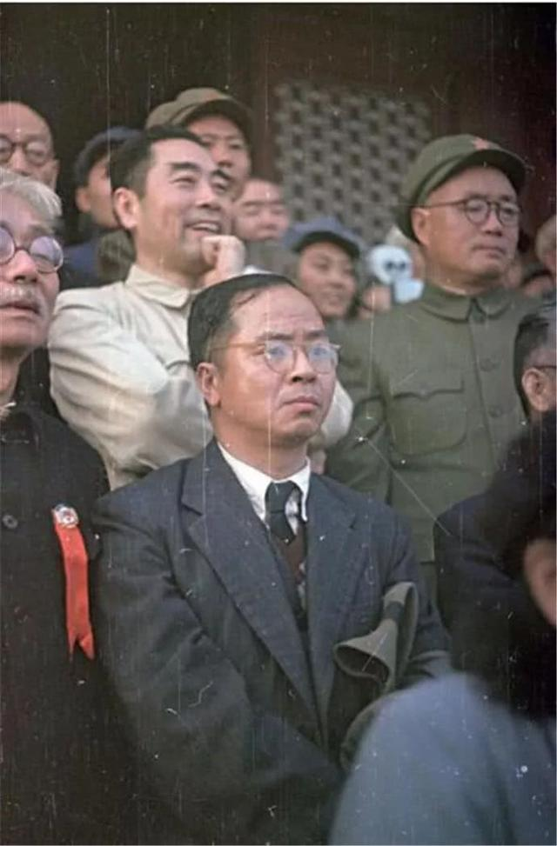
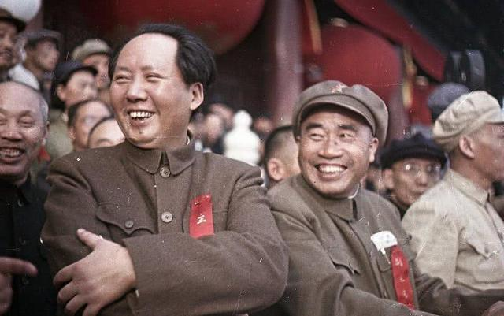
The movie, Mao Zedong 1949, hit domestic theaters on Sept 20. The cast comprises five veteran actors best known for playing political leaders in movies and TV dramas.

Slide 11
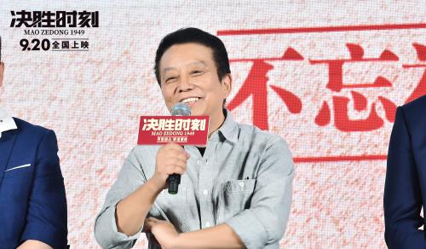
A highlight: the founding ceremony sequences near the end of the film is restored color footage that the crew purchased from Russia, says executive producer and director Huang Jianxin in a recent interview
.该片导演和监制黄建新表示，电影一大亮点是，影片末尾开国大典的片段色彩还原了剧组从俄罗斯购买的珍贵录像。

Slide 12
感恩遇见，相互成就，本课件资料仅供您个人参考、教学使用，严禁自行在网络传播，违者依知识产权法追究法律责任。
更多教学资源请关注
公众号：溯恩高中英语
知识产权声明

Slide 13
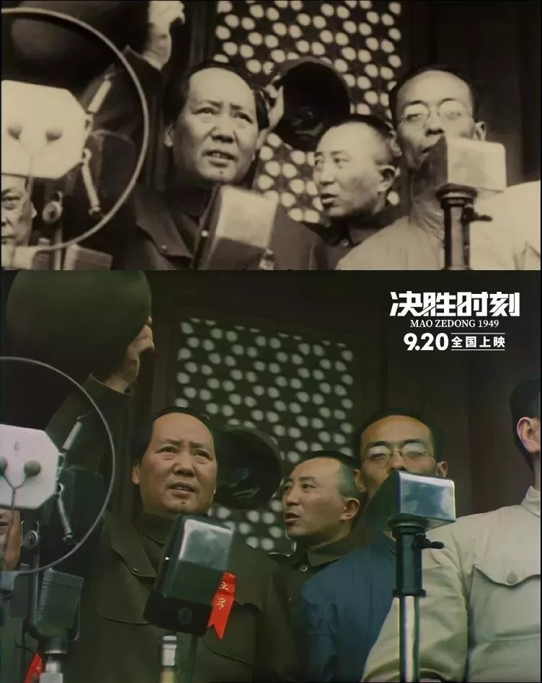
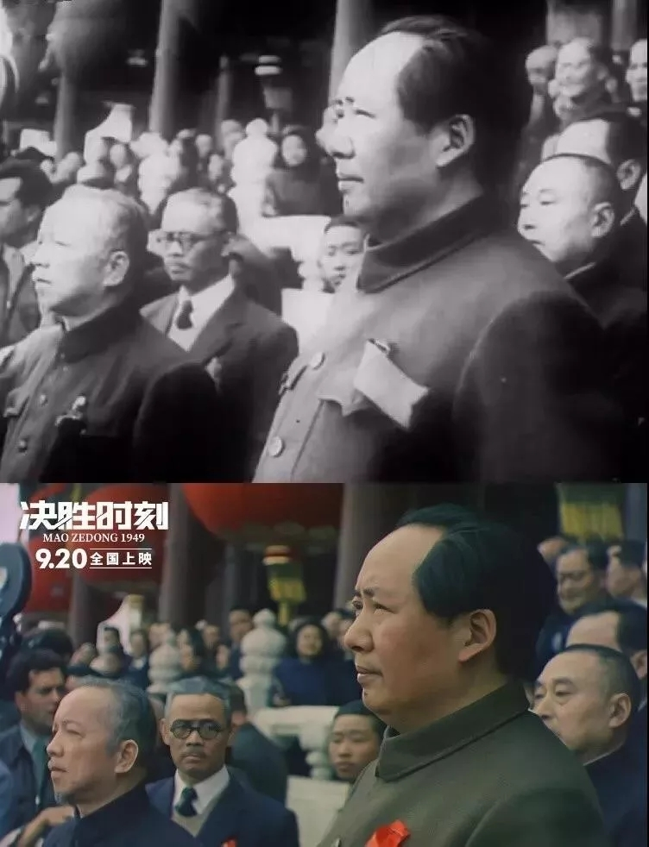

Slide 14
Speaking about how he laid his hands on the footage, Huang says he happened to hear that a person has watched the color clip on his smartphone, so he assigned two teams to go to Russia to find the four-minute footage that was shot by former Soviet Union photographers. The footage was restored by a Chinese company, which transformed it into 4K ultra high-definition version.

Slide 15
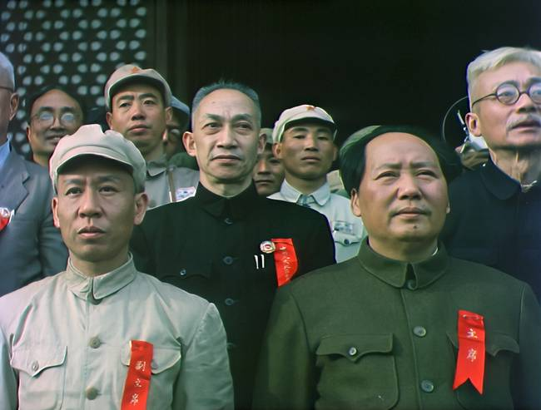
Chinese netizens hailed the six-episode Russian documentary on the founding of New China seven decades ago as a "precious gift" to the 70th anniversary of the founding of the the People's Republic of China (PRC) and the establishment of diplomatic relations between the two countries.
许多中国网友称赞这部记录新中国成立的6集俄罗斯纪录片是一份献给新中国成立70周年和中俄建交70周年的珍贵礼物。
hail :赞扬，称颂，下冰雹
episode：插曲，片段，一集
diplomatic :外交的，灵活变通的

Slide 16


Slide 17

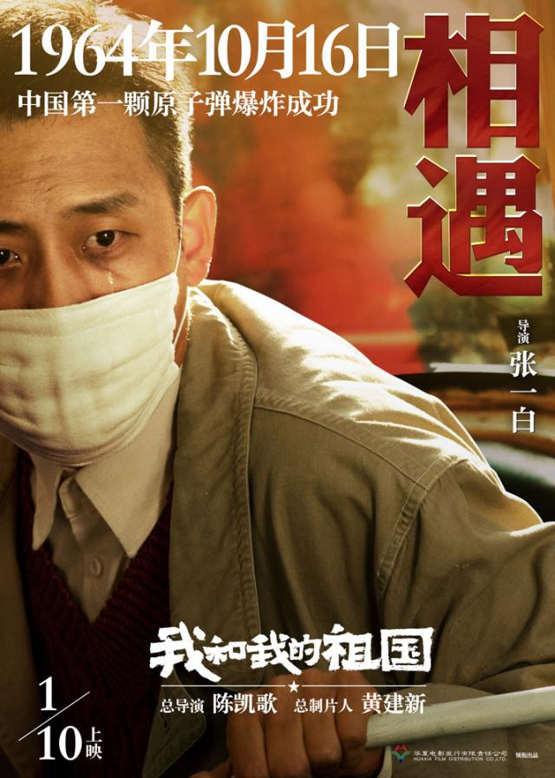


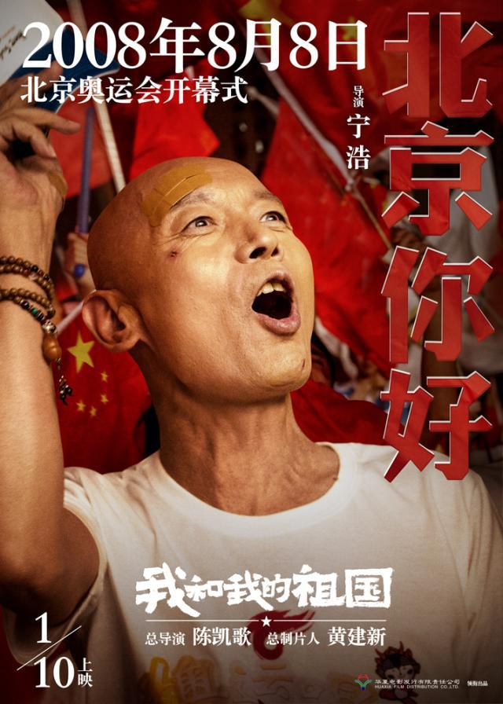



Slide 18

"Me and My Motherland" is a collection of famous directors and actors in China. It traces the course of ordinary people and the motherland with
seven different stories.
comprising

Slide 19
《我和我的祖国》
My Motherland and Me.
我和我的祖国
China catches my heart.
一刻也不能分隔。
No one can break us apart.
无论我走到哪里
No matter where I travel
都流出一首赞歌。
You are what I am singing for.
我歌唱每一座山。
I'm singing of your high mountains.
我歌唱每一条河。
Singing of your land and rocks.
袅袅炊烟小小村落。
Sing of hometown the big or small
路上一道辙。
Sing of them once more.
我最亲爱的祖国。
Oh, China, how I love you.
我永远紧贴着您的心窝。
When I nestle in your arms feeling blue.
您用那母亲的脉搏。
You share with me the stories before.
和我诉说。
Make me cheerful.
我的祖国和我。
My motherland and me.
像海和浪花一朵。
Are the spindrift and the sea.
浪是那海的赤子。
I am your dear spindrift.
海是那浪的依托。
You are the sea that hugs me.
每当大海在微笑。
Whenever you get to smile.
我就是那笑的漩涡。
You raise me up. Make me high.
我分担着海的忧愁。
I share all your sorrows and joys.
分享海的欢乐。
Share seashells on the shore.
啦啦啦啦啦
La la la la la la la la la.
啦啦啦啦啦
La la la la la la la la.
啦啦啦啦啦
La la la la la la la la la
永远给我碧浪清波。
You are the mother, we all adore.
心中的歌。
We all adore.
我最亲爱的祖国。
Oh, China, how I love you.
我永远紧贴着您的心窝。
When I nestle in your arms feeling blue.
永远给我碧浪清波。
You are the mother we all adore.
心中的歌。
We all adore.

Slide 20
70th
In this extraordinary 70 years, we have made a lot of achievements.
在这不平凡的70年里，我们取得了很多的成绩。
We launch many rockets and satellites, and success rate has achieved 100%.
我们发射的火箭和卫星的成功率达到了100%。
We have taken a leading position in the aerospace field.
我们已经在航天领域处于领先地位。
China is the fourth economic entity in the world, and affects the entire world's economy.
中国现在是世界第四的经济体，并影响着整个世界的经济。
In agriculture, the hybrid rice cultivated in our country, not only solves the problem of feeding the Chinese people, but also the problem of feeding the world's people.
在农业上，我们国家培育出杂交水稻，不但解决了中国人的吃饭问题，同时也解决了世界人民的吃饭问题。
In 2008 our country has successfully hosted the Beijing Olympic Games, showing the strength of our country and promoting world peace.
2008年我们国家有成功的举办了北京奥运会，彰显了我们国家的实力，促进了世界的和平。

Slide 21
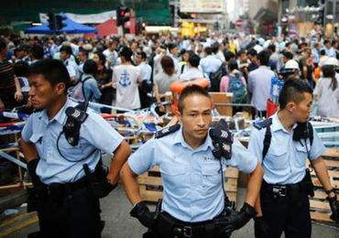
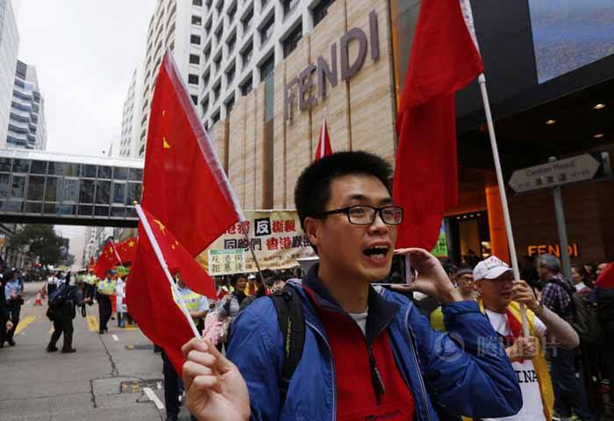
Now China is an indispensable force in world development.
现在的中国已经是世界发展不可少的一股力量。
We also made a great contribution to the development of the world.
我们也为世界的发展做出了很大的贡献。
Our growth rate is higher than any other countries in the world.
我们的发展速度是世界上其他任何国家都赶不上的。
However, some people still doubt our Chinese model.
但是还是有些人怀疑我们的中国模式不好。
But the quality of the Chinese model is determined by the Chinese people.
但是中国模式的好坏是由中国人民决定的。

Slide 22
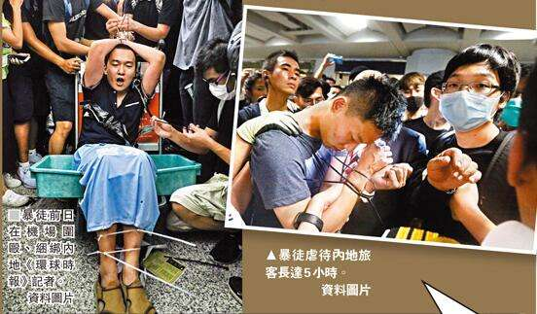
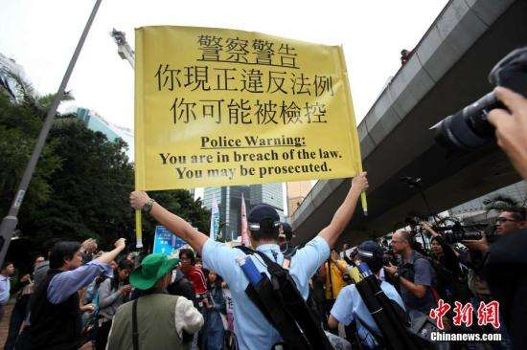
Stop using "freedom
democracy
human rights"
to cover up terrorism.
Fu Guohao, reporter of Global Times website, was attacked by rioters at the Hong Kong airport while he was performing reporting tasks. Radical protesters at the airport beat and tied him up, claiming that he took photos of them.
"I support Hong Kong police, you can beat me now," Fu said while he was surrounded by protesters with his hands tied, before passing out

Slide 23
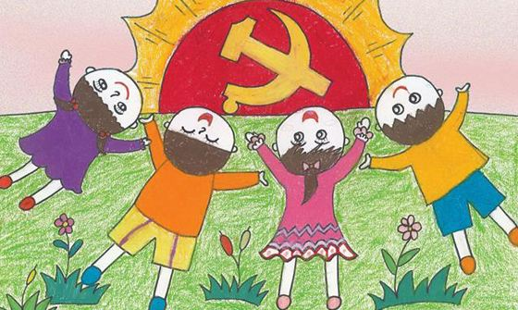
Now we are growing up in such a favorable environment.
现在我们成长在这样优越的环境当中，
Our life is so happy,
我们的生活是这样的幸福，
All people are closely united,
所有的民族团结一心，
How can any Chinese people not support their own country?
又有哪个中国人又会不支持自己的祖国呢，
We do not need to care about those doubts,
我们不需要理会那些怀疑，
The strength and progress of our nation is the best response to the doubt.
我们祖国的强大和我们生活的进步就是对怀疑最好的回应。
Our nation is modest, but we need to be proud.
我们是一个谦虚的民族，但是我们需要骄傲。
Our nation is cautious, but we need to show ourselves.
我们是一个谨慎的民族，但是我们需要展示。
Our nation is peaceful, but we need confidence to lead the world trend.
我们是一个和平的民族，但是我们需要自信。
If we take the right path, we should strengthen our faith, no matter what others say.
如果我们走的是一条正确的道路，我们应该坚定自己的信念，勇敢的走下去，不管别人说什么。

Slide 24
I love you, China, and I’m so proud of being a Chinese.
I’m proud that I’ve got the beautiful yellow skin, black eyes and black hair.
all we should do is to study hard and devote ourselves whole-heartedly in the future,
to the great cause of building you into an even stronger and greater country in the world
I will dedicate my prime youth to you,
I will devote my precious youth to you.

Slide 25
感恩遇见，相互成就，本课件资料仅供您个人参考、教学使用，严禁自行在网络传播，违者依知识产权法追究法律责任。
更多教学资源请关注
公众号：溯恩高中英语
知识产权声明

Slide 26

写作训练
用细节描写（动作，神态，心理，环境）来表达你和家人在观看建国70周年阅兵仪式时的场景和感受。

