Slide 1

感恩遇见，相互成就，本课件资料仅供您个人参考、教学使用，严禁自行在网络传播，违者依知识产权法追究法律责任。
更多教学资源请关注
公众号：溯恩高中英语
知识产权声明

Slide 2
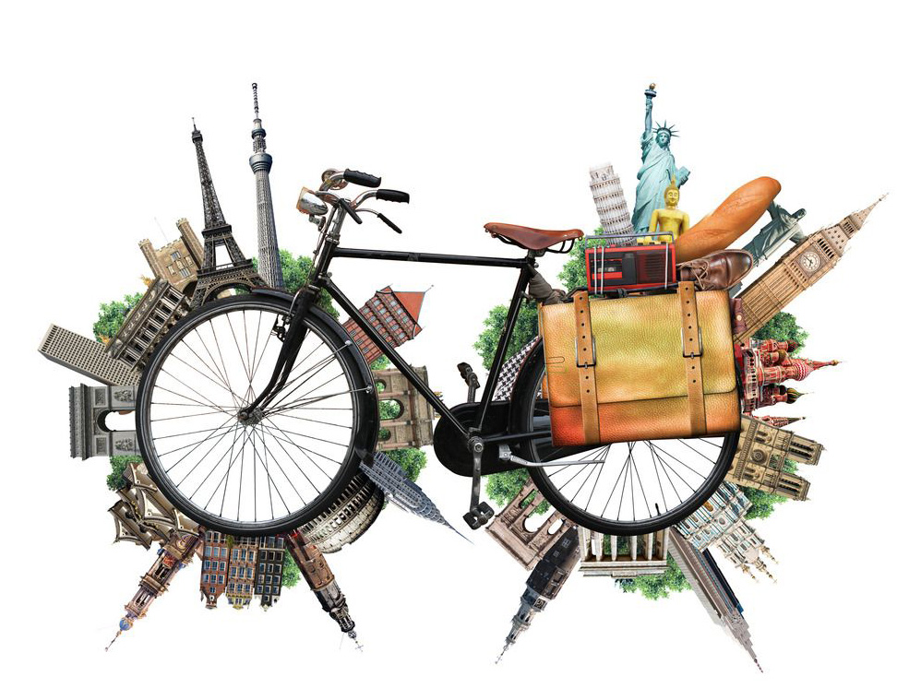
UNIT 2 TRAVELING
AROUND

Slide 3

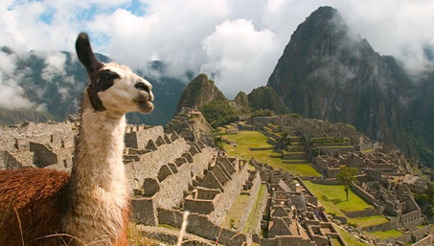
Read for the topic
What do you see about Peru in the video?
Do you want to explore more about Peru?
What other sources of information can you find about Peru?

Slide 4
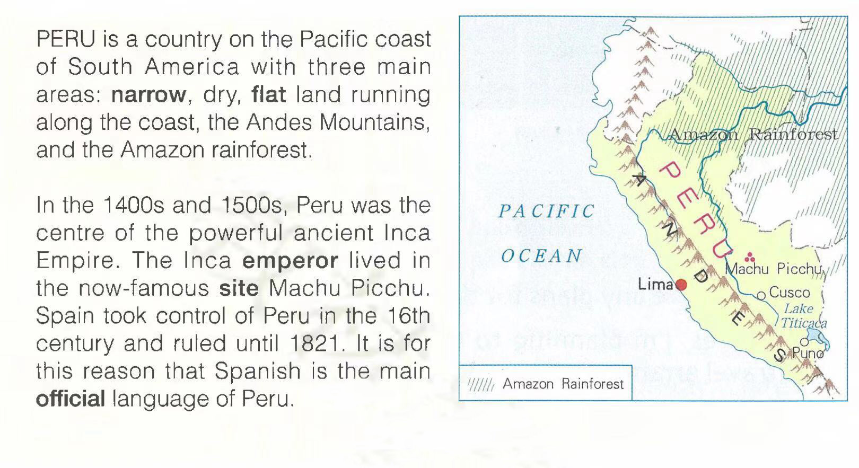
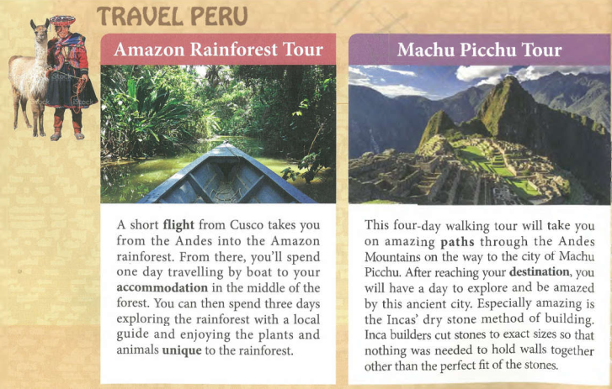
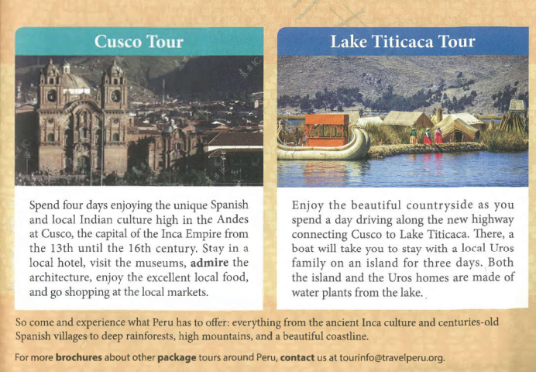

Read for the text type
Text 1
Text 2
Before you read, look through the text quickly for titles, headers, pictures, charts, and any other information that might tell you what type of text it is.
What types of text are they: encyclopedia or brochure?

Slide 5
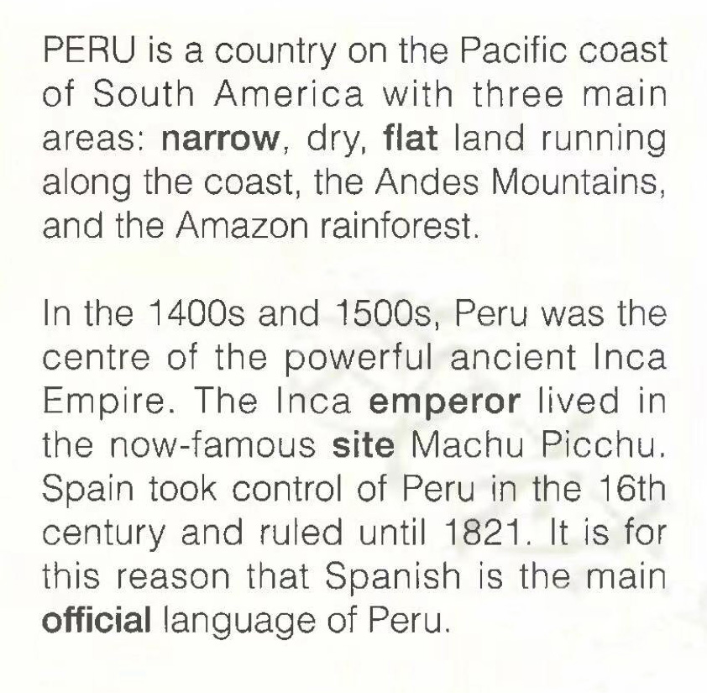
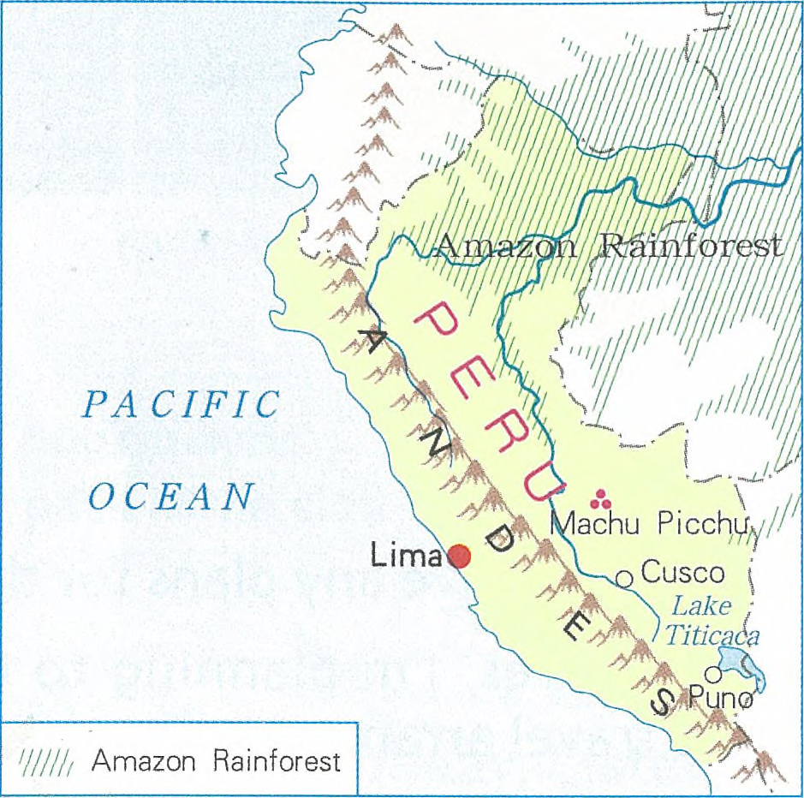
Read for the text type
Text 1
a brief introduction to the location, landscape and official language of Peru
a map of Peru
the captial of Inca Empire
the captial of Peru
Text 1 is taken from _______________ about Peru for it is made up of ___________________ and _____________________.
an encyclopedia
a brief introduction
a map (an illustration)

Slide 6
Read for the text type
title
--topic
Text 2
sub-title
-- key words
illustration
-- sights
text
-- detailed tour information
text
-- conclusion & further information
a travel brochure
Text 2 is _________________ about Peru for its format and this sentence ______________________________________________.
“For more brochures about package tours around Peru, contact…”

Slide 7
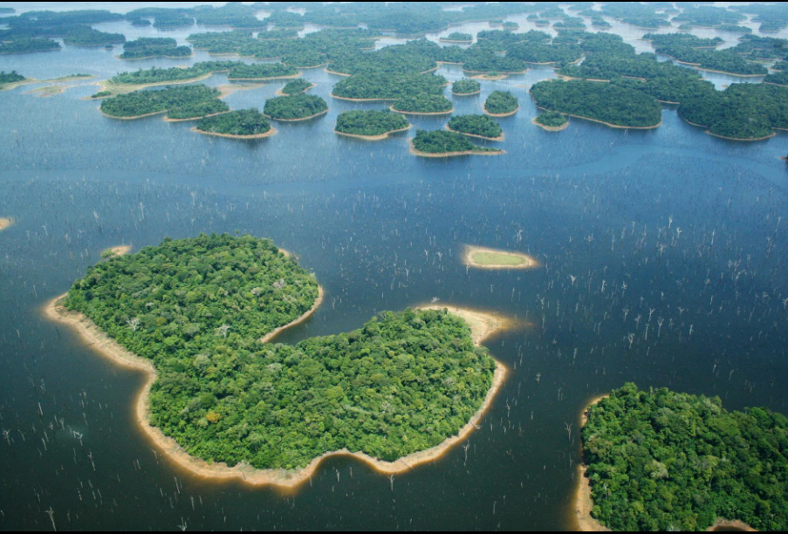
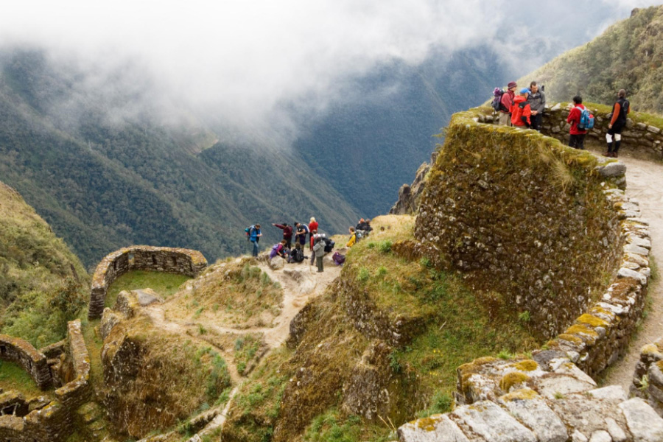
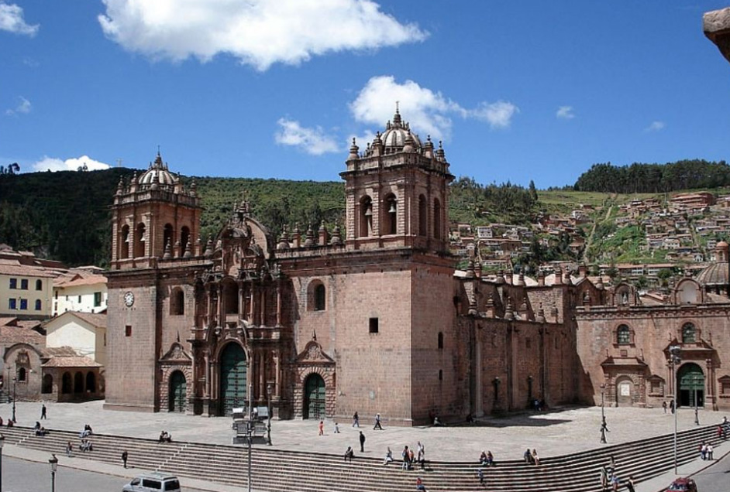
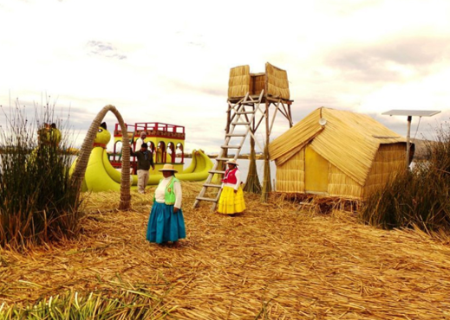
Read for the information
If you are traveling to Peru, which tour(s) will you choose? Why?

Slide 8
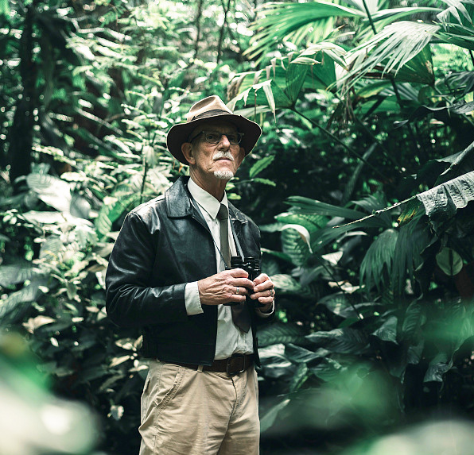

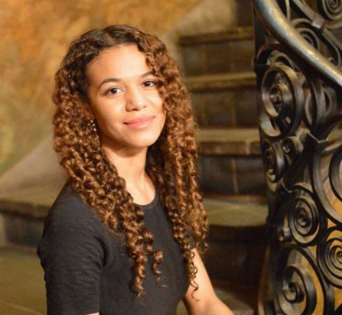
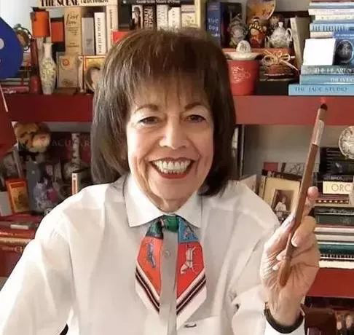
Read for the information
William
an explorer
Purpose:
shoot picutures
of rare birds
Jack & Rose
a newly-married couple
Purpose:
spend honeymoon on a unique island
Elizabeth
a major in history
Purpose:
explore more about the Inca Empire
Ann
a retired museum curator
Purpose:
spend a relaxed vacation & visit museums
Please help them choose the suitable tour(s) in Peru.

Slide 9
Read for the information
 | AMAZON RAINFOREST | MACCHU PICCHU | CUSCO | LAKE TITICACA
Number of days |  | 4 days
Transport
Accommodation
Activity | boating, hiking, exlporing nature
4 days
4 days
4 days
on flight,
by boat
/
by car, by boat
on foot
in the middle of the forest
/
in a local hotel
with a local Uros family
visiting the museum, admiring the architecture, enjoying local food, going shopping
hiking, exploring the ancient city
enjoying the countryside, experiencing the local life
Which tours would you recommend for people who enjoy history and culture? Why?

Slide 10
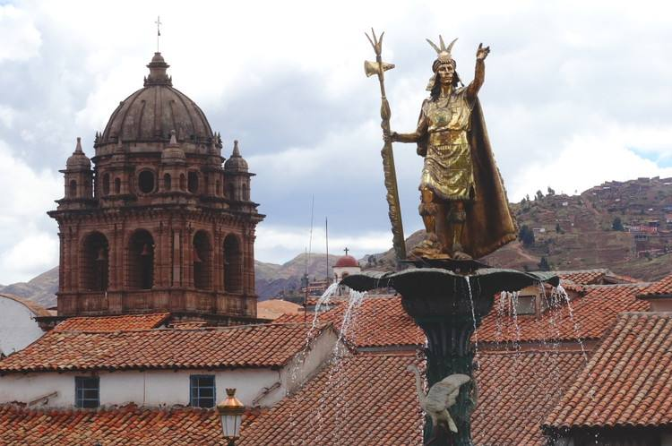
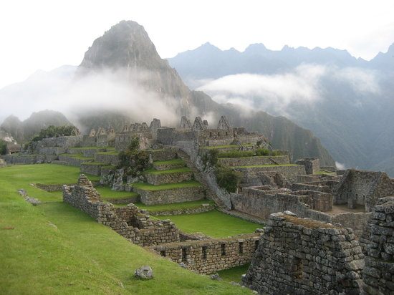
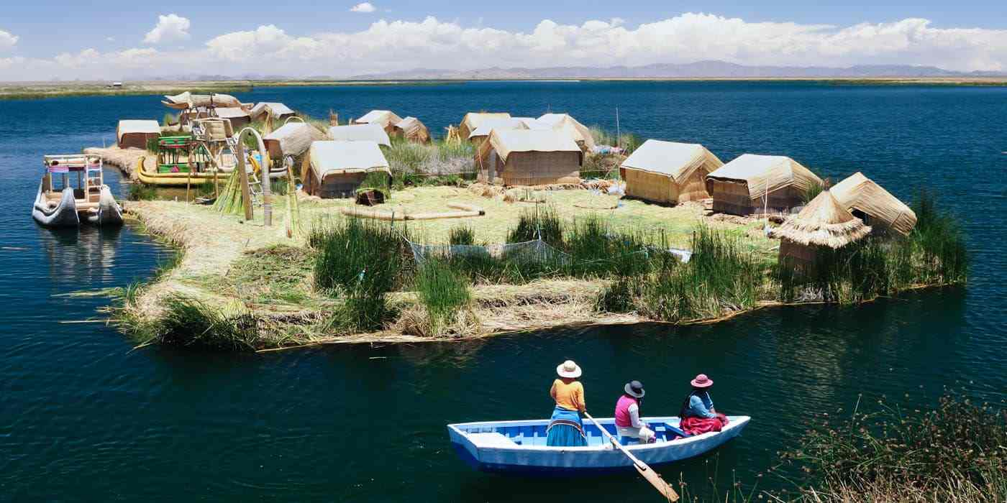
Read for the information
 | AMAZON RAINFOREST | MACCHU PICCHU | CUSCO | LAKE TITICACA
Number of days | 4 days | 4 days | 4 days | 4 days
Transport | on flight, by boat | on foot | / | by car, by boat
Accommodation | in the middle of the forest | / | in a local hotel | with a local Uros family
Activity | boating, hiking, exlporing nature | hiking, exploring the ancient city | visiting the museum, admiring the architecture, enjoying local food, going shopping | enjoying the countryside, experiencing the local life
If you are interested in …，I highly recommend tours to… because…
history & culture

Slide 11
Language focus
Text 1
What's the language characteristic of Text 1?
Is it subjective or objective? Why?
The language of text 1, an encyclopedia, is brief and plain with statistics to be obejective and authoritative.

Slide 12
Language focus
Please find the sentences in text 2 with the same meaning.
Compare and think about the language characteristic of text2.
Text 2
Tourists can take a plane from the Andes into the Amazon rainforest.
Tourists can go from the Andes Mountains to Machu Picchu, spending four days walking.
Tourists can stay in a local hotel, visit museums and see the achitecture, have the local food and go shopping at the local markets.
Tourists can experience different things in Peru, for example, Inca culture, and Spanish villages, forests, mountains and coastline.

Slide 13
Language focus
A short flight from Cusco takes you from the Andes into the Amazon rainforest.
This four-day walking tour will take you on amazing paths through the Andes Mountains on the way to the city of Machu Picchu.
Stay in a local hotel, visit the museums, admire the architecture, enjoy the excellent local food, and go shopping at the local markets.
So come and experience what Peru has to offer: everything from the ancient Inca culture and centuries-old Spanish villages to deep rainforests, high mountains, and a beautiful coastline.
A travel brochure appeals to tourists directly by using “You” or imperative sentence. Besides, it uses vivid adj.s / adv.s and verbs to make it more appealing.

Slide 14

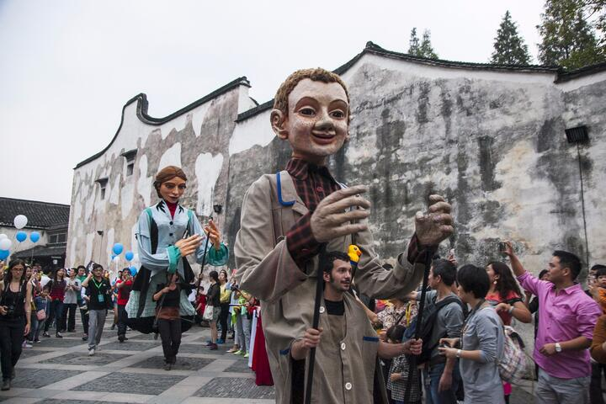
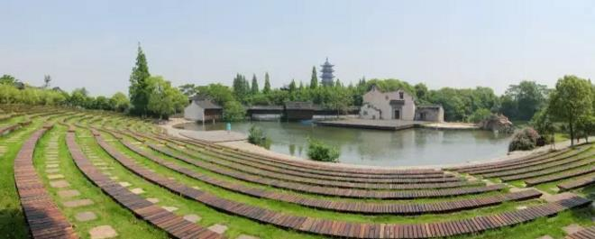
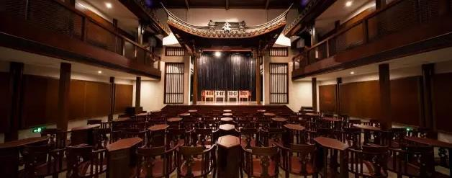
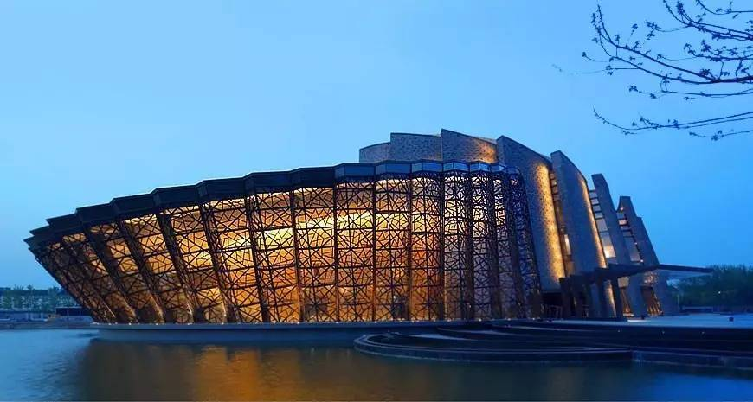
Read for writing
Here is a brief introduction to theWuzhen Theatre Festival. Please try to make it more appealing to the tourists.
The Wuzhen Theatre Festival, an annual theatre event in Wuzhen, Zhejiang Provice, China, is a popular festival around the world. Visitors can see the Specially Invited Plays, the Emerging Theatre Artists Competition, the Outdoor Carnival, and the Wuzhen Dialogues in the festival. Besides, there are different theatre spaces, such as indoor venues (场地), amphitheatres (圆形剧场) and outdoor plazas (广场) .
The Seventh Wuzhen Theatre Festival will be held in Wuzhen from Oct. 25th to Nov.3rd, 2019.

Slide 15
Read for writing
A Sample
Welcome to The Wuzhen Theatre Festival! As an annual theatre event in Wuzhen, Zhejiang Provice, China, it has become one of the most popular festivals around the world. A grand celebration of the art of performance! This theatre carnival is sure to take you on an adventure to experience what it has to offer: everthing from the Specially Invited Plays and the Emerging Theatre Artists Competition to the Outdoor Carnival and the Wuzhen Dialogues. Taste the unique charm of various theatre spaces: whether it is an indoor venue, an amphitheatres or an outdoor plaza, there is one for you.
Come to Wuzhen to dream. In the theatres, by the canal, at the little side streets. You are immersed in a paradise where the world meets China, and China meets the world, in the theatre.

