Slide 1

感恩遇见，相互成就，本课件资料仅供您个人参考、教学使用，严禁自行在网络传播，违者依知识产权法追究法律责任。
更多教学资源请关注
公众号：溯恩高中英语
知识产权声明

Slide 2

B2U5 The Band That Wasn’t
Reading

Slide 3
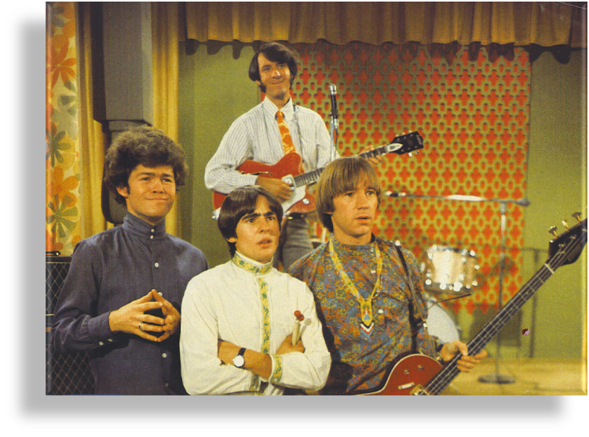
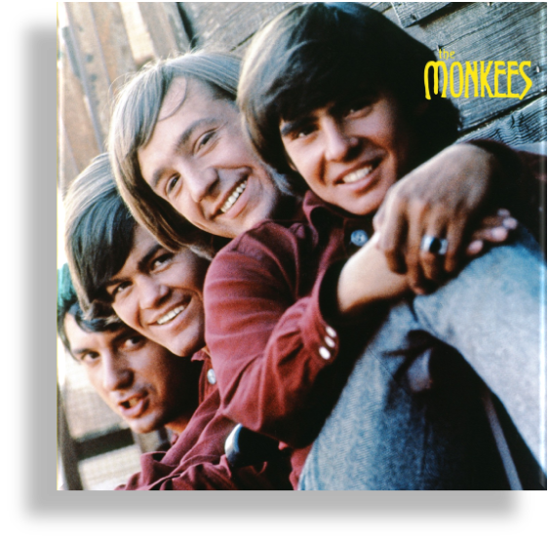
The Band That Wasn’t

Slide 4
1. Why was the Monkees not a real band?
2. Why was the Monkees a real band?
3. If given a chance, which way would you like to choose? Why?
music lovers
practice music
play to passers-by in the streets or give performances in pubs
make and sell records
achieve fame and make money
A regular way to form a band
A unique way to form a band
the Monkees (one musician &three actors)
play jokes and music in a TV show
become more serious about work
become even more popular than Beatles

Slide 5

Further thinking
What made the Monkees a real band?
  humorous performances as trigger
  fans’ support as motivator
  a serious attitude to work and great works as power
  …
  It started as a coincidence, but it turned itself into a success through serious practice.

Slide 6
The Structure
1. Why does the author raise four questions in para.1?
To lead into the topic.
2. What can we know with the three questions at the beginning of para.1?
3. What can we know with the fourth question at the end of para.1?
A lot of people attach great importance to becoming rich and famous.
Gaining fame and wealth is what many people believe important.
Many people consider it insignificant to be wealthy and popular.
a regular way
How do people form a band?
a unique way

Slide 7
Rephrasing
music lovers
practice music
play to passers-by in the streets or give performances in pubs
make and sell records
achieve fame and make money
A regular way to form a band
do rehearsals; give street and pub performances; accumulate wealth and enjoy popularity.
A unique way to form a band
the Monkees (one musician &three actors)
play jokes and music in a TV show
become more serious about work
become even more popular than Beatles
act humorously; make their own music; be all the rage.

Slide 8
Connecting
Many musicians meet and form a band because they like to write and play their own music. They may start as a group of high-school students, for whom practising their music in someone's house is the first step to fame. Sometimes they may play to passers-by in the street or subway so that they can earn some extra money for themselves or to pay for their instruments. Later they may give performances in pubs or clubs, for which they are paid in cash. Of course they hope to make records in a studio and sell millions of copies to become millionaires!(Para.2)
Possibly, …
do rehearsals; give street and pub performances; accumulate wealth and enjoy popularity.
Possibly, music lovers do rehearsals, give street and pub performances. _____________________, they’ll accumulate fortune and enjoy popularity.
Therefore/Thus

Slide 9
Connecting
A unique way to form a band (The Monkees) (Para. 3-4)
the Monkees (one musician &three actors)
play jokes and music in a TV show
become more serious about work
become even more popular than Beatles
act humorously; make their own music; be all the rage.
However
_____________, the Monkees began in a unique way. One musician and three actors performed humorously in a TV show. Later, they made their own music, becoming all the rage then.

Slide 10
Summary writing
Write a summary of the passage in around 80 words.
Checklist for Drafting
□ | 1. Does the writing cover all the key points?
□ | 2. Does the writing exclude any irrelevant details?
□ | 3. Does the writing exclude personal opinions or feelings?
□ | 4. Does the writing follow the logic of the original passage?
内容和框架
语言
Checklist for Revising
□ | 1. Is the writing written in your own words or phrases?
□ | 2. Are there transitional words or phrases to make the writing coherent?
□ | 3. Is the writing written in natural and standard English?

Slide 11
A possible version
Gaining fame and wealth is what many people believe important. Possibly, they are music lovers who form bands in the regular way - doing rehearsals and giving performances in the street or pubs. Thus they’ll accumulate fortune and enjoy popularity. However, the Monkees began in a unique way. One musician and three actors first performed humorously in a TV show, but later they made their own music, becoming all the rage then.

Slide 12
Assignment
Improve your summary with the help of the two checklists.
Checklist for Drafting
□ | 1. Does the writing cover all the key points?
□ | 2. Does the writing exclude any irrelevant details?
□ | 3. Does the writing exclude personal opinions or feelings?
□ | 4. Does the writing follow the logic of the original passage?
内容和框架
语言
Checklist for Revising
□ | 1. Is the writing written in your own words or phrases?
□ | 2. Are there transitional words or phrases to make the writing coherent?
□ | 3. Is the writing written in natural and standard English?

