Slide 1

感恩遇见，相互成就，本课件资料仅供您个人参考、教学使用，严禁自行在网络传播，违者依知识产权法追究法律责任。
更多教学资源请关注
公众号：溯恩高中英语
知识产权声明

Slide 2

M5U5 First Aid for Burns
Reading

Slide 3
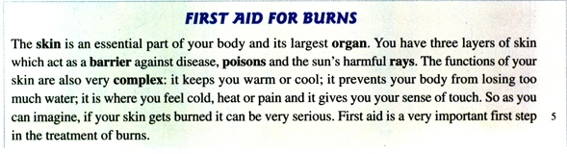
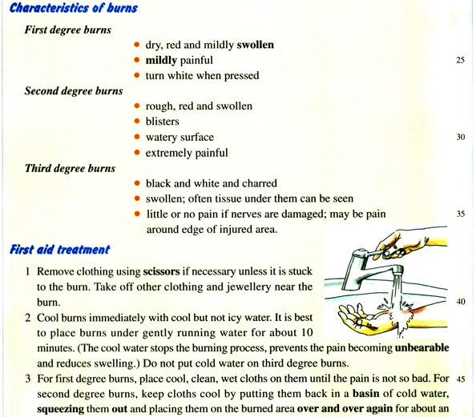
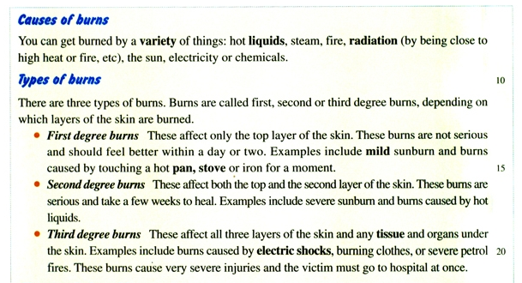
1. What is the feature of this text?
2. Why does the author include blue subtitles in italic, brown dots and numbers?
To highlight key information.
3. What can we learn in the passage?
We can learn first aid for burns, including ________________________________________________.

Slide 4
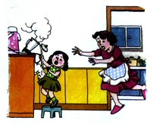
A young girl has reached up to a bench, and pulled the cord of an electric jug towards her. However, she gets burnt by the boiling water.
1. What may be the cause of the girl’s burns?
Hot liquids and stream.
2. Should the girl be sent to the hospital immediately?
It depends.
3. What should the mother do before she decides to send the girl to the hospital?
observe _________________________________________
determine ______________________________________
adopt ___________________________________________
the characteristics of burns
the types of the burns
proper first aid treatment

Slide 5
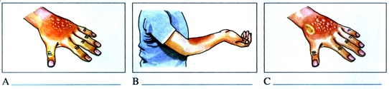
If the girl’s burns is A/B/C, can you describe the characteristics and types first, and then give the mother some proper first aid treatment advice?

Slide 6
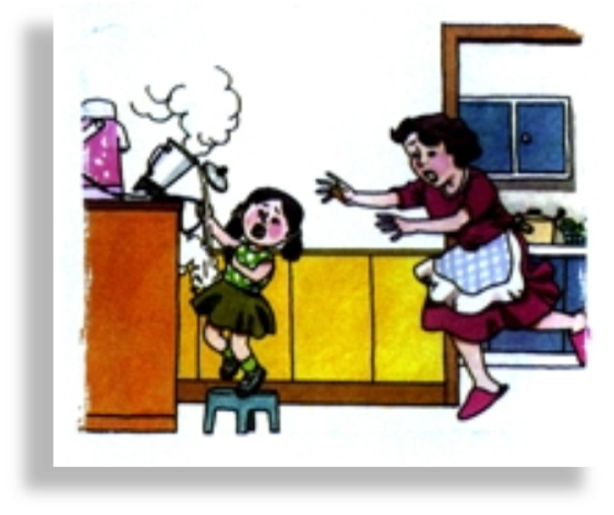

Type | Characteristics | First aid treatment
1. Cool burns immediately with ________________
__________ for ________ minutes.
2. Place ___________________on burns until the pain is not so bad.
3. Dry the burned area gently. Do not __________
4. Cover the burned area with __________________. Never put ____________________ to avoid ___________.
5. Keep the burns on arms _________, if possible.
dry, red and mildly ______
________ painful
turn ______ when pressed
first degree burns
_________________________ is affected.
These burns are __________ and __________.

Slide 7
Cool/Cover/Call
Type | Characteristics | First aid treatment
1. Cool burns immediately with ________________
__________ for ________ minutes.
2. Place ___________________on burns for _________ until the pain is not so bad.
3. Dry the burned area gently. Do not __________.
4. Cover the burned area with __________________. Never put ____________________ to avoid ___________.
5. Get the victim _____________________________.
rough, red and swollen
__________
watery surface
__________ painful
second degree burns
_________________________ are affected.
These burns are __________ and __________.

Slide 8
Type | Characteristics | First aid treatment
1. Do not _____________________________.
2. Do not _____________________________.
3. Never ______________________________.
4. Get the victim _____________________.
black and white and charred
swollen; ___________________
_________________if nerves are damaged; may be ______________
third degree burns
_________________________ are affected.
These burns are __________ and __________.

Slide 9

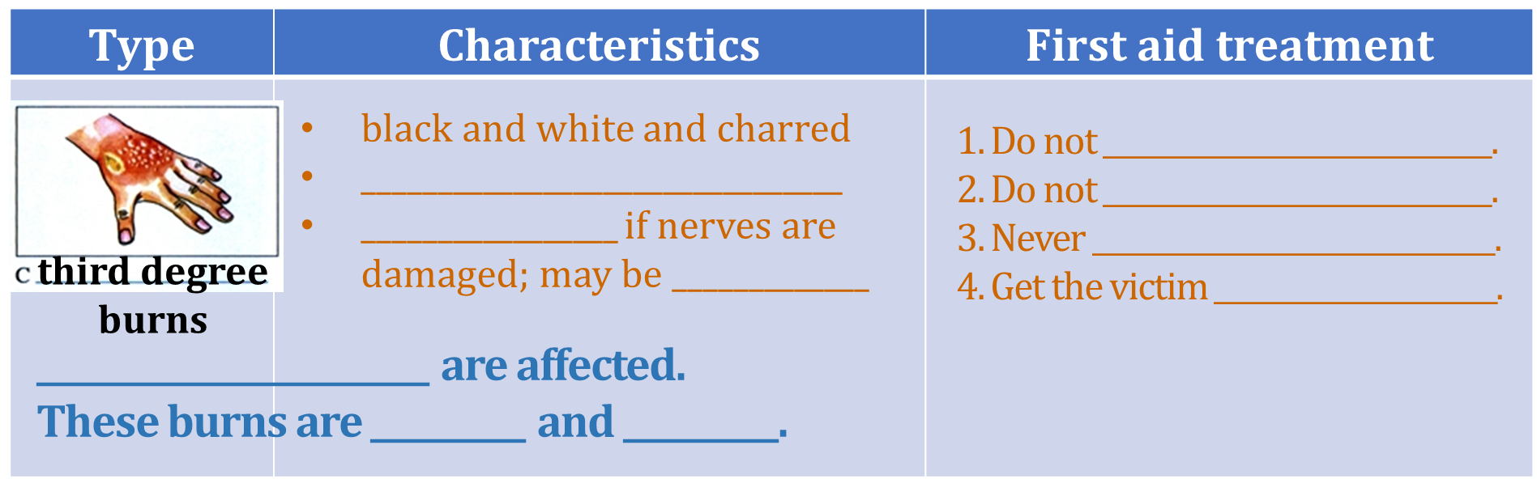
Retelling
Which type of burns is the girl most likely to get?
Can you describe the characteristics of burns, and offer proper aid treatment advice?
third degree burns

Slide 10
Further thinking
1. Why should you put cold water on a burn?
2. Why doesn’t a third degree burn hurt?
3. Why do you think clothes and jewellery near burns should be removed?
4. If someone has a third degree burn, why might you see tissue?
5. Are the suggestions in the seven steps persuasive?
The suggestions are followed by explanations, making them convincing.

Slide 11
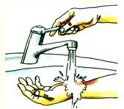
Further thinking
Of the seven stages, why does the author include a picture of the second stage?
Cooling burns immediately is a must for first and second burns.
This illustration helps to visualize the process.
Can we leave out para.1? Why?
No. It tells us the functions of skins, which introduces the topic.
The skin is an essential part of your body and its largest organ. You have three layers of skin which act as a barrier against disease, poisons and the sun's harmful rays. The functions of your skin are also very complex: it keeps you warm or cool; it prevents your body from losing too much water; it is where you feel cold, heat or pain and it gives you your sense of touch. So as you can imagine, if your skin gets burned it can be very serious. First aid is a very important first step in the treatment of bums.
The skin is an essential part of your body and its largest organ. You have three layers of skin which act as a barrier against disease, poisons and the sun's harmful rays. The functions of your skin are also very complex: it keeps you warm or cool; it prevents your body from losing too much water; it is where you feel cold, heat or pain and it gives you your sense of touch. So as you can imagine, if your skin gets burned it can be very serious. First aid is a very important first step in the treatment of bums.

Slide 12
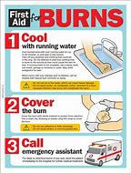
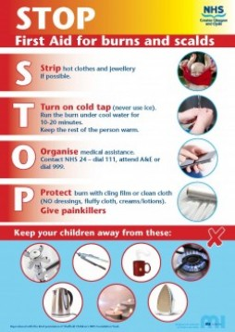
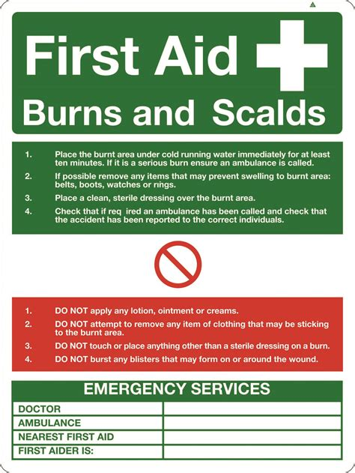
Assignment
1. Make an English poster titled First Aid for Burns.

Slide 13
Assignment
2. Write a list of dos and don’ts for first degree burns.
For First Degree Burns | Dos | Don’ts

Slide 14
A possible version
For First Degree Burns | Dos | Don’ts
 | 1. Cool the area right away. Place the affected area under cold running water. Do this for at least 5-10 minutes or until the pain is relieved. This will also reduce the amount of skin damage. 2. Keep the area uncovered and raised, if possible. Apply a dry dressing, if necessary. 3. Go to the hospital if after 2 days you show signs of infection(fever, chills, increased redness, or swelling) or if the affected area is still painful. | 1. Do not apply ice and cold water for too long a time. This may result in complete numbness leading to frostbite. 2. Do not use butter or other ointments. 3. Avoid using local anesthetic sprays and creams. They can slow heating and may lead to allergic reactions in some people. 4. Do not give aspirin or any medication containing salicylates(水杨酸盐) to anyone 19 years of age or younger, unless a doctor tells you to.

