Slide 1

感恩遇见，相互成就，本课件资料仅供您个人参考、教学使用，严禁自行在网络传播，违者依知识产权法追究法律责任。
更多教学资源请关注
公众号：溯恩高中英语
知识产权声明

Slide 2

Reading:
WHO AM I ?
Module 2 Unit 3 Computers
执教者：临海市回浦中学 吴超玲

Slide 3
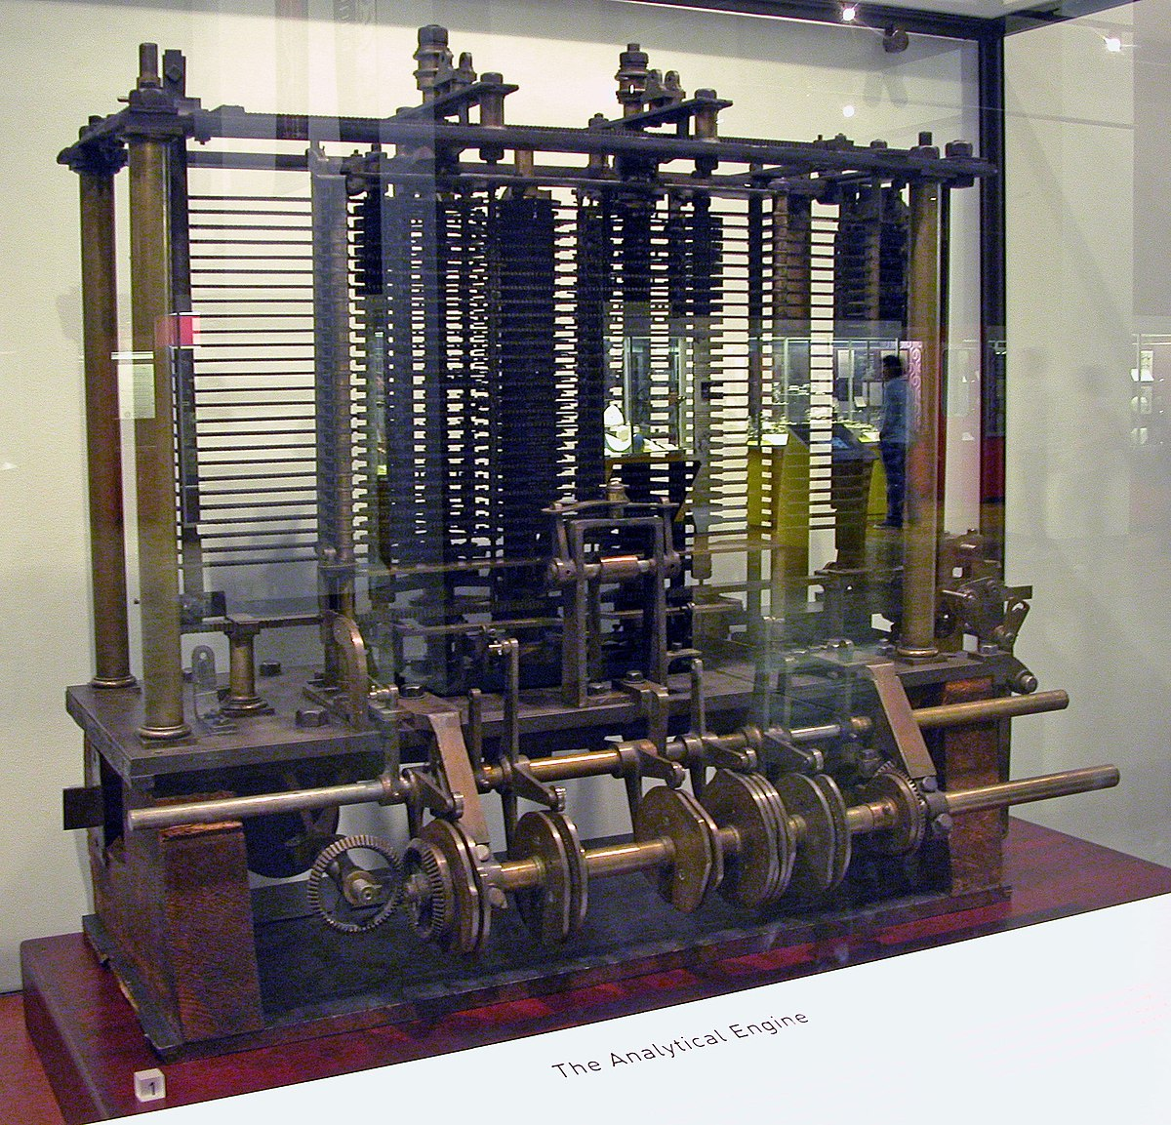
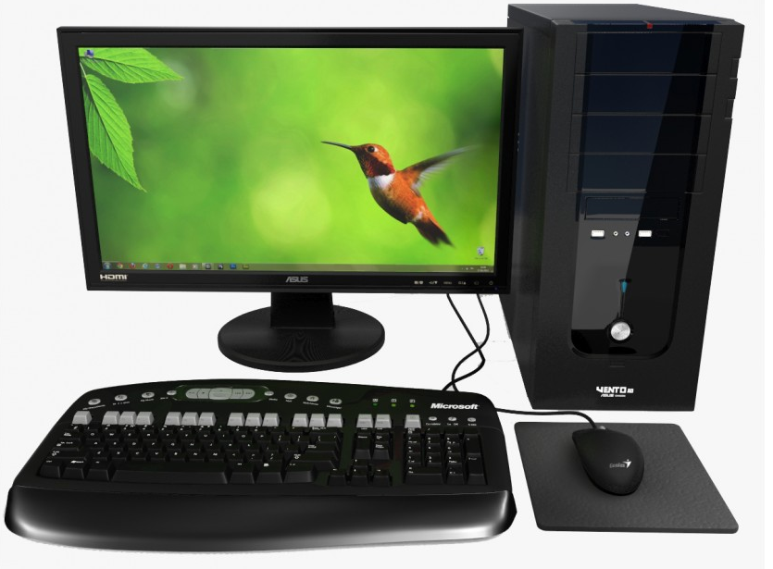
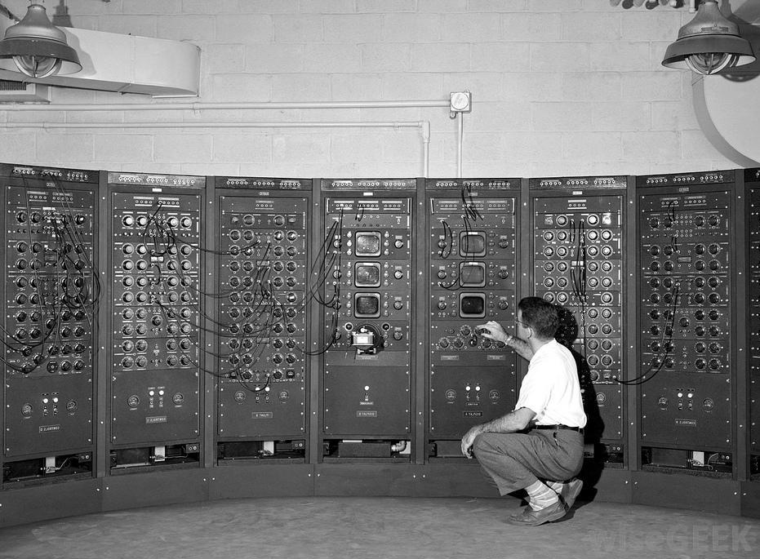
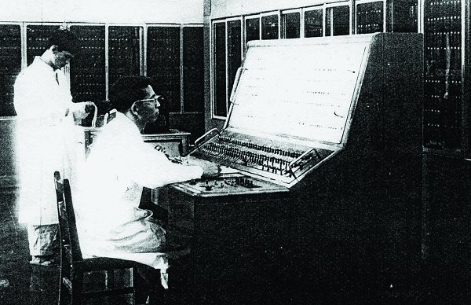
What is it?
Computer
a(n) ________ that can ___________________
an electronic machine for dealing with information
Common Operating Machine
Particularly Used for
Trade, Education, and
Research
Common Operating Machine
Particularly Used for
Trade, Education, and
Research

Slide 4
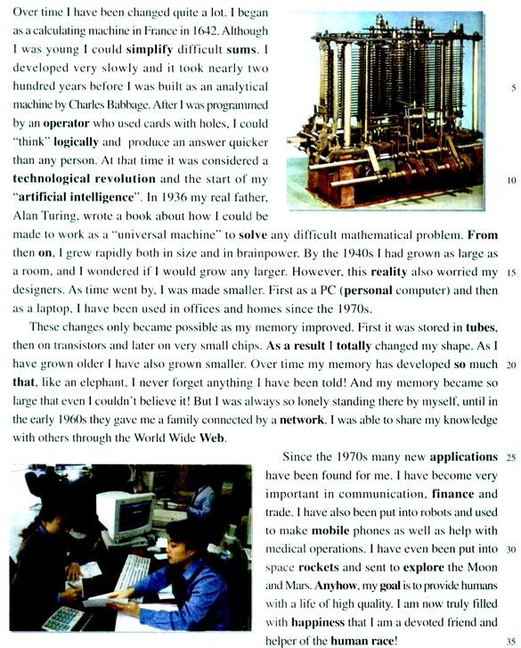

Reading: WHO AM I ?
Text type
Main idea
Structure

Slide 5
Reading: WHO AM I ?
Text type:
A. Narrative
B. Persuasive
C. Expository
D. Descriptive
Main idea:
The text mainly
______________
____________________________
introduces the development of computers.

Slide 6
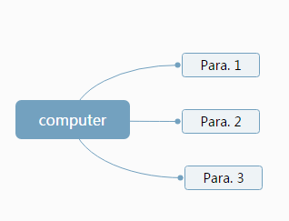
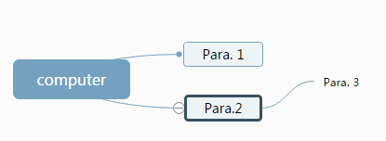


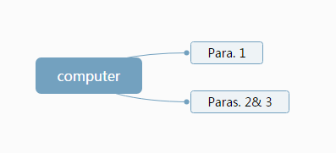
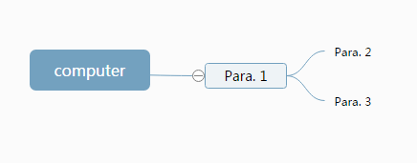
Reading for the structure
A. B.
C. D.

Slide 7
Reading for the main idea
topic sentence
① Over time I have been changed quite a lot. I began as ...in 1642. Although I was young I could simplify difficult sums. I developed very slowly and... it took nearly two hundred years before .... After I was programmed.... At that time it was considered .... In 1936 .... From then on, I.... By the 1940s .... However, .... As time went by, I was made smaller. First as a PC (personal computer) and then as a laptop, I have been used in offices and homes since the 1970s.
② These changes only became possible as my memory improved. First it was stored in tube... then on transistors and later on very small chips. As a result ....Over time .... But ... until in the early 1960s ....I was able to share my knowledge... through the World Wide Web.
③ Since the 1970s many new applications have been found for me. I have become very important.... I have also been .... I have even been ..... Anyhow, my goal is to provide humans with a life of high quality. I am now truly filled with happiness that I am a devoted friend and helper of the human race!
① Over time I have been changed quite a lot. I began as ...in 1642. Although I was young I could simplify difficult sums. I developed very slowly and... it took nearly two hundred years before .... After I was programmed.... At that time it was considered .... In 1936 .... From then on, I.... By the 1940s .... However, .... As time went by, I was made smaller. First as a PC (personal computer) and then as a laptop, I have been used in offices and homes since the 1970s.
② These changes only became possible as my memory improved. First it was stored in tube... then on transistors and later on very small chips. As a result ....Over time .... But ... until in the early 1960s ....I was able to share my knowledge... through the World Wide Web.
③ Since the 1970s many new applications have been found for me. I have become very important.... I have also been .... I have even been ..... Anyhow, my goal is to provide humans with a life of high quality. I am now truly filled with happiness that I am a devoted friend and helper of the human race!
① Over time I have been changed quite a lot. I began as ...in 1642. Although I was young I could simplify difficult sums. I developed very slowly and... it took nearly two hundred years before .... After I was programmed.... At that time it was considered .... In 1936 .... From then on, I.... By the 1940s .... However, .... As time went by, I was made smaller. First as a PC (personal computer) and then as a laptop, I have been used in offices and homes since the 1970s.
② These changes only became possible as my memory improved. First it was stored in tube... then on transistors and later on very small chips. As a result ....Over time .... But ... until in the early 1960s ....I was able to share my knowledge... through the World Wide Web.
③ Since the 1970s many new applications have been found for me. I have become very important.... I have also been .... I have even been ..... Anyhow, my goal is to provide humans with a life of high quality. I am now truly filled with happiness that I am a devoted friend and helper of the human race!
supporting details

Slide 8
Reading for the organziation
A. In order of time B. In order of space
C. In order of logic
Organzied?
...change...
+ supporting details
...memory...
+supporting details
... applications...
+ supporting details

Slide 9
Reading for the organziation
① Over time I have been changed quite a lot. I began as ...in 1642. Although I was young I could simplify difficult sums. I developed very slowly and... it took nearly two hundred years before .... After I was programmed.... At that time it was considered .... In 1936 .... From then on, I.... By the 1940s .... However, .... As time went by, I was made smaller. First as a PC (personal computer) and then as a laptop, I have been used in offices and homes since the 1970s.
② These changes only became possible as my memory improved. First it was stored in tube... then on transistors and later on very small chips. As a result ....Over time .... But ... until in the early 1960s ....I was able to share my knowledge... through the World Wide Web.
③ Since the 1970s many new applications have been found for me. I have become very important.... I have also been .... I have even been ..... Anyhow, my goal is to provide humans with a life of high quality. I am now truly filled with happiness that I am a devoted friend and helper of the human race!
in order of time
in order of time
in order of logic

Slide 10
Memory
In what ways have computers changed? How?
Reading for details
Applications
Time | Identity | Function
________
difficult sums
first stored in _____, then on ________, later on ________
________
calculating
simplify
________
machine
1642
tubes
communicat-ion, finance, trade, robots, mobile phones, medical operations, rockets
...
“think” _______, answer ______ ...
analytical
logically
transistors
(+≈200 yrs)
1822
________ machine
______
quicker
very small chips
solve _____ difficulty maths problem
_______ machine
any
universal
1936
became _______
1940s
(grow as large as a room )
large
used in offices & homes
(...1960s ...a _______)
______
PC/laptop
1970s
network

Slide 11
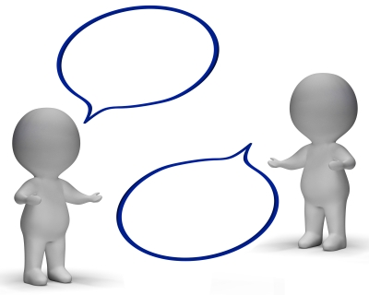
Memory
Reading between the lines
Applications
Computers have changed in...
Size: smaller (more convenient)
Memory: larger, quicker (more intelligent)
Function: more powerful
Application: wider
Goal
To provide humans with a life of high quality

Slide 12

Reading beyond the lines
What prolems does the computer technology bring to us?
getting addicted to online games
having less face-to-face communication
committing online crimes
...
we humans make good use of the computer technology
Only when ______________________ can we benefit from the computer technology.

Slide 13


Reading beyond the lines
The development/history of computers
WHO AM I ?
Computers are more than machines, but humans' friends and helpers.
Personification is used to catch readers' attention.

Slide 14
Writing skills
① After I was programmed by an operator who used cards with holes, I could “think” logically and produce an answer quciker than any perosn.
② By the 1940s I had grown as large as a room....
③ Over time my memory has developed so much that, like an elephant, I never forget anything I have been told!
personification
comparison
comparison
simile

Slide 15
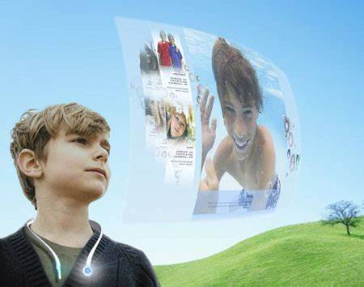
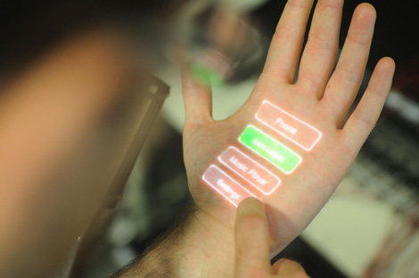
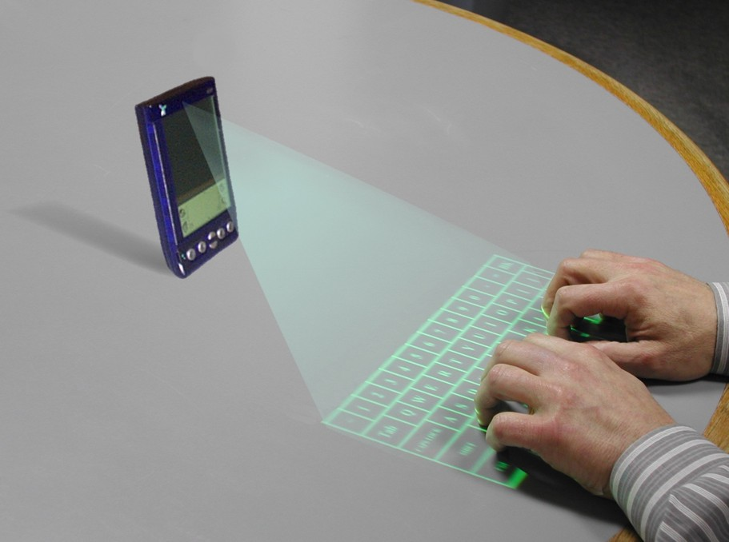
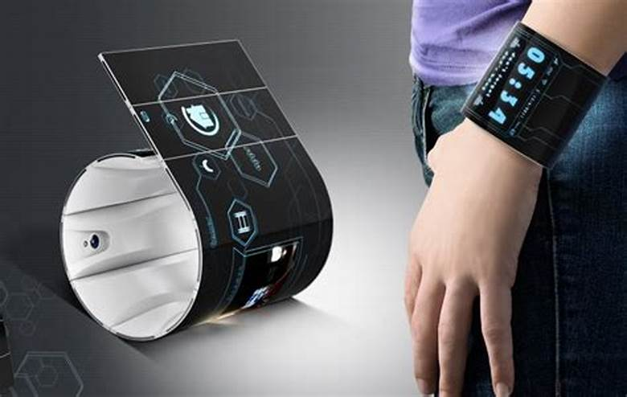
Thinking outside the box
Work in groups and design a future computer. Briefly introduce your design, using some good language and writing methods from the text.
size
shape
memory
function
application
...

Slide 16
Assignment
1. Appreciate some beautiful sentence structures from the text.
2. Write a brief introduction to a future computer, using some good language and writing skills from the text.
Thank You !

