Slide 1

感恩遇见，相互成就，本课件资料仅供您个人参考、教学使用，严禁自行在网络传播，违者依知识产权法追究法律责任。
更多教学资源请关注
公众号：溯恩高中英语
知识产权声明

Slide 2
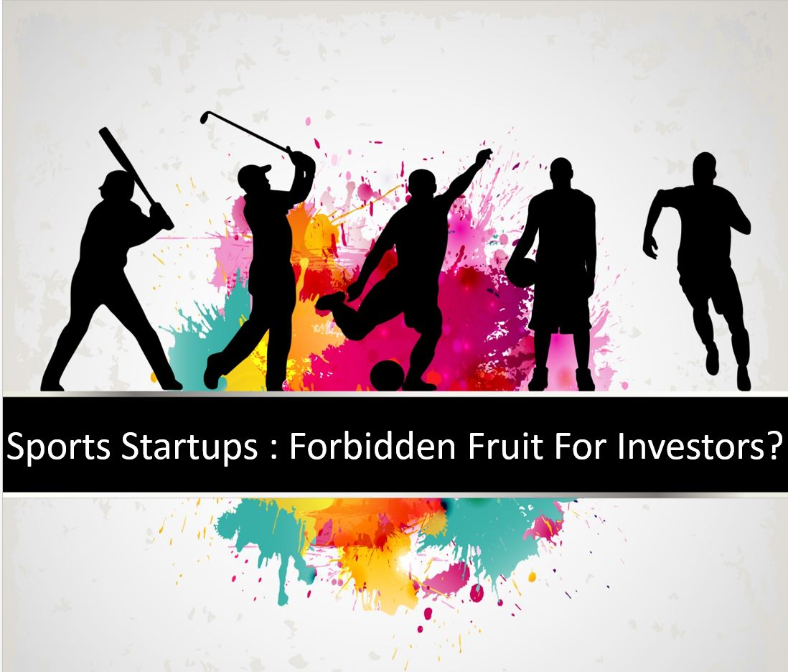
B1U3 Sports and Fitness（reading &thinking）

Slide 3
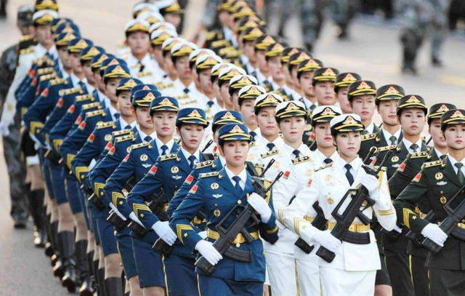
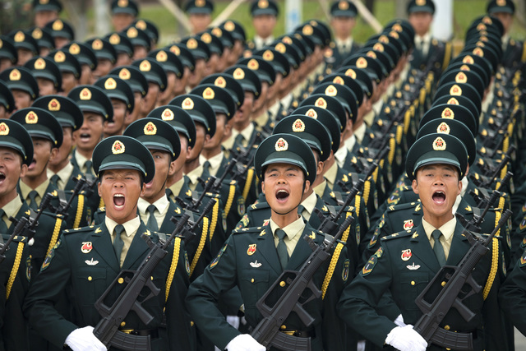
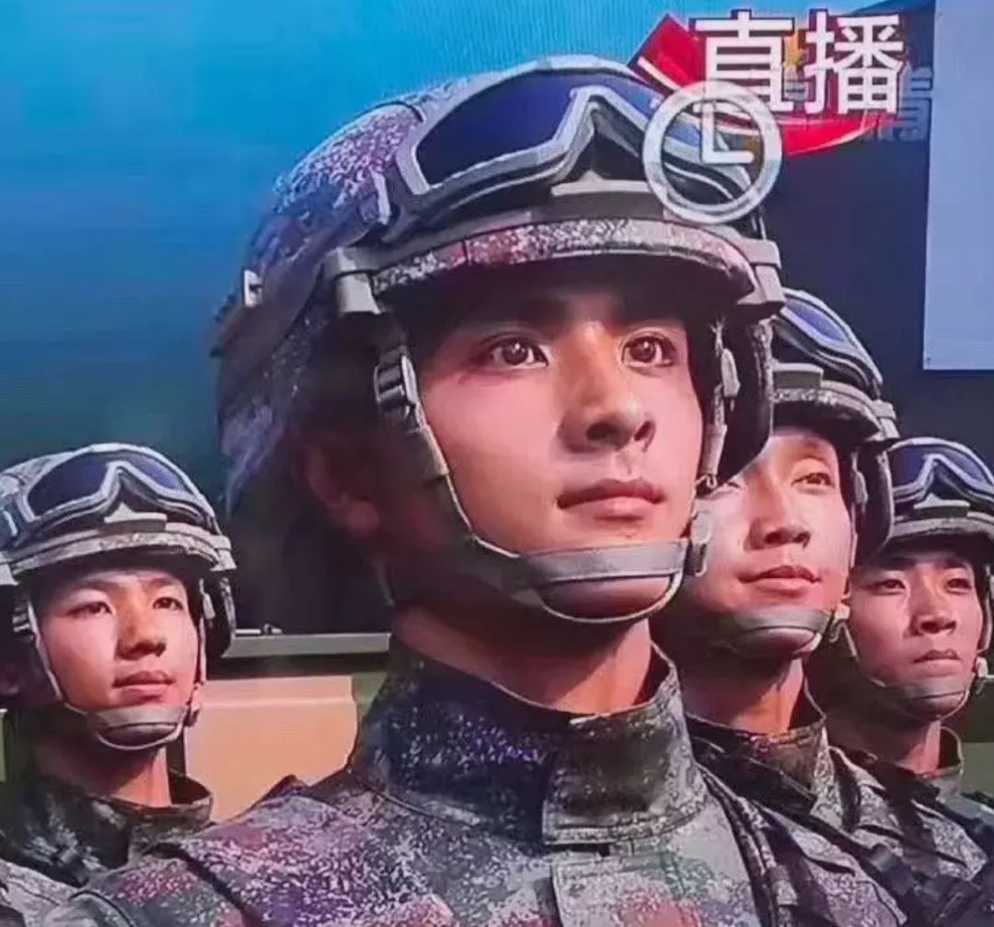

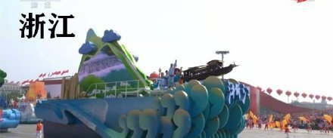
How was your National Day holiday?
Have you watched the parade?

Slide 4
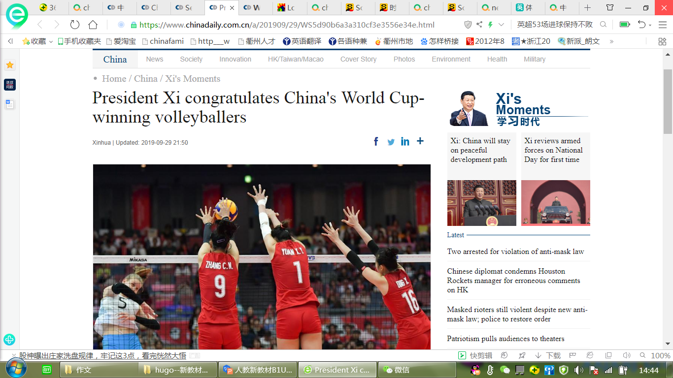
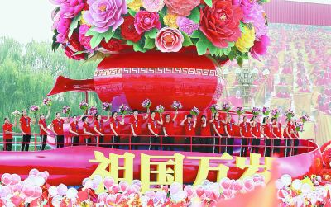
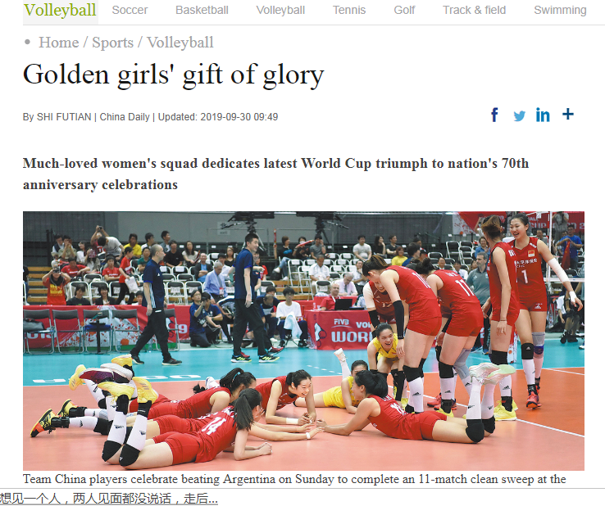
The most attractive float
who are they?
Why are they so welcomed?
What did they do?

Slide 5
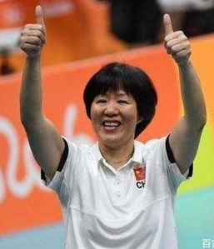
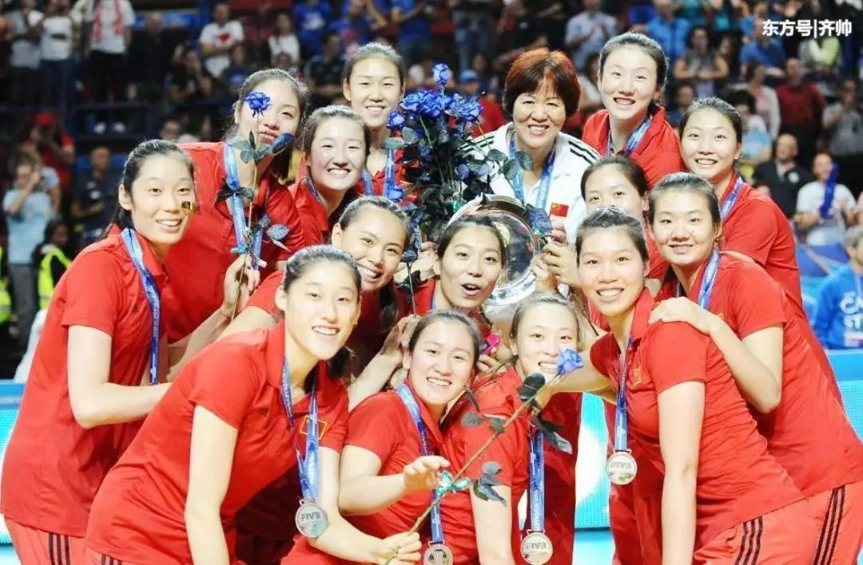

Lang Ping
living legend

Slide 6
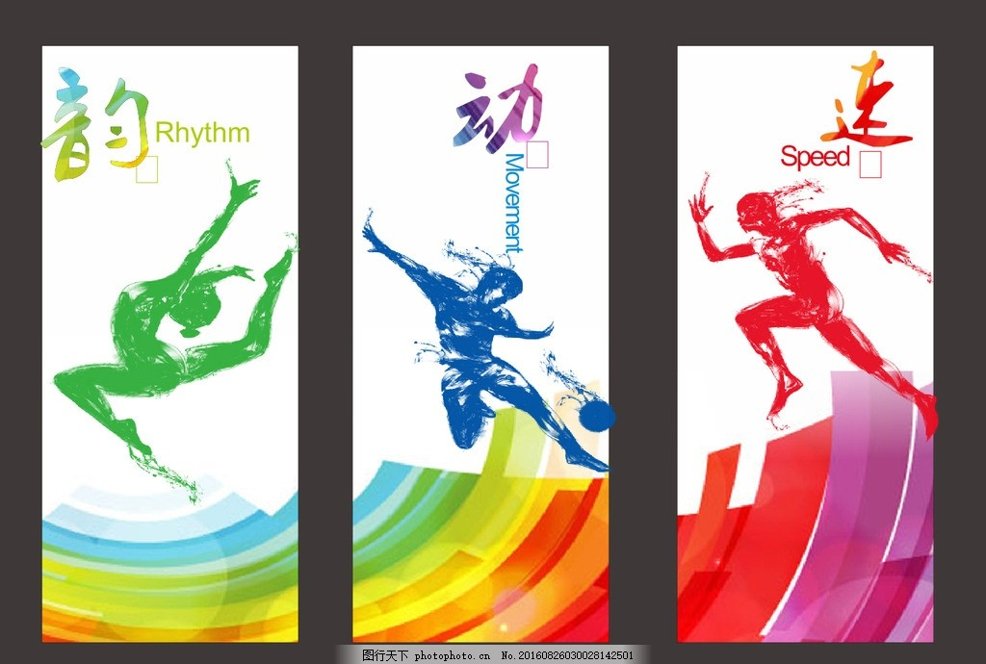
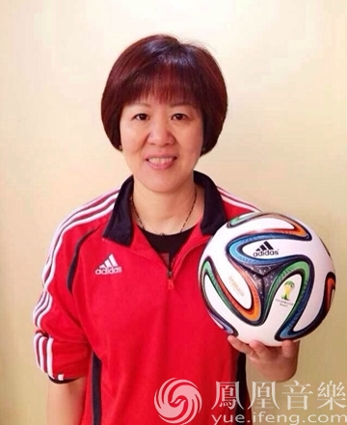
Living Legends-part 1
Reading
Lang Ping

Slide 7

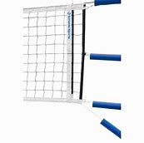
1) one of the best players____________
2) the team captain _____________( with heart problems)
had been injured
lost heart
(solution: not ___________
_+players _____________)
had to leave
worked together
was falling apart
The team ______________
time order
③
big challenge
In 2016
Lang Ping led her volleyball team to ________________ in Brazil
Olympic gold
her determination
②
______________was tested
Two weeks later
experiences
In 2015
①
world champions
They were__________________
World Cup
Read the passage
and fill in the blanks

Slide 8
As
, she ____ the China women's
volleyball team _________at the
world ___________ and the
Olympics
led
a coach
to medals
achievements
championships
parallel sentences
As
a player
, she ______________
__________to her country
brought honour
experiences
and glory
As
a person
, she ______ by fans_______________
is loved
at home and abroad

Slide 9
Lang
Ping
Biography writing
achievements
experiences

Slide 10
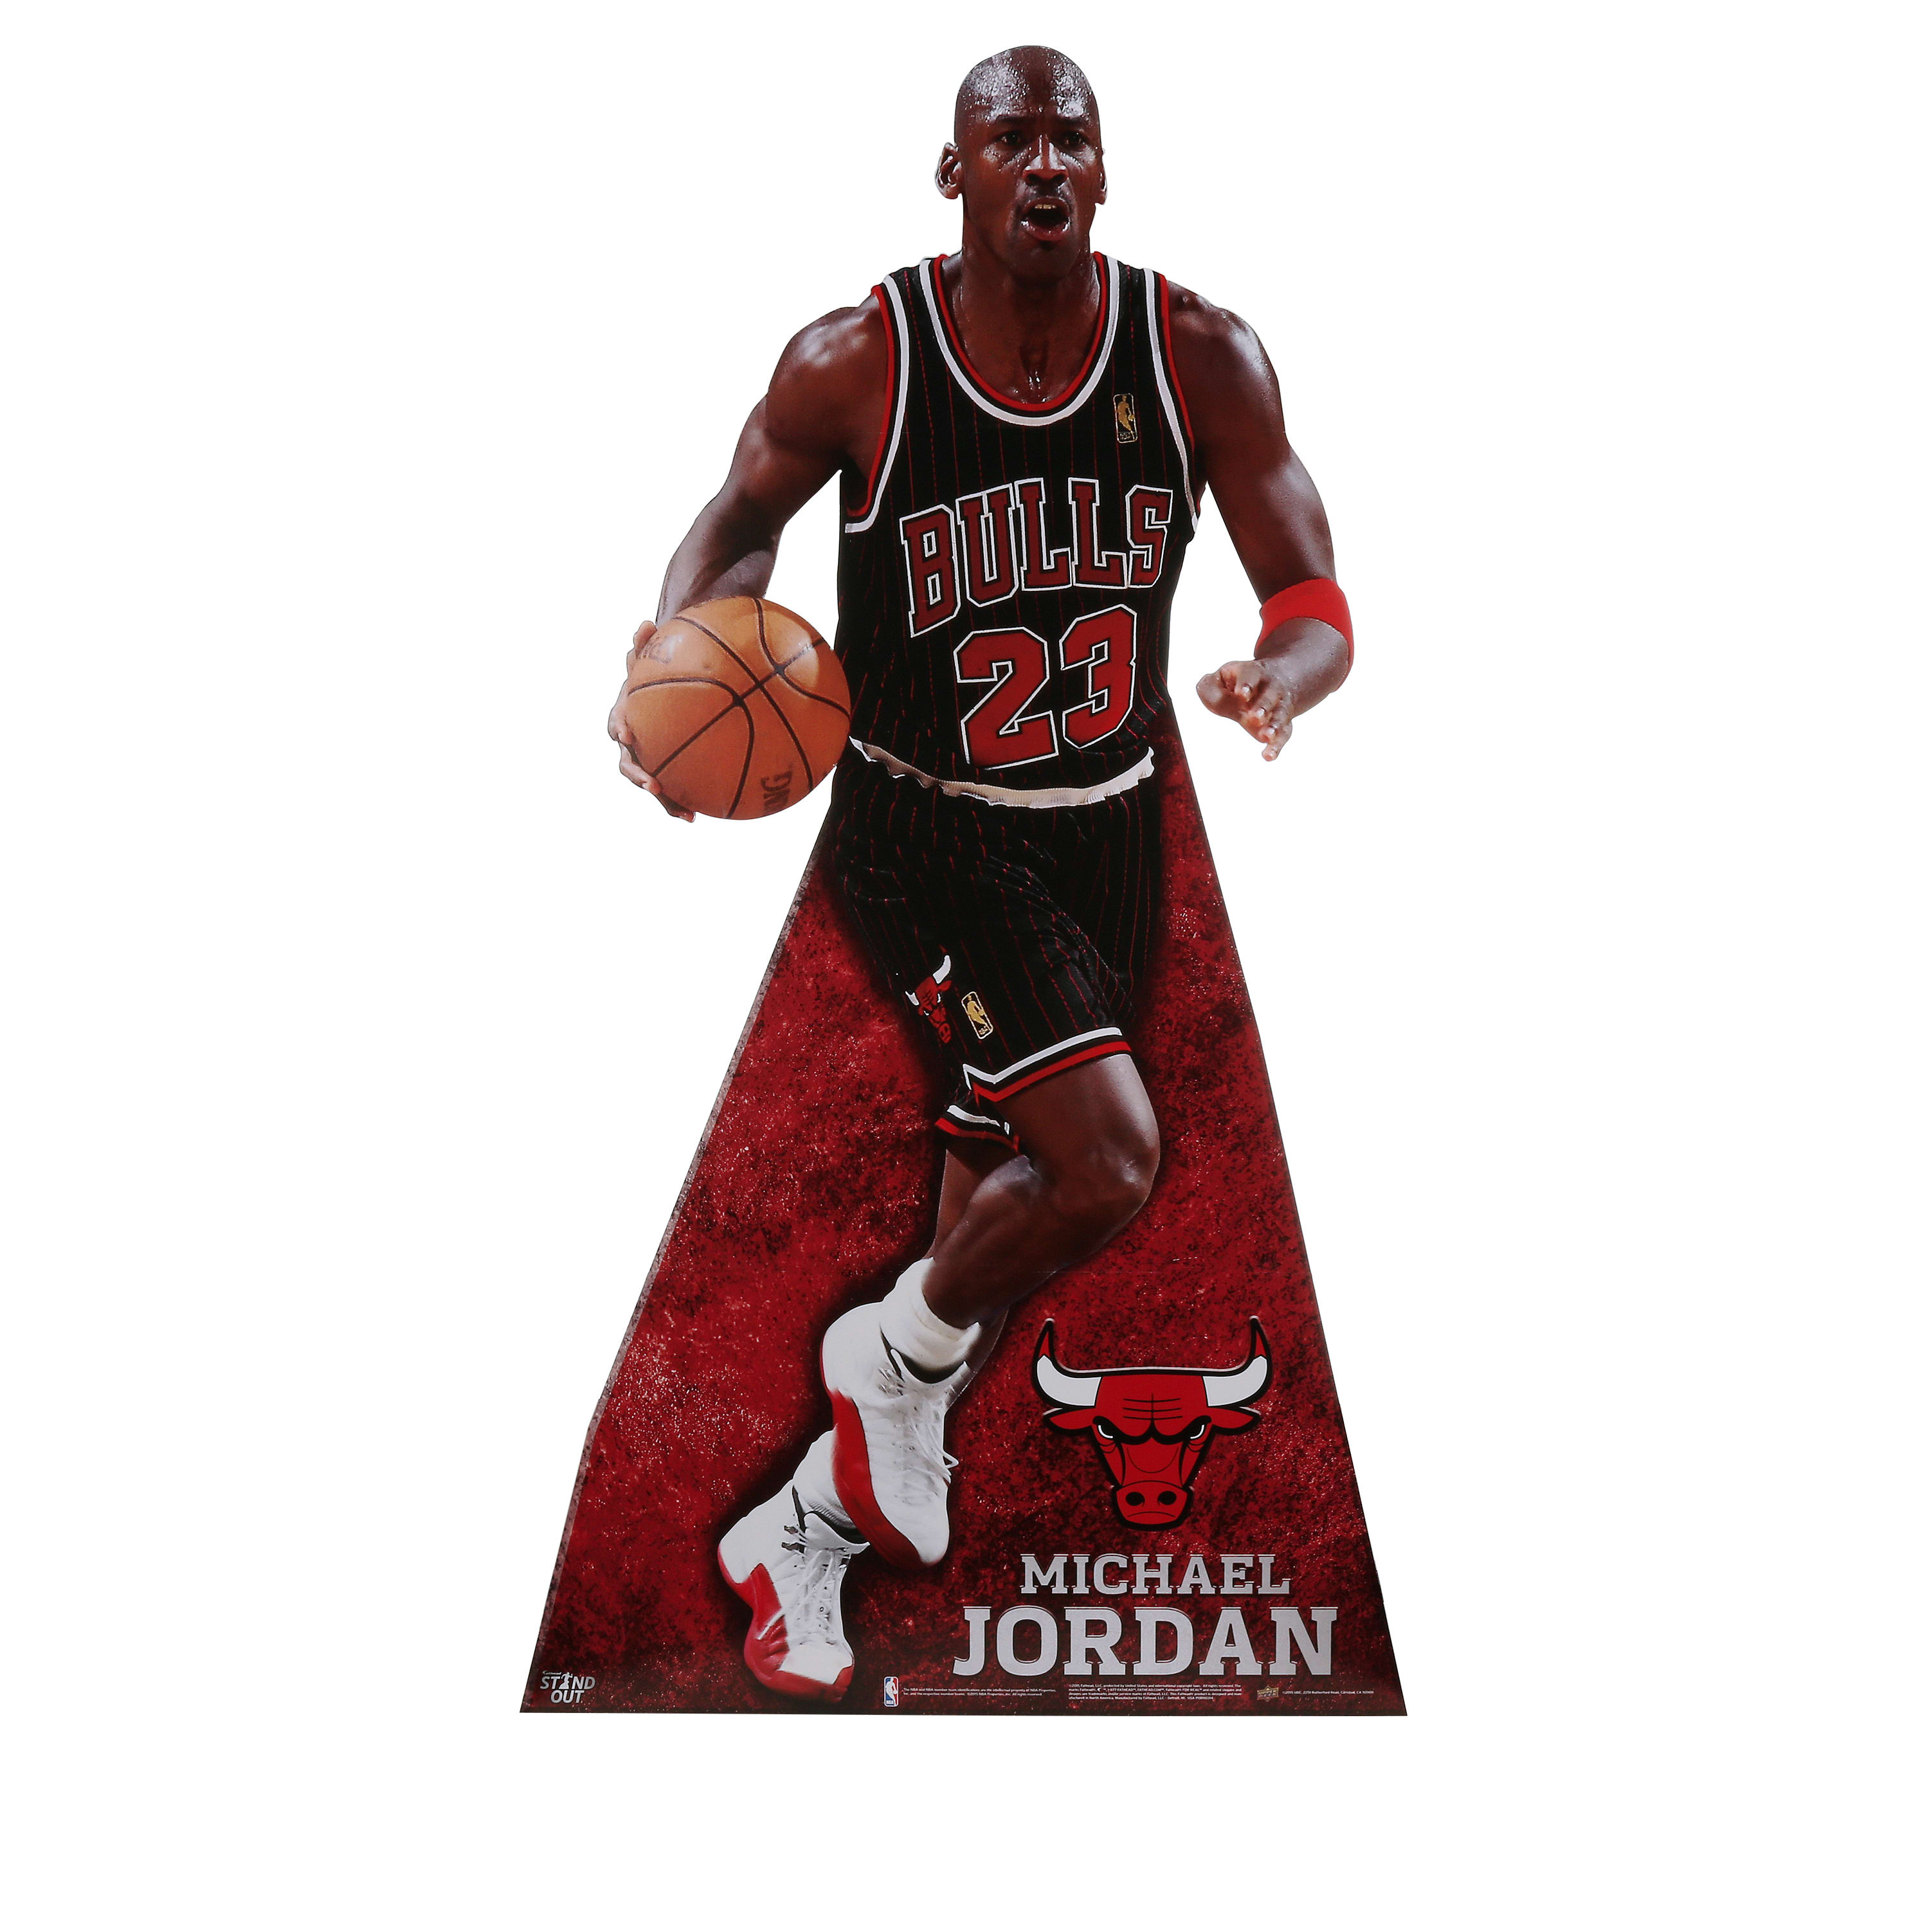
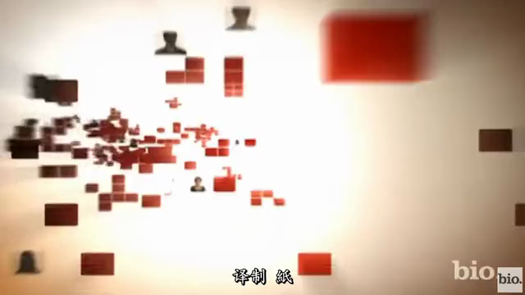
Living Legends-part 2
Reading
Michael Jordan

Slide 11
Michael Jordan
II.Read text on the right & answer the questions
1. What's the achievement of Michael Jordan?
He changed basketball with his graceful moves and jumps.
2.How could he achieve that?.
His skills were impressive.
The mental strength made him unique.
3, What are the examples for both aspects?
For skills:
For metal strength: the secret to his success is ______________________
his graceful moves and jumps
learning from his failures
( words +actions--
in his profession: losing games taught him--__________________________________
in his life: he has learnt to___________________
(e.g. The boys & Girls Club)
practise harder and never give up
share his success with others

Slide 12
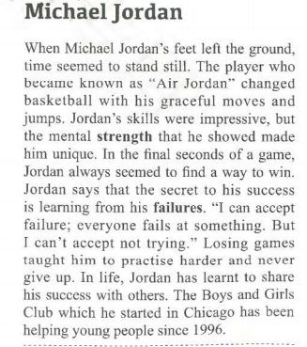
achevements
(总)
(分)
words
how to
achieve
(words
+actions:
advantages)
in profession
in life
actions

Slide 13
achievements
T
words
to
describe a person
how to
achieve
in his/her
profession
actions
in his/her
life
Draw a mind map of this part of the text

Slide 14
Conclusion
Biography Writing:
Lang
Ping
Michael Jordan
Model 1
Model 2
achievements
+
experiences:
list the events
(time order)
achievements
+
how to achieve
(words description
+ action description)

Slide 15
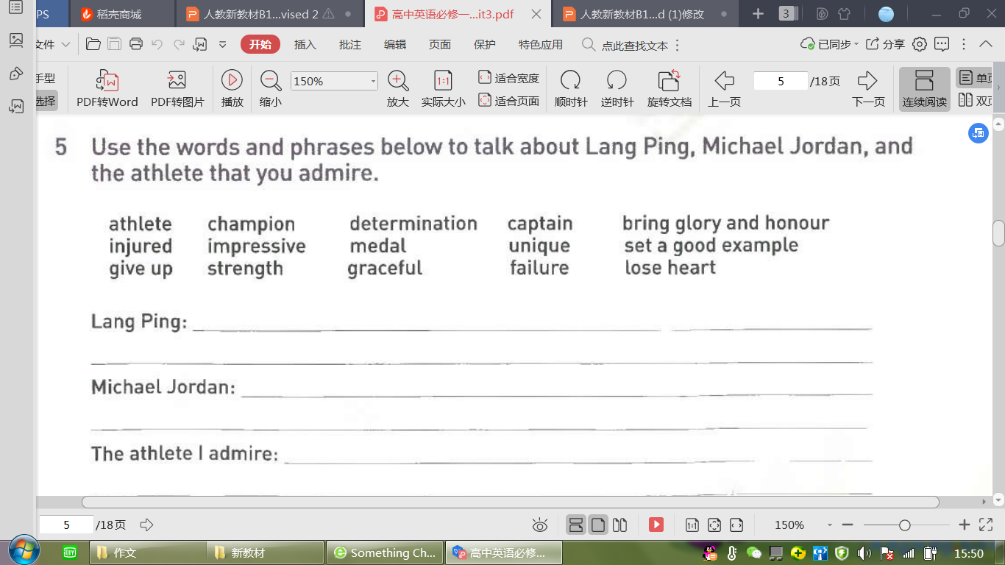
Discuss about a living legend
After-reading

Slide 16
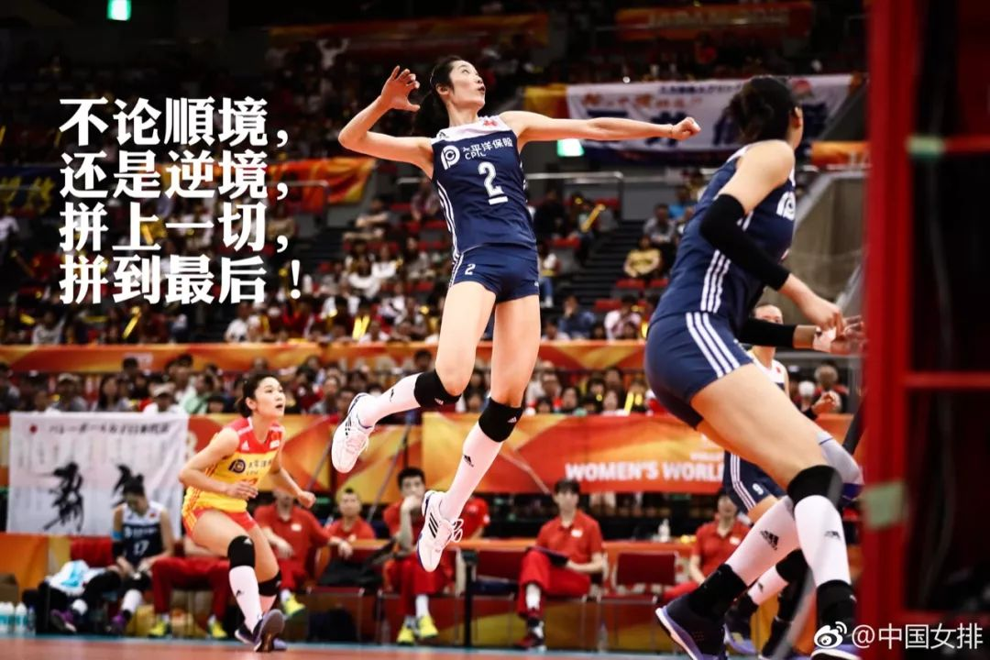
Summary: the spirit of living legends
Never give up!
Play to the end!

Slide 17
Homework:
please choose either writing model we mentioned to write a short passage about a living legend you admire
(choose and use the following words and expressions)
After-reading

