Slide 1

感恩遇见，相互成就，本课件资料仅供您个人参考、教学使用，严禁自行在网络传播，违者依知识产权法追究法律责任。
更多教学资源请关注
公众号：溯恩高中英语
知识产权声明

Slide 2
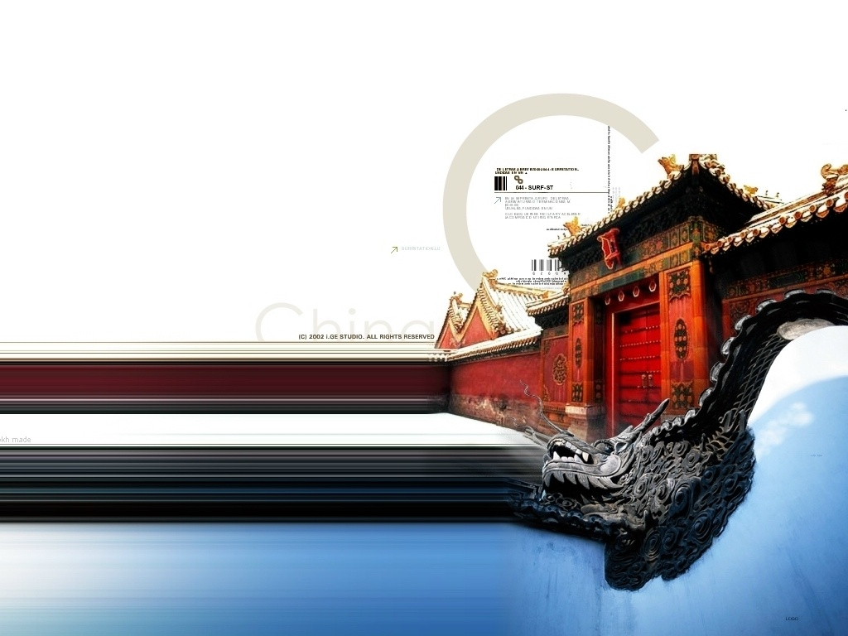

Unit 1 Great Scientists

Slide 3
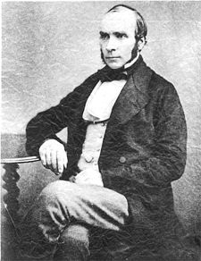
John Snow Defeats “King Cholera”

Slide 4
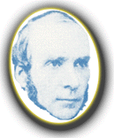
Raise questions based on the title:
Who was John Snow?
What kind of disease was cholera? Why was it called “king cholera”?
How did John Snow defeat it?
What is the point of learning such a story?

Slide 5
Understand the background of the story:
John Snow was an expert doctor, and the Queen’s personal physician in the 19th century in London.
Cholera was the deadly disease of the time, which killed thousands of people every time there was an outbreak. Neither its cause nor its cure was understood.

Slide 6
Understand the background of the story:
John Snow became inspired when thinking about helping ordinary people exposed to cholera. He wanted to find the cause of cholera so that it could be controlled.
with the desire /confidence /enthusiasm to do sth well; full of ambition; motivated
(who were) put at the risk of; threatened by

Slide 7
Two theories about how cholera reached the human body:
1. It was spread through the air.
2. It was spread by food.

Slide 8
Keep reading. Follow John on his journey to defeat cholera.
Circle the major verbs that describe John’s actions of each step.
For example, at the very beginning, John Snow suspected that the second theory was corrected. And when an outbreak hit London again, he began to gather information. (para.3)
Underline the stage results concluded in para. 3-6.
For example, (in para.4) when discovering many deaths were connected to the water pump, he concluded that “it seemed the water was to blame.”

Slide 9
Give a report of the process of his research.
action
conclusion
3. suspected – began his enquiry
–___________ information
4. _______ a map to better analyze information – _________ something unexpected – made further ____________
5. looked ____ the water source –found out the truth – had the handle ________ (it worked!)
6. found __________ evidence from the case of a woman and her daughter
gathered
drew
→It seemed that the water was to ______.
noticed
blame
investigations
into
→ … shown that cholera was spread by germs carried in the ______.
removed
water
supporting
→… announce ____ ________ that polluted water WAS to blame.
with
certainty

Slide 10
Evaluation: What do you think of John Snow’s way of doing research?
Serious-minded.
Cautious.
Smart and effective.
…

Slide 11
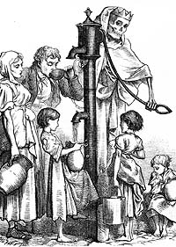
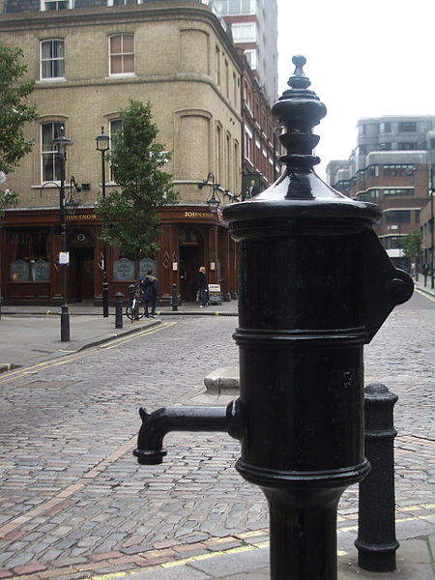
#7 public house (pub)

Slide 12
Voila! The culprit was found. But was this the end of the story?
suggestions:
① the source of all water supplies (should) be examined.
② the water companies (should) not expose people to polluted water anymore.
What do these suggestions tell you about John Snow’s personality / character?
He had a strong civic sense, a responsibility and love for the public.
(With great power comes great responsibility! --Spiderman)

Slide 13
Revision and Discussion:
What do we learn from the story of John Snow defeating cholera, in terms of scientific facts of cholera itself, Snow’s approach to the problem, and Snow’s character reflected in the story?

Slide 14
Free talk: Do you want to be like John Snow?
Try not to become a man of success but rather to become a man of value. (Albert Einstein)

Slide 15
Assignment
Write a summary of the article.
Sample:
John Snow was a well-known physician in London in the 19th century, when cholera, a deadly disease, killed many people every time there was an outbreak. He wanted to find its cause in order to defeat it. In 1854 when cholera hit London again, he began to gather information. He marked on a map where all the dead people had lived and he found that many of them had drunk the water from the pump. So he guessed that the water carried cholera. Then he found out that the water from the pump came from a polluted river and therefore had the pump handle removed. It worked, so he showed that cholera was spread by germs in the dirty water. After finding more evidence from two other deaths related to the pump, he could declare with confidence that contaminated water carried the cholera germs. He then made suggestions regarding water safety. Finally, “King Cholera” was defeated.

Slide 16
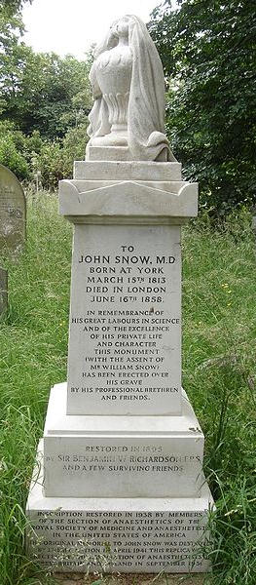
Creative assignment
Write an epitaph on John Snow’s grave in which you draw a conclusion of his achievements.
Sample:
"In Brompton cemetery there was laid to rest, at the age of forty-five, John Snow (1813-1858), exemplary citizen and useful physician. He demonstrated that cholera is communicated by contaminated water, and he made the art of anaesthesia a science."

