Slide 1

感恩遇见，相互成就，本课件资料仅供您个人参考、教学使用，严禁自行在网络传播，违者依知识产权法追究法律责任。
更多教学资源请关注
公众号：溯恩高中英语
知识产权声明

Slide 2

WHO
AM
I
Notes:
封面字体为系统自带字体：微软雅黑

Slide 3
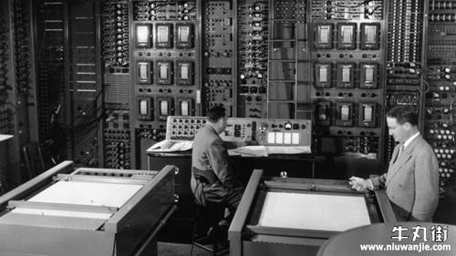
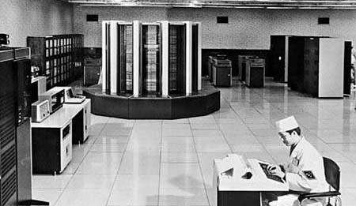
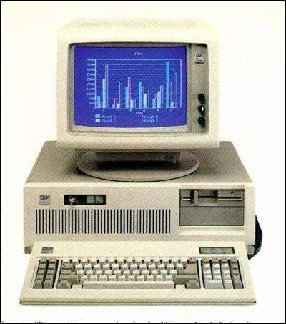
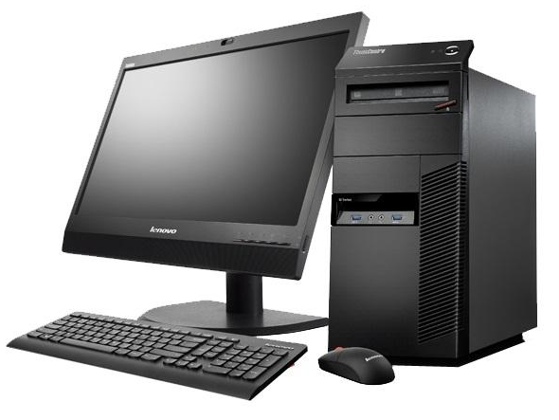

Warming-up
1. Can you guess what the following machines are?

Slide 4
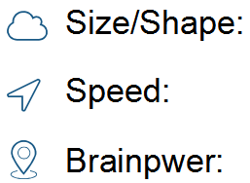
Reading for Information
1. According to Paragraph 1, how do computers change
over time? And What are their functions each time?
Small
Large
Small
Slow
Rapid
By the
1940s
Small
Large
1936
Alan Turing
1822
Charles
Babbage
Room-size
Machine
“Universal
Machine”
Since
1970s
1642
France
to solve any difficult mathematical problem,
PC and
Laptop
Analytical
Machine
Calculating
Machine
Used in offices and homes
to “think”logically and produce quick answer
to simplify difficult sums
2016

Slide 5
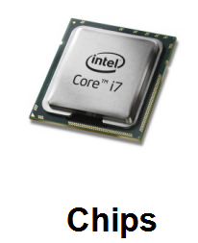
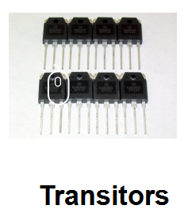
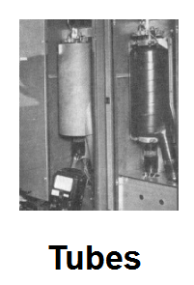
Reading for Information
2. Why could computers undergo (experience) these changes?
Can you infer what an elephant's memory is like?
These changes only become possible as my memory improved...
Over time my memory has developed so much that, like an elephant, I never forget anything I have been told...

Slide 6
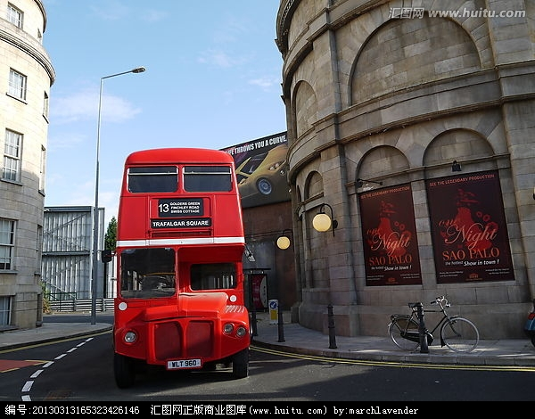


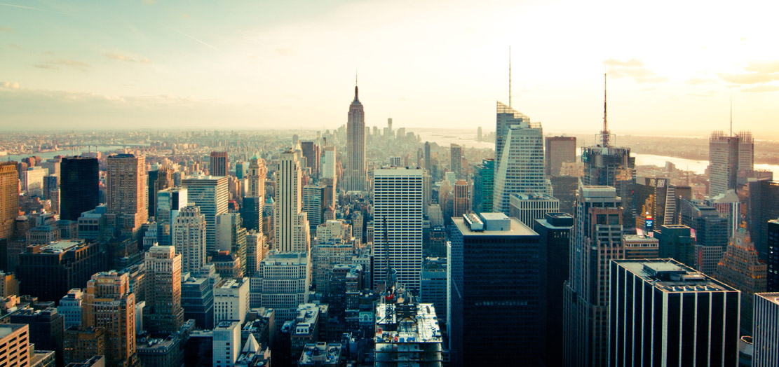
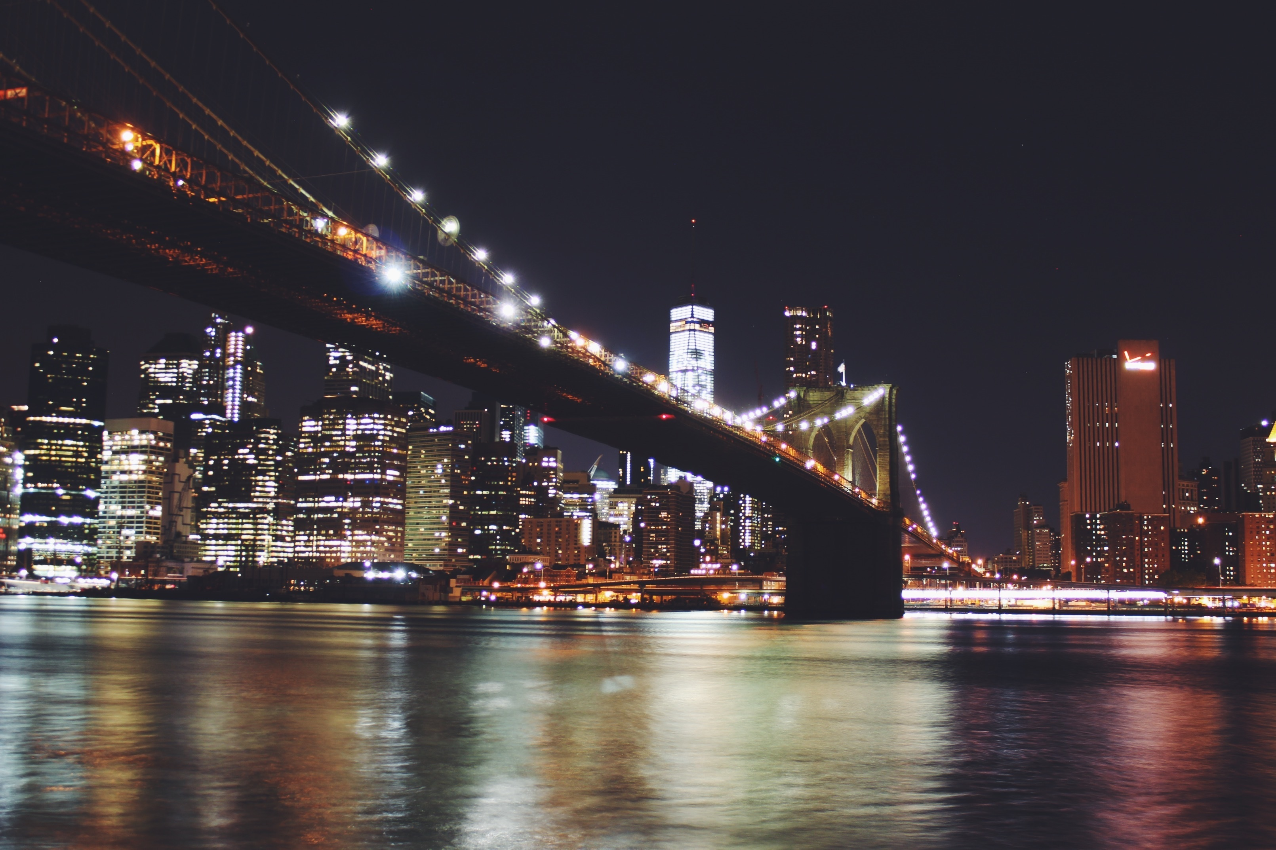


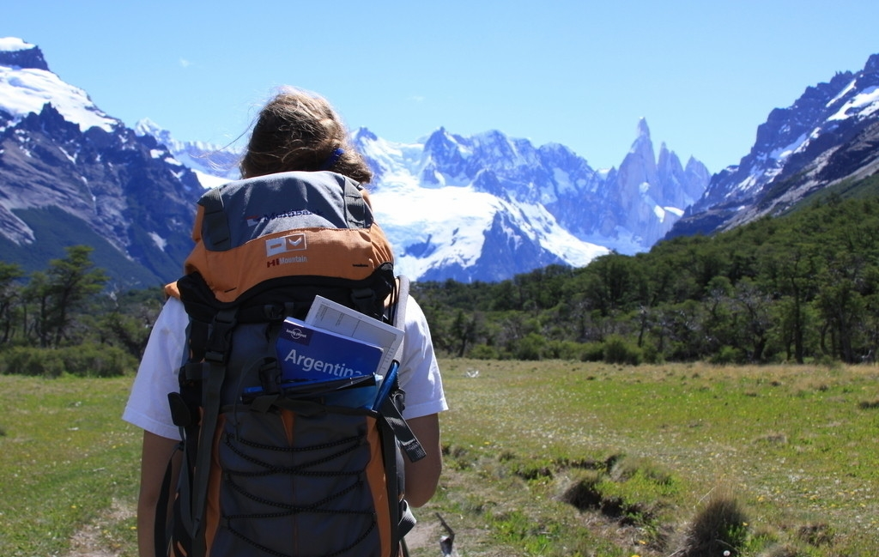
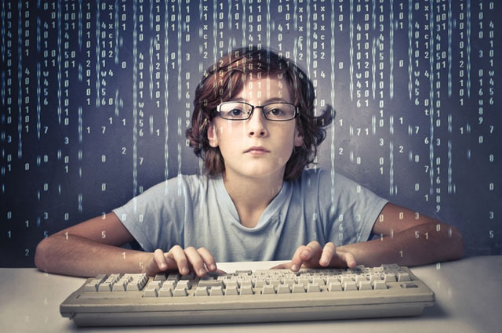

1960s
network
(WWW)

Slide 7
Reading for Information
3. After undergoing these changes, what areas have
computers been applied to?
Medical operation
Communication
Finance and Trade
Space rockets and exploration
Robots and Mobile phones
...

Slide 8
Structural Analysis
1. What's the text type and what's the purpose of this text?
▪ Exposition
▪ To inform readers the development of computers
2. Look at the first sentence of each paragraph and think
about their functions.
Over time I have been changed a lot.
Topic sentence
These changes only become possible as my
memory improved.
Since the 1970s many new applications have been found for me.

Slide 9

Structural Analysis
Main idea is the most important general point in a paragrah or a text.
Main idea
Supporting details are reasons, examples, facts, events, or other kinds of evidence that explain and develop the main idea
supporting details

Slide 10
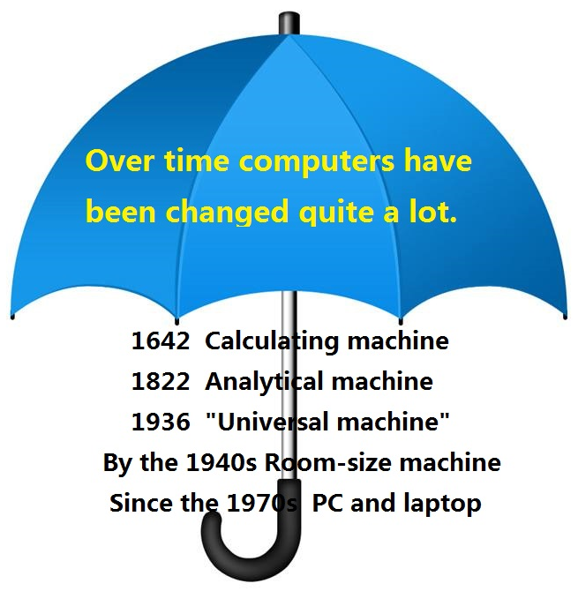
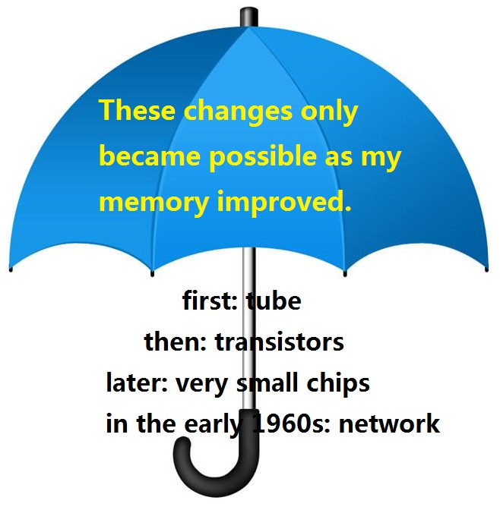
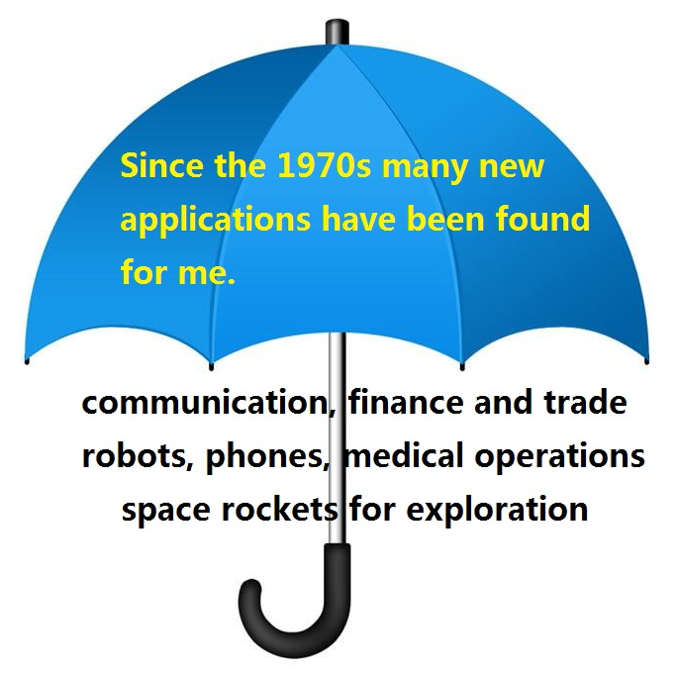
Structural Analysis
3. Try to analyze three paragraphs using the “umbrella” idea.

Slide 11
Reading for Structure
4. How can we tell a main idea from supporting details?
Clue words
General
Specific

Slide 12
Structural Analysis
5. Two ways to recognize a main idea.
Look for
General vs. Specific ideas.
Use Clue Words
to lead you to the main idea.
▪ My boss is hard to work for.
▪ He lacks a sensen of humor.
▪ He never gives praise.
▪ He times all our breaks to the
second.
▪ list words:
several causes of; five steps;
three advantages of
▪ addition words:
first; another; moreover
(Paragraph 2)

Slide 13
Who Am I?

Slide 14
Language Features
1. Which figure of speech does the writer employ throughout
the whole passage?
1. From then on, I grew rapidly both in size and brainpower.
▪ Personfication
▪ objects are represented with human qualities
2. The first rays of morning tiptoed through the meadow.
2. Contrary to other expositions that provide information in
an objective tone, why does the writer use “I”?
▪ to attract readers' interest
▪ to make the text easier to understand
▪ ...

Slide 15
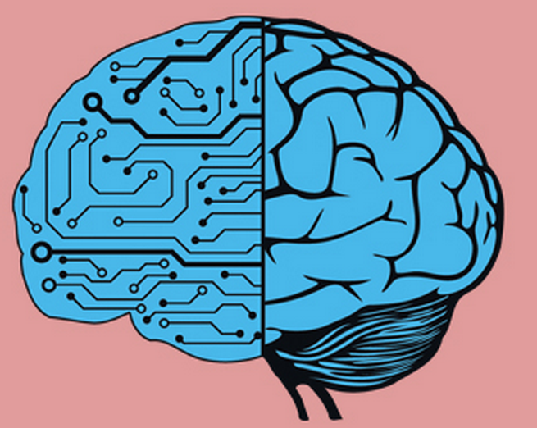
Artificial intelligence, simply put, is a sub-field of computer science. Its goal is to enable the development of computers that are able to do things normally done by people—in particular, things associated with people acting intelligently.
Based on this definition, any program can be considered AI if it does something that we would normally think of as intelligent in humans.
Artificial Intelligence

Slide 16
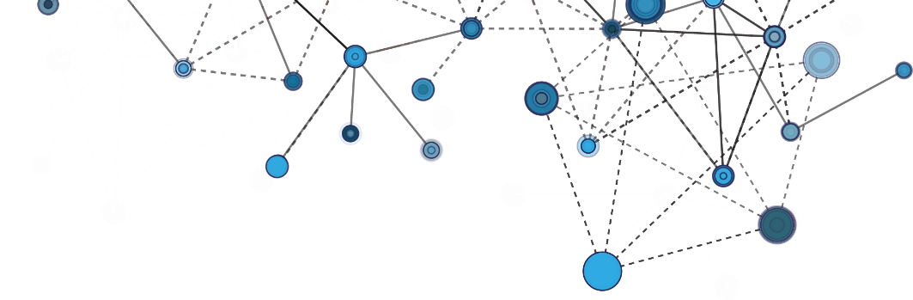

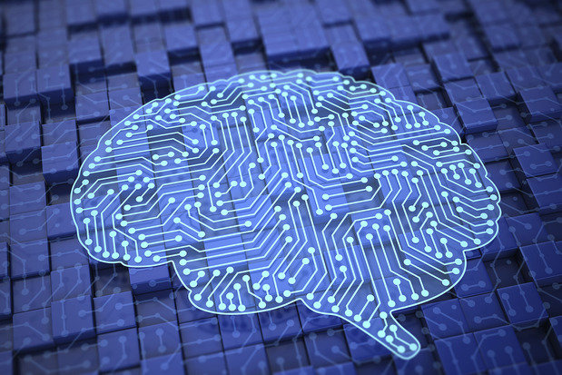
Reading for Writing
01
entertainment
household
arrangement
02
03
business schedule
But I need more
ideas for Jarvis...
04

Slide 17
Reading for Writing
If you're Jarvis, a devoted friend of the human race, brainstorm what areas you want to be applied in to provide humans with a high-quality life, and then write a short paragraph to convince Zuckerberg.
1. Use personification (“I”)
2. Begin with a topic sentence;
3. Explain in supporting details.

Slide 18
Artificial Intelligence
Dear Zuckerburg, I want to be applied in private cars. The last decade has witnessed dramatic increase in the number of cars, which in turn brings worsening traffic jam and more road accidents. With the help of me, cars could run automatically, choose routes wisely, and avoid collision, thus making it safer and more convenient for the human race. Anyhow, my goal is to provide humans with a life of high quality.

Slide 19
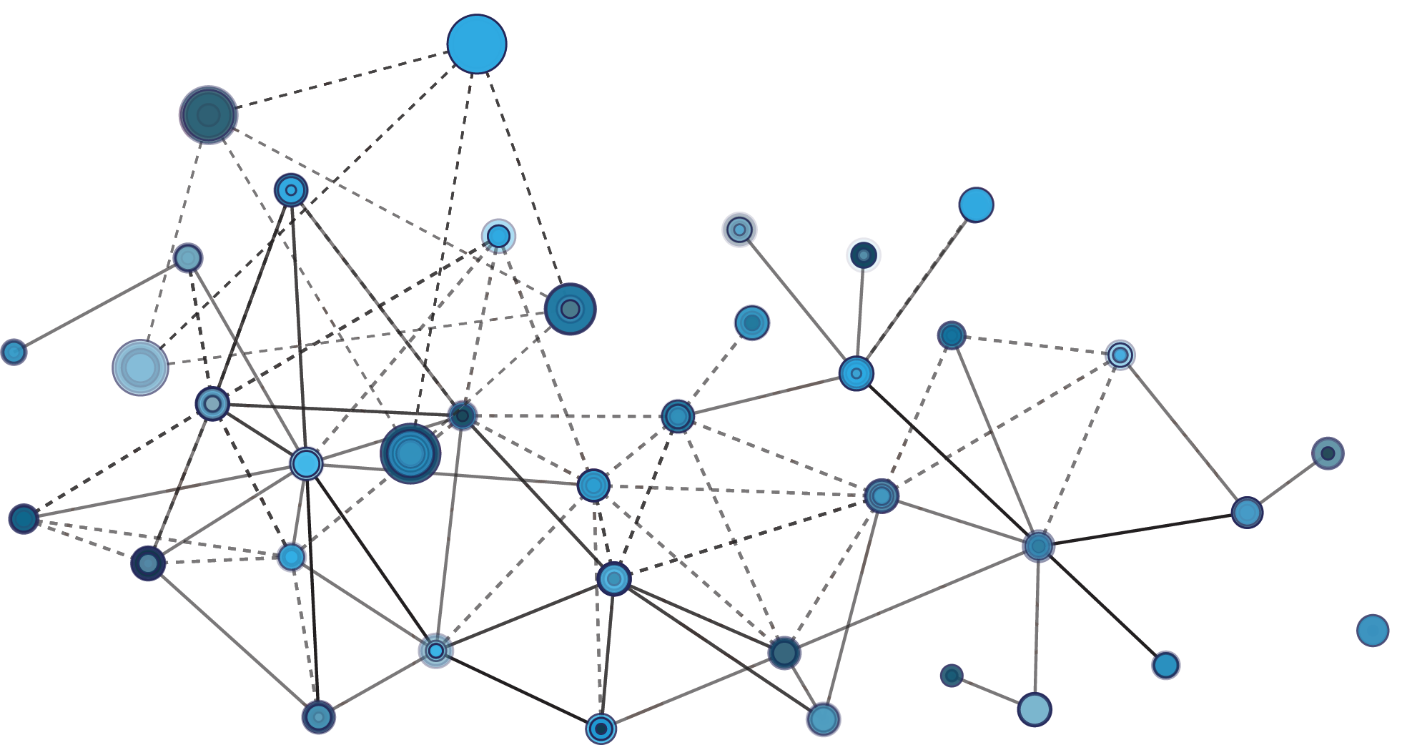
THANKS

