Slide 1

感恩遇见，相互成就，本课件资料仅供您个人参考、教学使用，严禁自行在网络传播，违者依知识产权法追究法律责任。
更多教学资源请关注
公众号：溯恩高中英语
知识产权声明

Slide 2


Welcome!
Tao Jiangying
Chengnan High School

Slide 3
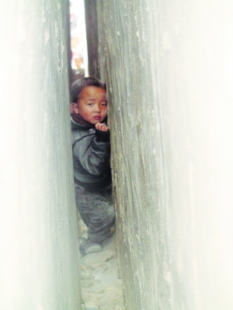

Lead-in
be stuck/trapped in the crack/ gap
What happened to the boy?
back and chest were touching…
move sideways to…
How can he get out of the crack?
climb/crawl out of…
drill a hole in…
rub the surface…
pull/push…
Tip1: Use specific verbs to describe a specific scene.

Slide 4
When
Who
Where
What
Why
How
Para. 1
Sunday
last year
the group
(we)
cave
explored
The tiring trip
Para. 2
The experienced leader
tried to rescue me
I was stuck in …
Para. 3-4
The helpful teammates

Slide 5
Reading for plot
Plot 1: The tiring trip
We
I
hiked for ______________
a couple of hours
tired, wet, cold
abseiled through an _________
icy waterfall
four hours
moved for ___________

Slide 6
Reading for plot
Plot 2: The experienced leader
Luca
Steve
guiding
got stuck in the crack
_________ 3 cavers
10 mins pulling and pushing him
was free
guiding
another 15 mins _______ him to an exit
leave
needed to _______
patient
experienced
tired

Slide 7
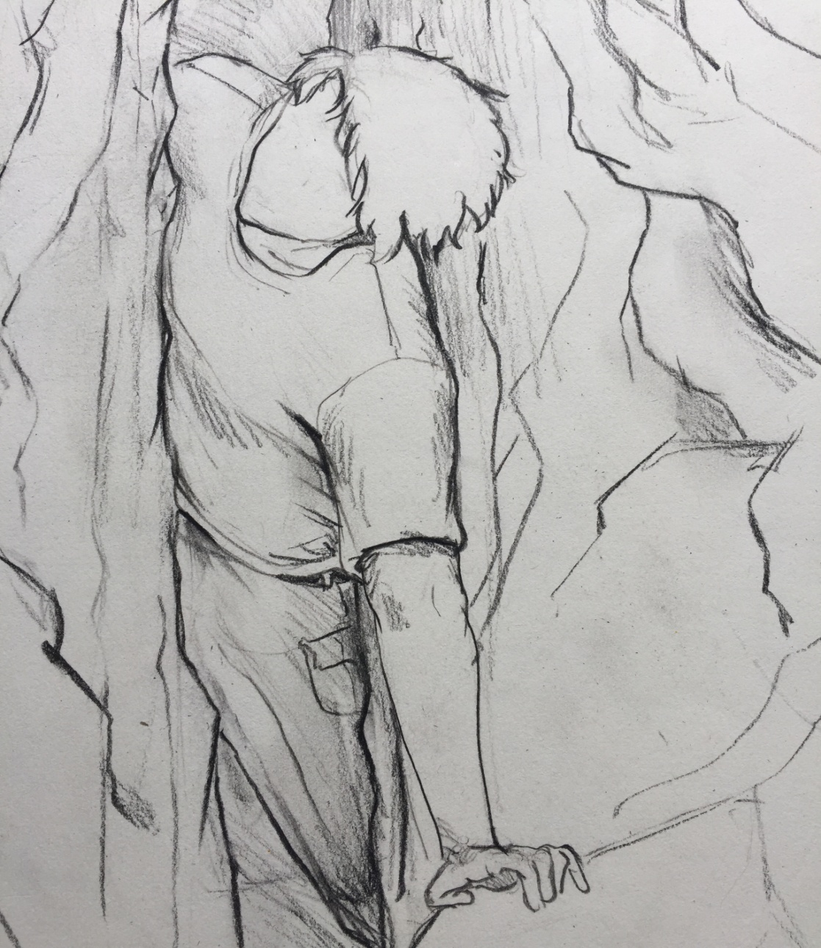
Reading for plot
Plot 3: The helpful teammates
I
The group
put…down
move…sideways
drop…to…
encouraged me
didn’t make it
disappointed, worried, nervous
helpful
kind
inconvenience
considerate
tried again, didn’t want to ____________ …
tried everything to…
hanging
supported
trapped, feet _______, left arm ________...
upset, frustrated
weakened
touching
arm ________, back and chest _______ ….
cold, harassed, scared
Jim tried to pull me back
blocking Jim’s escape
worried, upset
guilty
, discouraged, depressed

Slide 8
Reading for plot
Plot 3:
The helpful teammates
I
The group
put…down
move…sideways
drop…to…
disappointed,
worried, nervous
encouraged me
didn’t make it
helpful
kind
considerate
inconvenience
tried again, didn’t want to_____________ …
tried everything to…
hanging
supported
trapped, feet _______, left arm ________...
upset, frustrated
weakened
touching
arm ________, back and chest _______ ….
cold, harassed, scared
Jim tried to pull me back
blocking Jim’s escape
worried, upset
guilty, discouraged, depressed

Slide 9
More expressions to describe negative emotions:
The faith that I could make it alive faded gradually.
I felt more and more frustrated and hopeless.
It cast a cloud of gloom over my face.
I forced a smile at this dark and hopeless moment.
…
I was seized by a strong sense of panic.
Fear slowly crept upon me.
A flood of fear welled up me.
With fear and panic overwhelming me, I …
…

Slide 10
More expressions to describe positive emotions:
My face/eyes lit up with the hope of…
It filled my mind with a bright light.
My eyes twinkled with excitement.
Tears of joy flooded my eyes.
I let out/breathed a sigh of relief.
…

Slide 11
got stuck in a crack
Theme?
It was the teamwork that helped me out.
I
Luca
the group
How ?
the rescue team
Tip2: Have a good understanding of the story before writing.

Slide 12
Reading for writing
Paragraph 1:
With the risk of the low body temperature, the group supplied me with their own jackets. _______________________________________________________
______________________________________________________________________________________________________________________________________________________________________________________________________
Paragraph 2:
After eight hours, Luca found the rescue team. ___________________________
______________________________________________________________________________________________________________________________________________________________________________________________________
Did the jackets make me warm?
How did I feel at that moment?
What did the group do for me? Did Jim do something for me?
How did the rescue team save me?
Did Luca do something?
How did I feel in the end?

Slide 13
Writing
Paragraph 1:
With the risk of the low body temperature, the group supplied me with their own jackets. ________________________________________________________
the group/ Jim
I
worried, …
cold, tired, harassed, scared, hopeless, …
possible feelings
comfort, encourage, tell stories/jokes, pull, push, …
cried, fall asleep, pray, …
possible actions
underlined words
Jim, Luca, encouraged, feet, gap, minutes, trapped, …

Slide 14
Writing
Paragraph 2:
After eight hours, Luca found the rescue team. ____________________________
the rescue team/ Luca
I
possible feelings
calm, …
hopeful, thrilled, …
examine, remove, shift, drill, polish,…
light up, move, pull, crawl, thank, …
possible actions
underlined words
Luca, climbed, minutes, feet, make it, Thunder Canyon Cave, …
Tip3: Focus on the given sentences and underlined words.

Slide 15
Assessing
对第五档(21-25)作文的描述：
1. 与所给短文融洽度高，与所提供各段落、开头语衔接合理。
2. 内容丰富，应用了5个以上短文中标出的关键词语。
3. 所使用语法结构和词汇丰富、准确，可能有些许错误，但完全不影响意义表达；
4. 有效地使用了语句间的连接成分，使所续写短文结构紧凑；
Keep in mind:
1. Positive
2. Closely related
(between paragraphs and within paragraphs)
3. Specific words or vivid description
4. Various sentence patterns
5. Underlined words
Tip4: Keep the marking criterion in mind while writing.

Slide 16
Assessing
closely related
specific words and vivid description
Paragraph 1:
With the risk of the low body temperature, the group supplied me with their own jackets. Nevertheless, they were of no use for me to warm up. Feeling I couldn’t make it alive, I was seized by a strong sense of panic. Jim, whose escape was blocked by me, was surprisingly calm. As I was ready to bear his stormy blame, he began to crack jokes to comfort me. With the encouragement from the group, I firmly believed Luca could find someone to rescue me.

Slide 17
Polishing
How to improve it?
Paragraph 2:
After eight hours, Luca found the rescue team. When I saw them, I breathed freely. The rescue team used their technique to save me from the gap. I saw my parents near the rescue team. At that time tears welled up my eyes. After this experience, I knew that a thin body is important when you go through a gap.

Slide 18
Assessing
closely related
specific words and vivid description
Paragraph 1:
With the risk of the low body temperature, the group supplied me with their own jackets. Nevertheless, they were of no use for me to warm up. Feeling I couldn’t make it alive, I was seized by a strong sense of panic. Jim, whose escape was blocked by me, was surprisingly calm. As I was ready to bear his stormy blame, he began to crack jokes to comfort me. With the encouragement from the group, I firmly believed Luca could find someone to rescue me.

Slide 19
Assessing
specific words and vivid description
Paragraph 1:
With the risk of the low body temperature, the group supplied me with their own jackets. Nevertheless, they were of no use for me to warm up. Feeling I couldn’t make it alive, I was seized by a strong sense of panic. Jim, whose escape was blocked by me, was surprisingly calm. As I was ready to bear his stormy blame, he began to crack jokes to comfort me. With the encouragement from the group, I firmly believed Luca could find someone to rescue me.
closely related

Slide 20
Polishing
Paragraph 2:
After eight hours, Luca found the rescue team. When I saw them, I breathed freely. The rescue team used their technique to save me from the gap. I saw my parents near the rescue team. At that time tears welled up my eyes. After this experience, I knew that a thin body is important when you go through a gap.
At sight of them, my eyes lit up with hope.
The rescue team used their specific tools to rub the surface of the stone walls to free my hips.
It dawned on me that what really counted was the teamwork.

Slide 21
Appreciation
With the risk of the low body temperature, the group supplied me with their own jackets. However, they served no purpose. Frightened and exhausted, I was drifted in and out of a dreamlike state. Jim tried to crack jokes to keep me awake. As time went by, the faith that I could make it alive faded gradually. Noticing it, Luca decided to turn to a rescue team for help.
After eight hours, Luca found the rescue team. On their arrival, the team began to examine the spot. They attempted to jack the board near my hand to drag me out, but in vain. Luca kept on encouraging me while the rescue team used specific tools to drill and even rub part of the rock to free my hips. With their help, I managed to move my feet and climb out of the gap. I was so thrilled that I nearly forgot to thank all the fellows when I was sent to the nearest hospital.
Theme
Language
Plot

Slide 22
Tips for Continuation Writing
1. Use specific verbs to describe a specific scene.
2. Have a good understanding of the story before writing.
3. Focus on the given sentences and underlined words.
4. Keep the marking criterion in mind while writing.

Slide 23
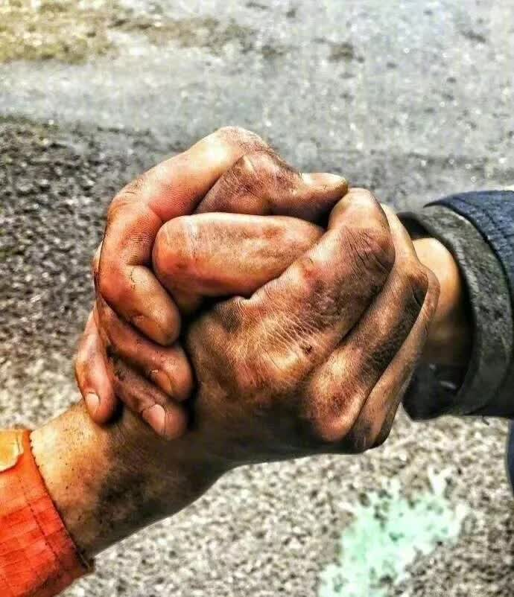
Assignment
Finish your writing after class.
Polish your writing according to the tips for continuation writing.
Grade the writing with each other and tell the reasons.

Slide 24



