Slide 1

感恩遇见，相互成就，本课件资料仅供您个人参考、教学使用，严禁自行在网络传播，违者依知识产权法追究法律责任。
更多教学资源请关注
公众号：溯恩高中英语
知识产权声明

Slide 2
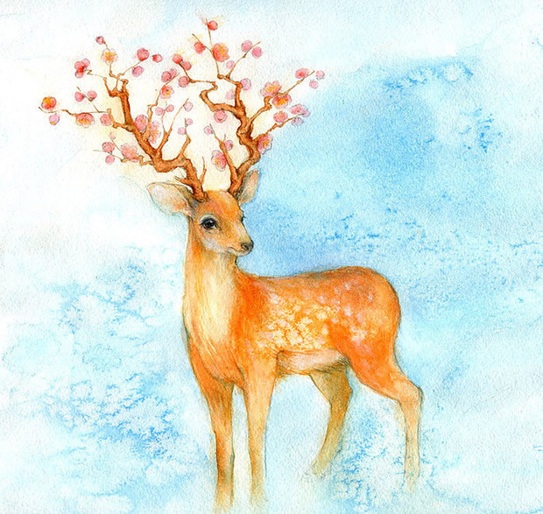

A Wise Deer
&
A Cowardly Tiger
浙江省十校联盟2019年10月高三联考读后续写
富阳中学 王璐

Slide 3

Analysis of the text
Literary genre (文体):
Fable 寓言故事
Features (特征):
Tell a short story using simple words and sentences, from which you can learn a lesson.
The character can be a person or an animal.

Slide 4

Task I: Read for plots
Who
Where
Mother deer and her fawns; a tiger; a jackal
in the tiger’s cave
Mother deer was trying to lead her fawns out of the cave when she saw the tiger coming back.
Her reaction?
stayed calm and thought of a plan
to scare the tiger away by pretending to be a fierce animal waiting to kill it for food.
What happened
Did the plan work?
The tiger got frightened and ran away …
clever / smart / intelligent, brave,
stay calm in danger
Mother deer

Slide 5
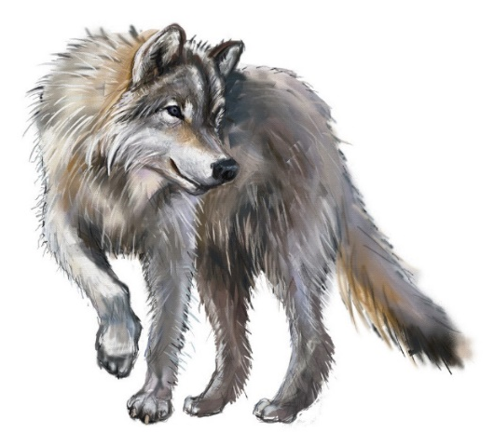

Tip 1: We can learn about the traits of a character according to what he says and does.
While escaping, the tiger came across a jackal, who suggested they go back to the cave to find out the truth.
Agree?
didn’t want to take a chance; afraid of being left alone to die
What happened
Jackal’s proposal?
knot their tails together; never leave
the jackal
Agree?
agreed unwillingly
Why?
frightened;
didn’t trust the jackal.
cowardly, timid
cunning (狡猾的)，
not reliable in the eyes of the tiger
the tiger

Slide 6
Tip 2: 根据原文已知情节和第二段所给开头句推断第一段可能的情节发展
Rules：续写情节发展连贯合理；续写两段之间衔接紧密；续写段落开头语与后续内容连贯。
Task III: What to write?
Para. 1 The deer saw the jackal and the tiger coming together.
Para. 2 The tiger was shocked to hear this and he was sure now the jackal cheated him.
What did the deer say that shocked the tiger and convinced him he was cheated by the jackal?
Think about what the jackal did to the tiger just now?
persuade the tiger to return to the cave; knot their tails together
How would the jackal cheat the tiger by doing so?

Slide 7
Tip 3: Keep the characters’ traits in mind while creating stories. In the continued stories, what the character says and does should be consistent with his traits.
How frightened would the deer feel when seeing the tiger and the jackal coming?
Would the tiger have a peaceful talk with the fierce animal since he was afraid to be eaten by him?
Was he easily fooled? If he heard he would be eaten, would he believe it and get scared?
the tiger
the jackal
Mother deer
clever / smart / intelligent, brave,
stay calm in danger
cowardly, timid
cunning (狡猾的)，
not reliable in the eyes of the tiger

Slide 8
Task II: What to write?
Para. 1 The deer saw the jackal and the tiger coming together.
Para. 2 The tiger was shocked to hear this and he was sure now the jackal cheated him.
How did the tiger feel and what would he do?
What would happen to the tiger, the jackal and the deer in the end?
Theme: intelligence can save one from dangerous situations

Slide 9
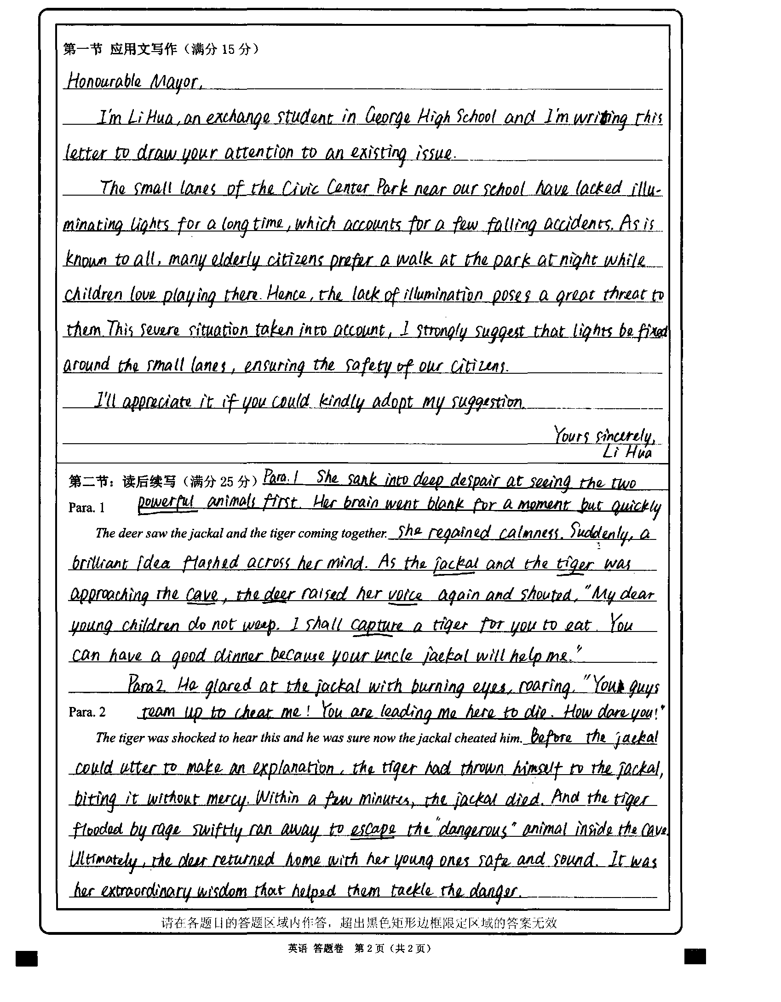
点评：
总的来说，这是一篇优秀的作文，情节设置符合逻辑、主题明确、融洽度高。考生通过细腻的表情、动作、语言等描写展现了鹿由恐惧到镇定的心理变化和机智的特征；老虎的愤怒和胆怯。语言基本准确、词汇和语法结构丰富。

Slide 10
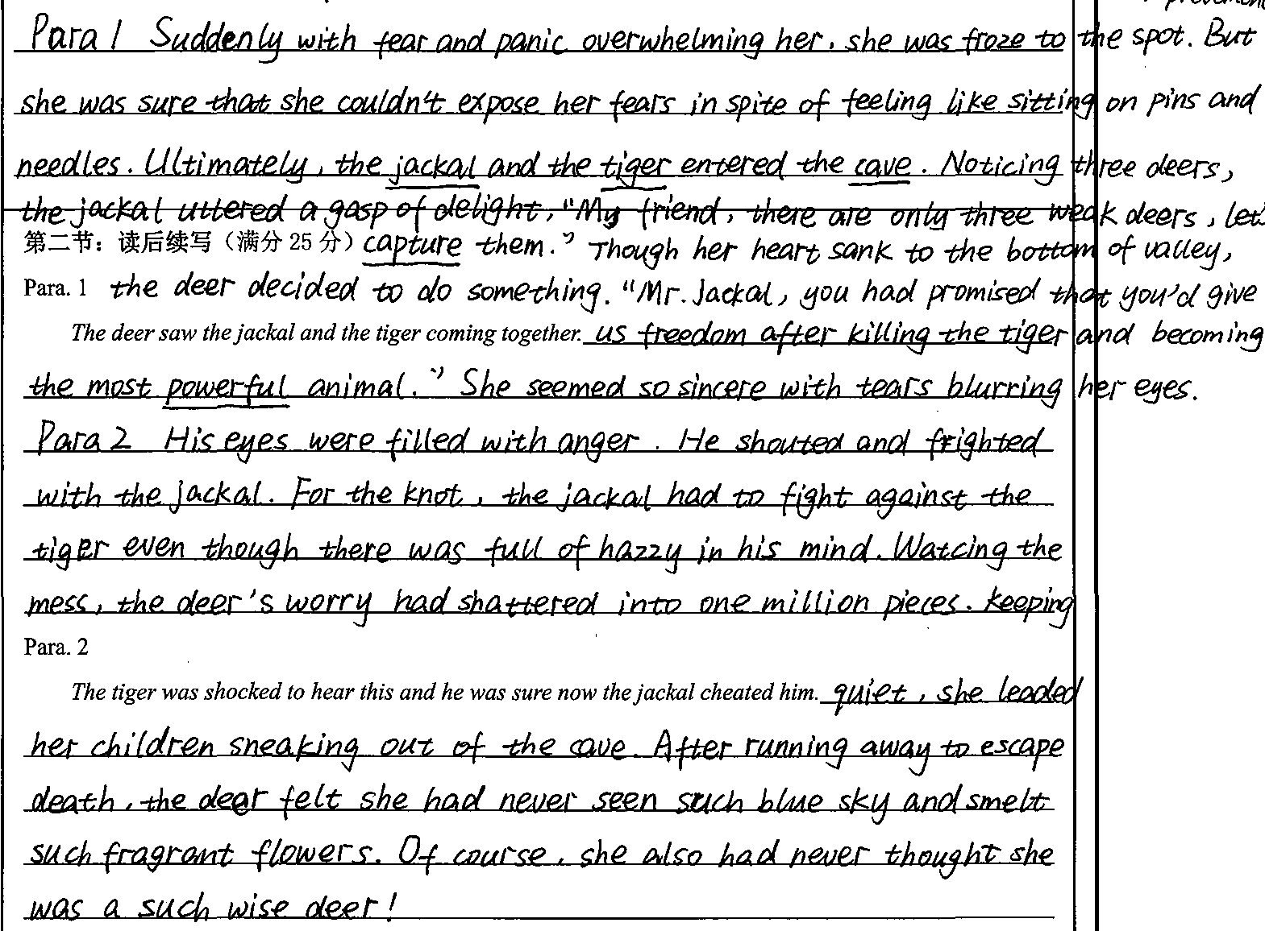
点评：
本文情节与众不同，倒也能自圆其说。考生着重刻画了鹿的心理变化：恐惧—委屈—愉快—自豪。词汇比较丰富、能灵活运用现在分词结构进行表达。当然，文章中存在一些错误，如was froze, deers,fighted,leaded等。还需夯实语言基本功

Slide 11
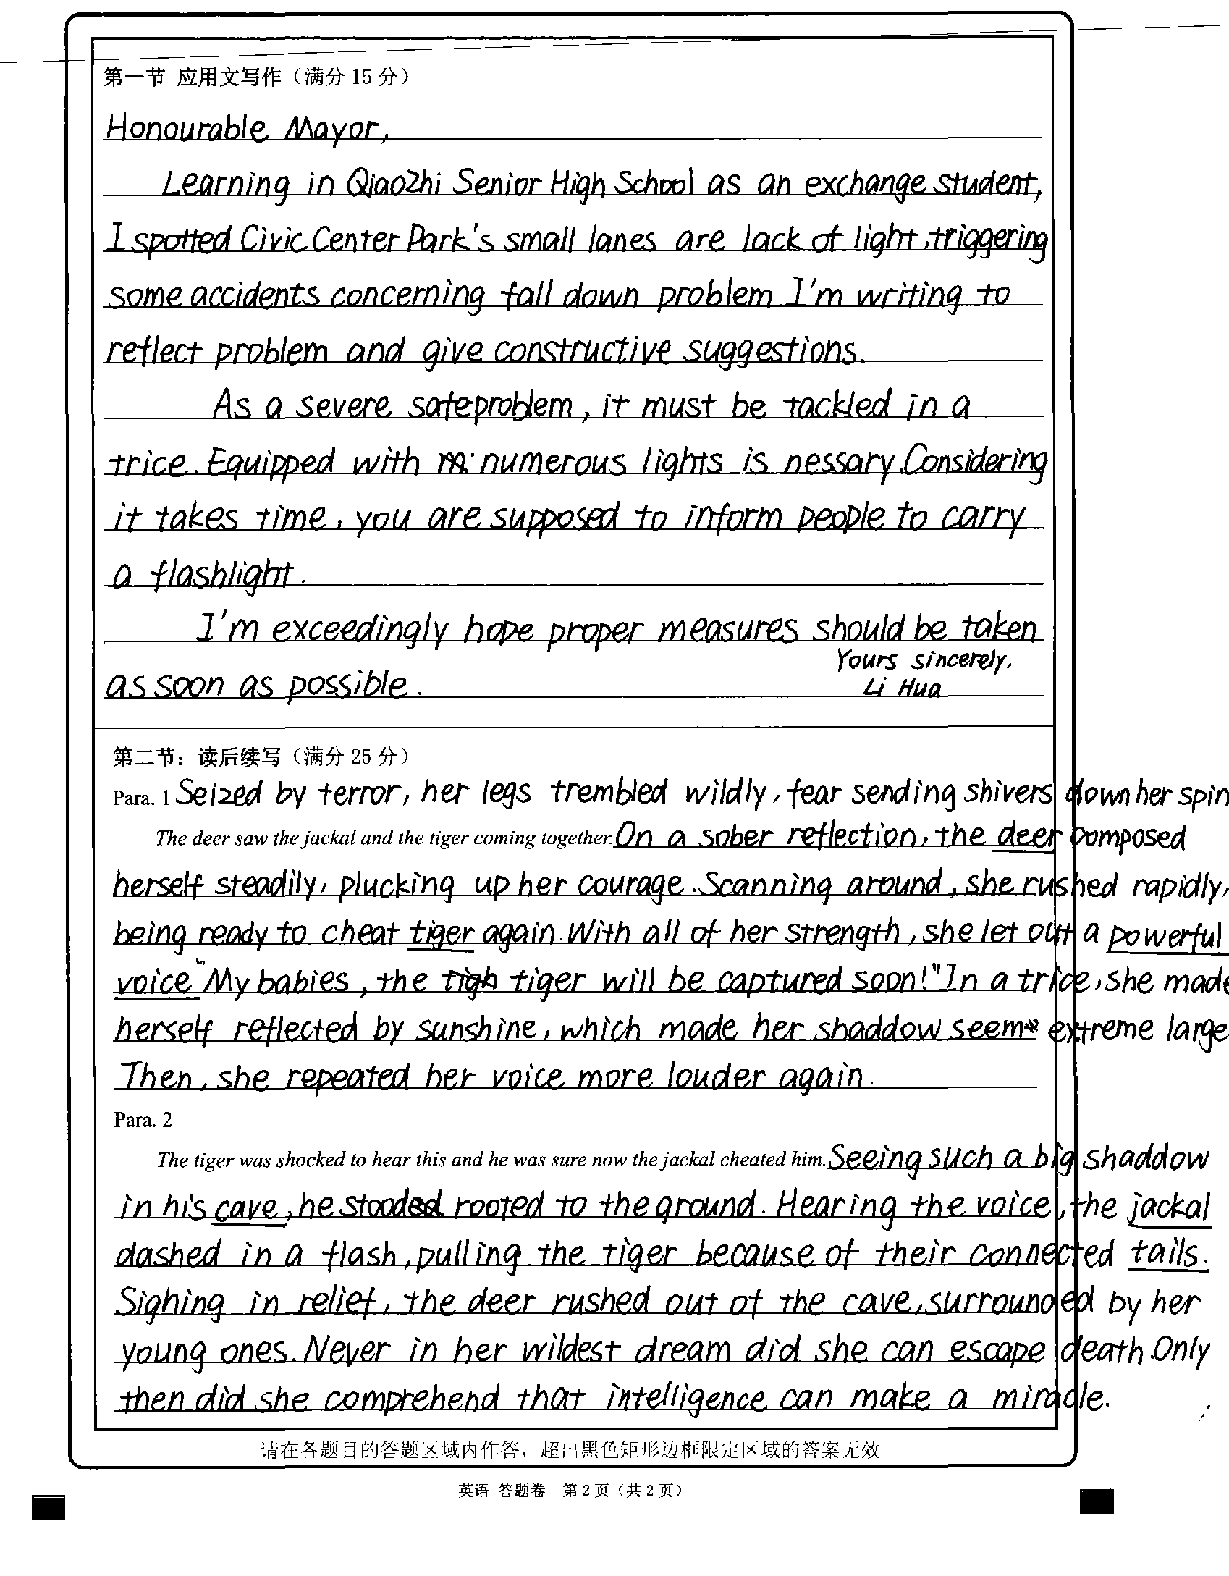
点评：
该生的语言运用能力较强，使用了大量的非谓语动词结构，突出了鹿的心理变化：害怕—鼓起勇气—如释重负。主题明确，但第一段的情节设计与第二段的开头句无法紧密衔接（只说了一句“老虎马上要抓到了”，老虎怎么会相信胡狼骗了自己？）

Slide 12
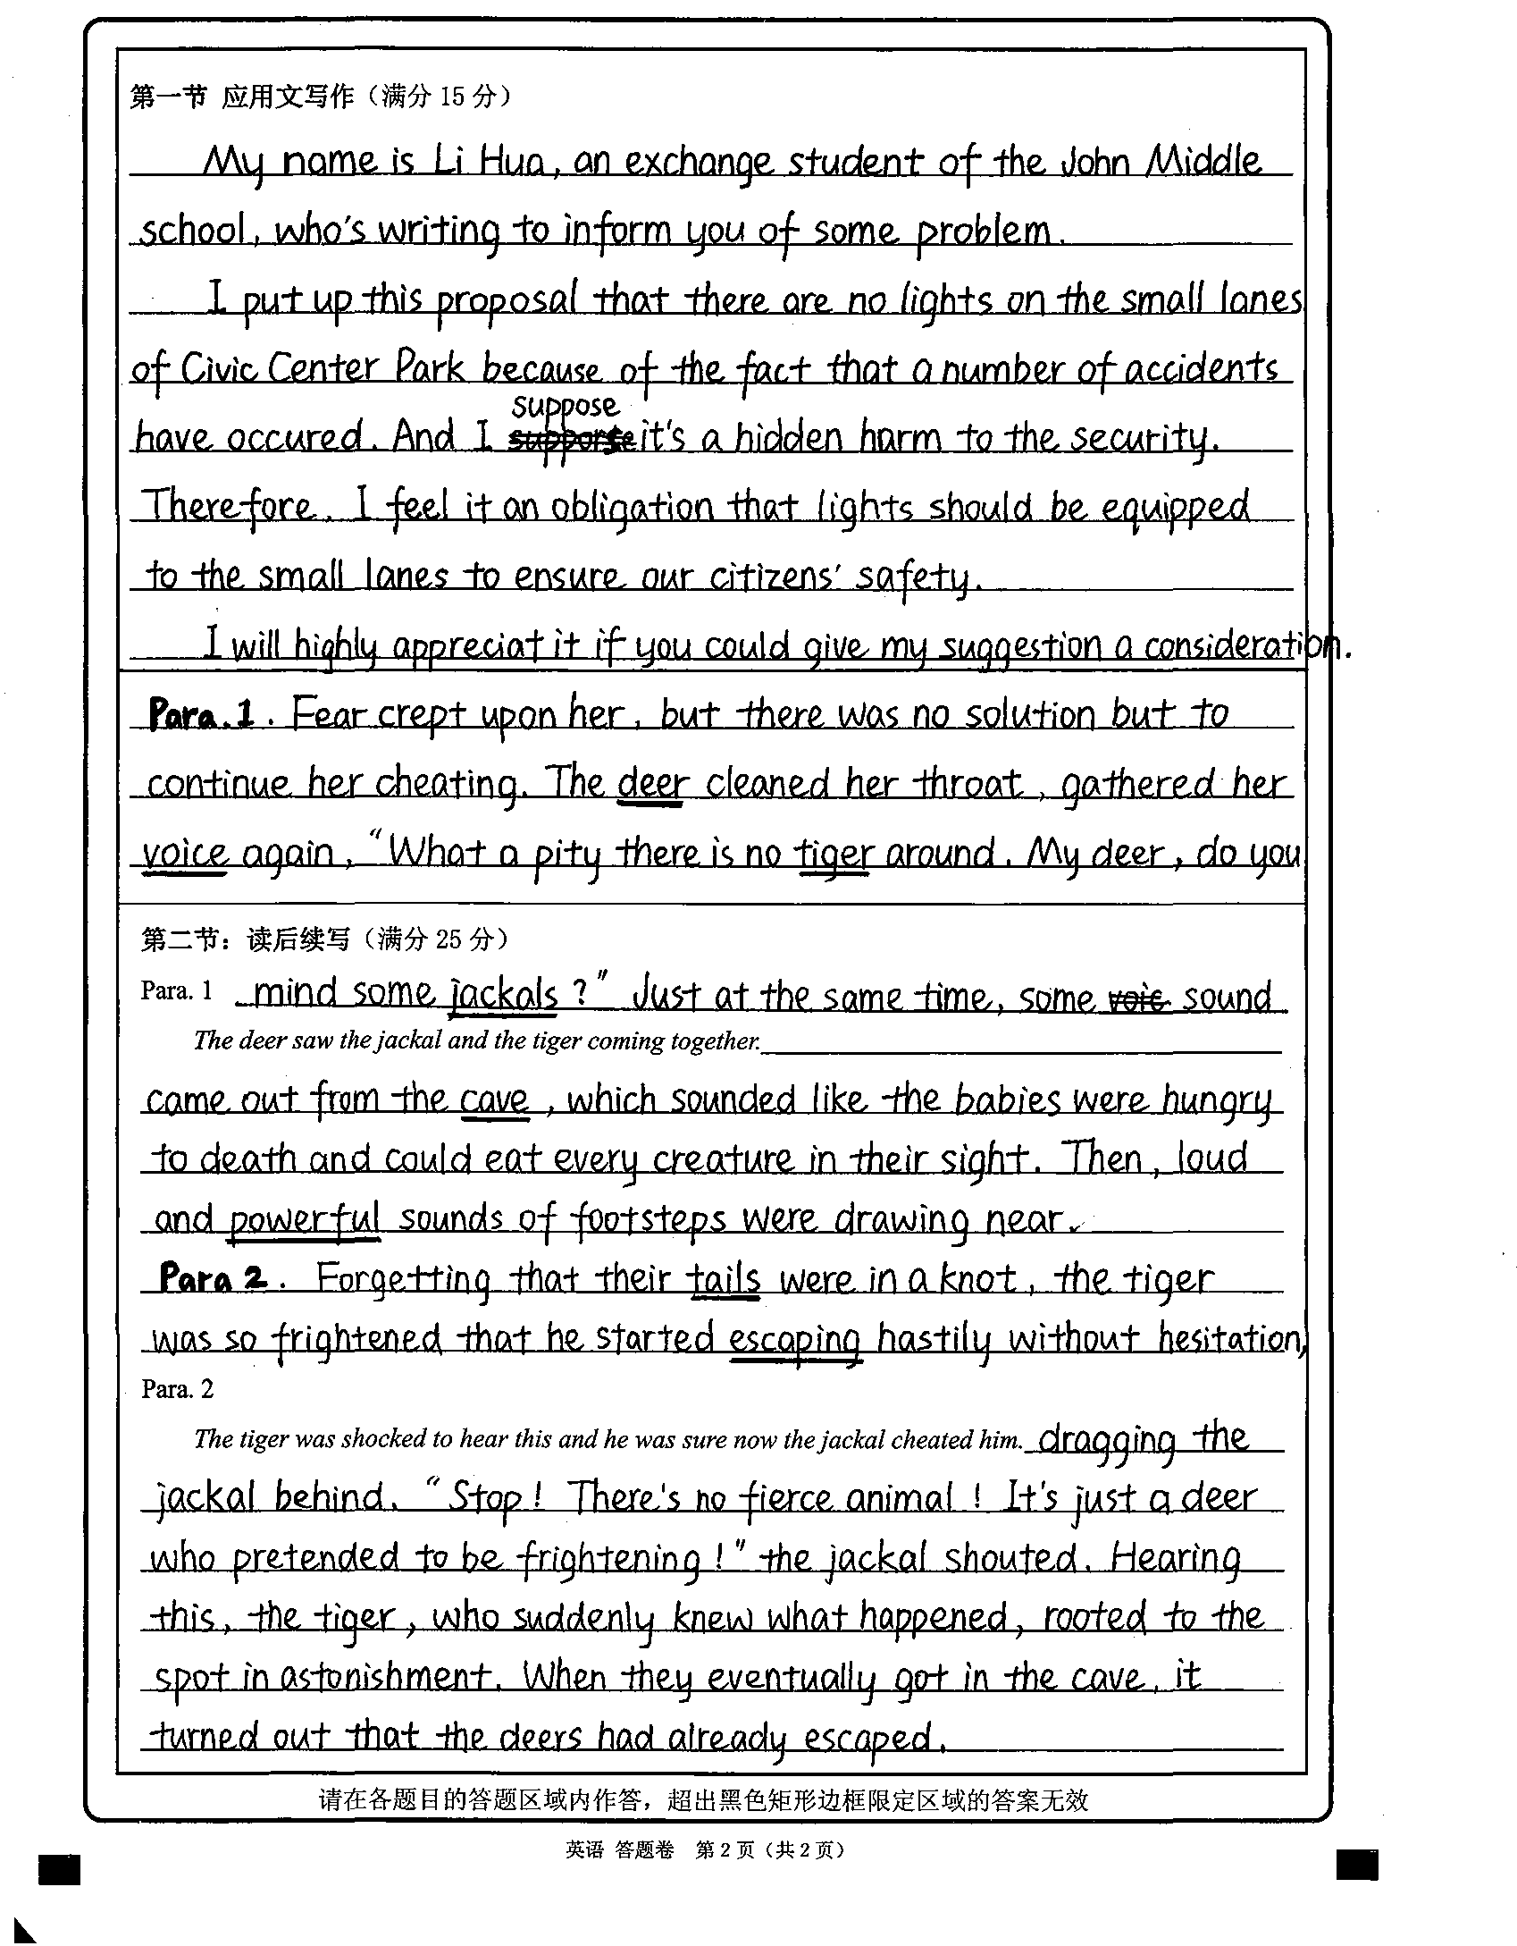
情节漏洞：
第一段中提到不吃老虎，换成胡狼，既然如此老虎为何要震惊？又为何会相信胡狼骗了自己？
第二段中既然两人没有进洞亲眼目睹，胡狼如何知道那是鹿假扮的？

Slide 13
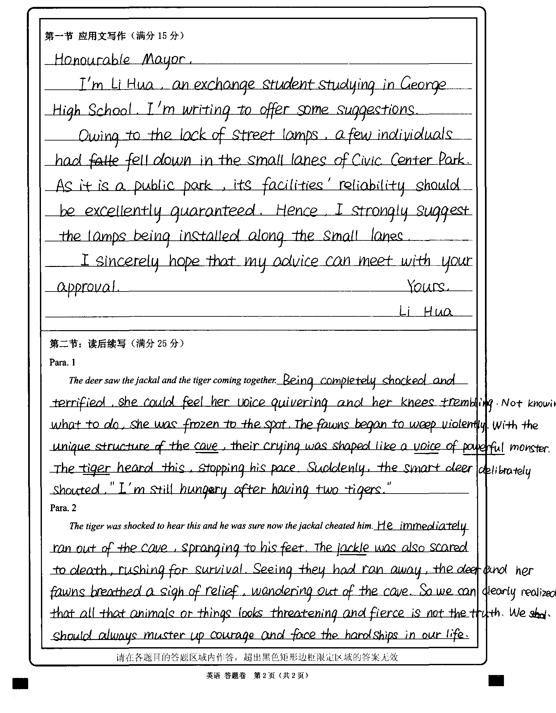
情节漏洞：听到鹿说“我吃了两只老虎还是很饿”，老虎也许会感到震惊，但是怎么就相信胡狼欺骗自己呢？
主题升华牵强：要勇敢面对困难？

Slide 14
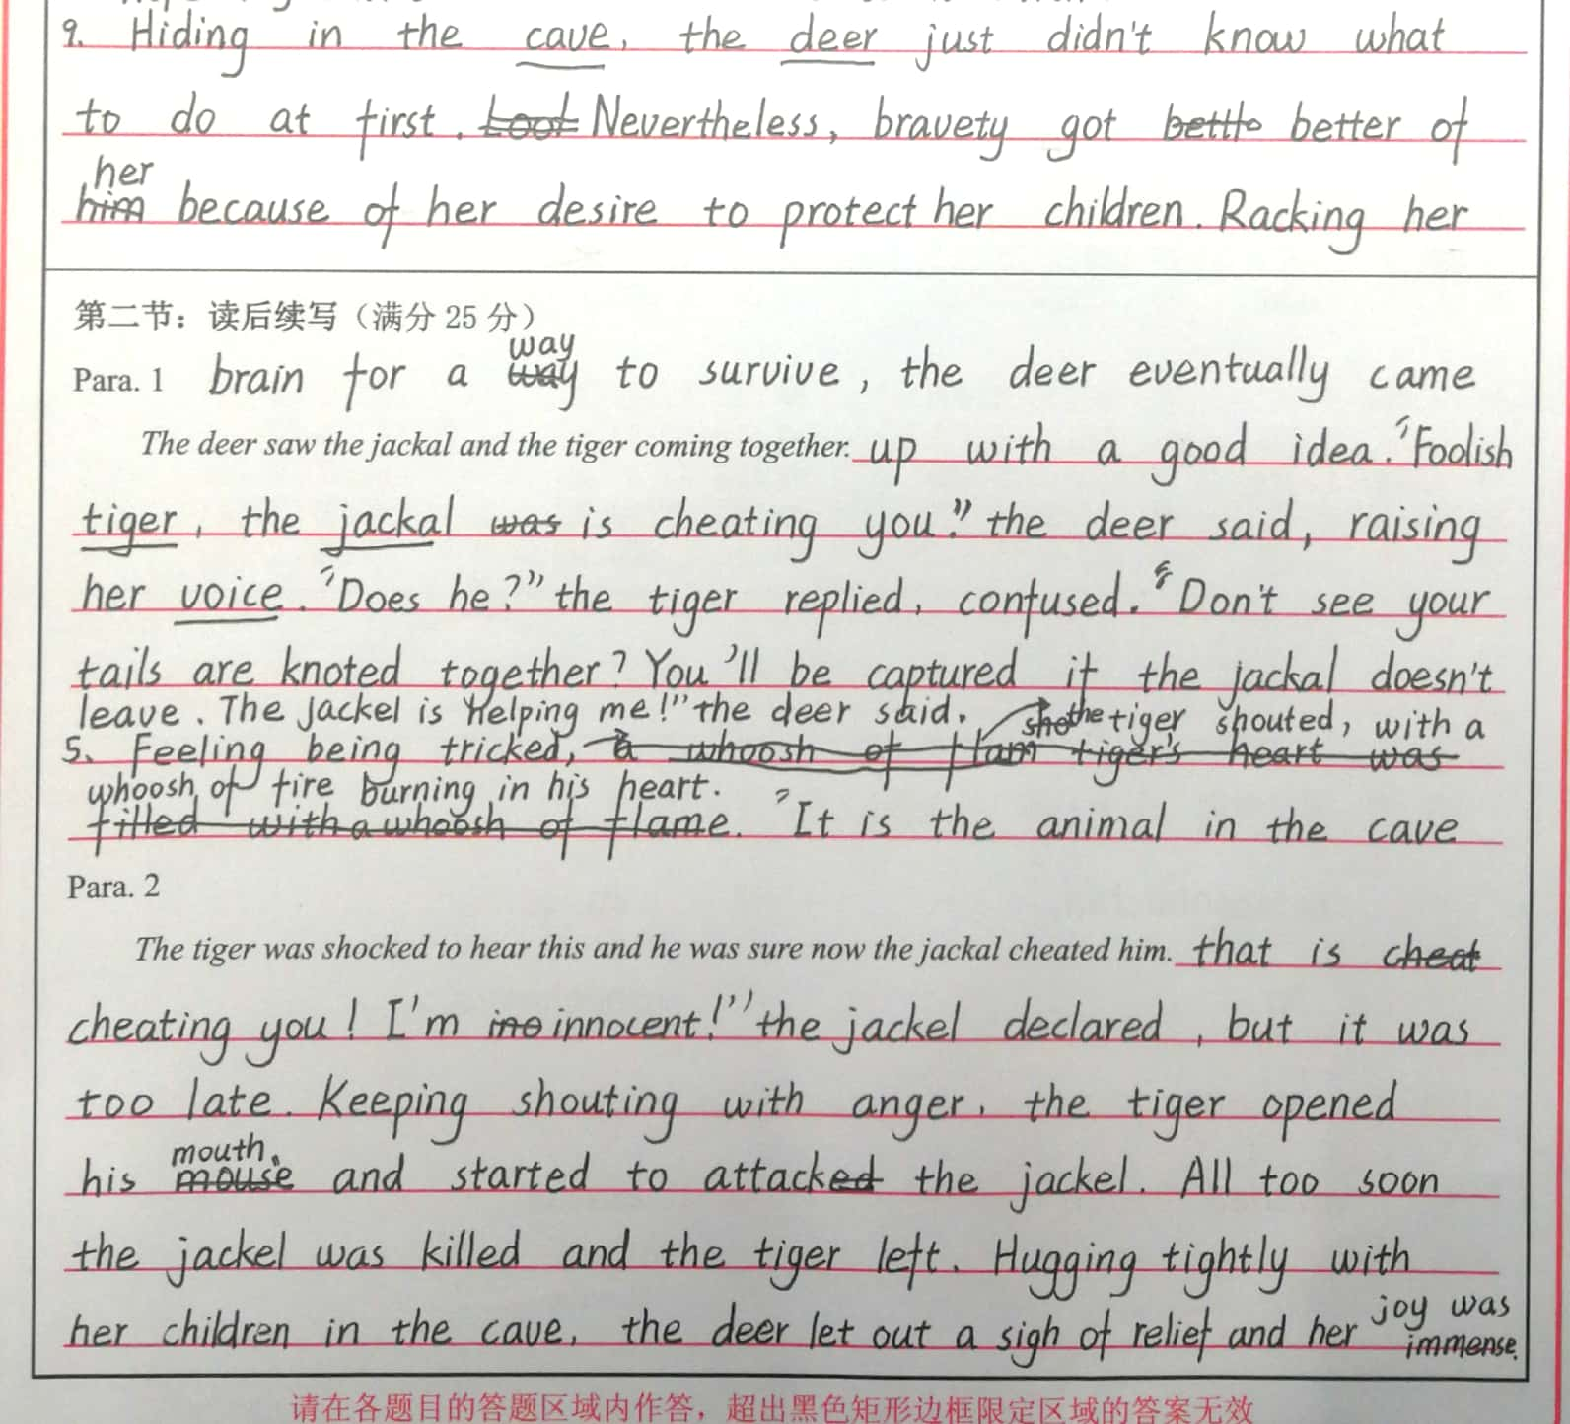
大量对话
情节合理吗？
老虎在如此恐惧的情况下会与山洞里的动物交谈吗？

Slide 15

一、情节建构问题：
两段衔接不连贯
情节发展不合逻辑
情节发展不符合人设
主题升华牵强
对话过多
二、语言表达问题：
1.拼写错误（尤其是动词过去式）：
frightened; attack; knot – knotted; unknot; loosen; fight – fought; lead – led; freeze – froze等

Slide 16
二、语言表达问题：
2. 名词用法错误：
3. 描写与情境不符
如：The tiger felt so frightened that his heart beat wildly, faster than a galloping horse.
deer – deer 单复数同形
a feeling of fright
描写人物时常使用这样的比喻，用此描写老虎合适吗？

Slide 17
感恩遇见，相互成就，本课件资料仅供您个人参考、教学使用，严禁自行在网络传播，违者依知识产权法追究法律责任。
更多教学资源请关注
公众号：溯恩高中英语
知识产权声明

Slide 18
Possible version 1
Para.1: The deer saw the jackal and the tiger coming together. She again raised her voice and shouted towards her children standing inside the cave, “My dear children, I requested my friend, the clever jackal, to capture a tiger for us. Now look the jackal has captured a tiger for us. He has tied the tiger’s tail to his tail. This is to prevent the tiger from escaping. You will soon have the tiger for dinner.”
Para. 2: The tiger was shocked to hear this and he was sure now the jackal cheated him. So, the tiger decided to escape from the terrible animal standing inside his cave. He started running. He forgot about the jackal. He dragged the jackal over rocks and thorns. In the mad escape the jackal was caught between two rocks. The tiger pulled with all his might. His tail got cut. The jackal was killed in this incident. The tail-less tiger ran away to another part of the forest. The deer and her young ones left the tiger’s cave. They joined their herd safely. Presence of mind and intelligence can save one from dangerous situations.

Slide 19
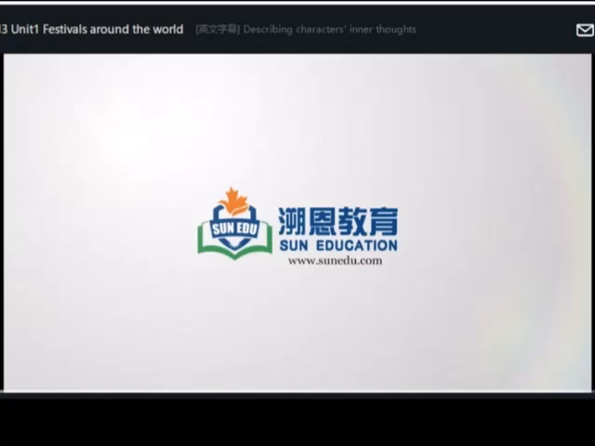
Task III: Polish your writing
Tag words(标记词) for writing
characters' inner thoughts
He thought / realized / imagined / dreamed / pictured / murmured / said to himself/ whispered / felt / assumed / wondered / sensed / felt like…
The idea is… / It occurred to him that … / In his mind ... / In his eyes… / His first feeling was …
All these thoughts(memories)crowded in that…
There was a voice inside that …
She heard a whispering voice from her heart …
describing inner thoughts
Direct thoughts (using quotation marks “…”)
Indirect thoughts (no quotation marks)

Slide 20
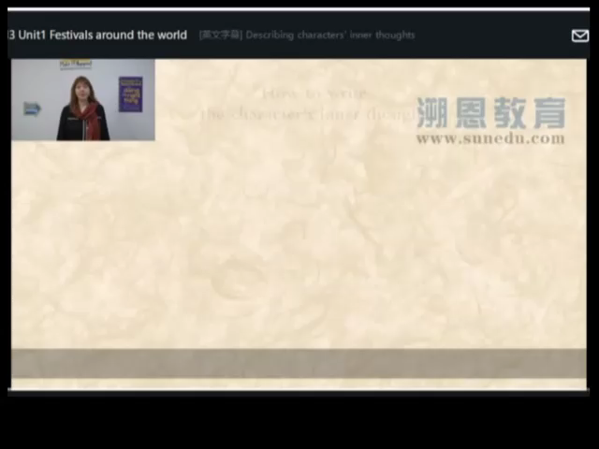
How to describe inner thoughts
Passage B
Tom was wandering in the street. Thinking of the large red “F” on the front page of his math paper, he felt a chill going down his spine. He could even see the disappointed and sad expression on his mother’s face. His father, a bad-tempered man, would probably show his fist to him. He could hear the furious shouts from his husky (沙哑的) throat.
A specific scene from his memory: the large red “F” on the front page …
What he will probably see/ what other people will probably do:
the disappointed and sad expression on his mother’s face
his father showing his fist to him
3) What he will probably hear/ what other
people will probably say:
the furious shouts from his father’s husky throat
Passage B
Tom was wandering in the street. Thinking of the large red “F” on the front page of his math paper, he felt a chill going down his spine. He could even see the disappointed and sad expression on his mother’s face. His father, a bad-tempered man, would probably show his fist to him. He could hear the furious shouts from his husky (沙哑的) throat.
Think about:
What the character will experience (see, hear or feel) in his / her mind
What the character or other people will do or say in his / her mind
Specific scenes from the character’s memory

Slide 21
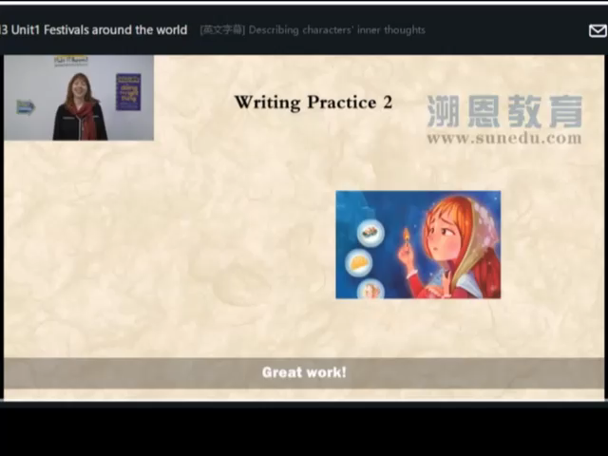
How to describe inner thoughts
The snow was falling harder now, and the girl was so cold that she thought she might freeze to death. She saw an older girl walk by in a beautiful coat. She was so lovely, and she laughed like a movie star. “If only I could be like that,” the girl thought. She imagined going home to a beautiful house where candles burned on every table. Her mother and father would welcome her home with a kiss, and the sound of their laughter would echo through the big wide entry hall. They would offer her cheesecake, and she would eat it gratefully. All her memories of the happy times with her mother and father flashed back. How she wished they were still together. The girl sighed. She knew a life like that could never be hers, and it made her sad. …
What she is doing in her mind:
What she sees in her mind:
What she hears in her mind:
How she feels:
Something in her memory:

Slide 22

Task V: Practice.
Find out the inner thoughts used in this passage.
He thought, “Whose is that strange voice from the cave? A dangerous animal is staying inside to capture me. I shall run away to escape death.”
Direct thoughts:
What does it show?
The tiger felt frightened.

Slide 23
Para.1: The deer saw the jackal and the tiger coming together. ________________________________________
______________________________________________________________________________________________She again raised her voice and shouted towards her children standing inside the cave, “My dear children, I requested my friend, the clever jackal, to capture a tiger for us. Now look the jackal has captured a tiger for us. He has tied the tiger’s tail to his tail. This is to prevent the tiger from escaping. You will soon have the tiger for dinner.”
The inner thoughts of the deer:
What she is doing in her mind:
What she sees in her mind:
What she hears in her mind:
How she feels:
Something in her memory:
“What should I do? If the tiger and the jackal came into the cave, we would undoubtedly become their meals,” she thought.
She shivered with nerves when she thought of the two fierce animals walking in, spotting them and feasting on their meat. “I will never allow it to happen!” she said to herself.
She thought hard about how to scare the tiger away and it occurred to her that she could fool the tiger by taking advantage of the jackal.
He thought / realized / imagined / dreamed / pictured / murmured / said to himself/ whispered / felt / assumed / wondered / sensed / felt like…
The idea is… / It occurred to him that … / In his mind ... / In his eyes… / His first feeling was …
All these thoughts(memories)crowded in that…
There was a voice inside that …
She heard a whispering voice from her heart …

Slide 24
Para. 2: The tiger was shocked to hear this and he was sure now the jackal cheated him. ___________________
_____________________________
______________________________________________________________________________________________________________________________________________ So, the tiger decided to escape from the terrible animal standing inside his cave. He started running. He forgot about the jackal. He dragged the jackal over rocks and thorns. ….
The inner thoughts of the tiger:
What he is doing in his mind:
What he sees in his mind:
What he hears in his mind:
How he feels:
Something in his memory:
He thought, “How stupid I was! I shouldn’t have trusted the jackal. They teamed up to capture me. I shall run away to escape death.”
He believed the cunning jackal made a deal with the powerful animal. He imagined them enjoying eating him together after he was tricked into the cave. He could even see the satisfied looks on their faces and hear the sound of their laughter echoing through the cave.

Slide 25
Possible version 2
Para.1: The deer saw the jackal and the tiger coming together. She thought hard about how to scare the tiger away and it occurred to her that she could fool the tiger by taking advantage of the jackal. So she again raised her voice and shouted towards her children standing inside the cave, “My dear children, I requested my friend, the clever jackal, to capture a tiger for us. Look, the jackal has captured a tiger and is now dragging it here into the cave. He has tied the tiger’s tail to his to prevent the tiger from escaping. You will soon have the tiger for dinner.”

Slide 26
Possible version 2
Para. 2: The tiger was shocked to hear this and he was sure now the jackal cheated him. He thought, “How stupid I was! I shouldn’t have trusted the jackal. They teamed up to capture me. I shall run away to escape death.” The tiger turned around and broke into a run, completely forgetting about the jackal. In the mad escape the jackal was caught between two rocks. The tiger pulled with all his might, his tail getting cut and the jackal killed in this incident. The tail-less tiger ran away to another part of the forest while the deer and her young ones left the tiger’s cave and joined their herd safely. Presence of mind and intelligence can save one from dangerous situations.

Slide 27

Homework
（一）故事选自浙江省名校新高考研究联盟（Z20联盟）2019届第二次联考读后续写试题
It was Christmas. Bobby wanted to buy his mother a gift. But he didn’t have any money. He was about to return home when suddenly he discovered a dime on the roadside. He went store after store, only to be told he couldn’t buy anything with only a dime. Finally he went into a flower shop, whose owner was so kind that he was given a bunch of roses. With the bunch of roses in his hands, Bobby walked out of the door and then broke into a run …
Describe his inner thoughts on the way home.

Slide 28
感恩遇见，相互成就，本课件资料仅供您个人参考、教学使用，严禁自行在网络传播，违者依知识产权法追究法律责任。
更多教学资源请关注
公众号：溯恩高中英语
知识产权声明

Slide 29
Homework
（二）故事选自浙江省2016年10月英语高考读后续写试题
One weekend in July, Jane and her husband, Tom, had driven three hours to camp overnight by a lake in the forest. Unfortunately, on the way an unpleasant subject came up and they started to quarrel. Jane got so angry that she walked away alone, but it was not long before she realized that she was lost in the forest. As night was beginning to fall, Jane was so tired that she had to stop for the night. Lying awake in the dark, Jane …
Describe her inner thoughts at that moment.

