Slide 1

感恩遇见，相互成就，本课件资料仅供您个人参考、教学使用，严禁自行在网络传播，违者依知识产权法追究法律责任。
更多教学资源请关注
公众号：溯恩高中英语
知识产权声明

Slide 2
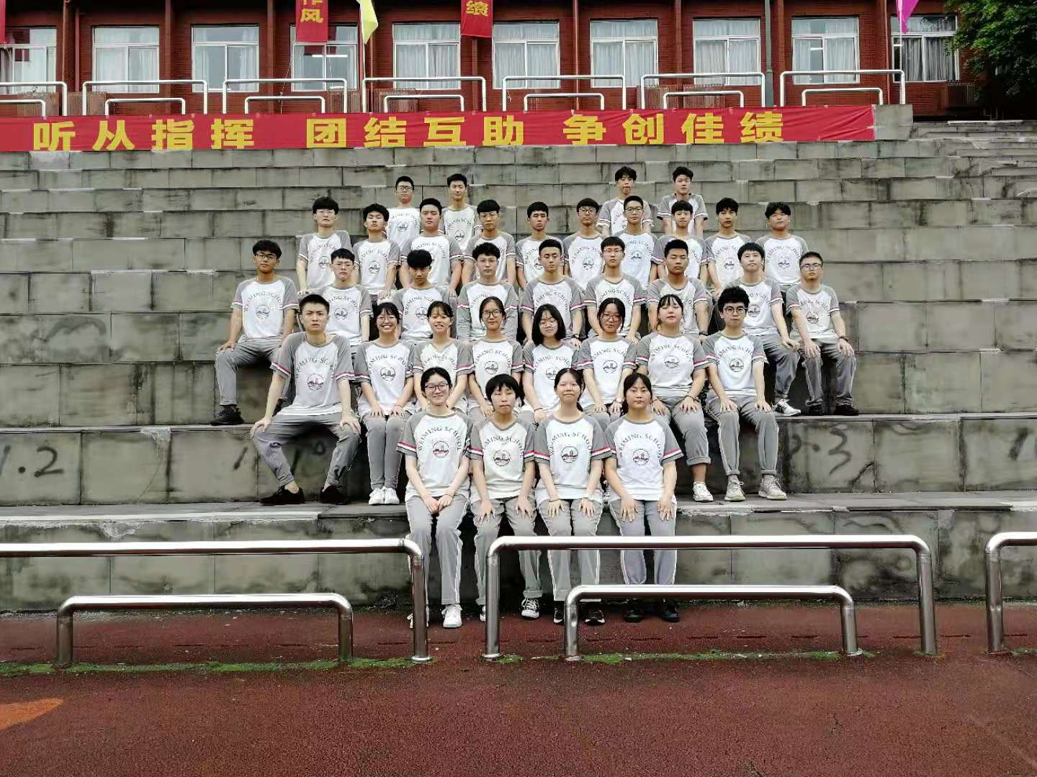
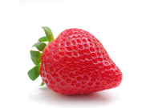
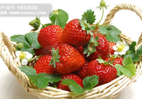
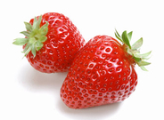
Welcome to our class!

Slide 3

Enjoy a video

Slide 4

Take me to your heart
Hiding
________ from the rain and snow;
________ to forget but I won't let go;
________ at a crowded street;
_________ to my own heart beat;
So many people all around the world，
Tell me where do I find someone like you girl.
Take me to your heart take me to your soul.
Give me your hand before I'm old.
Show me what love is - haven't got a clue.
Show me that wonders can be true.
They say nothing lasts forever, We're only here today
Trying
Looking
Listening

Slide 5

Love is now or never.
Bring me far away.
Take me to your heart take me to your soul.
Give me your hand and hold me,
Show me what love is - be my _________ star,
It's easy take me to your heart.
__________ on a mountain high;
__________ at the moon through a clear blue sky;
I should go and see some friends.
But they don't really comprehend.
Don't need too much _________ without ________ anything.
All I need is someone who makes me wanna sing.
guiding
Standing
Looking
talking
saying

Slide 6
Grammar
Unit 4 Body Language
V–ing form as adverbial
(动词-ing形式作状语）

Slide 7
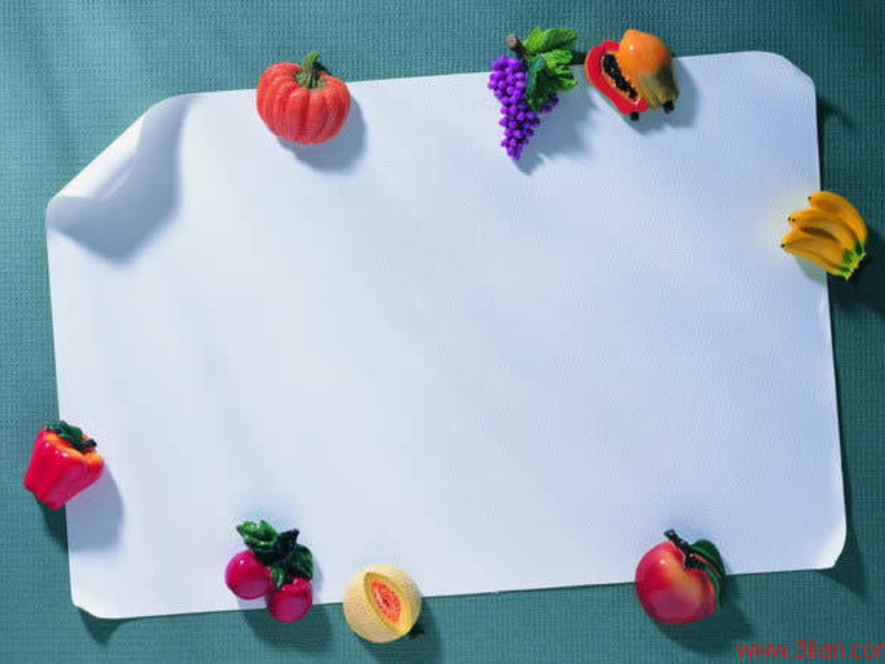
Learn by yourself
Task One
Observe and conclude I

Slide 8
Fill in the blanks.
1.______ in love makes man grow up or sink down.(fall)
2.Love is not a matter of ________ the days. (count)
3.Love is ________ the days count.(make)
4.Love is a vine ________ into our hearts.(grow)
5.Love keeps man________ all weakness.(ignore)
6.I'm just a sunflower,______for my only sunshine. (wait)

Slide 9

Tell the function of the Ving form
Falling in love makes man grow up or sink down.
Love is not a matter of counting the days.
Love is making the days count.
Love is a vine growing into our hearts.
Love keeps man ignoring all weakness.
I'm just a sunflower ,waiting for my only sunshine.
我只是一朵向日葵，等待着属于我的唯一的阳光。
陷入爱河能让人成长也能让人沉沦
主语
宾语
爱不是一件度日如年的事
表语
爱使得每天都有意义。
定语
爱是长在我们心中的藤蔓
宾语补足语
情人眼里出西施
状语
状语

Slide 10
Task 2
News about Love
Rewrite the compound sentences as simple sentences

Slide 11
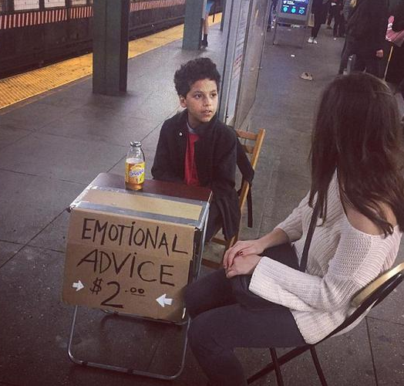
纽约地铁惊现11岁情感治疗师
v-ing作条件(condition)状语，the passengers是have的执行者, 故将look处理成v-ing而非v-ed形式作状语。
If they have emotional problems, the passengers can ask for emotional advice from Ortiz, a 11-year-old boy.
Having

Slide 12
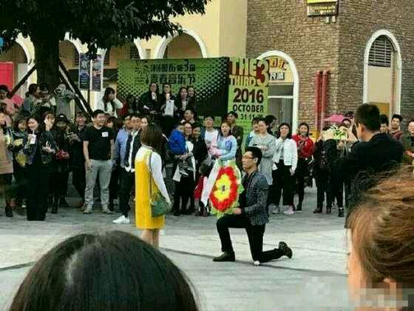
v-ing作原因(reason)状语，the man 执行了send a wreath这一动作, 所以将其处理成v-ing而非v-ed形式作状语。
Sending
Because he sent a wreath to show his love, the man was refused on the spot.

Slide 13
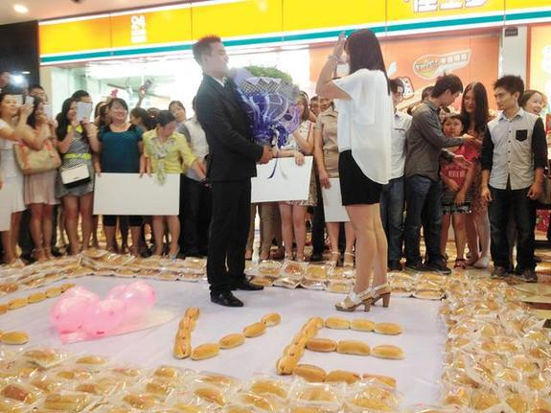
v-ing作时间(time)状语，the man是present这一动作的执行者, 所以用v-ing形式而非v-ed形式作状语。
When he presented “I love you” with hotdogs, the handsome man won the girl’s heart.
Presenting
___________ “I love you” with hotdogs , the handsome man won the girl’s heart.

Slide 14
Summary:
用现在分词改写句子作状语时，要求：
1.从句主语和主句主语__________
2.从句的动词与主句的主语构成____________
一致
主动关系

Slide 15


summary 2: 1.V-ing形式作状语可表_____________等。
2.v-ing作状语时，为了强调，可以在非谓语前加上：_____________________________________等
3.分词的否定形式是一律在_______前面加上 ______等否定词构成。
时间/原因/让步/条件/方式/结果
when,while,after,once,if, unless, although, because
not/never
为了使逻辑关系更明确，常在v-ing前加上连词：when, while, after, once, if, unless, although,though,thus, where,before, because…
分词短语
Being lack of confidence, Beyond accepted the
difficult tasks.
Not paying attention to the words she said, all the students gave a surprised expression.
Having emotional problems, the passengers can ask for emotional advice from Ortiz, a 11-year-old boy.
The film—Ne Zha had excellent plots(剧情),
becoming popular all over the world.
Although being
Because not paying
If having
thus becoming

Slide 16
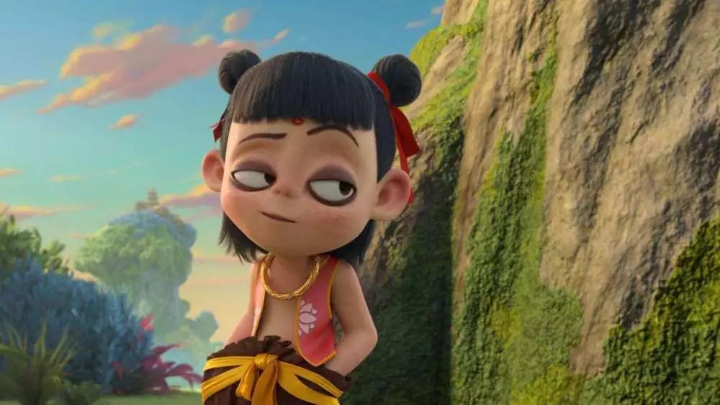
4. The film—Ne Zha had excellent plots(剧情),
thus becoming popular all over the world.
I hurried to buy the ticket of Ne Zha, only ___________(find)that it was sold out.
to find
现在分词表示必然结果，前可加_____,only后加____________表意外的结果.
thus
to do

Slide 17
Rewrite the sentences in 4 mins
Practice makes perfect.

Slide 18
Rewrite these sentences using v-ing as adverbial
1.When they heard the news, they couldn't help jumping.
____________________________________________________
2. Because I am not a student, I can’t go to the classroom.
____________________________________________________
3.If you exercise every day, you will improve your health.
____________________________________________________
4. The old lady sat and wait for him.
____________________________________________________.
5. Because he didn’t work very hard, he felt a bit regretful.
____________________________________________________
6. The heavy rain lasted for 3 days so that it resulted in serious traffic jams.
____________________________________________________.

Slide 19

Rewrite these sentences using v-ing as adverbial
When they heard the news, they couldn't help jumping.
(When) hearing the news, they couldn’t help jumping.
2. Because I am not a student, I can’t go to the classroom.
(Because) not being a student, I can’t go to the classroom.
3. If you exercise every day , you will improve your health.
(If) exercising every day , you will improve your health.
4. The old lady sat and wait for him.
The old lady sat, waiting for him.

Slide 20
Rewrite these sentences using v-ing as adverbial
5. Because he didn’t work very hard, he felt a bit regretful.
(Because) not working very hard, he felt a bit regretful.
6. The heavy rain lasted for 3 days so that it resulted in serious traffic jams.
The heavy rain lasted for 3 days, (thus)resulting in serious traffic jams.

Slide 21
Check yourself(quiz堂测)

Slide 22
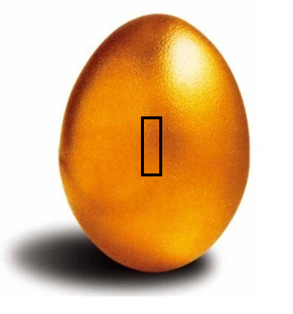
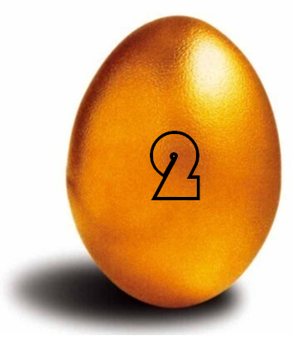


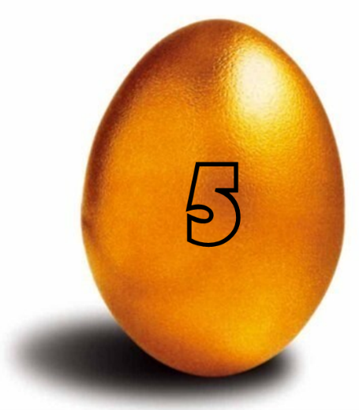
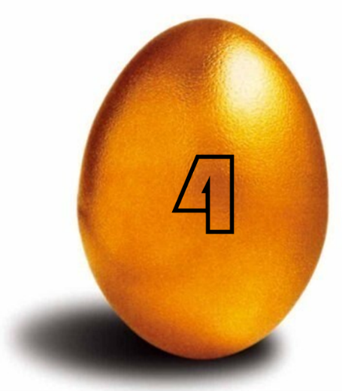
Playing Game
Not knowing
________________ English , he can’t
read some stories in English. (know)
Hearing the news, tear came into her eyes.
Hearing the news, she burst into tears.
√
Be late
he miss the bus(错过公交车)
Being late, he missed the bus.
Tom finished his homework.
Tom was so happy.
Finishing his homework, Tom was so happy.
arriving at the party/my friends/
I found/were there(排出正确的语序)
Arriving at the party, I found my friends were there.

Slide 23
Thank you!

