Slide 1

感恩遇见，相互成就，本课件资料仅供您个人参考、教学使用，严禁自行在网络传播，违者依知识产权法追究法律责任。
更多教学资源请关注
公众号：溯恩高中英语
知识产权声明

Slide 2



金华市孝顺高级中学 严晓倩Iris
Unit2 Travelling Around
Explore
Peru
Notes:
www.515ppt.com

Slide 3
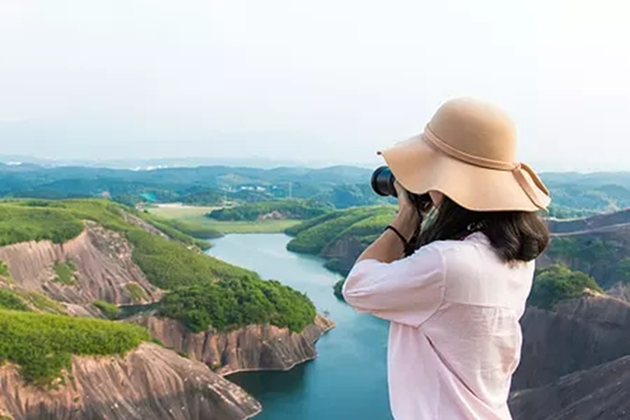

01
warming-up
Free
Talk
Do you like travel? (Why or why not?)
Notes:
www.515ppt.com

Slide 4
01
warming-up
broaden eyes
Do you like travel?
relax
......
taste various food
practise a foreign language
Advantages
experience different customs
arouse love for motherland
Notes:
www.515ppt.com

Slide 5
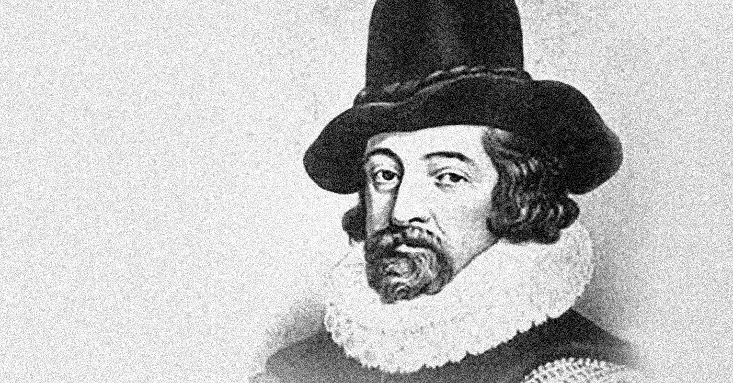
01
Travel, in the younger sort, is a part of education; in the elder, a part of experience.
Francis Bacon
Notes:
www.515ppt.com

Slide 6
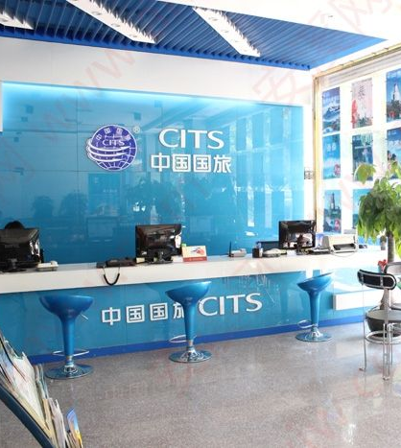



01
How do you usually make a plan for your travel?
01
02
03
Travel agency
Travel book
Travel Apps
Notes:
www.515ppt.com

Slide 7


01
The Package Tour
The Self-guided Tour
？
？

Notes:
www.515ppt.com

Slide 8
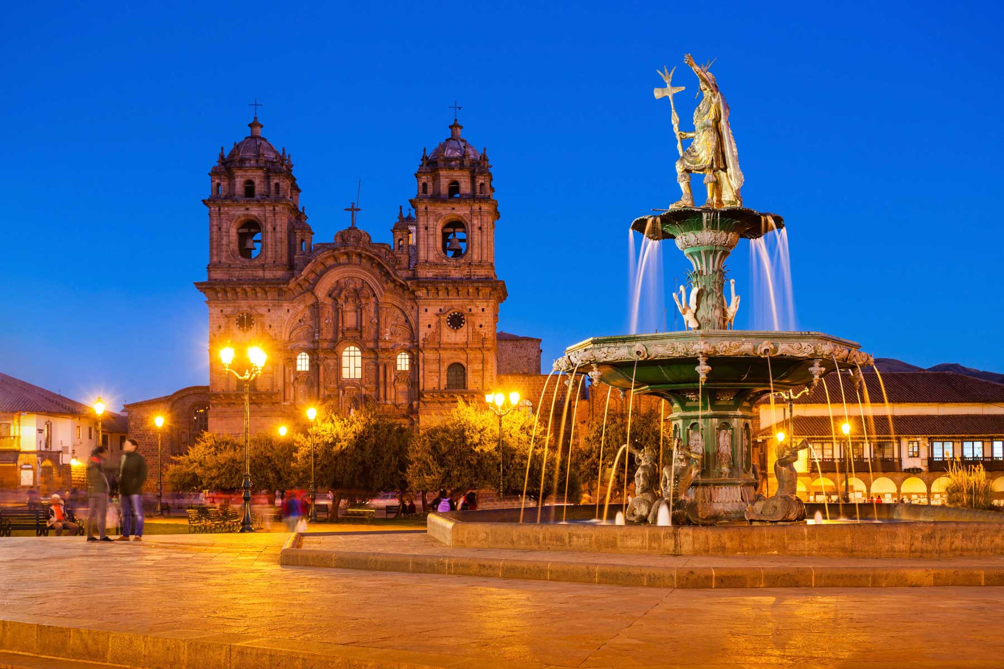
01
What information do you need to make a good plan?
01
Guidance from others
02
Encyclopedia
A
Self-guided Tour
03
Brochure
Notes:
www.515ppt.com

Slide 9
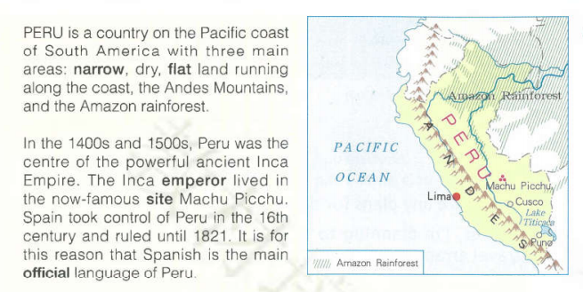
02
Reading and thinking
Read the information below and answer some questions.
What type of information does it belong to?
What does it mainly tell us?
Do you think it’s important to read such type of information when you are making a travel plan?
Notes:
www.515ppt.com

Slide 10
02
Reading and thinking
What type of information does it belong to?
A.Guidance
B.Encyclopedia
C.Brochure
Notes:
www.515ppt.com

Slide 11
02
Reading and thinking
② What does it mainly tell us?
Para1
Para2
Notes:
www.515ppt.com

Slide 12
02
Reading and thinking
② What does it mainly tell us?
Para1 Geography
Para2
Notes:
www.515ppt.com

Slide 13
02
Reading and thinking
② What does it mainly tell us?
Para1 Geography
A brief introduction of geography, history and official language about Peru.
Para2
History & language
Notes:
www.515ppt.com

Slide 14
02
Reading and thinking
③ Do you think it important to read such type of information when you are making a travel plan? Why?
short
82 words
numbers
exact
the 3rd person
objective
Tip1: A piece of encyclopedia is always short, exact, serious and objective.
Notes:
www.515ppt.com

Slide 15
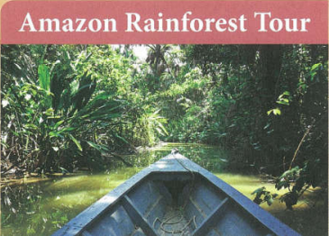


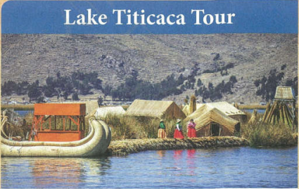
02
Read four paragraphs from TRAVEL PERU and fill in the form.
Notes:
www.515ppt.com

Slide 16
02
Read four paragraphs from TRAVEL PERU and fill in the form.
 | AMAZON RAINFORST | MACHU PICCHU | CUSCO | LAKE TITICACA
Number of days |  | 4 days
Transport
Accommodation |  |  |  | local home
Activity | boating, hiking, exploring nature
4 days
4 days
4 days
boat
On foot
boat
Local home
Local hotel
Walking, exploring the ancient city
Enjoying culture, visiting, admiring, shopping
Enjoying beautiful countryside
Notes:
www.515ppt.com

Slide 17
02
A.Guidance
B.Encyclopedia
C.Brochure
1.What type of information does it belong to?
Notes:
www.515ppt.com

Slide 18
02
C.Brochure
1.What type of information does it belong to?
Notes:
www.515ppt.com

Slide 19
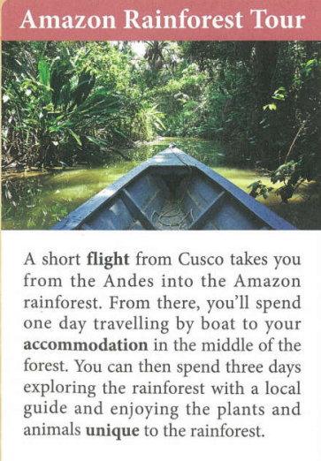
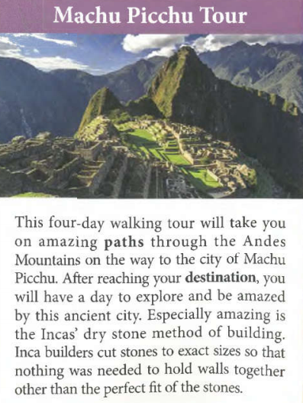
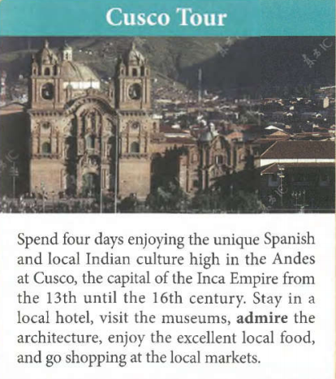
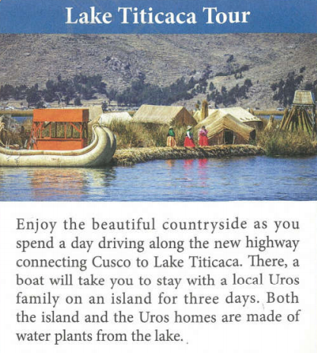
02
C.Brochure
2.Do you think it important to read such type of information when you are making a travel plan?
Why?
Notes:
www.515ppt.com

Slide 20
02
C.Brochure
take...from...into
spend...
explore...
enjoy...
be unique to...
take...on...
amazing
explore...
be amazed by...
perfect
spend...
enjoy...
unique
local
stay in...
visit
admire
enjoy
excellent
enjoy
beautiful
drive along
take
stay with
Tip2: A piece of brochure is always inviting, vivid and attractive.
Notes:
www.515ppt.com

Slide 21
02
What's the difference between an encyclopedia and a brochure?
Encyclopedia
Brochure
short, exact, serious and objective
vivid, inviting and attractive

Slide 22
02
What structure and language is often used to make each of them?
Encyclopedia
Brochure
short, exact, serious and objective
vivid, inviting and attractive
no specific order,
just a list of knowledge
(usually) in the order of time or route
structure
the 3rd person,
numbers,
facts
verb.
adj.
language

Slide 23
02
Which tour(s) would you recommend for people who enjoy history and culture?
 | AMAZON RAINFORST | MACHU PICCHU | CUSCO | LAKE TITICACA
Number of days |  | 4 days
Transport
Accommodation |  |  |  | local home
Activity | boating, hiking, exploring nature
4 days
4 days
4 days
boat
On foot
boat
Local home
Local hotel
Walking, exploring the ancient city
Enjoying culture, visiting, admiring, shopping
Enjoying beautiful countryside
Notes:
www.515ppt.com

Slide 24
02
Discuss in a group of four and think: if you have 8 days to visit Peru, design a travel schedule for your group and make a brochure, then present it in front of all the classmates.
Tip:
1.You can draw a picture about the route.
2.You can use more verbs to make it vivid and use adjs to make it attractive.
Notes:
www.515ppt.com

Slide 25
02
Possible version:
Machu Picchu and Lake Titicaca Tour
This eight-day tour will give you a unique experience about native life in Peru. The first sight is Machu Picchu, which is famous as an ancient city. Walking on amazing paths through the Andes Mountains, you’ll meet local plants, animals and people and be especially amazed by the Incas’ dry stone method of building. After four days’ tour in Machu Picchu, you’ll spend the next four days enjoying the beautiful lake Titicaca. There, you’ll have the chance to stay with a local Uros family, whose home is made of water plants from the lake. Take the dragon-like boat to explore Lake Titicaca, and your tour will be filled with happiness and ease.
Notes:
www.515ppt.com

Slide 26
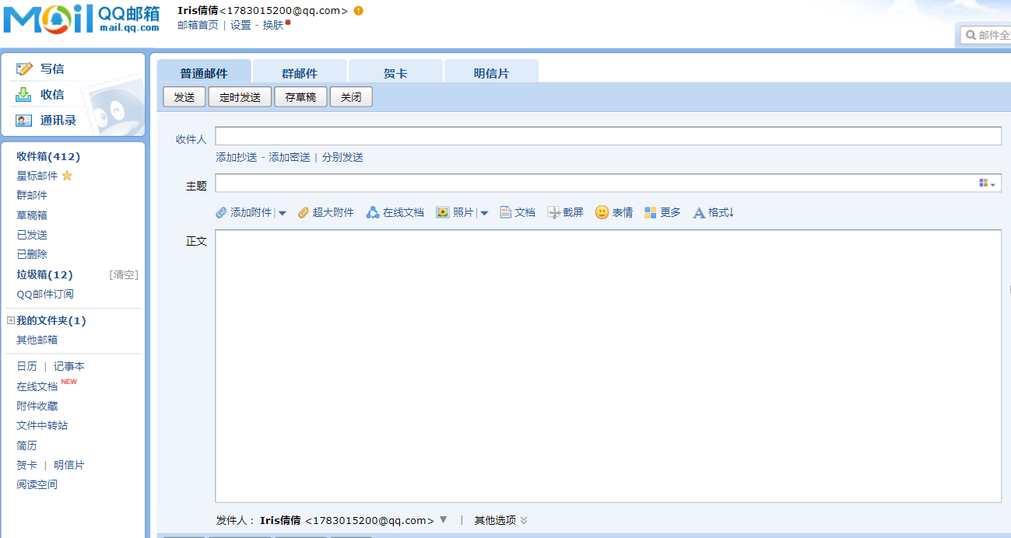
03
Assignment:Write an e-mail to invite your best friend or relatives to join you.

Slide 27
Thank
you!
Notes:
www.515ppt.com

