Slide 1

感恩遇见，相互成就，本课件资料仅供您个人参考、教学使用，严禁自行在网络传播，违者依知识产权法追究法律责任。
更多教学资源请关注
公众号：溯恩高中英语
知识产权声明

Slide 2
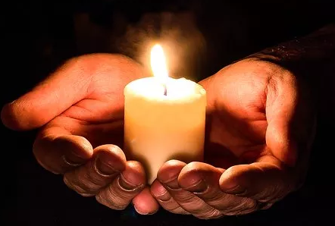
M1U4 Earthquakes
杭州师范大学附属中学
苏殷旦

Slide 3
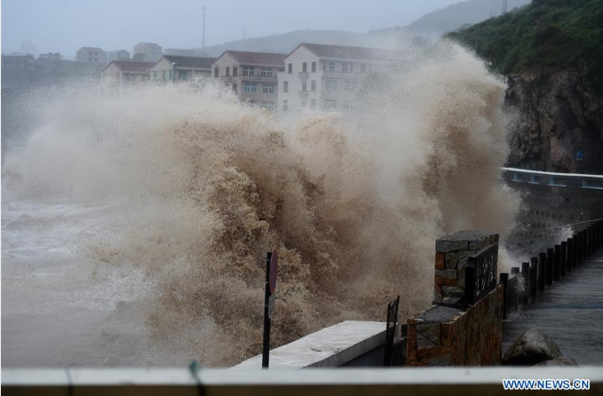
Lead-in
On August 10th, there was a serious disaster in Linhai Taizhou,
Eastern Zhejiang Province.
What was it ?
Typhoon Lekima

Slide 4
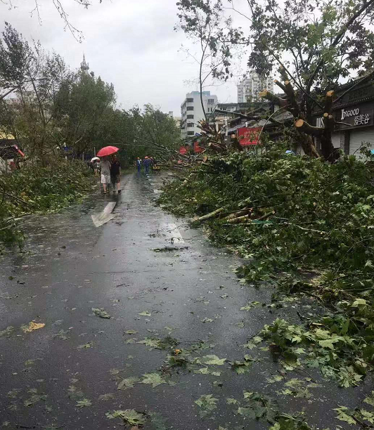
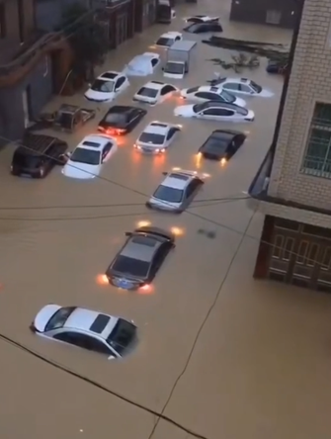
fell down
The traffic was stopped.
Water, food and ________ were hard to get
Trees __________
electricity

Slide 5
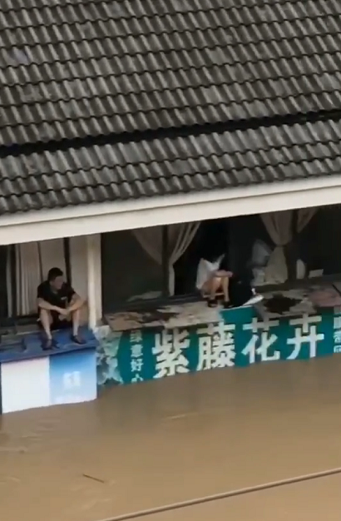
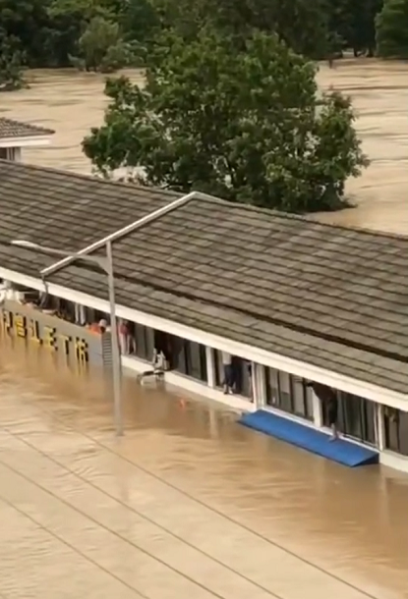
trapped
People were _________there and couldn’t get out in a short time.

Slide 6
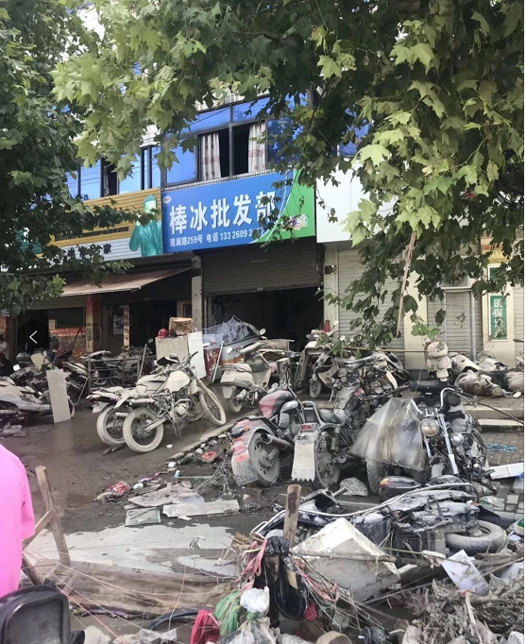
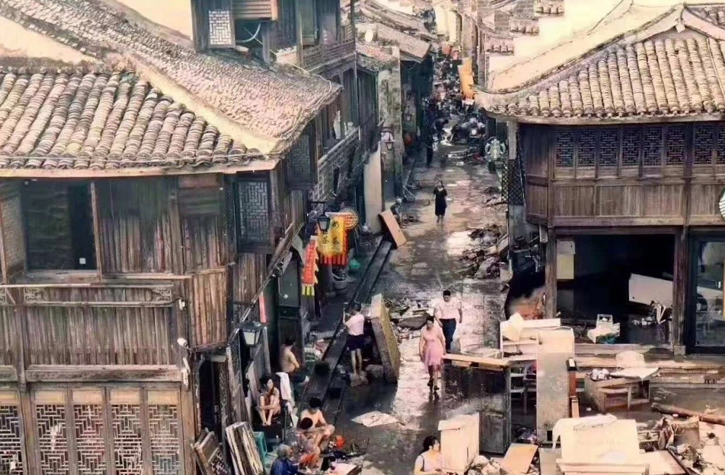
The city was ________.
in ruins

Slide 7
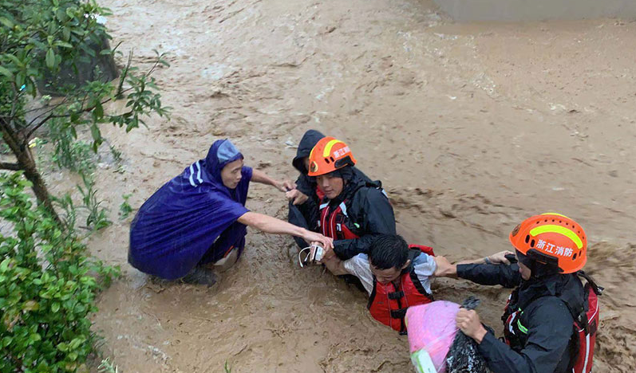
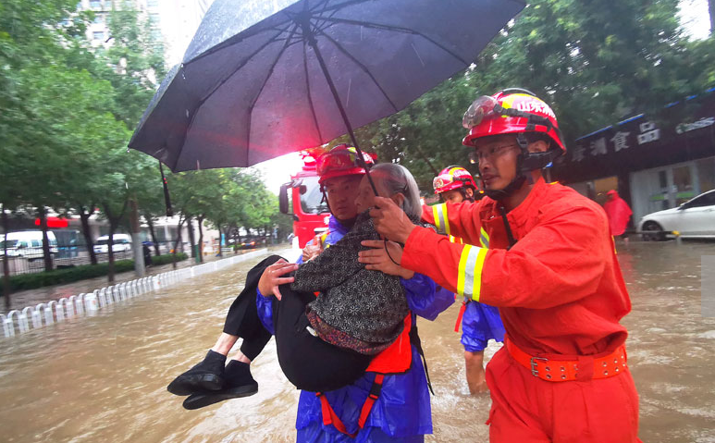
________ helped the trapped people.
Rescuers

Slide 8
A night the earth didn't sleep
Read and Answer
M1U4 Reading
1. What is the writing style of this passage?
An exposition (说明文)
B. An argumentation(议论文)
C. A narration(记叙文)

Slide 9
Read and Answer
2. What is structure of the passage?
3. What is the order of the passage?

Slide 10
1. Strange things were happening in the countryside of northeastern Hebei. For several days，the water in the village wells rose and fell，rose and fell. There were deep cracks that appeared in the well walls. At least one well had some smelly gas coming out of it. Chickens and even pigs were too nervous to eat，and dogs refused to go inside buildings. Mice ran out of the fields looking for places to hide，and fish jumped out of the water. At about 3：00 a.m. on 28 July 1976，bright lights were seen in the sky outside the city of Tangshan and loud noises were heard. But the city’s one million people were asleep as usual that night.
2. At 3：42 a.m.，everything began to shake. It seemed as if the world were coming to an end! Eleven kilometres directly below the city，one of the most deadly earthquakes of the 20th century had begun，a quake that even caused damage more than 150 kilometres away in Beijing. Nearly one third of the whole nation felt it! A huge crack，eight kilometres long and 30 metres wide，cut across houses，roads，and waterways. Hard hills of rock became rivers of dirt. In less than one minute，a large city lay in ruins. Two thirds of the people who lived there were dead or injured. Thousands of children were left without parents. The number of people who were killed or badly injured in the quake was more than 400000.
3. Everywhere survivors looked，there was nothing but ruins. Nearly everything in the city was destroyed. About 75 percent of the city’s factories and buildings，90 percent of its homes，and all of its hospitals were gone. Bricks covered the ground like red autumn leaves，but no wind could blow them away. Most bridges had fallen or were not safe to cross. The railway tracks were now useless pieces of metal. Tens of thousands of cows，hundreds of thousands of pigs，and millions of chickens were dead. Sand now filled the wells instead of water. People were in shock—and then，later that afternoon，another big quake shook Tangshan again. Even more buildings fell down. Water，food，and electricity were hard to get. People began to wonder how long the disaster would last.
4. But hope was not lost. Soon after the quakes，the army sent 150，000 soldiers to Tangshan to dig out those who were trapped and to bury the dead. More than 10，000 doctors and nurses came to provide medical care. Workers built shelters for survivors whose homes had been destroyed. Hundreds of thousands of people were helped. Water and food were brought into the city by train，truck，and plane. Slowly，the city began to breathe again.
5. Tangshan started to revive itself and get back up on its feet. With strong support from the government and the tireless efforts of the city’s people，a new Tangshan was built upon the earthquake ruins. The new city has become a home to more than seven million people，with great improvements in transportation，industry，and environment. Tangshan city has proved to China and the rest of the world that in times of disaster，people must unify and show the wisdom to stay positive and rebuild for a brighter future.
Before the earthquake
Part 1(para 1）:_________________
time
Part 2(para 2-3）:_________________
During the earthquake
Part 3(para 4-5）_________________
After the earthquake

Slide 11
Read for Beginning—Para 1
?
Strange things were happening in the countryside of northeast Hebei. For three days the water in the village wells rose and fell, rose and fell. There were deep cracks that appeared in the well walls. At least one well had some smelly gas coming out of it. Chickens and even pigs were too nervous to eat，and dogs refused to go inside buildings. Mice ran out of the fields looking for places to hide，and fish jumped out of the water. At about 3：00 a.m. on 28 July 1976，bright lights were seen in the sky outside the city of Tangshan and loud noises were heard. But the city’s one million people were asleep as usual that night.
Strange things were happening in the countryside of northeast Hebei.
Topic sentence?

Slide 12
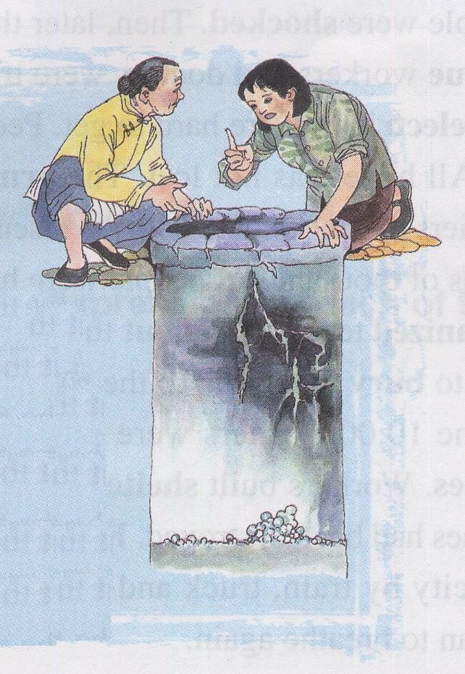
Read for Beginning—Para 1
Strange things were happening in the countryside of northeastern Hebei.①For several days the _____ in the village wells________________________. ② There were deep cracks that appeared in the well walls. ③At least one well had some smelly gas coming out of it. ④Chickens and even pigs were too nervous to eat，and dogs refused to go inside buildings. ⑤Mice ran out of the fields looking for places to hide，and fish jumped out of the water. ⑥At about 3：00 a.m. on 28 July 1976，bright lights were seen in the sky outside the city of Tangshan and loud noises were heard. But the city’s one million people were asleep as usual that night.
water
rose and fell, rose and fell

Slide 13
Read for Beginning—Para 1
Strange things were happening in the countryside of northeast Hebei. ①For several days, the water in the village wells rose and fell, rose and fell.② There were __________ that appeared in the well walls. ③At least one well had some smelly gas coming out of it. ④Chickens and even pigs were too nervous to eat，and dogs refused to go inside buildings. ⑤Mice ran out of the fields looking for places to hide，and fish jumped out of the water. ⑥At about 3：00 a.m. on 28 July 1976，bright lights were seen in the sky outside the city of Tangshan and loud noises were heard. But the city’s one million people were asleep as usual that night.
deep cracks

Slide 14
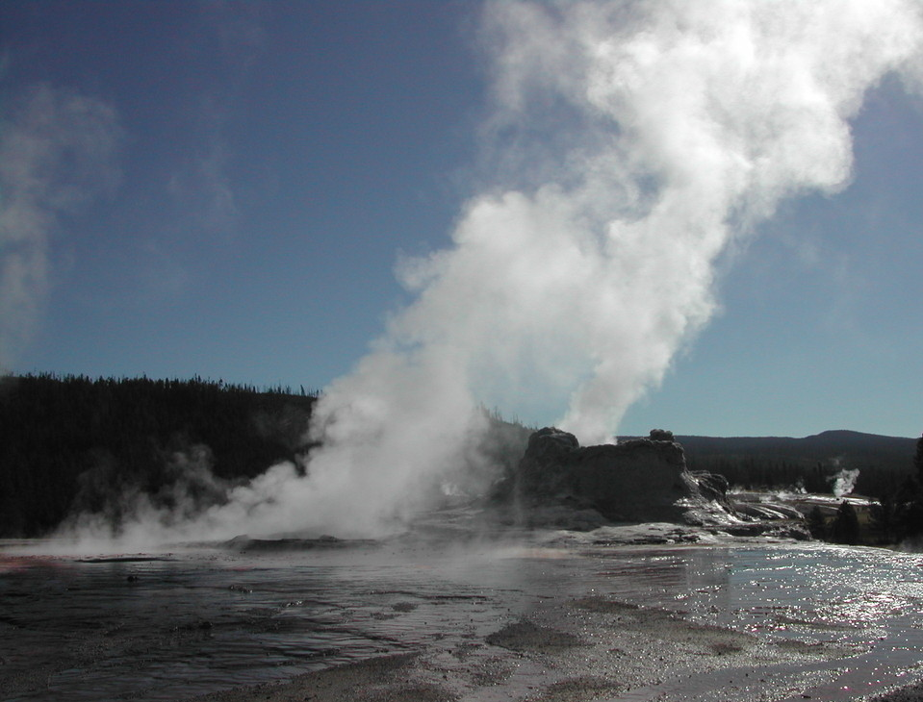
Read for Beginning—Para 1
Strange things were happening in the countryside of northeast Hebei. ①For several days, the water in the village wells rose and fell, rose and fell.② There were deep cracks that appeared in the well walls. ③At least one well had some ________ coming out of it. ④Chickens and even pigs were too nervous to eat，and dogs refused to go inside buildings. ⑤Mice ran out of the fields looking for places to hide，and fish jumped out of the water. ⑥At about 3：00 a.m. on 28 July 1976，bright lights were seen in the sky outside the city of Tangshan and loud noises were heard. But the city’s one million people were asleep as usual that night.
smelly gas

Slide 15
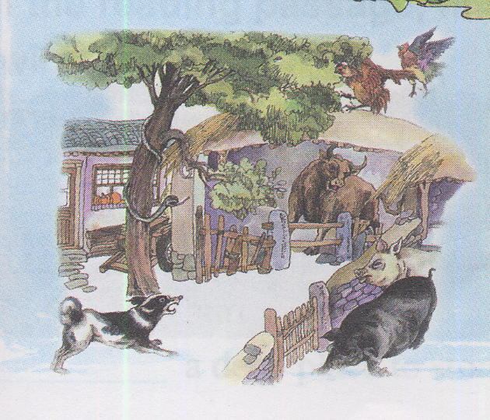
Read for Beginning—Para 1
Strange things were happening in the countryside of northeast Hebei. ①For several days, the water in the village wells rose and fell, rose and fell.② There were deep cracks that appeared in the well walls. ③At least one well had some smelly gas coming out of it. ④________and even _______were too nervous to eat，and _____ refused to go inside buildings. ⑤Mice ran out of the fields looking for places to hide，and fish jumped out of the water. ⑥At about 3：00 a.m. on 28 July 1976，bright lights were seen in the sky outside the city of Tangshan and loud noises were heard. But the city’s one million people were asleep as usual that night.
Chickens
the pigs
dogs

Slide 16
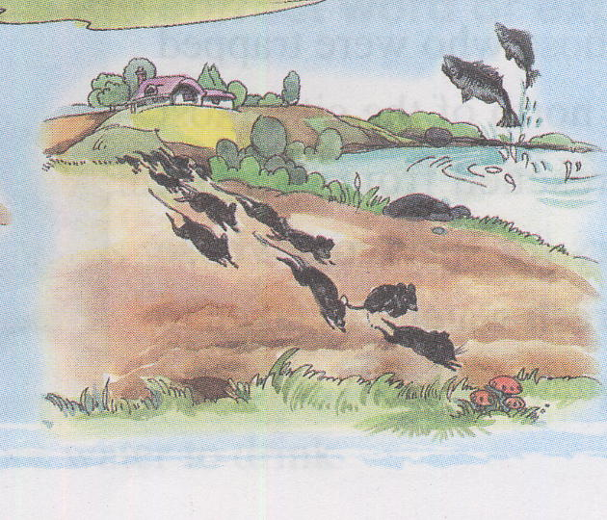
Read for Beginning—Para 1
Strange things were happening in the countryside of northeast Hebei. ①For several days, the water in the village wells rose and fell, rose and fell.② There were deep cracks that appeared in the well walls. ③At least one well had some smelly gas coming out of it. ④Chickens and even pigs were too nervous to eat，and dogs refused to go inside buildings. ⑤Mice ____________ the fields looking for places to hide，and fish____________ the water. ⑥At about 3：00 a.m. on 28 July 1976，bright lights were seen in the sky outside the city of Tangshan and loud noises were heard. But the city’s one million people were asleep as usual that night.
ran out of
jumped out of

Slide 17
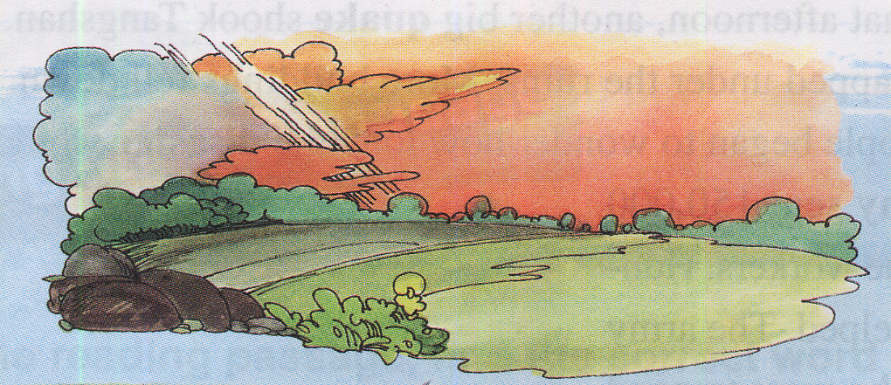
Read for Beginning—Para 1
Strange things were happening in the countryside of northeast Hebei. ①For several days, the water in the village wells rose and fell, rose and fell.② There were deep cracks that appeared in the well walls. ③At least one well had some smelly gas coming out of it. ④Chickens and even pigs were too nervous to eat，and dogs refused to go inside buildings. ⑤Mice ran out of the fields looking for places to hide，and fish jumped out of the water. ⑥At about 3：00 a.m. on 28 July 1976，__________were seen in the sky outside the city of Tangshan and loud noises were heard. But the city’s one million people were asleep as usual that night.
bright lights

Slide 18
Read for Beginning—Para 1
Strange things were happening in the countryside of northeast Hebei. ①For several days, the water in the village wells rose and fell, rose and fell.② There were deep cracks that appeared in the well walls. ③At least one well had some smelly gas coming out of it. ④Chickens and even pigs were too nervous to eat，and dogs refused to go inside buildings. ⑤Mice ran out of the fields looking for places to hide，and fish jumped out of the water. ⑥At about 3：00 a.m. on 28 July 1976，bright lights were seen in the sky outside the city of Tangshan and loud noises were heard. But the city’s one million people were asleep as usual that night.
Strange Signs

Slide 19
Read for Beginning—Para 1
Strange things were happening in the countryside of northeast Hebei. ①For several days, the water in the village wells rose and fell, rose and fell.② There were deep cracks that appeared in the well walls. ③At least one well had some smelly gas coming out of it. ④Chickens and even pigs were too nervous to eat，and dogs refused to go inside buildings. ⑤Mice ran out of the fields looking for places to hide，and fish jumped out of the water. ⑥At about 3：00 a.m. on 28 July 1976，bright lights were seen in the sky outside the city of Tangshan and loud noises were heard. But the city’s one million people were asleep as usual that night.
But the city’s one million people were asleep as usual that night.
Tansitional Sentence
Function?

Slide 20
Read for Beginning—Para 1
Topic Sentence
Strange things were happening in the countryside of northeast Hebei. ①For several days, the water in the village wells rose and fell, rose and fell.② There were deep cracks that appeared in the well walls. ③At least one well had some smelly gas coming out of it. ④Chickens and even pigs were too nervous to eat，and dogs refused to go inside buildings. ⑤Mice ran out of the fields looking for places to hide，and fish jumped out of the water. ⑥At about 3：00 a.m. on 28 July 1976，bright lights were seen in the sky outside the city of Tangshan and loud noises were heard. But the city’s one million people were asleep as usual that night.
Supporting Sentences
Transitional Sentences

Slide 21
Read for Beginning—Para 1
Strange
Strange things were happening in the countryside of northeast Hebei. For three days the water in the village wells rose and fell, rose and fell. There were deep cracks that appeared in the well walls. At least one well had some smelly gas coming out of it. Chickens and even pigs were too nervous to eat，and dogs refused to go inside buildings. Mice ran out of the fields looking for places to hide，and fish jumped out of the water. At about 3：00 a.m. on 28 July 1976，bright lights were seen in the sky outside the city of Tangshan and loud noises were heard. But the city’s one million people were asleep as usual that night.
Strange things were happening in the countryside of northeast Hebei.
a common way of expressing unusual things
contrast
People’s ignorance of these unusual things
asleep as usual
The sharp contrast between the commonly unusual signs and people’s usual behaviors futher implies the huge cost and negative impacts the earthquake brings to the city
Function?

Slide 22
Read for Developing —Para 2-3
2. At 3：42 a.m.，everything began to shake. It seemed as if the world were coming to an end! Eleven kilometres directly below the city，one of the most deadly earthquakes of the 20th century had begun，a quake that even caused damage more than 150 kilometres away in Beijing. Nearly one third of the whole nation felt it! A huge crack，eight kilometres long and 30 metres wide，cut across houses，roads，and waterways. Hard hills of rock became rivers of dirt. In less than one minute，a large city lay in ruins. Two thirds of the people who lived there were dead or injured. Thousands of children were left without parents. The number of people who were killed or badly injured in the quake was more than 400000.
3. Everywhere survivors looked，there was nothing but ruins. Nearly everything in the city was destroyed. About 75 percent of the city’s factories and buildings，90 percent of its homes，and all of its hospitals were gone. Bricks covered the ground like red autumn leaves，but no wind could blow them away. Most bridges had fallen or were not safe to cross. The railway tracks were now useless pieces of metal. Tens of thousands of cows，hundreds of thousands of pigs，and millions of chickens were dead. Sand now filled the wells instead of water. People were in shock—and then，later that afternoon，another big quake shook Tangshan again. Even more buildings fell down. Water，food，and electricity were hard to get. People began to wonder how long the disaster would last.
How does the author express the severity of the earthquake?

Slide 23
Read for Developing —Para 2-3
everything began to shake
2. At 3：42 a.m.，everything began to shake. It seemed as if the world were coming to an end! Eleven kilometres directly below the city，one of the most deadly earthquakes of the 20th century had begun，a quake that even caused damage more than 150 kilometres away in Beijing. Nearly one third of the whole nation felt it! A huge crack，eight kilometres long and 30 metres wide，cut across houses，roads，and waterways. Hard hills of rock became rivers of dirt. In less than one minute，a large city lay in ruins. Two thirds of the people who lived there were dead or injured. Thousands of children were left without parents. The number of people who were killed or badly injured in the quake was more than 400000.
caused
damage more than 150 kilometres away
Nearly one third of the whole
nation
A huge crack, eight kilometres long and 30 metres wide,
In less than one minute，a large city lay in ruins
Two-thirds
Thousands of children
more
than 400000.
The extent of the earthquake
An unbelievable amount of loss
The severity of the earthquake

Slide 24
Read for Developing —Para 2-3
Evidence?
Everywhere survivors looked，there was nothing but ruins. Nearly everything in the city was destroyed. About 75 percent of the city’s factories and buildings，90 percent of its homes，and all of its hospitals were gone. Bricks covered the ground like red autumn leaves，but no wind could blow them away. Most bridges had fallen or were not safe to cross. The railway tracks were now useless pieces of metal. Tens of thousands of cows，hundreds of thousands of pigs，and millions of chickens were dead. Sand now filled the wells instead of water. People were in shock—and then，later that afternoon，another big quake shook Tangshan again. Even more buildings fell down. Water，food，and electricity were hard to get. People began to wonder how long the disaster would last.
was destroyed
were gone
fallen or were not safe to cross
were dead.
People began to wonder how long the disaster
would last.
desperate and hopeless

Slide 25
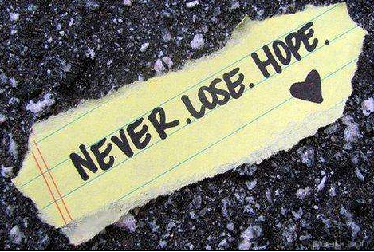
Read for Resolution—Para 4
But hope was not lost.
sent
4. But hope was not lost. Soon after the quakes，the army sent 150，000 soldiers to Tangshan to dig out those who were trapped and to bury the dead. More than 10，000 doctors and nurses came to provide medical care. Workers built shelters for survivors whose homes had been destroyed. Hundreds of thousands of people were helped. Water and food were brought into the city by train，truck，and plane. Slowly，the city began to breathe again.
came to provide
built
were helped
were brought into
Why?
A series of actions bring hope to the earthquake-stricken areas

Slide 26

Read for Resolution—Para 5
revive
get back up
5. Tangshan started to revive itself and get back up on its feet. With strong support from the government and the tireless efforts of the city’s people，a new Tangshan was built upon the earthquake ruins. The new city has become a home to more than seven million people，with great improvements in transportation，industry，and environment. Tangshan city has proved to China and the rest of the world that in times of disaster，people must unify and show the wisdom to stay positive and rebuild for a brighter future.
strong support
government
tireless efforts
people
people must unify

Slide 27
Read for Numbers —Para 1-4
Sentence examples
Function
At about 3:00 am on 28 July ,1976
● _____________________________, bright lights were seen in the sky.
●At _________ everything began to shake.
exact time
Indicate the ____________of the earthquake
3:42 am
1/3
● ________nation felt it.
● In ____________________ a large city lay in ruins.
● ____of people who lived there died or injured.
● ____________________ were left without parents.
● ______ of its factories and buildings and _____of its homes were gone.
less than one minute
Numbers
Convincing
the severity
2/3
Indicate the ___________of the earthquake
Thousands of children
75%
90%
150,000
●________soldiers were sent to Tangshan to help the rescue
workers.
● ______________________ of people were helped.
● _________________miners were rescued
hope
Indicate the ___________after the earthquake
Hundreds of thousands
most of the 10,000

Slide 28
Further Thinking
1. Can you think of a title for the passage? Give your reasons
A Night the Earth Didn’t Sleep
Figure of Speech ?
Personification
Unusual time for sleep due to the disastrous earthquake
Usually time for sleep

Slide 29
Read for Appreciation
Sentence | Figures of Speech | Function
For several days the water in the village wells rose and fell, rose and fell.
Repetition
to make a deeper impression on the reader
It seemed as if the world were coming to an end!
to emphasize the seriousness of the disaster and people’s desperation
Exaggeration
Bricks covered the ground like red autumn leaves.
Simile
to create a vivid image of the ruins
Slowly, the city began to breathe again.
Personification
to create a vivid image

Slide 30
Homework
Try to imitate Para 1 and write your own experience of a natural disaster in a short paragraph with the words given, at least five.
burst, pipes, at an end, in ruins, suffering, injured, disaster, electricity, dig out, shelter...
________________________________________________________
________________________________________________________
________________________________________________________

