Slide 1

感恩遇见，相互成就，本课件资料仅供您个人参考、教学使用，严禁自行在网络传播，违者依知识产权法追究法律责任。
更多教学资源请关注
公众号：溯恩高中英语
知识产权声明

Slide 2

Unit 5 Travelling abroad

Slide 3
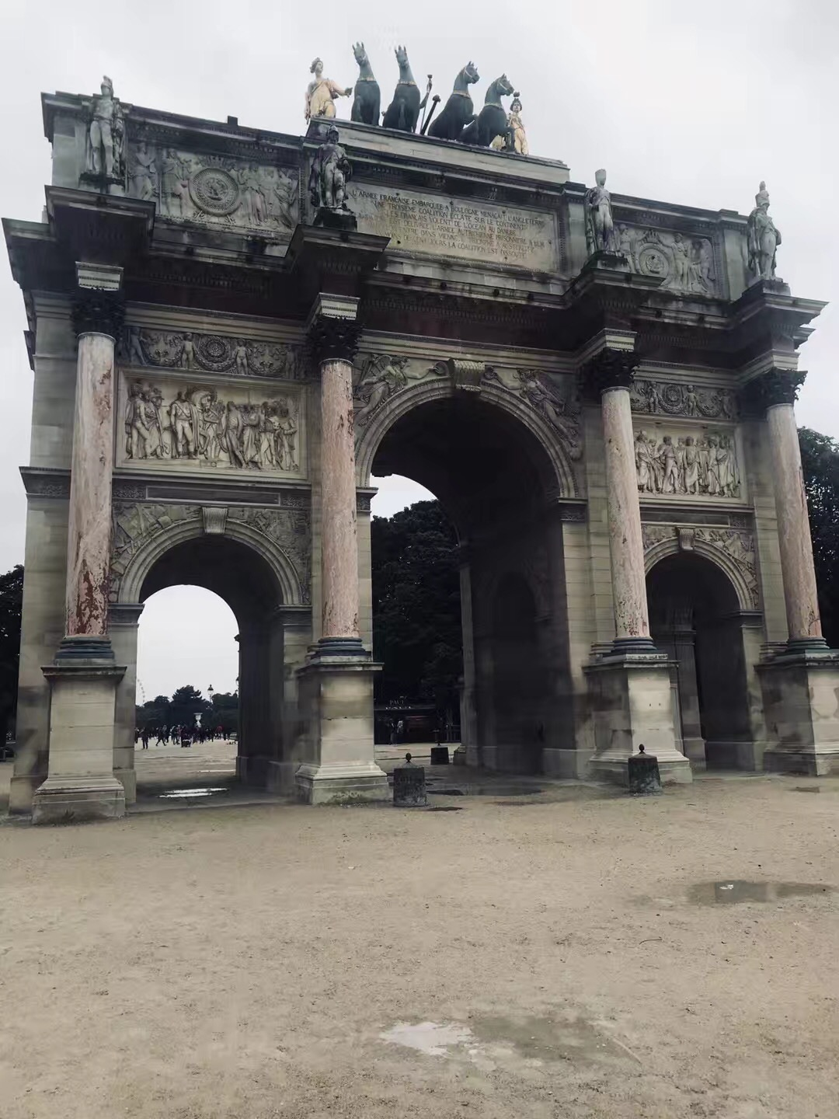

Exposed to art and culture
the museum of Louvre

Slide 4


Rewarded with scenery
the countryside of
Switzerland
Athens, Greece

Slide 5
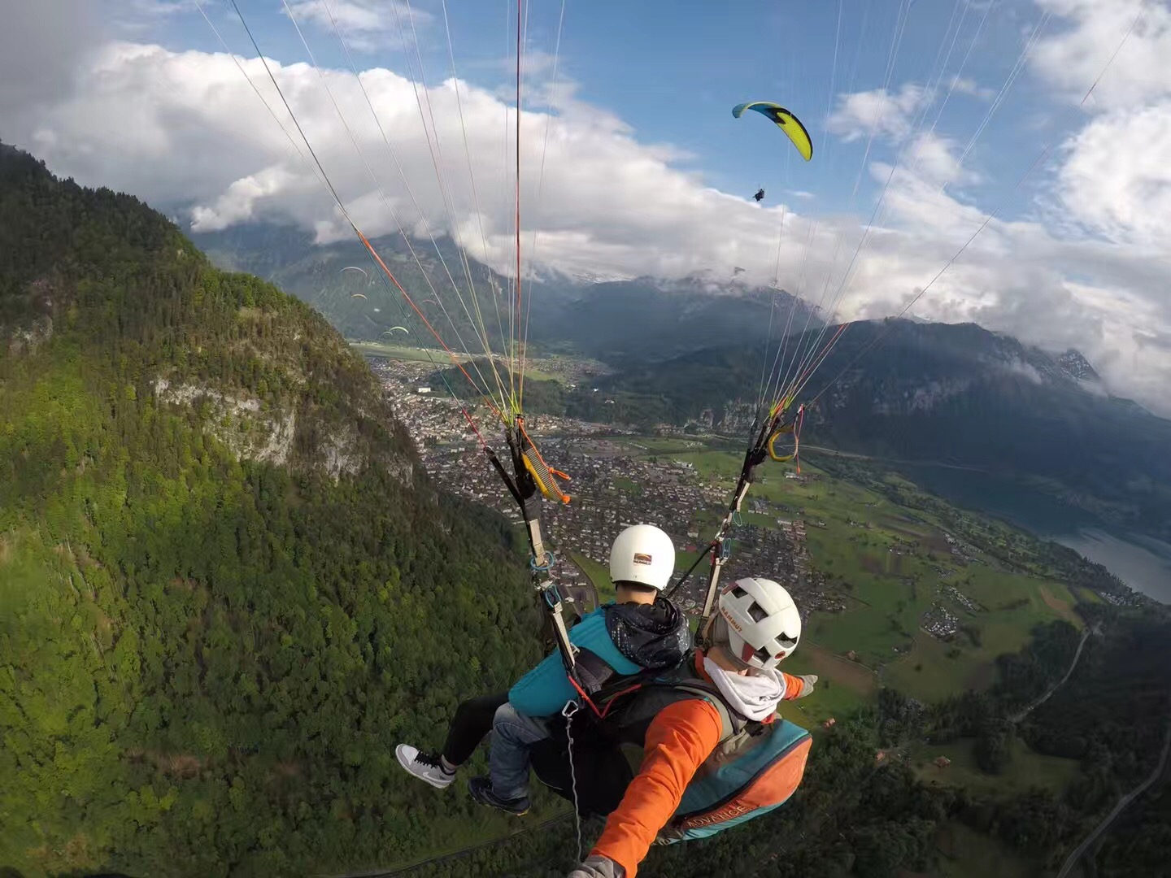

Having great fun
funny posing
exciting skydiving

Slide 6

Studying abroad

Slide 7

What do you think of studying abroad?
Much fun?
Great difficulty?

Slide 8
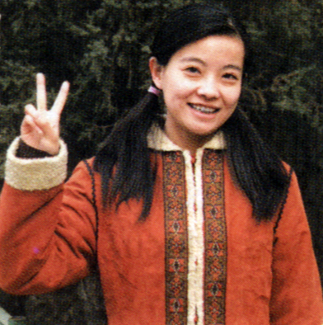

Keep it up, Xie Lei
Chinese student fitting in well
What questions come into your mind when you read the title?
Who…
What…
How…
is Xie Lei?
did she experience, fun or difficulty?
is she getting on now?
How did she make it?

Slide 9

Para.1
WHO…?
Xie Lei, a Chinese student studying in London
How did she feel shortly after she arrived in London?
It was the first time she had ever left
her motherland.
excited
She had dreamed of the day so long.
nervous; uncertain
I didn’t know what to expect (of the future).
Fun?
Difficulty?

Slide 10
She was more growing worried about difficulty than looking forward to fun.
Para.2 & 5
Difficulty with _____
study
Para.3, 4 & 6
Difficulty with ____
life

Slide 11


Para.2 & 5 Difficulty with study
different from
Studying in England is _____________ that in China in a_______ r___________.
What differences did she realize?
She couldn’t write others’ opinions without __________________
She should give ________ opinion and e______ it.
She need to dare to c________ the authors.
How did she overcome the difficulty?
cademic
equirements
Plagiarism!
How…?
by taking a preparation course by turning to her tutor
numb with shock
acknowledging them
confused
her own
xplain
lacked confidence
ontradict
more autonomous; confident
taking a preparation course
make good preparation
well prepared for her degree course
turning to one’s tutor
get used to the requirements

Slide 12
Para.3, 4 & 6 Difficulty with life
Culture shock
Difficulty with d____ life
Difficulty with s_____ life
aily
ocial
Getting used to a whole new way of life took up all her concentration.
So occupied with work, she had no time for social activities
What difficulty?
helpless; stressed; anxious
boarding with a host family
joining a few clubs
make new friends
How …?
comfortable; feel at home; well-organized; hopeful
getting good advice;
learning about new culture; relieving homesickness
strike a balance between study and a social life
What benefits?
highly confident; fully prepared

Slide 13
Keep it up, Xie Lei
Chinese student fitting in well
confident
prepared
The change of Xie lei’ feelings
What’s the tone of the news reporter?
approving, hopeful, positive
excited
comfortable
hopeful
nervous
helpless
shocked
confused
Para. 7

Slide 14
Studying abroad
study
life
Difficulty with ______ and _______
Solution:
Benefits:
Taking a preparation course
Turning to one’s tutor
boarding with a host family
becoming an autonomous learner
becoming confident and independent
learning about new culture
learning a foreign language more quickly
enjoying new experiences

Slide 15
Studying abroad
假定你是李华，正在国外留学。你的朋友David最近被一所国外大学录取了，但是担心国外学习生活的困难，想要放弃。请你用英文写一封信，给他提供一些建议。
注意：1.词数80左右；2.行文连贯；3.开头和结尾已给出，不计入总词数。
Dear David
Yours,
Li Hua

Slide 16
Studying abroad
introduction
be admitted into your dream university
not easy to study and live abroad
benefits
learn about new customs and culture
improve language skills
gain practical knowledge
become independent, autonomous and self-confident
broaden minds and enjoy new experiences
solutions
taking preparation courses
turning to tutors and classmates
boarding with a host family

Slide 17
You can either travel or read, but either your body or soul
must be on the way!

Slide 18

Assignment for today
Complete and polish your writing
Complete the consolidation exercise

