Slide 1



Slide 2

Use Verbs To Describe Scenes
writing techniques (1)

Slide 3
Content
1
Learn to read
1
2
Learn to imitate
2
3
Learn to use
3

Slide 4
1
Accumulate materials
This still leaves plenty of work for me, carrying the firewood in to stack in the backyard, waking early each morning to light the stove , looking after it through the day, staring at the fire each evening thinking of matters great and small. Many evenings I fall asleep while staring at the fire, exhausted by my labors(劳动).
-----a paragraph from English Weekly

Slide 5
2
Analyze the material
This still leaves plenty of work for me, carrying the firewood in to stack in the backyard, waking early each morning to light the stove , looking after it through the day, staring at the fire each evening thinking of matters great and small. Many evenings I fall asleep while staring at the fire, exhausted by my labors(劳动).
-----a paragraph from English Weekly
This still leaves plenty of work for me,
----------- topic
carrying
carrying
A series of verbs
waking
Describe activities of a day
waking
looking after
Supporting details
Describe the specific scene
staring at
thinking of
looking
Convey the certain feeling
staring
exhausted by
exhausted
----------- conclusion
my labors
Fall asleep

Slide 6
Learn to imitate

Slide 7
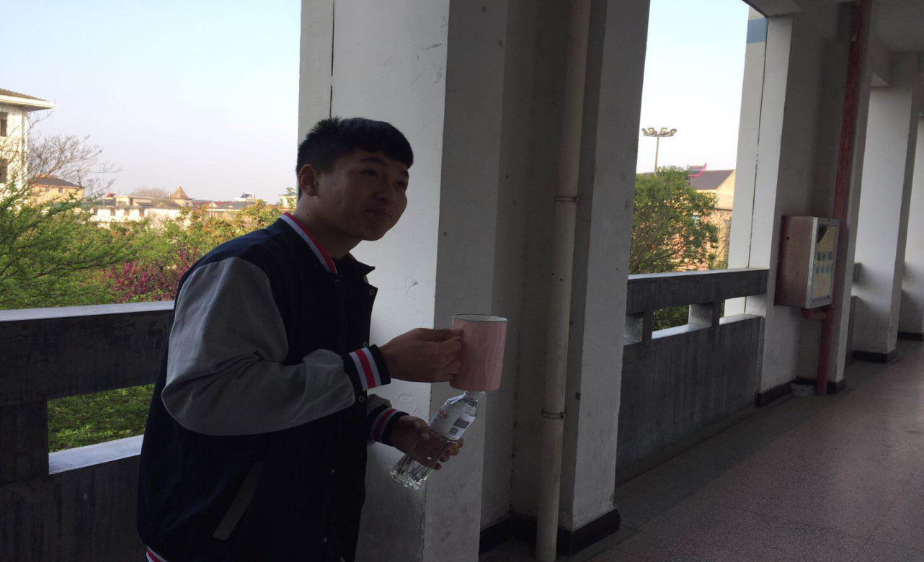
1
Sentences’ writing
Get up early
Finish the breakfast quickly
Collect the verbs
He got up early and finished the breakfast quickly in the clear morning.
In the early morning
Add the exact purpose/time/places..etc

Slide 8
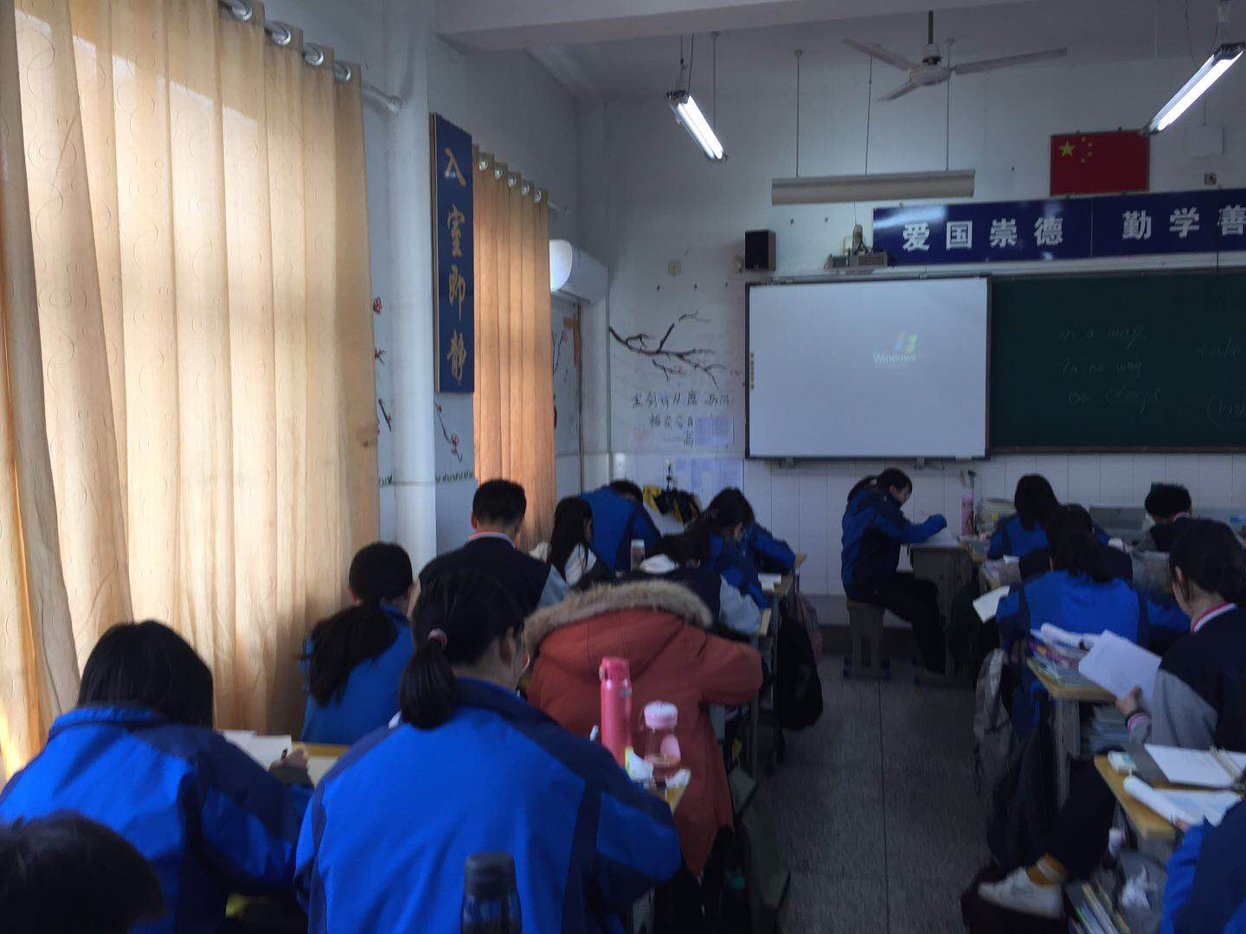
1
Sentences’ writing
Collect the verbs
Activities in class:
Take notes carefully
Listen to the teacher seriously
“study” is not proper, for it is too general!
He took notes carefully when attending class.
Add the exact purpose/time/places..etc
In the class
when taking/attending class

Slide 9
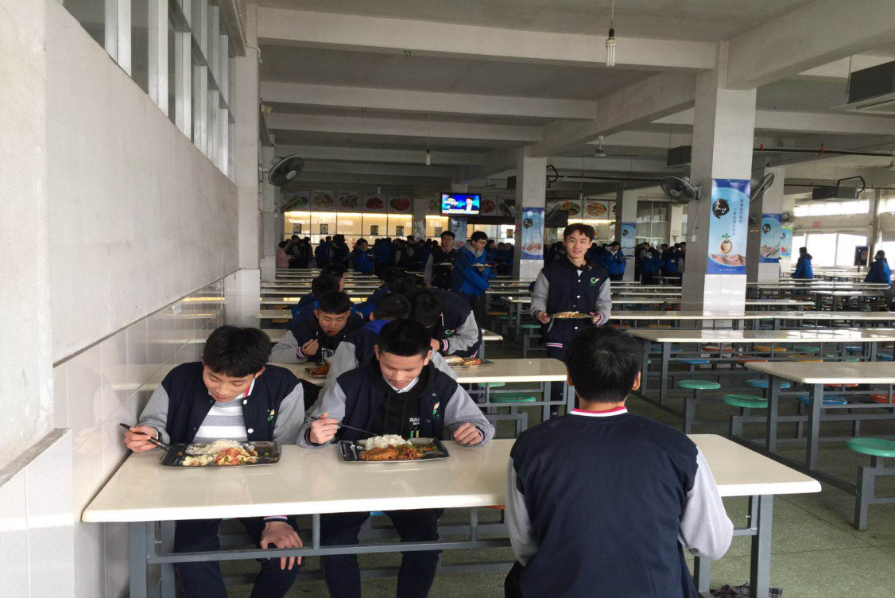
1
Sentences’ writing
Have lunch
Dine
Eat meals
Have food
Collect the verbs
He ate meals in the canteen with friends.
In the canteen
With classmates/friends
……
Add the exact purpose/time/places..etc

Slide 10
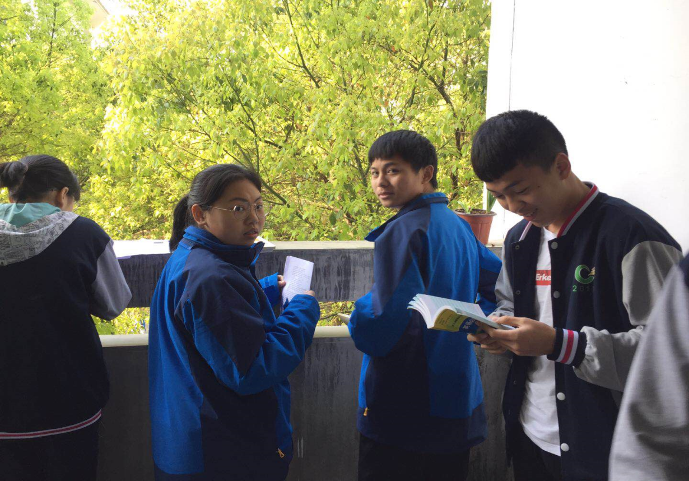
1
Sentences’ writing
Do one’s homework
Finish one’s homework
Be absorbed in doing
……
Collect the verbs
Every evening, he did his homework carefully.
Every evening/in the class
To realize one’s dream
Add the exact purpose/time/places..etc

Slide 11



2
Be sure of the topic & feeling/conclusion
These pictures describe a common school day.
Topic :__________________________________
This still leaves plenty of work for me,
This is also a common school day,
frightened
feelings:__________________________________
exhausted
excited
satisfied
amazed
delighted
grieved(sad)
……

Slide 12
3
Integrate sentences into one paragraph
This is also a common school day for him, getting up early in the early morning, taking notes carefully in the class , doing homework through the whole evening. Many evenings he falls asleep , satisfied!
-----a paragraph on your own
Topic
This still leaves plenty of work for me, carrying the firewood in to stack in the backyard, waking early each morning to light the stove , looking after it through the day, staring at the fire each evening thinking of matters great and small. Many evenings I fall asleep while staring at the fire, exhausted by my labors(劳动).
-----a paragraph from English Weekly
Make use of the verbs or expressions flexible.
Add details to make your passage logically
A series of V-ing
Feeling/conclusion

Slide 13

Learn to use
Watch the video & collect the words

Slide 14
“This is also a common school day for him,”
1
Outline your passage
collect
Time/
Place/purpose
verbs
Topic
feeling
上坟
上香
踏青
享受春天
visit the graves
“This still leaves plenty of work for me,”
visit the graves
上坟
扫墓
踏青
享受春天
of one’s relatives
sweep the tombs
to remember the family members who passed away
sad
sorrowful
grieved
delighted
light the incense
to show respect
go outside and walk
on the green
Although/however
This is also a traditional festival for Chinese people,
enjoy the spring
to enjoy the blossoming spring

Slide 15
2
Integrate your passage
How do people celebrate their Qing Ming holiday?
This is also a traditional festival for Chinese people, visiting the graves of their relatives, lighting incenses to remember the family members who passed away, or going outside and walking on the green to enjoy the blossoming spring.
-----a paragraph on your own
Make the output of feeling consistent with the description of verbs.
Although this festival has its lighter side, it's mostly a sorrowful time.

Slide 16
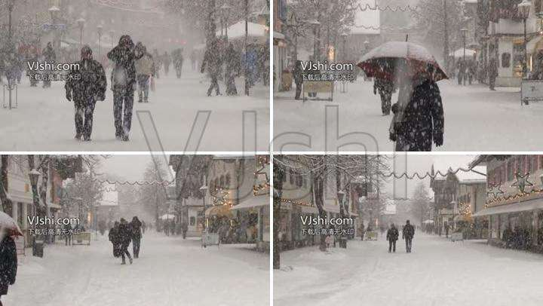
1
pictures for writing

Slide 17
passages for appreciating
It was a night that promised nothing good for him, braving the gale-force wind, standing rooted to the deep snow, keeping prowling the streets up and down, looking for a shop named Military Curios . He shook his head and tried to clear his trembling mind.
-----a paragraph by Z
﹡prowl: move around quietly

Slide 18


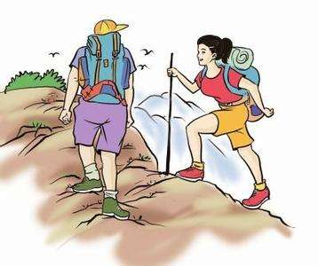
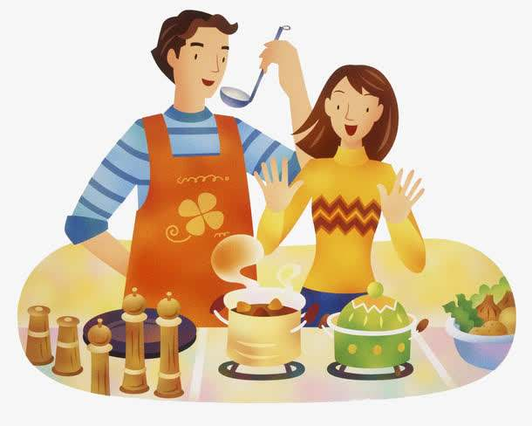
2
pictures for writing

Slide 19
Works for appreciating
There are still plentiful things we’re going to do, getting up early in every blossoming spring morning, walking along the river after dinner in the hot, summer sunshine, climbing up high when the autumn leaves fall, preparing meals under a blanket of snow all winter.
-----a paragraph by Z
It’s like in every moment, the whole universe existed just to bring us together.
The strong feeling of love hides between the lines!

Slide 20

Draw a conclusion
imitate
use
practice
Writing

Slide 21
Imitating is the first step to create your own writing.

Slide 22
THANKS

