Slide 1

感恩遇见，相互成就，本课件资料仅供您个人参考、教学使用，严禁自行在网络传播，违者依知识产权法追究法律责任。
更多教学资源请关注
公众号：溯恩高中英语
知识产权声明

Slide 2

http://www.sunedu.com
Stay here forever
浙江省常山一中 吴俊峰
Learn to sing English songs

Slide 3




stay here forever
1. Explore the subject
http://www.sunedu.com
Play the MP3 of the song. While listening, please explore the following questions.
1.What kind is the song?
A. Rock & roll B. Country music
C. Folk music D. Classical music.
2.What is the theme of the song?
A. About friendship
B. About romantic love
C. About country life
D. About travelling
E. ...

Slide 4

stay here forever
1. Explore the subject
http://www.sunedu.com
3. On which occasion do you
think is the song suitable to play?
Wedding ceremony
Graduation ceremony
Couples tour

Slide 5
stay here forever
2. Tune in, tune out, turn off
http://www.sunedu.com
How do you react to the song if you hear it on the radio? And why?
tune in – listen carefully
tune out – leave it on as background music
turn off – switch off the radio
Discuss your ideas in groups and explain the reasons in descriptive language.
This earpleasing,heartwarming song is more than I can love, just like such a wife is more than her husband loves.
Bright and light, the song softens,sweetens and warms each and every cell of mine.

Slide 6
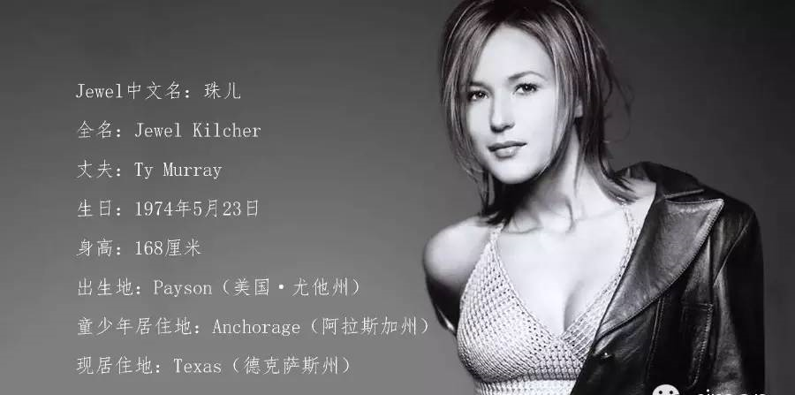
stay here forever
3. Singer Profile
http://www.sunedu.com
singer-songwriter
创作型歌手
nomination /ˌnɒmɪˈneɪʃn/
n. 任命，提名；提名权
album /ˈælbəm/
n. 相簿；唱片集
Jewel Kilcher (born May 23, 1974), well-known as “珠儿” in China, is an American singer-songwriter, musician, producer, actress, author, and poet. She has received four Grammy Award nominations and, as of 2015, has sold over 30 million albums worldwide.

Slide 7



stay here forever
3.Singer Profile
http://www.sunedu.com
Accompanied by lively music, this spontaneously outburst song was featured on the soundtrack of the film Valentines' Day. And the song has a bright melody and rhythm, making people feel comfortable and conveying the faith in love.
accompany /əˈkʌmpəni/ v. 陪伴，伴随；伴奏
spontaneously /spɒn'teɪnɪəslɪ/adv. 自然地；不由自主地
feature /ˈfiːtʃə(r)/ vt. 特写；以…为特色
soundtrack /ˈsaʊndtræk/ 影视原声；主打歌
melody /ˈmelədi/ n. 旋律
rhythm /ˈrɪðəm/ n. 节奏；韵律

Slide 8

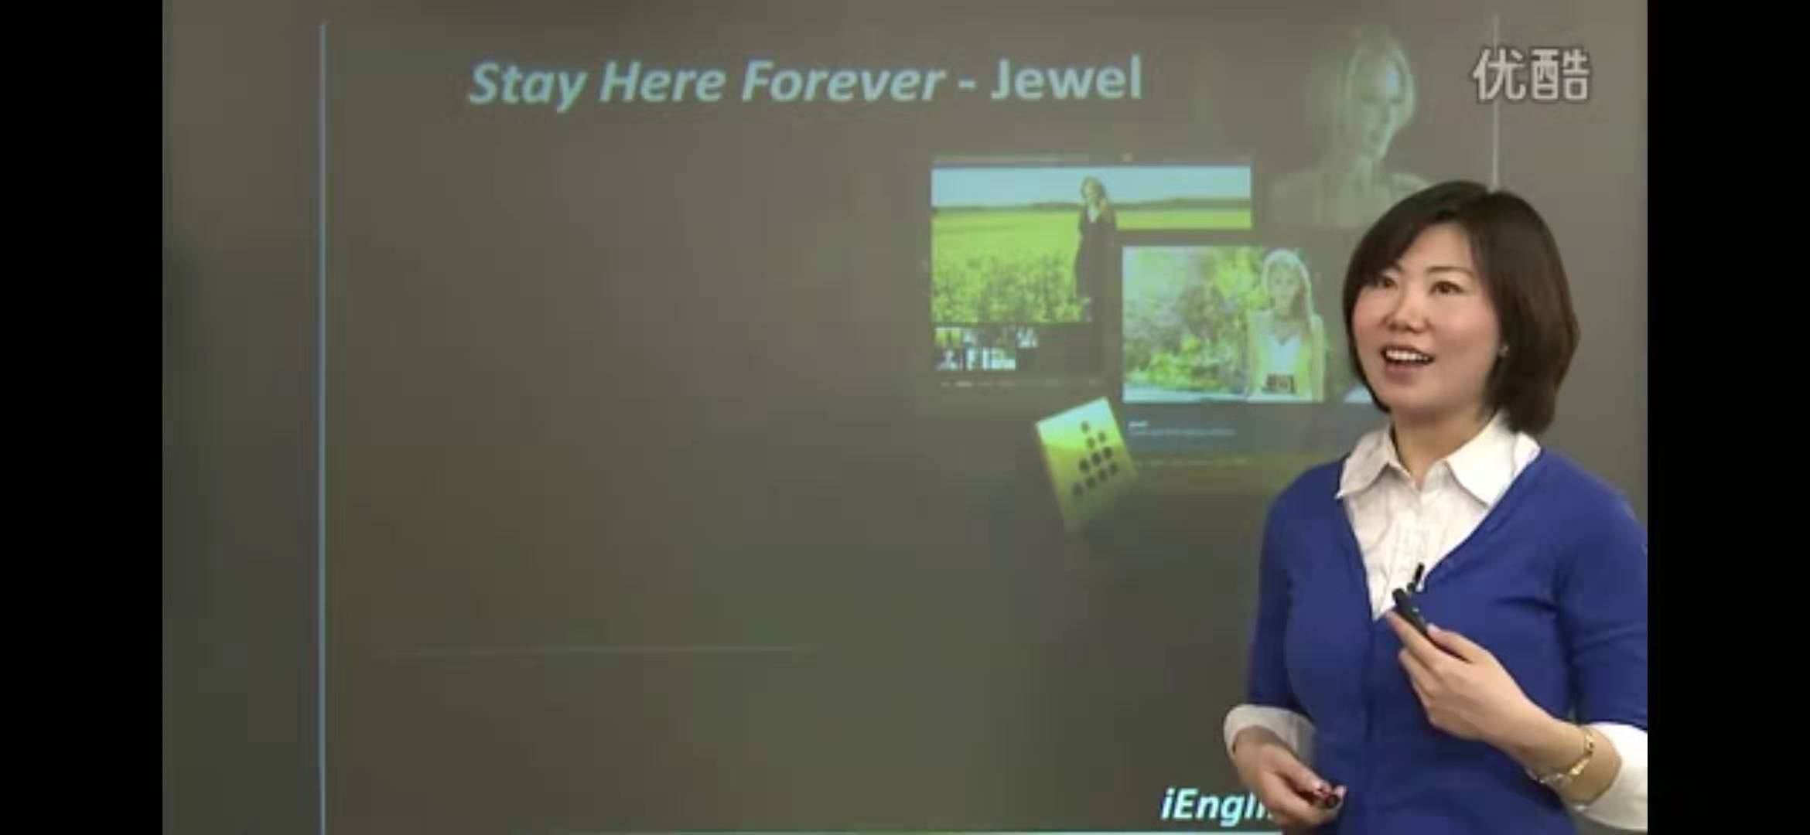
stay here forever
4. Practice listening skills
http://www.sunedu.com
Play the video lectured by Cyndi Hao form New Oriental

Slide 9
stay here forever
4. Practice listening skills
http://www.sunedu.com
After learning the video lectured by Cyndi Hao, we have practiced some listening skills:
Reduced forms
Liaison连读
Loss of voice blasting失去爆破
Contractions缩读
Key words
Synonymy and Echo
Rhyme
wanna= want to/ gotta= got to/ gonna= going to
stay-lay/ rock-roll/
go-roll-all/ together-forever/ walk-talk

Slide 10

5. Learn the lyric
stay here forever
1、Oh Oh oh oh oh oh oh
I'm laying here dreaming, staring at the ceiling,
Wasting the day away .
The world's flying by our window outside,
But hey baby that’s OK .
This feels so right it can't be wrong.
So far, as I can see,
Where you wanna go baby,
I'll do anything.
1、Oh Oh oh oh oh oh oh
我盯着天花板做着白日梦
浪费了整天的时间
我们窗外的世界在变
但宝贝，没关系
这种感觉真完美 不会有错
在我能看见的未来里
宝贝你想去哪里
我会为你做任何事情
http://www.sunedu.com

Slide 11

2、Cause if you wanna go, baby let's go
If you wanna rock on, I'm ready to roll
And if you wanna slow down
We can slow down together
If you wanna walk, baby let's walk
Have a little kiss, have a little talk
We don't gotta leave at all
We can lay here forever
Stay here forever
2、
因为如果你想去，宝贝，那我们就出发
你想怎样，我就怎样
如果你想放慢脚步
我们可以一起慢下来
如果你想漫步，宝贝，那我们就去走走
来点亲吻，来点话题
假如说不想走的话，我们就哪儿都不去
我们可以永远躺在这里
永远待在这里
stay here forever
http://www.sunedu.com

Slide 12

5. Learn the lyric
stay here forever
http://www.sunedu.com
3、Oh oh oh oh, If you wanna see that Italian tower leaning,
Baby we can leave right now.
If that's too far,
We can jump in the car, and take a little trip around town.
They say that California is nice and warm this time of year,
Baby, say the word, and we'll just disappear
3、
如果你想看意大利的比萨斜塔
宝贝，我们现在就可以出发
如果那太远了
咱们就跳进车子里，围着小镇旅行
他们说，每年这个时候加利福尼亚温暖怡人
只要你说，说走就走的旅行

Slide 13
REPEAT -
2、Cause if you wanna go, baby let's go
因为如果你想去，宝贝，那我们就出发 If you wanna rock on, I'm ready to roll
你想怎样，我就怎样
And if you wanna slow down
如果你想放慢脚步
We can slow down together
我们可以一起慢下来
If you wanna walk, baby let's walk
如果你想漫步，宝贝，那我们就去走走
Have a little kiss, have a little talk
来点亲吻，来点话题 We don't gotta leave at all
假如说不想走的话，我们就哪儿都不去 We can lay here forever
我们可以永远躺在这里 Stay here forever
永远待在这里
stay here forever
http://www.sunedu.com

Slide 14
5. Learn the lyric
stay here forever
4、Oh, It's a big world for a boy and a girl,
Letting go of it all,
Holding on to one another.
Oh, there's a whole lot of world to discover,
Under the covers.
http://www.sunedu.com
4、
哦，这个大千世界里只有我们俩
放下一切，
彼此拥有
世界正等着我们去探寻
等着我们去发现
REPEAT -2
So if you wanna go,
Baby let's go Let's just lay here forever，Stay here forever，
Oh Oh Oh Oh Oh

Slide 15
stay here forever
5. Notes to the lyrics
http://www.sunedu.com
I'm laying here dreaming, staring at the ceiling , wasting the day away.
The present participles serve as adjoint adverbial
Letting go of it all.
let go (of) : to stop holding sb/sth
to give up an idea, or an attitude, or control of sth
hold on to
to keep holding sb/sth
to keep sth that is an advantage for you; to not give or sell sth
We should hold on to our business during the recession.
在经济衰退时期我们要把业务坚持下去。
He held on to the back of the chair to stop himself from falling.
他牢牢抓住椅子后背，以免摔倒。
She took an early lead in the race and held on to it for nine laps.
赛跑一开始她便冲到前面，并一直保持领先了九圈。

Slide 16

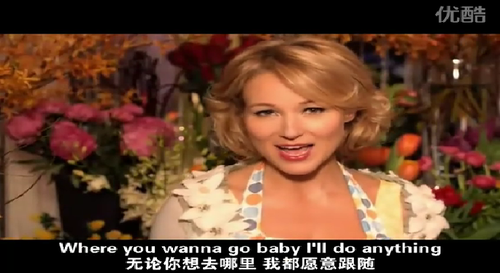


stay here forever
6. Enjoy and Imitate
http://www.sunedu.com

Slide 17


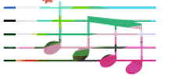
7.Show your talent
X-performers
five judges
Show talent
feedback and assess

Slide 18
stay here forever
8. Think creatively and critically
http://www.sunedu.com
Please describe Jewel Kilcher
after learning her song stay here forever?
Among American singers,when it
comes to exquisite daintiness and ravishing beauty, none can be compared with Jewel.
It is a happiness to dream of such a beautiful,
caring,considerate and dignified and elegant lady as Jewel as his wife, who who will roll if her husband wants to rock, who will slow down if he wants to, who will visit any places with him if his mood allows them to. Such a wife is an angel.
Jewel is my icon because of her beauty,
capability and glamor, but also because this song is an ode to a unique love, which can only be dreamed of by most couples.

Slide 19
stay here forever
8. Think creatively and critically
http://www.sunedu.com
Write a 80-word passage themed “A vacation with...”, and the following expressions may be used:
I'm laying here dreaming, staring at the ceiling, wasting the day away
jump in the car, and take a little trip around town
nice and warm this time of year
there's a whole lot of world to discover under the covers
Letting go of it all. Holding on to ...
just lay here forever，stay here forever

Slide 20

Thank you

