Slide 1

感恩遇见，相互成就，本课件资料仅供您个人参考、教学使用，严禁自行在网络传播，违者依知识产权法追究法律责任。
更多教学资源请关注
公众号：溯恩高中英语
知识产权声明

Slide 2
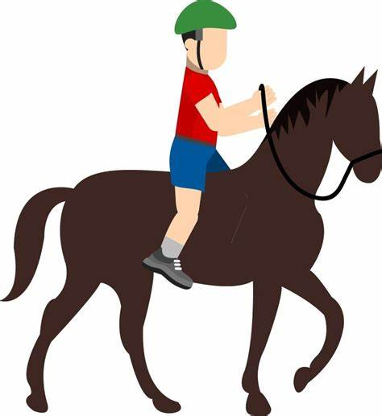
2018年6月浙江高考
Continuation writing
龚金萍 浙江省春晖中学

Slide 3
第二节 读后续写 (满分25分)
阅读下面短文，根据所给情节进行续写，使之构成一个完整的故事。
It was summer, and my dad wanted to treat me to a vacation like never before. He decided to take me on a trip to the Wild West.
We took a plane to Albuquerque, a big city in the state of New Mexico. We reached Albuquerque in the late afternoon. Uncle Paul, my dad’s friend, picked us up from the airport and drove us up to his farm in Pecos.
His wife Tina cooked us a delicious dinner and we got to know his sons Ryan and Kyle. My dad and I spent the night in the guestroom of the farm house listening to the frogs and water rolling down the river nearby. Very early in the morning. Uncle Paul woke us up to have breakfast. “The day starts at dawn on my farm,” he said. After breakfast, I went to help Aunt Tina feed the chickens, while my dad went with Uncle Paul to take the sheep out to graze (吃草). I was impressed to see my dad and Uncle Paul riding horses. They looked really cool.

Slide 4
In the afternoon, I asked Uncle Paul if I could take a horse ride, and he said yes, as long as my dad went with me. I wasn’t going to take a horse ride by myself anyway. So, my dad and I put on our new cowboy hats, got on our horses, and headed slowly towards the mountains. “Don’t be late for supper,” Uncle Paul cried, “and keep to the track so that you don’t get lost!” “OK!” my dad cried back. After a while Uncle Paul and his farm house were out of sight. It was so peaceful and quiet and the colors of the brown rocks, the deep green pine trees, and the late afternoon sun mixed to create a magic scene. It looked like a beautiful woven (编织的) blanket spread out upon the ground just for us.

Slide 5
Read for basic information
Focus on the major characters
Elements of a story
Who (characters)
When (time)
Where (place)
What (event)
Why (purpose)
How (solution)
Dad, I, Uncle Paul (major characters)
Tina, Ryan, Kyle (minor characters)
Focus on time order
in the late afternoon
early in the morning
Focus on the changes of locations
summer
after breakfast
in the afternoon
...
farm
mountains
...
Focus on the main plot
a horse ride to the wild
got lost
treat me to a vacation like never before
Focus on the beginning
?

Slide 6
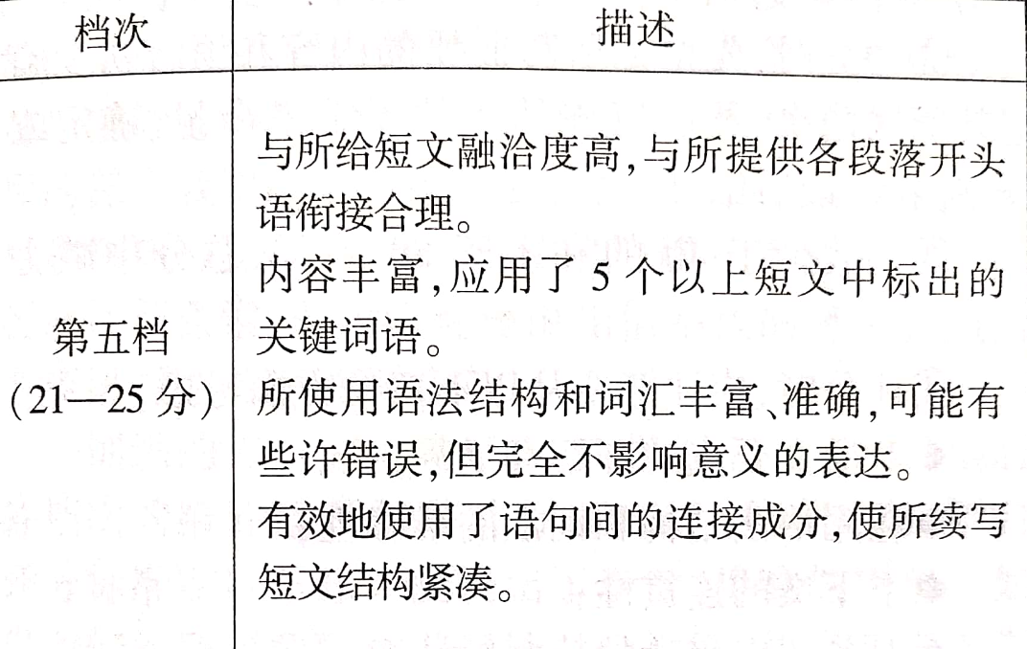


plot
language

Slide 7
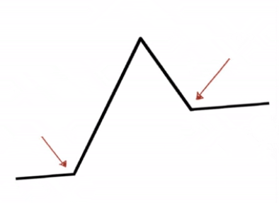

Parts of a plot (情节的构成)
Climax
Falling action
Resolution
Rising action
inciting incident
Denouement
setting

Slide 8


plot (情节)
How?
1. Dig out the clues
(解读文本，理清情节)
2. Choose key words
(选择关键词，预判情节)
3. Explore the plot
(精读段首句，推测情节)
4. Enrich the details
(推敲故事发展，细化情节)

Slide 9

Dig out the clues
Para.1
It was summer, and my dad wanted to treat me to a vacation like never before.
Clue 1: We had a(n) _____________ vacation I have never had before.
exciting/unforgettable
Para.3
His wife ... My dad and I spent the night ... of the farm house listening to the frogs and water rolling down the river nearby....
Clue 2:A suggestive method: to return home ____________
by riding along the river
Para.4
...“Don’t be late for supper,” Uncle Paul cried, “and keep to the track so that you don’t get lost!”“OK!” my Dad and I...
Clue 3: We got lost
because____________________________
they rode off the track

Slide 10
Choose key words
The underlined words
Character
Place
Time
Event
Dad, Uncle Paul, sheep
farm house, river
late
feed, sight, track, get lost
Choose the words closely related to your pedication of the story

Slide 11
Explore the plot
① I was attracted by the rabbit.
② I caught the rabbit and killed it. Then we had a
barbecue.
③ I chased the rabbit and Dad followed me to keep
my safety.
④ The rabbit disappeared in the forest and we rode
off the track.
⑤ We got lost and scared as night came.
⑥ We were hungry and killed my horse for food.
⑥ The horses guided us home.
⑦ Dad noted a river and suggested riding along it.
⑧ Uncle Paul came and found us.
⑨ Uncle Paul's sheep appeared and led us home.
⑩ The rabbit directed us home.
...
Paragraph1:
Suddenly a little rabbit jumped out in front of my horse.
Paragraph2:
We had no idea where we were and it got dark.
Explore the plot that is:
positive
theme-related
logical
① ③ ④
⑤ ⑦

Slide 12
Enrich the details
Paragraph1:
Suddenly a little rabbit jumped out in front of my horse.
Paragraph2:
We had no idea where we were and it got dark.
Feelings?
I was attracted by the rabbit.
I chased the rabbit and Dad followed me to keep my safety.
The rabbit disappeared in the forest and we rode off the track.
Reactions?
We got lost and scared as night came.
Dad noted a river and suggested riding along it.
Lesson?
Taking risks can be dreadful.
We can walk out of any plight as long as we stay calm.
...
Taking risks can be dreadful.
We can walk out of any plight as long as we stay calm.
...

Slide 13
language(语言)
How?
运用
1. 具体的动词
2. 形象的形容词、副词
3. 有效的非谓语
进行动作描写、语言描写、心理描写、外貌描写以及环境描写

Slide 14

Use specific verbs
马儿受惊狂奔起来。
It ran wild in a great fright (惊恐万分地).
It sped up in a great fright (惊恐万分地).
It galloped away in a great fright.
(gallop /ˈɡæləp/ :vt.飞驰 )

Slide 15
Use specific verbs
我大声呼救。
I shouted at the top of my voice.
I screamed for help.
I cried for help.
I bawled for help. (bawl /bɔːl/ to shout loudly 大喊）
“Help!” I yelled. (yell /jɛl/ to shout loudly 大喊）

Slide 16

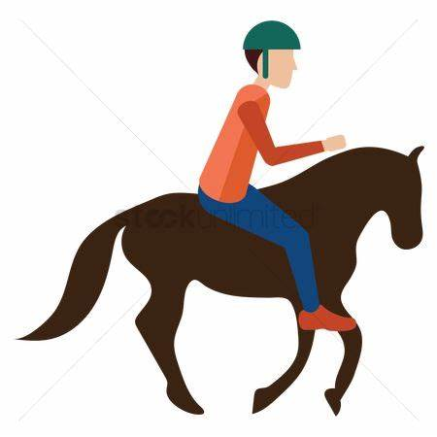

Use specific verbs
我爸爸注意到在深绿的松树下，褐色的石头堆边上有一条小河,静静流淌着。
Dad saw beneath the deep green pine trees, beside the
brown rocks, lies a river, flowing silently
spotted: to see or notice sth suddenly
noted：to notice or pay attention to
noticed:to see or hear sth or become aware of sth
sighted: to suddenly see sth
observed: to see or notice sth

Slide 17

Use specific verbs
看到我们安全归来，叔叔跑出来迎接我们。
Overjoyed to see us safe and sound, Uncle Paul ran to meet us.
Overjoyed to..., Uncle Paul rushed at us.
Overjoyed to..., Uncle Paul dashed out the door.
Overjoyed to..., Uncle Paul scuttled to meet us with happy cries.(scuttle /ˈskʌtl/ : to run with quick short steps疾跑 )
Overjoyed to..., Uncle Paul trotted to meet us.(trot /trɑːt/ : to move forward at a speed faster than a walk 小跑 )

Slide 18
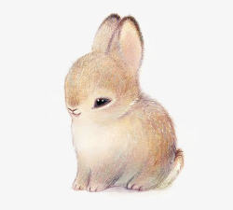
Use vivid adj.s /adv.s
Give a detailed descriptions of the rabbit's appearance:
It was my first sight of such cute creature, which was large for an ordinary rabbit(个头比一般兔子大), and had reddish-grey colour with beautiful dark glittering eyes. However, it ran into the forest swiftly before I could stop it.
reddish-grey 红灰色的

Slide 19
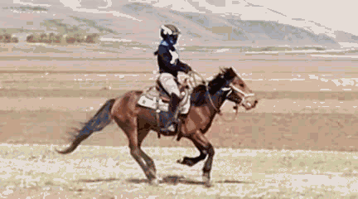
Use effective vt-ing
/ˈwɪnɪ/ vt. (马)嘶鸣
①. My horse let out a frightened whinny, and galloped off the track.
—————————————————————————————————
My horse let out a frightened whinny galloping off the track.
②. I felt a wild rush of (一阵) terror.
I yelled out loud.
______________________________________________________
Feeling a wild rush of terror, I yelled out loud.
③. 爸爸感觉到了我的恐惧和担忧，尽力让我
平静下来。
_______________________________
_______________________________
Sensing my fear and concerns, my dad tried to calm me down.

Slide 20
How?
1. 夯实课本知识点，做好积累
2. 关注练习，注重积累
3. 阅读课外小说，丰富积累
4. 学习他人作品，补充积累

Slide 21
Useful expressions in NOVELs
描述人物紧张\害怕的单词，词块
nodded, “...”点头说
XX blinked, “It's for you.” 眨着眼睛说
nervously/cautiously
chewed his lip. 咬着嘴唇
With an upset look on his face 不安的神情
with his heart thudding心砰砰地跳
---The Secret Garden

Slide 22
Useful expressions in NOVELs
描述人物恐惧\害怕的单词，词块
Henry stopped suddenly and gasped 吸了口气
He shivered with fear. 害怕地发抖
The cub felt his mother quiver at the sound. 听到声音发抖
...the cub felt all his fear melt away 害怕消失
Wild with panic, the cub jumped in the water. 非常害怕
He leaped at the boys, snarling, and they fled in terror.
害怕地逃走了
---White Fang

Slide 23
Useful expressions in the continuation writings
He turned to me, with his eyes full of horror.
Fear slowly creeps upon her. 恐惧笼罩了她
She was struck with horror when...一阵恐慌
She was choked by fear. 害怕得呼吸困难
Her face turned pale and stood there tongue-tied.说不出话的
A flood of fear welled up in him. 他心中涌起一阵恐惧。
Fear flooded over him.恐惧淹没了他。
Her heart beat so violently that she felt nearly suffocated /'sʌfəkeitid/ (窒息的).
She shook all over, feeling like sitting on pins and needles.如坐针毡
Mac came out from the car, with his two legs shaking.
Jane felt overwhelmingly scared. 极度害怕
描写害怕

Slide 24
Though he was safe, he still felt the dread(恐惧) stopping the passage of air to his lung, with his legs trembling.
At the sight of the fierce wolf, I felt so scared that my throat tightened and my knees felt weak. 喉咙紧绷
At the sight of the fierce wolf, I froze with terror, too scared to move an inch.
At the sight of the fierce wolf, I was seized by a strong sense of horror and my palms were sweating.
It was really a moment of life and death. Sitting in the car, he still felt his heart beating wildly. 狂跳
He sat there, too frightened to utter a word(说话).
He sat there with his hands trembling for quite a while.
He sat there, all wet through because of the extreme fright(惊吓).
He sat there, his face totally pale.

Slide 25

Appreciation

Slide 26
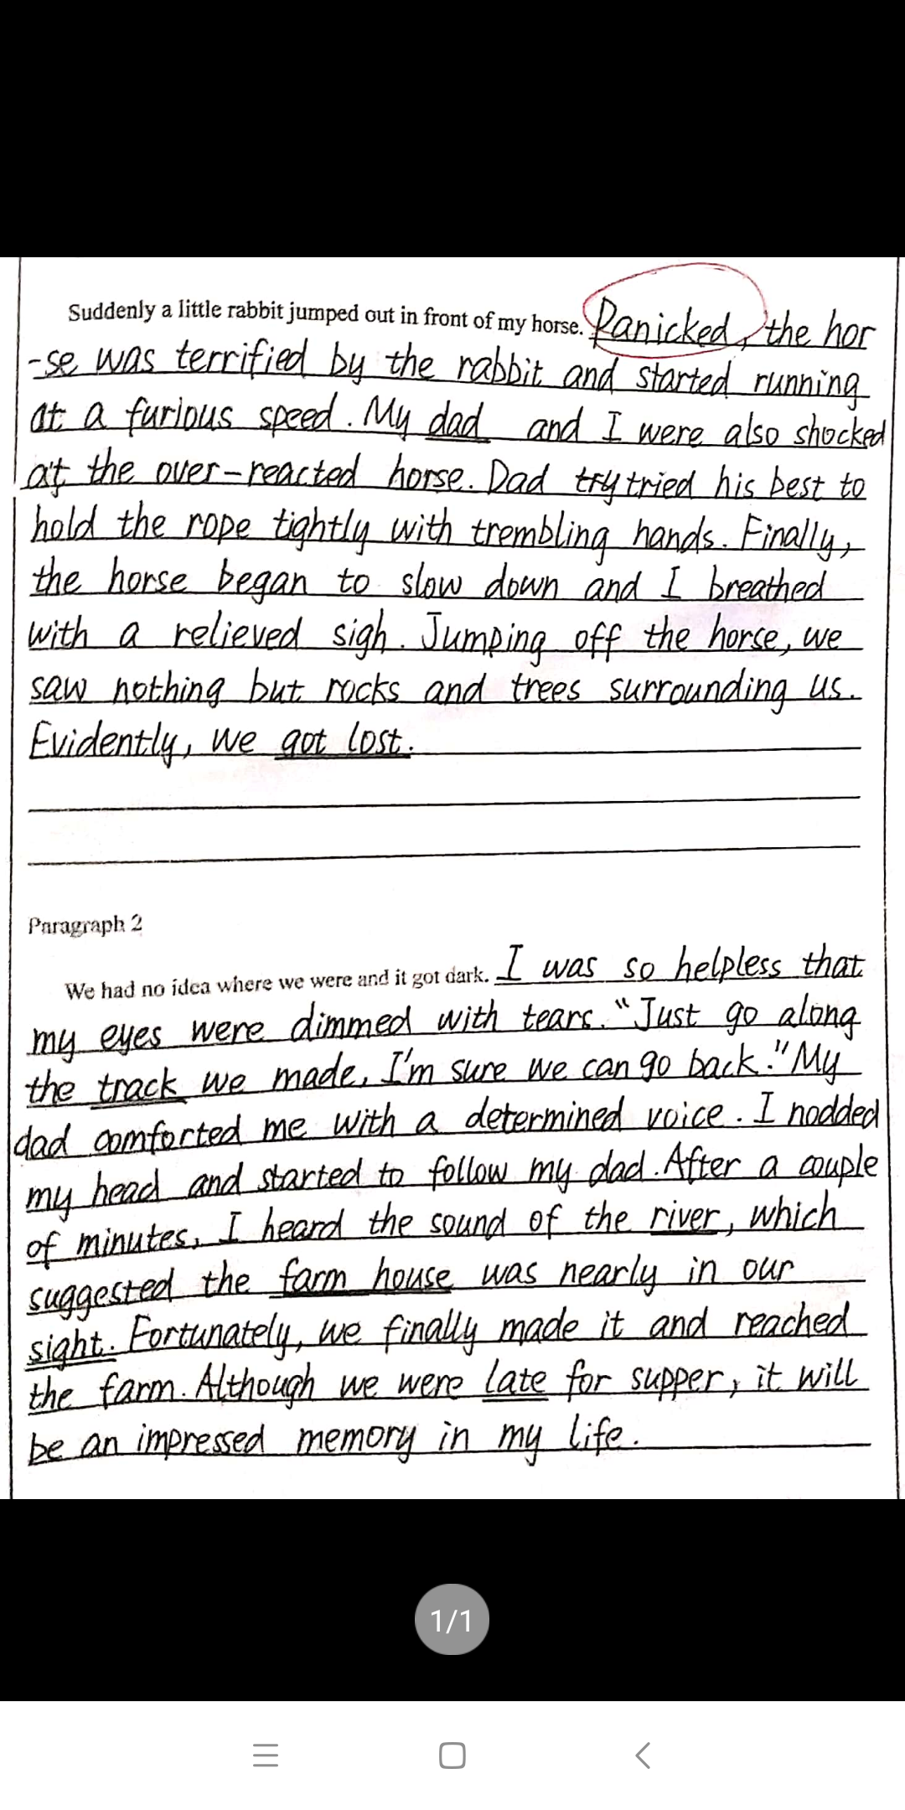
使用了恰当的动词描写动作细节；使用了形象的形容词和副词补充内容细节

Slide 27
增加了具体的动词和形容词，丰富故事情节，凸显主题。
impressive

Slide 28
Suddenly a little rabbit jumped out in front of my horse. Afraid that I might hurt the lovely small creature, I automatically无意识的 let out a cry to stop my horse. However, it became scared and started to run like crazy. All this coming, without warning, I was seized by fear. "Don't let go the rope! Keep calm!" yelled Dad. I followed what he told me to. To my relief, it stopped slowly. But before we jumped off the horses, we found that we had been off the beaten track and got lost. (81字)

Slide 29
We had no idea where we were and it got dark. Exhausted and hungry, I wondered if we could find our way back. I kept shouting for help, hoping my shouts could be heard by someone, but there was no reply. Dad sounded a little worried as he reminded me to calm down. It was then that my mind raced. "Listen, Dad, the rushing river water," I shouted excitedly, "we can return to the farm house down the river." Before long, we caught sight of the lights in the distance. We knew we were safe. What a thrilling vacation, like never before, we had! (93字)

Slide 30
Homework
1. 话题词汇 喊道 vt.________________
发现 vt. ________________ (马等)飞奔vt.________________
马鸣叫 vt. _______________ 闪闪发光的adj.______________
红灰色的 adj.______________ 拥抱 vt._______________
害怕的 adj. ______________
shout/cry/scream/yell/bawl
see/spot/note/notice/observe/sight
gallop
whinny
glittering
reddish-grey
hug hugged hugged
frightened/scared/afraid/fearful/terrified

Slide 31
2. 话题词块 骑马_______ 从马背上跳下来_______________ 加速_______________ 迷路_______________ 朝...前进________________ 鼓起勇气_______________
跑来迎接某人_____________ 毫不犹豫地________________ 在远处______________ 进入视线___________________ 安然无恙的___________ 令某人非常高兴的是____________
令某人庆幸的是________ 追猎_________________ 如释重负地___________ 保持冷静____________ 影响深刻的经历________________ 握紧缰绳____________
ride a horse/
take a horse ride
jump off the horse
speed up (sped sped)
get lost
head towards
gather/muster up the courage
run/ dash/rush/scuttle/trot to meet us
without hesitation
in the distance
come into view/sight
safe and sound
much to one's delight/joy/happiness
to one's relief
hunt for
in relief
stay/keep calm
an impressive/unforgettable/ memorable experience
hold/grab the rein tightly
(grabbed)

Slide 32
①. The moment we saw the faint (微弱的) light _____ _____ ____________, we
felt a rush of (一阵) excitement.
②. On the way, we spotted a man hiding a piece of paper that said, “Lost my job. Family to feed.”(15全国完型) ____________(vt. 同义替换)
③. We rode a horse across the field towards the mountains.____________ (vt.)
④. Uncle Paul h_________ us tightly __________ _________(stop concerning).
⑤. It turns out there’s always a way out of any plight(困境) as long as we ______
______.
⑥. We returned to the farm, ________ ________ ________ (out of danger)
⑦. As a quick response , I __________ in a loud voice."Dad, I’m here!
⑧. As night fell, we hastened quickly along the river.______ ______
in the distance
noted/...
galloped
ugged
in relief
stay
calm /keep
safe and sound
screamed/...
sped up
speeded up

Slide 33
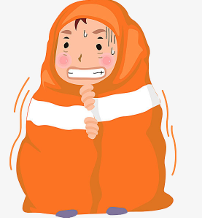
3. 用生动的形容词/副词描述我当时的紧张、害怕的心情
The night came._________________________________________ _________________________________________________________
I felt a wild (强大的 )rush of (一阵) terror, and desperately( 非常) wanted to go home.
Full of horror, I couldn't help trembling.
I cried hard in a great fright.
Shocked to see the track was out of sight, I nearly fainted.
I realized to my deep horror that we had galloped off the track
The chill (寒冷) made my flesh go cold with enormous horror.
We wandered around aimlessly. For a moment I was close to despair.

Slide 34
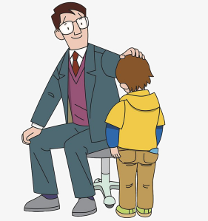
4. 用具体的动词描述爸爸安抚我情绪： ___________________________________________________ ___________________________________________________
Sensing my deep depression and horror, Dad kept telling jokes to lift my spirits, which helped remove my anxiety.

Slide 35
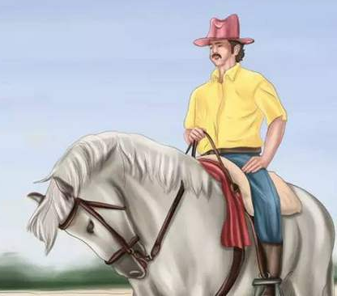
5. 用vt-ing 改写下列语段： We took out the cell phone but soon found something was wrong: no signal. And no compass. I was frightened, and I stared at Dad. I tried to seek a solution for the trouble from him. “Maybe what you have learned in geography class works," he said. He pointed to the stars in the sky. I knew he meant the North Star. Soon we found the right direction.
Taking out the cell phone, we soon found something was wrong, no signal. And no compass. Frightened, I stared at Dad, trying to seek a solution for the trouble from him. “Maybe what you have learned in geography class works,"he said, pointing to the stars in the sky. I knew he meant the North Star. Soon we found the right direction.

