Slide 1

感恩遇见，相互成就，本课件资料仅供您个人参考、教学使用，严禁自行在网络传播，违者依知识产权法追究法律责任。
更多教学资源请关注
公众号：溯恩高中英语
知识产权声明

Slide 2
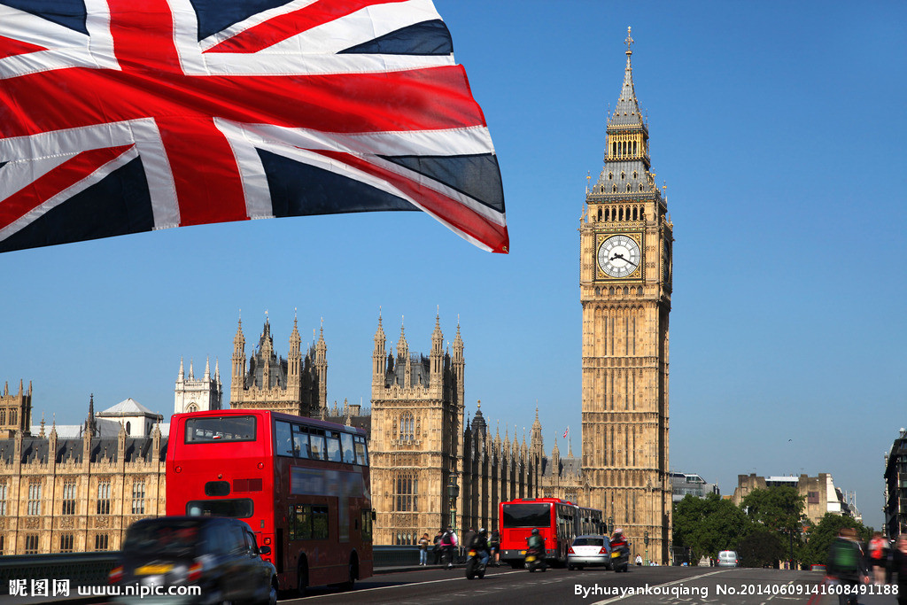
Sightseeing in London
Notes:
What tourist attractions are mentioned in the video we saw just now?

Slide 3


Slide 4
I Lead in
New words： 英 中
['saɪtsiːɪŋ] __________ __________
[dɪ'laɪt] __________ __________
['rɒɪəl] __________ __________
['juːnɪfɔːm] __________ __________
['splendɪd] __________ __________
['stætjuː] __________ __________
['kɒmjʊnɪz(ə)m] __________ __________
[θrɪl] __________ __________
sightseeing
观光；游览
delight
快乐；高兴
royal
皇室的
uniform
制服
splendid
壮丽的；辉煌的
statue
雕像；塑像
communism
共产主义
thrill
使激动；使胆战心惊

Slide 5
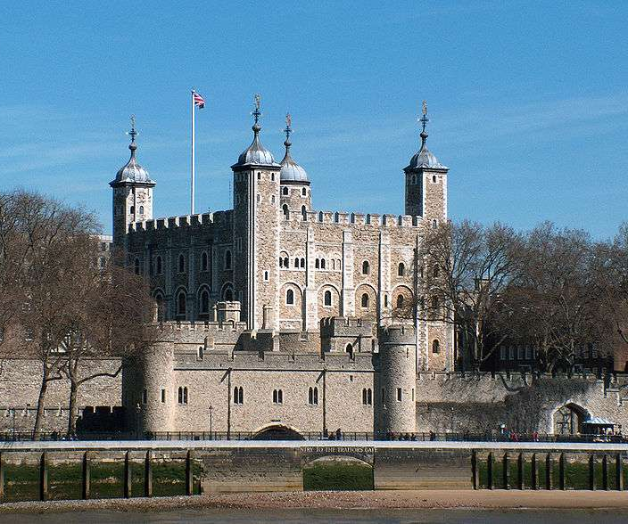
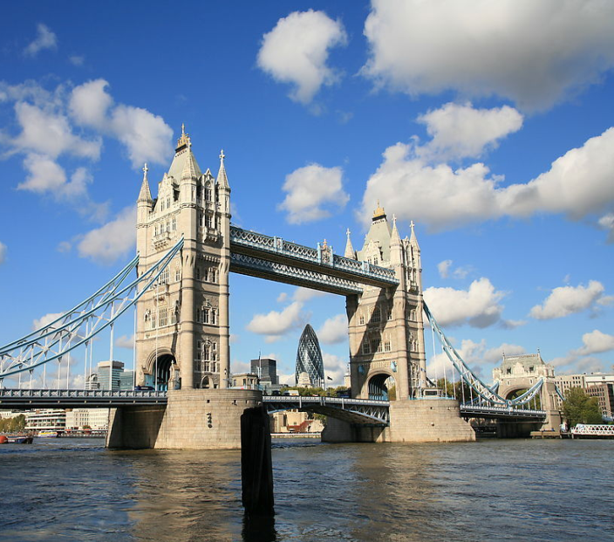
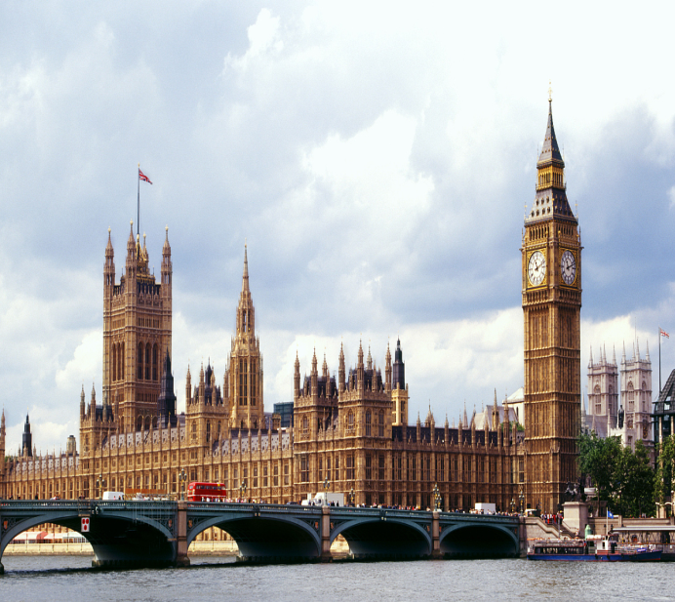
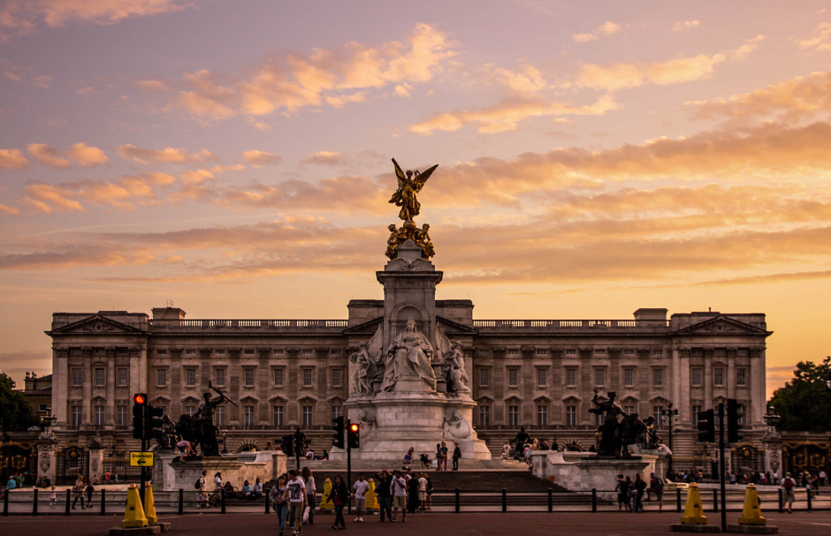
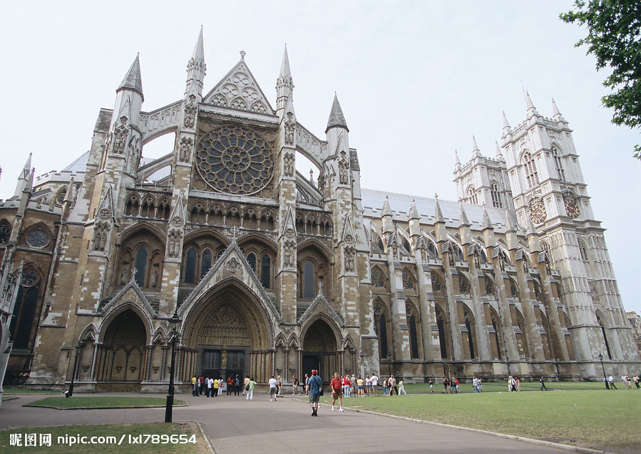
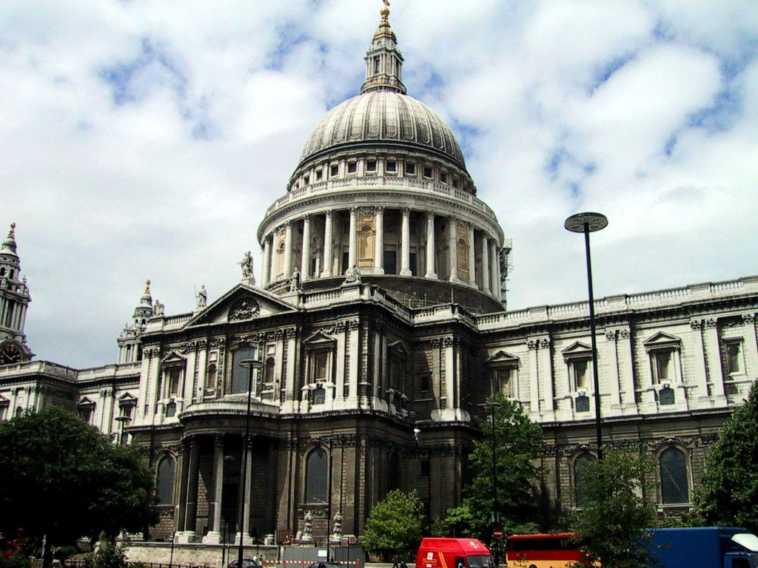
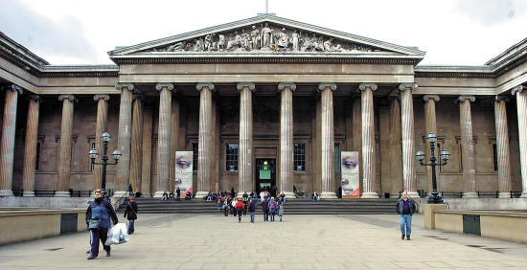
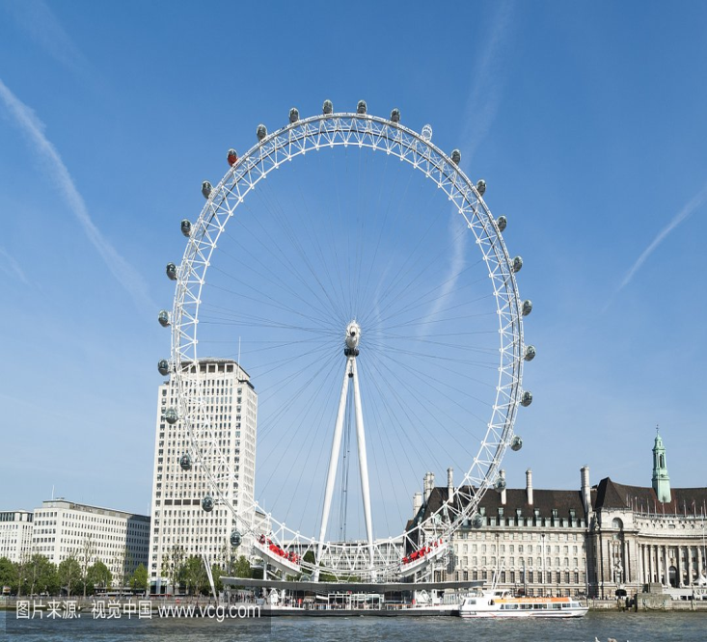
Houses of Parliament
Tower of London
London Tower Bridge
Westminster Abbey
Buckingham Palace
St Paul's Cathedral
London Eye
Bristish Museum

Slide 6

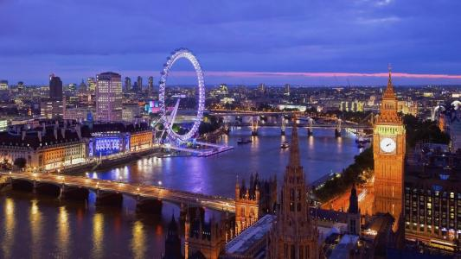
Task 1 Skimming
1.Sum up the main ideas then fill in the blanks.
It is about a Chinese girl,________________
who made her first visit to __________where
she spent ___________ and enjoyed
the beautiful historical sites there.
Zhang Pingyu
London
three days

Slide 7
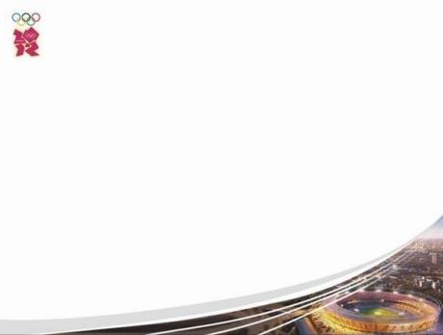
Task 1 Skimming
2. Which paragraphs tell us the visit on the first day ? What about day 2, and day 3?
Day1——Para.1-2；
Day2—Para.3;
Day3—Para.4.

Slide 8
Task 1 Skimming
3. In what order is the text organized?
Day 1
Day 2
Day 3
Next day
Para 1,2
Para. 3
Para. 4
Para. 5
time
The text is organized in the order of _________.

Slide 9
Task2 Careful reading
1.Read the passage carefully and make a list of Zhang Pingyu’s tour of London and a comment on each place she visited.

Slide 10
time
place
comment
1.The tower of London
delight
The first day
2.St. Paul’s Cathedral
splendid
Para 1,2
3.Westminster Abbey
interesting
4.Big Ben
famous & very loud
\
5.Buckingham Palace
The second day
Greenwich
famous & interesting
Para. 3
\
1.Karl Marx’s statue
The third day
2.The Library of the British Museum
Para. 4
famous
The next day
Windsor castle（in London？）
\
Para. 5

Slide 11
Task2 Careful reading
2.Summarize Zhang Pingyu’s travelling experience in Landon

Slide 12
Worried
Travel journal
____about the time available, Zhang Pingyu had made a list of the sites she wanted to see in London. Her first delight was going to the Tower, which remained standing for one thousand years. There followed splendid St Paul’s Cathedral. It contained statues _____________dead poets and writers. She finished the first day by looking at the outside of Buckingham Palace.
The second day , __________________ was the longitude line in Greenwich. Pingyu __________________________ standing on either side of the line.
The last day, she visited Karl Marx’s statue. It seemed strange that the man who had developed communism should have lived and died in London. But she ________________ by so many wonderful treasures from different cultures ____________ in the museum. When she saw many visitors enjoying looking at the beautiful objects _______________,she felt very proud of her country.
The next day Pingyu left London for Windsor Castle.
excited，shocked
in memory of
what interested her most
had a photo taken
was thrilled
displayed
on show,

Slide 13








Task3 Further reading
How does the author show the change of places on the first day?
What sites did Zhang Pingyu visit in London? And how many days did it take?
Highgate Cemetery
British Museum
Buckingham Palace
Big Ben
Notes:
How many days? How do you know? This is river Thames. on first day, what did she visit? all thes sites are locted along River Thames.
underline the words or phrases.

Slide 14

... Her first delight was going to the Tower. It was built long ago by the Norman invaders of AD 1066. Fancy! This solid stone, square tower had remained standing for one thousand years.Although the buildings had expanded around it, it remained part of a royal palace and prison combined. To her great surprise, Zhang Pingyu found the Queen's jewels guarded by special royal soldiers who, on special occasions, still wore the four-hundred-year-old uniform of the time of Queen Elizabeth I.
There followed St Paul's Cathedral built after the terrible fire of London in 1666. It looked splendid when first built! Westminster Abbey, too, was very interesting. It contained statues in memory of dead poets and writers, such as Shakespeare. Then just as she came out of the abbey, Pingyu heard the famous sound of the clock, Big Ben, ringing out the hour. She finished the day by looking at the outside of Buckingham Palace, the Queen's house in London. Oh, she had so much to tell her friends!
first
Writing Tip 1
various ways of showing_________
the change of time & places
There followed
too
Then just as
finished the day by

Slide 15
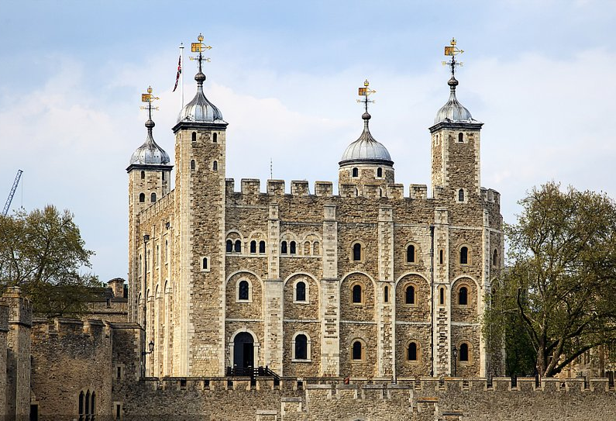
The Tower
Notes:
Her first delight was to go to the Tower.

Slide 16
Task3 Further reading
Para.1
What made Zhang Pingyu think it was her delight to visit the Tower?
?
Her first delight was going to the Tower. It was built long ago by the Norman invaders of AD 1066. Fancy! This solid stone, square tower had remained standing for one thousand years.Although the buildings had expanded around it, it remained part of a royal palace and prison combined. To her great surprise, Zhang Pingyu found the Queen's jewels guarded by special royal soldiers who, on special occasions, still wore the four-hundred-year-old uniform of the time of Queen.
a long history
a special function
a royal tradition
Notes:
could you please use your own words to summarize the points?
To sum up, The Tower impressed ZPY.

Slide 17
Para.2
Task3 Further reading
What's Zhang Pingyu's impression of each site?
There followed St Paul's Cathedral built after the terrible fire of London in 1666. It looked splendid when first built! Westminster Abbey, too, was very interesting. It contained statues in memory of dead poets and writers, such as Shakespeare. Then just as she came out of the abbey, Pingyu heard the famous sound of the clock, Big Ben, ringing out the hour. She finished the day by looking at the outside of Buckingham Palace, the Queen's house in London. Oh, she had so much to tell her friends!

Slide 18
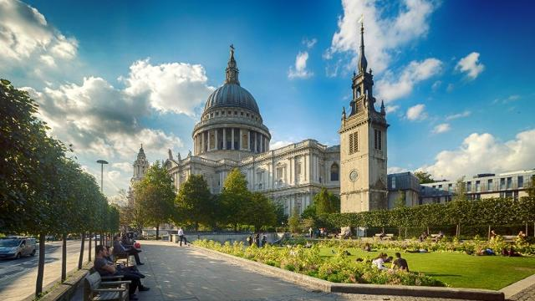
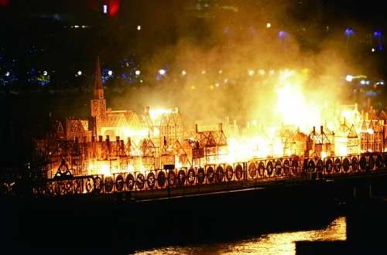
In 1666, a big fire swept through London. It lasted for four days, ruined one sixth of the buildings in London and caused 100, 000 people homeless. The place is_____.
St Paul’s Cathedral
Notes:
Do you know the big fire in 1666? St paul's cathedral was rebuilt after the london fire in 1666.

Slide 19
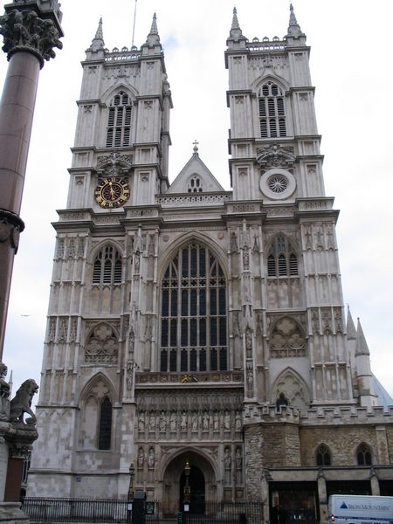
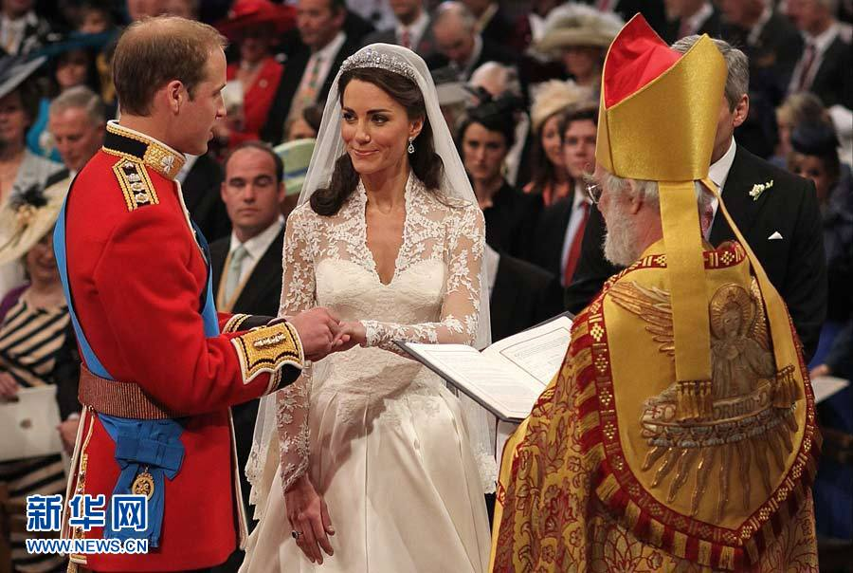
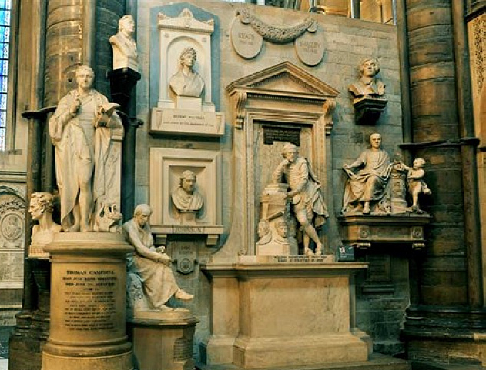
Many important people are buried here, including kings, queens, writers, scientists, etc.
Prince William held the wedding ceremony there.
Westminster Abbey
statues
Notes:
Charles Dickems (writer) Issac Newton(scientist)

Slide 20


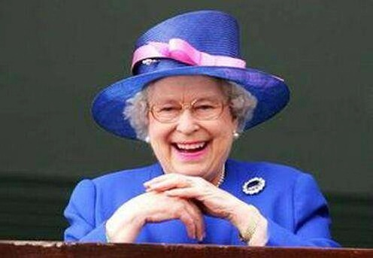
?
Big Ben
Elizabeth Tower
Benjamin Hall
Benjamin Hall
In 2012, _______was renamed Elizabeth Tower _____________ (honor)the Queen's 60th year on throne(王位).
Big Ben
in honor of
Notes:
Who does this Elizabeth refer to?

Slide 21
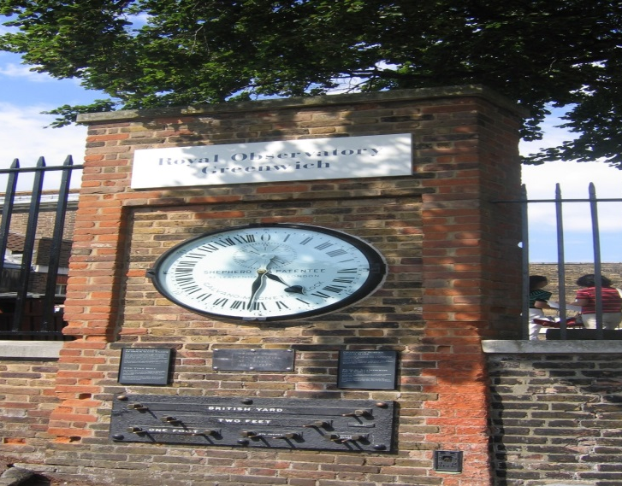
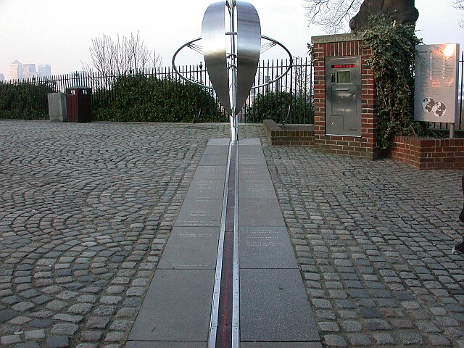
Task3 Further reading
Para.3
What did Zhang Pingyu see in Greenwich?
And what are their funcitons?
Its old ships and famous clock.
enrich knowledge of g_________
eography
set the world time
divide the eastern and western halves of the world
be of use for navigation
Notes:
Which one attracted ZPY most? How do you know?

Slide 22
Highgate Cemetery
British Museum
Buckingham Palace
Big Ben
Notes:
The last day she visited....

Slide 23
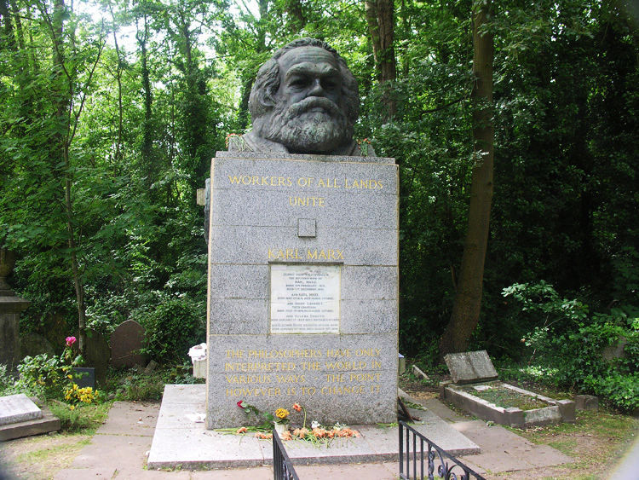
Task3 Further reading
Para.4
?
How did Zhang Pingyu feel? And why?
It seemed strange that ... should have lived and died in London.
puzzled
sad
Sadly,... had moved from...was gone.
thrilled
...was thrilled by...wonderful treasures...
...Chinese pots and other objects...felt very proud of...
proud
?
Writing Tip 2
various ways of showing______
feelings
Notes:
Do you think it is strange?
If you were ZPY，how would you feel seeing all these Chinese pots and objects? How did the British get these wonderful treasures from different cultures? Can they do that now?

Slide 24
What did Zhang Pingyu learn about London?
Highgate Cemetery
British Museum
experience English culture
geography
history
tradition
architecture
...
Buckingham Palace
Big Ben

Slide 25
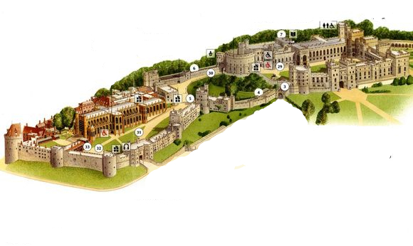
Task3 Further reading
Windsor Castle
"Perhaps I will see the Queen?“Why?
Because it’s an official residence of Queen Elizabeth II

Slide 26


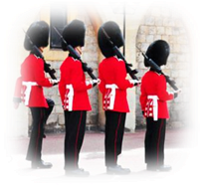
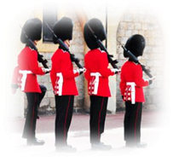

读后续写（continuous writing）If you were the author,introduce Zhang Pingyu's sightseeing in Windsor Castle.
State Apartment
a reception room
St. George's Hall
church
wedding ceremony
special royal soldiers
uniform

Slide 27
读后续写（continuous writing）If you were the author,introduce Zhang Pingyu's sightseeing in Windsor Castle.
State Apartment
注意：
所续写短文的词数应为150左右；
应使用5个以上括号里的关键词语（Zhang Pingyu, soldiers，hall, royal,Windsor Castle, sightseeing, walk, road, room, wonderful）；
续写部分分为两段，每段的开头语已为你写好；
续写完成后，请用下划线标出你所使用的关键词语。
Paragraph 1:
She went on her journey after waking up.________________
__________________________________________________
Paragraph 2:
Seeing the marvelous architecture, Zhang Pingyu was shocked. __________________________________________
__________________________________________________

Slide 28
Paragraph 1:She went on her journey after waking up. The first sight—St. George’s Hall attracted her attention. As we all know, American famous actor Meghan Markle and Prince Harry whose wedding ceremony was held in St. George’s Chapel loved the splendid and wonderful architecture. Then walking through the passage of Windsor Castle, Zhang Pingyu was amazed by the special landscape design, including rare plants and particular sculpture.
Paragraph 2:Seeing the marvelous architecture, Zhang Pingyu was shocked. There followed National diplomatic Hall which was served as a reception room being a cultural relic like the Amber Room. When

Slide 29
prime minister meet distinguished guests, it’s no wonder that National diplomatic Hall is a suitable place to choose. Next, Outdoor Courtyard was another part of Windsor Castle where you could see special royal soldiers. They were a pretty scenery line,
wearing the same old-fashioned uniform. In conclusion, the three parts were tourist attractions that Zhang Pingyu couldn’t miss in Windsor Castle.

Slide 30
反思&总结
Read the passage and appreciate the two writing tips.
Exchange your writing with your group members and polish it.

