Slide 1

感恩遇见，相互成就，本课件资料仅供您个人参考、教学使用，严禁自行在网络传播，违者依知识产权法追究法律责任。
更多教学资源请关注
公众号：溯恩高中英语
知识产权声明

Slide 2
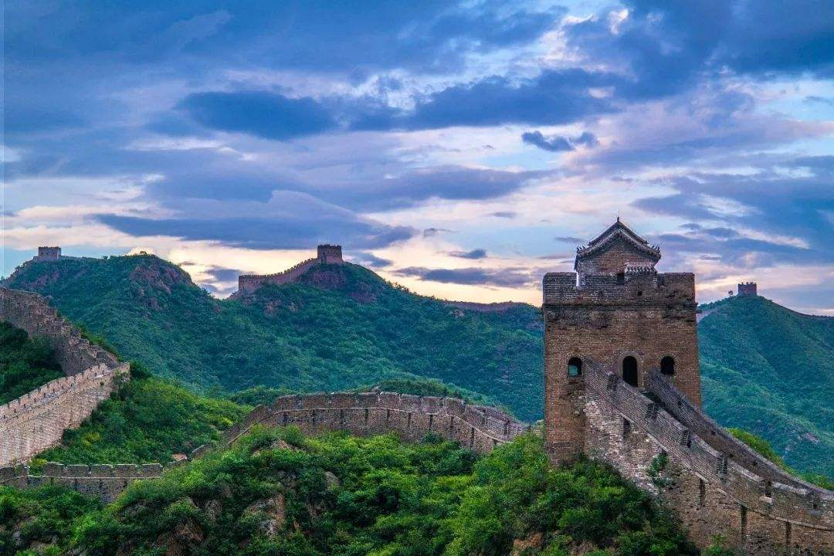
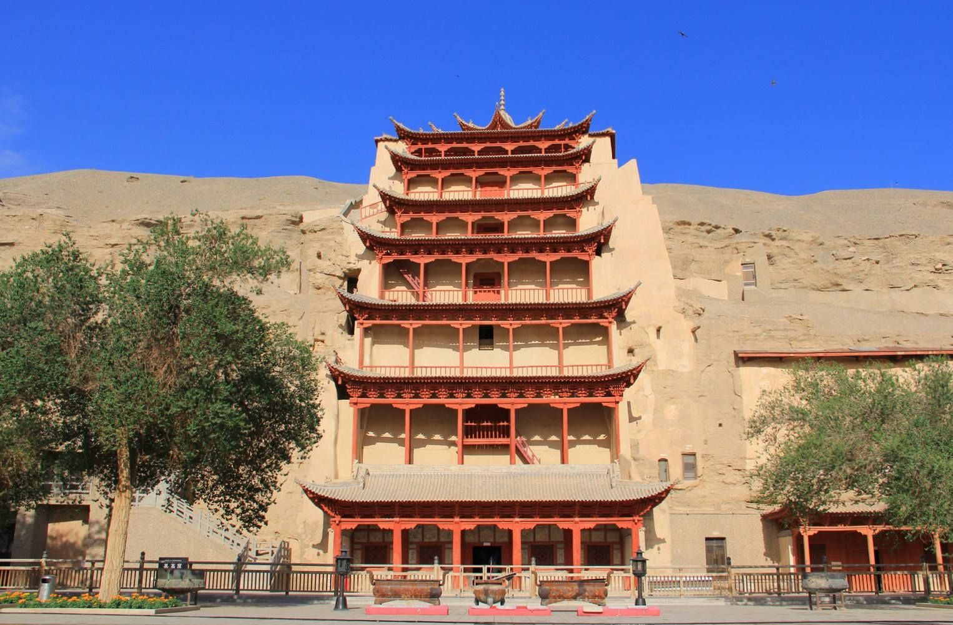
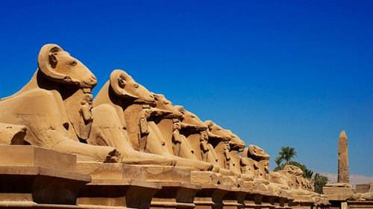
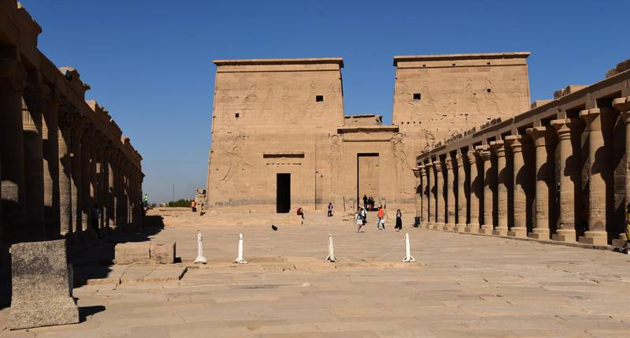
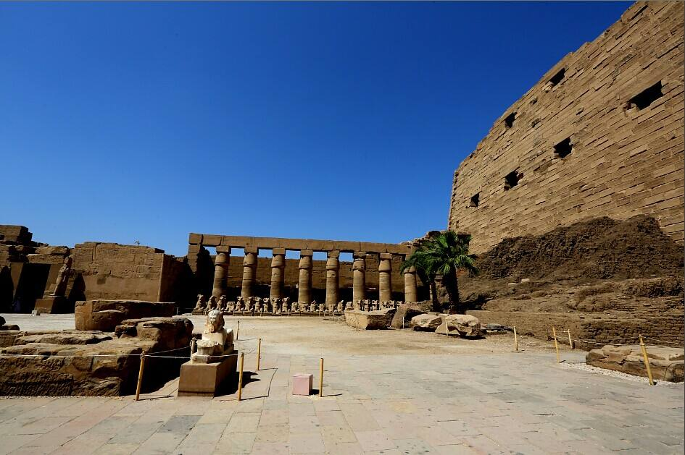
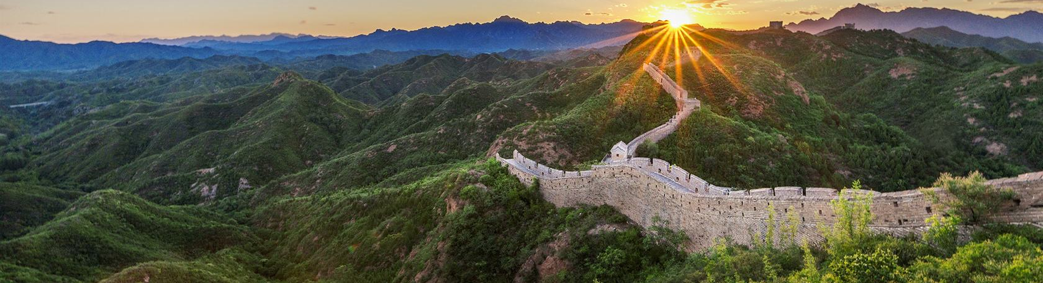
Safeguarding Cultural Heritage

Slide 3
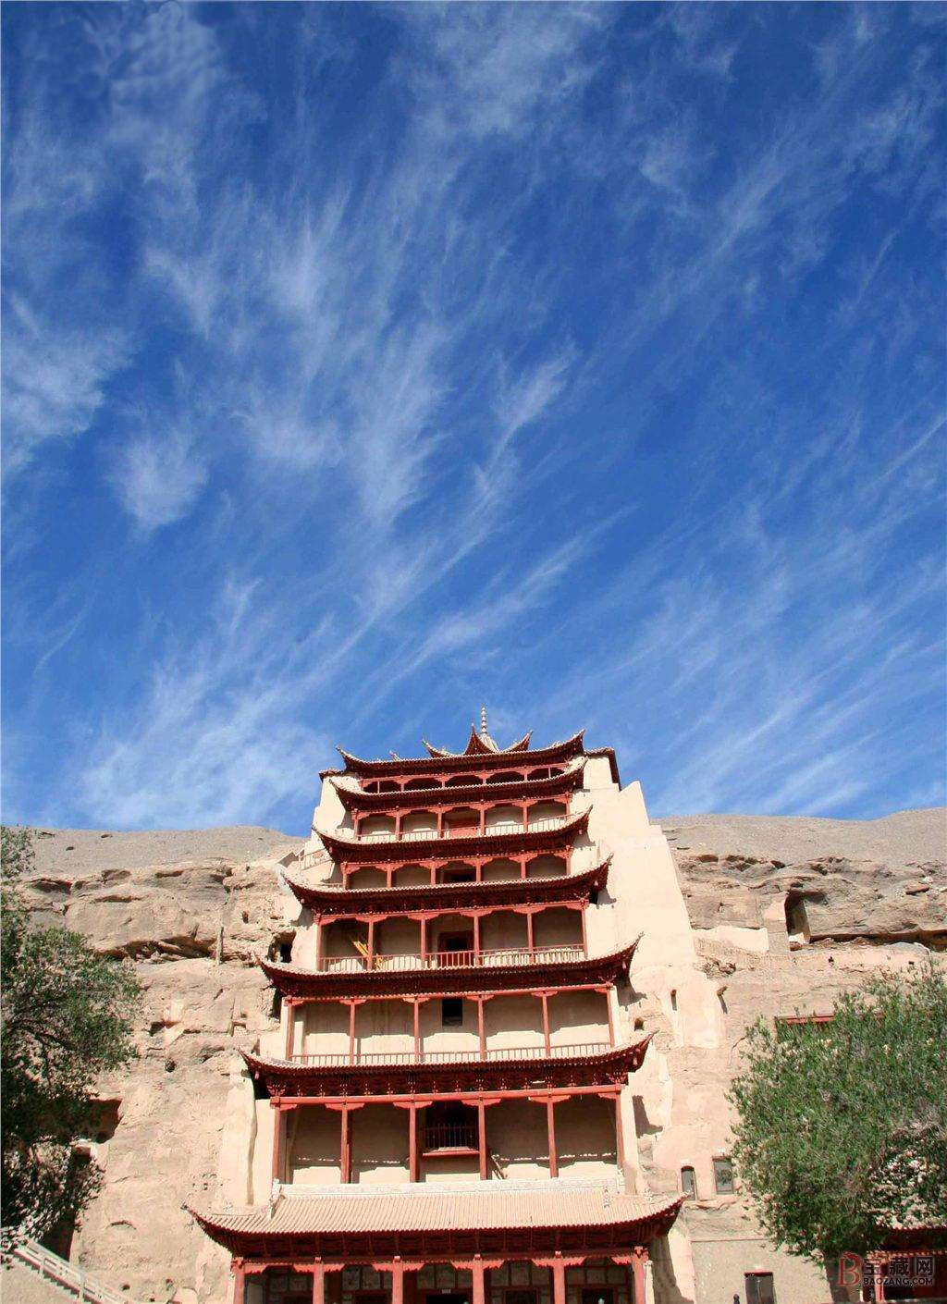
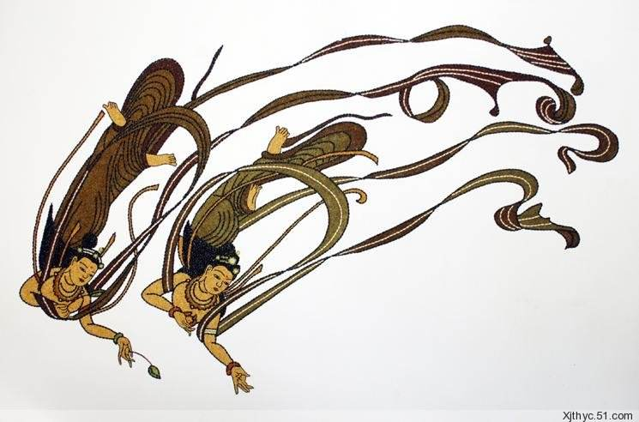
Warming-up
Located in western China's Gansu Province. Dunhuang Mogao Caves were cut a cliff 25 kilometers southeast to Dunhuang, on a mount called Mingsha. The caves are regarded the biggest and the longest preserved Buddhist art treasures, with more than 46,000 square meters of frescoes (壁画) in 735 caves. which show Buddha's images and behaviour, and the relationship between Buddha and men. Dancing
images in Dunhuang frescoes are a
brilliant jewel for all human beings.
What do you know
about Mogao caves?

Slide 4
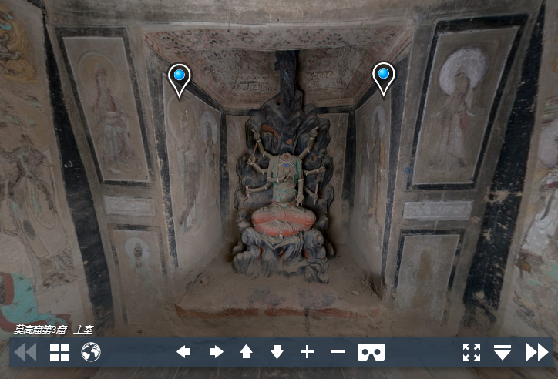
Read for Content
1. What are researchers and scientists doing?
A group of researchers and scientists from China and other countries are working together to help increase knowledge and appreciation of China's ancient cultural heritage.
They are recording and collecting digital images of cultural relics from the Mogao cave...Nearly 5000,000 high-quality digital photographs have been produced since the international project started in 1994.
What's the function of
these two sentences?

Slide 5
Read for Content
2. Why did scientists and researchers do such work
in Mogao Caves?
01
02
03
A key stop along the Silk Road in China's
ancient history
A meeting point for different cultures and part of many countries' history
Today as international as they were in the history
Mogao Caves are important both in history and today, which bear significant value.

Slide 6

Read for Content
3. Why do scientists and researchers share so many
digital photos?
To promote even wider interest around the world in China's ancient history, culture and traditions
01
To further educate people about the importance of safeguarding historic and cultural relics for future generations to understand and appreciate
02
各美其美，美人之美，
美美与共，天下大同。
——费孝通
“Appreciating one's own cultural heritage is very important for understanding oneself. Appreciating the cultural heritage of other countries is very important for international communication and understanding.”
Culture serves as a bridge for communication and understanding for different cultures.

Slide 7
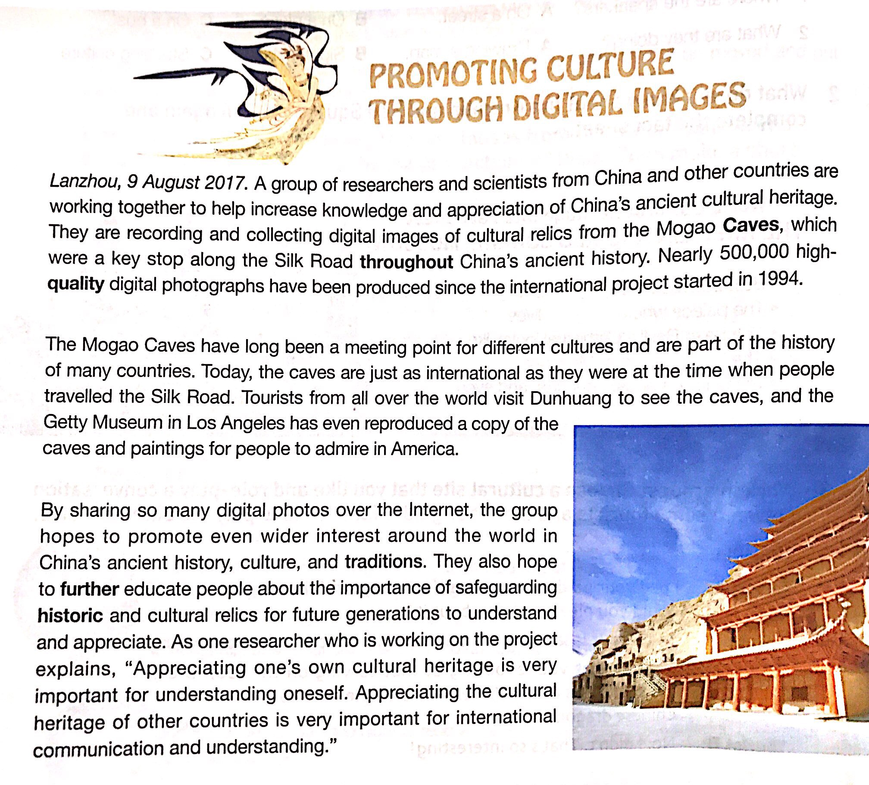
Read for Structure
Headline
Place line
the Lead
Body
Quotes

Slide 8
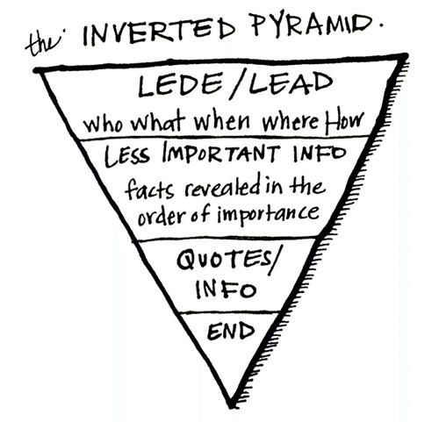
Read for Structure
Headline | Promoting Culture Through Digital Images
Place Line | Lanzhou, 9 August 2017.
The Lead | A group of researchers and scientists from China and other countries are working together to help increase knowledge and appreciation of China's ancient cultural heritage.
Body | They are recording and collecting... The Mogao Caves have long been a ... By sharing so many digital photos...
Quotes | “Appreciating one's own cultural heritage is very important for understanding oneself...
Accurate and Clear
Place (and Time)
Who (people)
What (do)
Where (place)
When (time)
(why
how)
more Detailed and Specific facts stated in the Lead
Direct and indirect quotes to convey information

Slide 9
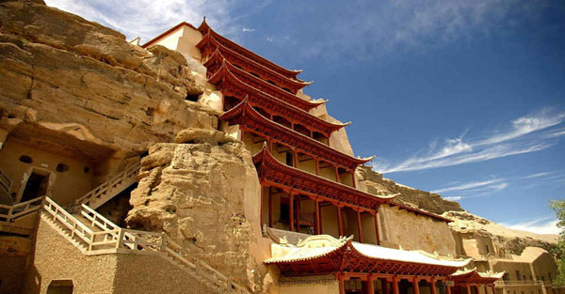
Read for Structure
Israel Tastes the Majesty of the Mogao Grottoes
JERUSALEM—An exhibition about the Mogao Grottoes, a famous UNESCO World Heritage Site in Northwest China's Gansu province, kicked off last week at the China Cultural Center in Israel.
The exhibition, which has been met with fascination by local people, includes two parts—the digital Dunhuang exhibition, and the Chinese painting exhibition.
Wearing virtual reality glasses, visitors are able to appreciate the majesty of the famous caves, sculptures and paintings from the Mogao Grottoes, and interact with them.
Dozens of Chinese paintings showing the Mogao Grottoes and their art proved to be a star attraction.
"It is an incredible cultural heritage and a great treasure of Buddhist knowledge," says Bairey, who has visited China twice. He adds he has a great interest in Chinese culture and would like to know more.
Israel Tastes the Majesty of the Mogao Grottoes
JERUSALEM—An exhibition about the Mogao Grottoes, a famous UNESCO World Heritage Site in Northwest China's Gansu province, kicked off last week at the China Cultural Center in Israel.
The exhibition, which has been met with fascination by local people, includes two parts—the digital Dunhuang exhibition, and the Chinese painting exhibition.
Wearing virtual reality glasses, visitors are able to appreciate the majesty of the famous caves, sculptures and paintings from the Mogao Grottoes, and interact with them.
Dozens of Chinese paintings showing the Mogao Grottoes and their art proved to be a star attraction.
"It is an incredible cultural heritage and a great treasure of Buddhist knowledge," says Bairey, who has visited China twice. He adds he has a great interest in Chinese culture and would like to know more.

Slide 10
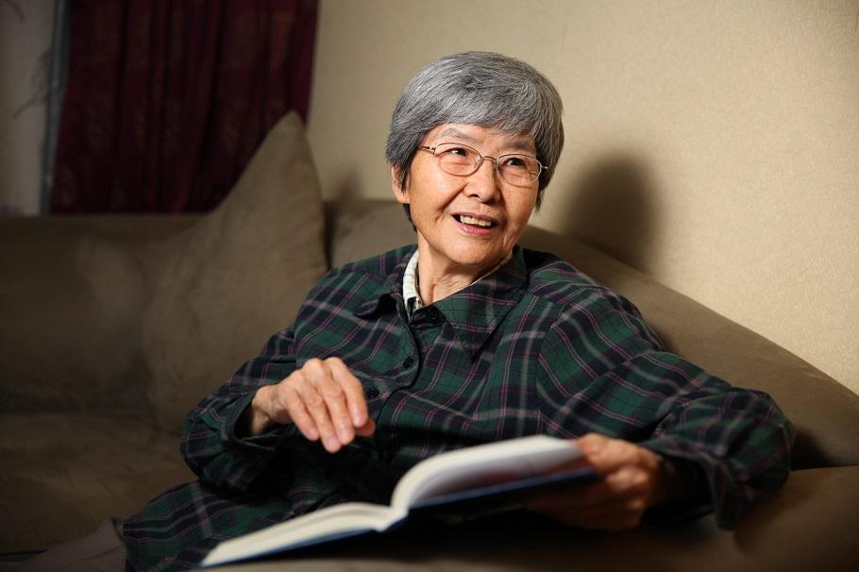
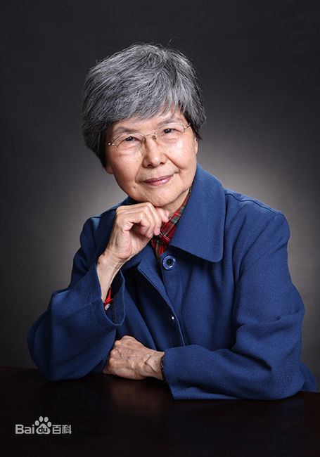
Warming-up
Name: Fan Jinshi
Birthday: 1938.7
“Daughter of Dunhuang”
What do you want to know about Fan Jinshi?

Slide 11
Read for Content
1. What's Fan Jinshi's first impression of Dunhuang?
However, the land that appeared so dreamy in books turned her expectations upside down.
It was beyond Fan Jinshi's wildest imagination that the real condition turned out so different from what's said in books.
What's the implied meaning of this sentence?
2. Why did Fan go to Dunhuang after graduation without
hesitation despite bad conditions?
(1). Bearing the value of serving the country;
(2). Moved and inspired by Chang Shutong's devotion;
(3). Her own interest and determination.

Slide 12
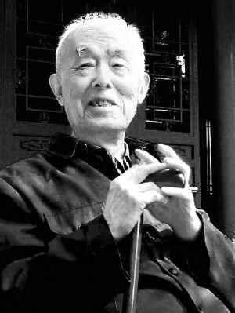
Read for Content
3. What did Fan do to Dunhuang?
(1). Investigating and measuring caves;
(2). Editing papers, books and publications on Funhuang
4. How do you understand Ji Xianlin's comment?
“The benefits of Fan's work are beyond measure,” commented Ji Xianlin, a great master of Chinese culture, at the celebration of the 100th anniversary of the discovery of the Du Huang Caves in 2000.
▪ Fan made immeasurable contributions to Dun Huang.
▪ What Fan did to Dun Huang can't be measured by any material.

Slide 13
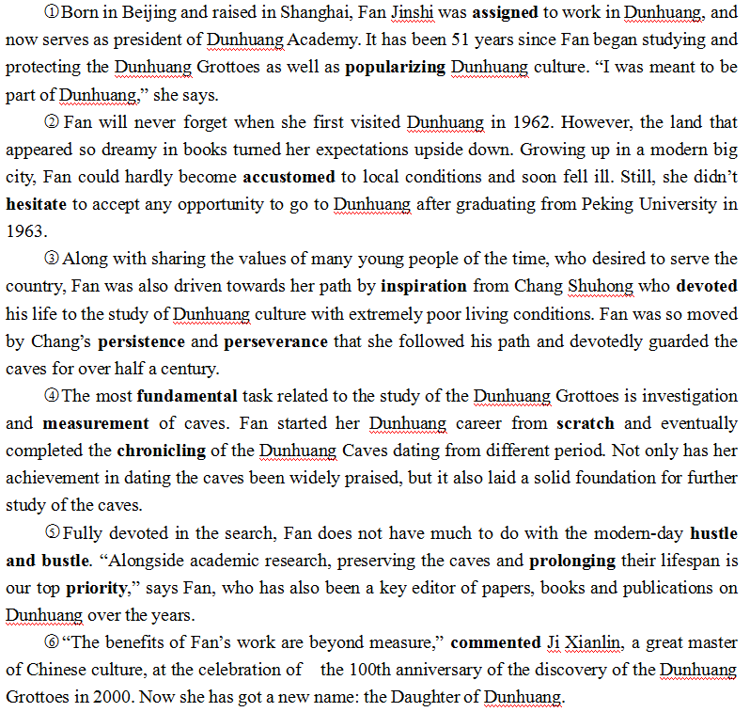
Read for Structure
Who is Fan Jinshi?
Why did Fan go to Dun Huang?
What did Fan do to Dun Huang?
How did people comment Fan?

Slide 14
Read for Writing
On Stepember 17, 2019, Fan Jinshi was awarded an honorable title for her outstanding work in protecting cultural heritagez. Write a news report based on this incident.
Headline | Write a title to get the readers' attention
The Lead | Tell the readers who, what, where, and why
Body | ▪Explain what fan Jinshi does ▪Explain why Fan Jinshi does this ▪Use relative clauses ▪Use quote
Ending | End with a short summary to help the readers remember the main idea

Slide 15
Read for Writing
Fan Jinshi: “Daughter of Dunhuang”
Yugao, 12 September 2019—Fan Shijin, president of the Dunhuang Academy, was awarded an honorable title for her life-time preservation of the Dunhuang Mogao Grottoes.
After graduating from Peking University in 1963, Fan went to Dunhuang to fulfill her dream to serve the country without hestitation despite the poor local conditions. From then on, she has devoted the four decades to the study of Dunhuang culture.
With perservance and persistence, she investigated and measured caves, finally completing the chronicling of the Dunhuang Caves dating from different period. Moreover, she cooperated with scientists worldwide to recording and collecting digital images of the valuable frescoes, which greatly popularizing the cultural relics.
“The benefits of Fan's work are beyond measure,” commented Ji Xianlin.
Now she's got a new name: “Daughter of Dunhuang”. Just like what Fan said: “The longer I've stayed here, the deeper my love has grown for Dunhuang."

