Slide 1

感恩遇见，相互成就，本课件资料仅供您个人参考、教学使用，严禁自行在网络传播，违者依知识产权法追究法律责任。
更多教学资源请关注
公众号：溯恩高中英语
知识产权声明

Slide 2


课程导读——祝贺信的意义：
为别人祝贺喝彩是一种美德，你付出的是赞美，收获的是友谊与合作。
为别人祝贺喝彩是一种智慧，你在欣赏别人的时候，也在不断提升和完善自我。
为别人祝贺喝彩是一种素养，有礼有节地向对手报以掌声，为自己走向美好世界打开友善之门。
为别人祝贺喝彩，让世界更精彩！

Slide 3
课程导读——祝贺信的内容：
祝贺信是指在日常生活中，得知同学或朋友竞赛获奖、考上大学、结婚、过新年或重大节日等，给对方祝贺的信件。书写时应做到真诚、自然、亲切动人。祝贺信通常包括以下内容：
1.说明事由，表达祝贺：极其简略明了地概括说明背景，由此生发祝贺原因，热烈表示祝贺之意。
2.充分肯定，积极评价：肯定被祝贺人所取得的成绩；或者赞扬对方付出的努力，或者恰当评价祝贺事实的重要意义，进而表明祝愿和希望，这也是更深一层地阐明祝贺的原因和表示祝贺之意。若是祝贺会议召开的，应说明召开该会议的重要意义，表明对会议的期望；若是祝贺寿辰，应赞扬对方取得的成功和做出的贡献，表明对他的尊敬与尊重；若是对下级的成绩表示祝贺的，应提出希望和鼓励。
3.简要作结，再次祝贺：一般是另起一行单独写一句话。如“预祝大会圆满成功”，“衷心祝愿健康长寿”，“祝取得更大的胜利”，“祝幸福快乐”等。

Slide 4

课程导读——祝贺信的写作特点：
高考英语应用文写作基本上是提纲式或图表式的半开放性作文，考生要学会给写作要点增加适当的细节让文章内容饱满，而找出题目要点中的“开放点（即思维突破口）”是恰当增加细节的关键。写作祝贺信应注意之点：
1. 感情真挚充沛：语言要热情洋溢，积极大方；叙事要有强烈的感情色彩。
2. 着力“开放要点”：为别人喝彩祝贺，突显和挖掘别人的成功及其艰辛的过程，并予以肯定和鼓励，也是发自自己内心的一种无私的美的展示。篇幅尽可能精炼，叙述对方成绩宜提纲挈领式地概括写出。
3. 语气得体激励：评价要实事求是，态度要得体而不能过度表扬和奉承，祝贺要能精神鼓励和引导美好未来。

Slide 5
课程导读——外教视频的内容：
1
2
3
4
5
6
7
8
Lead-in
The right usage of “congratulations”
Pay more attention to “Cross-culture”
Use proper expressions of hopes and wishes
Use causality to make coherent salutations
Further practice
Appreciate the possible version
Homework

Slide 6


Focusing on the "Highlight" makes your congratulations the icing on the cake
着力“开放要点”，让你的祝贺锦上添花
Congratulations Letters
Designers: 吴俊峰；Jen-Jay Chen
Lecturer: Tor

Slide 7
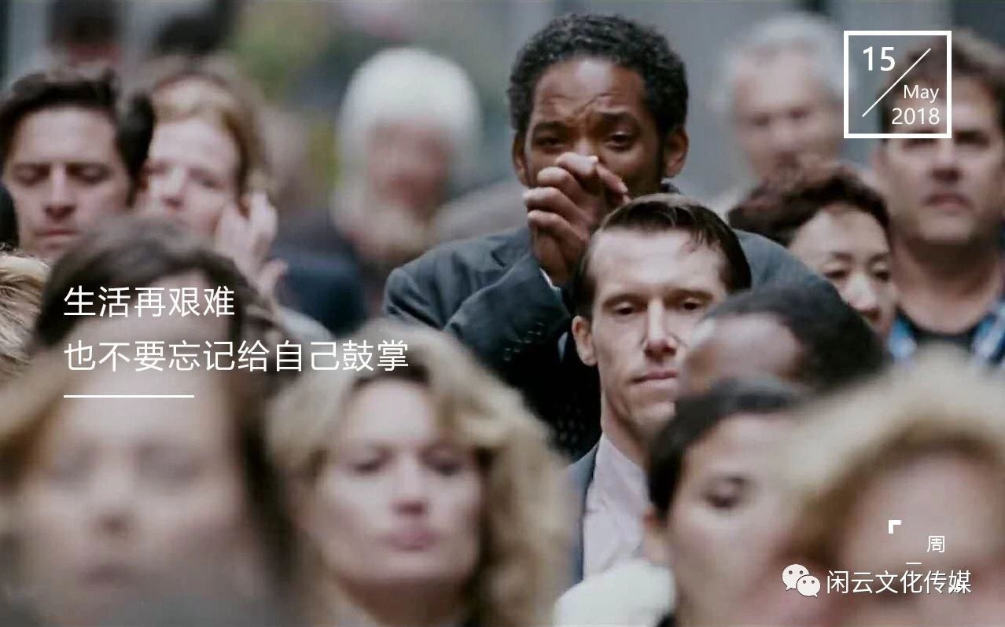
1. Lead-in
Not everyone takes the time to notice and acknowledge the ways in which people grow and improve. This doesn't have to be complicated. If someone you know is close to reaching a milestone, set yourself a reminder to be the first to congratulate them when they hit it.
Appreciate others' contributions. Congratulate others for the success of their new project. This shows not only self-confidence, but it help you feel good about yourself and have stronger relationships with others.

Slide 8
2. The right usage of “congratulations”
These phrases can be used to congratulate people on wedding, graduation award or the beginning of something worth celebrating!
Congratulations
on
marriage
new house
good grade/ graduation
new job/ job promotion
college admission
winning a prize

Slide 9
2. The right usage of “congratulations”
I'm writing to express my heartfelt congratulations on your winning the first place in the English speech contest.
01
It gives me immense pleasure to convey my felicitation on the auspicious occassion of your securing a new job with good career prospects and promotion avenues.
02
03
I'm Li Hua, a member of Beijing Opera Club. I'm writing to give my heartiest congratulations on your being admitted to our club.
Congratulations on graduation. How hard you have worked to accomplish this achievement, and all the sacrifices you made will lead you along a prosperous and rewarding career path.
04
Congratulations on your success in the University Entrance Examination and admittance to the prestigious Peking University. Your hard work paid off and we're all so proud of you.
05

Slide 10

3. Pay more attention to “Cross-culture”
Contents | Not Religious | Religious
Wedding | Wishing you a happy and prosperous married life. | You're a perfect pair. I pray to heaven to bring you days filled with compassion and love.
Newborn | Congratulations on the arrival of your latest family member. May your days together be filled with joy. | Congratulations on your new bundle of joy. May her home always be blessed with love and happiness.
Exam | I wish you all the best for your exam. You're going to make it. | Good luck for your exams. I'll keep my fingers crossed.
When congratulations between western people who are religious , the expressions are always “blessed, Lord, pray, keep fingers crossed” etc.

Slide 11
3. Pay more attention to “Cross-culture”
Contents | Not Religious | Religious
Birthday | I wish you all the best in the coming year! | May the Lord bless you with health and strength in the coming year!
Christmas Day | Wishing you a joyful season of celebration. | Wishing you a blessed season as you remember Christ's birth.
Graduation | Dear son, Congratulations! You've worked so hard over the past four years.I'm so proud of you! All the best as you as you start a new chapter of life! | Dear son, Congratulations! You've worked so hard over the past four years.I'm so proud of you! May the Lord bless you as you start a new chapter of life!

Slide 12

4. Use proper expressions of hopes and wishes
In formal English contexts, the modal verb “may” is often used when expressing your hopes and wishes for others. It usually stands at the beginning of the sentence. Sometimes, there's an introductory phrase before your wish,such as “let us pray that” or “let us hope that”.
May you have a prosperous New Year.
May the sun shine wherever you go.
May countless blessings come your way.
May your birthday bring you everything you wish for.
Let us pray that he may return safe and sound to us.
Let us hope that the young couple may enjoy many happy years to come.

Slide 13

4. Use proper expressions-- wishes for wedding
Wishing you a happy and prosperous married life.
May this special day give you countless fond memories.
Here goes my wedding wish for you. May your conjugal life be filled with joy and happiness.
You're a perfect pair. I pray to heaven to bring you days filled with compassion and love.
Warm wishes to you on your wedding day. May you never lose sight of your love for each other.

Slide 14

4. Use proper expressions-- wishes for newborn
Congratulations on the arrival of your latest family member. May your days together be filled with joy.
I'm really excited that your baby has arrived happy and healthy. May you find lots of happiness in your new role as proud parents.
May your son's life be filled with happiness and love.
Congratulations on your new bundle of joy. May her home always be blessed with love and happiness.
Wishing your little bundle of joy a lifetime of happiness and laughter.

Slide 15

4. Use proper expressions--wishes for exams or graduation
Good luck for your exams. I'll keep my fingers crossed.
I wish you all the best for your exam. You're going to make it.
I wish you good luck for your exam. Give it your best.
Don't let the stress get under your skin. Ace your exams. Good luck!
Wishing you have boundless prospects
Wishing you a promising future.

Slide 16
5.Use causality to make “open-ended point” logical
Achievement (Effects) | Hard work (Causes) | Hope (wishes)
be awarded with accomplish the goal of have wonderful performance in be successful in manage to efforts have paid off win public recognition | devote efforts to struggle to go all out to/for take great pain to endeavor to smooth away the obstacles in show great interest in keep on practicing | wish you success and fulfillment in the years ahead our pleasant business relationship will continue for years to come to be independent emotionally is the first step in adjusting to university life believe you can serve students better and make more progress in your work.

Slide 17
5.Use causality to make “open-ended point” logical
Achievement (Effects) | Hard work (Causes) | Hope (wishes)
You have received the first prize of “Chinese Bridge” Chinese speech contest. | This match is very difficult and competitive for a foreign student. You practiced speaking Chinese every day. | If you go on studying Chinese harder, you will have more amazing opportunities to have a deeper insight into Chinese culture and have a wondertul time in China.
I would like to express my congratulations to you on your receiving the first prize of “Chinese Bridge” Chinese speech contest. Although this match is very difficult and competitive for a foreign student, you persistently practiced speaking Chinese every day. If you go on studying Chinese harder, you will have more amazing opportunities to have a deeper insight into Chinese culture and have a wondertul time in China.

Slide 18
5.Use causality to make “open-ended point” logical
Achievement (Effects) | Hard work (Causes) | Hope (advice)
You open your own firm, and realize your long-cherished dream | your diligence, persistence and ambition. | Keep your ambition. Never overestimate the difficulties and underestimate your ability
I was happy to learn that you had opened your own firm and I would like to express my warmest congratulations.The final realization of your long-cherished dream should be attributed to your diligence, persistence and ambition. As a good friend of you, I advise you to keep your ambition. Moreover, in response to challenges, please never overestimate the difficulties and underestimate your ability.

Slide 19

Further practice
假定你是李华，得知你班的外教Mr. Smith当选为杭州市杰出外籍人才（Outstanding Foreign Talents of Hangzhou）；你代表班级给他写一封信表示祝贺。内容包括：
1. 祝贺他光荣当选；
2. 表达赞赏和感激之情；
3. 邀请他参加庆祝派对。
注意：1. 词数80词左右；
2. 可以适当增加细节，以使行文连贯。

Slide 20
Appreciate the possible version
Dear Mr. Smith,
I'm writing to offer my sincerest congratulations on your election of Outstanding Foreign Talents of Hangzhou on behalf of my class.
We are lucky to have you as our teacher and share your pride. In our view, you are a talented and professional teacher who has helped us make great progress in English. Besides, you have devoted yourself to education of this city for 10 years. In a word, you richly deserve the title.
Finally, we would like to invite you to the congratulation party to be held at 4：00 p.m. this Friday in our classroom. We are looking forward to receiving your early reply.
Yours respectfully,
Li Hua

Slide 21

Homework
假定你是李华，你的英国朋友Lucy在当地的一所孔子学院（Confucius Institute）学习，你刚获悉她在学院举办的中文诗词（poetry）比赛中荣获一等奖。请你用英语给她写一封电子邮件，内容包括：
1. 表示祝贺；
2. 近期活动；
3. 希望来中国深造。
注意：1．词数80左右；
2．可以适当增加细节，以使行文连贯；

Slide 22
One possible version
Dear Lucy，
I'm pleased to learn you've just won first prize in the Chinese poetry competition held in your institute. I'm writing to offer my sincere congratulations to you.
It came as no surprise to me because I know you love Chinese culture, especially Chinese poetry, and you've been studying in a local Confucius Institute for years. I'm so proud to see all your efforts have paid off. I hope you can have a chance to come to China for further study in the near future and have a better understanding of my country.
Wish you greater progress in the study of Chinese poetry.
Yours genuinely,
Li Hua

Slide 23
Thank you！

