Slide 1

感恩遇见，相互成就，本课件资料仅供您个人参考、教学使用，严禁自行在网络传播，违者依知识产权法追究法律责任。
更多教学资源请关注
公众号：溯恩高中英语
知识产权声明

Slide 2
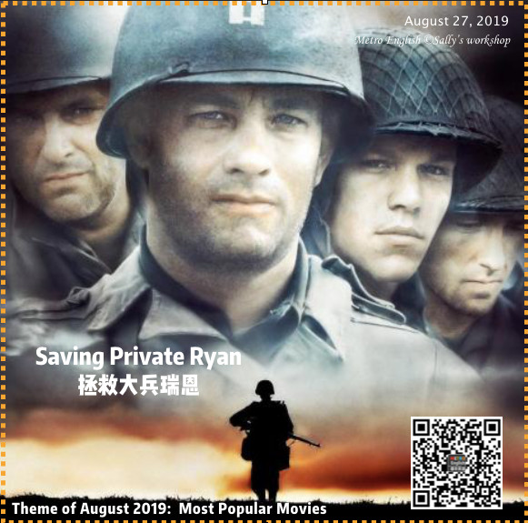
Continuation writing 读后续写
作文提升指导
Rescue 拯救
浙江省/常山一中/吴俊峰
金丽衢十二校2019学年高三第一次联考

Slide 3
CONTENTS
1
Lead-in
Saving Private Ryan
2
narrative elements and structure
6 basic plots conflicts
Read and analyze the material
3
Writing Scaffold
Transitions; Inclusio; Theme
Let the surroundings speak
Describe actions specifically
Add proper mental activities
4
Language
5
Appreciation
one possible version
6
Summary
Labov’s model of narrative structure

Slide 4
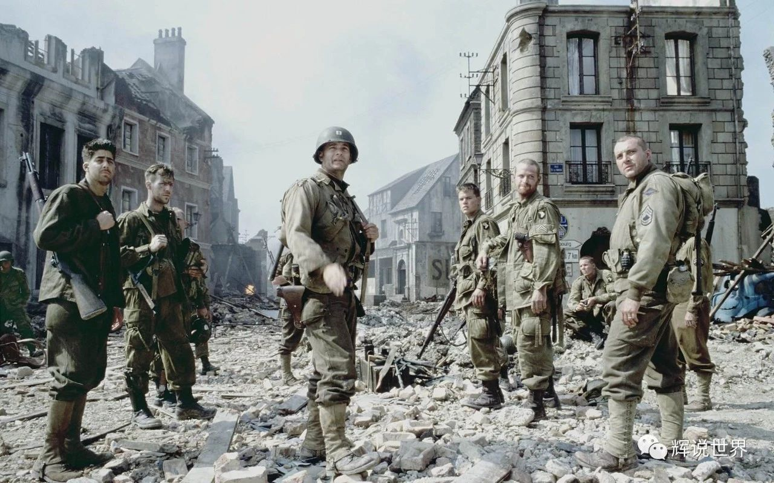
01
Lead-in: Saving Private Ryan 《拯救大兵瑞恩》
What do you know about the film?
——During World War II, Mrs. Ryan, is
to receive all three of the grave telegrams on the same day. The United States Army Chief of Staff, George C. Marshall, is given an opportunity to relieve some of her grief when he learns of a fourth brother, Private James Ryan, and decides to send out 8 men (Cpt. Miller and select members from 2nd Rangers) to find him and bring him back safely home to his mother...
Please guess how many soldiers will survive in this mission?
——Only two.

Slide 5
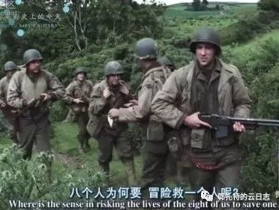
Saving Private Ryan 《拯救大兵瑞恩》
Before the saving-
doubt
What do you think of the line in the
film “You want to explain the math of this to me? I mean, where's the sense in risking the lives of the eight of us to save one guy?”
—— Naturally, the eight soldiers on the rescue team must examine why Ryan's life is valued over their own.
Ryan serves as a symbol that soldiers sacrifice their lives for their country. To save Ryan is to save helpless mothers, to save countless families, to save hope and peace.
Once detetermined, the eight soldiers need perseverance, calmness and teamwork to deal with whatever difficulties.

Slide 6
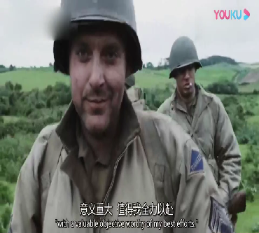
01
Before the saving-
Saving Private Ryan 《拯救大兵瑞恩》
argue
Play the video to find out the value of the mission.
Captain Miller:
In that case, I'd say this is an excellent mission,sir, with an extremely valuable objective, sir. Worthy of my best efforts, sir. Moreover, I feel heartfelt sorrow for the mother of Private James Ryan and am willing to lay down the lives of me and my men - -especially you, Reiben - -to ease her suffering.
米勒上尉：
如果是那样的话，我会说这是一次极佳的使命，长官，这次任务的目的太有价值了，长官。值得付出我最大的努力。另外，我为瑞恩的母亲由衷感到悲哀，我愿意用我和弟兄们的生命，特别是你，莱本，去减轻她的苦痛。

Slide 7
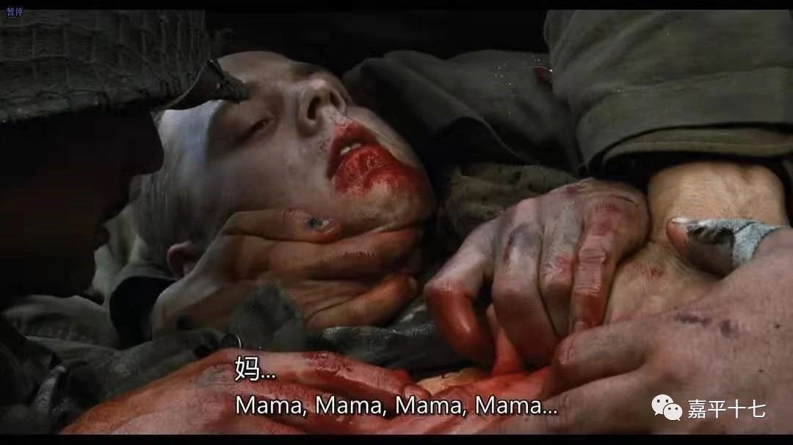
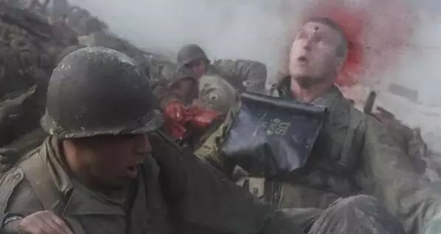
During the saving-
Saving Private Ryan《 拯救大兵瑞恩》
sacrifice
When the rescueteam fell into the enemy's territory, they met with various dangers.
The war was so cruel that life might be sacrificed at any moment.

Slide 8
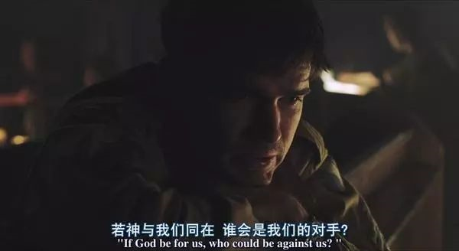
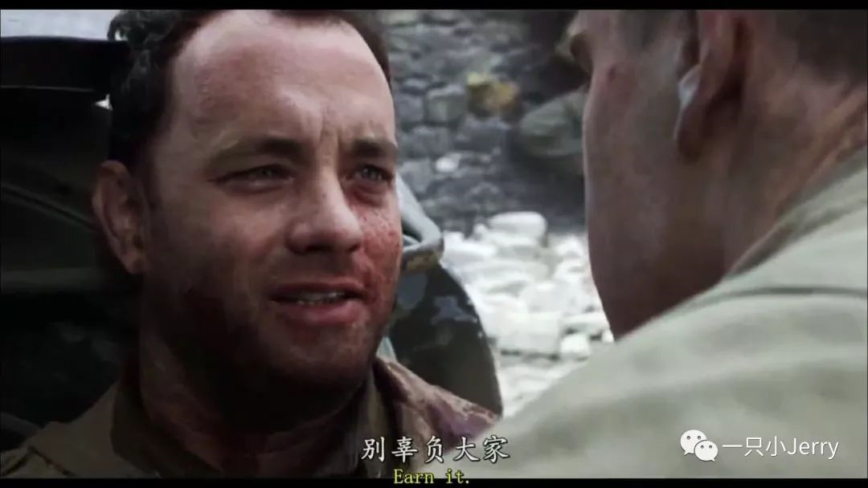
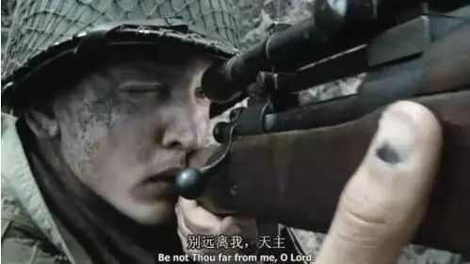
During the saving-
Saving Private Ryan 《拯救大兵瑞恩》
faith
be not thou far from me,O Lord！
上帝，求你别远离我 ！
As he lay dying, Captain Miller whispered in Ryan's ear, “earn it.” Don't live up to the freedom that everyone lives for.米勒上尉弥留之际，在瑞恩耳边留下这么一话：“别辜负大家”。别辜负了大家用生命换来的自由。
If God be for us, who could be against us？
若神与我们同在，谁会是我们的对手？

Slide 9
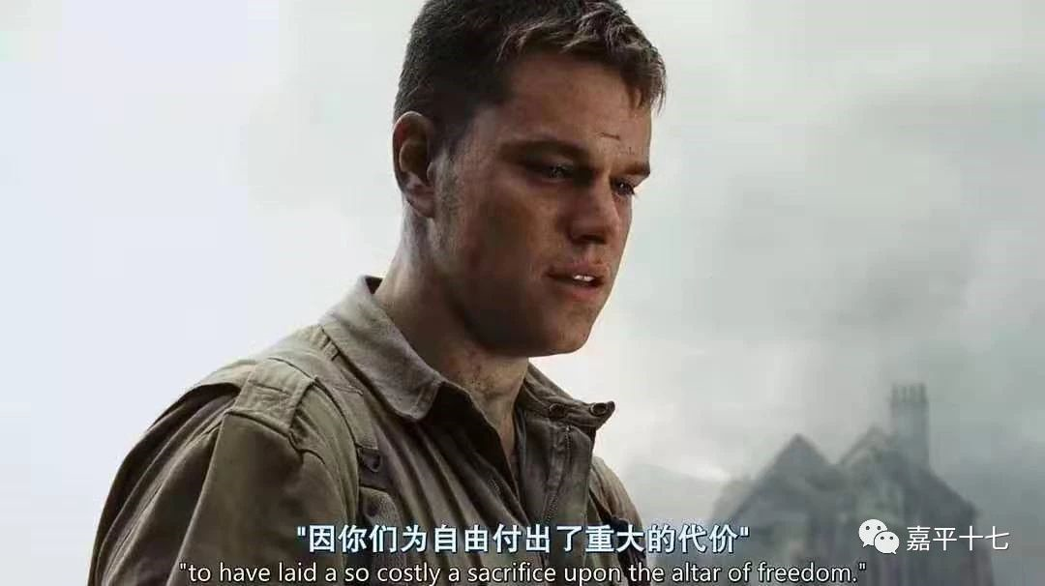
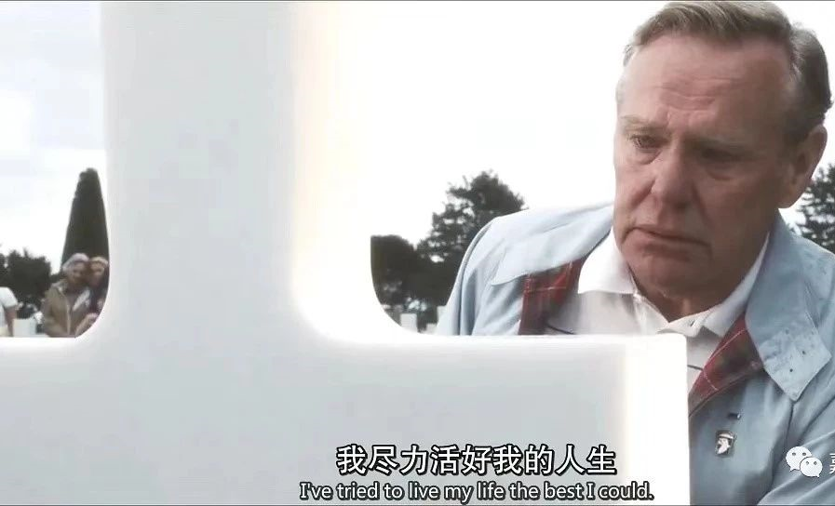
After being saved-
Saving Private Ryan 《拯救大兵瑞恩》
value
I've tried to live my life the best I could.
to have laid a so costly a sacrifice upon the altar of freedom.
altar /ˈɔːltə(r)/n. 祭坛；圣坛

Slide 10
01
Saving Private Ryan 《拯救大兵瑞恩》
+
value
faith
sacrifice
Before
the saving
During
the saving
After
being saved
Emotional experience
Time
argue
doubt
_
Today, let's explore the similar story themed Rescue.

Slide 11


02-03
Read and analyze the material → Writing Scaffold
Learn Period2-3 from the video lectured by Tor from Canada

Slide 12

02-03
Read and analyze the material → Writing Scaffold
Continuation writing 读后续写
Clearly read the material
Logically analyze the material
Systematically build a writing scaffold
Three key skills of continuation writing
Learn Period2-3 from the video lectured by Tor from Canada

Slide 13

04
Vivid and descriptive language
Mood, or atmosphere, can be indicated through the author's choice of verbs, as well as nouns and adjectives. Strong verbs are always the best. Weather can also be used to indicate the atmosphere in a story.
Let the surroundings speak
Describe actions specifically
Let the surroundings speak
Describe actions specifically
Add proper mental activities
Language
Add proper mental activities

Slide 14

04
Vivid and descriptive language
Let the surroundings speak
1
The bone-chilling wind slowly dragged the time on, making the darkness of the dawn even more suffocating.
2
So exhausted was Old Tin Hat that he collapsed on the ground. Whining gently, Raf, the dog, snuggled with him, nuzzled him, licked his hand to keep his spirits up.
3
The ladder descending into the deep crater seemed endless, Old Tin Hat followed it through logically, step by step by step, with tinny echoes of breathing. Suddenly he found that his legs seemed to stop working right - as if they couldn't hold his body up any longer - and he ended up sitting on the ground eventually.

Slide 15
04
Vivid and descriptive language
Describe actions specifically
1
“Old Tin Hat, what can we do?” Harry threw his arms around him tightly, quivering and seized by stark horror. “All is going well!” Old Tin Hat answered gently, calm and mollified.
2
Narrowly escaping, Harry squared his shoulders, saluted awkwardly and gave Old Tin Hat a reassuring smile, “You're a real hero,Old Tin Hat, you 're my sunshine!” his voice had some gentle and firmness.
3
The captain grited his teeth and held the rope tightly, staring at the bomb nervously, as if it would explode the next minute.

Slide 16
04
Vivid and descriptive language
Add proper mental activities
Pressed down by a physical exhaustion that haunted his body and seemed to reach into his soul, Old Tin Hat felt his legs filling lead— heavy and stiff. He took a deep breath and then exhaled slowly to calm himself down.
2
Being torn as to whether to risk everyone's safety to let the dog out, suddenly he thought that the dog might be the best friend and comfort to the boys in the war. A ripple of excitement ran through his body, “Come and grab my hand!” he ordered.
3
Catching sight of the overhead sunlight , Harry felt a feeling of relief and relaxation surging through himself. What a narrow escape!

Slide 17
05
Appreciation - one possible version
Rescue
With a sudden fall of earth, Old Tin Hat froze halfway up. Harry gasped with terror but luckily the ladder was steady. Old Tin Hat started up again. No sooner had he got to the top than hands reached out and Jack disappeared. Again down the ladder came Old Tin Hat, gently and cautiously. Eventually, he joined Harry and Raf. Though he suggested that dog went last, Harry insisted that they would be together. Old Tin Hat puled Harry onto his back, carrying Raf under his arm. Old Tin Hat started to climb the ladder for the second time. The weight of the boy and the dog made him gasp. With great efforts, they came to the top of the crater. Everybody was rescued! A faint cheer rose from a long way off. A group of people crowded behind the barrier. And there was Mom! Harry rushed over, hugging his mom tightly. Later, news came that the bomb was taken away, safe.
Use specific, evocative and vivid verbs, nouns, and adjectives in describing.

Slide 18
05
Appreciation - one possible version
Rescue
With a sudden fall of earth, Old Tin Hat froze halfway up. Harry gasped with terror but luckily the ladder was steady. Old Tin Hat started up again. No sooner had he got to the top than hands reached out and Jack disappeared. Again down the ladder came Old Tin Hat, gently and cautiously. Eventually, he joined Harry and Raf. Though he suggested that dog went last, Harry insisted that they would be together. Old Tin Hat puled Harry onto his back, carrying Raf under his arm. Old Tin Hat started to climb the ladder for the second time. The weight of the boy and the dog made him gasp. With great efforts, they came to the top of the crater. Everybody was rescued! A faint cheer rose from a long way off. A group of people crowded behind the barrier. And there was Mom! Harry rushed over, hugging his mom tightly. Later, news came that the bomb was taken away, safe.
Complex and flexible sentence patterns are used.

Slide 19
05
Appreciation -one possible version
Rescue
With a sudden fall of earth, Old Tin Hat froze halfway up. Harry gasped with terror but luckily the ladder was steady. Old Tin Hat started up again. No sooner had he got to the top than hands reached out and Jack disappeared. Again down the ladder came Old Tin Hat, gently and cautiously. Eventually, he joined Harry and Raf. Though he suggested that dog went last, Harry insisted that they would be together. Old Tin Hat puled Harry onto his back, carrying Raf under his arm. Old Tin Hat started to climb the ladder for the second time. The weight of the boy and the dog made him gasp. With great efforts, they came to the top of the crater. Everybody was rescued! A faint cheer rose from a long way off. A group of people crowded behind the barrier. And there was Mom! Harry rushed over, hugging his mom tightly. Later, news came that the bomb was taken away, safe.
A good descriptive
writer is being a good observer.
Good descriptive
writing shows the reader and gives a clear impression of the subjects.

Slide 20
05
Appreciation - one possible version
Rescue
With a sudden fall of earth, Old Tin Hat froze halfway up. Harry gasped with terror but luckily the ladder was steady. Old Tin Hat started up again. No sooner had he got to the top than hands reached out and Jack disappeared. Again down the ladder came Old Tin Hat, gently and cautiously. Eventually, he joined Harry and Raf. Though he suggested that dog went last, Harry insisted that they would be together. Old Tin Hat puled Harry onto his back, carrying Raf under his arm. Old Tin Hat started to climb the ladder for the second time. The weight of the boy and the dog made him gasp. With great efforts, they came to the top of the crater. Everybody was rescued! A faint cheer rose from a long way off. A group of people crowded behind the barrier. And there was Mom! Harry rushed over, hugging his mom tightly. Later, news came that the bomb was taken away, safe.
Appropriate coherence and cohesion make the writing logically organised.
The conclusion of a fictional narrative must reveal the end of the conflict and/or the lesson learned or insight gained by the characters from the experience.

Slide 21
06
Summary — Labov’s model of narrative structure
Dimensions | Narrative Elements | Content | Your Roles | Examples
what | Abstract （概述） | title, beginning | level-top designer 顶层设计师 | Rescue
what | Orientation （发生） | characters, setting, objects | setting investigator 背景调查员 | at dawn; in the 4-meter-deep crater
what | Complicating action （矛盾激化） | elaborative detail | conflict mediator 冲突调解员 | How were two boys and a dog rescued by the soldiers?
how | Evaluation （评判） | character's thoughts and feelings | character portrayer 角色描绘师 | Old Tin Hat was brave and kind
how | Result /resolution（结局） | corresponding resolution | plot magician 剧情魔术师 | Everybody was rescued
why | Coda （尾声） | memory, wish, decision | theme explorer 主题探索者 | war and peace; danger and survive; the human nature

Slide 22

07
Homework
1. Further polish your own composition using the form of Labov’s model of narrative structure, and copy it neatly on the paper after class.
2. See the film Saving Private Ryan, exploring the theme of the film.
Homework

Slide 23

Thank You!

