Slide 1

感恩遇见，相互成就，本课件资料仅供您个人参考、教学使用，严禁自行在网络传播，违者依知识产权法追究法律责任。
更多教学资源请关注
公众号：溯恩高中英语
知识产权声明

Slide 2

A Father and a Son
Shengzhou Senior High School
Yin Juan

Slide 3
One good father is more than a hundred schoolmasters.
F
A
T
H
E
R

Slide 4
on Saturday morning
the Atlanta airport/
on the train
I, a man & his son
laughter
When
Where
Who
What

Slide 5


Questions:
1. How did the author and others think of the trains?
2. How did the man and his son think of the trains?
Comparison1
free
boring
impersonal
not fun
laughing
enjoying
having fun
happy
optimistic
sunny

Slide 6
A father and his son were enjoying taking a free train on a Saturday morning on the Atlanta airport.
When
Where
Narration
（记叙文）
Who
What (plot)
How (comparisons or conflicts)

Slide 7
their first trip
What did the father do and say? And what were the son's reactions?
Father:
Here we go! Hold on to me tight!
energetic
Look out there! See that pilot? I bet he's walking to his plane.
imaginative
Son:
The boy made sounds of sheer delight.
curious
The son craned his neck to look.

Slide 8
Question:
What were the differences between most of the people on the train and the father & the son?
Comparison2
white
dressed for business trips or vacations
black
dressed in inexpensive clothes
poor but
satisfied with life
their first trip

Slide 9
Why did the author reboard the train? And why did the father and son reboard it?
The author:
wanted to buy something in the terminal
The father and Son:
just wanted to ride the shuttle
their second trip

Slide 10
The dialogues between the father and the son
clear pleased
mock-exasperated
Son:
Father:
I want to ride more!
More? You're not tired?
This is fun!
All right.
patient
Where are all these people going?
All over the world.
be full of hope

Slide 11
Question:
What were the purposes of the other people and the father & son in the airport?
Comparison3
leaving for distant destination or arriving at the ends of their journeys
riding this shuttle together, making it exciting, sharing each other's company
loving
passionate
(充满热情的)
their second trip

Slide 12

Describe your feelings about the father and the son.
happy & excited.
enjoying the riding.
They are...
appreciating the company
sharing happiness.
poor
unhappy
expressing their love.

Slide 13


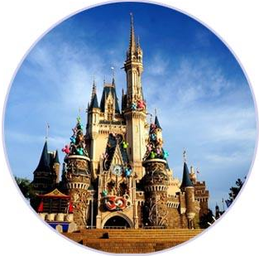
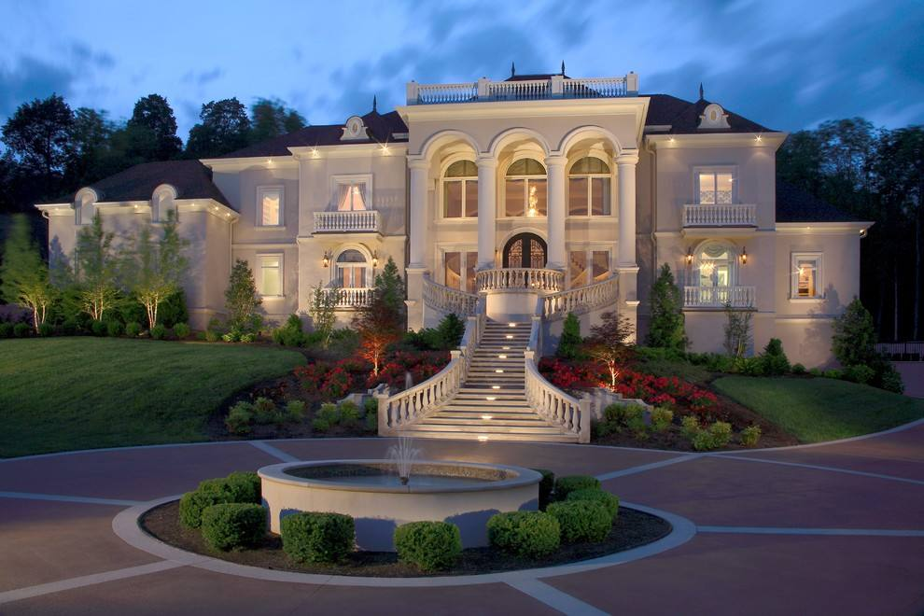
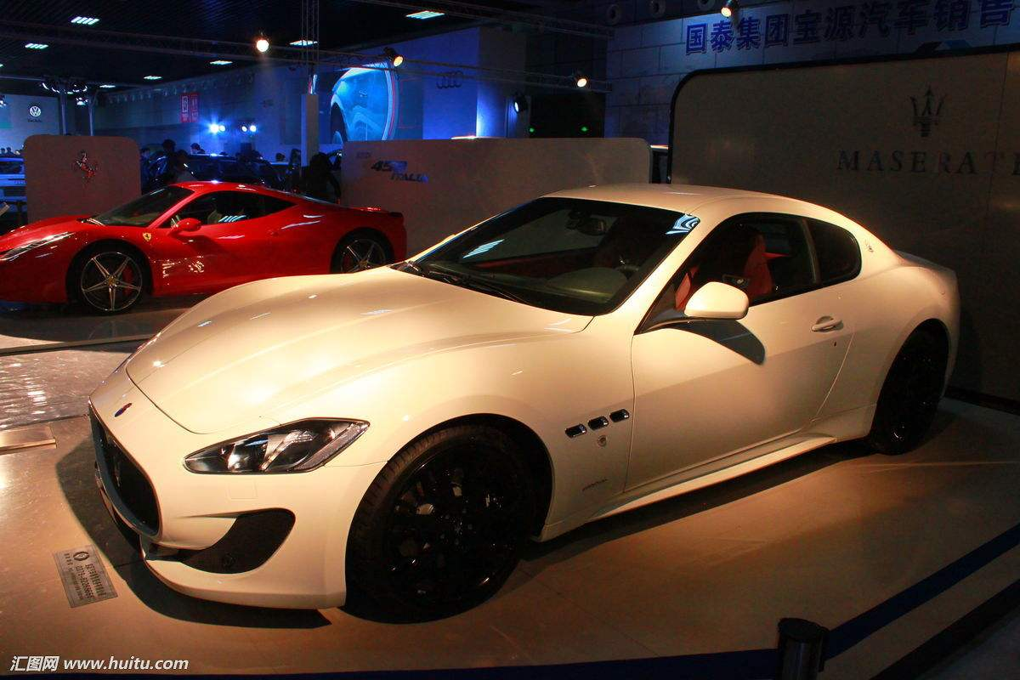
What did the father give his son? And what about other parents?
The Father
love;
time;
company...
laughter; delight;
fun...
generous
Comparison4
Other parents
rotten;
go wrong

Slide 14
What are the troubles in this country?
selfishness
the lowering of educational standards
the disappearance of simple manners
Like Father like Son！
questions about what to do

Slide 15
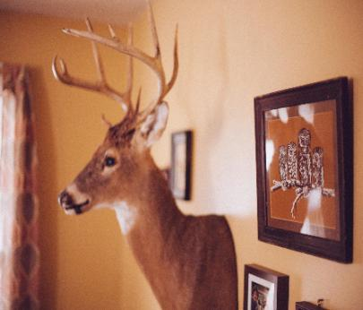
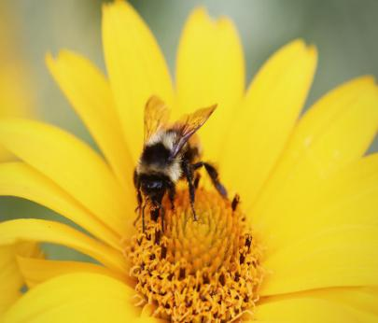
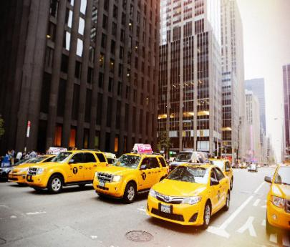
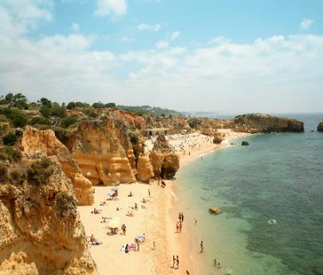
The answer is so simple:
care enough to spend time
pay attention & try their best
share happiness and sorrow
keep their children's company
It doesn’t cost a cent, yet it is the most valuable thing in the world.

Slide 16
Enjoy company!
Enjoy the meaningful life!

Slide 17

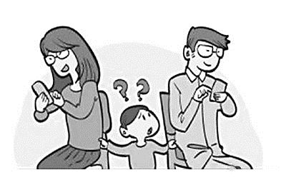
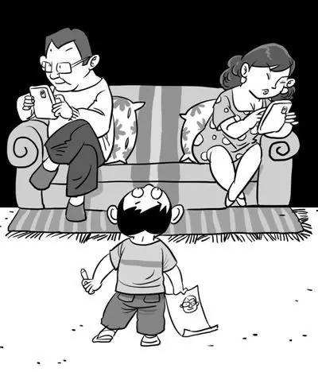
Sharing & writing:
Give your suggestions to these parents and share your ideas.

Slide 18
Thank you for your company!

