Slide 1

感恩遇见，相互成就，本课件资料仅供您个人参考、教学使用，严禁自行在网络传播，违者依知识产权法追究法律责任。
更多教学资源请关注
公众号：溯恩高中英语
知识产权声明

Slide 2






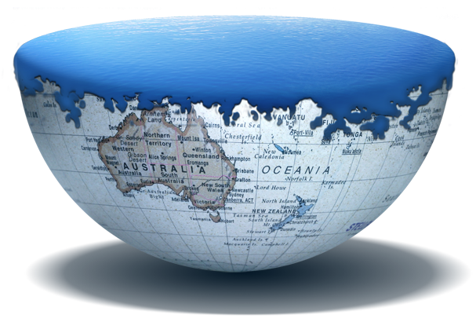


Global Warming
嵊州市高级中学 尹娟
单击此处编辑母版副标题样式

Slide 3
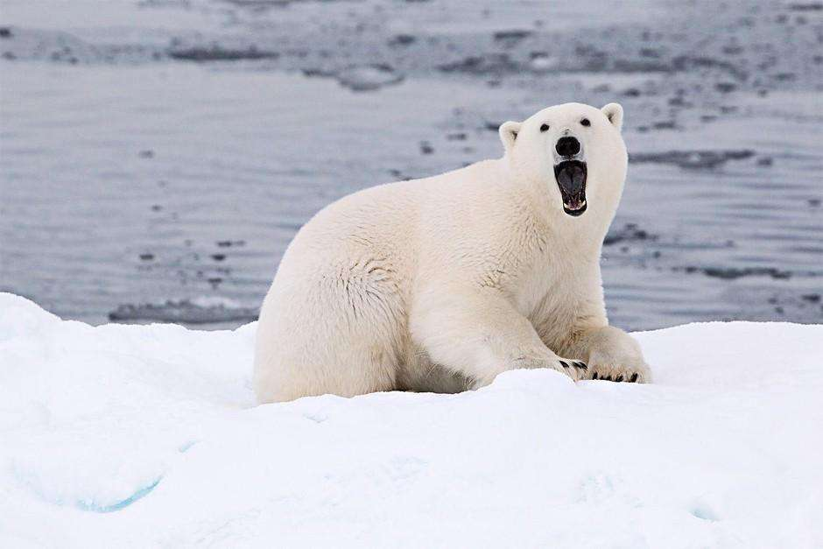
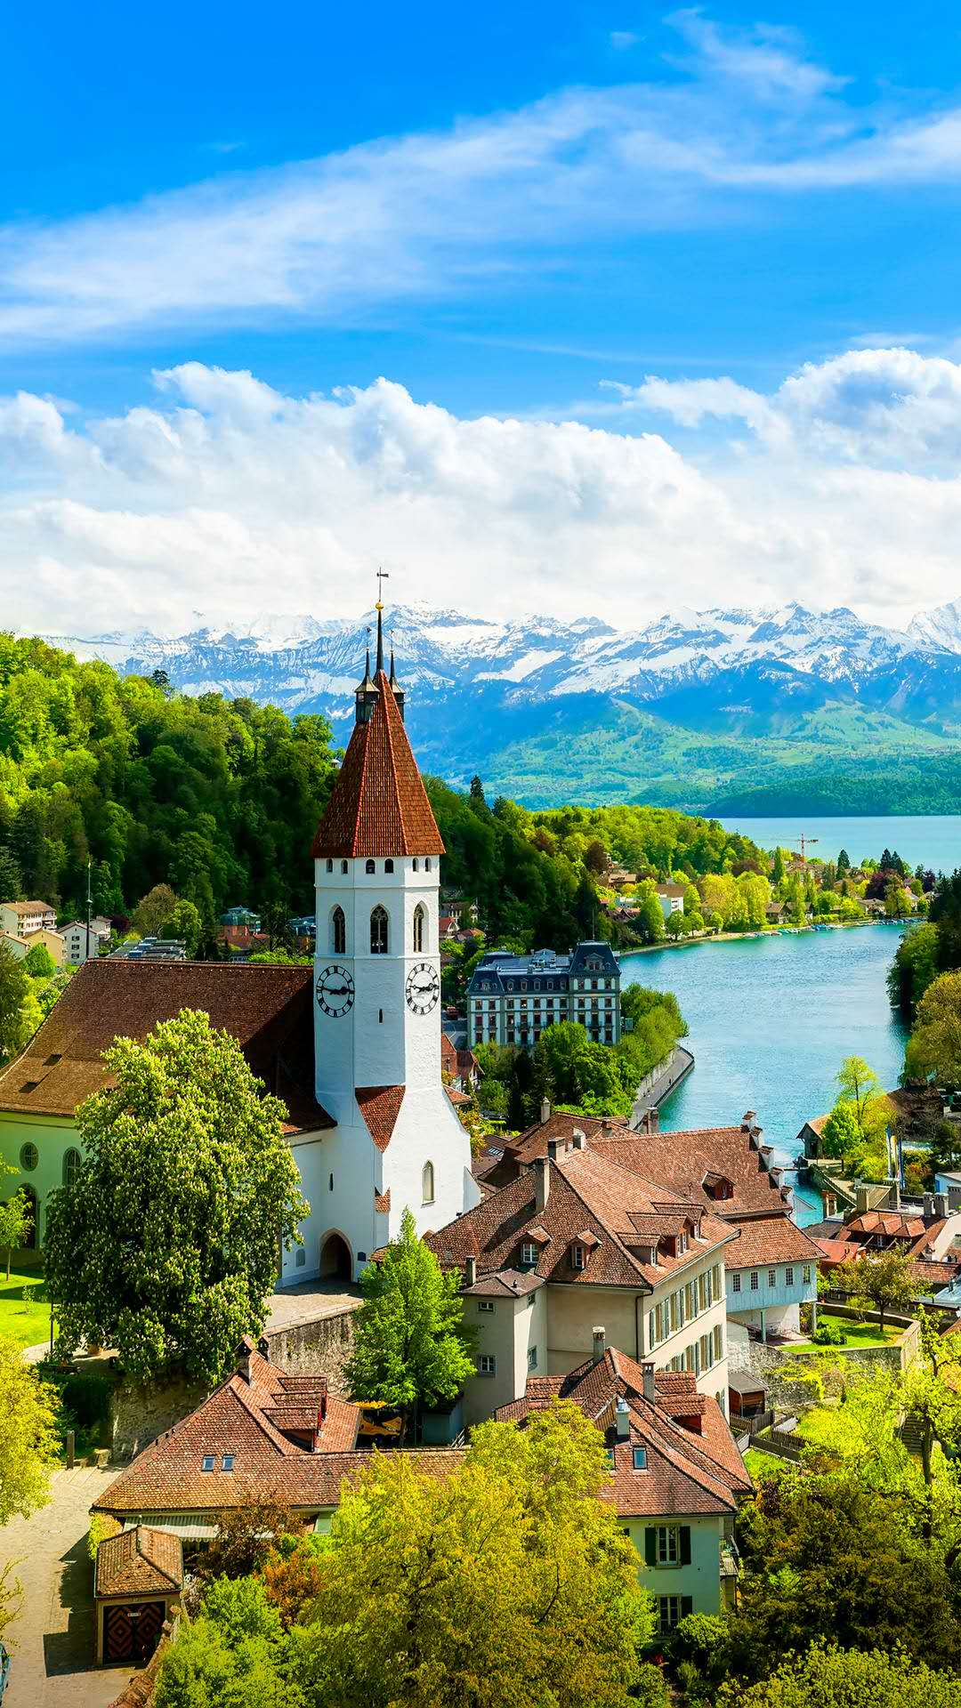
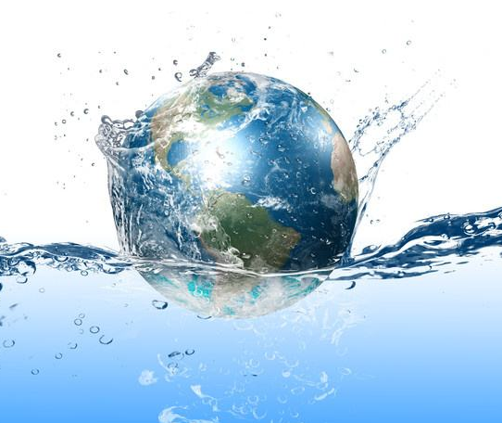
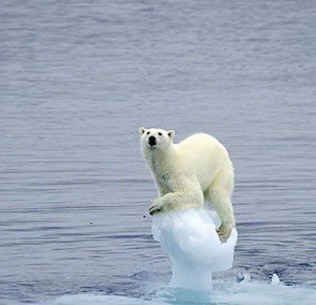
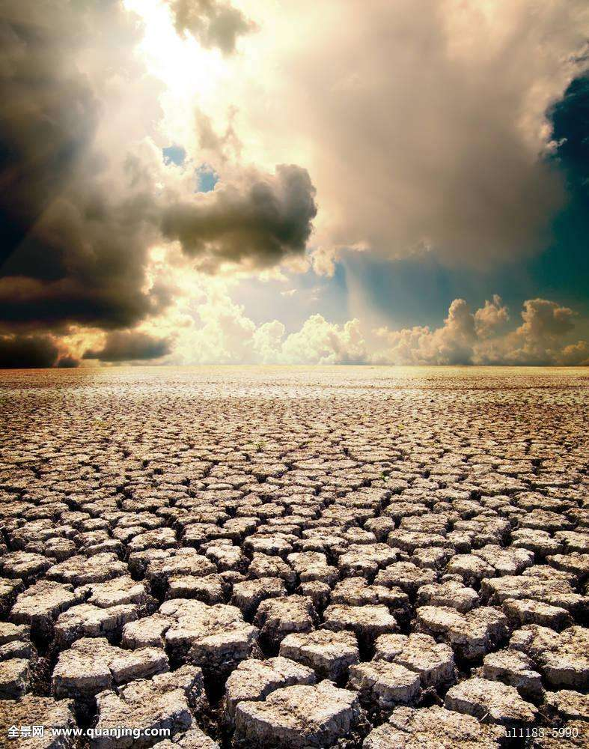
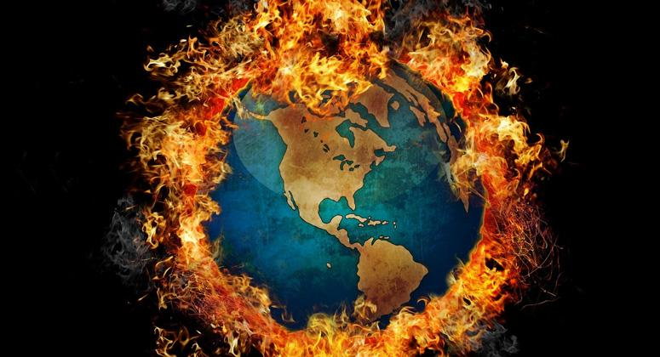

Slide 4
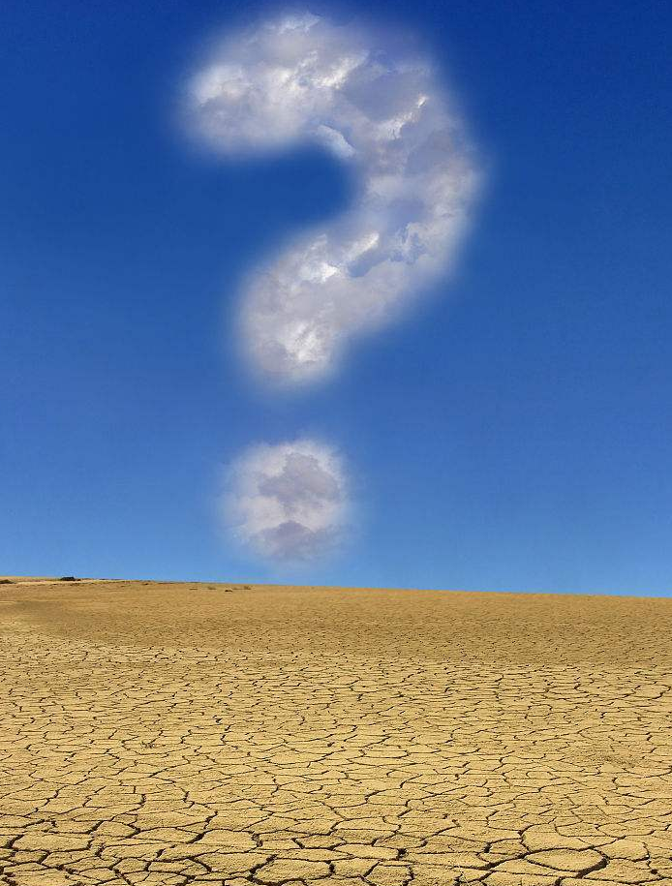

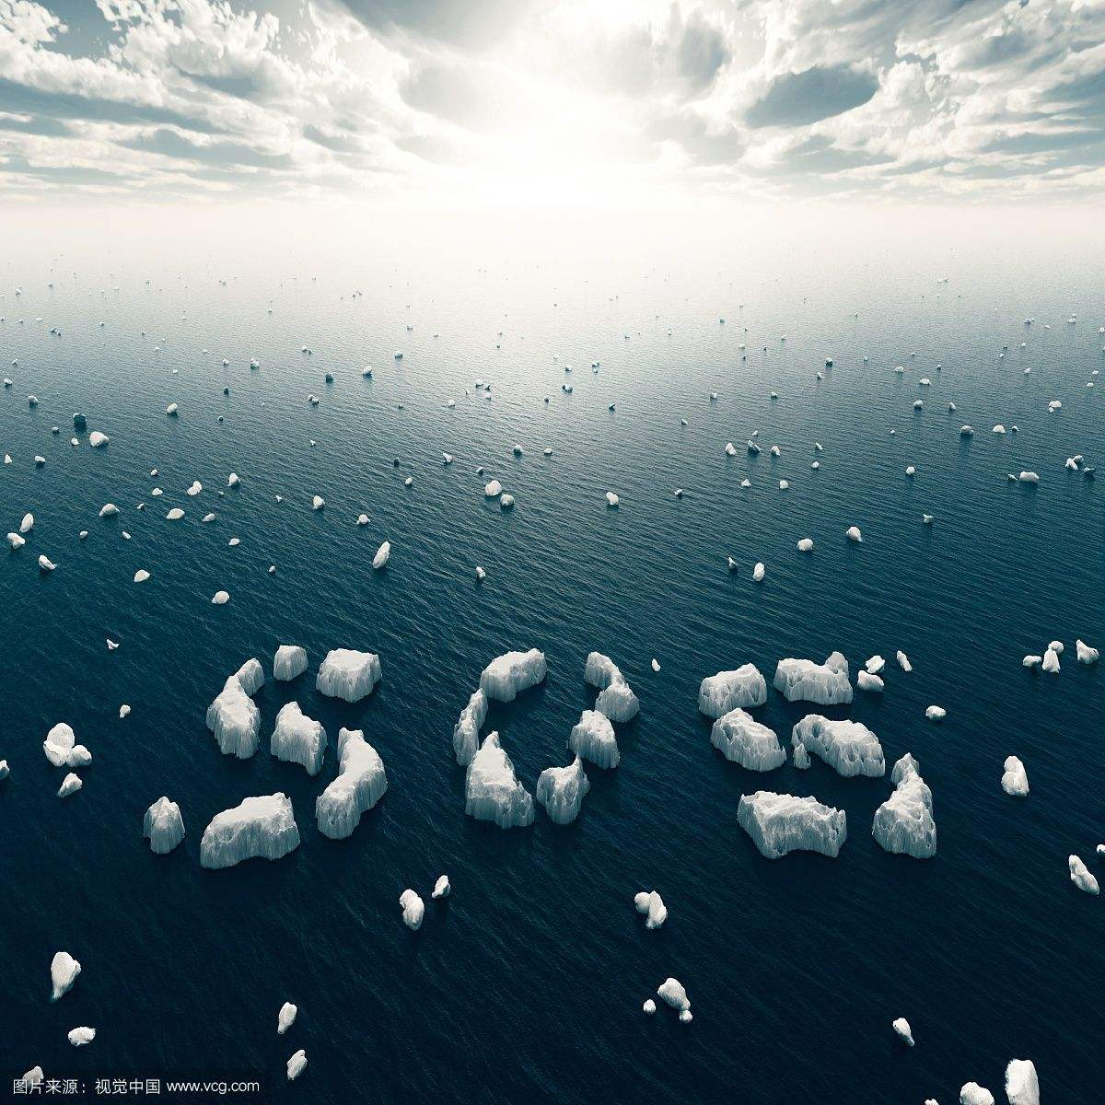

Slide 5

From your perspective, what is global warming?

Slide 6
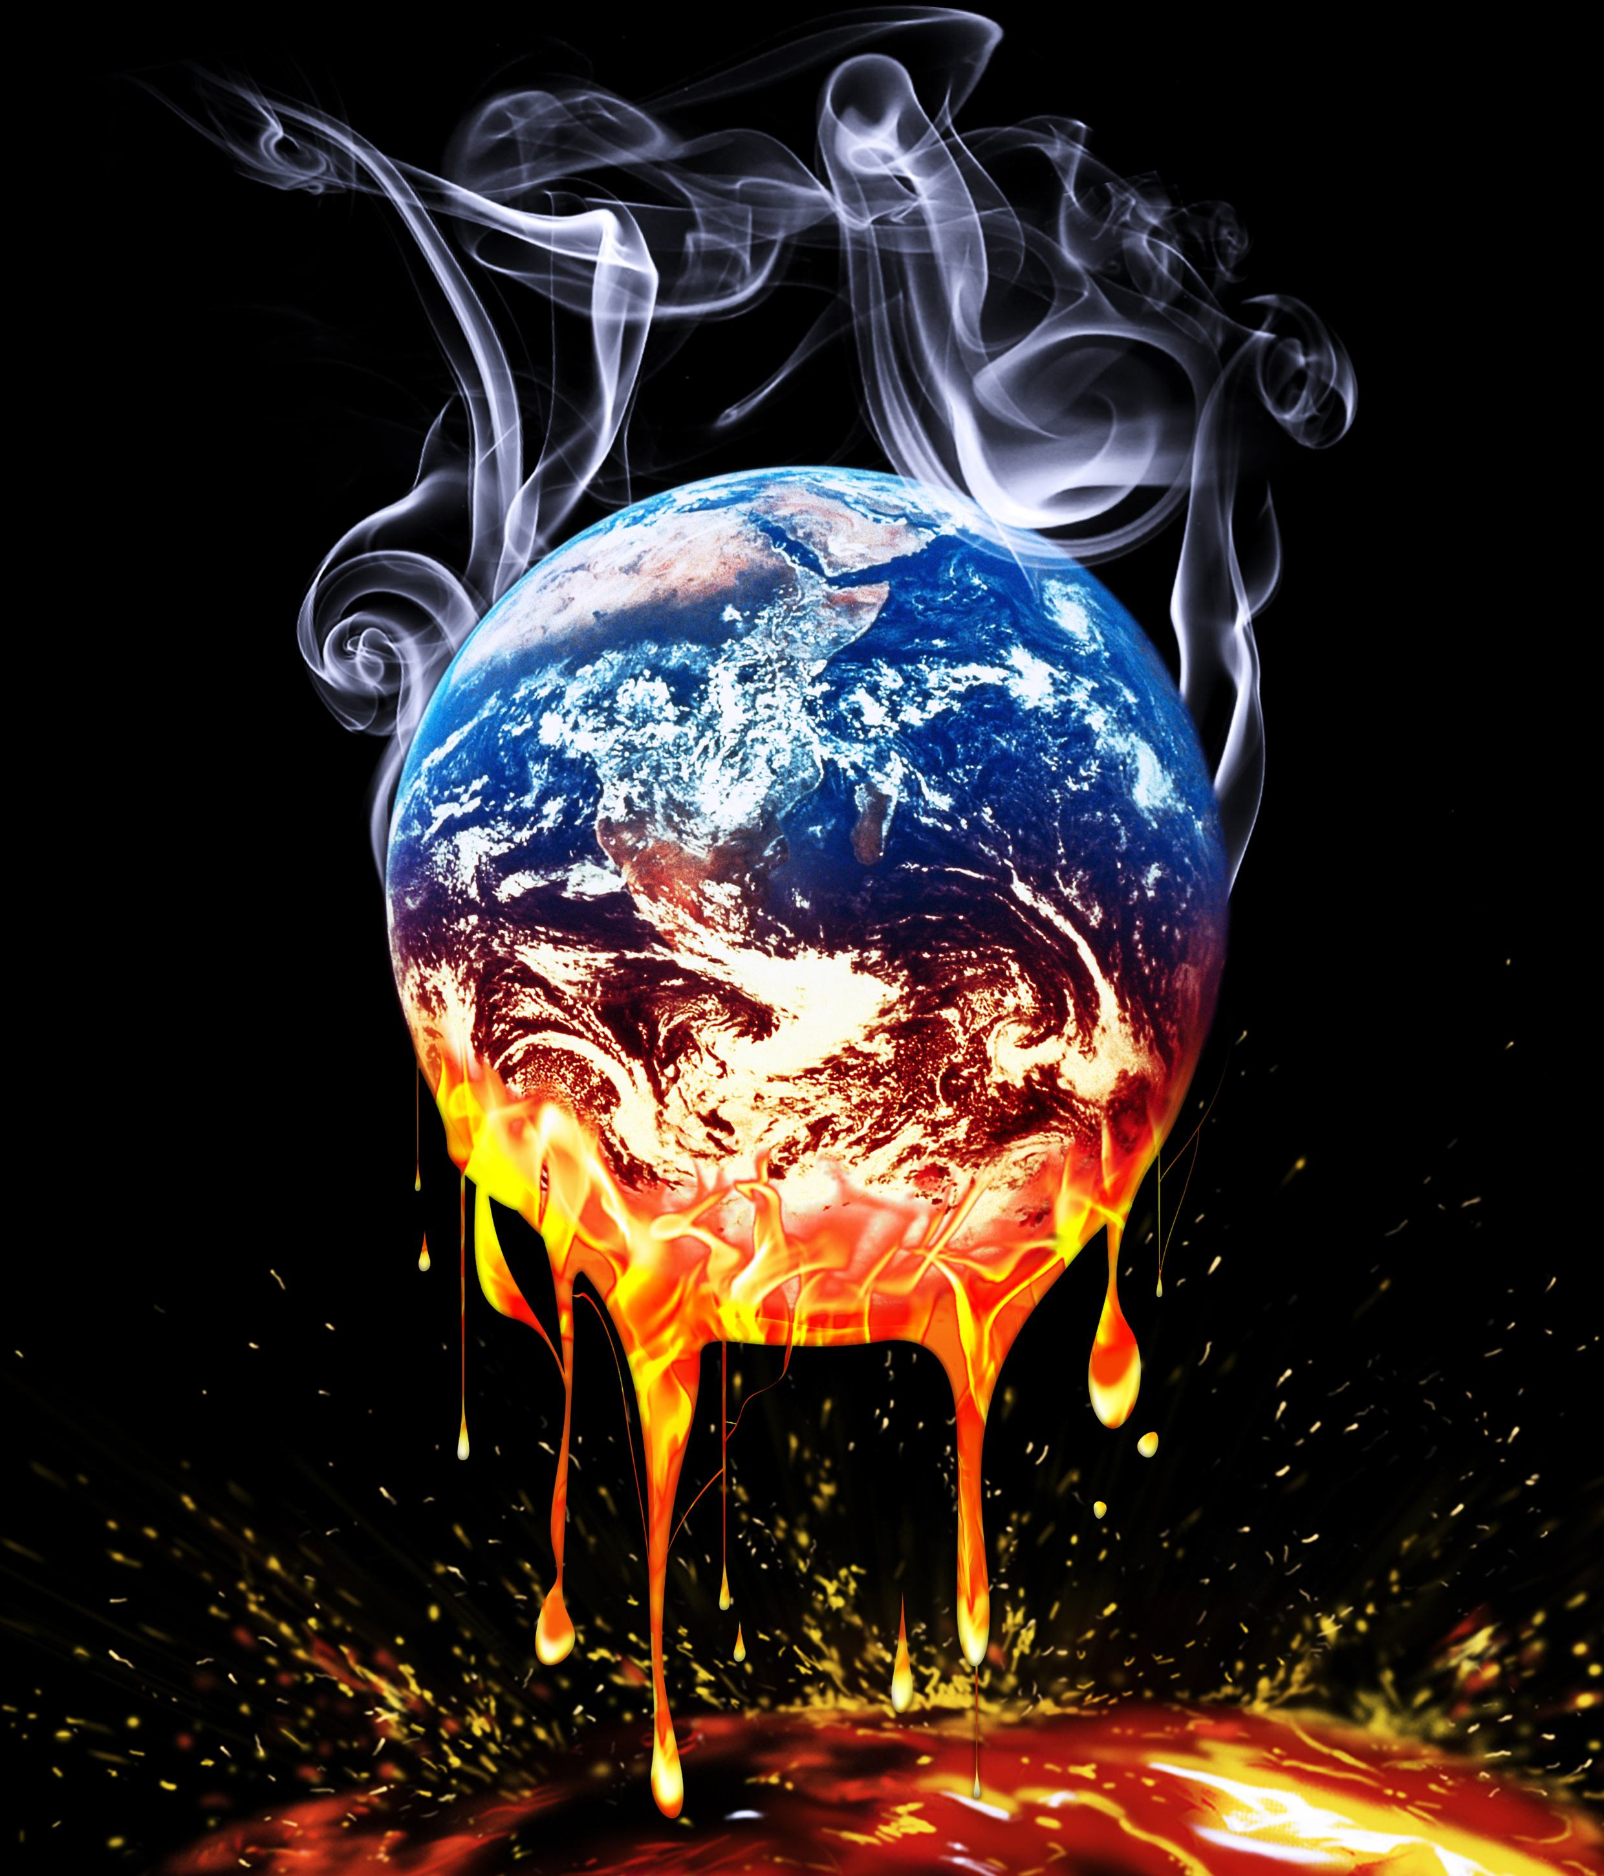
The fact
The earth is becoming warmer
---but does it matter?
The problem

Slide 7
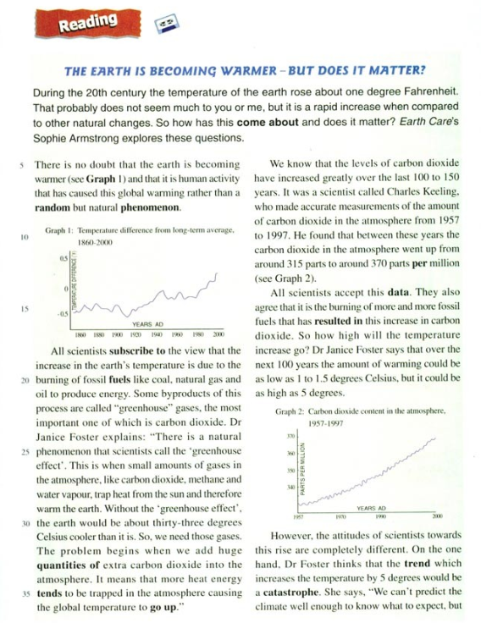

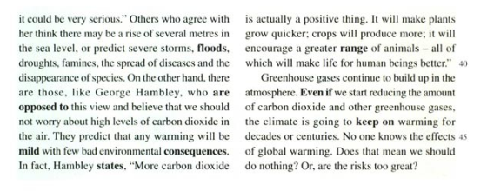
Read for structure
Title：It gives the topic and main idea.
Para1：It runs across the page
and is in bold.
Two graphs：They illustrate points by providing evidence.
Para2-7: The main text is in two columns.
Three quotes: They are important
and interesting points.

Slide 8
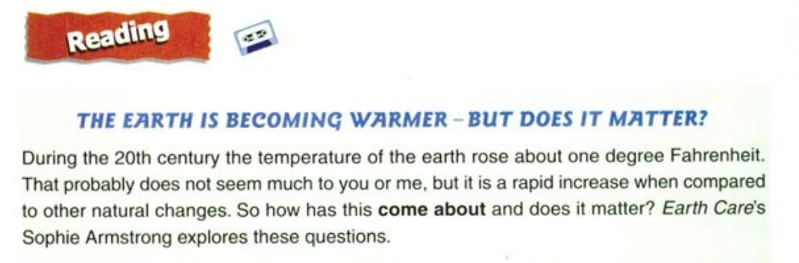
Read for specific information(Para1)
1℃=33.8℉
Q1: What's the purpose of the Para1?
Q2: Who wrote the magazine article? What is the name of the magazine?
To introduce the topic and specify the title.
Sophie Armstrong. Earth care.

Slide 9
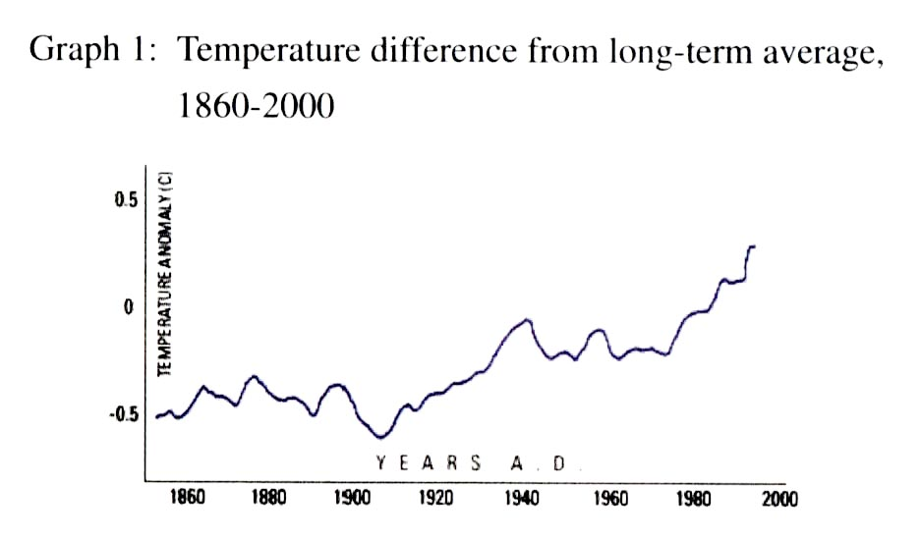
Read the Graph1 for specific information
(Para2)
There is no doubt that the earth is becoming warmer (see Graph 1) and that it is human activity that has caused this global warming rather than a random but natural phenomenon.
!
Detailed information
Between ______ to ______, the global average temperature went up from ______to _____ Fahrenheit.
1860
2000
-0.5
0.5

Slide 10
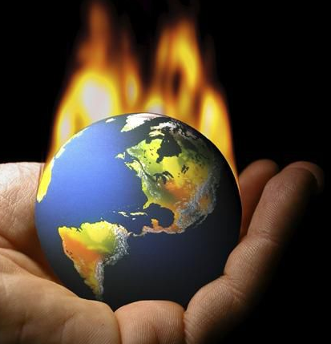
Read for specific information(Para3)
Q: What causes the increase of earth's temperature?
To produce energy.
greenhouse gases
The burning of fossil fuels like coal, natural gas and oil.
CO₂
Some byproduct.
Q: Do all scientists share the same view?
YES. They subscribe to the view.
(share the view / agree with others/ reach an agreement)

Slide 11
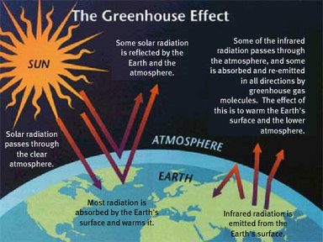
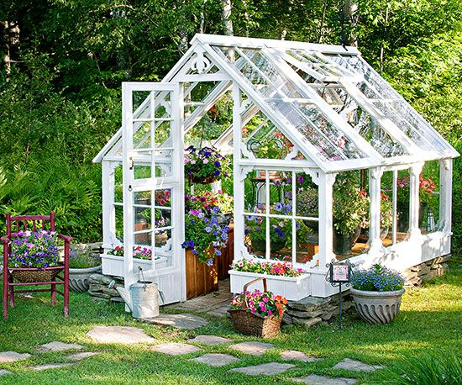

Greenhouse
Glass traps the heat from the sun and keeps it from escaping, making the greenhouse heat up.
The greenhouse gases perform the same function as the glass. They trap the heat from the sun and keep it from escaping, making the earth heat up.

Slide 12
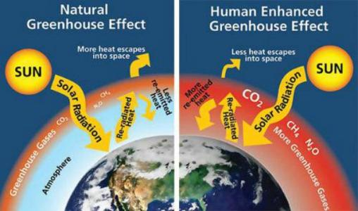

Slide 13
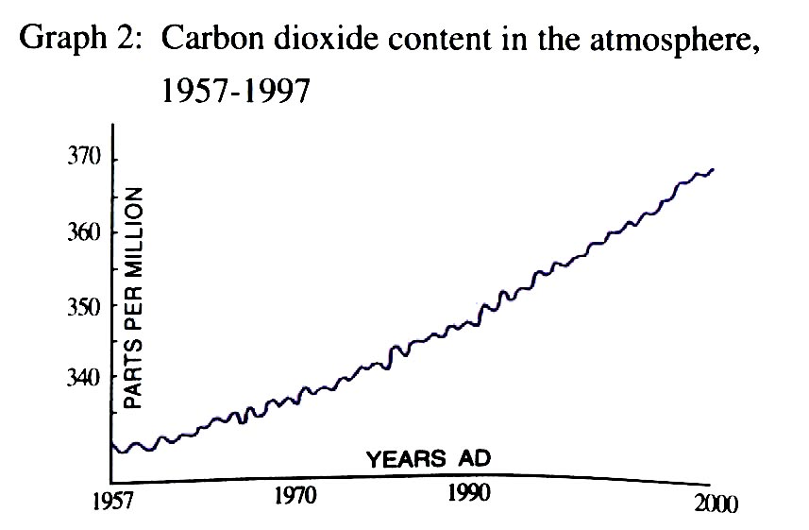
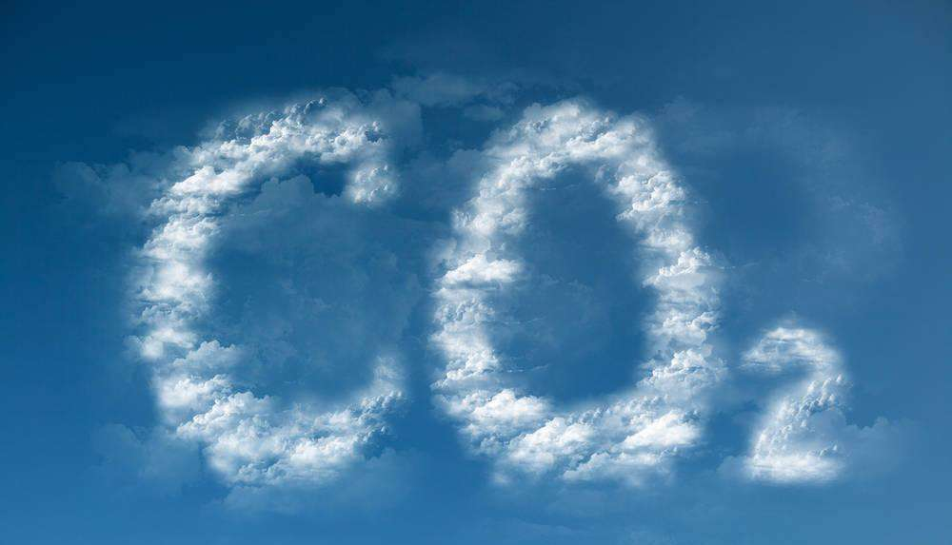
Read the Graph2 for specific information
(Para4-5)
We know that the levels of carbon dioxide ______________________ over the last 100 to 150 years.
It was a scientist called _______ ____________ who made accurate measurements of CO₂ in the atmosphere from ______ to ______. He found that between these years, the carbon dioxide content of the atmosphere went up from around ____ parts per million to around ____ parts per million.
have increased greatly
Charles
Keeling
1957
1997
315
370

Slide 14
Q: Do all scientists subscribe to this data?
YES. They accept this data.
P2: All scientists subscribe to the view that the increase in the earth's temperature is due to the burning of fosil fuels...
They agree that it is the burning of more and more fosil fuels that has resulted in this increase in carbon dioxide.
Q: What will happen to the temperature in
the next 100 years?
The amount of warming could be as low as 1 to 1.5 ℃, but it could be as high as 5℃.

Slide 15
Read for ideas(Para6)
All scientists subscribe to the view.
They agree to some facts.
They accept the data.
They agree that the burning of fosil fuels has resulted in the increase in carbon dioxide.
Different ideas
Do all scientists share the same attidute towards the rise?
Different ideas
Different ideas
No. The attitudes are completely different.
Different ideas

Slide 16
DR Janice Foster
George Hambley
a catastrophe
a positive thing
rise of sea level
plants grow quicker
severe storms
VS.
crops produce more
floods
droughts
famines
greater range of animals
spread of diseases
disappearance of species

Slide 17
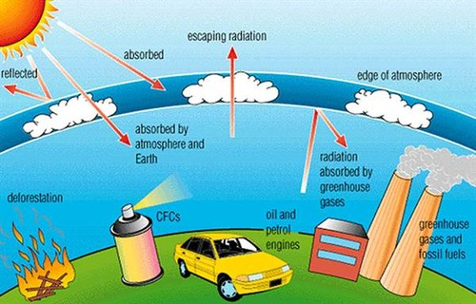
Read for further thinking (Para7)
Greenhouse gases
The climate keeps on warming
The amount of CO₂
effects
do nothing
the risks

Slide 18
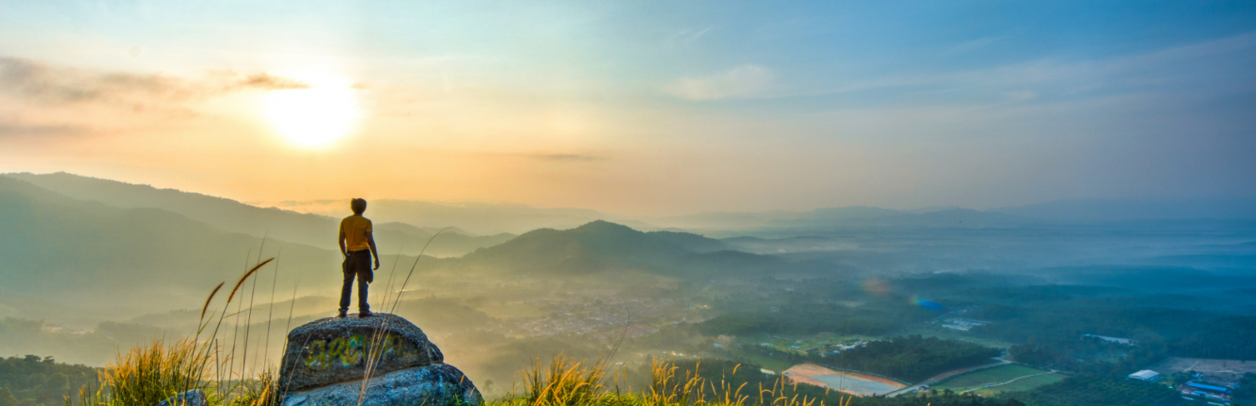
What should we do for our earth and for ourselves?

Slide 19
Thank you!

