Slide 1

感恩遇见，相互成就，本课件资料仅供您个人参考、教学使用，严禁自行在网络传播，违者依知识产权法追究法律责任。
更多教学资源请关注
公众号：溯恩高中英语
知识产权声明

Slide 2
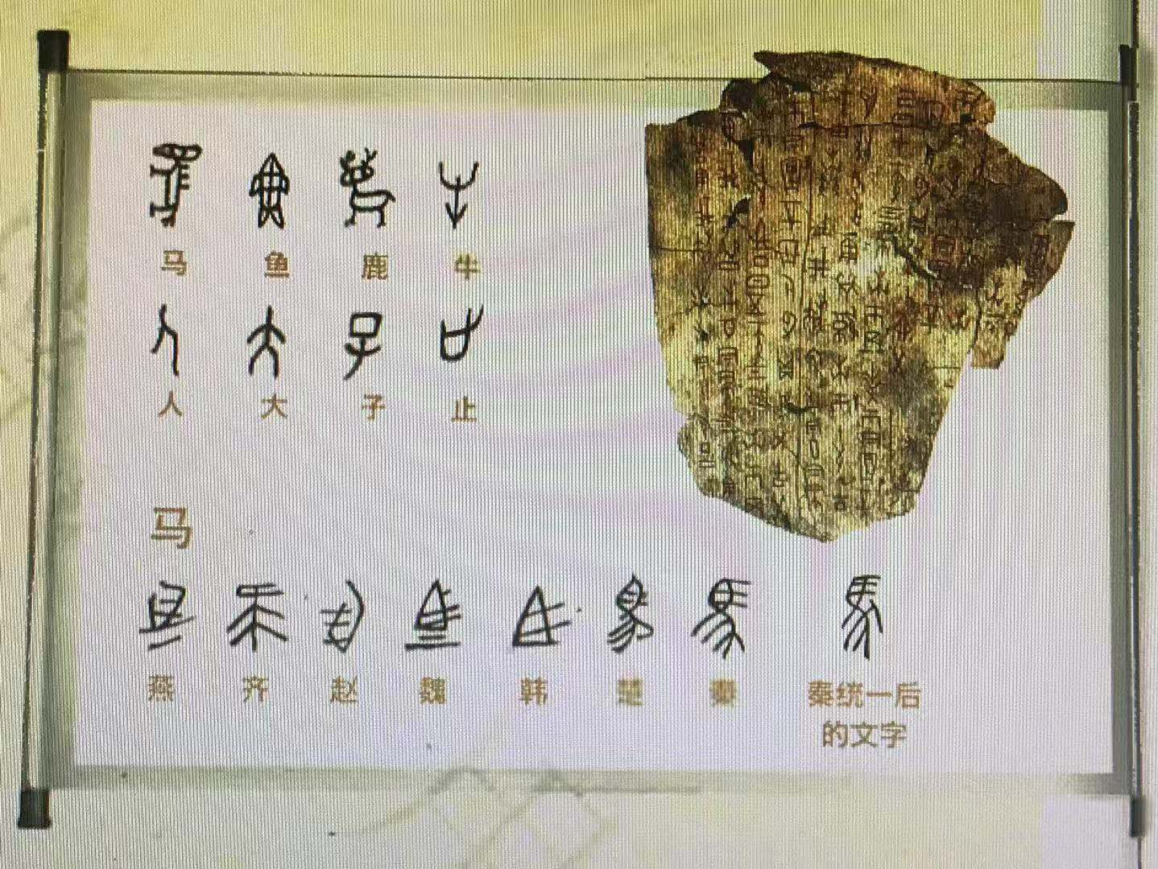
Welcome！
上虞区城南中学 陶江英

Slide 3
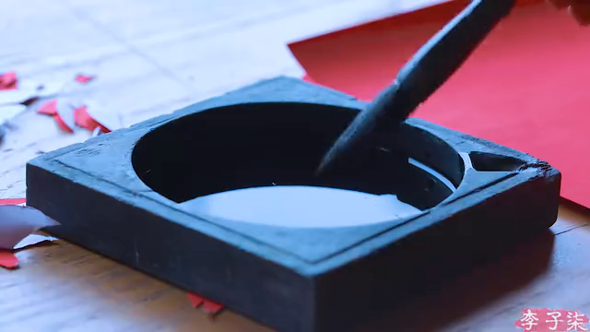


Lead in: free talk
Watch the video and discuss what Li Ziqi is doing?
write spring couplets
paste New Year pictures
decorate the house
A big hit/Internet celebrity
How much do you know about her?
In a Chinese traditional way
Connect China and the world
Millions of fans abroad

Slide 4
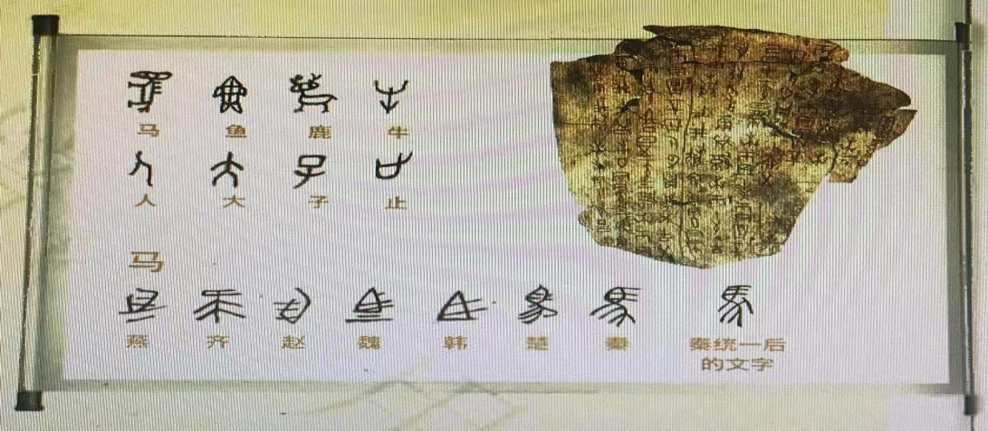
task1 PREDICTION
Look at the title and picture below. Predict what the text will be about.
THE CHINESE WRITING SYSTEM:
CONNECTING THE PAST AND THE PRESENT

Slide 5
task2 SKIMMING
Divide the text into THREE parts and find the main idea of each part.
Part1(Para.1)
Topic
the Chinese writing system
Part2(Para.2-3)
History
Part3(Para.4-6)
Importance
What’s the writing style?
A.Narration(叙述文) B.Description(描述文) C.Exposition (说明文)

Slide 6
task3 scanning:
Part1 Topic
China is widely known for its ancient civilisation which has
continued all the way through into modern times, despite the many ups and downs in its history. There are many reasons why this has been possible, but one of the main factors has been the Chinese writing system.
ancient civilisation
pass down/survive
Why can ancient civilisation pass down?
Topic: The Chinese writing system helps Chinese ancient civilisation survive.

Slide 7
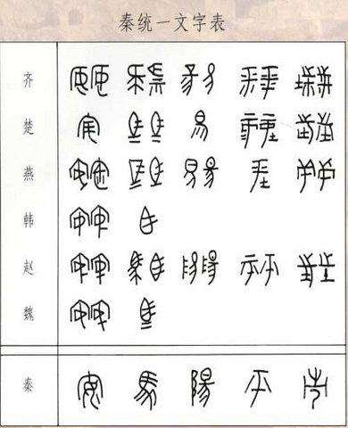
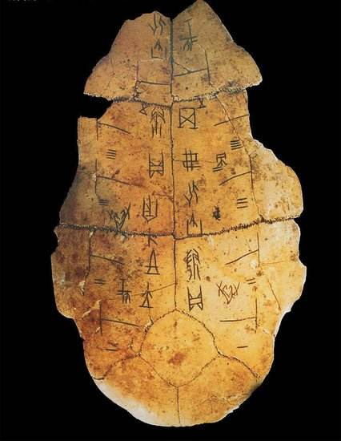
task3 scanning:
Part2 History
How does the Chinese writing system develop?

Slide 8
task3 scanning:
Part2 History
Carved on bones or shells
Many varieties and characters
Shang Dynasty
Qin Dynasty
Several thousand years ago
Well-developed
People were divided
A unified system

Slide 9
task3 scanning:
Part3 Importance
How?
Para.4
标题文本
Connect_____________ divided by geography
Chinese people
Para.5
Importance
标题文本
the past
Connect _________and __________
the present
Para.6
标题文本
Connect _______ and _________
China
the world

Slide 10

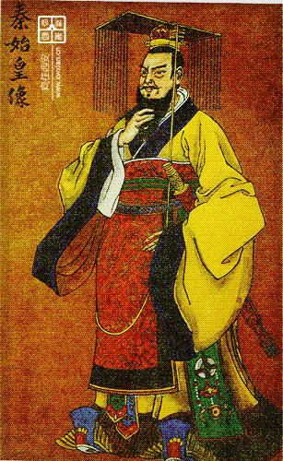
task3 further-thinking
Try to make comments from different perspectives.
How did written Chinese unify Chinese people divided by geography?
1
founded the unified country
People can communicate in writing.
established the unified system
imposed severe punishment
01
CRITICAL THINKING: Do you like Emperor Qinshihuang? Why?

Slide 11

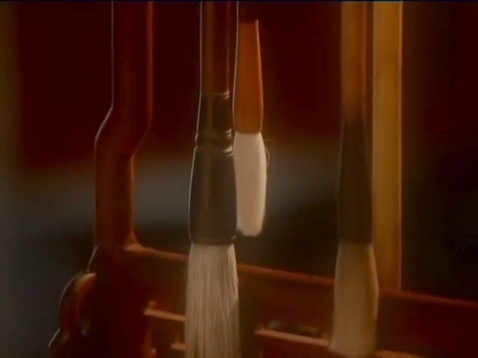
task3 further-thinking
How does written Chinese connect the past and the present?
a long history
an art form
part of Chinese culture
contain life lessons
show people’s taste/ characters
…
2
classic works
calligraphy
How much do you know about calligraphy?
01
With the development of new technology, some people think there is no need to improve handwriting or learn calligraphy. Do you agree?

Slide 12
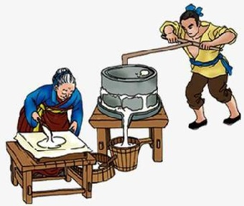
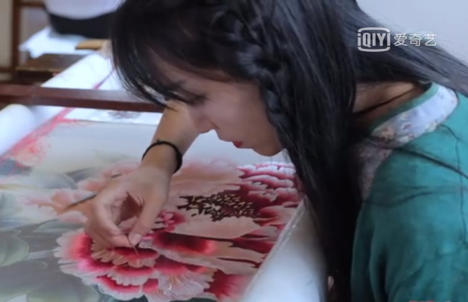
task4 discussion
The Chinese writing system is one factor that has helped the Chinese language and culture survive. What do you think are some of other factors?
Chinese painting
Beijing opera
Beijing duck
china
Hot Pot
tea
architecture
Traditional arts
Traditional food
wine
dumpling
…
mooncake
soya-bean milk
Shu embroidery
…
paper-cutting
01
Chinese people’s contributions

Slide 13

task4 discussion
As a Chinese teenager, what will you do to help to spread Chinese culture?
Expressions for reference:
Improve our Chinese and English.
Hold a positive attitude to Chinese culture.
Have a good knowledge of Chinese culture.
Learn some traditional arts when interested.
Introduce Chinese culture to foreigners if possible.
…
01

Slide 14
HOMEWORK
Read the text again and recite the expressions you like.
Finish writing the following speech after class.
你校将举行一次主题为“传承中华文明，传播中国文化”的英语演讲比赛，请你写一篇演讲稿，内容包括：
如何传承；
如何传播；
注意：
词数80左右；
可适当增加细节，以使行文连贯

Slide 15
Thank You！

Slide 16
one possible version
Dear friends,
I’m really proud to share my opinions about Chinese culture. As Chinese teenagers, we should attempt to appreciate Chinese culture and have a good knowledge of it. Surely, it’s better to learn some traditional arts, like calligraphy.
Nowadays, China plays an increasingly vital role in global affairs. Therefore, it’s a good idea to introduce Chinese language, arts, foods and the stories behind to foreigners if possible. So we’d better learn both Chinese and English well to make the communication smoothly. Actually it’s our responsibility to connect China to the world more closely.
Thanks for your listening!
01

