Slide 1

感恩遇见，相互成就，本课件资料仅供您个人参考、教学使用，严禁自行在网络传播，违者依知识产权法追究法律责任。
更多教学资源请关注
公众号：溯恩高中英语
知识产权声明

Slide 2
励志歌曲
Born To Be Somebody
天生不凡
浙江省常山一中 吴俊峰

Slide 3
I was born to be somebody. And nothing that ever gonna stop me.
我们生来不同, 却不能被任何阻挡
I light up the sky like lightning. I gonna rise above.
我们犹如闪电照亮天空，只为迎难而上
01
CONTENT
目录
Singer Profile
02
Theme of the song
03
Learn the lyric
04
Enjoy and Imitate
05
Beautiful essay
Born to Win

Slide 4


1 Singer Profile
Born To Be Somebody
天生不凡
http://www.sunedu.com
这是17岁少年偶像Justin Bieber推出的一首励志歌曲。
歌曲中表达了Justin Bieber永不言弃，天生不凡的王者风范！贾斯汀·比伯是欧美乐坛窜红速度最快的少年歌手。不仅在音乐上有惊人的才华；创作、打鼓、跳舞、弹吉他、弹琴、小号样样行，而且长相很帅气。
在“2011年福布斯全球百位巨星排行榜”上贾斯汀名列第三。

Slide 5

2 Theme of the song
Born To Be Somebody
天生不凡
http://www.sunedu.com
天生我材必有用！我天生就是大人物，生来不平凡。即使很困难，即使会失败，即使未来有很多未知，但我始终坚信，没有人能打倒我。世界很大，我们要做的就是做到最好的自己，在自己的世界里我们就是王！
同学们，遇到挫折的时候霸气地吼一句“我就是我，我怕谁！”。The world makes way for the man who knows where he is going.只要确定了前进的方向，世界都会为你让路！
For what it's worth, it's never too late, or too early, to be whoever you want to be. 一件值得做的事无论太晚，或者太早，都不会阻拦你成为你想成为的那个人。

Slide 6

3 Learn the lyric
Born To Be Somebody
天生不凡
http://www.sunedu.com
1、There's a dream in my soul 我一直有一个梦想
A fire is deep inside me 灵魂深处火焰在燃烧
There's a me no one knows 那有一个无人知晓的自己
Waiting to be set free 在等待着被释放
I am gonna see that day 我将会看见那么一天
2、I can feel it, I can taste it 我能感受到,我能体味到
Change is coming my way 我将会变化
set free释放；使获得自由

Slide 7
3 Learn the lyric
Born To Be Somebody
天生不凡
http://www.sunedu.com
3、I was born to be somebody 我生来不凡
And nothing that ever gonna stop me 没有什么可以阻拦我
I light up the sky like lightning 我如闪电一样点亮夜空
I gonna rise above 我将会扶摇直上
Show them what I'm made of 向他们展示我的实力
I was born to be somebody, 我生来就是大人物,
I was born to be 天生就是
This world will belong to me 我将征服这世界

Slide 8
3 Learn the lyric
Born To Be Somebody
天生不凡
http://www.sunedu.com
4、This life can kick you around (woah)
生活可以使你颠沛流离
This world can make you feel small (woah)
世界可以让你觉得自己渺小
They will not keep me down (woah)
但是他们不会一直让你处在谷底
I was born to stand tall 我天生就该身居高位
I'm going on the way 我将会看到那一天
I can feel it, I believe it ,I'm here, I'm here to stay
我能感受到,相信它,在此处,在静立.
kick around 粗暴而轻率地对待

Slide 9
3 Learn the lyric
Born To Be Somebody
天生不凡
http://www.sunedu.com
REPEAT-3.I was born to be somebody 我生来不凡
And nothing that ever gonna stop me 没有什么可以阻拦我
I light up the sky like lightning 我如闪电一样点亮夜空
I gonna rise above 我将会扶摇直上
Show them what I'm made of 向他们展示我的实力
I was born to be somebody, 我生来就是大人物,
I was born to be 天生就是
This world will belong to me 我将征服这世界
Feel it ,Believe it ,Dream it, Be it 去感受,去相信,去梦想,去实现

Slide 10

3 Learn the lyric
Born To Be Somebody
天生不凡
http://www.sunedu.com
REPEAT-3.I was born to be somebody 我生来不凡
And nothing that ever gonna stop me 没有什么可以阻拦我
I light up the sky like lightning 我如闪电一样点亮夜空
I gonna rise above 我将会扶摇直上
Show them what I'm made of 向他们展示我的实力
I was born to be somebody, 我生来就是大人物,
I was born to be 天生就是
This world will belong to me 我将征服这世界
Whoa oh；Whoa oh，And this world will belong to me
我将征服这世界
Ye-ah ye-ah，Oh，And this world will belong to me
我将征服这世界

Slide 11
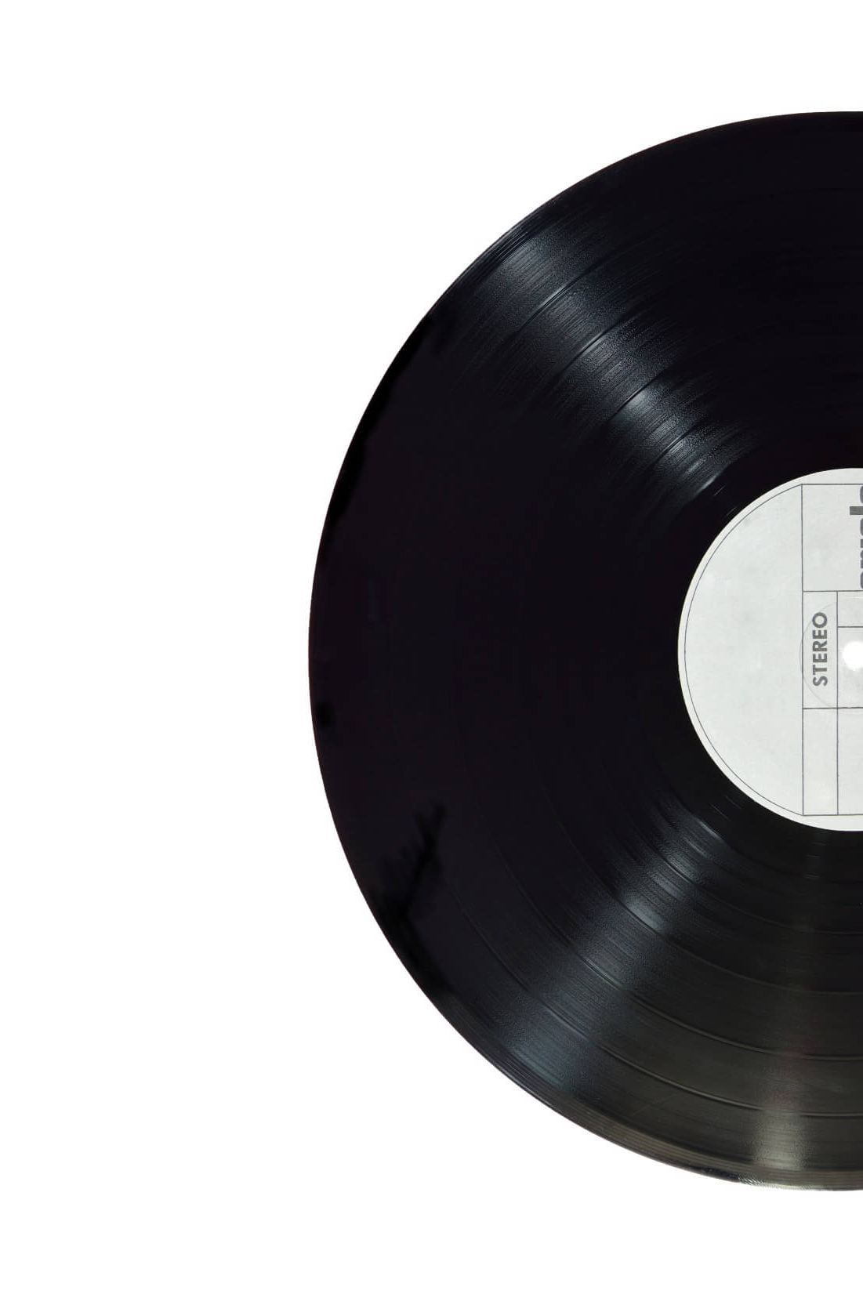
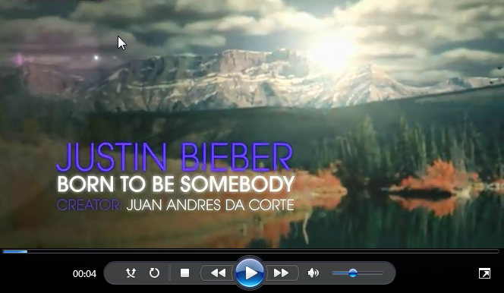
4 Enjoy and Imitate
Born To Be Somebody
天生不凡
http://www.sunedu.com

Slide 12

5 Beautiful essay
Born to Win 生而为赢
http://www.sunedu.com
Each human being is born as something new, something that never existed before. Each is born with the capacity to win at life. Each person has a unique way of seeing, hearing, touching, tasting and thinking. Each has his or her own unique potentials---capabilities and limitations. Each can be a significant, thinking, aware, and creative being---a productive person, a winner.
人皆生而为新，为前所未有之所存在；人皆生而能赢。人皆有其特立独行之方式去审视，聆听，触摸，品味及思考，因而都具备独特潜质-能力和局限。人皆能举足轻重，思虑明达，洞察秋毫，富有创意，成就功业。
capacity /kəˈpæsəti/
=capability /ˌkeɪpəˈbɪləti/
n. 才能，能力

Slide 13
5 Beautiful essay
Born to Win 生而为赢
http://www.sunedu.com
The word “winner” and “loser” have many meanings. When we refer to a person as a winner, we do not mean one who makes someone else lose. To us, a winner is one who responds authentically by being credible, trustworthy, responsive, and genuine, both as an individual and as a member of a society.
“成者”与“败者”含义颇多。谈及成者，我们并非指令他人失意之人。对我们而言，成者必为人守信，值得信赖，有求必应，态度诚恳，或为个人，或为社会一员皆能以真诚回应他人。
authentically /ɔ:'θentɪklɪ/ adv. 真实地; 真诚地

Slide 14
5 Beautiful essay
Born to Win 生而为赢
http://www.sunedu.com
Winners do not dedicated their lives to a concept of what they imagine they should be; rather, they are themselves and as such do not use their energy putting on a performance, maintaining pretence and manipulating others. They are aware that there is a difference between being loving and acting loving, between being stupid and acting stupid, between being knowledgeable and acting knowledgeable. Winners do not need to hide behind a mask.
成者行事并不拘泥于某种信条，即便是他们认为应为其奉献一生的理念；而是本色行事，所以并不把精力用来表演，保持伪装或操控他人。他们明了爱与装家，愚蠢与装傻，博学与卖弄之间迥然有别。成者无须藏于面具之后。
dedicated /ˈdɛdɪˌketɪd/ adj. 专用的; 专注的;投入的
concept /ˈkɒnsept/ n. 观念，概念
pretence /prɪˈtens/ n. 假装；借口；虚伪
manipulate /məˈnɪpjuleɪt/ vt. 操纵；操作；巧妙地处理

Slide 15
5 Beautiful essay
Born to Win 生而为赢
http://www.sunedu.com
Winners are not afraid to do their own thinking and to use their own knowledge. They can separate facts from opinions and don't pretend to have all the answers. They listen to others, evaluate what they say, but come to their own conclusions. Although winners can admire and respect other people, they are not totally defined, demolished, bound, or awed by them.
成者敢于利用所学，独立思考，区分事实与观点，且并不佯装通晓所有答案。他们倾听，权衡他人意见，但能得出自己的结论。尽管他们尊重，敬佩他们，但并不为他们所局限，所推翻，所束缚，也不对他人敬若神灵。
evaluate /ɪˈvæljuˌet/ vt. 评价；估值
define /dɪˈfaɪn/ vt. 定义；使明确；规定
demolish /dɪˈmɑ:lɪʃ/ vt.(knock down)拆除; (refute)驳倒; (defeat)彻底打败
awe /ɔ/ n. 敬畏 vt. 使敬畏

Slide 16
5 Beautiful essay
Born to Win 生而为赢
http://www.sunedu.com
Winners do not play “helpless”, nor do they play the blaming game. Instead, they assume responsibility for their own lives. They don't give others a false authority over them. Winners are their own bosses and know it.
成者既不佯装“无助”，亦不抱怨他人。相反，他们对人生总是独担责任，也不以权威姿态凌驾他人之上。他们主宰自己，而且能意识到这点。
assume /əˈsu:m/ vt.(suppose) 假定；(take on) 获得; 承担; 担任
authority /ɔːˈθɒrəti/ n. 权威；权力；当局

Slide 17
5 Beautiful essay
Born to Win 生而为赢
http://www.sunedu.com
A winner's timing is right. Winners respond appropriately to the situation. Their responses are related to the message sent and preserve the significance, worth, well-being, and dignity of the people involved. Winners know that for everything there is a season and for every activity a time.
成者善于审时度势，随机应变。他们对所接受的信息做出回应，维护当事人的利益，康乐和尊严。成者深知成一事要看好时节，行一事要把握时机。
timing /ˈtaɪmɪŋ/ n. uncountable (scheduling) 时间选择； uncountable(skill) 时机掌握
preserve /prɪˈzɜːv/ vt. 保存；保护；维持
dignity /ˈdɪɡnəti/ n. 尊严；高贵

Slide 18
5 Beautiful essay
Born to Win 生而为赢
http://www.sunedu.com
Although winners can freely enjoy themselves, they can also postpone enjoyment, can discipline themselves in the present to enhance their enjoyment in the future. Winners are not afraid to go after what he wants, but they do so in proper ways. Winners do not get their security by controlling others. They do not set themselves up to lose.
postpone /pəˈspəʊn/ v. 延缓，延迟
discipline /ˈdɪsəplɪn/ n. 纪律
enhance /ɪnˈhɑːns/ vt. 提高；加强
尽管成者可以自由享乐，但他更知如何推迟享乐，适时自律，以期将来乐趣更盛。成者并不忌惮追求所想，但取之有道，也并不靠控制他们而获取安然之感。他们总是使自己立于不败。

Slide 19
5 Beautiful essay
Born to Win 生而为赢
http://www.sunedu.com
A winner cares about the world and its peoples. A winner is not isolated from the general problems of society, but is concerned, compassionate, and committed to improving the quality of life. Even in the face of national and international adversity, a winner’s self-image is not one of a powerless individual. A winner works to make the world a better place.
isolated /ˈaɪsəleɪtɪd/ adj. 孤立的
compassionate /kəmˈpæʃənɪt/
adj. 有同情心的
committed /kəˈmɪtɪd/ adj. 坚定的
adversity /ədˈvɜ:rsəti/ n.逆境；困境
成者心忧天下，并不孤立尘世弊病之外，而是置身事内，满腔热情，致力于改善民生。即使面对民族，国家之危亡，成者亦非无力回天之个体。他总是努力令世界更好。

Slide 20
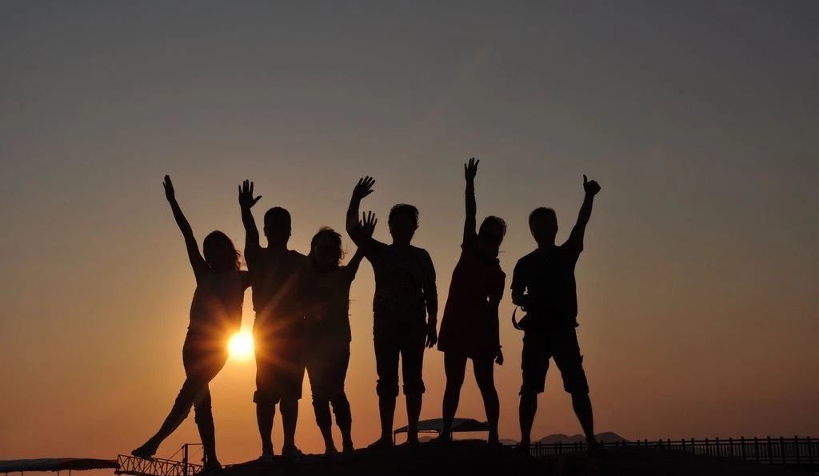
I was born to be somebody. My destiny is held in my hands. Gaokao, win!
我天生不凡，我的命运掌握在我自己的手中。
高考，必胜！

