Slide 1

感恩遇见，相互成就，本课件资料仅供您个人参考、教学使用，严禁自行在网络传播，违者依知识产权法追究法律责任。
更多教学资源请关注
公众号：溯恩高中英语
知识产权声明

Slide 2

Kobe Bryant

Slide 3
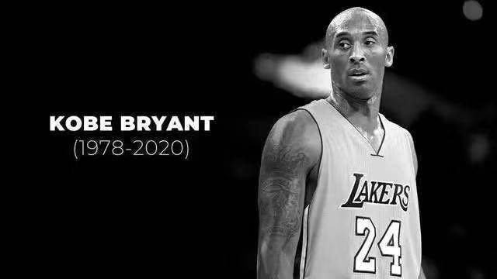
It's hard to believe NBA superstar Kobe Bryant, whose prodigious talent and win-at-all-costs spirit made him one of the most famous and decorated athletes in history, is gone.
Bryant died on January 26, 2020, in a helicopter crash in Calabasas, California. Eight others, including his 13-year-old daughter Gianna Bryant, were also killed.
一代传奇球星猝然陨落。据美国媒体消息，当地时间26日，NBA名宿科比·布莱恩特在美国加利福尼亚州洛杉矶县卡拉巴萨斯的一场直升机坠机事故中遇难，年仅41岁，他13岁的女儿Gigi也在事故中遇难。
1978
2020

Slide 4

Content
Who he is
His career
His spirit

Slide 5
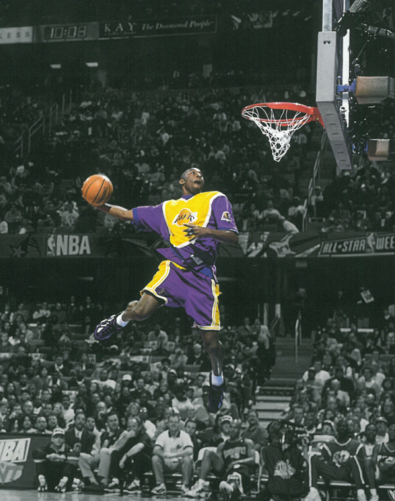
Who he is
一
I don't want to be
the next Michael Jordan,
I only want to be
Kobe Bryant.
----Kobe Bryant

Slide 6
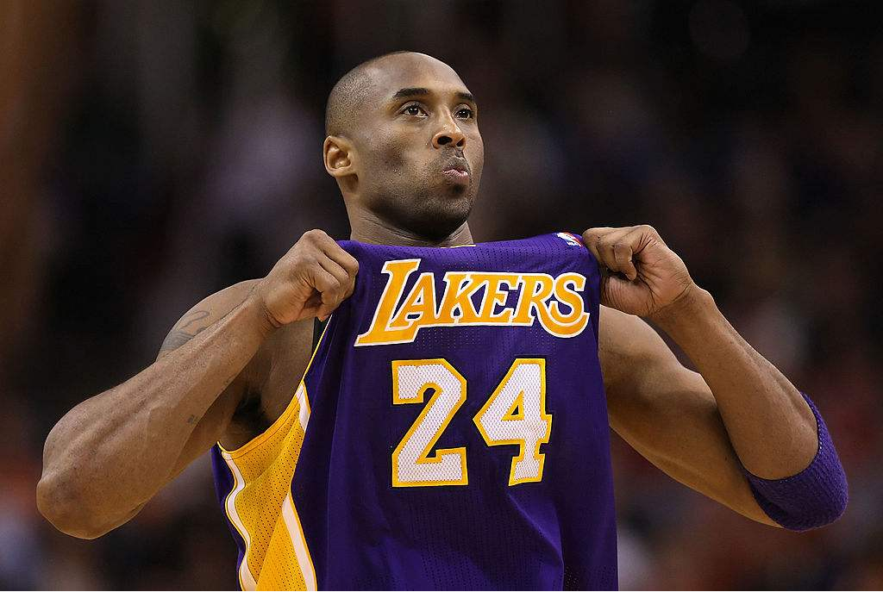
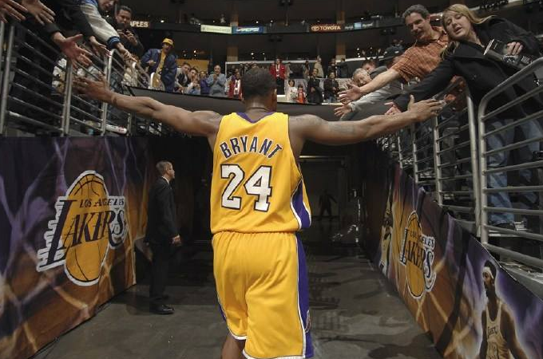
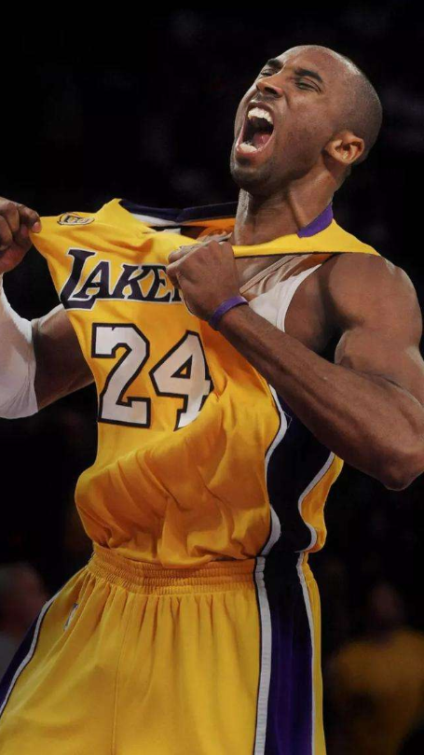
Who is he?
Kobe Bean Bryant ( 23th August,1978 – 26th January, 2020) was an American professional basketball player.
A shooting guard, Bryant entered the National Basketball Association (NBA) directly from high school, and played his entire 20-season professional career in the league with the Los Angeles Lakers.
Widely regarded as one of the greatest players of all time,he led the NBA in scoring during two seasons, ranks fourth on the league's all-time regular season scoring, and ranks fourth on the all-time postseason scoring list.

Slide 7
what's more?
“There is always someone to win. Why not me?”he said.
“The most important thing is to try and inspire people
so they can be great in whatever they want to do.”he said.
"I don't want to be the next Jordan, I just want to be myself - Kobe Bryant." he said.
“Some of life,you have to go to great challenges.”he said.
"Not every moment is a celebration,
a champagne and a championship celebration,
but you have to go through those rough patch." he said.
“I just go. I just go.
I just keep going until it feels right to me,"
Kobe says of his habits.

Slide 8
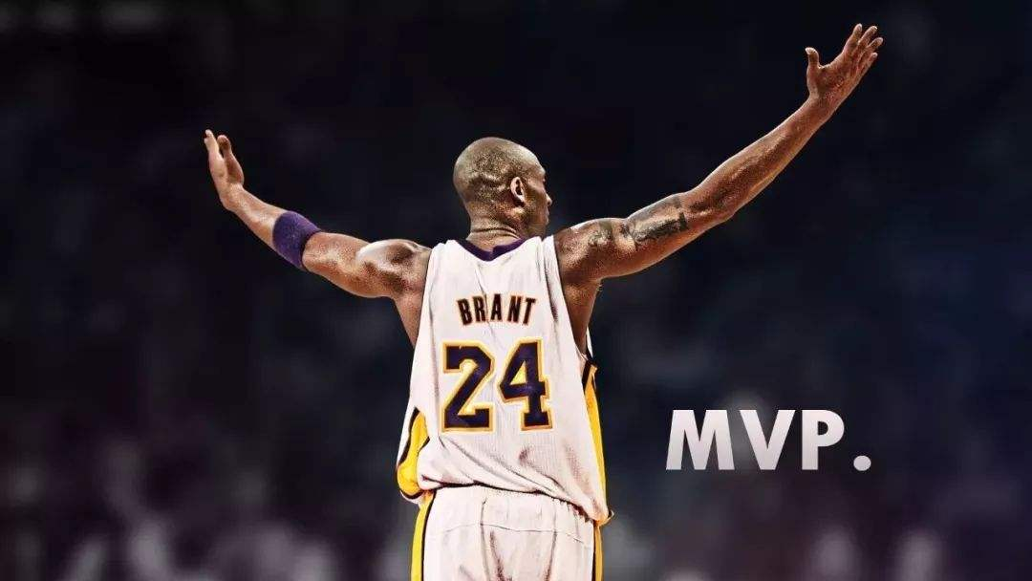
5 NBA championships
career regular-seaon points
33643
18-time All-Star
15-time member of the All-NBA Team
12-time member of the All-Defensive Team
His Career

Slide 9

Kobe Bryant
HISTORY
1978
Born in Philadelphia, Pennsylvania
1996
was chosen in NBA Draft
2000 -2002
Get 3 consecutive champions
2003
-2007
Disappoinment season
2008
MVP Season
2009 -2010
2consecutive champions
2016
Retired
2020
Rest in peace

Slide 10
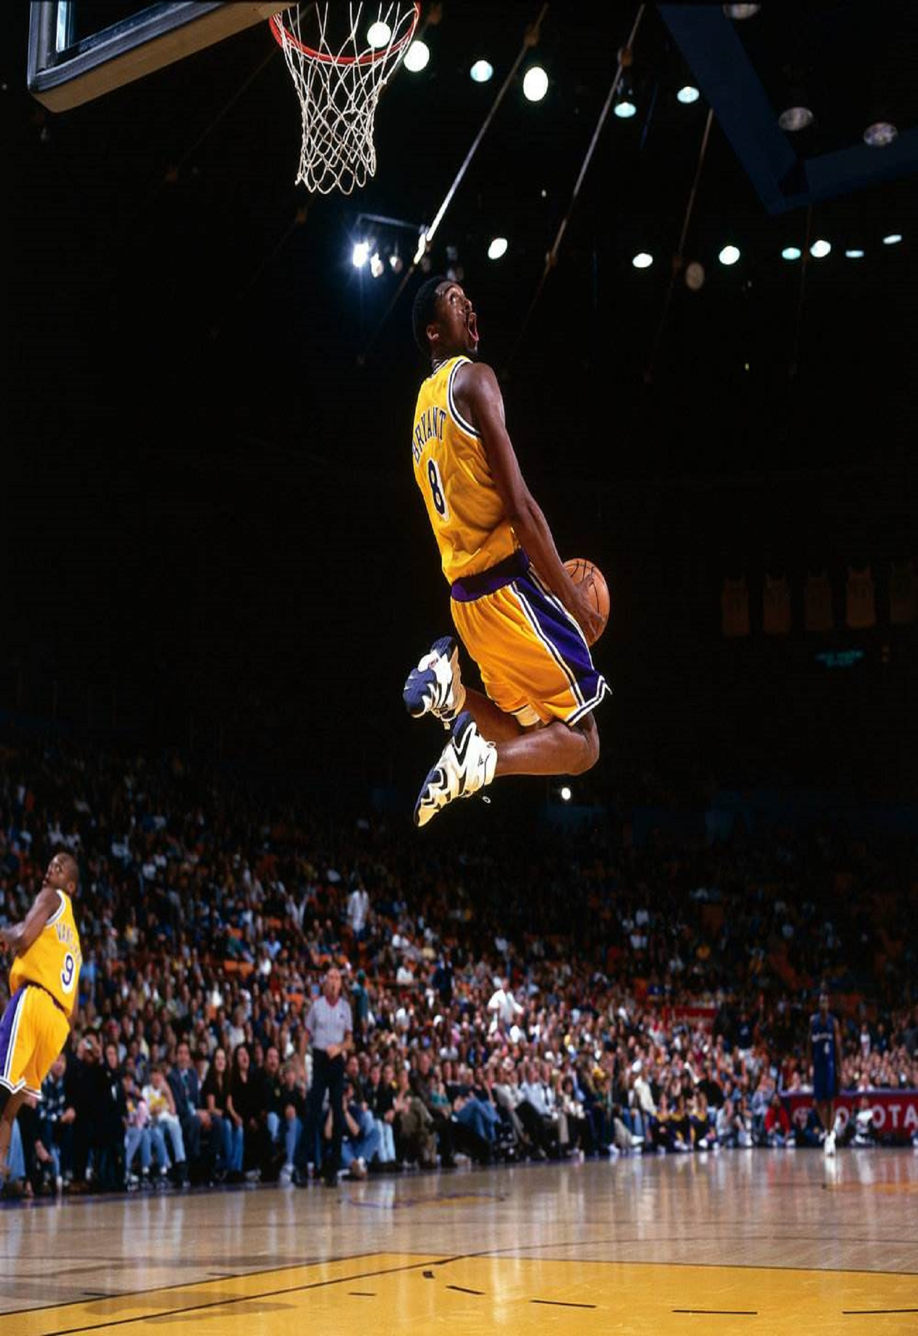
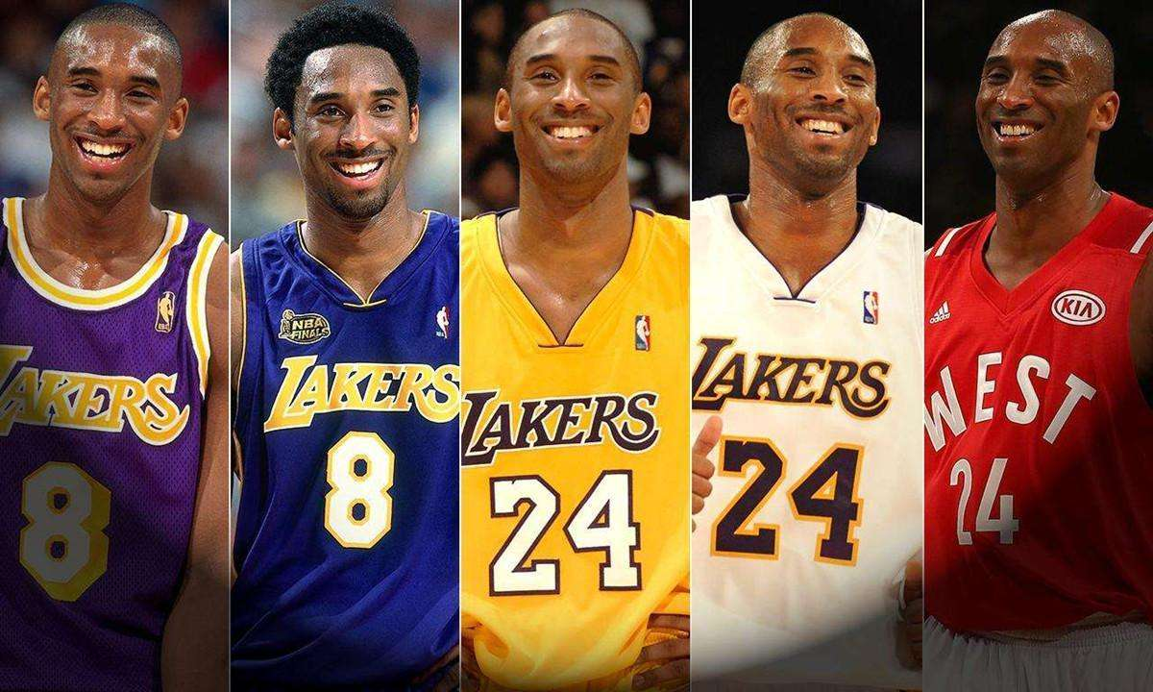
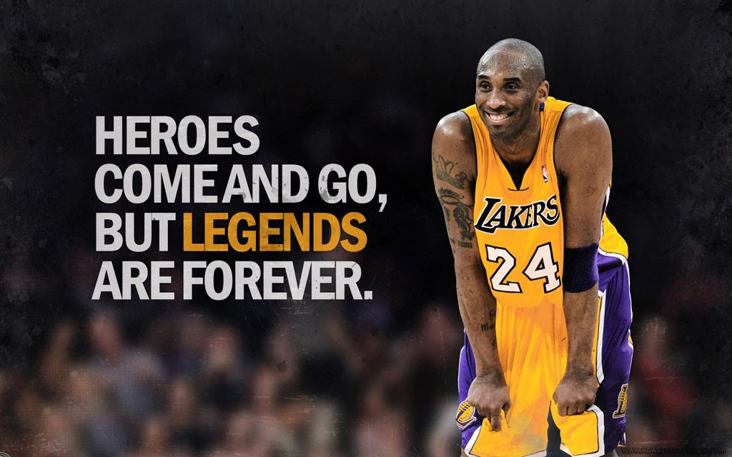

K
Let's see the video to
learn more about Kobe
B

Slide 11
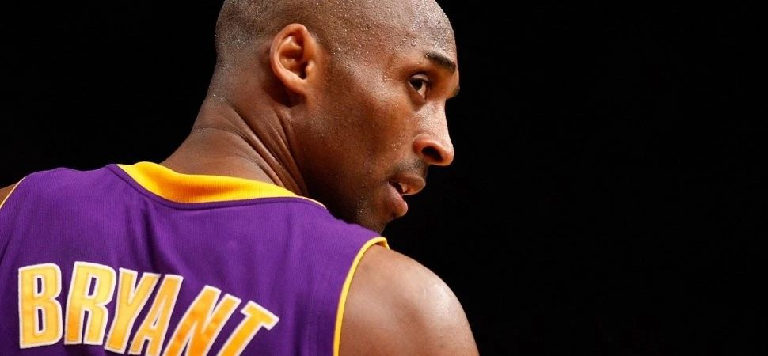
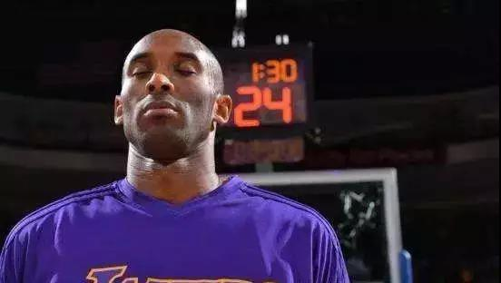

His Spirit
Love me or hate me, it’s one or the other. Always has been. Hate my game, my swagger. Hate my fade away, my hunger. Hate that I’m a veteran. A champion. Hate that. Hate it with all your heart. And hate that I’m loved, for the exact same reasons.

Slide 12
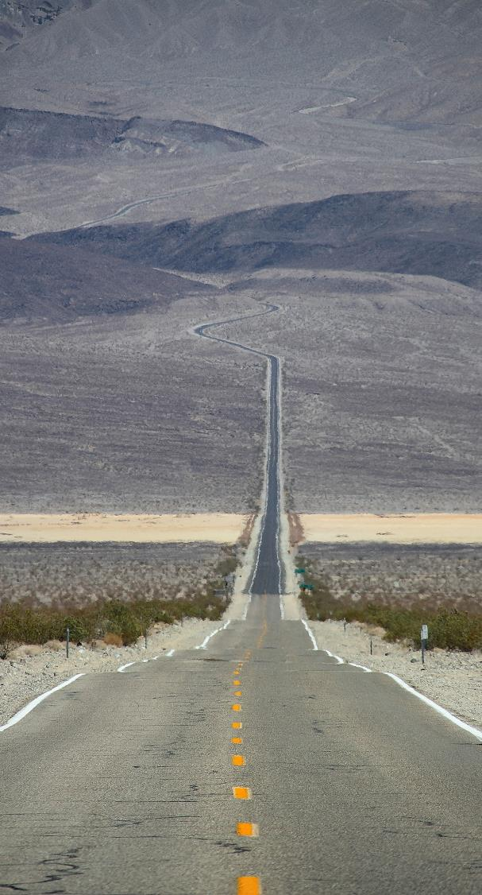
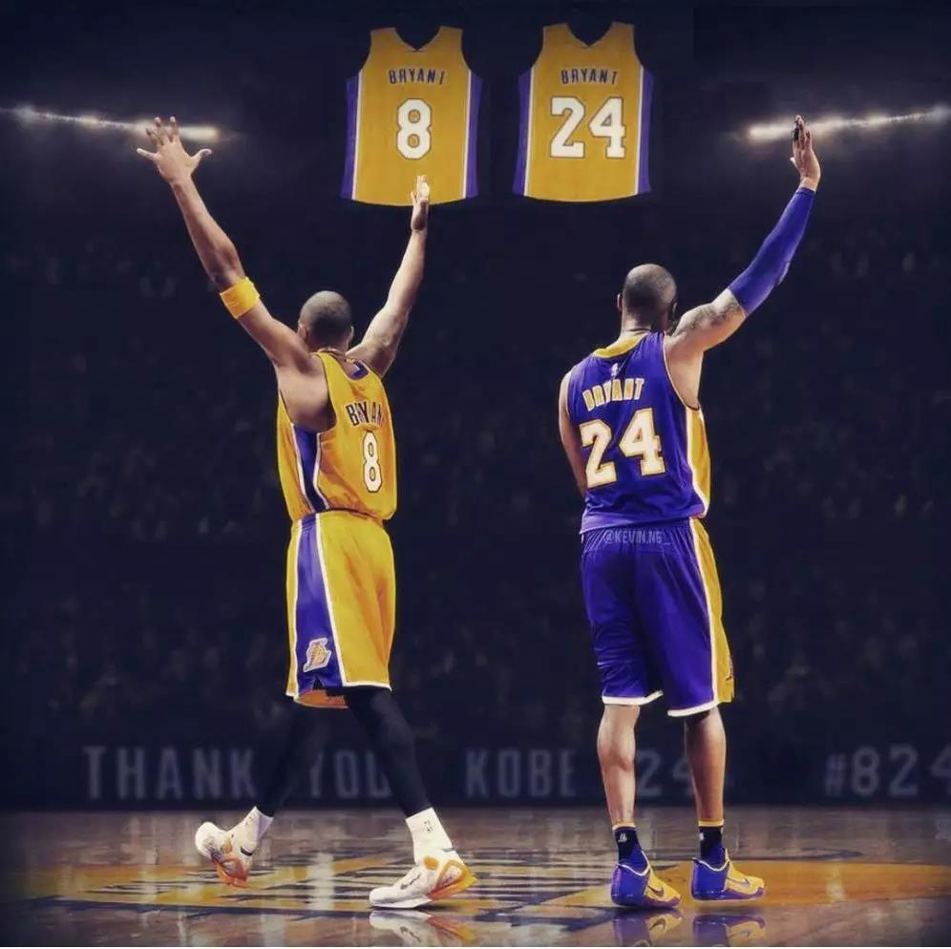
梦想真正的意义在于旅途本身
I want to say, It’s a… Thank you so much for tonight, but you know, it’s not about my jerseys([ˈdʒɜːziz] 球衣) that are hanging out there for me.
我想说的是：这真的是......嗯，今天非常感谢大家。但大家需要明白的是，这其实并不是为了我的那两件悬挂着的球衣。
It’s about the jerseys that were hanging there before. Without them, I couldn’t be here today. They inspired me to play the game at a high level, Magic, Kab, Shaq push me every day, Baylor, Chamberlain, Goodrich, West, Worthy, it goes on and on.
这更多的是关于那些以前就悬挂着的球衣。是他们激励着我去保持在一个高水准。魔术师，贾巴尔，沙克，他们每天都在激励着我。还有贝勒，张伯伦，古德里奇，韦斯特，沃西等等等等。
And, secondly, it’s about this class organization. Jenny Buss, your father, believed in a skinny old kid, from Lower Merion High School, Philadelphia.
其次，是为了这个组织。珍妮巴斯，您父亲当年是如此地信任我这么一个从费城洛儿梅因中学来的瘦小个。

Slide 13
梦想真正的意义在于旅途本身
And it’s also about the next generation. It’s about this current Laker roster([ˈrɒstə(r)] 名单) we have here. It’s about embodying（[ɪmˈbɒdi] 体现、代表） the spirit that exist in those jerseys up there and carrying this organization forward, so that the next 20 years are better than the past 20 years. That’s what this is about.
这也是为了湖人的下一代、为了我们当前所拥有的这些球员、为了发扬这些退役球衣的精神以及如何带领这个俱乐部前进——好让我们未来的20年会比过去的20年更棒。这才是这一切的关键。
It’s also about the fans, fans, the media. I don’t think you guys understand how present your guys were with me. You guys were there with me at 5:30 in the morning, when I was running the track, was middle way through my workout(锻炼). I didn’t know if I can make it through. I thought about the expectation you guys have for me, you have for our team, and it pushes me through. You got me through those 800, 400, and 100, at 5:30 in the morning. So I thank you.
这也是为了球迷和媒体。我觉得大家并没有意识到你们其实是一直与我同在的。每天早上5:30，当我在跑步机上运动的时候，当我在健身的时候，你们都与我同在。有时候我会怀疑自己是不是能够达成这些目标。但我会联想到你们对我的期待，对球队的期待,这促使我去达成这一切。是你们帮助我完成了那些在凌晨5:30的800米，400米，100米的训练。所以我必须谢谢大家。

Slide 14
梦想真正的意义在于旅途本身
And it’s about family. It’s about my wife Vanessa. You know you guys aren’t noticed, but the last game, my last game, that we had here against Utah Jazz, I was really tired. I got home, I was like, you know what, I don’t know if I can do this thing. We got one more game left, but I don’t have any legs. She said I want to show you something, I got a gift for you for your last game.
这也是为了我的家庭。为了我的妻子瓦妮莎. 你们不知道的是，我的最后一场比赛，在这里对决犹他爵士的时候，我是真的很累。比赛前一天，我回到家里，你们明白吗，我都不确定自己是否能坚持下去。我们还剩下一场比赛，但我的腿是真的累得不行了。我妻子说：给你看样东西,我为你的最后一场比赛准备了一份礼物。
She proceeded to show me a roll of retired jerseys, from Baylor, from Magic, from Shaq, from Kab, all of the persons that Magic just signs to me. Including from Machel Jorden, including from the Great Bill Russell, including from the great Larry bird. When I saw that, I knew then that I had to turn it up. Thank you, babe, for being an inspiration to me.
于是乎她给我看了一系列的退役的球衣，贝勒、魔术师、沙克、贾巴尔......所有那些魔术师刚指给我看的球衣。还包括迈克尔乔丹，伟大的比尔拉塞尔、伟大的拉里伯德。当我看到这些时，我知道我必须让自己振作起来。感谢你，宝贝，感谢你鼓舞了我。

Slide 15
梦想真正的意义在于旅途本身
And lastly, our daughters: Natalia, Gianna, Bianka. You know, I hope that tonight is not, you know, you guys know that if you do the work, you work hard, and the dream comes true. You know that, we all know that.
最后，为了我们的女儿：Natalia, Gianna, Bianka. 你们需要明白的是，如果你努力工作，梦想就会成真。你们懂的，我们所有人都懂的。
But hopefully, what you get from tonight is understanding that those times when you get up early, you work hard, those times you stay up late and you work hard, those times when you don’t feel like working, you’re too tired, you don’t want to push yourself, but you do it anyway. That is actually the dream. That’s the dream. It’s not the destination, it’s the journey.
但是我希望你们今天晚上能够明白：那些你们早起、努力工作的时光，那些你熬夜努力工作到很晚的时候，那些你不想工作、你太累了、但你最终还是坚持了的时刻，那其实就是梦想。梦想无关乎目的地，而是在于旅程。

Slide 16
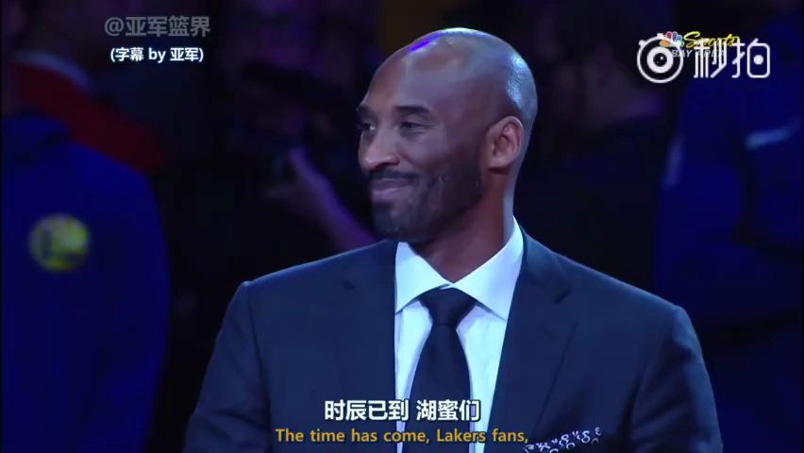
梦想真正的意义在于旅途本身
If you guys can understand that, then what you will see happen is that you won’t accomplish your dreams. Your dreams will come true. Something greater will. And if you guys can understand that, then I’m doing my job as a father.
如果你们可以明白这一点，那么你们就会发现，并不是你们完成了梦想，而是梦想自然成真了。比梦想更好的东西也会成真。如果你们可以明白这一点，那么我也就尽到了做父亲的责任。
Thank you guys so much, I love you. Mamba out
非常谢谢大家，爱你们。

Slide 17
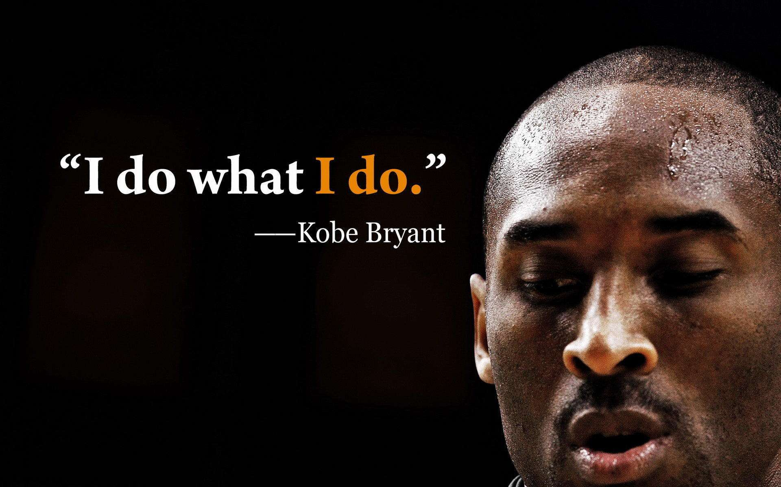
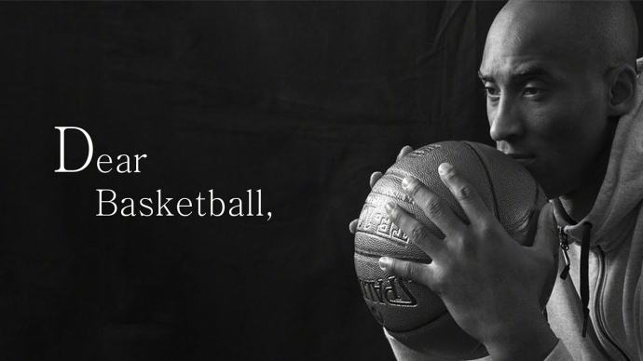
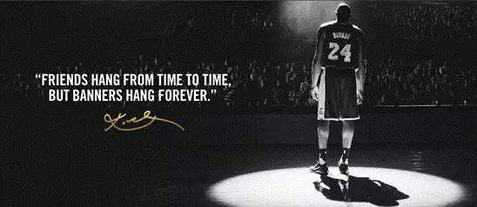
What is the Mamba Spirit

Slide 18


曾经有记者问科比：“为什么你能取得现在的成功？”
科比答道：“你们知道凌晨4点的洛杉矶是什么样子吗？”
台下记者一篇茫然。
科比笑着说：“知道，我知道洛杉矶每一天凌晨四点的样子。”
凌晨四点的洛杉矶，代表着科比超乎常人的勤奋。
科比的成功是用汗水所浇筑的，他的教练曾经对媒体说过这样的细节：训练结束了，球场上的灯光已经关闭，其他人都回去休息了，但是我听到有人在漆黑中投篮。那人就是科比。
永不言弃-Never give up
正如科比自己所说，“实现梦想是一个非常艰辛的过程，当我们挣扎在追梦之路上时，我们需要试图在挣扎中找到乐趣。”
我们更不会忘记，他所展现出的篮球精神，那一种近乎于偏执的，对于梦想的不懈追求，造就了他不服输、永不放弃、“我命由我不由天”的性格，也正是这种“曼巴精神”让天赋并不是顶级的科比能在人才济济的NBA联盟里统治长达20年，科比曾经羡慕的说：“迈克尔乔丹有着一双大手，而我没有，他能把篮球抓得像一个橘子一样”，科比天生就比别的球员手小，但在科比的字典里并没有放弃二字，只要是他自己认定的，咬碎牙齿也要坚持，科比的凌晨4点也成为了努力的代名词，无论黄昏还是清晨，寒冬还是酷暑，只要是训练，一切的付出都值得，追逐梦想的路上没有别人所谓的辛苦，这就是“曼巴精神”。

Slide 19
“I just go. I just go. I just keep going until it feels right to me," Kobe says of his habits. "If something doesn't feel right, I'm gonna stay there until I get it right. I just continue to keep pushing and pushing and pushing. That’s all I've known. That's how my parents raised me. If you're going to be focused on something, if you want to do something, you can't, you can't go about it in a half-assed way. You really gotta dedicate yourself to it, try to be the best at it. That's the only way.
永不言弃-Never give up
As far as carrying the torch for the years to come, I don't know. I just want to be the best basketball player I can be.
Everything negative - pressure, challenges - is all an opportunity for me to rise.

Slide 20
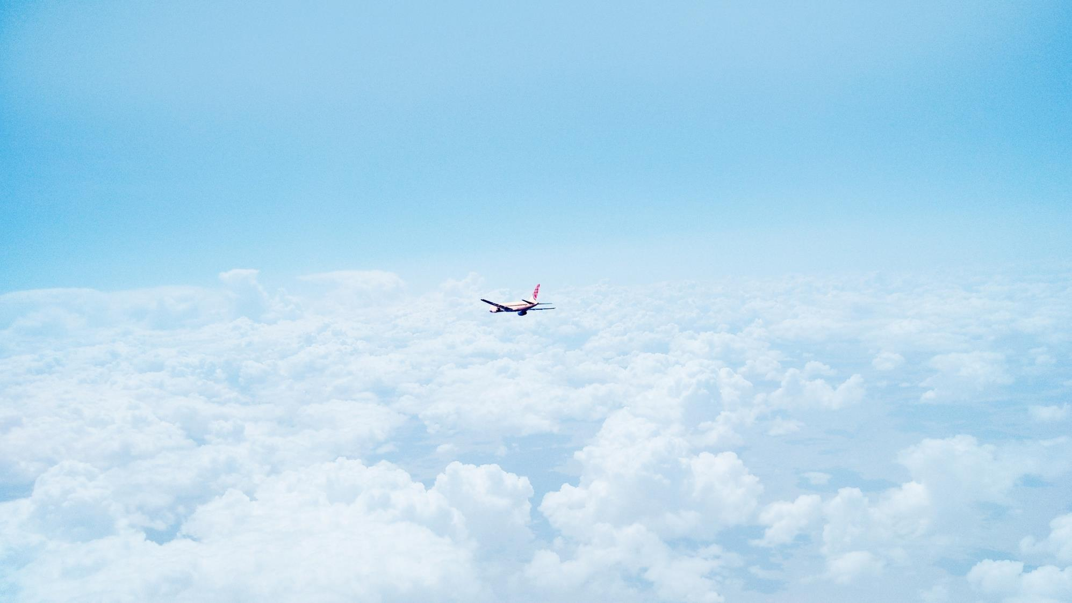
Future
we are coming,never give up,

