Slide 1

感恩遇见，相互成就，本课件资料仅供您个人参考、教学使用，严禁自行在网络传播，违者依知识产权法追究法律责任。
更多教学资源请关注
公众号：溯恩高中英语
知识产权声明

Slide 2


Slide 3


an advanced city
Wuhan
hot-dry noodles

Slide 4
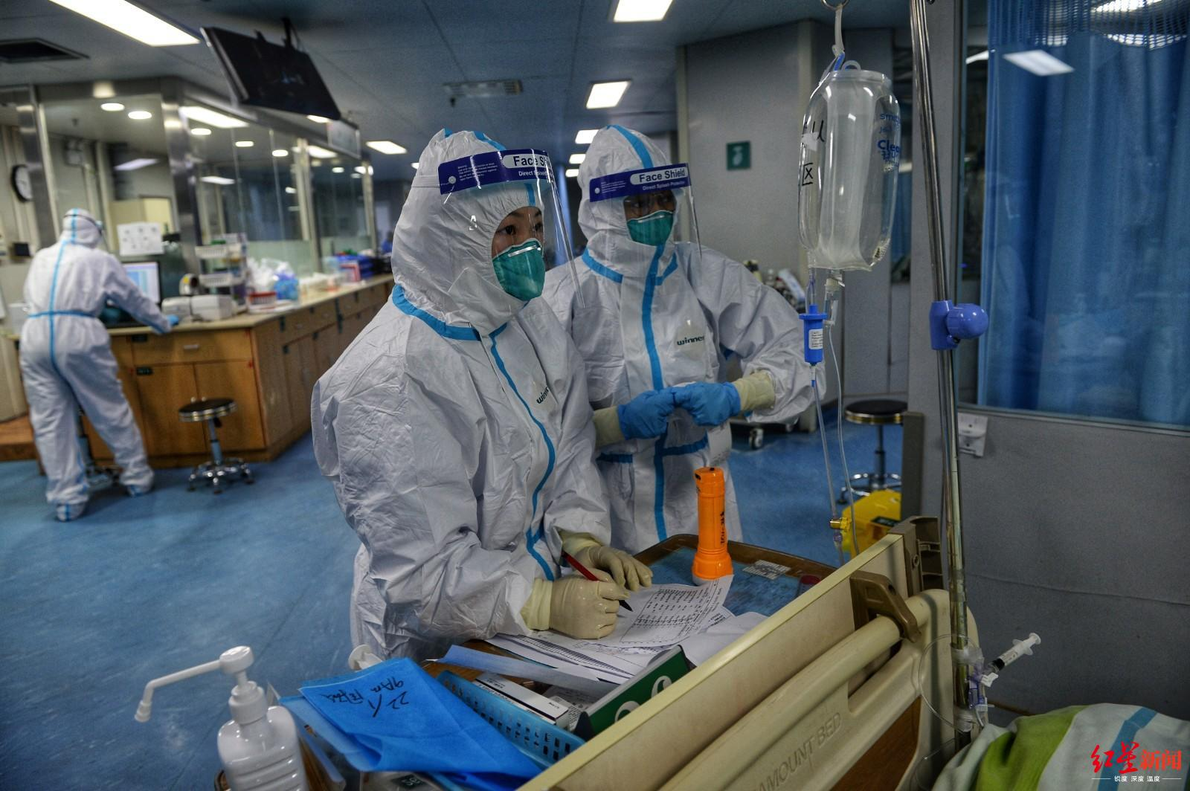
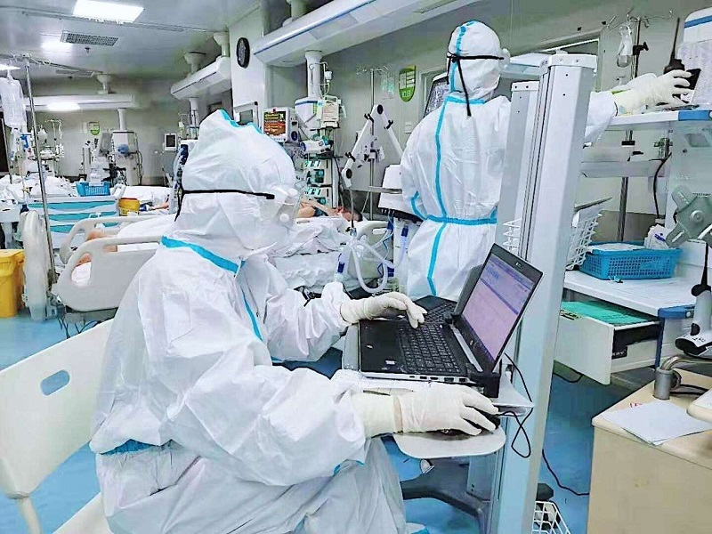
There is an outbreak of disease that started in Wuhan.
A lot of them are infected. And the number of infected people is still increasing throughout China.
It is caused by a novel corona virus that means it is so brand-new that actually it doesn’t have a name..
outbreak
爆发 n
novel
新奇的 adj
infect
感染 vt
brand-new

Slide 5
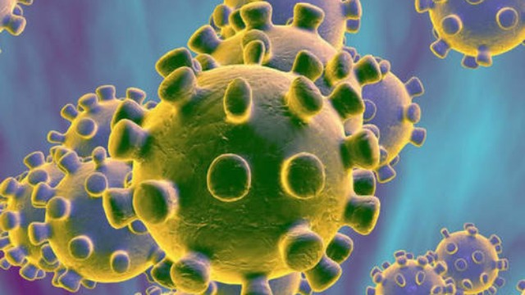
a novel coronavirus
[kə,rəunə'vaiərəs]
crown
病毒
王冠，皇冠
冠心病（冠状动脉性心脏病）
WHO（World Health Organization） named it
2019-nCoV
Coronary
Heart Disease

Slide 6

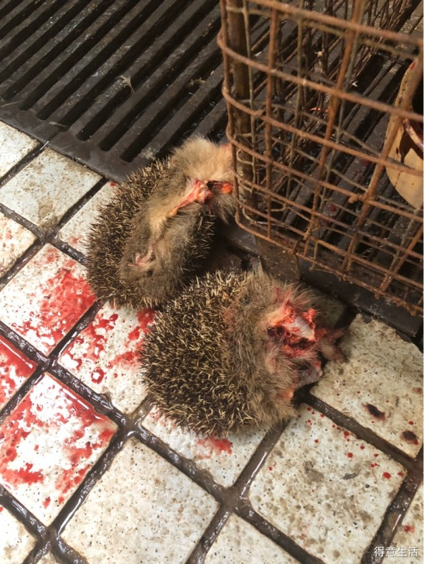
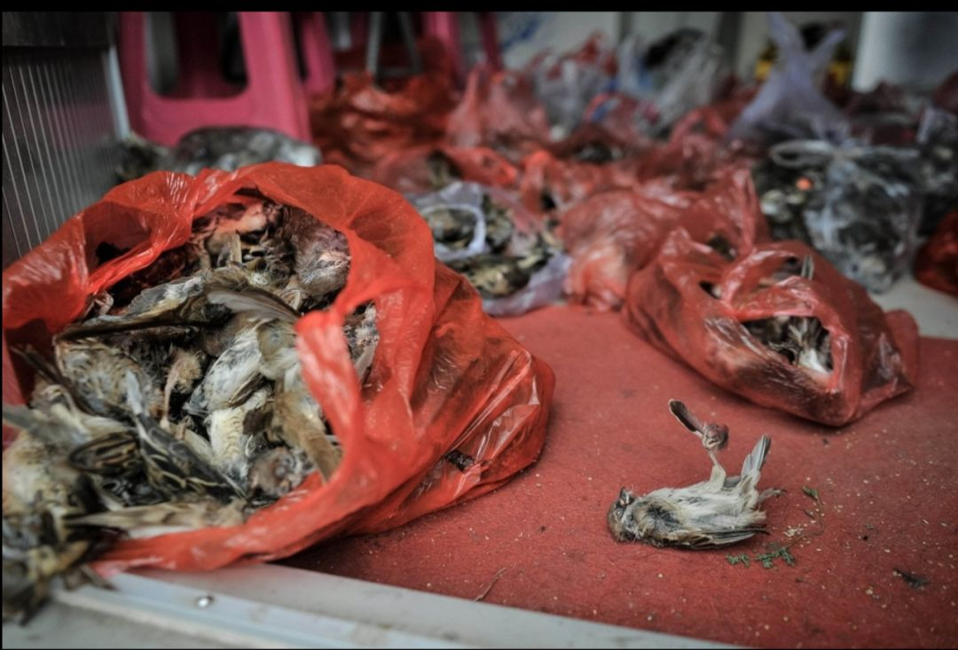
Origin
This brand new coronavirus , which is the same family as the virus that causes SARS, came from wild animals, and it is believed that the source was actually a seafood market in Wuhan, which also sells wild animals.

Slide 7
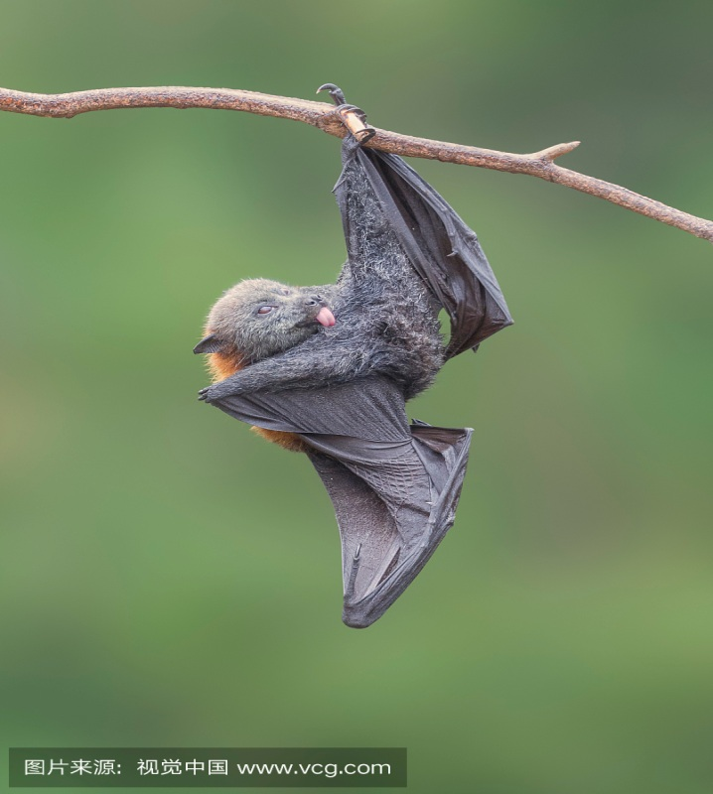
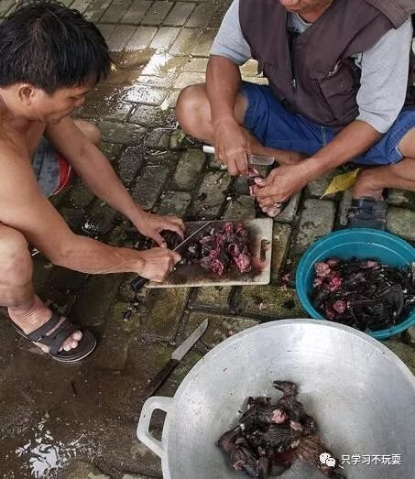
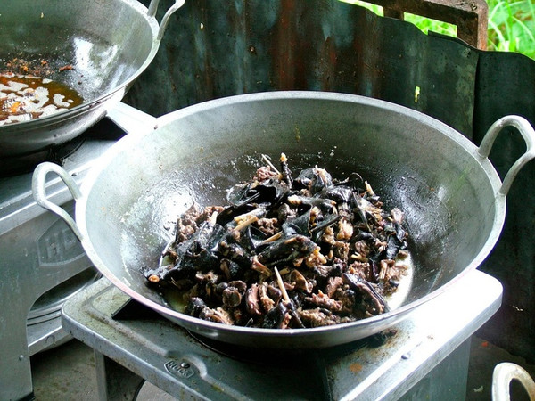
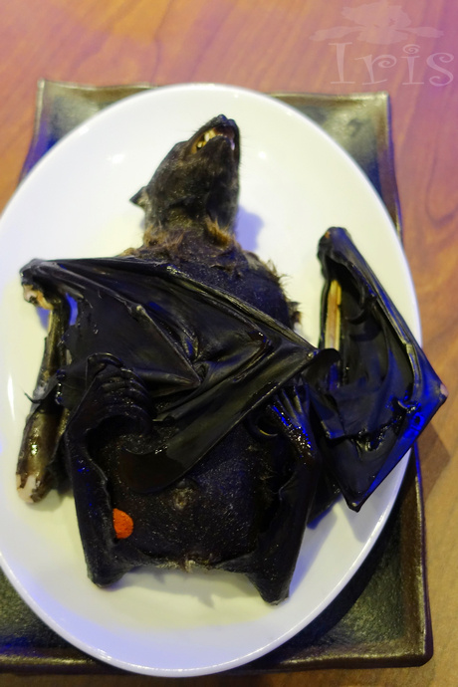
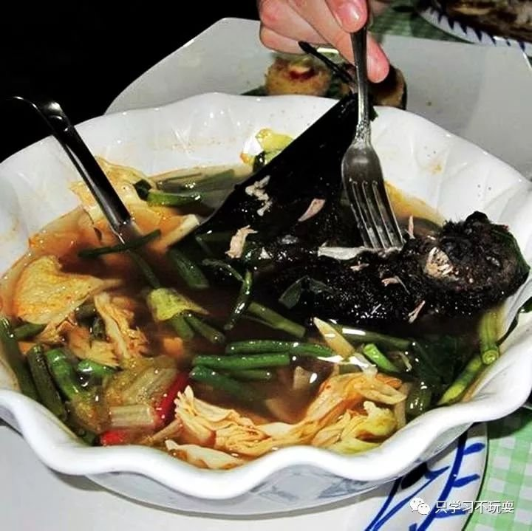
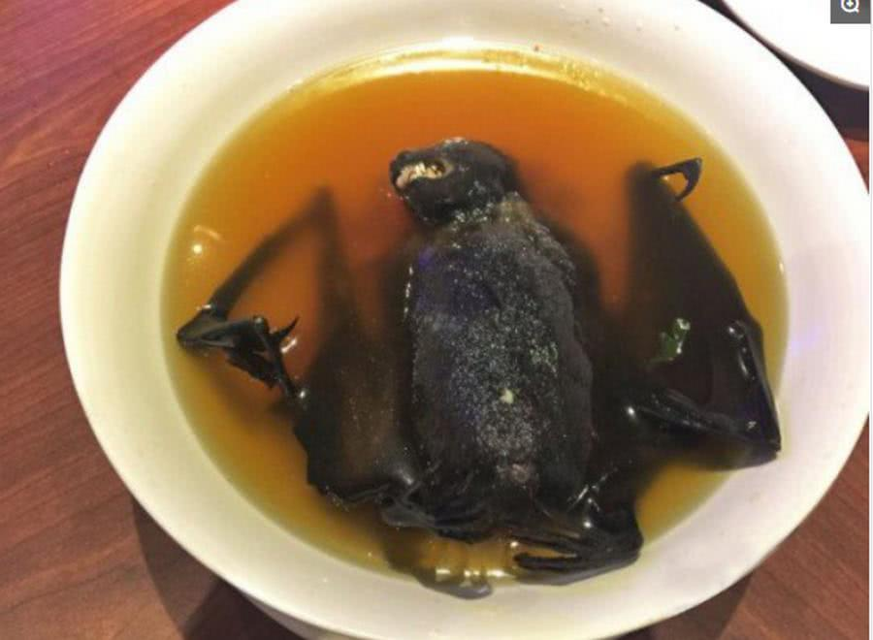
bat

Slide 8
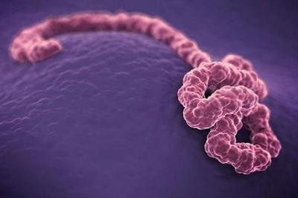
Ebola virus
The Ebola Virus Disease is a deadly virus, believed to be caused by wild animals (specifically bats) coming into contact with humans.
[fəˈtæləti]
Outbreaks of Ebola have a 90% fatality rate and
there is no known vaccine or treatment.
[vækˈsiːn]
signs and symptoms of Ebola:
Fever
Aches
Weakness
diarrhea(腹泻） and vomiting（呕吐）
Unexplained bleeding（流血）
deadly
致命的 adj
[ˈsɪmptəm]
fatality
致命的性 n
vaccine
疫苗 n
symptom
症状 n

Slide 9
What are the symptoms of 2019-nCoV?
The symptoms of this illness are pretty common on the face of it like a flu or a cold：it is a dry cough, fever and then breathing problems.

Slide 10
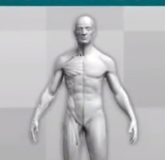

symptoms
mild
severe
headache
pneumonia
fever
[njuːˈməʊniə]
肺炎 n
cough
trouble breathing
kidney failure
[ˈkɪdni]
To the people who has weak immune systems, it can be fatal.
肾脏 n
Then it will progress to severe symptoms, such as…..
immune system
免疫系统 n

Slide 11
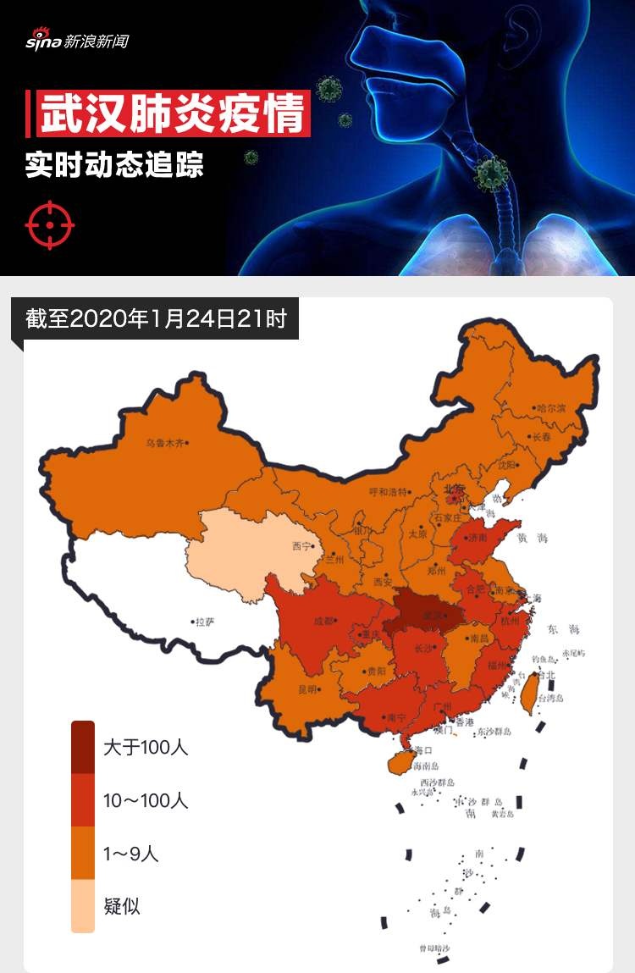
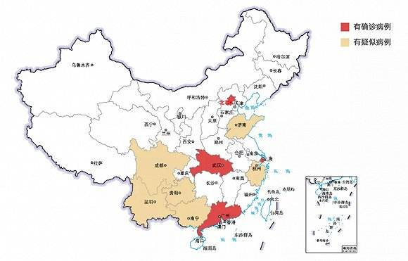
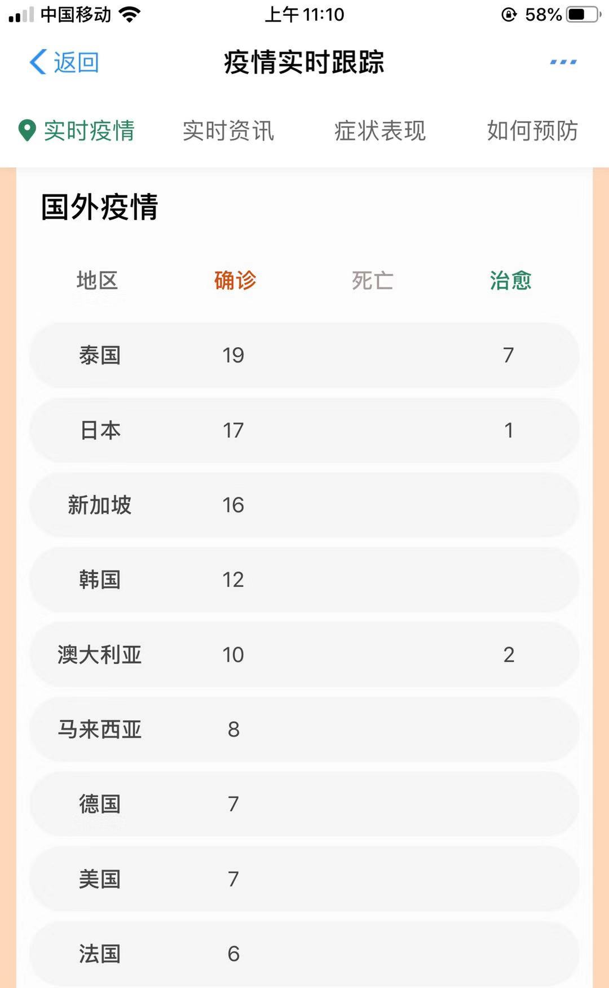
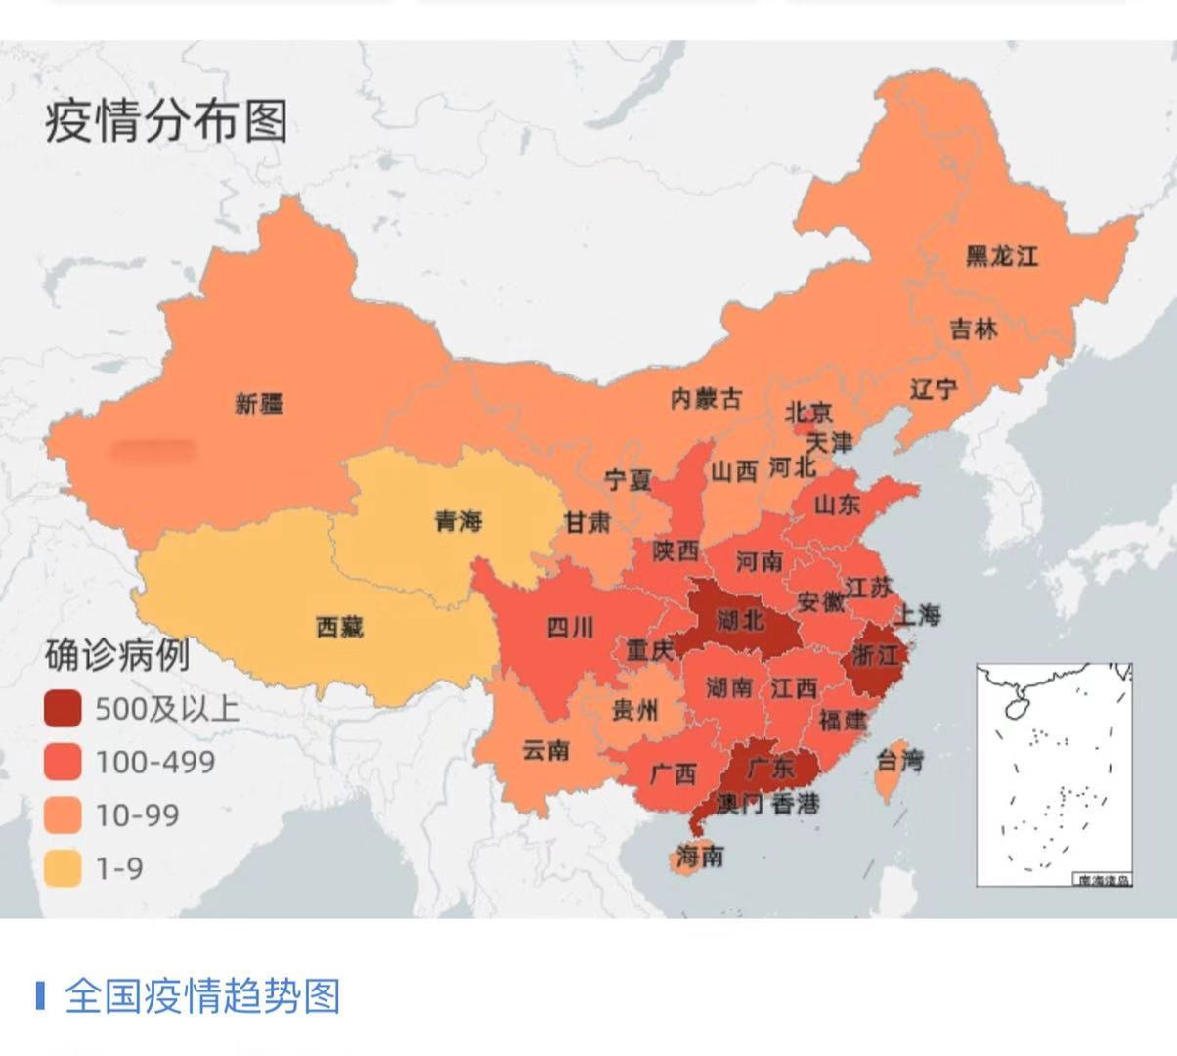
infectious disease
epidemic disease

Slide 12
How is the novel coronavirus transmitted?
It was discovered and confirmed by experts that the novel coronavirus is actually transmitted from one person to another. So we’ve got people to people transmission.
人传人
transmit
传播 vt
confirm
确认 vt

Slide 13
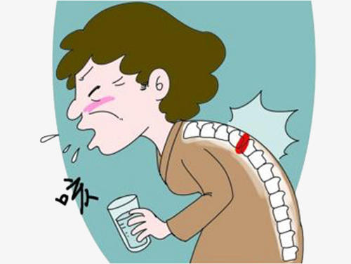
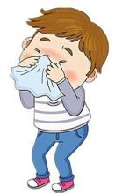

coughing
contact with the infective surface
sneezing
It will spread through……..

Slide 14
Is there any treatment available now?
There actually isn’t any effective treatment at the moment at all, because it is a virus and it is novel. Antibiotics(抗生素）won’t work. They only work against bacteria rather than viruses. But now, a team of many experts in Texas, New York and China are working together to develop a vaccine for coronavirus.
[vækˈsiːn]
The best way to avoid it is to isolate yourself at home.
隔离自己
bacteria
细菌 n

Slide 15

How to protect ourselves?
The best way to avoid it is to isolate yourself at home.
Words and phrases:
fever
monster
Are you joking ?
cough
dinosaur
bat
be sacred
ninja

Slide 16
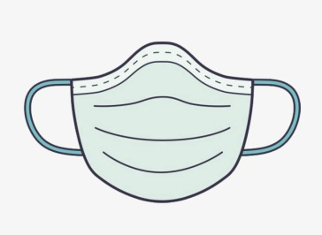
How to protect ourselves?
The best way to avoid it is to isolate yourself at home.
Wash hands often.
Wear face masks.
Don’t eat wild animals.

Slide 17
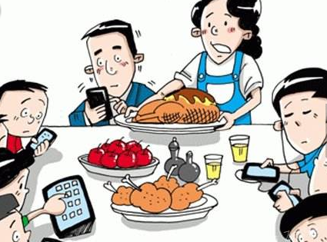
The best way to avoid it is to isolate yourself at home.
People get addicted to phones.
phubbing

Slide 18

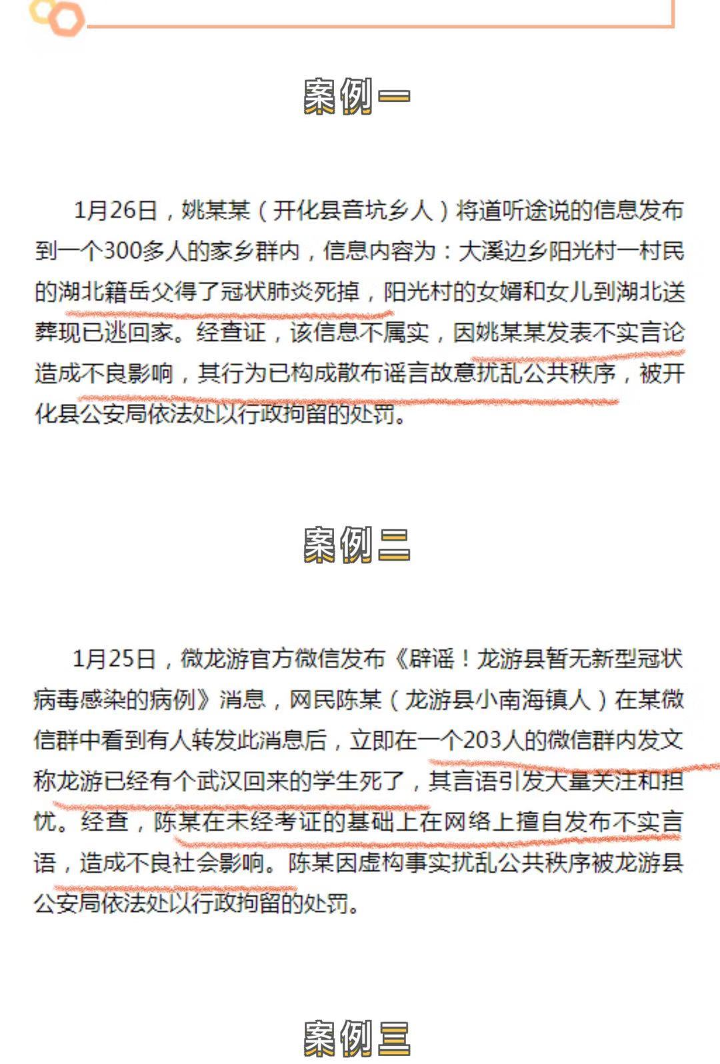
建德
杨村桥 绪塘
The photo of the patient in RT-Mart was posted on the internet.
rumors
fake news

Slide 19
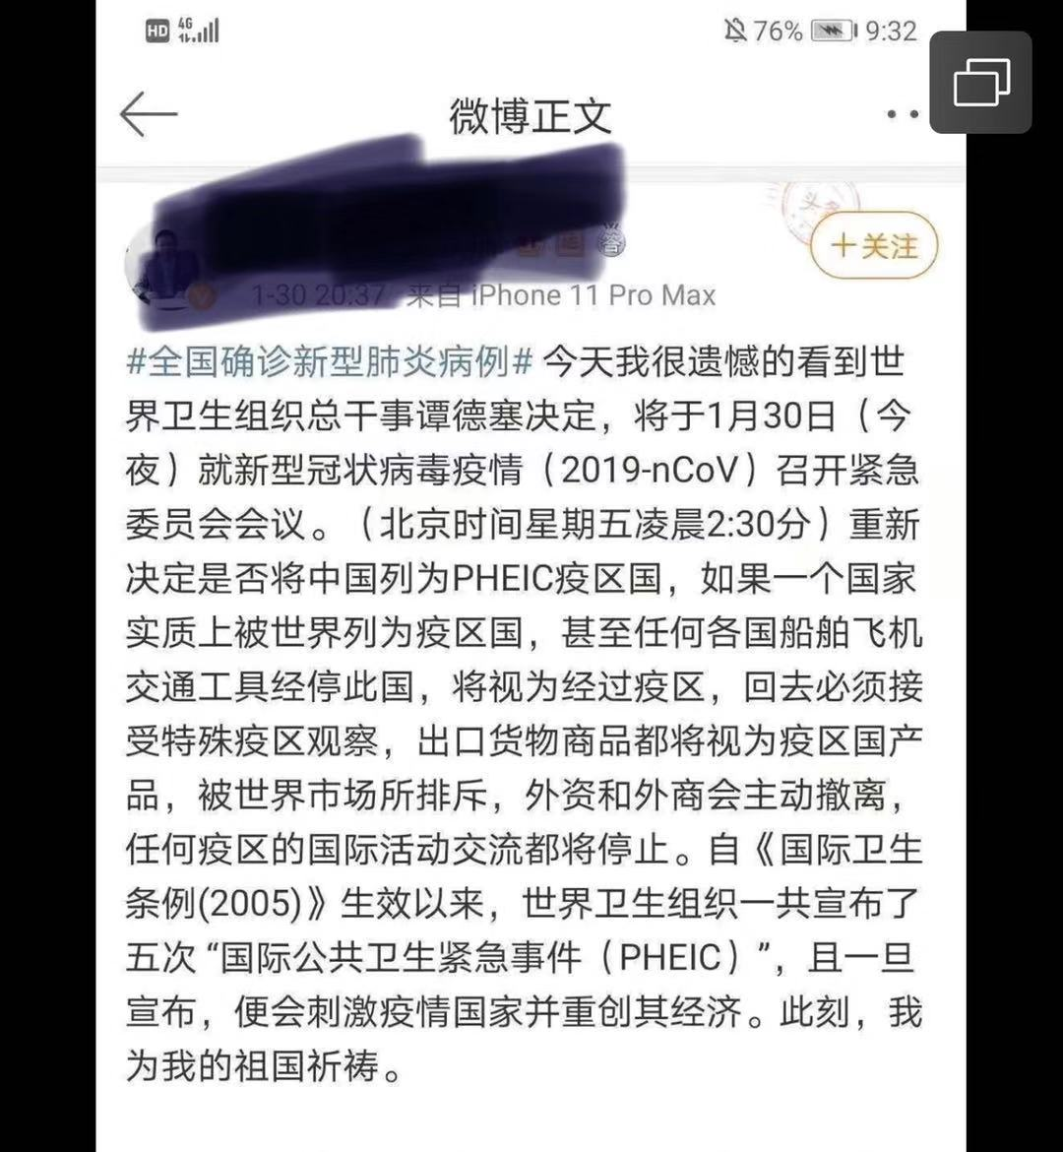
WHO declares coronavirus outbreak global health emergency.
economy
economic recession
[rɪˈseʃn]
经济衰退

Slide 20
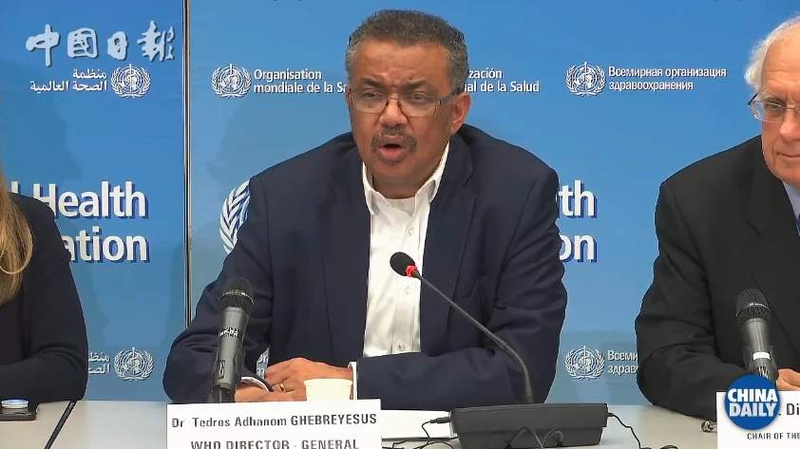

Slide 21
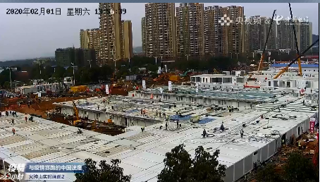
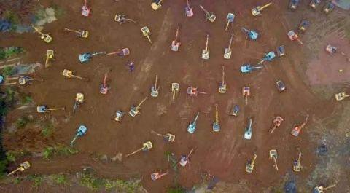
remarkable
Believe in China and Chinese people fighting against 2019-nCoV.

Slide 22
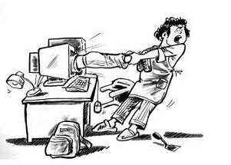
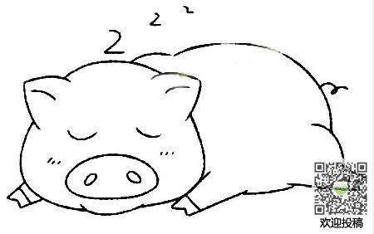
The best way to avoid it is to isolate yourself at home.
People get addicted to phones.
phubbing
People get addicted to…...
People love sleep-ins.

Slide 23

Well equipped youth lead to a powerful China!

Slide 24
Everyone can get sick, so please don’t isolate Wuhanese and anyone who is connected to Wuhan. You cannot discriminate against the patients, because this behavior will make those patients ashamed of themselves, so as to hide the illness and reject to protect others. We are against the virus, not Wuhanese . The more emergency arises, the more need for calmness, humanity and unity.

