Slide 1

A Practical Lecture for Continued Writing

Slide 2

感恩遇见，相互成就，本课件资料仅供您个人参考、教学使用，严禁自行在网络传播，违者依知识产权法追究法律责任。
更多教学资源请关注
公众号：溯恩高中英语
知识产权声明

Slide 3
Content Page

Slide 4
a real example:
map the essay outline.
4
5
Speaking: define an object.
1
Define continued writing.
2
a real example: follow the six steps.
3
the six steps of continued writing.
a real example: sample continued writing
6

Slide 5
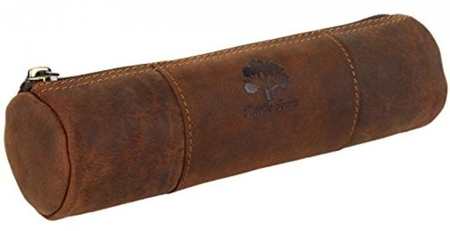
Speaking: Define an Object
What is a pencil-case?

Slide 6
Speaking: Define an Object
A pencil-case is a small bag that contains stationery.

Slide 7
Speaking: Define an Object
A pencil-case
is a small bag that contains
stationery.
A pencil-case is a bag.
It is small.
It contains stationery.

Slide 8
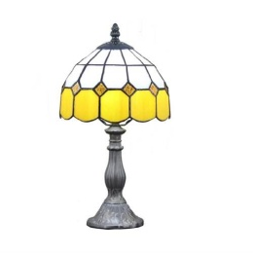
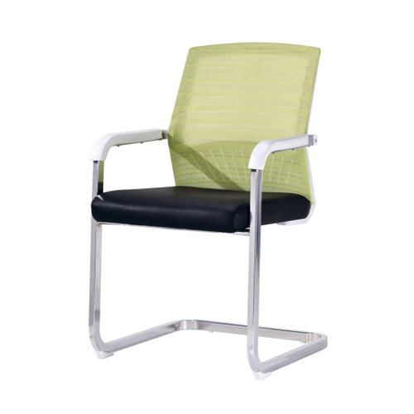
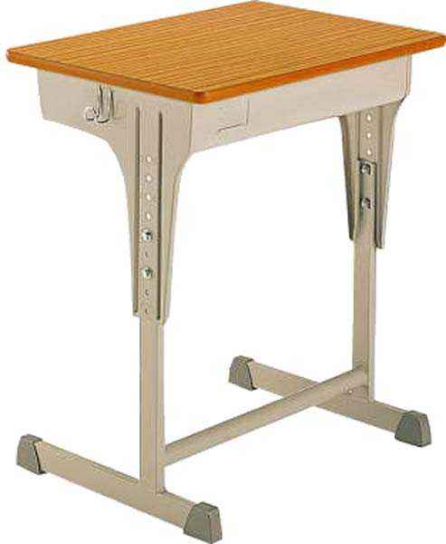
Speaking: Define an Object
Now, find those in the classroom and define them.

Slide 9
How should we define continued writing then?

Slide 10
Continued writing refers to the process of ending or concluding an essay by continuing and fulfilling its logical outline as well as content after mapping it into a logical outline.

Slide 11
Phase 1 We map an incomplete essay into its logical outline.
Phase 2 We continue and fulfill the logical outline as well as the essay
content that lies upon it.
Continued writing refers to the process of ending or concluding an essay by continuing and fulfilling its logical outline as well as content after mapping it into a logical outline.
Phase 3 We end the essay.

Slide 12

Phase 1 We map an incomplete essay
into its logical outline.
Step 1 Comprehend the essay.
Step 2 Map the rough logical outline of essay.
Phase 2 We continue and fulfill the
logical outline as well as
the essay content that lies
upon it.
Step 3 Analyze the leading sentences given to unwritten paragraphs.
Step 4 Provide two designs for the outline of ending.
Step 5 Decide which design to use.
Phase 3 We end the essay.
Step 6 Start writing.

Slide 13
Read the example passage and find out the information below:
1. What is the theme of the passage?
2. What is the main focus of the passage?
3. In which way does the author plot the development of story?

Slide 14
Read the example passage and find out the information below:
1. What is the theme of the passage?
Poppy the dog has experienced the change of mood ever since her young owner
entered university.
2. What is the main focus of the passage?
It focuses on the changes in Poppy’s mood.
3. In which way does the author plot the development of story?
It used timeline as the only base to develop the changes in Poppy’s mood.

Slide 15
Explore the outline of the passage and write it down.

Slide 16
Leaving for university
Transition
Returning from school
Paragraphs 1-3
Paragraphs 6
Paragraphs 7-8
Paragraphs 4-5
Paragraphs 7-8
A week after separation
Entering of new family member

Slide 17
Speaking:
Tell the teacher, What do the openings
of paragraphs 8 and 9 tell you?

Slide 18
Opening of paragraph 8
Dad opened the box and a sweet little dog appeared.

Slide 19
Opening of paragraph 9
A few weeks later, the boy arrived home from university.

Slide 20
How are you going to write the outline for the
unwritten paragraphs?

Slide 21
Parents came home.
Dad shows a small puppy.
Poppy confirms it as a puppy.
Poppy tries to go nearer.
Poppy licks the puppy.
Design 1
Dad puts the box down.
Poppy bites the handle of box carries the puppy to her own bed.
The boy returns.
He seeks Poppy.
Poppy marches out with a puppy behind her.
She kisses the boy’s hands.

Slide 22
Parents came home.
Dad shows a small puppy.
Poppy walks one and half steps to the puppy.
Poppy barks angrily.
Mum comforts the puppy and Poppy.
Dad takes the puppy out of the box.
Design 2
Poppy comforts the puppy.
The boy returns.
Poppy takes the puppy to him with her mouth.
He cuddles the puppy and hugs Poppy.
She kisses the boy’s hands.
The dogs kiss him.

Slide 23
Which design do you prefer to see the teacher writing?

Slide 24

Design 1
Dad opened the box and a sweet little dog appeared. A dark brown nose shakily stretched to the opened side of box before the face after it could be exposed. Air squeezed in and out of the holes on it as if a button was breathing. It clearly failed to prepare for its sudden meeting with a large nose. The air froze a bit as the noses hit and separated. Sharp barking came out of the box as Poppy poked its nose inside again. It did not touch the little dog. Poppy’s tongue did. She stepped an inch nearer to make herself closer to the box. Comforting it with licking rather than watching was perhaps the friendliest way of communication between puppies. Dad hugged Poppy a bit and put the box gently on the floor. He has not expected for what happened next. Poppy took the handle of his box by her mouth. Trembling from the little Corgis inside seemed to be slightly visible when Poppy jogged and took it away with the box. A fat tail danced trippingly on her way.
A few weeks later, the boy arrived home from university. His sight swept around for his lovely Poppy. The tip of her tongue led the long way to her young owner. She had waited for half a year. Pupils on the boy’s sharp face shone while capturing the rounded Poppy marching quickly to him. It became too bulky to run. A tiny Corgis shyly hid at the back of his large female Labrador as they appeared. It saw the boy coming forward and shared his cuddling with Poppy who kissed his hands repeatedly.

Slide 25
Design 2
Dad opened the box and a sweet little dog appeared. A warning look floated in the pupils of Poppy when she saw the little creature. She stepped half an inch forward. Odor brought by the air ruled her nose as the organ of walnut size shook slightly. It belonged to another dog. Bearing the existence of a dog who shared the love of her owners with Poppy was the last thing she would do on earth. Sharp teeth of Poppy completely exposed as she roared to the poor puppy. Staring from a wolf and voice of a tiger were the first gift Poppy gave out to welcome her little friend. It was never expected to meet an end till mum hugged Poppy in her arms. Warmth still belonged to Poppy. She did not mind to see dad getting the tiny Corgis out of its box. Mum cuddled the shaky little puppy together with her Poppy and walked to the sofa. A large cookie for dog was the weapon she used to shut Poppy’s watery mouth. The little dog which spent all its strength hiding at the back of mum received a tiny soft biscuit. It trembled again when Poppy gave it a glance. She took a piece of cookie and turned her head to the Corgis. That piece of dessert did give mum too much time to react when it was given to the little dog. Poppy dropped the cookie before its mouth and licked its fur. It was possibly soft and a bit salty.
A few weeks later, the boy arrived home from university. He has imagined how cheerful it would be to see his parents and Poppy again. What he had no idea about was the appearance of Poppy when he arrived. She took a baby puppy to him with her mouth. These lives could be misunderstood as a mother dog and her baby only if they looked more similar. The boy took the puppies in his arms. His sapphire pupils questioned the emerald ones of Poppy. What the lady did was to kiss his hands. The little Corgis did the same as if being taught by its princess.

Slide 26

Homework
Your beloved teacher has written a short conversation with two scenes. Unfortunately, he did not complete it. He needs your help to finish writing the dialogue. Help, please!

Slide 27

场景1：未婚妻Luna逛街的同时，贴心的Adam正在一家珠宝店里为她挑选订婚礼物。
人物：Adam, Delia
Delia: Good morning. What can I help?
Adam: I’m aiming at a present for my fiancée. She likes mellite and olivine. I have already bought her a mellite pendant, so I want to
see olivine.
Delia: (taking Adam to the olivine apartment) Here they are.
Adam: I prefer to a ring. How about the heart shape one?
Delia: (taking it out) Its color happens to even and bright. Is your fiancée's finger thick or skinny?
Adam: Quite skinny actually.
Delia: Then it might suit her, not so big olivine inlayed on a platinum ring.
Adam: It looks charming. How much is it?
Delia: 8950 RMB. It’s on 95 percent discount.
Adam: Thanks. Perhaps I shall take a look at another one.

Slide 28
场景2：为了追求满意的效果，Adam决定将戒面和戒指分开购买、搭配，然后再镶嵌。两天后，正是Luna的生日，戒
指成型，Adam下班的时候去取了回来。他约Luna来到东方明珠彩电塔上，在黄浦江迷人的夜色环绕下向她
正式求婚了。灯光下，帅气的Adam单膝跪地为Luna戴上了那枚魅力四射的橄榄石戒指，激动Luna在拉未婚
夫起来的时候想都没想便扑到了他怀里。旁观众人纷纷鼓掌高呼：亲一个！亲一个！
人物：Luna, Adam
Adam: (kiss Luna first) Darling.
Luna: (in her husband’s arms) En?
Adam: Where do you prefer to eat in the evening?
Luna: Anywhere.
Adam: Where is anywhere?
Luna: Don’t know. Where did you buy the ring?
Adam: I found the ringstone from an old store in the Bund. And I was originally thinking about where to get a titanium ring
for it.
Luna: This ringstone looks really lovely. Its greenish luster shining in a natural way tells its hometown as Arizona. I truly love it.
How did my love get the ring at last?

Slide 29

Thanks for your attention and patience.

