Slide 1

感恩遇见，相互成就，本课件资料仅供您个人参考、教学使用，严禁自行在网络传播，违者依知识产权法追究法律责任。
更多教学资源请关注
公众号：溯恩高中英语
知识产权声明

Slide 2
Battling the 2019-nCoV
A different Spring festival
致敬奋斗在一线的最美工作者，尤其是医护人员们！
“哪有什么岁月静好,不过是有人替你负重前行 ”
好好学习是当下所能为国家做的最大贡献，也唯有这样，将来才能担起更大的社会责任！
---from Jenny Yu 富阳中学

Slide 3
少年强 则国强
A country's future relies on its youth.

Slide 4
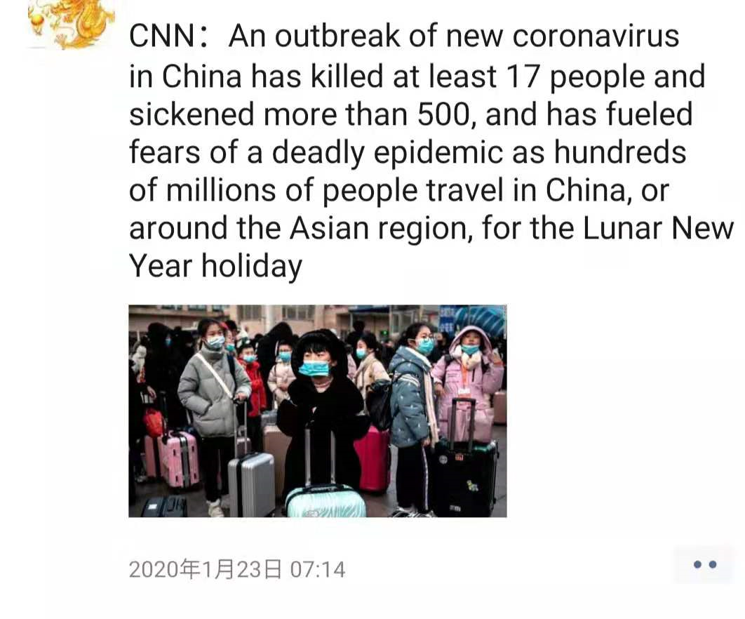
Jan. 23
An ourbreak of new coronavirus has fueled fears.
to increase sth; to make sth stronger 增加；加强；刺激

Slide 5
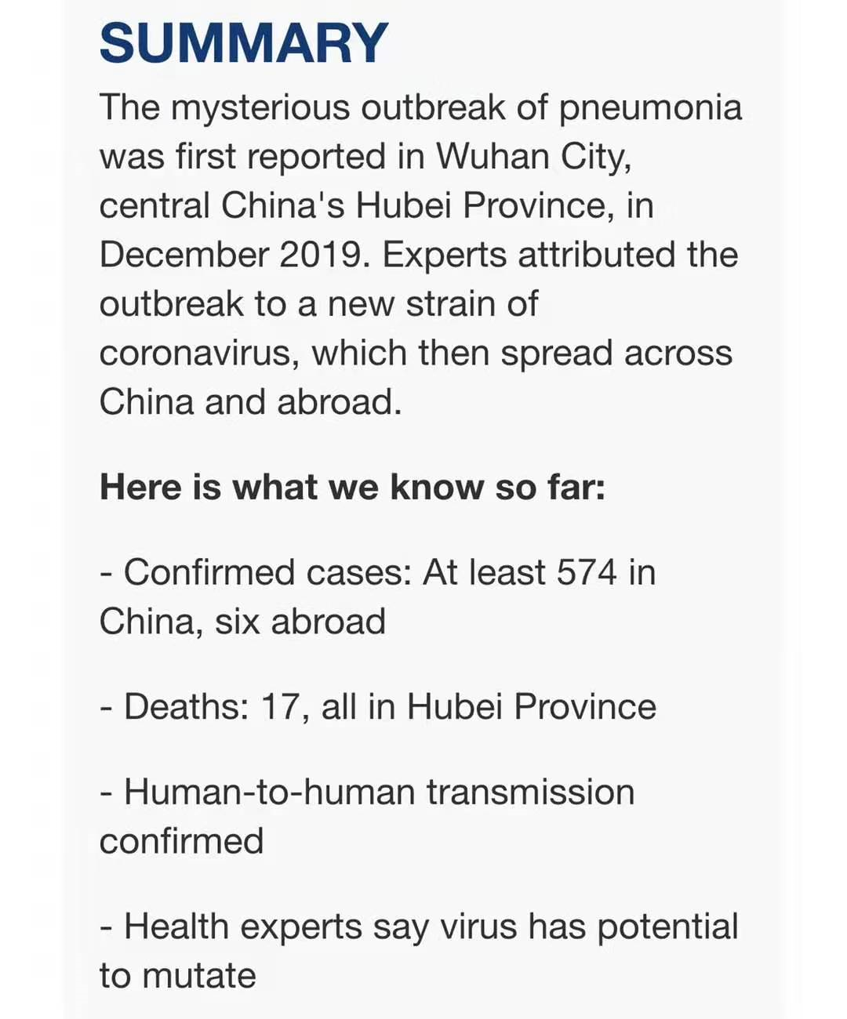
Jan. 23
Human-to-human transmission has been confirmed.

Slide 6
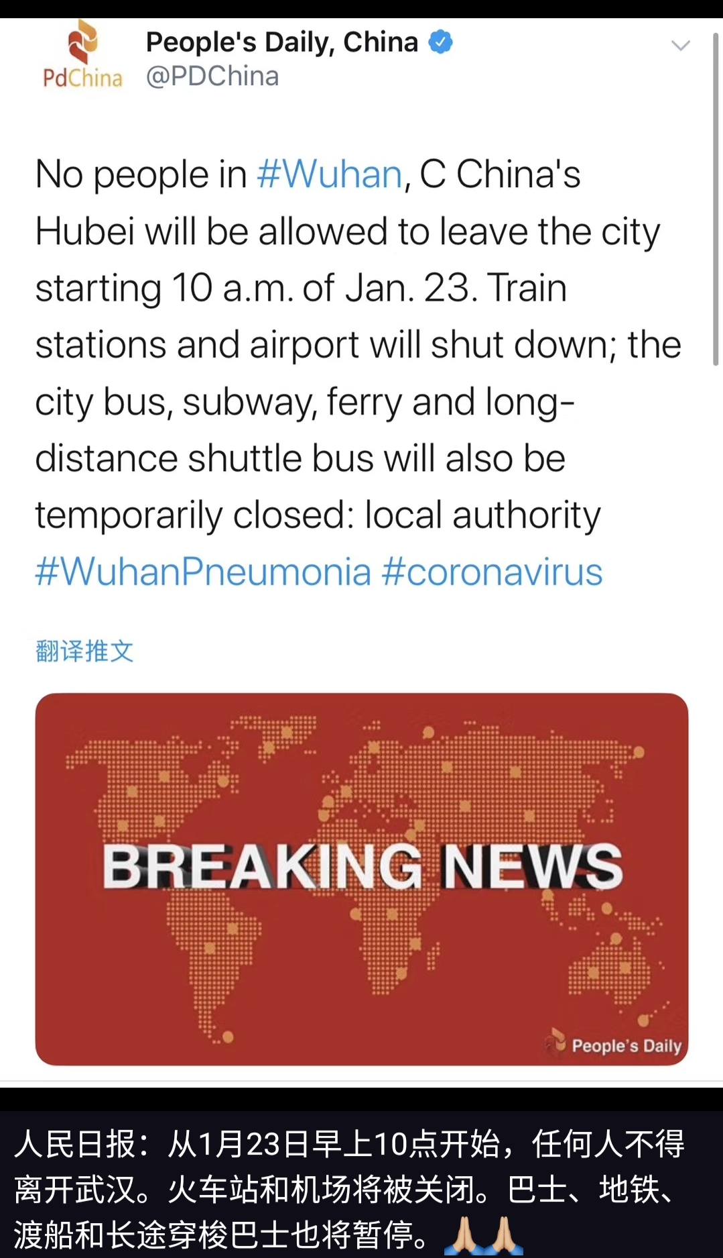
封城Jan. 23
No people will be allowed to leave Huhan.

Slide 7
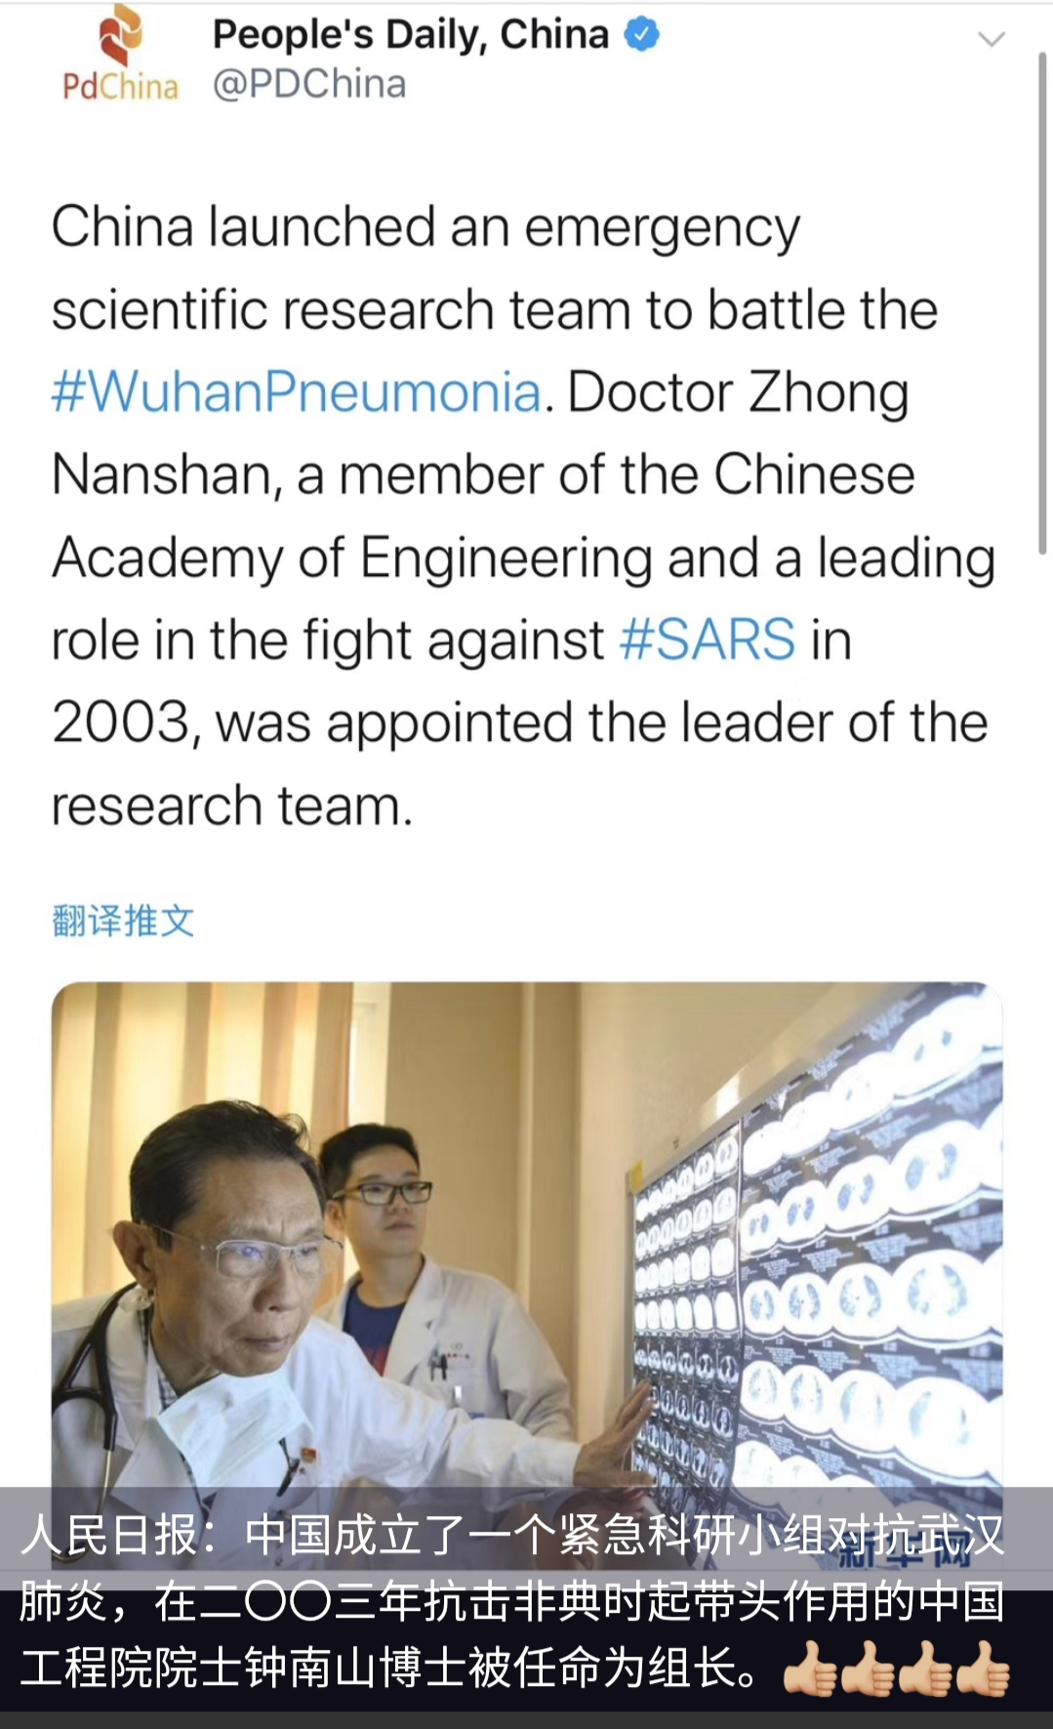
英雄Jan. 24 Zhou Nanshan

Slide 8
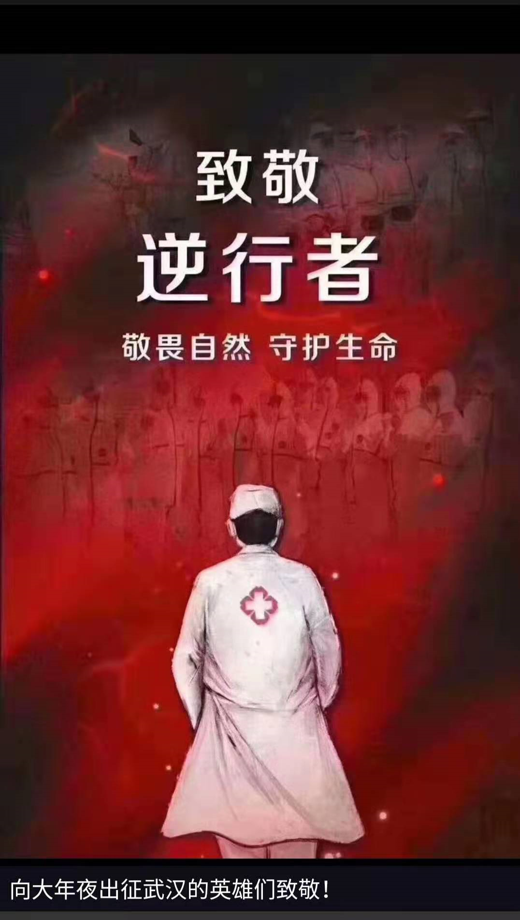
Heroes

Slide 9
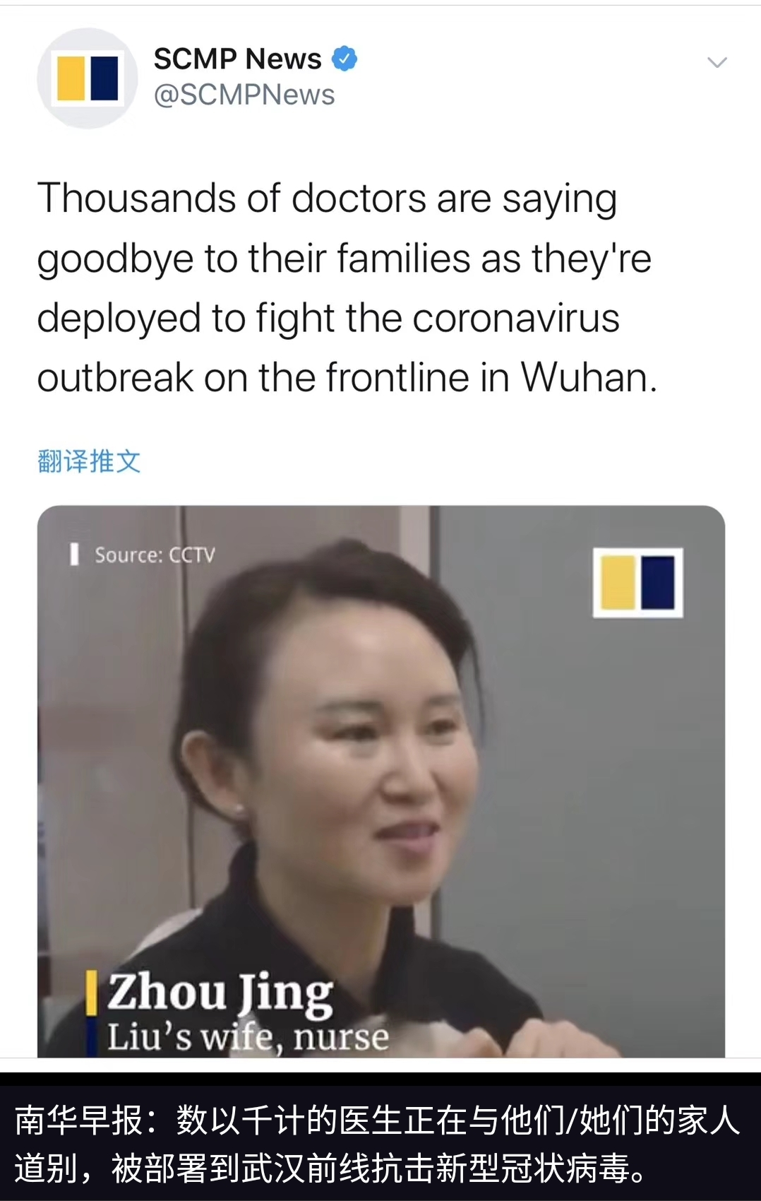
Jan. 25 Rescue teams are deployed to the frontline.

Slide 10
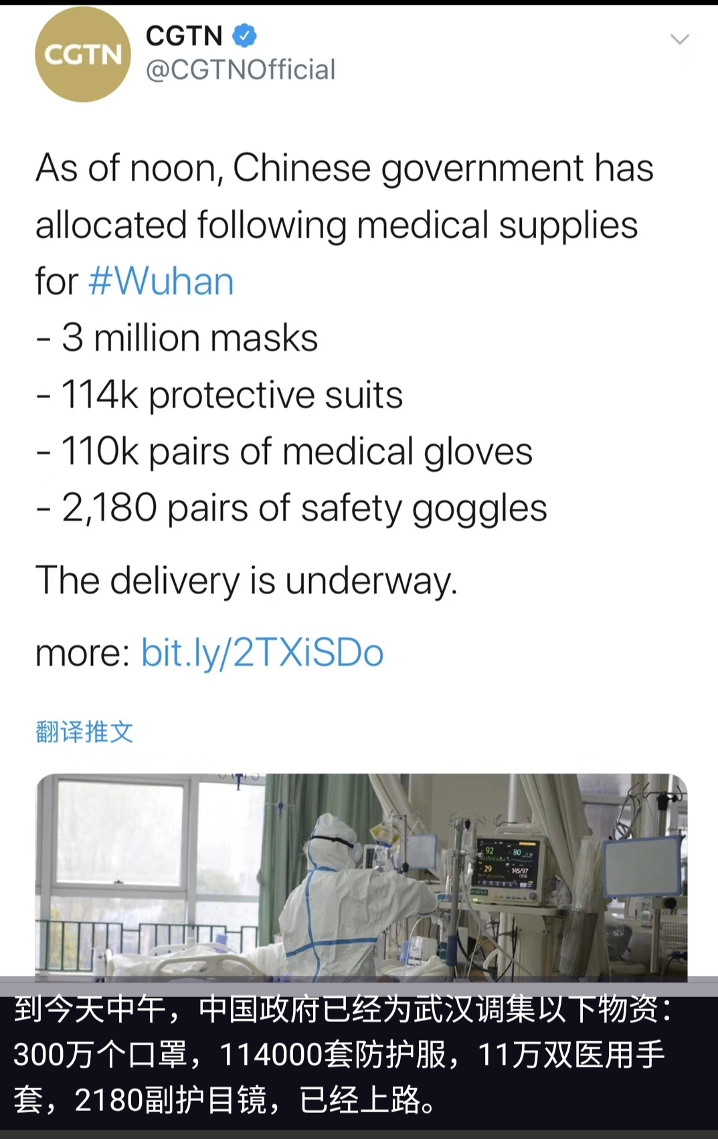
Jan. 25 The delivery of supplies is underway.

Slide 11
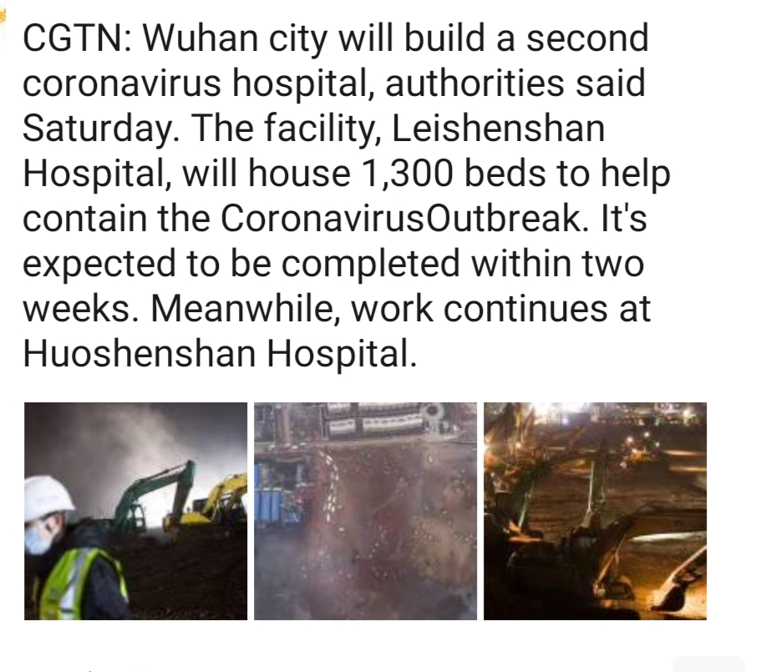
Jan. 25 Leishenshan Hospital is to be built.

Slide 12
What can we do?

Slide 13
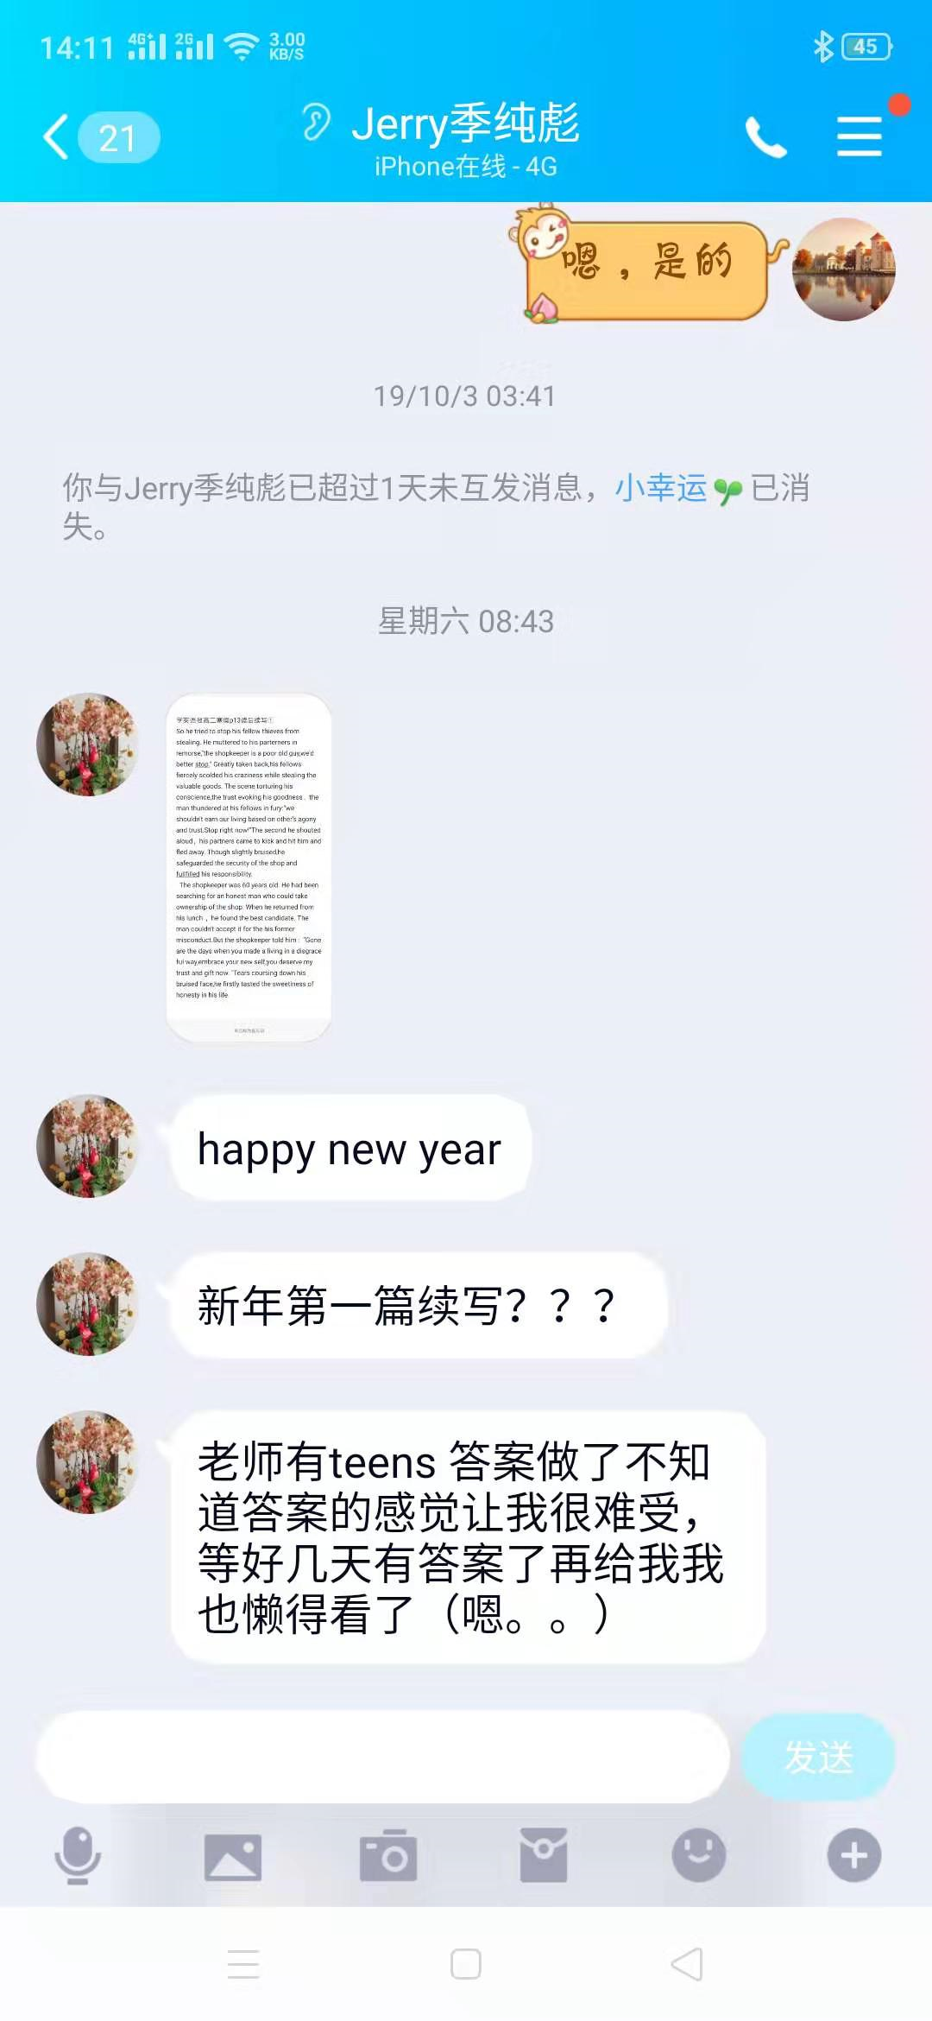
Jerry(class 3) 冒出来要Teens答案了 还写了续写求批改
这是正月初一，老师被感动了!

Slide 14
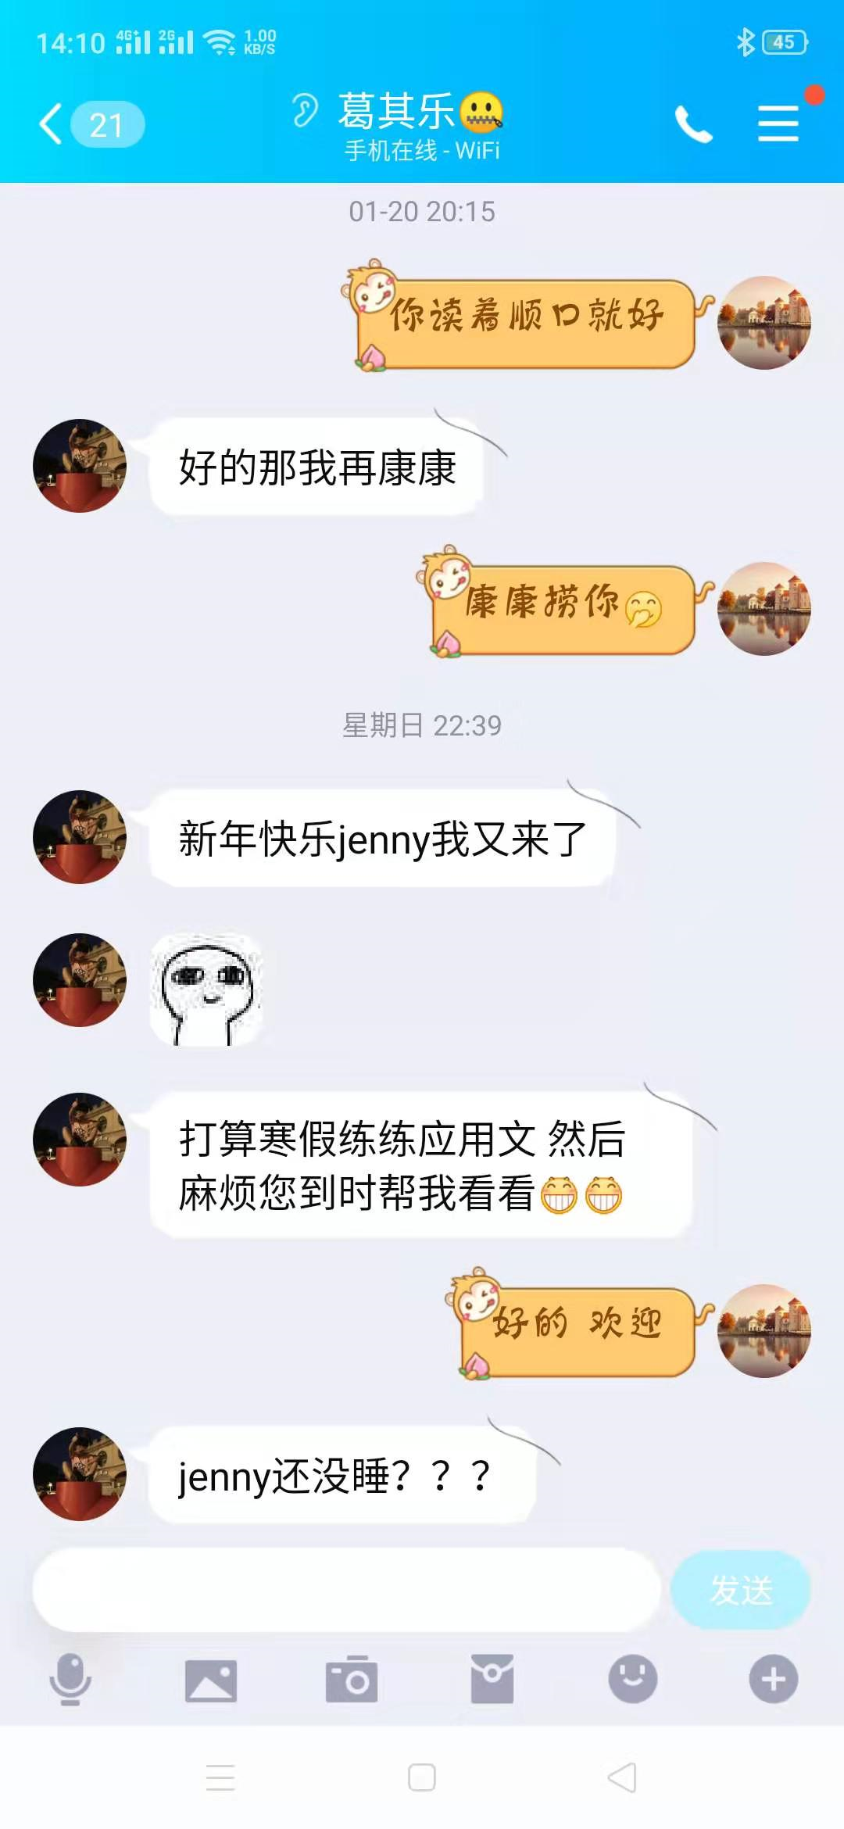
年初二的Elaine
写起了感谢信系列3篇

Slide 15
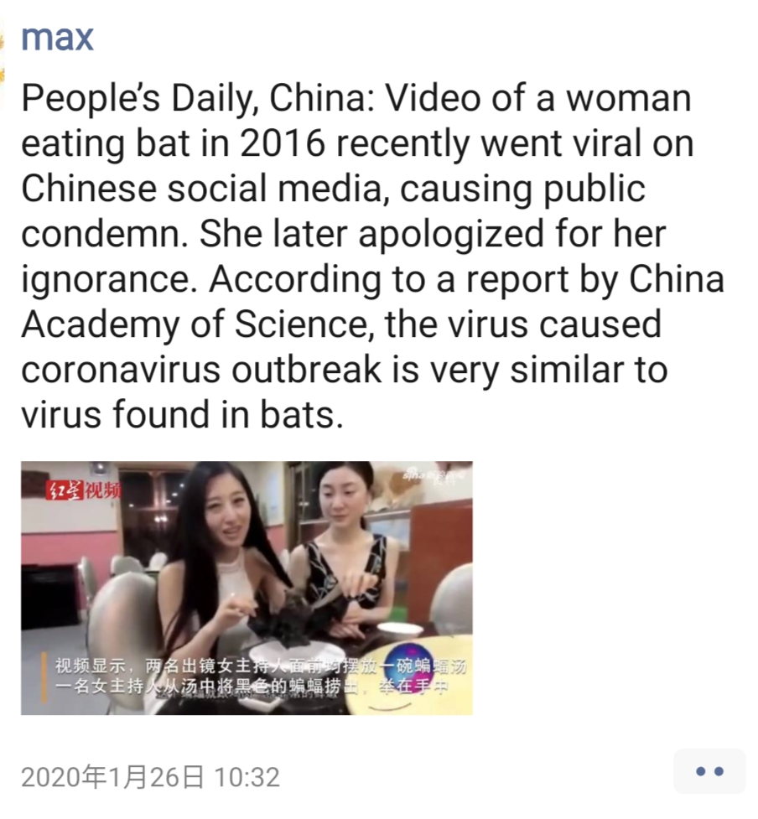
Jan. 26 go viral? Being stupid!!!

Slide 16
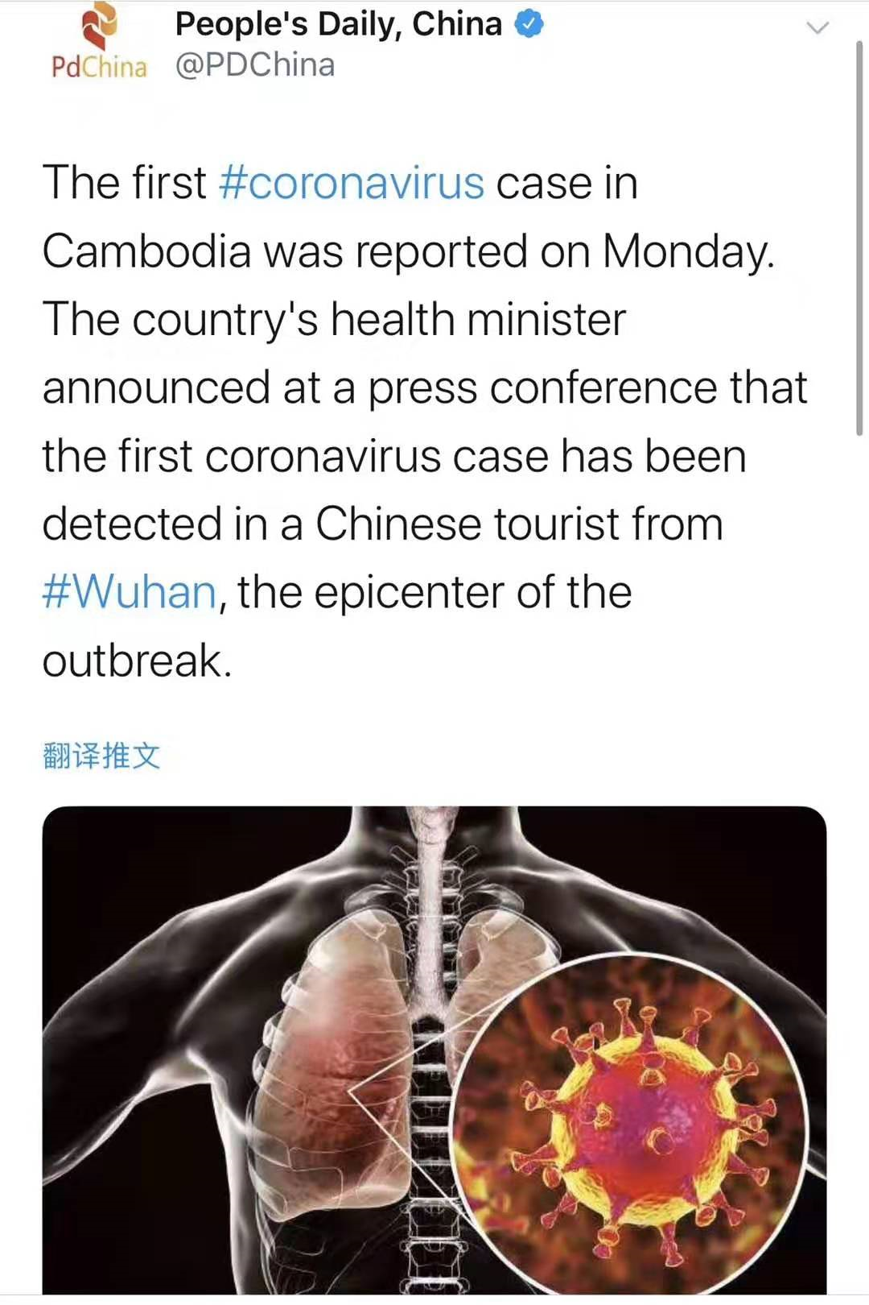
The first case in Cambodia.

Slide 17
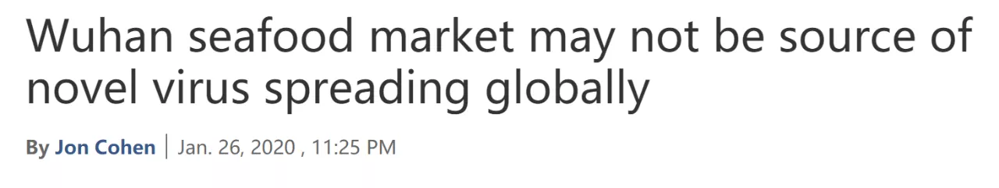
Jan. 26 大年初二

Slide 18
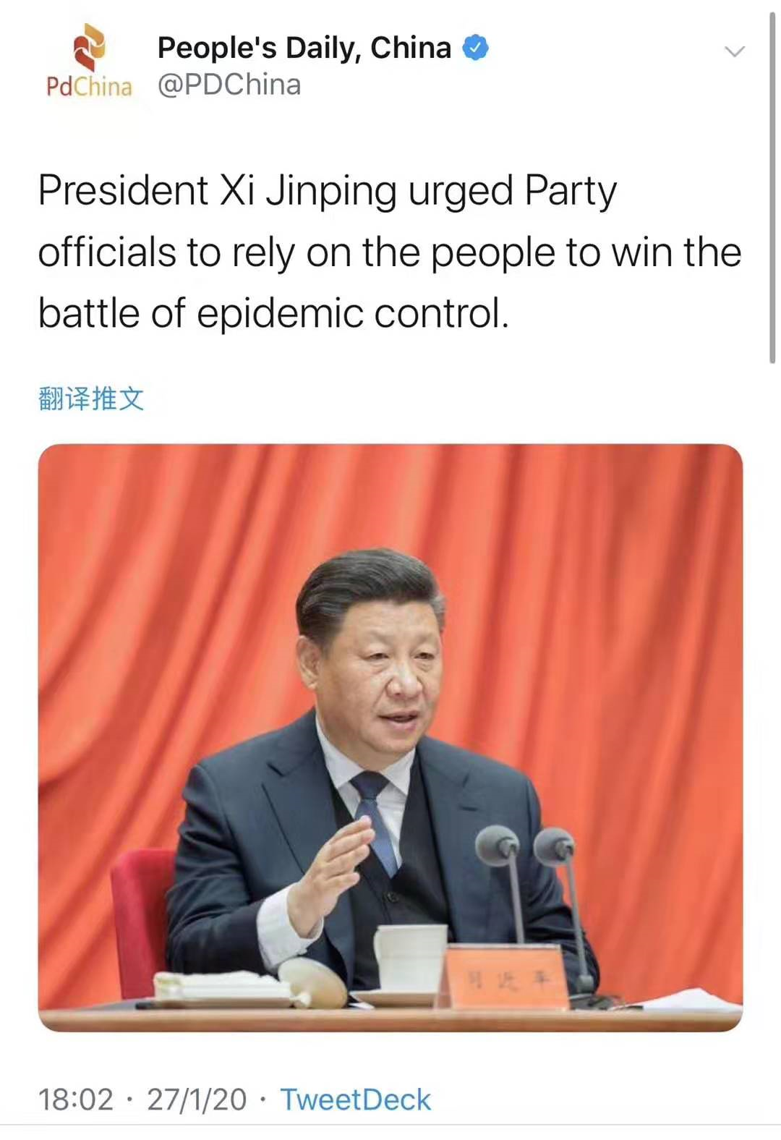
Jan. 27
rely on the people to win the
battle.

Slide 19
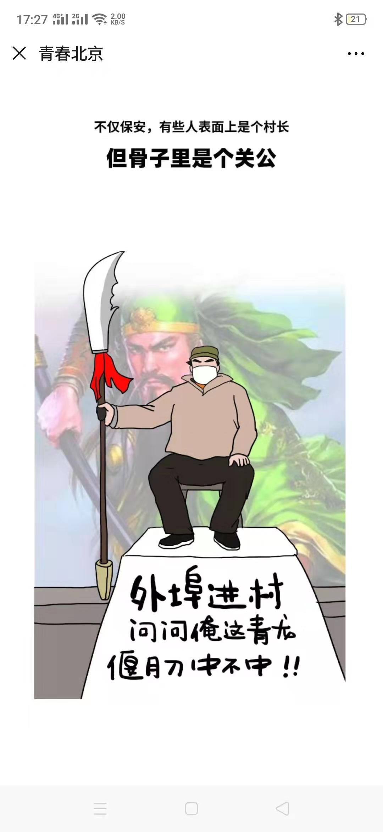
State of Emergency

Slide 20
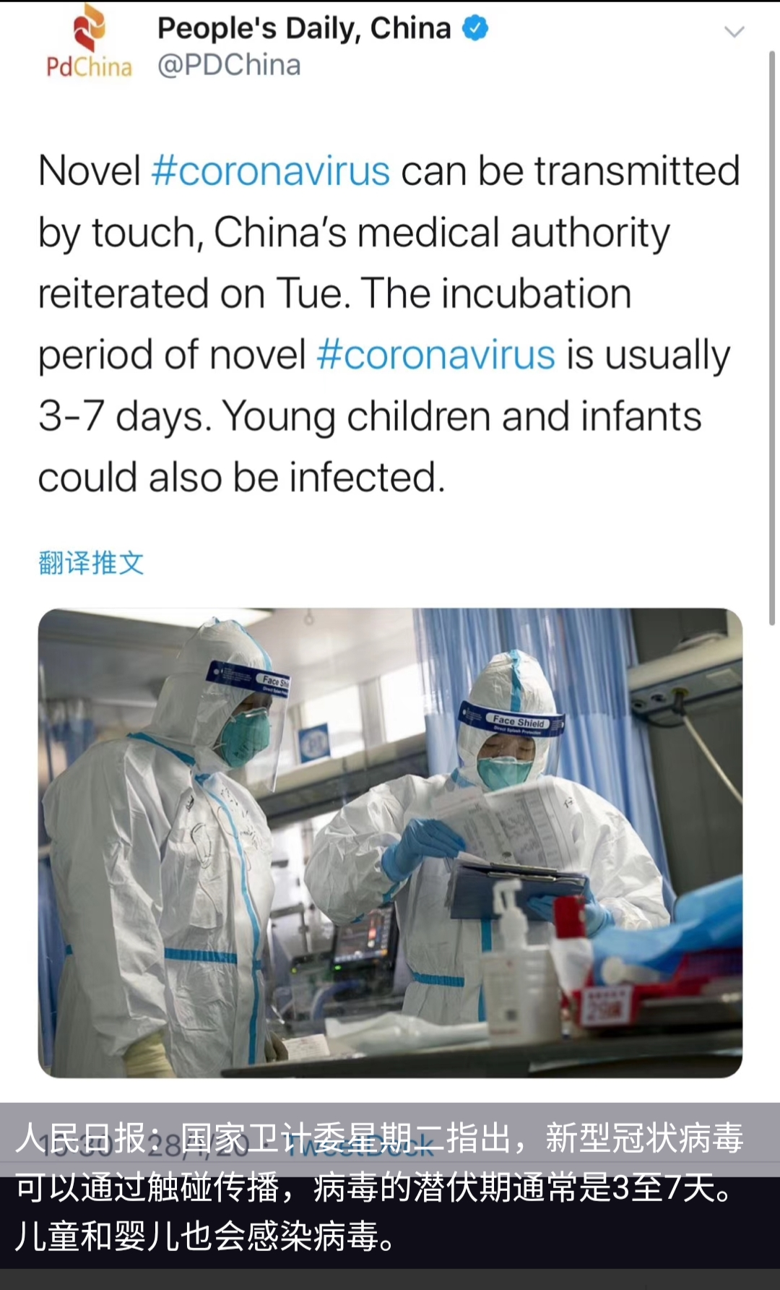
Jan. 28 by touch incubation

Slide 21
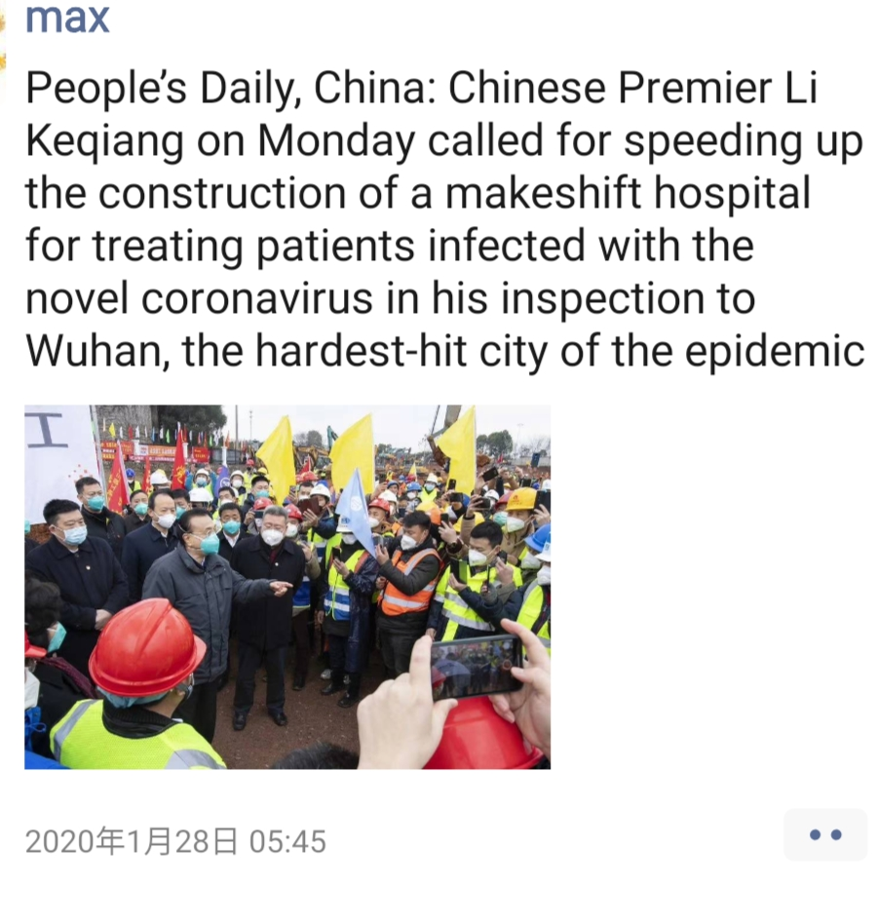
Jan. 28
The Primier's inspection

Slide 22
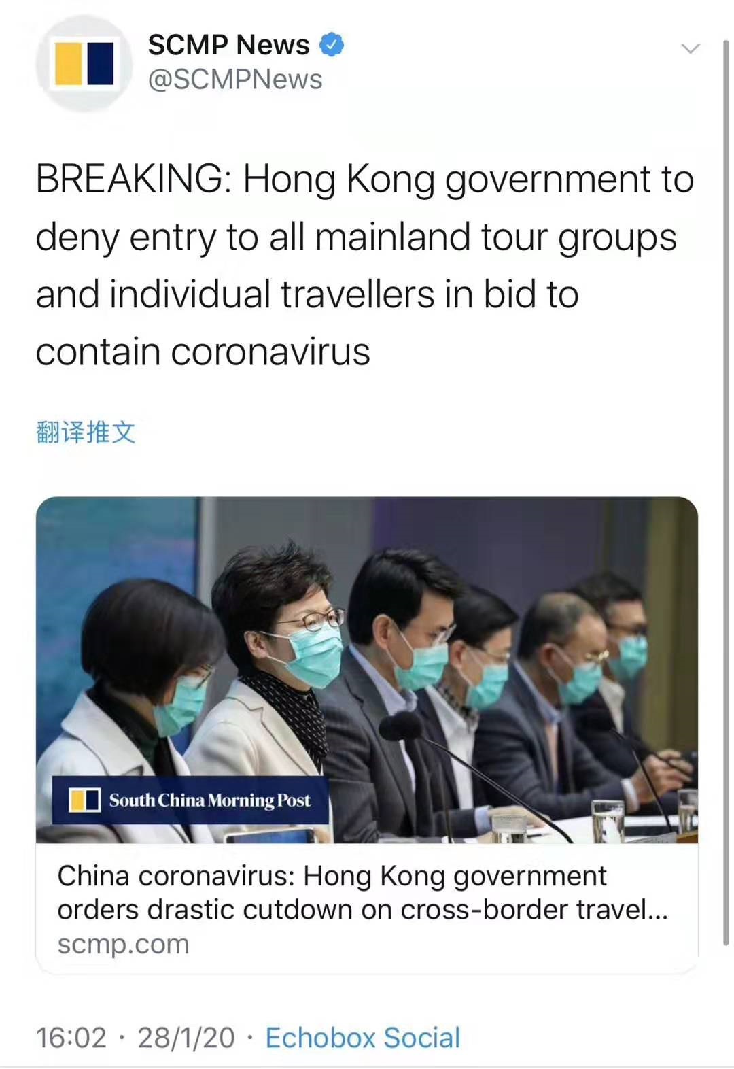
Hongkong government deny entry to ...

Slide 23
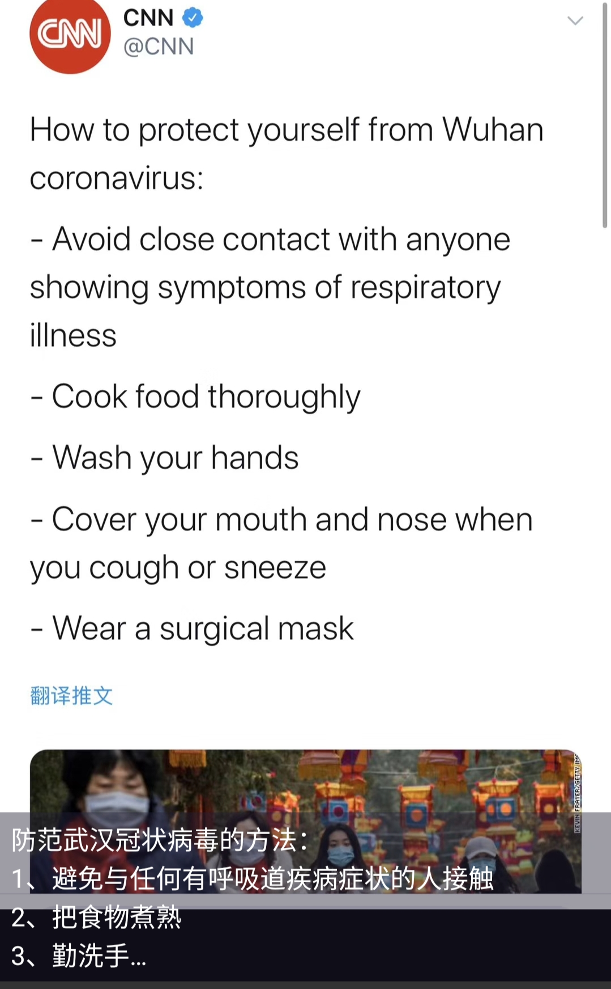
Jan. 29 How to Protect yourself ?

Slide 24
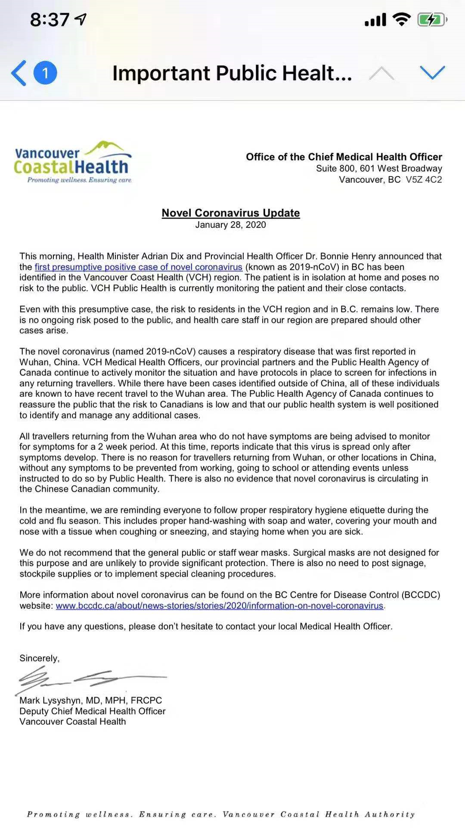
温哥华市长给市民的一封信

Slide 25
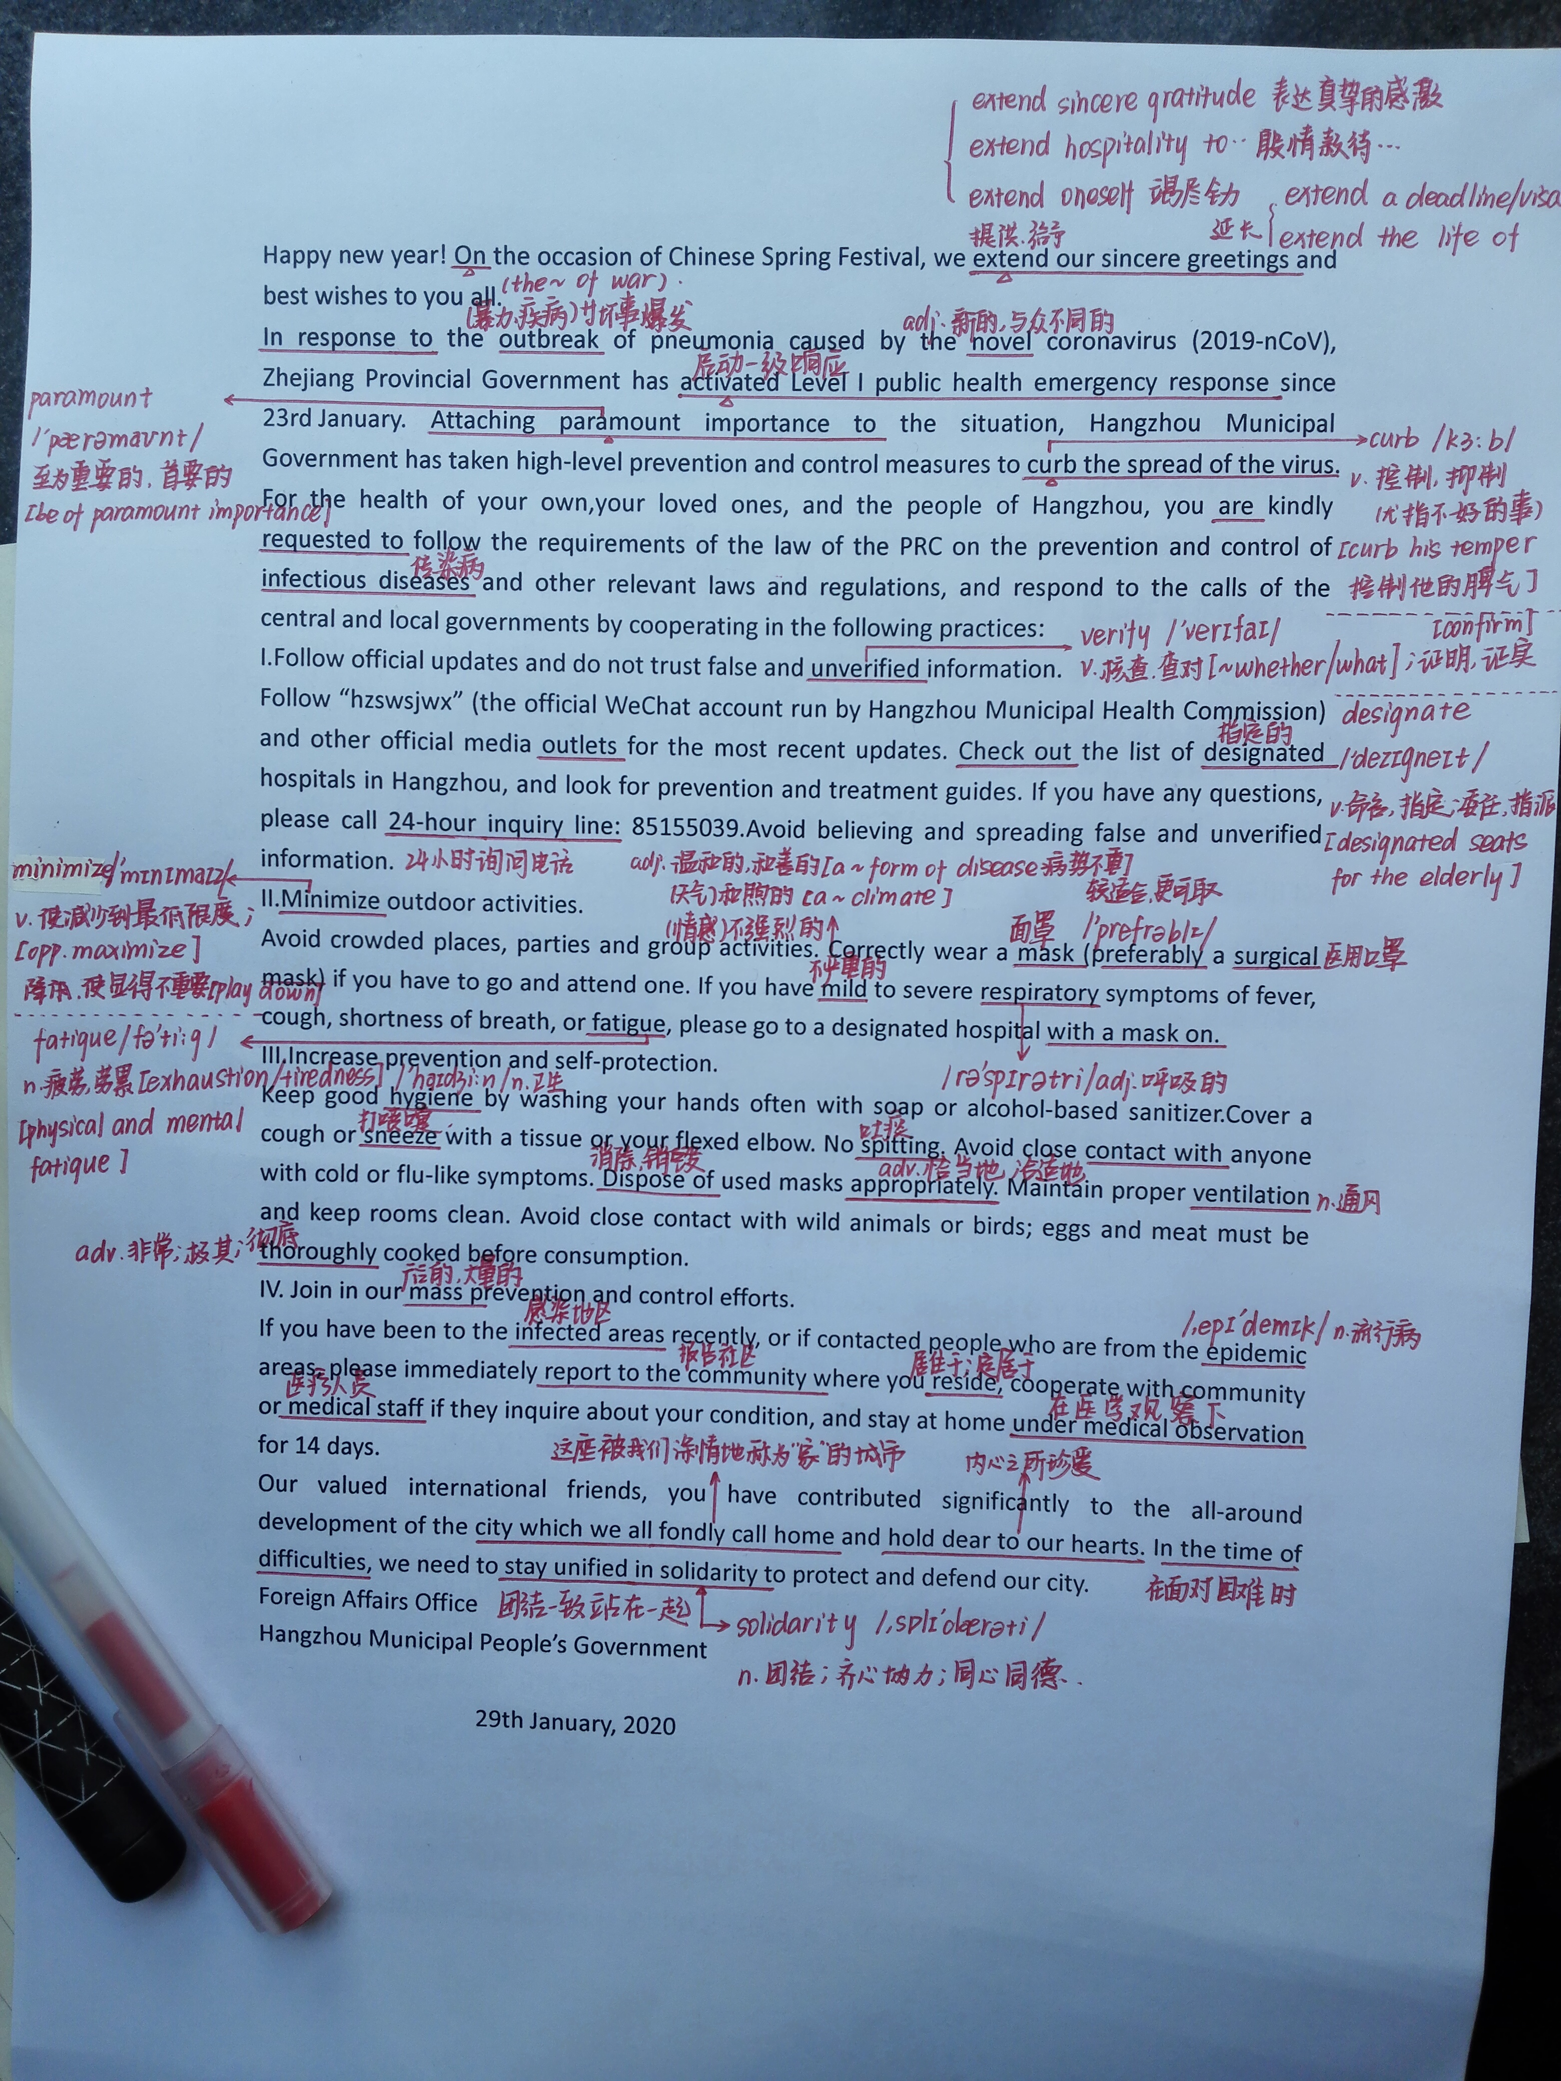
杭州市政府给外籍人员的一封信 Elaine 的学习笔记

Slide 26
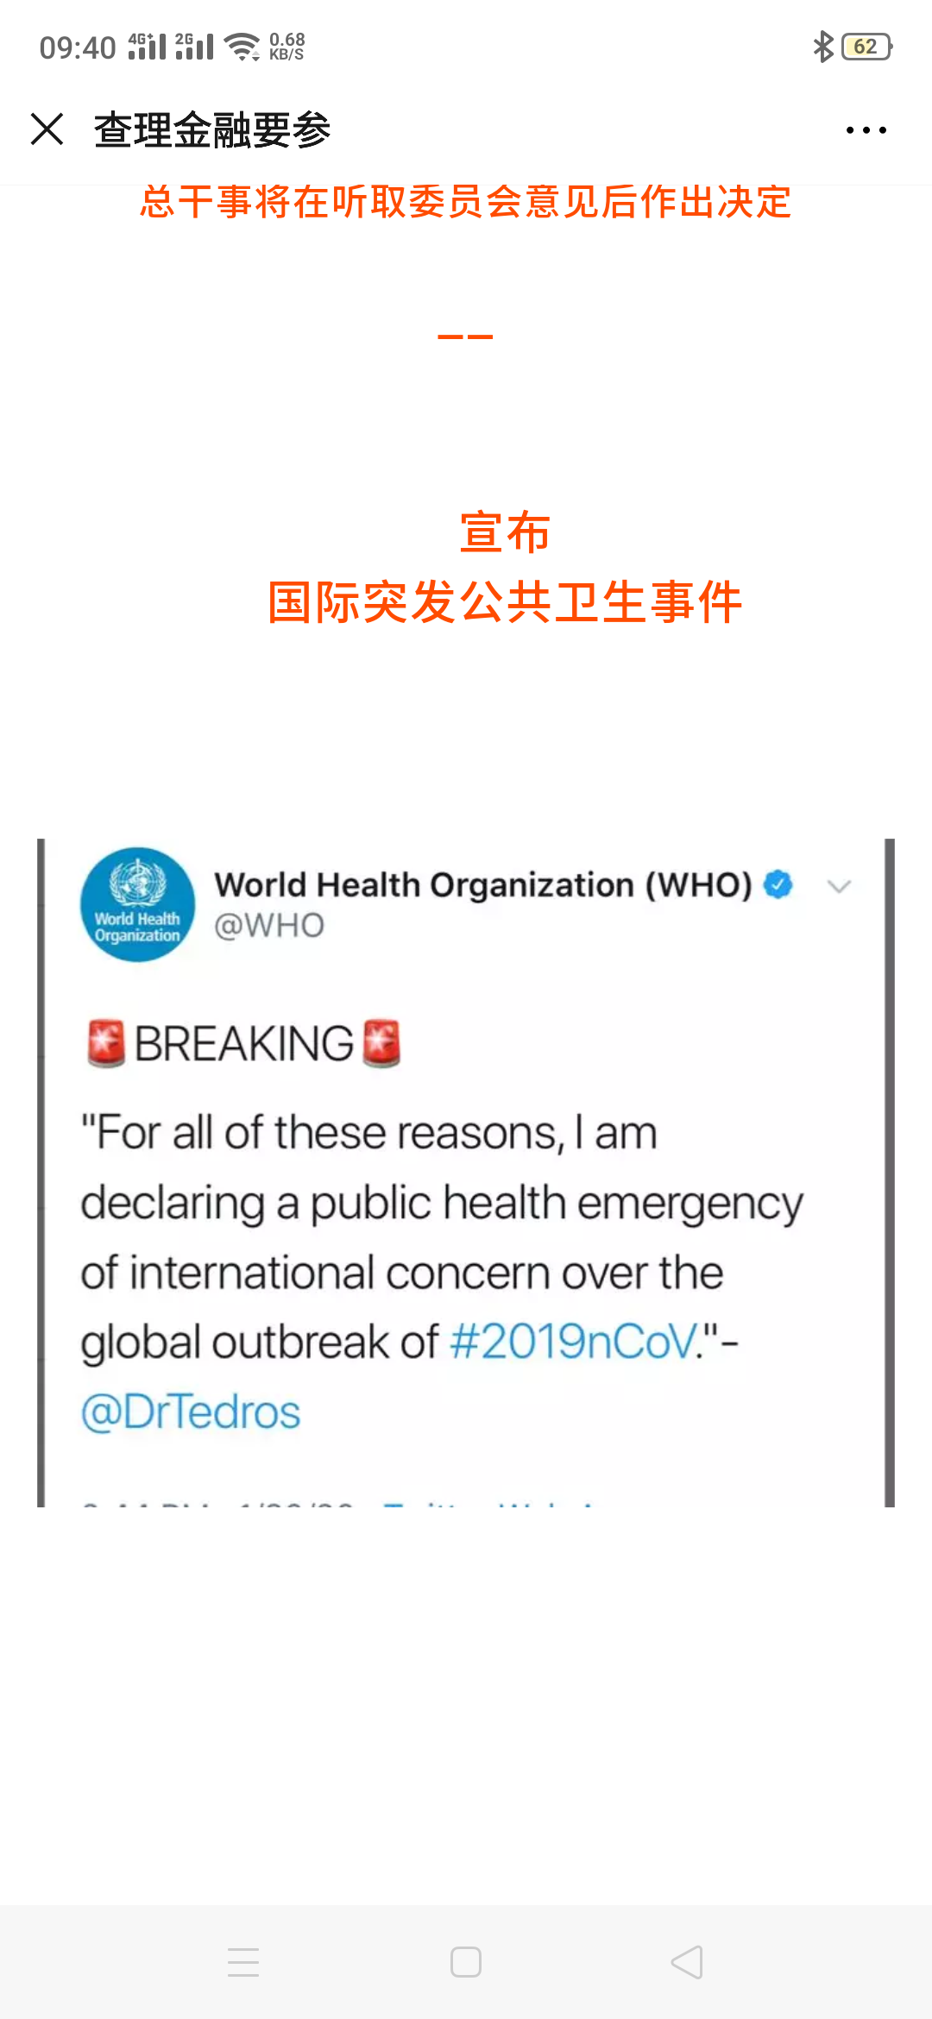
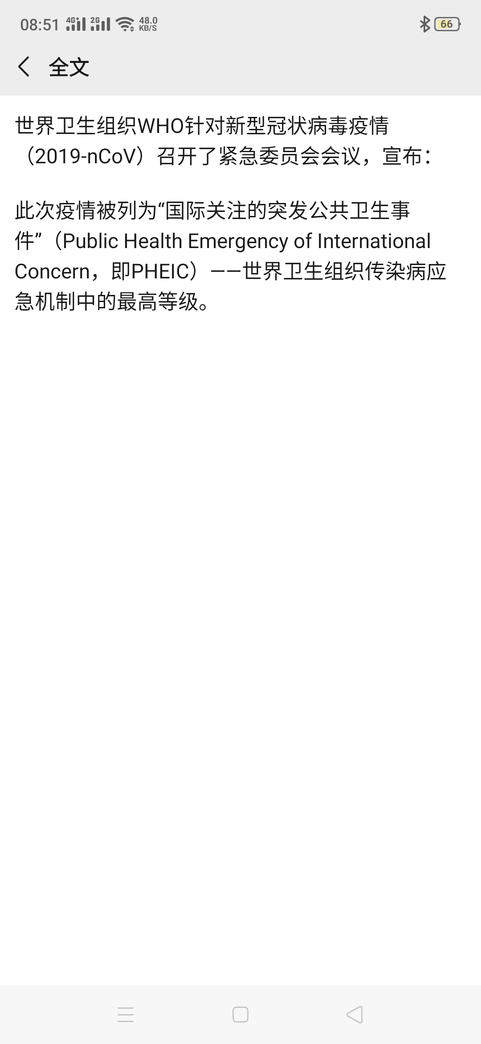
Jan, 30 PHEIC

Slide 27
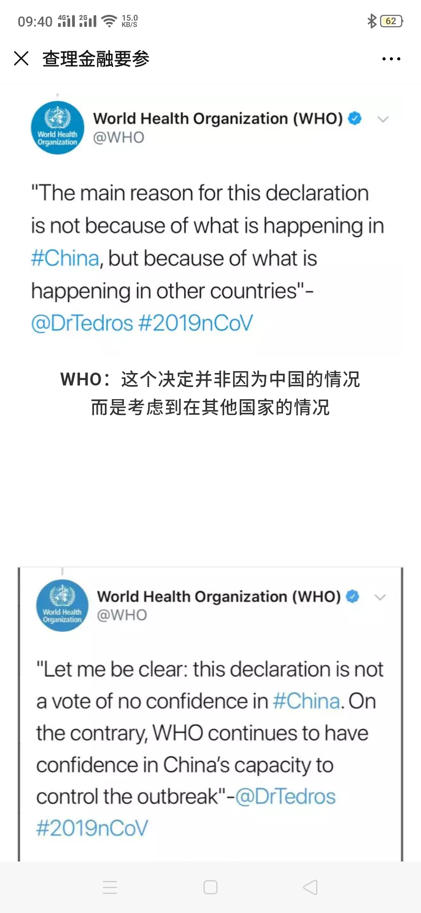
WHO

Slide 28
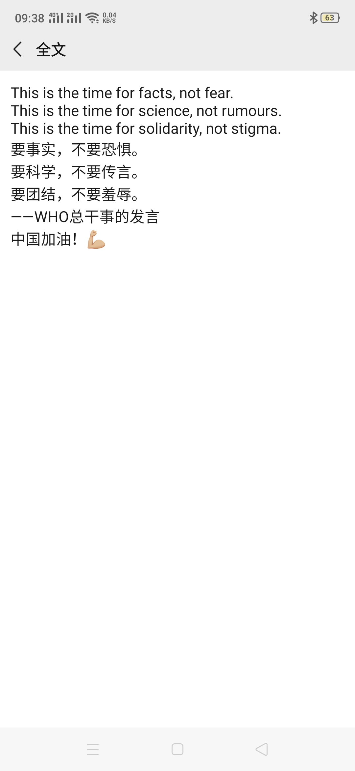

Slide 29
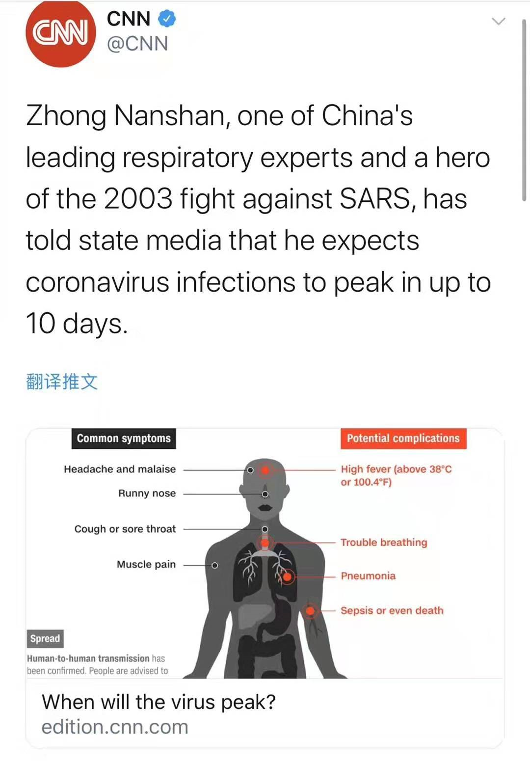
Hope

Slide 30

苍生大医

Slide 31

vaccine 疫苗

Slide 32
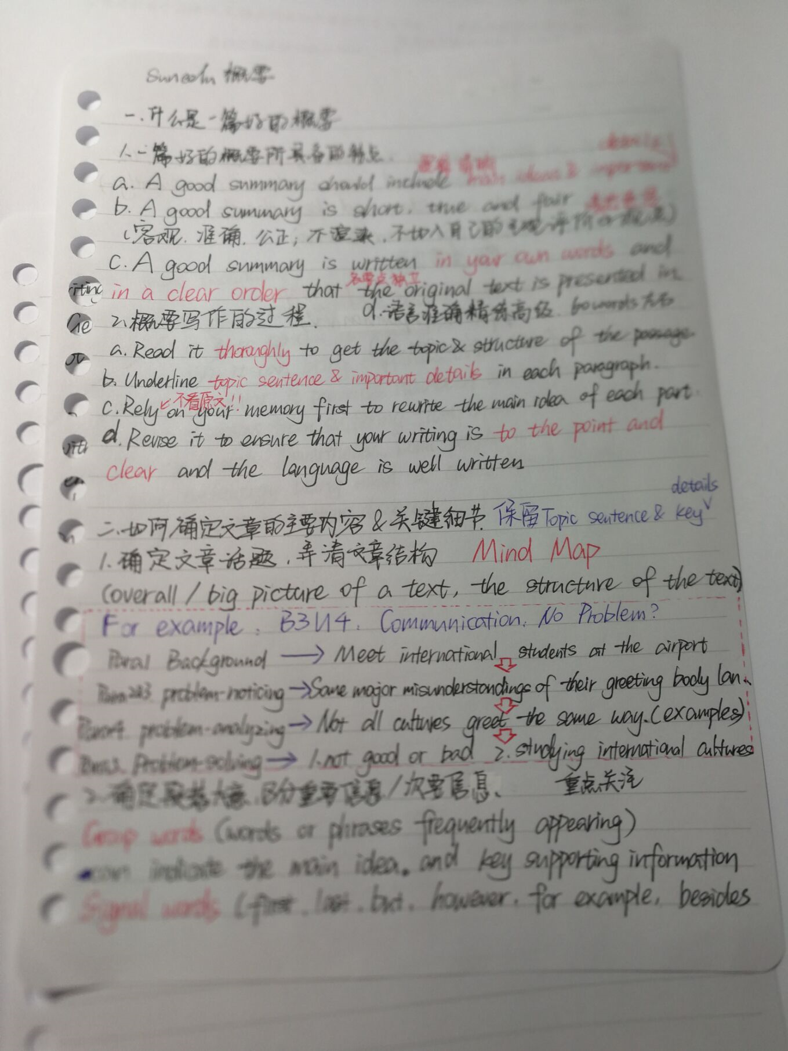
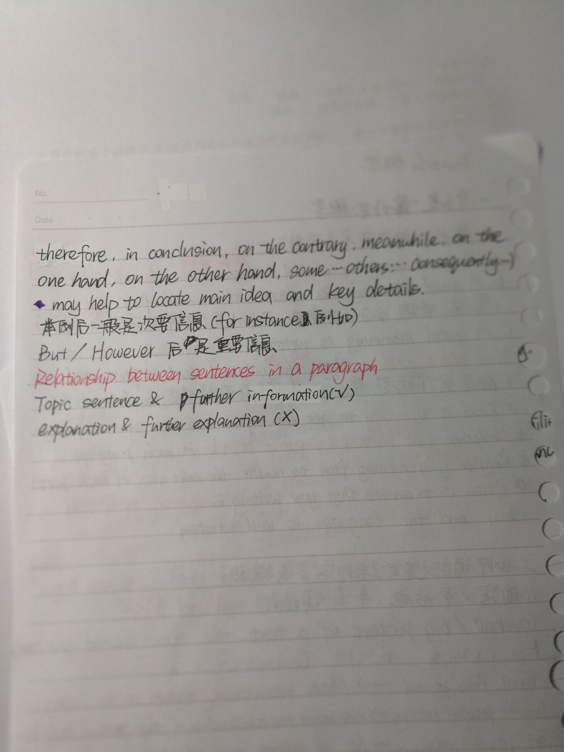
Jan. 30
Miranda非常喜欢溯嗯英语免费作文课
我也喜欢！

Slide 33

efforts

Slide 34
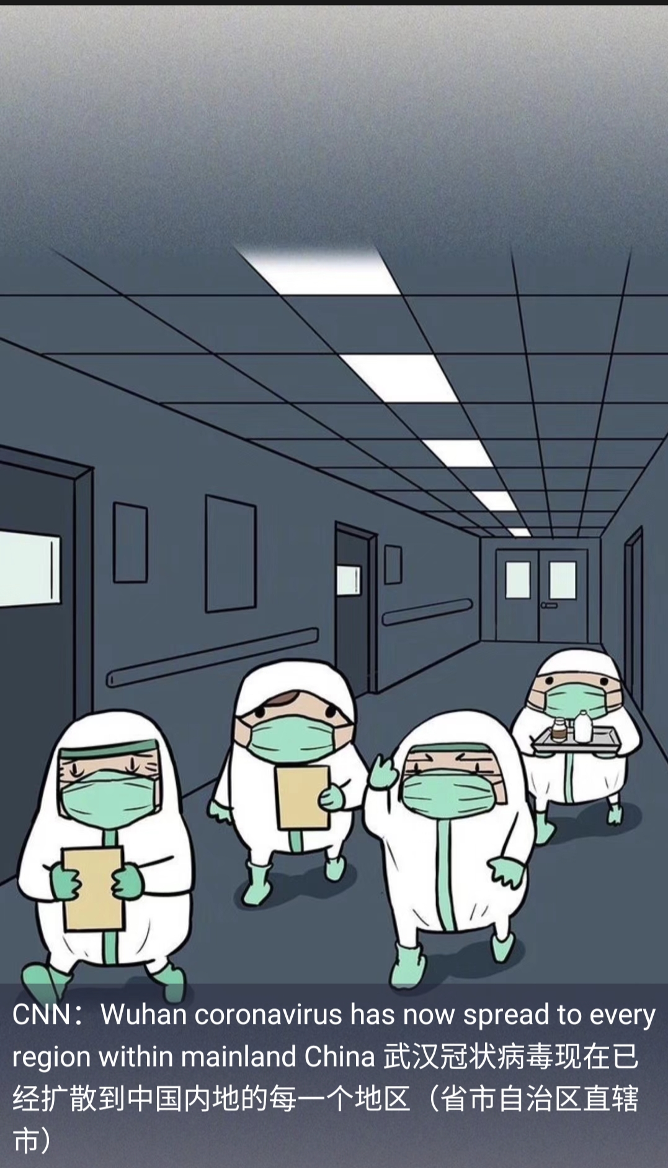
Jan.30 spread to every region

Slide 35
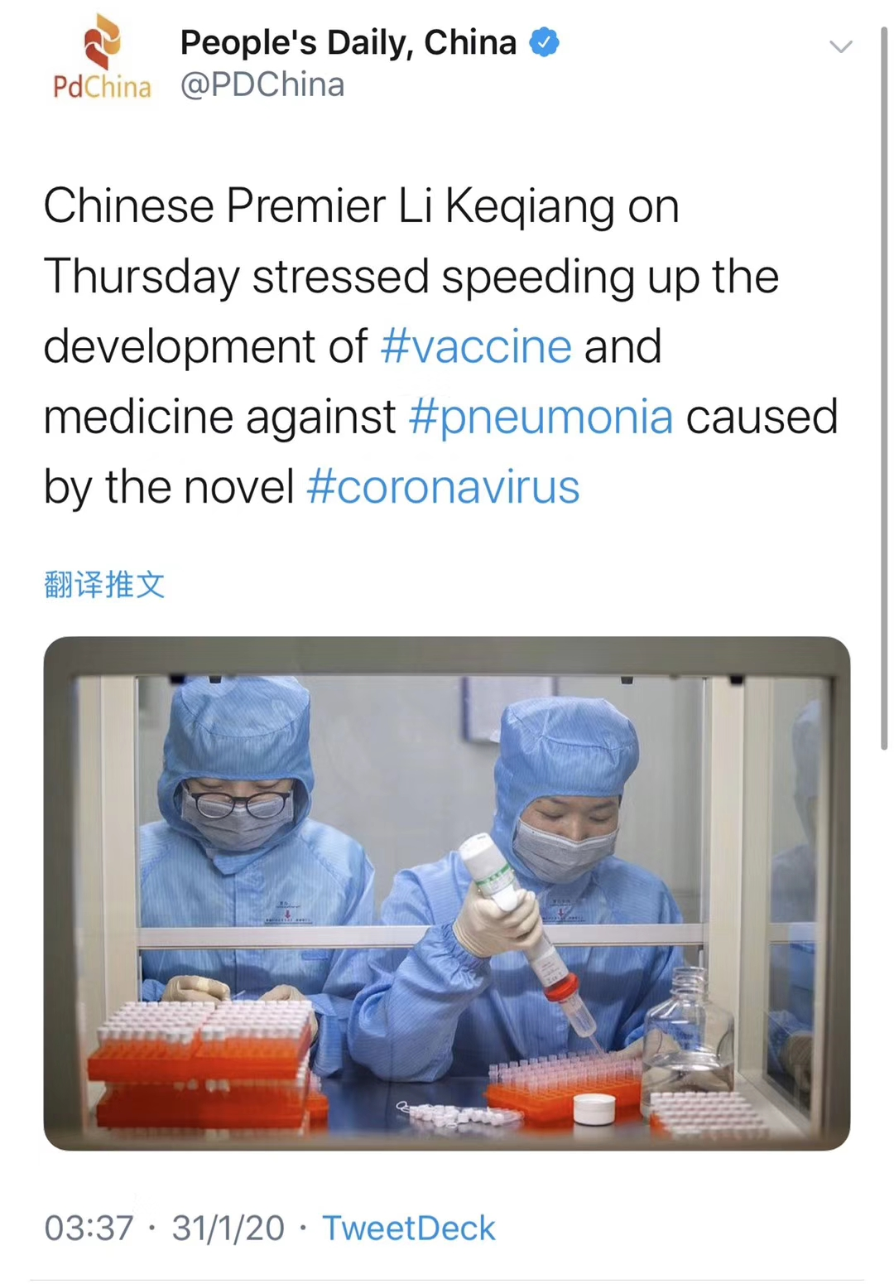
Jan. 31

Slide 36
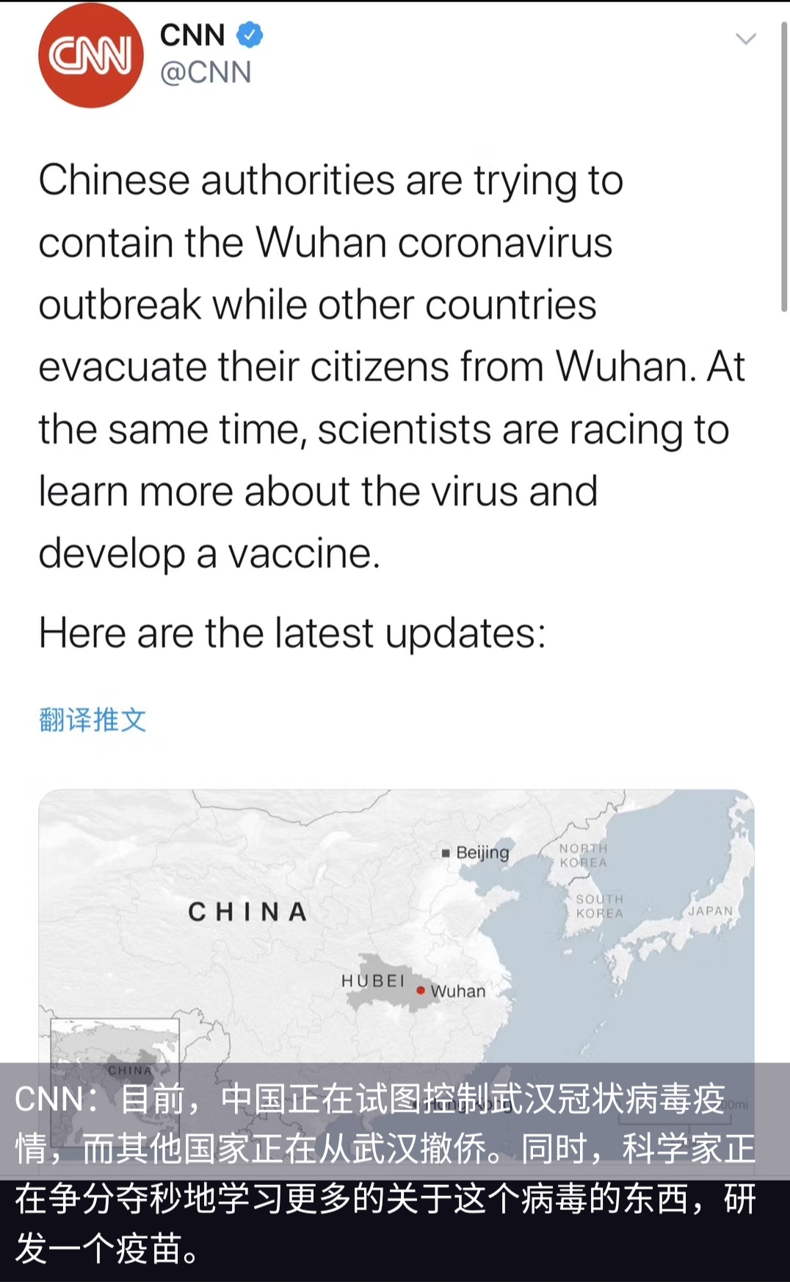
Jan. 31 evacuate： to move people from a place of danger to a safer place （把人从危险 的地方） 疏散，转移，撤离

Slide 37
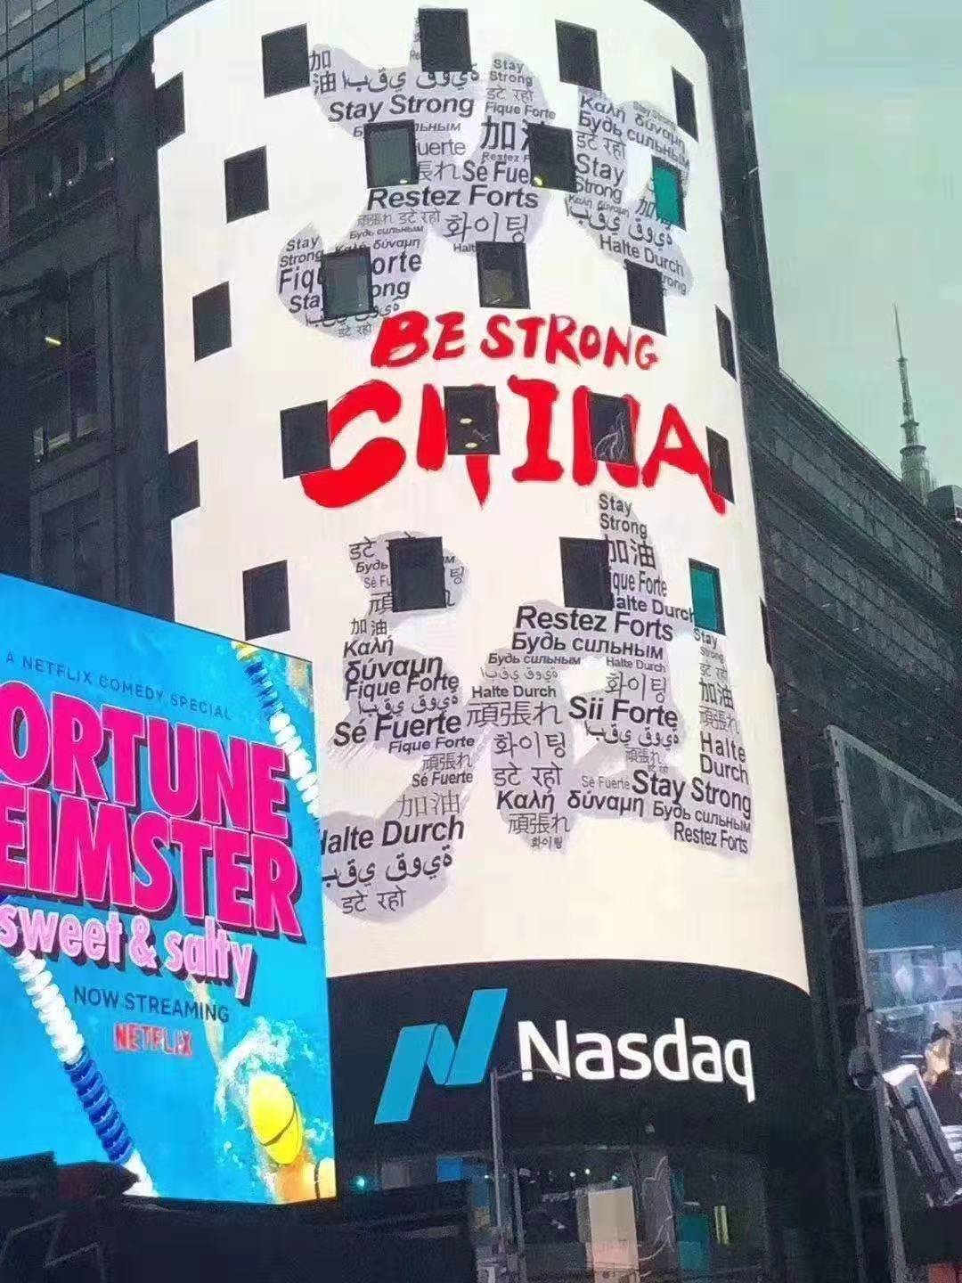
Be strong， China
Time square

Slide 38
They are the heroes：
曾有记者向李兰娟提出三个问题：
一问：“幸福是什么？”
李兰娟：“对一个医生来说，幸福就是看着一个个患者恢复健康。”
二问：“科学家精神是什么？”
李兰娟：“严谨求实，开拓创新，勇攀高峰。”
三问：“院士的核心价值观是什么？”
李兰娟：“不断攻克科学难题，救死扶伤造福人民。”

Slide 39
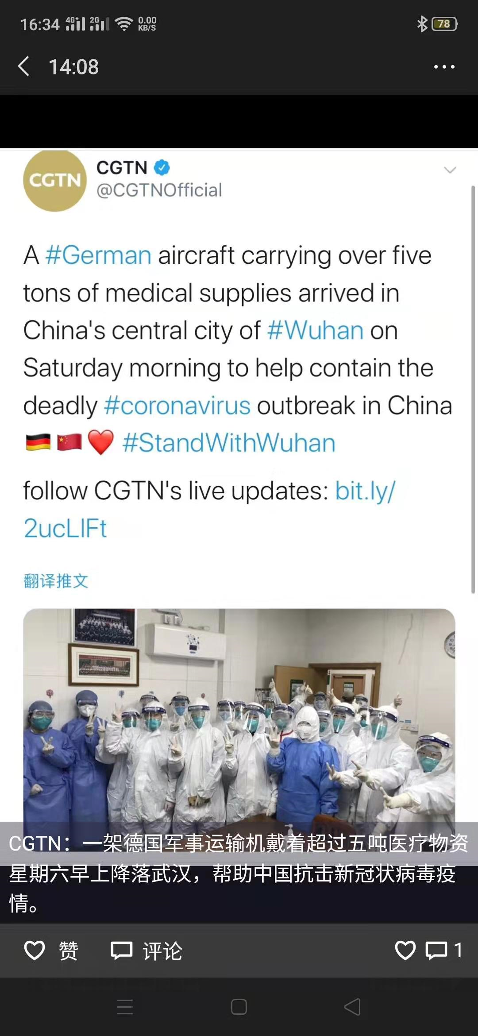
medical supplies from Germany

Slide 40
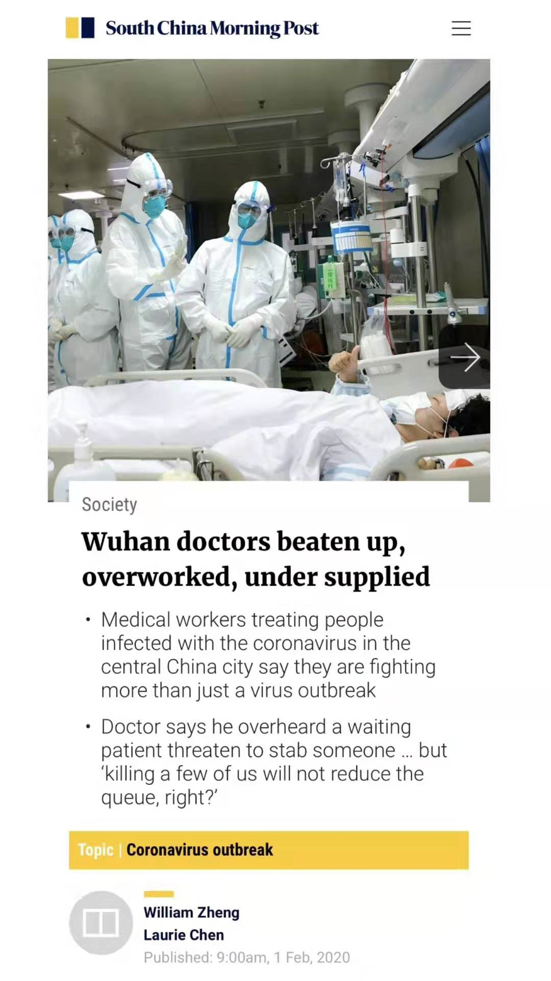
Feb. 1 Wuhan doctors
beaten up
overworked
under supplied

Slide 41
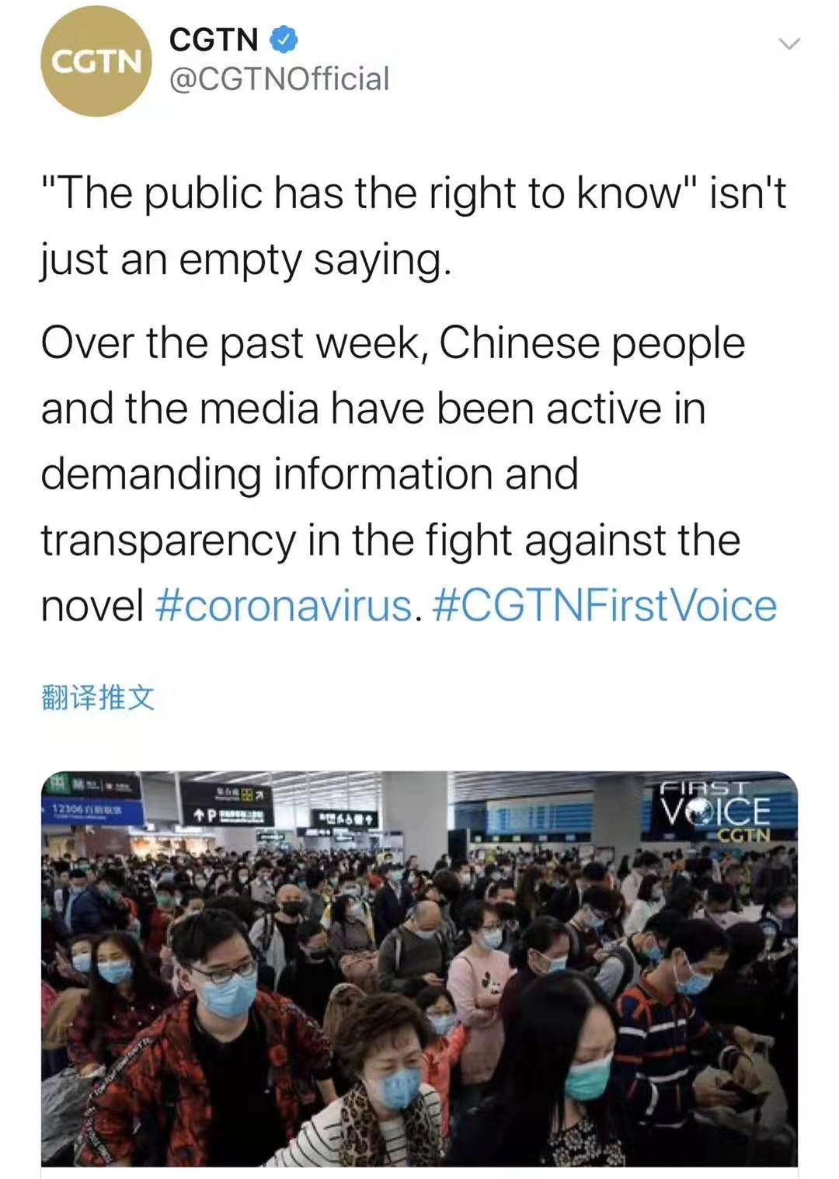
demanding information and transparency

Slide 42
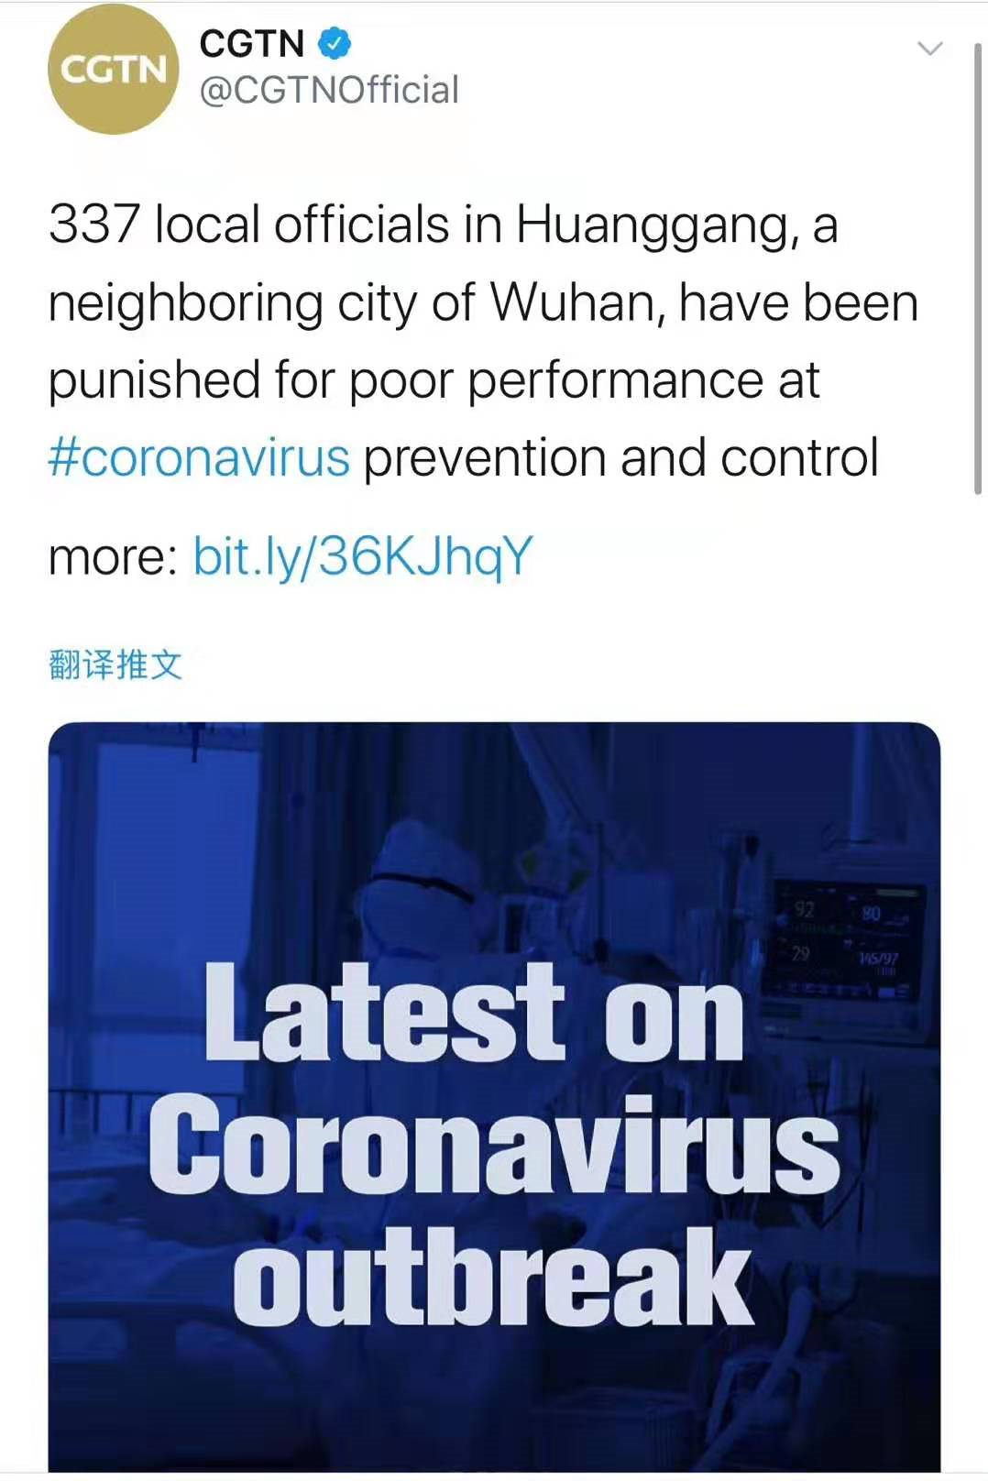
some officials got punished for poor performance at coronavirus prevention and control.
Feb. 2

Slide 43
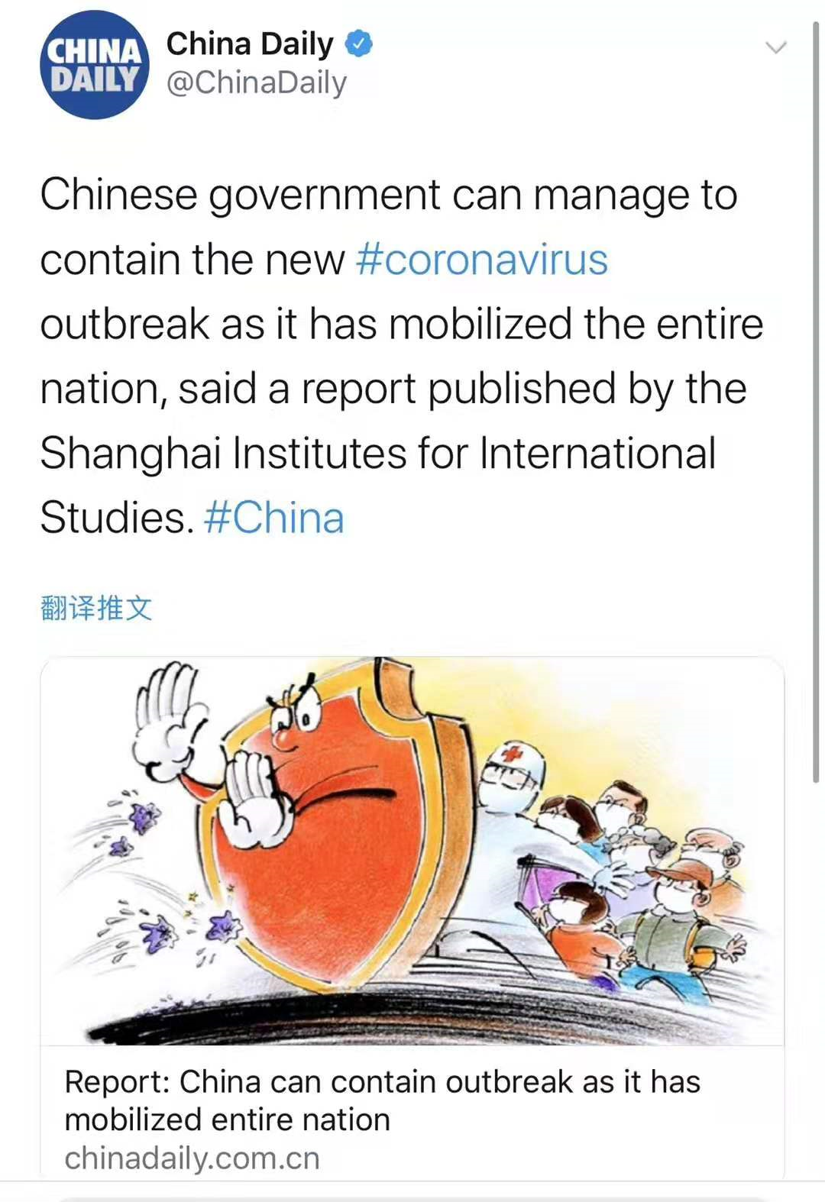
contain：to prevent sth harmful from spreading or getting worse 防止…蔓延（或恶化） mobilize： to work together in order to achieve a particular aim; to organize a group of people to do this 组织；鼓动；动员
Feb. 3

Slide 44
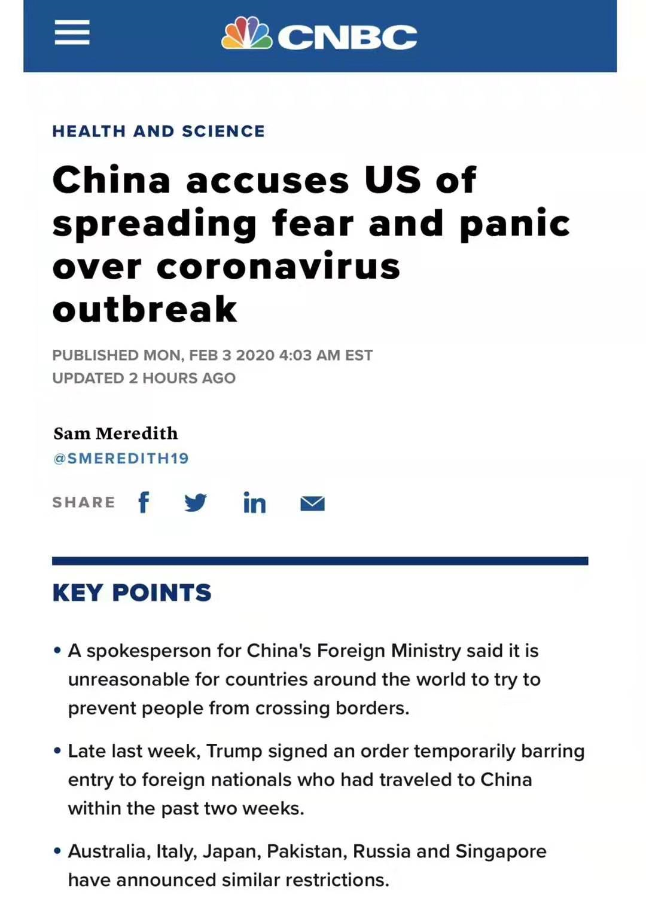
USA spread fear and panic over coronavirus outbreak

Slide 45
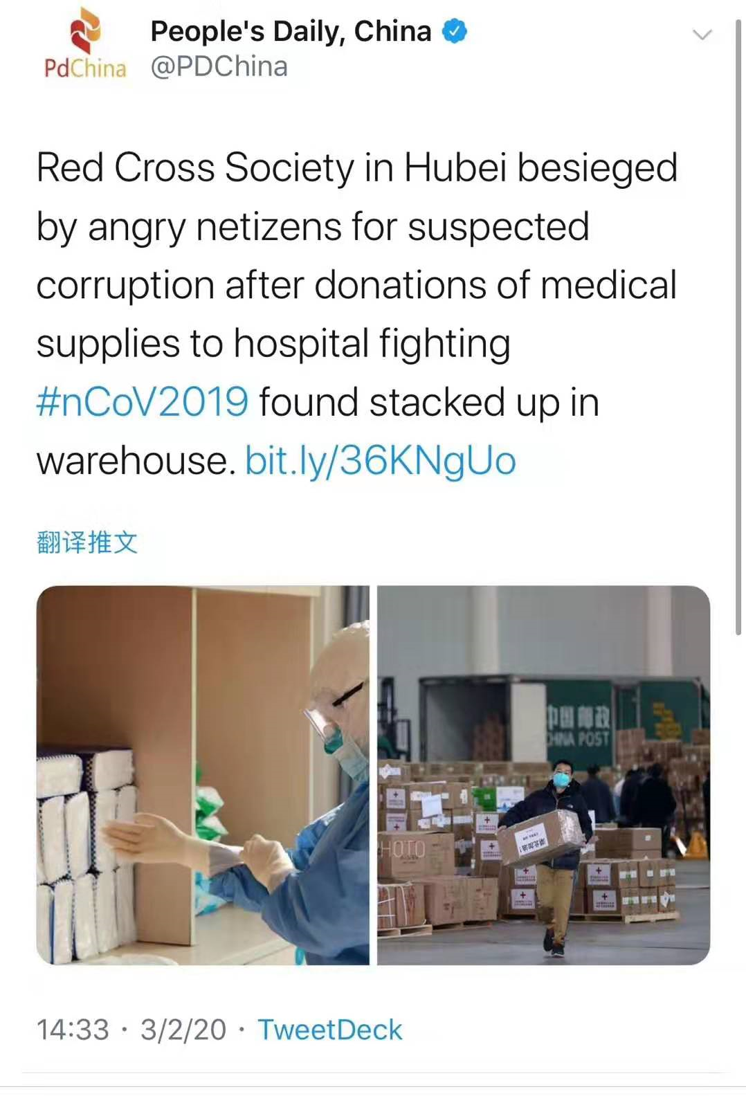
besiege/ bɪˈsiːdʒ/: send so many letters, ask so many questions, etc. that it is difficult for sb to deal with them all （用大量的信件、提问等）使某人应接不暇

Slide 46
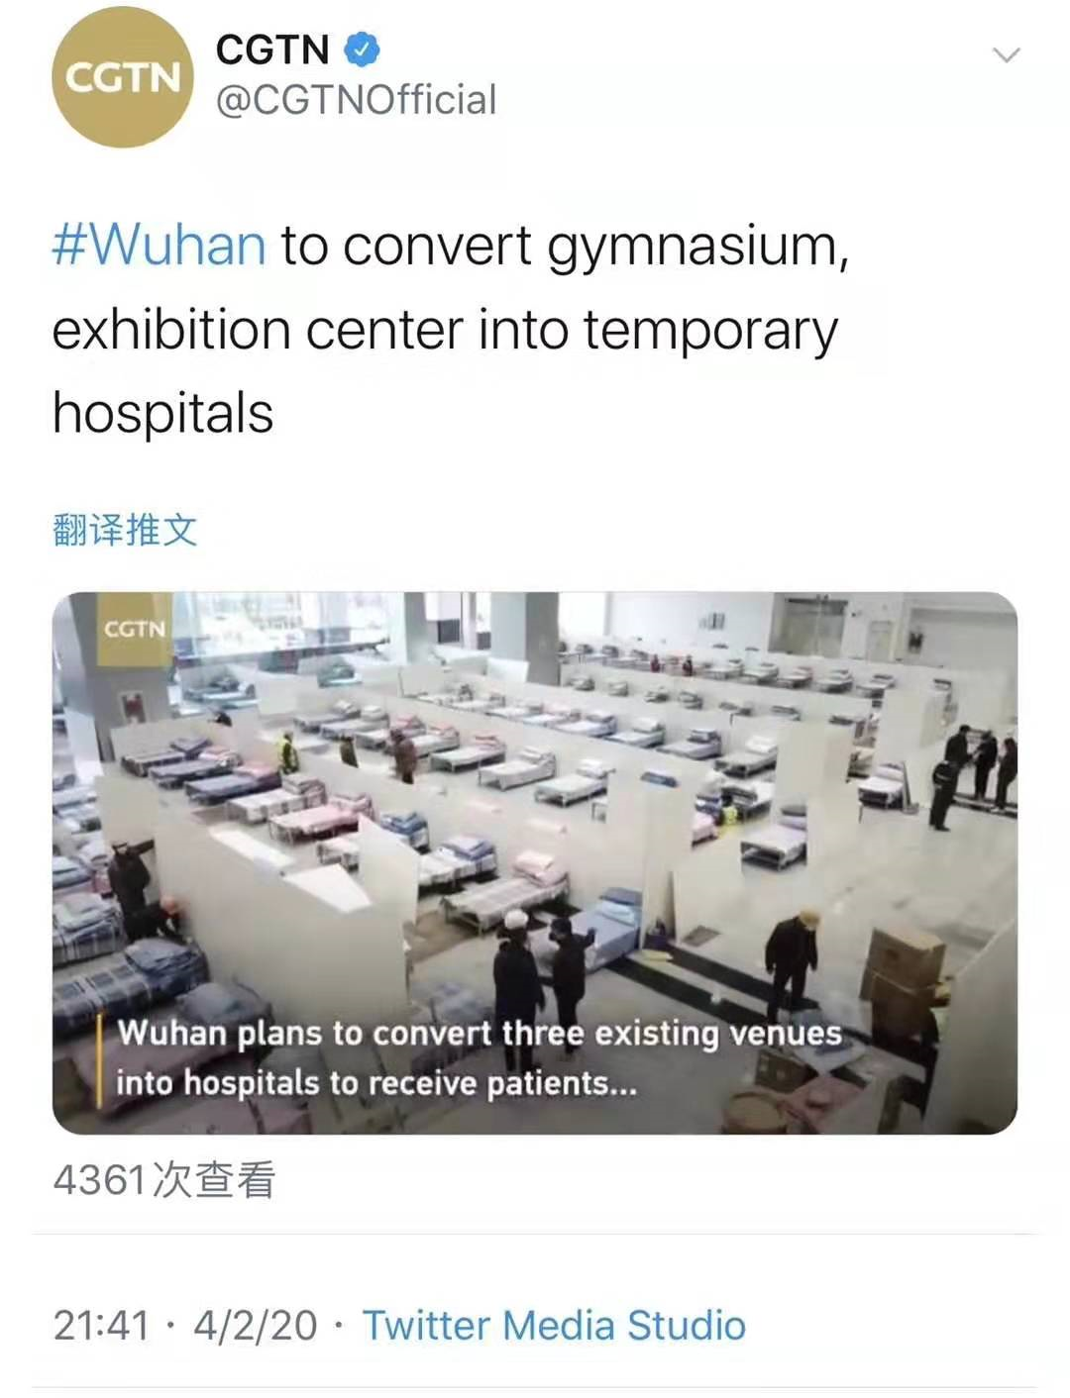
convert: to change or make sth change from one form, purpose, system, etc. to another （使）转变，转换，转化 temporary: lasting or intended to last or be used only for a short time; not permanent 短暂的；暂时的；临时的
Feb. 4

Slide 47
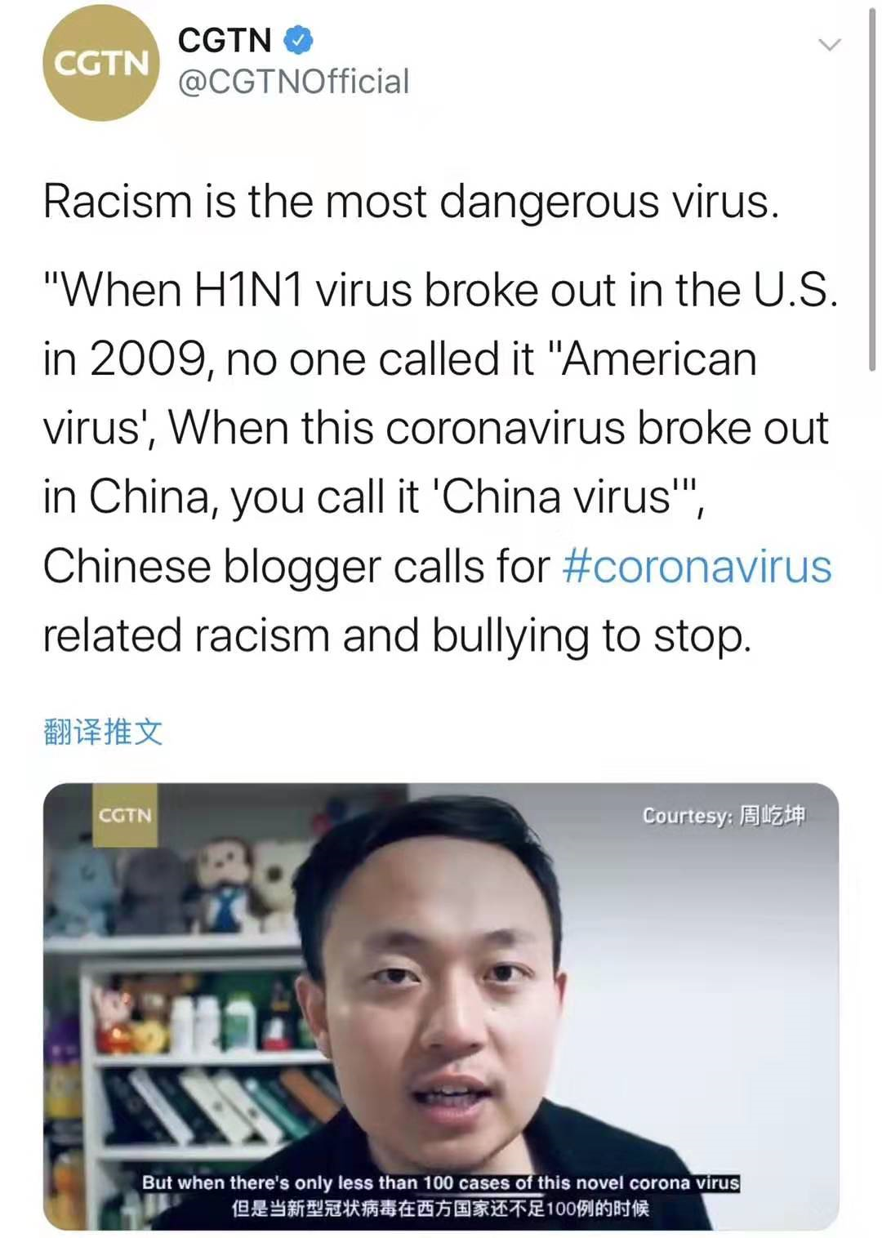
Racism is the most dangerous virus.

Slide 48
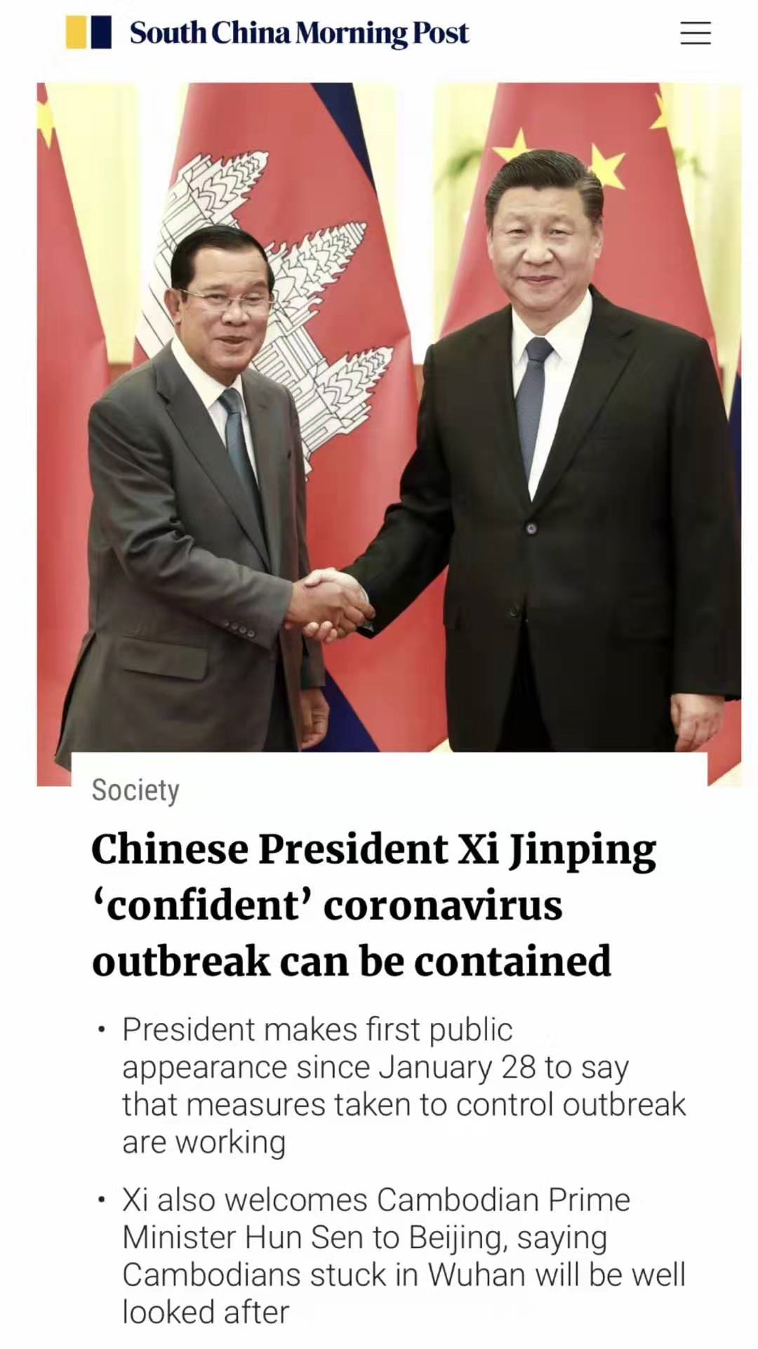
Confident
Feb. 5

Slide 49
Everybody, do your bit to fight the 2019-nCoV.
My dear students,
Equip yourself with more knowledge.
This is the exact way to show your respect for those working on the frontline。
This is just the way to prepare yourselves for the responsibilities you are to carry in the future.

