Slide 1

感恩遇见，相互成就，本课件资料仅供您个人参考、教学使用，严禁自行在网络传播，违者依知识产权法追究法律责任。
更多教学资源请关注
公众号：溯恩高中英语
知识产权声明

Slide 2


Reading Between the Lines
—How to make inferences
推理判断题型的解题策略

Slide 3
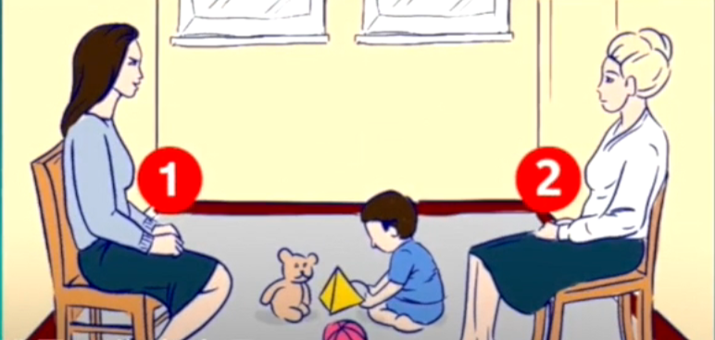
Who do you think is the real mother of the child?

Slide 4
What is the author trying to tell us from the following information?
In the mirror John Bell noticed that his hair was graying in the temples. As he picked up the morning paper, he realized that he could no longer see well at all without his glasses. Looking at the hands holding the paper he saw that they were wrinkled.
John Bell is realizing
that he is aging.

Slide 5
Statistics on four types of questions
38.6%
年份 | 主旨大意 | 细节理解 | 词义猜测 | 推理判断
2016.10 | 0 | 6 | 0 | 4
2017.06 | 1 | 5 | 1 | 3
2017.11 | 2 | 4 | 1 | 3
2018.06 | 3 | 3 | 1 | 3
2018.11 | 1 | 3 | 1 | 5
2019.06 | 2 | 5 | 1 | 2
2020.01 | 1 | 2 | 0 | 7
Total | 10 | 28 | 5 | 27

Slide 6


What is making inferences
Making inferences is ____________________ which is _____________________.
a fact
a reasonable guess
based on what the author says
based on your own experience

Slide 7
Making inferences in reading comprehension
01
How to infer the implied meanings
02
How to infer the writing purpose
03
How to infer the authors’ opinion and attitude
04
How to infer the source of the passage

Slide 8

1
How to infer the implied meanings
解题策略:
1).全面分析 2).忠实原文3).不要选择表层信息
Modern America was born on the road, behind a wheel. The car shaped some of the most lasting aspects of American culture: the roadside diner, the billboard, the motel, even the hamburger. For most of the last century, the car represented what it meant to be American—going forward at high speed to find new worlds. The road novel, the road movie, these are the most typical American ideas, born of abundant petrol, cheap cars and a never-ending interstate highway system, the largest public works project in history.(2018浙江卷)
Why is hamburger mentioned in this paragraph？
A. To explain Americans’ love for travelling by car.
B. To show the influence of cars on American culture.
C. To stress the popularity of fast food with Americans.
D. To praise the effectiveness of America’s road system.
✔

Slide 9

Exercise 1
Visiting an apple event is a good chance to see, and often taste, a wide variety of apples. To people who are used to the limited choice of apples such as Golden Delicious and Royal Gala in supermarkets, it can be quite an eye opener to see the range of classical apples still in existence, such as Decio which was grown by the Romans. Although it doesn’t taste of anything special, it’s still worth a try, as is the knobbly(多疙瘩的) Cat’s Head which is more of a curiosity than anything else.(2016全国卷)
What can we learn about Decio?
A. It is a new variety. B. It has a strange look.
C. It is rarely seen now. D. It has a special taste.

Slide 10

How to infer the implied meanings
The common question forms (P273)
The strategies(策略) to make inferences
_____________________________________________________________________________________________________________________________________________________________________________________________________________________________________________________
_____________________________________________________________________________________________________________________________________________________________________________________________________________________________________________________
What do we know about the author
from the first paragraph?
What can be inferred from the passage?
What can we learn about Ireland from the text?

Slide 11

Four tips of making inferences
01
Read
silently
the implied message
02
Understand
underline
circle
RULE
03
Locate
the sentences using the key words
04
Eliminate
Narrow your choices down

Slide 12
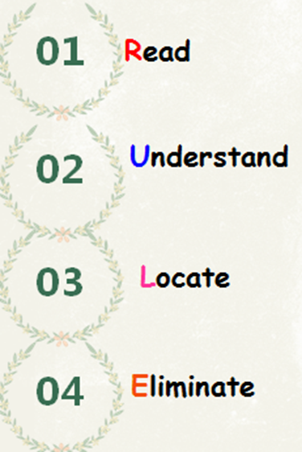
2
How to infer the writing purpose
... They know the shortest way possible without even looking at a map, because everyone who wants to become a taxi driver must pass a very difficult examination in order to get a license to drive a taxi. The exam is called “The Knowledge.” It is a written test, and in it drivers are asked the shortest way from one place to another. They must take into account the time of day—in rush hour, a longer route(路线) may be quicker—and describe the best way. Moreover they must never forget the one-way streets!(2018浙江卷)
What is the purpose of "The Knowledge"?
To qualify one to drive a taxi.
B. To assess one’s driving skills.
C. To test drivers’ ability to write.
D. To check taxi drivers memory.
✔

Slide 13
Exercise 2
Support Pacific Science Center
Since 1962, Pacific Science Center has been inspiring a passion(热情) for discovery and lifelong learning in science, math and technology. Today, Pacific Science Center serves more than 1.3 million people a year and brings inquiry-based science education to classrooms and community events all over Washington State. It‘s an amazing accomplishment and one we cannot achieve without generous support from individuals, corporations, and other social organizations. Visit pacificsciencecenter.org to find various ways you can support Pacific Science Center.（2017全国卷）
What is the purpose of this part?
A .To encourage donations.
B .To advertise coming events.
C .To introduce special
D .To tell about the Center's history.

Slide 14
解题策略:根据文体类别推断写作目的
常见于故事类文章。to make people laugh; to tell an interesting experience
(1) to entertain readers(娱乐读者，让人发笑)
常见于广告类文章。to sell a product or a service; to attract more visitors/readers/audience
(2) to persuade readers(说服读者接受某种观点)
(3) to inform readers(告知读者某些信息)
多见于科普类、新闻报道类、文化类或社会类的文章。

Slide 15
3
How to infer the authors’ opinion and attitude
Friedman points out that the green economy（经济）is a chance to keep American strength. “The ability to design, build and export green technologies for producing clean water, clean air and healthy and abundant food is going to be the currency of power in the new century.”(2018浙江卷)
What is Friedman’s attitude towards America’s future？
A.Ambiguous B.Doubtful
C.Hopeful D.Tolerant
✔

Slide 16
Exercise 3
More broadly the Wakefield survey suggests that employers may be missing a low-cost way to give workers something of value. Sixty-four percent of those survey participants who haven’t worked remotely would rather give up some bonus in order to get even one day a week working from home. Under such circumstances, smart firms need to find ways to let their employees have enough ability to change or be changed easily to suit a different situation to manage their time efficiently.(2016浙江卷)
What seems to be most workers' attitude toward remote working?
Favorable. B. Doubtful.
C. Reserved. D. Disapproving.
解题策略：
注意作者表达感情色彩的形容词、副词、动词及所举的例子，才能推断出作者的弦外之音。

Slide 17

for
objective
neutral
against
Tip: Pay attention to the adjectives, adverbs, verbs and examples related to the authors’ feelings.
disapproving
favorable
indifferent
negative
supportive
reasonable
critical
optimistic

Slide 18
4
How to infer the source of the passage
As data and identity theft becomes more and more common, the market is growing for biometric(生物测量) technologies-like fingerprint scans-to keep others out of private e-spaces. At present, these technologies are still expensive, though.（2019全国卷)
Where is this text most likely from?
A. A diary. B.A guidebook
C. A novel. D. A magazine.
✔

Slide 19
解题策略
这类问题应从文章的内容或结构来判断其出处：
(1) 报纸 (2)广告 (3)产品说明 (4)网络
Exercise 4
If you have a juicer, you can simply feed in frozen bananas and some berries or sliced fruit. Out comes a “soft-serve” creamy dessert, to be eaten right away. This makes a fun activity for a children’s party; they love feeding the fruit and frozen bananas into the top of the machine and watching the ice cream come out below.（2018全国卷）
From which is the text probably taken？
A.A biology textbook.
B.A health magazine.
C.A research paper.
D.A travel brochure.

Slide 20
2020年1月浙江卷阅读理解推理判断真题解析
语篇 | 话题 | 体裁 | 词数 | 难度
阅读理解A | 人与自我：回忆童年的阅 读经历 | 记叙文 | 294 + 56 = 350 | 易
阅读理解B | 人与自然：威斯康星州用 奶酪盐水给道路除冰 | 说明文 | 311+98 = 409 | 易
阅读理解C | 人与自我：父亲影响孩子 学习毅力 | 议论文 | 250+128=378 | 中

Slide 21
A篇
I never knew anyone who’d grown up in Jackson without being afraid of Mrs. Calloway, our librarian. She ran Jackson’s Carnegie Library absolutely by herself. SILENCE in big black letters was on signs hung everywhere. If she thought you were dressed improperly, she sent you straight back home to change your clothes. I was willing; I would do anything to read.
….
Mrs. Calloway made her own rules about books. You could not take back a book to the library on the same day you’d taken it out; it made no difference to her that you’d read every word in it and needed another to start. You could take out two books at a time and two only….(2020浙江卷)
对衣着严格要求
对图书借阅严格规定
Which of the following best describes Mrs. Calloway?
A. Quiet. B. Strict.
C. Humorous. D. Considerate.
✔

Slide 22
A篇
…I read library books as fast as I could go, rushing them home in the basket of my bicycle. From the minute I reached our house, I started to read. I knew this was extreme happiness, knew it at the time.
My mother shared this feeling of mine. Now, I think of her as reading so much of the time while doing something else. I remember her reading a magazine while taking the part of the Wolf in a game of “Little Red Riding Hood” with my brother’s two daughters. She’d just look up at the right time, long enough to answer — in character — “The better to eat you with, my dear,” and go back to her place in the magazine article.
作者那时候如饥似渴地阅读
母亲也很渴望阅读。
What do the underlined words “this feeling” refer to in the last paragraph?
A. Desire to read. B. Love for Mrs. Calloway.
C. Interest in games. D. Fear of the library rules.
✔
Where is the text probably from?
A. A guidebook. B. An autobiography.
C. A news report. D. A book review.
回忆自己童年时代的阅读经历
✔

Slide 23
B篇
In addition to saving money, cheese brine could also be a more eco-friendly option. Many people suspect that all the rock salt used every winter is harming the environment.
…
The chemical washes off roads and goes into the ground. There it can pollute drinking water, harm plants, and eat away soil. By spreading cheese brine on streets before adding a layer of rock salt, Milwaukee may be able to cut its rock salt use by 30 percent.
What is a benefit of using cheese brine on roads?
A. Improving air quality. B. Increasing sales of rock salt.
C. Reducing water pollution. D. Saving the cheese industry.
✔

Slide 24
Wisconsin, also called “America’s Dairyland,” is famous for its cheese. The state produced 2.8 billion pounds of cheese last year! As a result, there was a lot of leftover cheese brine. Disposing of (处置) the brine can be expensive. So what should cheese makers do with the waste?
…
In addition to saving money, cheese brine could also be a more eco-friendly option. Many people suspect that all the rock salt used every winter is harming the environment.
B篇
Milwaukee’s new way to de-ice streets may be an example of ______.
A. barking up the wrong tree
B. putting the cart before the horse
C. robbing Peter to pay Paul
D. killing two birds with one stone
[习语] 把方法搞错，走错路线
[习语] 本末倒置
[习语] 借新债还旧账，拆东墙补西墙
✔
[习语] 一石二鸟，一箭双雕，一举两得

Slide 25
... A key skill set for success is persistence (毅力), a characteristic that researchers say is heavily influenced by fathers. Researchers from Brigham Young University discovered that fathers are in a unique position to help their adolescent children learn persistence.
Researchers determined that dads need to practice an “authoritative” parenting style. Authoritative parenting is not authoritarian: rigid, demanding or controlling. Rather, an authoritative parenting style includes some of the following characteristics: children feel warmth and love from their father; responsibility and the reasons behind rules are stressed; children are given an appropriate level of autonomy (自主权).
C篇
What is special about the BYU professors’ study?
A. It centered on fathers’ role in parenting.
B. It was based on a number of large families.
C. It analyzed different kinds of parenting styles.
D. It aimed to improve kids’ achievement in school.
What would an authoritative father do when raising his children?
A. Ignore their demands. B. Make decisions for them.
C. Control their behaviors. D. Explain the rules to them.
✔
✔

Slide 26

Thank you！

