Slide 1

感恩遇见，相互成就，本课件资料仅供您个人参考、教学使用，严禁自行在网络传播，违者依知识产权法追究法律责任。
更多教学资源请关注
公众号：溯恩高中英语
知识产权声明

Slide 2
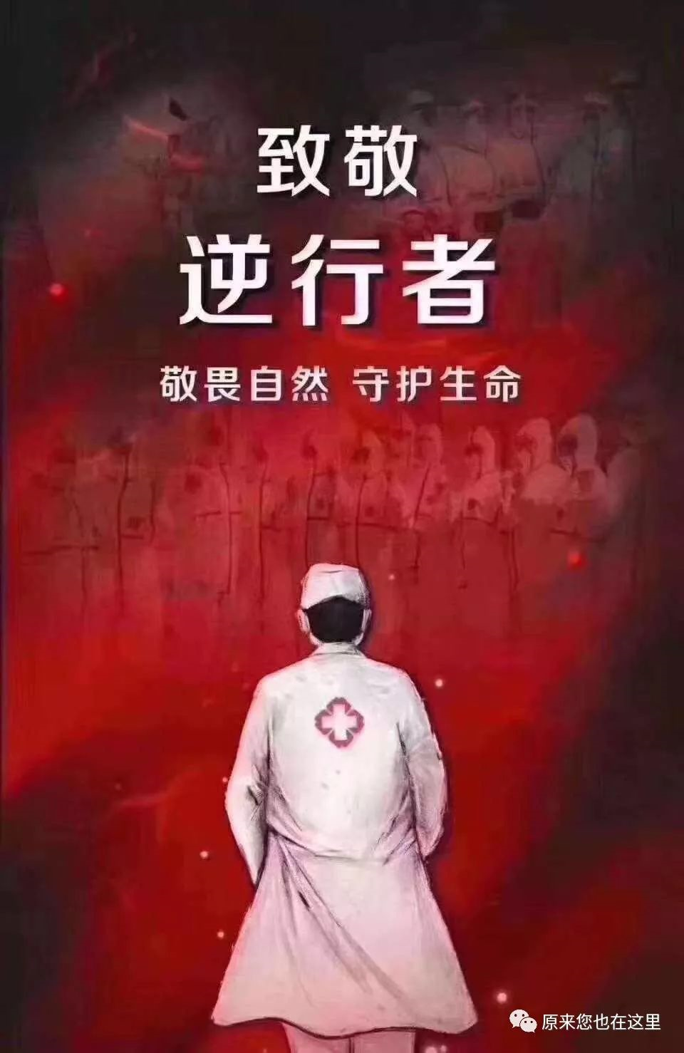
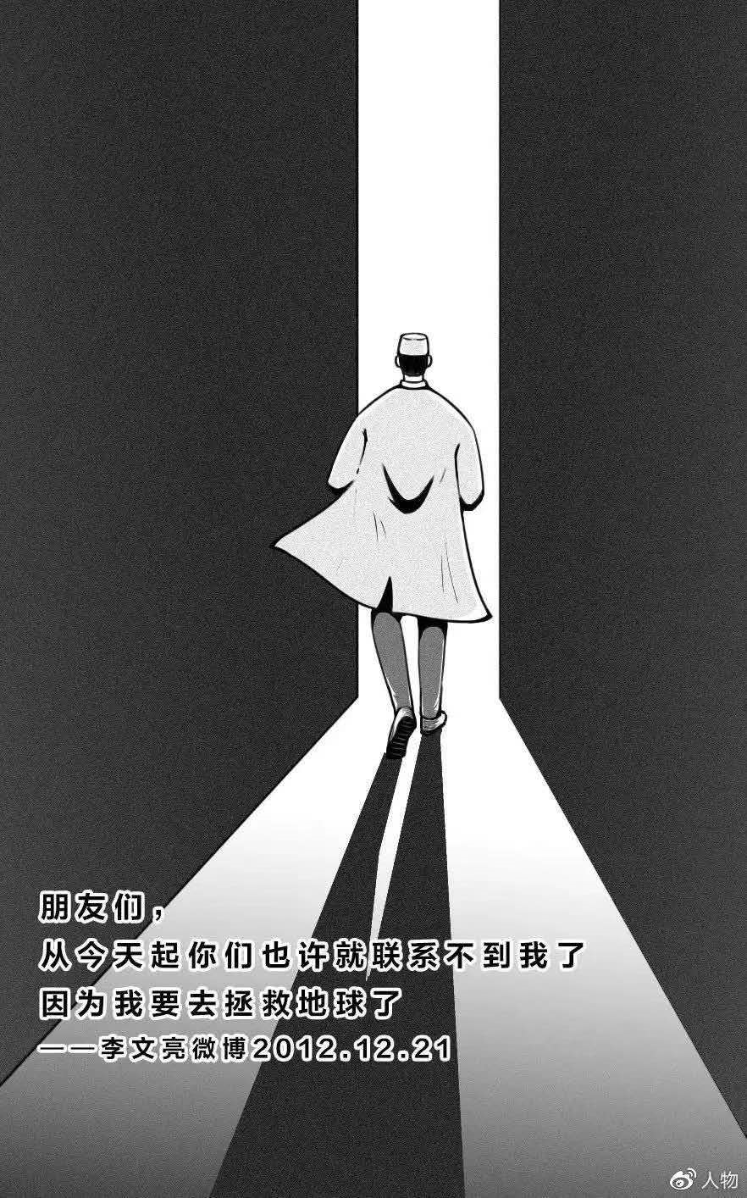
Sing for all the people fighting against the epidemic !
You raise me up
Fighters
Guardian angels
Countermarching saviors
常山一中 吴俊峰

Slide 3



01
Lead-in
http://www.sunedu.com
How do you feel in danger?
Fear?
Helplessness?
The danger is threatening the comfort zone even the life.
1
2
This is a sign overwhelmed by the situation. The next step would be despair.
Struggle?
Frustration?
3
4
flee or adventure?
panic or stay calm?
being brave or coward?
self-rescue or rescue others?
Frustration is the feeling arising when expectations or desired outcomes are not met.

Slide 4
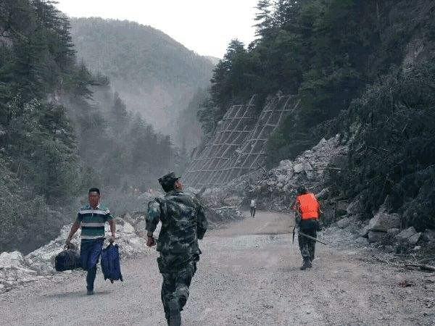

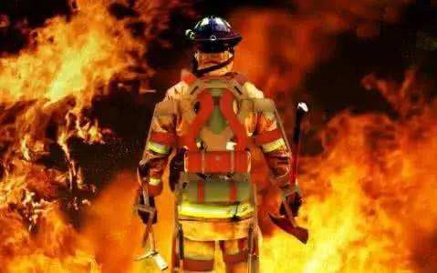
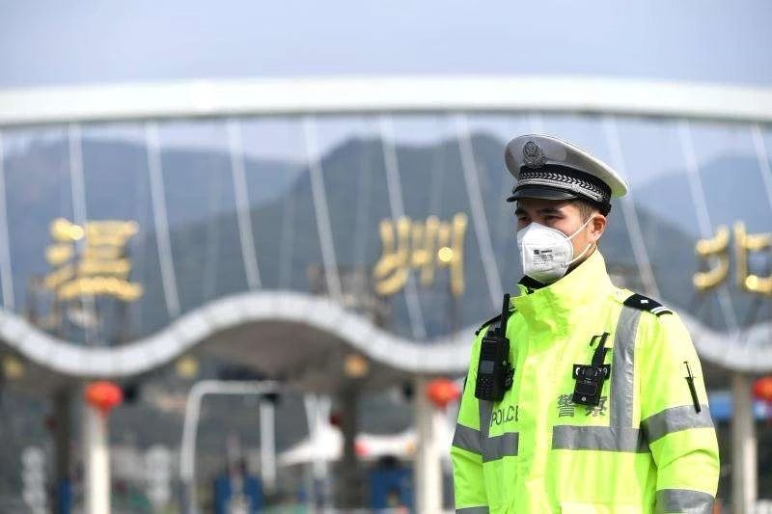
02
People fighting the virus
http://www.sunedu.com
What do you call those who risk their lives to save others in danger?
Fighters
Guardian angels
Heroes / Heroines
Countermarching saviors

Slide 5

02
People fighting the virus
http://www.sunedu.com
Zhong Nanshan, an 83-year-old doctor 1. became a household name 17 years ago for “daring to speak” in the fight 2._____ SARS, is the public image of China’s effort to control a new strain of coronavirus.
Despite his 3.______ (advance) age, Zhong was appointed to lead the 4.______ (investigate) into the new virus, which has rattled(使发狂)millions of Chinese who are traveling for the week-long Lunar New Year holiday. His announcement on Monday 5._____ the virus could spread between humans ratcheted up(增加) the safety precaution about the outbreak,
who
against
advanced
investigation
that

Slide 6
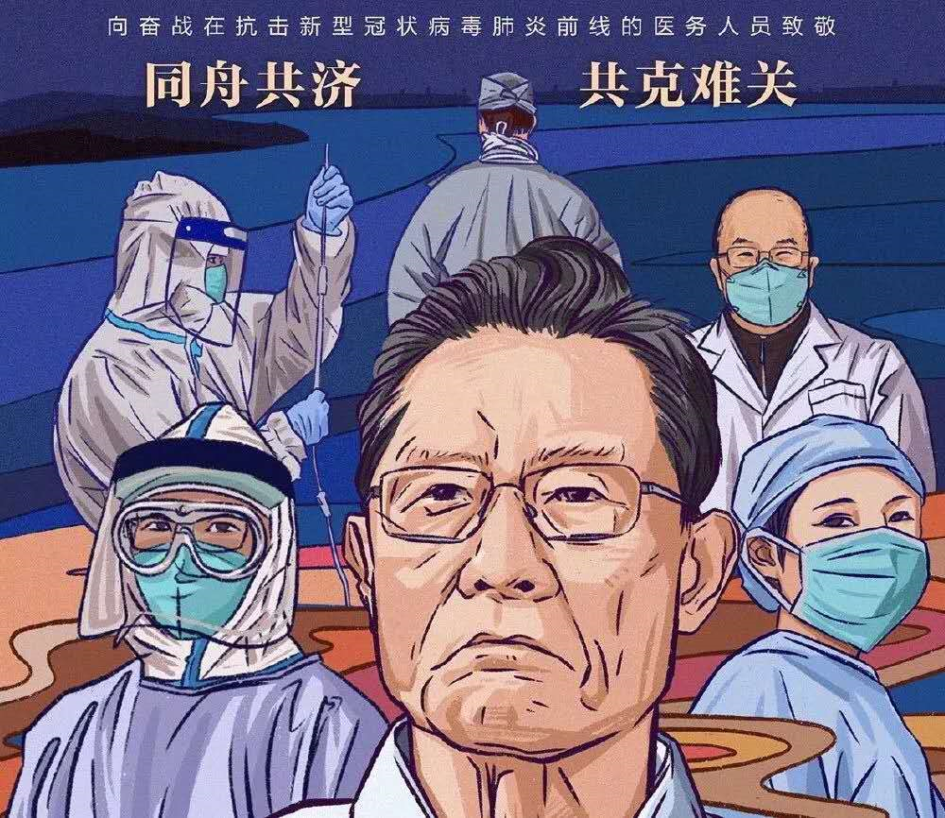
02
People fighting the virus
http://www.sunedu.com
warmth
Ruthless virus brings out 6. (warm) in humanity. More and more white-robed nurses and doctors are fighting the virus on the front line,
7. selfless devotion deserve our respect！
China has the confidence and the capacity 8. (win) this battle.The people's sense of 9. (responsible) to the country has been fully displayed in this joint fight against the outbreak. We believe care and compassion will not 10. (shadow) by panic and fear.
The Chinese people, fighting united as one, will surely defeat the epidemic.
whose
to win
responsibility
be shadowed

Slide 7
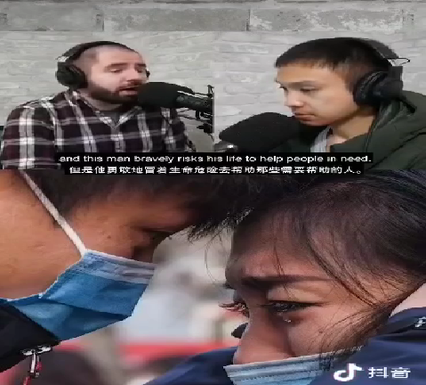
02
People fighting the virus
http://www.sunedu.com
The video shows Chinese doctors are doing everything in their power to help save lives and sacrificing themselves for the national interest.
They deserve a lot more praise!
They are real life superheroes putting themselves in danger to save someone.
They raise up the Chinese nation !

Slide 8
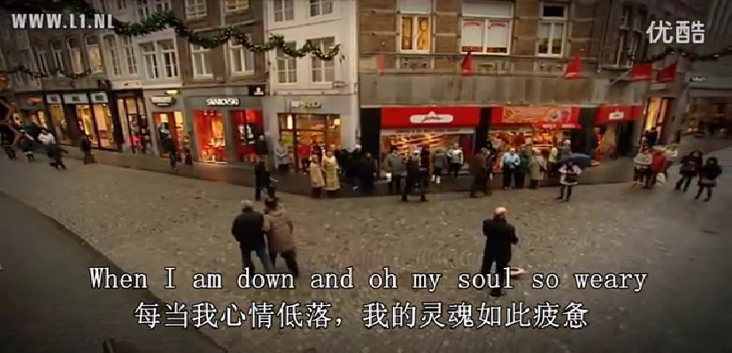
03
You raise me up
http://www.sunedu.com

Slide 9
3-1
Background Introduction
http://www.sunedu.com
You Raise Me Up is a song originally composed by Irish-Norwegian duo Secret Garden.The music was written by Secret Garden's Rolf Løvland and the lyrics by Brendan Graham. The song has been recorded by more than a hundred other artists.
“你鼓舞了我”是爱尔兰和挪威的二人组合“秘密花园”原创的。谱曲是Rolf Lovland完成的，而Brendan Graham创作了歌词。这首歌被超过一百位的歌手翻唱过。
The song was made by and for Løvland himself and performed for the very first time at the funeral of Løvland's mother. Here he noted "there's something about the song people are embracing - which becomes emotionally strong. I believe people think of it as a song they use for their own purposes.".
这首歌是Løvland为了自己而制作，并在他母亲的葬礼上首演。他说“这首歌里有一些东西是人们都想拥抱的 - 它使得人们从情感上更加强大。我相信每个人都可以从这首歌中找到自己的情感归属。”
There are always a group of people in our lives. That group, may not be your brothers and sisters, but share weal and woe just like brothers; That group, perhaps have no blood relationship with you, but willing to go through fire and water for you.
在我们的生命中总有一群人。那群人，或许不是你的兄弟姐妹，却胜似兄弟姐妹；那群人，或许和你没有血缘关系，却愿为你赴汤蹈火。

Slide 10

3-2
Sense cohesion and coherence
http://www.sunedu.com
Up
Me
Raise
You
When I am down and, oh my soul so 1 ;
When troubles come and my heart burdened be;
Then, I am 2 and wait here in the silence,
3 you come and sit awhile with me.
You raise me up, so I can stand on 4 ;
You raise me up, to walk on stormy seas;
I am 5 , when I am on your shoulders;
You raise me up to 6 I can be.
A. noble B. weary C. healthy
A. still B. confident C. active
3. A. When B. After C. Until
4. A. shoulders B. sky C. mountains
A. strong B. tall C. happy
A. other than B. more than C. rather than
weary
still
Until
moutains
strong
more than

Slide 11
3-2
Sense cohesion and coherence
http://www.sunedu.com
You raise me up
When I am down and, oh my soul so 1weary ;
When troubles come and my heart burdened be;
Then, I am 2 still and wait here in the silence,
3 Unitl you come and sit awhile with me.
You raise me up, so I can stand on 4 mountains ;
You raise me up, to walk on stormy seas;
I am 5 strong , when I am on your shoulders;
You raise me up to 6 more than I can be.

Slide 12
3-3
Practice singing skills
http://www.sunedu.com
When I am down and, oh my soul, so weary
我变得失落，我心已倦
When I am连读（在词尾以 [i:] [ai] [ei] 等接元音时可以加 [j]）； and oh连读
When troubles come an_{d} my hear_{t} burdene_{d} be
我遇到了困难，我心绪烦扰
And d省音； heart t省音； burdened d省音
Then, I am still an_{d} wai_{t} here in the silence
我在茫然中不知所措
Then I am连读； still and 连读； and d省音； wait t省音； here in连读( 摩擦音[r]与其后面的首元音连读,读为 [rin])
Until you come an_{d} sit awhile with me
直到你来到我身边，临我而坐
And d省音, Sit a while连读（单词词尾的辅音连缀可以和后面的某个元音开头的单词形成一种新的浊化现象，读为 [dail]）

Slide 13
3-3
Practice singing skills
http://www.sunedu.com
You raise me up, so I can stand on mountains
因为你的鼓舞，我才可以征服群山
Me up 连读； so I 连读 （字尾元音+字首元音，加入[w]或[j]，读为 [wai])； stand on连读
You raise me up, to walk on stormy seas
因为你的鼓舞，我才能够冒着暴雨破浪前行
Me up连读（在词尾以 [i:] [ai] [ei] 等接元音时可以加 [j]）； walk on连读
I am strong, when I am on your shoulders
因为有你的肩膀倚靠，我才如此强大
I am连读； when I am on连读
You raise me up…To more than I can be
因为你的鼓舞，我才能超越自我
Me up连读； than I连读

Slide 14
3-4
Notes to the lyrics
http://www.sunedu.com
1.When I am down and, oh my soul so weary
(1)down:adj.沮丧的(情绪)
Fresh air can have an amazing effect on our feelings. So if we start to feel down, take some deep breathes and feel the fresh air. 新鲜空气能对我们的情绪产生极大的影响。所以，如果我们开始感到沮丧，做一些深呼吸，感受新鲜的空气。
(2)weary：adj/v 使疲劳;使疲倦;失去热情;疲惫的
He gave me a weary smile.他对我疲惫地一笑。
If you have experienced symptoms of fever, feeling weary, cough or a traveling history at Hubei Province, China in the past 14 days, please contact us immediately. 如果您在过去14天内有发烧、疲劳、咳嗽等症状，或有在中国湖北省旅游的经历，请立即与我们联系。
2. When troubles come and my heart burdened be
my heart burdened be，正常语序应该是My heart is burdened。这里是为了押韵以及强调，所以把burdened放前面，形成了倒装。be burdened with ... 使负重担...
If one wants to live here without being burdened by vision, without being burdened by will, then that person should be absolutely innocent. 如果一个人想不承载着愿景，不承载着意志，而存在于此，那么这个人应该是纯粹天真单纯的。

Slide 15
3-4
Notes to the lyrics
http://www.sunedu.com
3. Then, I am still and wait here in the silence
(1) Still adj,安静的; 静止的; 平静的
Still water runs deep. 大智若愚;静水流深
Stand still, Don't move. 站着别动!
They told her to stay still until the emergency personnel arrived. 他们告诉她在急救人员到来之前不要动。
Get the patient to hold still. I can’t get a pulse! 让病人保持不动，我检测不到脉搏了！
(2) Still adv. 仍然
He’s not out of the woods yet; he’s still in critical condition. We’re moving him to intensive care.他还没有脱离危险，他的情况仍然危急。我们要把他转移到重症监护室。
4. Until you come and sit awhile with me
awhile adv,片刻;一会儿
After dinner sit awhile, after supper walk a mile. 正餐后，休息片刻；晚餐后，步行一哩。
Because we must trudge in the dust awhile, some of us whimper that life's all wrong.But somehow, we live and our sky grows bright, and everything seems to work out all right. 只因我们要在泥尘中跋涉， 我们中的一些人就哀诉生活多磨难。 但我们挺过来了，守得云开见月明， 一切事都终得顺利解决。

Slide 16
3-4
Notes to the lyrics
http://www.sunedu.com
5. You raise me up, so I can stand on mountains
raise sb up 引申义encourage or inspire，“养育成人; 鼓舞...”
In this way, I will repay the efforts my parents have made to raise me up. 我将会以这种方式报答父母对我的养育之恩。
6. You raise me up, to walk on stormy seas
stormy adj.有暴风雨(或暴风雪)的; 群情激愤的; 激烈争吵的
The flight was cancelled due to the stormy weather. 由于暴风雨的天气，航班被取消了
7. I am strong when I am on your shoulders
If I looked compared to others far, it is because I stand on giant's shoulder. 如果我看得比别人远，是因为我站在巨人的肩膀上。
Countries should follow the trend of the times, shoulder responsibility for development, meet challenges and risks, jointly promote global governance in cyberspace and strive to build a community with a shared future in cyberspace. 各国应该顺应时代潮流，承担发展责任，应对挑战和风险，共同推进网络空间全球治理，努力构建网络空间命运共同体。shoulder vt. 肩负，承担；shoulder the responsibility承担责任

Slide 17
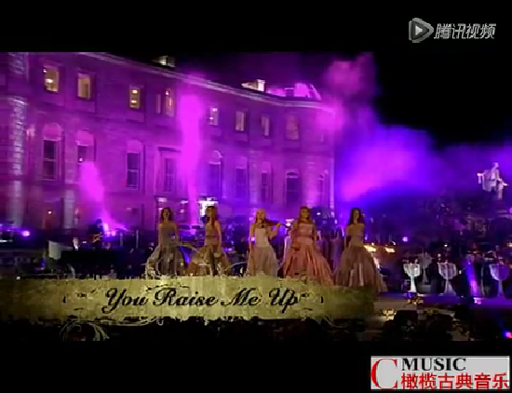
Notes to the lyrics
http://www.sunedu.com
Secret Gardan版还有下面一段
There is no life -
no life without its hunger;
Each restless heart
beats so imperfectly;
But when you come
and I am filled with wonder,
Sometimes, I think
I glimpse eternity.
世上没有——
没有失去热望的生命
每颗悸动的心
也都跳动得不那么完美
但是你的到来
让我心中充满了奇迹
甚至有时我认为 因为有你
我瞥见了永恒
eternity /ɪˈtɜːnəti/ n. 来世；不朽；永恒

Slide 18
04
The hymns to heroes
http://www.sunedu.com
In face of the COVID-19 epidemic, doctors are just like firefighters, putting their pledges into actions.
A firefighter's Pledge
I promise concern for others.
A willingness to help all those in need.
I promise courage - courage to face and conquer my fears.
Courage to share and endure the ordeal of those who need me.
I promise strength - strength of heart to bear whatever burdens might be placed upon me.
Strength of body to deliver to safety all those placed within my care.
I promise the wisdom to lead, the compassion to comfort,
and the love to serve unselfishly whenever I am called.
英
释义
pledge /pledʒ/ n. 保证，誓言 vt. 保证，许诺
conquer /ˈkɒŋkə(r)/ vt. 战胜，征服；攻克，攻取 vi. 胜利；得胜
endure /ɪnˈdjʊə(r)/ v. 忍耐；容忍；持续
ordeal /ɔːˈdiːl / n. 折磨；严酷的考验；痛苦的经验
compassion /kəmˈpæʃn/ n. 同情；怜悯
whatever引导宾语从句, whenever=no matter when引导让步状语从句, 意为 “无论...；不管...” 。

Slide 19
04
The hymns to heroes
http://www.sunedu.com
英
A firefighter's Pledge
I promise concern for others.
A willingness to help all those in need.
I promise courage - courage to face and conquer my fears.
Courage to share and endure the ordeal of those who need me.
I promise strength - strength of heart to bear whatever burdens might be placed upon me.
Strength of body to deliver to safety all those placed within my care.
I promise the wisdom to lead, the compassion to comfort,
and the love to serve unselfishly whenever I am called
汉
一名消防员的承诺
我保证关心他人。愿意帮助所有需要帮助的人。
我承诺勇气——勇敢地面对恐惧。有勇气去分享和忍受那些需要我的人的磨难。
我承诺力量——心灵的力量来承受任何可能是强加于我的负担; 身体的力量把我照顾的人送到安全的地方。
我承诺以智慧引导，以怜悯安慰，以及无论何时我被召唤时无私服务的爱

Slide 20
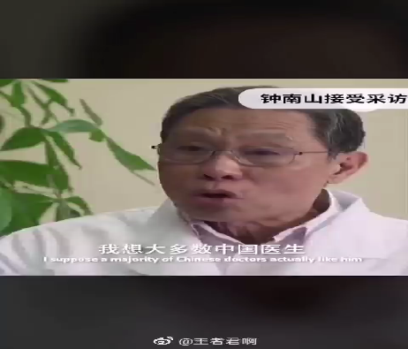
04
The hymns to heroes
http://www.sunedu.com
Hymn to the Fallen Heroes
向倒下的英雄们致敬！

Slide 21
04
The hymns of heroes
http://www.sunedu.com
Hymn to the Fallen Heroes
Young and aged, volunteer and career, man and woman of all races and colors,
you left aching hearts behind
An eternal flame warms your names inscribed on cold, lifeless plaques around this stone cairn
In the hearts you left behind, your memories abide in undying gratitude
You asked nothing more
You knew the risks, served without fear and paid the highest price
You embody a quality of which many only dream
Your selflessness for others is now your eternal crown
O fallen comrades, give us all this quality
that we may more fittingly prolong your memory
英
向倒下的英雄们致敬
年轻人和老年人，志愿者和各行各业，所有种族和肤色的男人和女人，
你把痛苦的心留在身后
永恒的火焰温暖着你铭刻在冰冷纪念牌上的名字，环绕着这个石冢
在你留在身后的心中，你的记忆永远留在感激中
hymn /hɪm/ n.赞美诗 v. 唱赞歌
eternal /ɪˈtɜːnl/adj. 永恒的；不朽的
inscribe /ɪnˈskraɪb/vt. 题写；题献；铭记；雕
plaque /plæk/ n. 纪念匾；纪念牌
cairn /keən/ n. 石冢；堆石界标；石堆纪念碑
abide /əˈbaɪd/ v. 持续；忍受；停留

Slide 22
04
The hymns of heroes
http://www.sunedu.com
英
Hymn to the Fallen Heroes
Young and aged, volunteer and career, man and woman of all races and colors,
you left aching hearts behind
An eternal flame warms your names inscribed on cold, lifeless plaques around this stone cairn
In the hearts you left behind, your memories abide in undying gratitude
You asked nothing more
You knew the risks, served without fear and paid the highest price
You embody a quality of which many only dream
Your selflessness for others is now your eternal crown
O fallen comrades, give us all this quality
that we may more fittingly prolong your memory
你别无所求
你知道风险，但无所畏惧，付出了最高的代价
你体现了许多人梦寐以求的品质
你对他人的无私是你永恒的王冠
啊，倒下的同志们，给了我们所有这些品质
让我们更好地延续你的精神和对你的记忆
汉
embody /ɪmˈbɒdi/ vt. 体现，使具体化；具体表达
crown /kraʊn/ n. 王冠 vt. 加冕；居…之顶；表彰
comrade /ˈkɒmreɪd/ n. 同志；伙伴
fittingly /'fitiŋli/ adv. 适切地，适合地
prolong /prəˈlɒŋ/ vt. 延长；拖延

Slide 23
5-1
Describe the hospital - sights
http://www.sunedu.com
Moved by these white-robed guardian angels, we 'd better learn how to describe something related to the hospital.
The corridors are long, the paint peeling, the smell diabolical.
走廊狭长，油漆剥落，气味刺鼻。/ˌdaɪəˈbɒlɪkl/ adj. 糟糕透顶的
rooms with nameplates(laundry room, medication room,therapy room, cafeteria, etc.)
有铭牌的房间(洗衣房、药品室、治疗室、自助餐厅等) /ˈθerəpi/ n. 治疗，疗法
Automatic sliding doors that lead to a waiting room full of beat-up chairs
自动滑动门，通往满是破旧椅子的候诊室
sliding doors to the individual rooms where patients are waiting (lying in treatment beds, hooked up to IV poles, wearing blood pressure cuffs as a nurse takes measurements)
通往病人等候的各个房间的滑动门 (躺在病床上，挂着输液管，护士测量时戴着血压袖带)
/kʌf/ n. 袖口，裤子翻边
a basic fitness room and outside recreational area that can be utilized
一个基本的健身室和一个可以利用的户外休闲区域 /ˈjuːtəlaɪz/ vt. 利用
doors with a small window insert
带有小窗插孔的门

Slide 24
5-1
Describe the hospital - sights
http://www.sunedu.com
trays with paper medication cups holding pill
托盘里有纸杯装着药丸 /treɪ/ n. 托盘；文件盒
with a scannable code containing information about medication
带有可扫描的代码，其中包含有关药物的信息
stethoscope hung around necks
挂在脖子上的听诊器 /ˈsteθəskəʊp/ n. 听诊器
X-ray and CAT scan rooms
X 光和CAT扫描室 CT扫描; 计算机化X线轴向断层扫描
orderlies checking on patients and monitoring them
护理员检查病人并监督他们 orderly /ˈɔːdəlɪ/ n. 看护人; 护理员
stretchers zooming past with paramedics attending to victims
医护人员载着担架急速驶过，抢救伤员 /ˈstretʃə(r)/ n. 担架；延伸器
doctors in scrubs and white coats passing through the area
穿着工作服和白大褂的医生们穿过这个地区 /skrʌbs/外科手术服
nurses and doctors making the rounds and distributing medications
护士和医生巡视，分发药品
security personnel walking the ward or working out of security stations
保安人员在病房内走动或在保安室外工作 /wɔːd/ n. 病房；保卫

Slide 25
5-1
Describe the hospital - sights
http://www.sunedu.com
patients with varying degrees of injury or illness (with broken bones and bloody noses, cuts, scrapes, bruising, holding garbage bins to catch vomit, pressing ice packs to injuries, wearing surgical masks, crying, holding onto the person next to them for support)
不同程度受伤或不舒服的病人(骨折、流鼻血、割伤、擦伤、瘀伤、拿垃圾桶接呕吐物、把冰袋压
在伤口上、戴医用口罩、哭泣、抓住旁边的人寻求支持)
/ˈbruːzɪŋ/ n. 挫伤 v. 擦伤（bruise的ing形式）
/ˈvɒmɪt/ v. 呕吐；喷出 n. 呕吐；呕吐物
/ˈsɜːdʒɪkl/ adj. 外科的；手术上的
patients wearing color-coded wrist bands that indicate possible risk factors
患者戴彩色腕带，表明可能的危险因素
patients being checked on the first few nights with a flashlight or woken up by a nurse with a needle as she takes blood for testing.
病人在头几个晚上用手电筒被检查，或者在护士用针抽血化验时被叫醒
worried parents and friends crammed together
挤在一起的忧心忡忡的父母和朋友 cram /kræm/ v. 填满，塞满；（应考）突击准备，死记硬背
small children huddled in parents' arms
蜷缩在父母怀里的小孩子们 /ˈhʌdl/ v. 挤在一起；缩成一团；蜷缩

Slide 26
5-1
Describe the hospital -sounds /smells
http://www.sunedu.com
the calming voice of a nurse or therapist
护士或治疗师平静的声音
secure doors opening with a click as a nurse swipes an access card over a reader
当护士在读卡器上刷门禁卡时，门会咔哒声自动打开
echoing footsteps
脚步声回响
people (talking to themselves, humming, singing, muttering, crying or screaming)
人们(自言自语、哼歌、唱歌、喃喃自语、哭泣或尖叫)
patients making repetitive noises (throat clearing, clicking, or swearing) associated with certain disorders
患者发出与某些疾病相关的重复性噪音 (清嗓子、咔哒声或咒骂声)
Murmuring, crying, labored breathing, someone gagging and throwing up, moaning and whimpering, a loved one whispering a prayer, newspapers rattling
喃喃自语，哭喊，呼吸困难，有人作呕，呕吐，呻吟和呜咽，爱人低声祈祷，报纸哗啦哗啦
the soft breaths of someone sleeping or snoring
睡觉或打呼噜时的轻柔呼吸
family members trying to keep the conversation positive and upbeat
家庭成员试图保持积极乐观谈话

Slide 27
5-1
Describe the hospital -sounds/smells
http://www.sunedu.com
a squeaky laundry cart being pushed down the hall
一辆吱吱作响的洗衣车被推下大厅 /ˈskwiːki/ adj. 嘎吱作响的
the beeps of monitoring equipment
监控设备的哔哔声 /biːp/ n. 哔哔声，嘟嘟声；警笛声
the squeaky wheel on a crash cart or stretcher
急救车或担架上吱吱作响的轮子
air conditioning or heaters that click and rattle
空调或加热器发出咔嗒咔嗒的声音 /klɪk/ v. /n. (发)咔哒声; 滴答声; /ˈrætl/ v. /n. (发出)卡嗒卡嗒声;格格声
codes being called over a speaker system
通过扬声器系统呼叫代码
SMELLS
disinfectant /ˌdɪsɪnˈfektənt/ , deodorant /diːˈəʊdərənt/ , bleach-scented sheets and towels, urine/ˈjʊərɪn/, vomit, alcohol swabs/swɒb/
消毒剂、除臭剂、漂白床单和毛巾、尿液、呕吐物、酒精棉签、
bleach / bliːtʃ/ v. 漂白；用漂白剂给……清洗，消毒 n. 漂白剂，消毒剂
scent /sent/ n. 气味；察觉能力 vt. 闻到；发觉；使充满…的气味 vi. 发出…的气味

Slide 28
5-2
Describe the hospital - sensations
http://www.sunedu.com
sniffing back tears and snot
忍住泪水和鼻涕
eyes prickling as tears begin to form
眼睛刺痛，泪水开始形成 prickle /ˈprɪkl/ v. /n. 刺；刺痛
taking deep breaths and rapidly blinking in an effort not to cry
深呼吸，快速眨眼，努力不让自己哭出来 blink /blɪŋk/ v. /n. 眨眼；闪烁
blurred vision
视力模糊
shakiness in the limbs
四肢发抖 /lɪm/n. 肢，臂; 四肢
sweaty palms as one nervously awaits a reading
手心冒汗，紧张地等待报告单
the rough feel of chapped lips
嘴唇干裂的粗糙感觉 /tʃæpt/（尤指因风吹或天冷而）皲裂的，开裂的
sweat-soaked hair sticking to one's forehead and neck
汗湿的头发粘在前额和脖子上 /səʊk/ v. 浸泡；渗透
jittery or tense muscles
紧张的肌肉 /ˈdʒɪtəri/ adj. 神经过敏的；战战兢兢的；紧张不安的

Slide 29
5-2
Describe the hospital - sensations
http://www.sunedu.com
muscles aching at restricted movement
因运动受限而肌肉酸痛
pain or sensations that are specific to the patient's injury or illness
疼痛或与病人受伤或不适有关的感觉
I jammed my hands in my pockets, thinking I'd officially lost my mind.
我把双手插在口袋里，以为自己真的疯了。
grogginess from pain medication
因服用止痛药而昏昏沉沉
n. 酒醉；东歪西倒 → groggy /ˈɡrɒɡi/adj. （因生病、劳累等）眩晕无力的；昏昏沉沉的；踉踉跄跄的
the cool brush of an alcohol swab
冰凉的酒精棉签刷
the painful pinch of an IV needle going in
打针时的疼痛 /pɪntʃ/ 挤压; 收缩; 箍缩; 拧
tape being pulled away from the skin
胶带被从皮肤上扯下来
the cold shock of a stethoscope against the skin
听诊器对皮肤的冷冲击
the soft touch of a nurse pressing her finger against the wrist or inner elbow for a pulse read
护士将手指按在手腕或手肘内侧进行脉搏读数时的柔软触感

Slide 30
5-3
Describe the hospital-A paragraph
http://www.sunedu.com
Leda woke, squinting at the bright light overhead. Someone was rubbing something cool on the back of her hand, but the slickness quickly turned to a jab of pain. She flinched and turned her head. A nurse was securing an IV into her hand with tape. An IV? She was in the hospital? Pain slithered between her temples, fogging her thoughts, and the bleach smell wafting off the sheets turned her stomach. The last thing she remembered was dropping Caren off at her house after the basketball game. Then, nothing.
丽达醒来了，眯着眼睛看着头顶上明亮的灯光。有人在她的手背上擦着什么凉快的东西，但那光滑很快就变成了一阵刺痛。她退缩了一下，转过头去。一位护士正在用胶布把静脉点滴固定在她的手上。静脉注射? 她住院了? 疼痛在她的太阳穴间蔓延，使她的思想一片混乱，从床单上飘来的漂白剂的气味使她作呕。她记得的最后一件事是看完篮球赛后把卡伦送到她家。然后,什么都不记得了。
Techniques and Devices Used: Multisensory descriptions
Resulting Effects: Hinting at backstory, passage of time, reinforcing emotion, tension and conflict

Slide 31
5-3
Describe the hospital-A paragraph
http://www.sunedu.com
A foul stench coated the hallway, and Cam was not the least bit surprised to smell it the strongest outside room 34. William Rand was a long term schizophrenic who was known for regurgitating his meds and tossing them away. He was also known for his habit of smearing feces across the safety glass in his door. Sure enough, William had decorated his window, this time adding a smiley face flourish. Cam's gag reflex kicked in and he rushed to the custodial room's sink. He'd had it with this place. Time to get a new job.
走廊里弥漫着一股恶臭，而小卡闻到34号房间外最强烈的恶臭时一点也不惊讶。威廉·兰德(William Rand)是一名长期患有精神分裂症的患者，人们都知道他会反刍自己的药物，然后把它们扔掉。他还有个习惯，就是把粪便抹在门上的安全玻璃上。果然，威廉装饰了他的窗户，这一次他在窗户上画了一个笑脸。小卡的呕吐反射开始起作用，他冲进了保管室的水池。他受够了这个地方。是时候找份新工作了。
Techniques and Devices Used: Multisensory descriptions
Resulting Effects: Establishing mood, foreshadowing

Slide 32
5-3
Describe the hospital-A paragraph
http://www.sunedu.com
After the symphony of coughing, hacking and wheezing that greeted Becky in the ER waiting room, she found the closest antibacterial hand dispenser and starting working it like a gambling addict hitting up a slot machine.
贝基在急诊室的候诊室里听到一阵咳嗽、干咳和呼哧呼哧的喘息声，然后她找到了离她最近的抗菌手摇贩卖机，开始像一个嗜赌成瘾的人在老虎机上赌博一样使用它。
Techniques and Devices Used: Simile
Resulting Effects: Establishing mood

Slide 33
5-3
Describe the hospital- A paragraph
http://www.sunedu.com
While Mother was in with the doctor, I selected a magazine from the wall rack near reception but quickly found I couldn't concentrate. Who could in a place like this? I flipped pages to give my hands something to do, snatching glances at other patients occupying the blue plastic chairs. The woman with the headscarf and the man with the ball cap pulled low- -it was obvious why they were waiting to see this particular doctor. Other patients broke my heart though, like the litle girl whose hands were clenched around a glossy picture book, the cover unopened, and the teenage boy who looked lost and vulnerable in clothes that billowed around his shrunken body. I blinked back tears. Cancer had a lot to answer for.
当母亲和医生在一起时，我从接待处附近的壁柜上拿了一本杂志，但很快发现我无法集中注意力。谁能在这样的地方?我翻着书页，让双手有事可做，不时瞥一眼坐在蓝色塑料椅上的其他病人。戴头巾的女人和戴球帽的男人都拉得很低——很明显他们在等着看这位特别的医生。还有一些病人伤透了我的心，比如那个小女孩，她的手紧握着一本光滑的图画书，封面没有打开，还有那个十几岁的男孩，衣服在他干瘪的身体周围空荡荡的，他看起来很失落，很脆弱。我忍住眼泪。癌症有很多原因。
Techniques and Devices Used: Symbolism
Resulting Effects: Characterization, reinforcing emotion

Slide 34


