Slide 1

感恩遇见，相互成就，本课件资料仅供您个人参考、教学使用，严禁自行在网络传播，违者依知识产权法追究法律责任。
更多教学资源请关注
公众号：溯恩高中英语
知识产权声明

Slide 2

Words and expressions
Festivals around the world
M3-U1 单词讲解
语音/拼写/语用

Slide 3
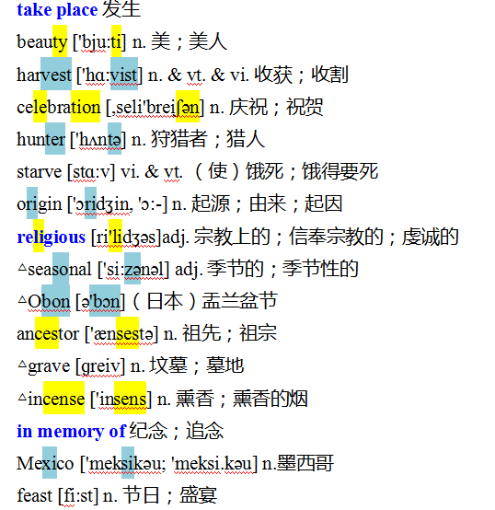
M3U1 单词讲解
注意音节的划分
http://www.sunedu.com

Slide 4
M3U1 单词讲解
http://www.sunedu.com
take place 发生
take place是不及物动词短语，其后不能接宾语，也不能用于被动语态。
Great changes have_taken_place in China in the last few years.
过去的几年里，中国发生了巨大的变化。
词语 | 意义 | 用法
take place | 发生；举行；举办 | 多指有组织有计划的事件的“发生”， 没有偶然性
happen | 碰巧发生 | 一般用于偶然或突发性事件

Slide 5
M3U1 单词讲解
http://www.sunedu.com
take place 发生
When the gathering took place，he happened to pass by and a new idea occurred to him that he should attend it. Suddenly，a quarrel broke out and he wondered how it came about.
当聚会进行时，他碰巧经过那里，他突然想到他应该参加这个聚会。就在这时争吵发生了，他想知道这到底是为什么。

Slide 6
M3U1 单词讲解
http://www.sunedu.com
beauty ['bju:ti] n. 美；美人
celebration [,seli'breiʃən] n. 庆祝；祝贺
beautiful- beautify
a party in celebration of their fiftieth wedding anniversary
庆祝他们金婚纪念的聚会
birthday/ wedding celebrations 生日庆祝；结婚庆典
The National-Day celebration this year was an unprecedentedly great occasion.
今年国庆日庆祝仪式空前盛大。

Slide 7
M3U1 单词讲解
http://www.sunedu.com
starve [stɑ:v] vi. & vt. （使）饿死；饿得要死
origin ['ɔridʒin, 'ɔ:-] n. 起源；由来；起因
religious [ri'lidʒəs]adj. 宗教上的；信奉宗教的；虔诚的
△seasonal ['si:zənəl] adj. 季节的；季节性的
starve to death 饿死
starve to do sth. / for sth. 渴望做某事/ 渴望得到某物
starve sb. into ... 断绝食物(或资金)来源以迫使某人……
die of starvation 死于饥饿
original /əˈrɪdʒənl/ adj. 原来的；开始的；首创的，新颖的，创新的；原作的
religious adj.宗教上的；信奉宗教的；虔诚的→religion n．宗教
region /ˈriːdʒən/ -- regional /ˈriːdʒənl/ adj. 地区的；局部的；整个地区的
seasoned adj. 经验丰富的；老练的
a seasoned performer/traveller 经验丰富的表演者/旅行家

Slide 8
M3U1 单词讲解
http://www.sunedu.com
ancestor ['ænsestə] n. 祖先；祖宗
in memory of 纪念；追念
feast [fi:st] n. 节日；盛宴
后代的人: later generations; posterity; descendant; offspring;successors
bring up successors to the revolution 培养革命的后代
benefit future generations 为后代造福
descendants of the dragon 龙的传人
the problems parents have with their teenage offspring
父母与青少年子女之间的问题
常见的“in +名词+of ”短语有：in favour of 支持；赞同
in need of 需要…… in honor of 为纪念……
in case of 以防…… in praise of 为称赞……
in search of 寻找…… in charge of 负责……
in possession of 拥有…… in terms of 鉴于；就……而言
an audio-visual feast 视听盛宴
If you have enough free time, you’ll find it surprising with a feast of colors created by nature. 如果你有足够空闲时间，你会惊奇发现大自然创造了一场盛宴。

Slide 9
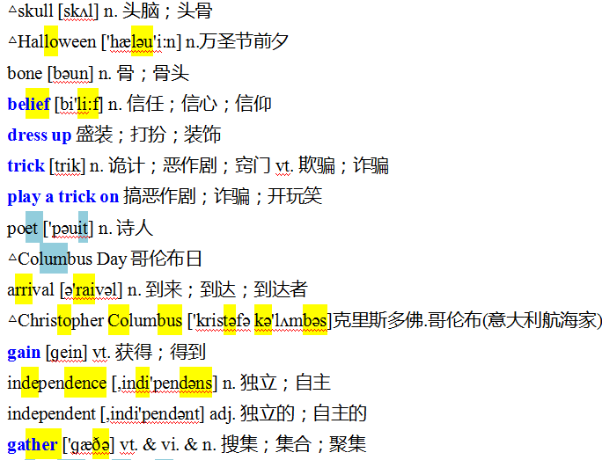
M3U1 单词讲解
注意音节的划分
http://www.sunedu.com

Slide 10
M3U1 单词讲解
http://www.sunedu.com
belief [bi'li:f] n. 信任；信心；信仰
dress up 盛装；打扮；装饰
trick [trik] n. 诡计；恶作剧；窍门vt. 欺骗；诈骗
believe vt.--- relieve-relief
have a strong belief in ... 绝对信任……
hold the belief that ... 坚信……
beyond belief 难以置信
make up 化妆 / do up梳妆打扮
dress oneself up as ... 把自己打扮成……
be dressed in 穿着
play a trick on sb.＝ play tricks on sb.

Slide 11
M3U1 单词讲解
http://www.sunedu.com
play a trick on 搞恶作剧；诈骗；开玩笑
poet ['pəuit] n. 诗人
arrival [ə'raivəl] n. 到来；到达；到达者
play a joke/jokes on sb. 和某人开玩笑
make fun(不可数) of sb. 取笑某人
①poem n．诗
②poetry n. 诗歌
In poetry, you will admire echoes of human emotions and enjoy linguistic (/lɪŋ'gwɪstɪk/ adj. 语言的) diversity through poetic expression. Through the bridge of poetry, people today can resonate with the values and wisdom of our ancestors.在诗歌中，你会欣赏人类情感的共鸣，并通过诗歌的表达享受语言的多样性。通过诗歌的桥梁，今天的人们可以与我们祖先的价值观和智慧产生共鸣。
There are 120 arrivals and departures every day in the airport.
每天有120次航班离港和抵港。

Slide 12
M3U1 单词讲解
http://www.sunedu.com
gain [ɡein] vt. 获得；得到
不劳(pain)无获(gain)→No pains, no gains.
gain reputation/ strength /power/ experience 获得声誉/ 增加力气/权力/经验gain other’s respect/love/trust 获得别人的尊敬/爱戴/信任
*After six years’ study，I acquired a good knowledge of computer and my perseverance won me many friends in the university. Therefore I got a good job, which has made me gain much experience. And now I earn up to $100, 000 a year.
gain | 指经过很大努力而“获得”, 所得的东西常具有一定的价值
win | 常指取胜的一方具有优越的特质或条件而能克服各种障碍, 意为“赢得”
get | 普通用词, 有时指不一定需要努力就能“得到”
earn | 意为“赚得”, 表示经过努力所得的报酬
acquire | 意为“获得, 取得”, 一般指通过漫长的过程而逐渐获得

Slide 13
M3U1 单词讲解
http://www.sunedu.com
independence [,indi'pendəns] n. 独立；自主
independent [,indi'pendənt] adj. 独立的；自主的
gather ['ɡæðə] vt. & vi. & n. 搜集；集合；聚集
①informal 非正式的
②incomplete 不完整的
③invisible 看不见的
④inconvenient 不方便的
①gather ... around 聚集；集合
②gather together 集合起来；合拢
③gather in 收割；收获
④gather up 集拢；拾拢

Slide 14
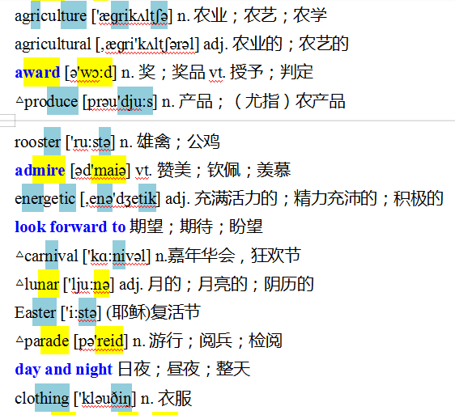
M3U1 单词讲解
注意音节的划分
http://www.sunedu.com

Slide 15
M3U1 单词讲解
http://www.sunedu.com
award [ə'wɔ:d] n. 奖；奖品vt. 授予；判定
△produce [prəu'dju:s] n. 产品；（尤指）农产品 v. 生产；引起；创作；繁殖
admire [əd'maiə] vt. 赞美；钦佩；羡慕
the first award/prize/place 一等奖；第一名
win/get/receive an award for ... 因……而获奖
award sb. sth.＝ award sth. to sb. 为某人颁发奖品
award 指较为正式地或官方地颁发、授予、给予，也可以指法庭裁决给予奖励
prize 多指在各类竞赛、竞争或抽奖中得奖
reward 多指对某人的工作或服务等的报答、酬谢。reward作名词，常用give
reward to sb.；作动词，常用reward sb. with sth.
production n. 成果；产品；生产；作品; 产量 productive adj.富有成效的
(1)admire sb. for (doing) sth. 因(做)某事而钦佩某人
(2)admiration n. 钦佩；羡慕 with/in admiration 钦佩地
(3)admiring adj. 佩服的；称赞的
admiration n.羡慕;钦佩 admirer n.赞赏者;羡慕者

Slide 16
M3U1 单词讲解
http://www.sunedu.com
energetic [,enə'dʒetik] adj. 充满活力的；精力充沛的；积极的
look forward to 期望；期待；盼望
△lunar ['lju:nə] adj. 月的；月亮的；阴历的 the lunar calendar
△parade [pə'reid] n. 游行；阅兵；检阅
energy n. [物] 能量；精力；活力；
hearing
We look / are looking forward to _______(hear) from you.
【拓展延伸】含介词to的常用动词短语: get down to 开始认真做……
stick to 坚持 lead to 导致
object to 反对 see to 处理；料理
refer to 提及；查阅；参考 contribute to 促成
solar /ˈsəʊlə(r)/ adj. 太阳的；日光的；利用太阳光的
on parade 受检阅；在游行
military parade 阅兵；军事博览

Slide 17
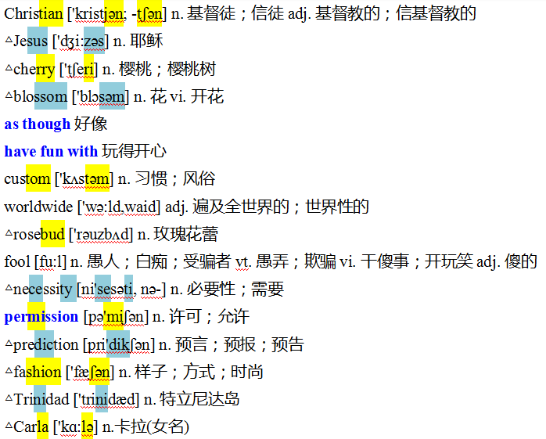
M3U1 单词讲解
注意音节的划分
http://www.sunedu.com

Slide 18
M3U1 单词讲解
http://www.sunedu.com
△blossom ['blɔsəm] n. 花 vi. 开花
△rosebud ['rəuzbʌd] n. 玫瑰花蕾
as though 好像= as if
have fun with 玩得开心
custom ['kʌstəm] n. 习惯；风俗; 海关，关税
Children, like rosebuds, bloom /bluːm/ at different time. However, the last bloomsom is just as pretty as the first.
孩子就像玫瑰花蕾，有不同的花期。最后开的花，与最早开的花一样美丽。
What fun it is to do sth! 多么有趣呀！
it's fun to do sth. 做某事很有趣
It's fun to swim in the pool with friends in summer.
= What fun it is to swim in the pool with friends in summer!
get insight into the architecture culture and folk custom in the central Shaanxi plain, especially the Xi'an district
深入了解关中特别是西安地区的建筑文化和民俗风情。

Slide 19
M3U1 单词讲解
http://www.sunedu.com
△necessity [ni'sesəti, nə-] n. 必要性；需要；必然性；必需品--necessary
permission [pə'miʃən] n. 许可；允许--permit ----admit - admission
△prediction [pri'dikʃən] n. 预言；预报；预告--predict ----forecast
△fashion ['fæʃən] n. 样子；方式；时尚
out of necessity 出于需要，必定
by necessity 不得已；必然地，不可避免地
Many people cannot even afford basic necessities such as food and clothing.
许多人甚至买不起食物和衣服之类的基本必需品。
without (official) permission 未经(正式)许可
in fashion 合于时尚，流行
out of fashion 过时
come into fashion 时兴起来

Slide 20
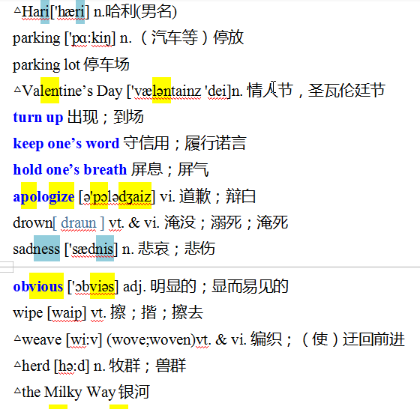
M3U1 单词讲解
注意音节的划分
http://www.sunedu.com

Slide 21
M3U1 单词讲解
http://www.sunedu.com
turn up 出现；到场; 开大（音量）；向上翻
keep one’s word 守信用；
hold one’s breath 屏息；屏气
turn down 拒绝；关小，调低
keep/ break one's word 短语中的word不能用复数形式
promise
Word comes/came that(同位语从句)... 消息传来...
take a deep breath /breθ/ ＝ breathe /briːð/ deeply 深呼吸
lose one’s breath 喘不过气来
out of breath = breathlessly 上气不接下气；喘不过气来
catch one’s breath 喘口气；歇口气；恢复正常呼吸
breathtaking adj. 惊人的；惊险的；令人激动的

Slide 22
M3U1 单词讲解
http://www.sunedu.com
apologize [ə'pɔlədʒaiz] vi. 道歉；辩白
【记一记➡构建知识】
(1)apologize to sb. ＋that从句 向某人道歉
apologize to sb. for (doing)sth. 因(做)某事向某人道歉
(2)apology n. 道歉；辩白
make an apology to sb. for (doing) sth.
offer an apology to sb. for (doing)sth. 因(做)某事向某人道歉
offer sb. an apology for (doing) sth.
owe an apology to sb.
owe sb. an apology
accept/refuse an/one’s apology 接受/拒绝某人的道歉
应向某人道歉

Slide 23
M3U1 单词讲解
http://www.sunedu.com
drown[ draun ] vt. & vi. 淹没；溺死；淹死
sadness ['sædnis] n. 悲哀；悲伤
obvious ['ɔbviəs] adj. 明显的；显而易见的--obviously---evident-evidently
wipe [waip] vt. 擦；揩；擦去
△weave [wi:v] (wove;woven)vt. & vi. 编织；（使）迂回前进
△herd [hə:d] n. 牧群；兽群
drown one's sorrows /sadness/ fears/ loneliness in alcohol... 借酒...浇愁...
Clapping drowned the speaker's words. 掌声盖过了发言人的说话声。
wipe sth (off/off sth) 消除，抹去（计算机、磁带或录像机上的信息等）
wipe sth from sth/ wipe sth out 抹去（旧事）
I tried to wipe the whole episode from my mind. 我设法把这整个经历从心中抹掉
• The cars then weaved in and out of traffic at top speed.
汽车然后在车流中高速穿梭前进。
a herd of cows/deer/elephants 一群牛╱鹿╱象

Slide 24
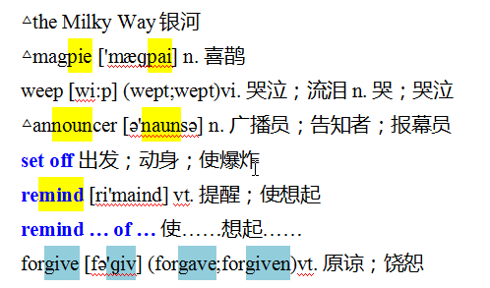
M3U1 单词讲解
注意音节的划分
http://www.sunedu.com

Slide 25
M3U1 单词讲解
http://www.sunedu.com
weep [wi:p] (wept;wept)vi. 哭泣；流泪n. 哭；哭泣
△announcer [ə'naunsə] n. 广播员；告知者；报幕员
set off 出发；动身；使爆炸
set about 着手/开始做……(后接名词、动名词)
set out 出发，开始做……(后接动词不定式)
set down 放下，记下
set up 建立，树立，搭起
She wept uncontrollably / tears of joy . 她不由自主地哭了起来/ 喜极而泣。
announcement n.
Hearing the news, they immediately set off for the railway station. ( )
The slightest spark can set off the explosives stored here. ( )
If uncontrolled, the shortage would set off a new rise in meat prices. ( )
出发
使……爆炸
引起

Slide 26
M3U1 单词讲解
http://www.sunedu.com
remind sb. to do sth. 提醒某人做某事
remind (sb. ) that/how/what从句 提醒……
remind [ri'maind] vt. 提醒；使想起
remind … of … 使……想起……
forgive [fə'ɡiv] (forgave;forgiven)vt. 原谅；饶恕
【拓展延伸】常见的“v. ＋sb. ＋of sth. ”短语有：
cure sb. of sth. 改正（某人的不良行为 accuse sb. of sth. 指控某人某事
cheat sb. of sth. 骗取某人某物 inform sb. of sth. 通知某人某事
convince sb. of sth. 使某人相信某事 rob sb. of sth. 抢劫某人的某物
forgive sb. for (doing)sth. 原谅某人(做了)某事
forgive one’s doing sth. 原谅某人做了某事
forgive me 请原谅；对不起
forgive and forget 不计前嫌
*（2012·江苏高考）It is a virtue to forgive and forget, especially in such a competitive and stressful society.
不计前嫌是一种美德，尤其是在竞争如此激烈，压力如此沉重的社会中。
Forgiveness is not something you give to someone else. It is a gift you give yourself.
原谅不是你给别人的什么东西，它只是你给自己的一份礼物。

Slide 27
晚读及默写
http://www.sunedu.com
1. 发生（5个） 2. 美（名-形-动） 3.n. & v.收获；收割 4.n. 庆祝；祝贺
5. n. 狩猎者；猎人 6. 饿死(动-名) 7. 起源；由来（名-形） 8. 宗教（名-形）
9. 季节的 10. n. 祖先；祖宗 11.n. 坟墓；墓地 12.纪念；追念
13. n.墨西哥 14.n. 节日；盛宴 15.n. 头脑；头骨 16.n. 骨；骨头
17.信任（名-动） 18. 盛装；打扮 19.开玩笑（三个词组） 20. 诗人-诗-诗歌
21 n. 到来；到达 22. vt. 获得；得到 23. 独立；自主（名-形） 24. 搜集；集合
25. 农业 （名-形） 26. n. 奖vt. 授予 27. n. 产品；农产品 28.n. 雄禽；公鸡

Slide 28
晚读及默写
http://www.sunedu.com
1. 赞美；钦佩(动-名) 2. adj. 精力充沛的 3.n.嘉年华会，狂欢节 4.adj.月亮的(反义词)
5.n. 游行；检阅 6. n. 樱桃；樱桃树 7.好像 (2个) 8. 习惯；风俗
9.adj. 遍及全世界的 10.n. 必要性；需要 11. 许可 (动-名) 12.n. 预言；预报
13.n. 样子；时尚 14. 停车场 15. 出现；到场 16. 守信用；履行诺言
17.屏息；屏气 18.v道歉；辩白 19. v 淹没；溺死 20.n. 悲哀；悲伤
21. adj. 明显的 22 v. 擦；揩；擦去 23.v. 编织；（使）迂回前进 (过去式-过去分词)
1. 孩子就像玫瑰花蕾，有不同的花期。最后开的花，与最早开的花一样美丽。
2. 在夏天，与朋友们一起是多么开心啊！（fun)

Slide 29
晚读及默写
http://www.sunedu.com
1. 一群牛╱鹿╱象 2. 不由自主地哭了起来/ 喜极而泣 3.广播员-口头通知
4.出发；动身；使爆炸 5. 使……想起……
1. 不计前嫌是一种美德，尤其是在竞争如此激烈，压力如此沉重的社会中。
2. 原谅不是你给别人的什么东西，它只是你给自己的一份礼物。
3. 我钦佩他从冰冷的水中救出男孩的勇敢。
4. 2015年诺贝尔科学奖授予屠呦呦。
5. 穿着一件红色的外套，她看上去更漂亮了。
6. 他相信她会借钱给他，所以去她家拜访。
7. 他们因在沙漠中迷路而饿死了。

Slide 30
晚读及默写
http://www.sunedu.com
1. a herd of cows/deer/elephants 2. weep uncontrollably / tears of joy
3.announce - announcement 4.set off 5. remind……of……
1. It is a virtue to forgive and forget, especially in such a competitive and stressful society.
2. Forgiveness is not something you give to someone else. It is a gift you give yourself.
3. I admired his bravery for saving the boy from the cold water.
4. The Nobel Prize in science was awarded to Tu Youyou in 2015
5. Dressed in a red coat, she looks more beautiful.
6. He called at her house in the belief that she would lend him the money.
7. They got lost in the desert and starved to death．

Slide 31
晚读及默写
http://www.sunedu.com
1. 牧师 2. 迷人有趣的起源 3. 拥抱 4.季节性的疯狂行为
5.亲善大使，友好大使 6.数码设备 7.显示；透露；揭露
8.10至12岁之间的少年 //13至19岁青少年 9.真理和错误
1. 未经允许看别人的私人信件是不合法的。
2.我的老师看起来好像完全知道这件事了。（虚拟）
3.她就像对待自己的孩子一样对待这个婴儿。（虚拟）
4.天气晴朗，吹着一股清风。（with复合结构）
5.由于孩子们在上学，所以我们不能想去度假就去。（with复合结构）
6. 我在房间坐了一会儿，眼睛盯着天花板。（with复合结构）

Slide 32
晚读默写-参考答案
http://www.sunedu.com
1. priest /priːst/ 2. fascinating origins 3. embrace /ɪmˈbreɪs/ v.
4.seasonal madness 5.goodwill ambassador /æmˈbæsədə(r)/
6.digital device /dɪˈvaɪs/n. 7. reveal /rɪˈviːl/ vt.
8. tweens n. // teens n. 9. truth and myth /mɪθ/n. 神话；虚构的人或事
1. It's illegal to read people's private letters without permission.
2. My teacher looked as though/if he had known the thing completely.
3.She treats the baby as if/though he were her own child.
4. The day was bright, with a fresh breeze blowing.
5.With the children at school, we can't take our vacation when we want to.
6. I sat in my room for a few minutes with my eyes fixed on the ceiling.

Slide 33
晚读及默写
http://www.sunedu.com
【经典语篇】
（2013·辽宁高考）一个英文网站面向中学生征稿。请你写一篇英语稿件, 介绍“中秋节”及这个节日里的主要活动。要点：
1. 它是中国的传统节日之一；
2. 家人团聚；
3. 赏月、吃月饼；
4. 还有旅游、访友等其他活动。

Slide 34
晚读及默写
http://www.sunedu.com
The Mid-Autumn Festival
[节日时间]The Mid-Autumn Festival falls on the 15th of the eighth month of our Chinese lunar calendar. [节日地位]As one of the traditional Chinese festivals, it has been enjoying great popularity in our country. [活动内容]Usually, however far away or however busy we are, we will try to come home for the celebration. The moon that night looks the brightest in the whole lunar month. What we love most is when we enjoy the full moon together. With the beautiful moon up in the sky, we sit together and eat mooncakes and fruit, sharing our stories. In addition to these traditional activities, we have a wider range of choices such as travelling and visiting our relatives or friends.

Slide 35
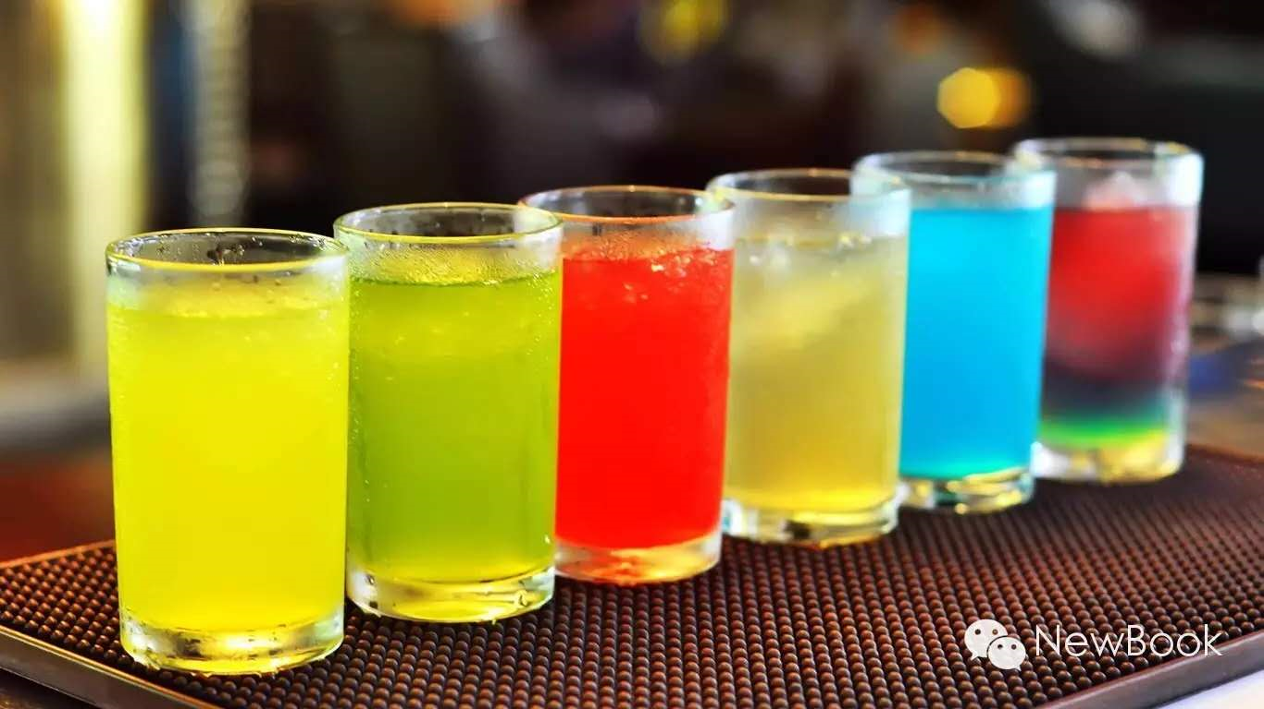
THANK YOU

