Slide 1

感恩遇见，相互成就，本课件资料仅供您个人参考、教学使用，严禁自行在网络传播，违者依知识产权法追究法律责任。
更多教学资源请关注
公众号：溯恩高中英语
知识产权声明

Slide 2


Burning passion, challenge the limit, beyond the self
Welcome to Albert's class!

Slide 3

May the Year of the Rat bring you and your family good health, prosperity and joy!

Slide 4
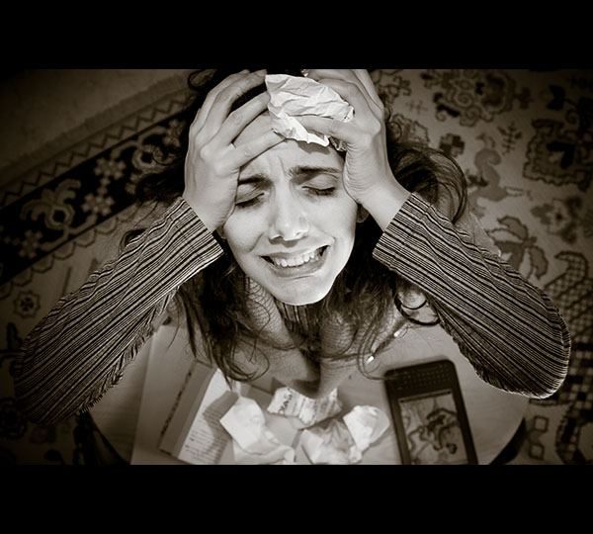
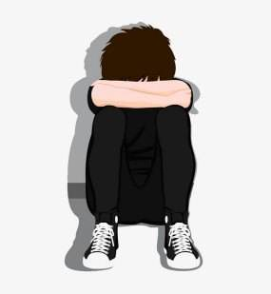

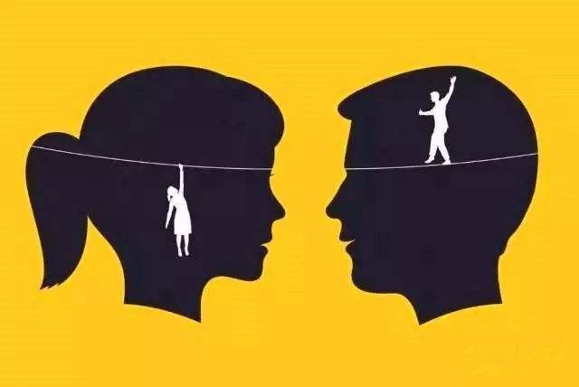
On the way to our dreams, goals and prosperity, we are sure to encounter
Challenges like frustrations, disappointment, loneliness, something unexpected, misunderstandings and so on.
As students, how can we face such Challenges?

Slide 5
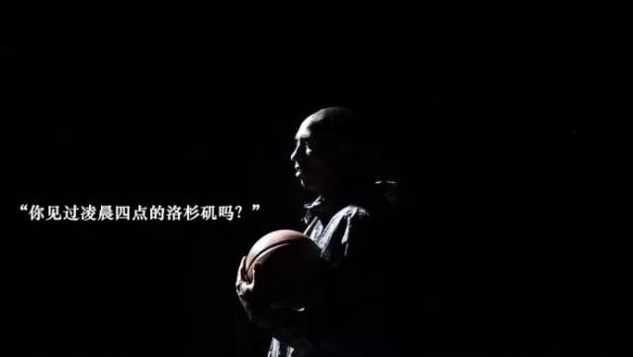
Have you ever seen the scene of Los Angeles at 4am?
I see often.
Because I have been starting training at the time.
------Kobe Bryant

Slide 6
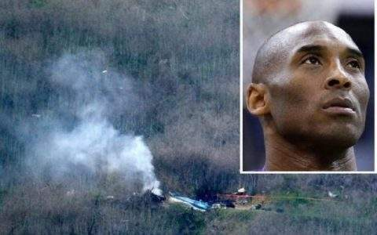
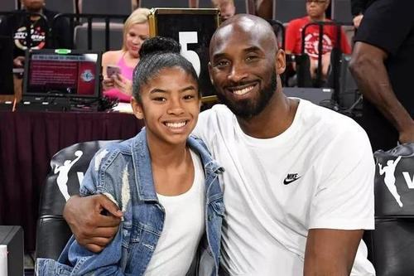
Bryant was killed in a helicopter crash in California, along with his 13-year-old daughter Gianna and seven other people. He was 41 years old.
Bryant was on his way to attend a youth basketball competition on Sunday with his daughter. The helicopter carrying Bryant and the others crashed into a hilly area in foggy conditions outside Los Angeles.

Slide 7
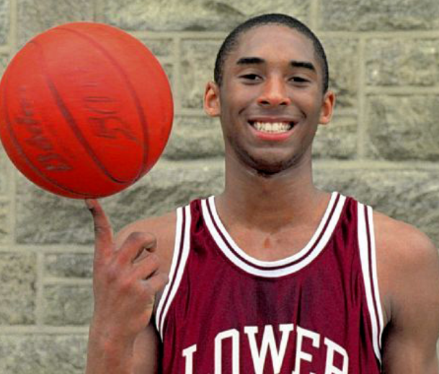
Life before joining NBA
Bryant was born in 1978 in Philadelphia. When Bryant was six, his family moved to Italy. He learned to play soccer
and once considered
becoming a professional
soccer player. Back in the
USA, he excelled in
high school basketball
and joined the NBA,
aged 17.

Slide 8
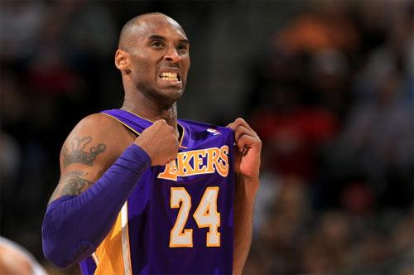
The road to success
Bryant joined the
Lakers in 1996. His first
three seasons were
spent coming off the
bench but he still
managed to become a
favourite with fans. From 2000, Bryant was one of the top shooting guards in the league. He helped the Lakers win NBA championships in 2000, 2001, and 2002 and entered basketball’s elite. He has become a cornerstone of the Lakers team.

Slide 9
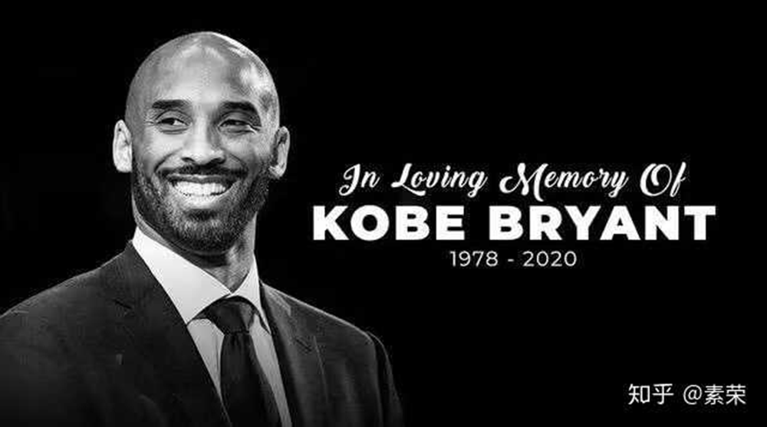
Achievements
Bryant was an 18-time All-Star player. He won five NBA championships and two Olympic gold medals. He was widely considered one of the greatest basketball players of his generation during his 20-year career with the Los Angeles Lakers.

Slide 10
Kobe Bryant's Classic Quotes
I know the appearance(scene) of Los Angeles at 4 am every day！
I’ll do whatever it takes to win games, whether it’s sitting on a bench waving a towel, handing a cup of water to a teammate, or hitting the game-winning shot.
Everything negative ---- pressure, challenges ------ is all an opportunity for me to rise.
What I’m doing right now, I’m chasing perfection.
I don’t want to be the next Michael Jordan, I only want to be Kobe Bryant.

Slide 11
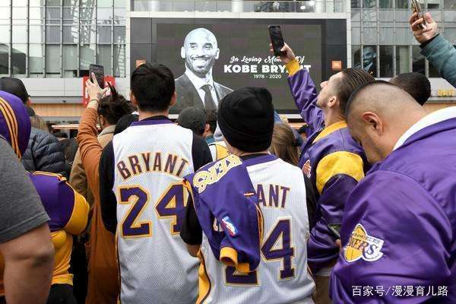
Reactions to his death
“He is a legend across the world. The world lost a really huge person, a role model and an idol. It’s a huge loss for everyone. When you think about Kobe, it’s no excuses. Nothing can take your mind off what you love to do.” ---------Jokić

Slide 12
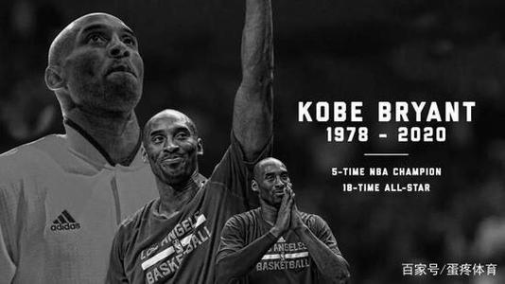
“Words can't describe the pain I am feeling. I loved Kobe — he was like a little brother to me. We used to talk often, and I will miss those conversations very much. He was a fierce competitor, one of the greats of the game and a creative force. Kobe was also an amazing dad who loved
his family deeply — and
took great pride in his
daughter's love for the
game of basketball.”
—Michael Jordan

Slide 13
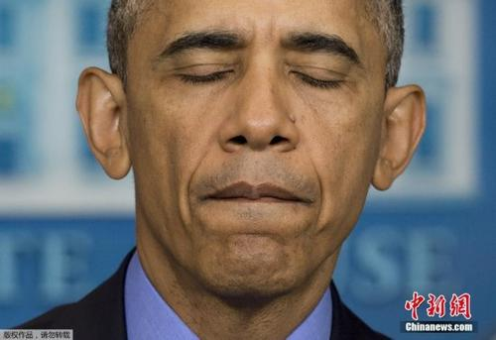
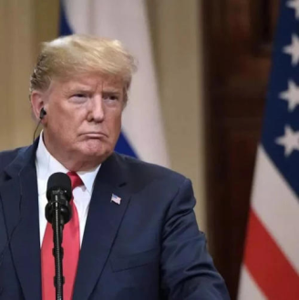
Kobe was a legend on the court and just getting started in what would have been just as meaningful a second act. To lose Gianna is even more heartbreaking to
us as parents. Michelle and I send love
and prayers to Vanessa and the entire
Bryant family on an unthinkable day.
Melania and I send our warmest condolences to Vanessa and the wonderful Bryant family. May Gob be with you all! Kobe Bryant, despite being one of the truly great basketball players of all time, was just getting started in life.
He loved his family so much, and had
such strong passion for the future. The
loss of his beautiful daughter makes this
moment even more devastating---

Slide 14
Mamba Mentality
Nicknamed Black Mamba，a very poisonous snake in Africa.
Passionate: passion comes from love. He loves the smell of basketball and sports shoes.
Obsessive: irresistible, uncontrollable, fascinated
Relentless: refusing to give up or be less strict or severe
Resilient: able to feel better quickly after sth. unpleasant such as shock, injury, etc. People and things that are resilient are able to recover easily and quickly from unpleasant or damaging events.
Fearless: the biggest fear is not from outside, but from within oneself.

Slide 15
As a person, Kobe Bryant ---
As a nation, we are now faced with a big challenge that is threatening people’s life.

Slide 16
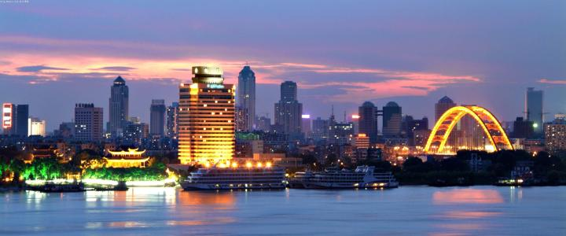
Wuhan, the capital city of Central China's Hubei province

Slide 17
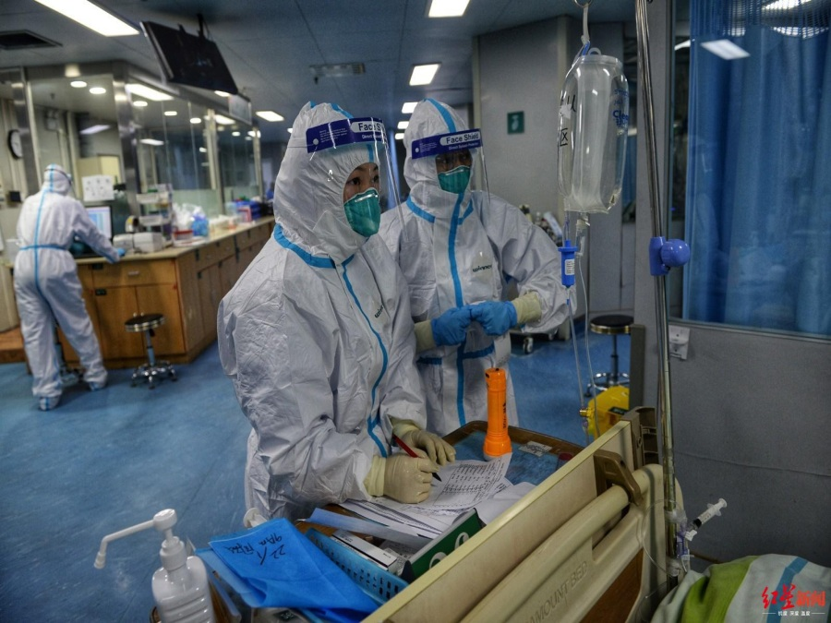
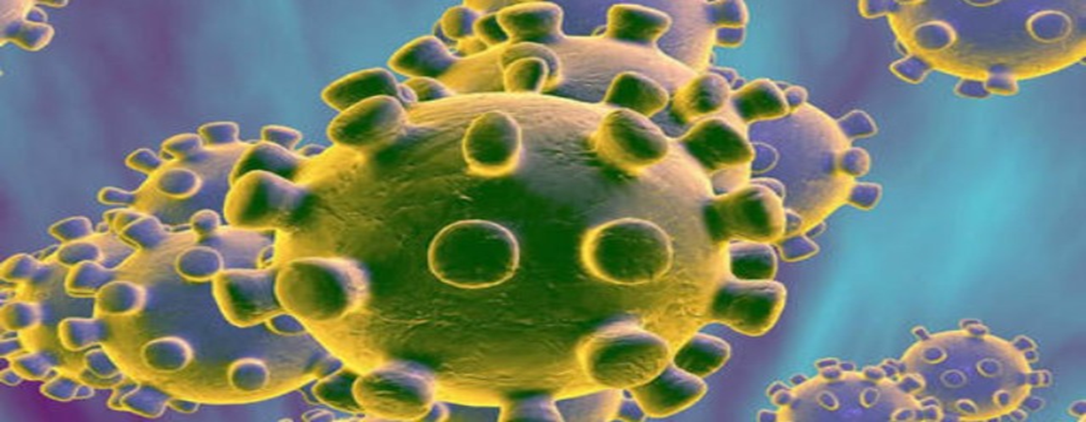
There is an outbreak of disease that started in Wuhan. A lot of them are infected. And the number of infected people is still increasing throughout China.
It is caused by a novel coronavirus
[kə,rəunə'vaiərəs]
that means it is so brand-new that actually it doesn’t have a name.

Slide 18
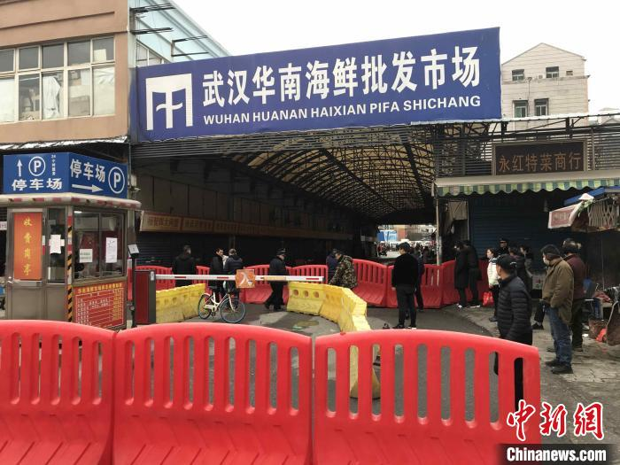
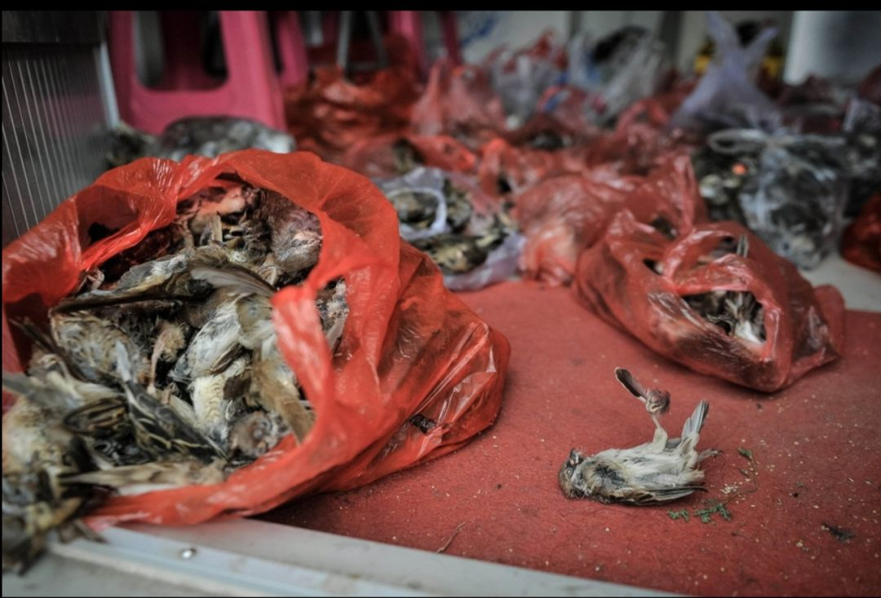
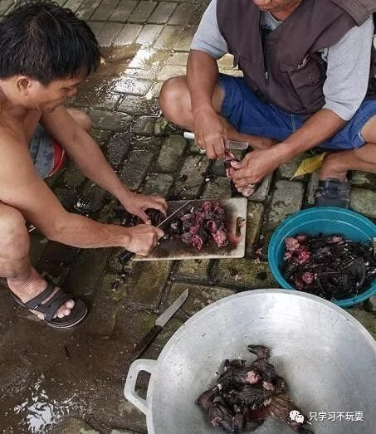
Origin of the virus
This brand-new coronavirus , which is the same family as the virus that caused SARS, came from wild animals, and it is believed that the source was actually a seafood market in Wuhan, which also sells wild animals.

Slide 19
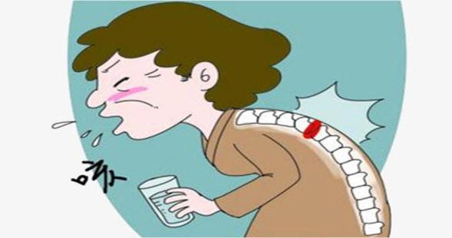
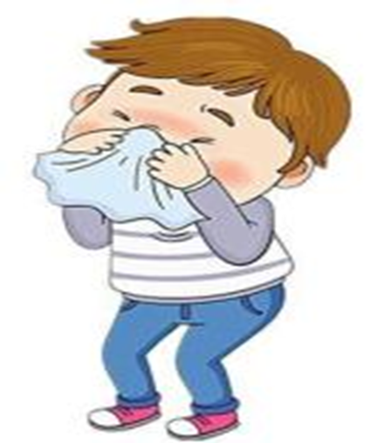
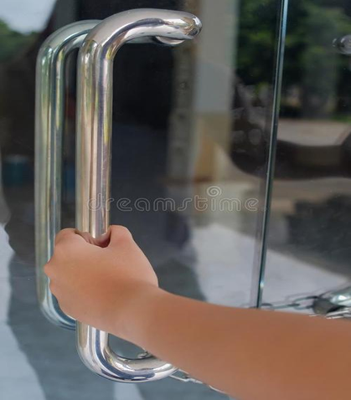
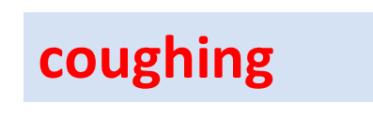
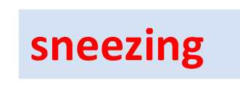
Symptoms And Transmission
The symptoms of this illness are pretty common , just like a flu or a cold：it is a dry cough, fever and then breathing problems.
contact with the infective surface
It was discovered by experts that the novel coronavirus is actually transmitted from one person to another. So we’ve got people to people transmission.

Slide 20
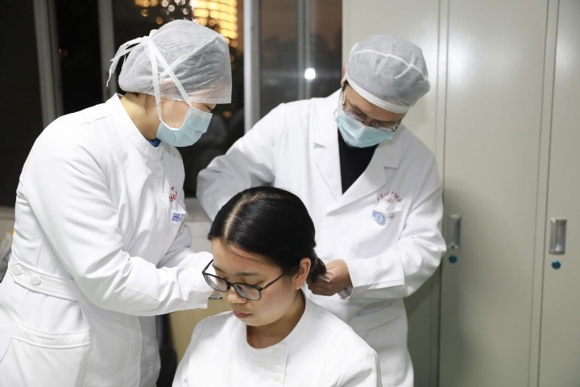
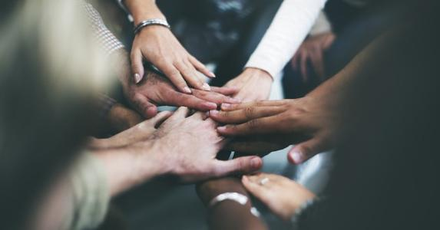
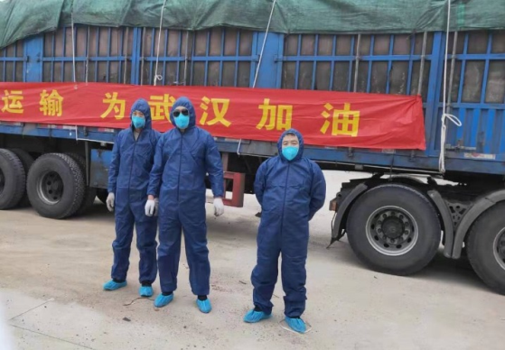
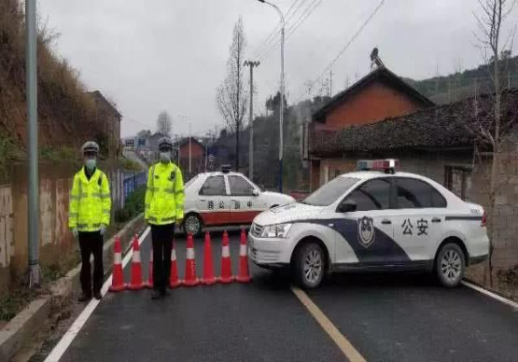
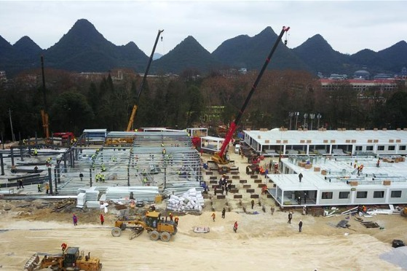
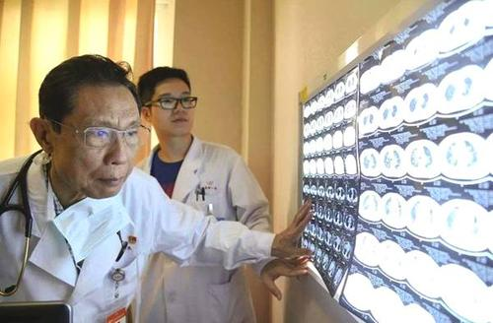
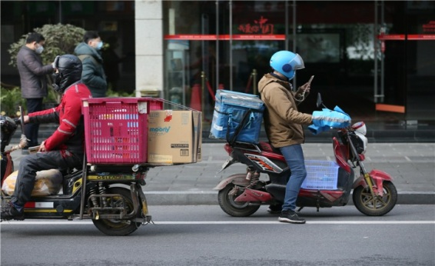
Actions taken to face this challenge
Hair-cutting
volunteer drivers
police
People from all walks of life face challenges hand in hand.
Construction of hospital
Acts of human kindness bring hope in challenging times
Experts and scientists

Slide 21
What can we do as students?
The best way to avoid it is to isolate yourself at home.
Always remember:
Wash your hands.
Use masks properly.
Have temperature taken regularly.
Avoid large crowds.
Never touch your face or eyes with your unclean hand.
Your health is our concern!

Slide 22
Burning passion, challenge the limit, beyond the self

Slide 23
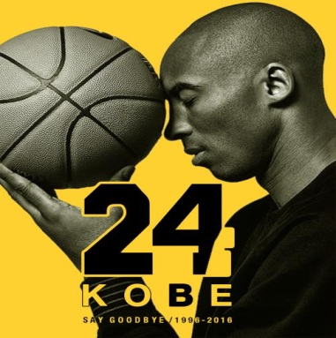
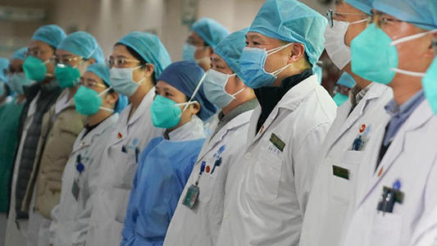
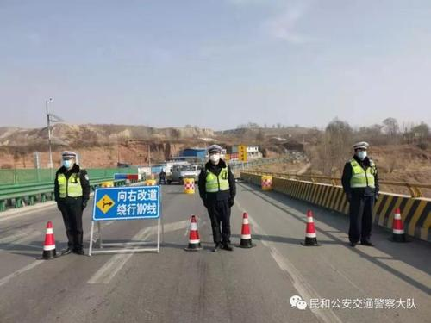
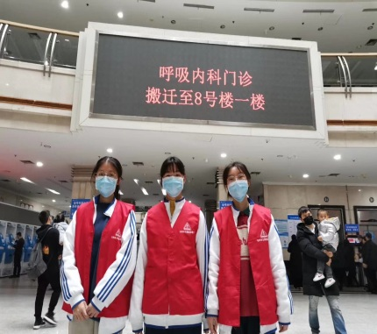
Life needs challenges. Youth has no limits.
Stand at a new starting point, meet new challenges and create new achievements.

Slide 24
Assignment
1. Kobe Bryant died in a helicopter crash in California, along with his 13-year-old daughter Gianna. Please write a news report for the school newspaper about the accident in about 80 words.
2. Challenges are everywhere in our lives. Please write a speech centered on challenges, properly using Kobe Bryant or people fighting the epidemic as an example. Limit your speech within 100 words.

Slide 25
Thank You!

