Slide 1

感恩遇见，相互成就，本课件资料仅供您个人参考、教学使用，严禁自行在网络传播，违者依知识产权法追究法律责任。
更多教学资源请关注
公众号：溯恩高中英语
知识产权声明

Slide 2

M5U5
Grammar
---Ellipsis (省略)

Slide 3
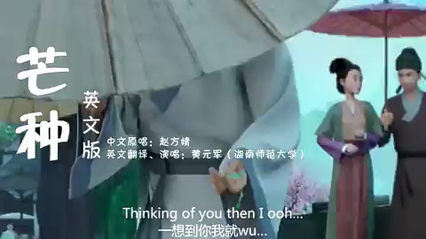
Lover of pre-life
________was carved
I can see tear _________from your eyes wow
Buddha______
Don't be stupid
How can I follow all this right in peace
...
Resent love is short and _______ in pain ooh...
Leaves stay in vain _______flying away ooh
Love means nothing and ___does your swear
What I wish for
Sow lots of lotuses...
They grow in all well beings
______ mortal world to give answer
The rosary meets the sand of time
Abandoning reading of mercy
...
(the lover's) Palm was carved
Palm
I ...tears (which is) dropping from...
dropping
Buddha said (that)
said
________of you then I ooh
Dream to stay with you ooh
______ memory by willow
My hurry _______ from the branches ________
Was the price of telling me _____
The afterglow touched the passer's hair
He chose to give up missing
Beneath bridge
... is short and (resent love is) trapped...
Thinking
trapped
(When I am) Thinking of you ...
Leaves stay in vain (and) flower (is) flying ...
flower
(and I) Burn memory by willow...
Love means nothing and your swear means nothing
Burn
so
falling
My hurry (that is) falling from the branches (that are) newly-born
newly-born
Ellipsis
... telling (me) why (my heart thudded)
why
Waiting
(and they are) waiting mortal world...

Slide 4
Sentences from the Reading: First Aid For Burns
1. These burns are serious and (these burns) take a few
weeks to heal.
2. Often the illness or injury is not serious, but there are
other times when (the illness or injury is serious and)
giving first aid quickly can save lives.
3. Burns are called first (degree burns), second (degree burns)
or third degree burns, …
4. These affect both the top (layer of the skin) and the
second layer of the skin.
5. If burns are on arms or legs, keep them higher than the
heart, if (it is) possible.

Slide 5
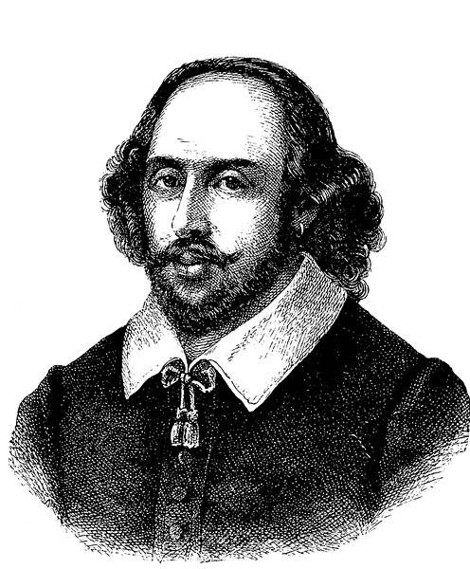

Brevity is the soul of wit.
(言以简为贵)
A. The film was inspired by the traditional Chinese fable (寓言) Legend of the White Snake, and the film was released in China on January 11, 2019.
Functions
功能
Ellipsis
B. The film, released in China on January 11, 2019, was inspired by the traditional Chinese fable (寓言) Legend of the White Snake.
concise
closely-linked
highlighted
避免重复，简洁明了；
连接紧密，结构紧凑；
强调重点，突出信息。

Slide 6




concise
closely-linked
highlighted
Functions
功能
简单句中的省略
Ellipsis
状语从句中的省略
并列句中的省略
宾语从句中的省略
Types
类型
复合句中的省略
定语从句中的省略
动词不定式的省略
其他省略
介词的省略
替代此so等的省略

Slide 7

It's time for you to explore the rules!

Slide 8
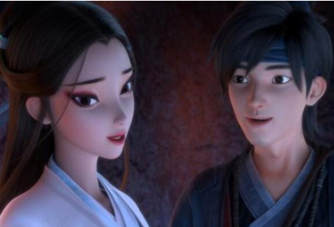
简单句中的省略
(I) Thank you for your saving my life!
(I saved your life) With pleasure!
主语省略: 祈使句中的主语通常被省略。
省略重复的句子成分

Slide 9
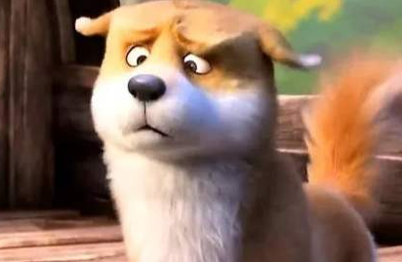
Don’t stare at a girl unless you are told to
(stare at her).
--- He hasn’t finished the task.
--- Well, he ought to have (finished it).
省略重复的宾语: 可以省略作宾语的动词不定式, 保留to。
但如果该宾语是动词be或完成形式, 则须在to后加上be或have。

Slide 10
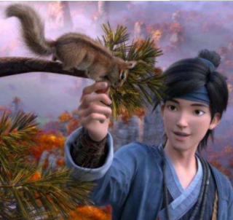
Yes, I am (hungry).
Are you hungry?
省略重复的表语

Slide 11

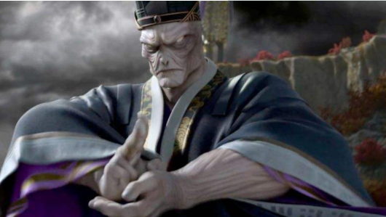
并列句中的省略
In the late Tang Dynasty, the Taoist (国师) plotted to enhance
his power and (the Taoist) launched people to catch snakes for him. Therefore, people hunt for big (snakes) and small snakes. Only some of the snakes have survived, but most (of the snakes) have not (survived). So, the white snake was sent to end this.
两个并列分句中，后一分句常省略与前一分句中相同的部分。

Slide 12
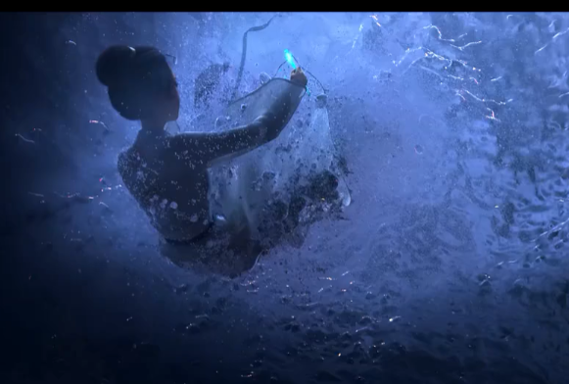
复合句中的省略
——状语从句中的省略
Though (she was) armed with a magic weapon-hairpin(珠钗), she was struck with a stunning blow by the enemy and fell into the deep river. _________(当她苏醒过来的时候，她发现自己身在捕蛇村了。)
A. When coming to life, she found herself was in the Snakecatcher Village.
B. When was coming to life, she found herself in the Snakecatcher
Village.
A
在though, when, if,unless, as if, as though, whether等 引导的状语从句中如果主语与主句的主语一致，同时从句中又含有动词be则通常可省去从句中的主语和动词be.

Slide 13
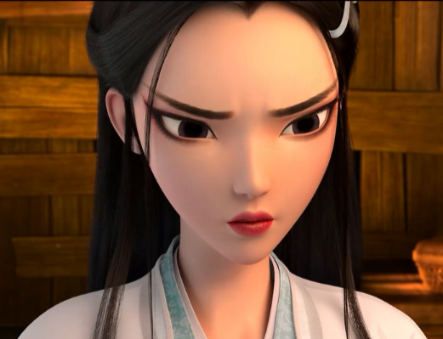
复合句中的省略
——状语从句中的省略
Observe the examples
Make a conclusion
Example1:
Everything went on worse than (everything had been) expected, for she couldn't remember anything.
Example2:
Gradually she learnt from others that she was rescued by Xuan. Hadn't he saved her from the river, she would have drowned.
以as, than引导的比较状语从句可以全部或部分省去。
虚拟条件句中有had, were, should 常省略if， 并将had, were,should提前。

Slide 14
复合句中的省略
——宾语从句中的省略
Observe the examples
Make conclusions
Example1:
He told her (that) she was found lying on a rock by the waterfall half of her body in water.
Example2:
When told the fact, she restored part of her memory. She believed (that) she could remember everything but didn't know when (she could remember everything).
1. 在say, know, think, decide, consider, suppose, believe等动词后
所接宾从连接词that可省略。
2. 由which, when, where, how和why引导的宾语从句可全部或部分省去。

Slide 15
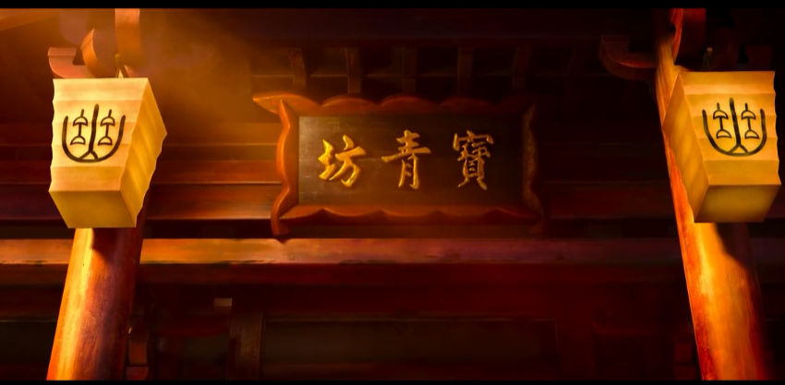
复合句中的省略
——宾语从句中的省略
Observe the examples
Make conclusions
Example3:
He said (that) he could help her and that they should go together to find out the lost memory.
Example4:
He suggested that they (should) go to the Precious Jade Workshop to ask for plots.
3. 多个宾语从句并列时, 通常只省略第一个that。
4. 在suggest/request/order/advise/recommend等相关的宾语从句的虚拟语气中，should可以省略

Slide 16
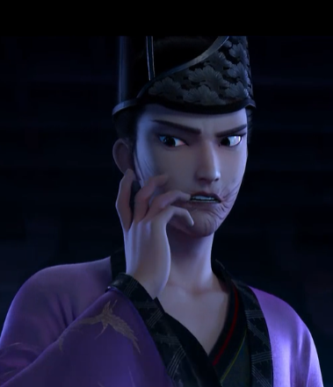
复合句中的省略
——定语从句中的省略
他就是那个小白决心要杀的人之一.
He is one of the men (who/that/whom) Xiaobai made her mind to kill.
在定语从句中的that/which/who/whom
作宾语时可以省略

Slide 17
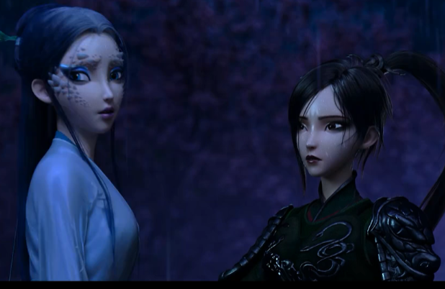
其他省略
——动词不定式的省略
Explore the differences
Make conclusions
①. Awakened by her sister, Xiaobai remembered her mission
was to kill the enemy and (to) return the hairpin to her master.
②. But she didn't know whether to go on or to stop.
①. Her sister Xiaoqin made her retake her mission.
②. She was made to retake her mission by her sister Xiaoqin.
1. 并列的不定式可省去后面的to;但表示对比关系的两个不定式to不可省。
2.感官动词see, hear等和使役动词make, let, have等后面加省略to的不定式；但改为被动语态时to不能省。

Slide 18
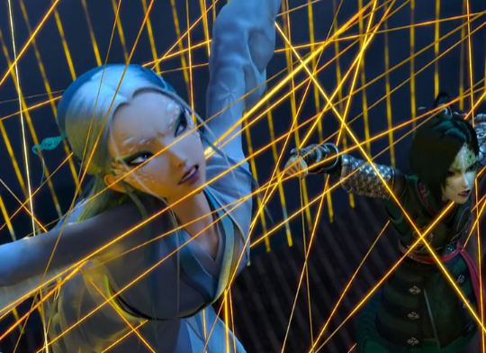

——动词不定式的省略
其他省略
这场战斗打得很艰难，他们所能做的就是鼓起勇气坚持到底。
A. The battle was a tough one and all
they could do was nothing but to
muster up their courage and hang on.
B. The battle was a tough one and all
they could do was nothing but muster
up their courage and hang on.
but前若有实义动词do, 后面不定式
不带to。

Slide 19
其他省略
——介词的省略
Review | 常见的介词可省的固定结构有：
have difficulty/trouble (in) doing sth
be busy (in) doing sth
spend some time (in) doing sth
stop/prevent sb (from) doing sth
There is no sense/point (in) doing sth
It's no good/use (in) doing sth
注意：表示时间的介词at,on,in在next, last, this, yesterday, tommorrow等词前，
一般省略。
eg. They all fought for a new life tommorrow.

Slide 20
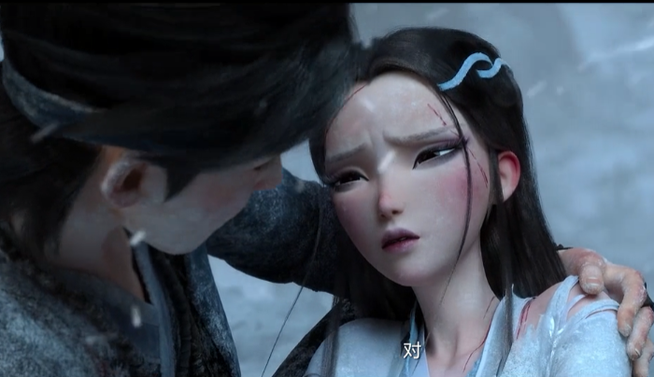
其他省略
——替代词so/not等的省略
I think so.
Can you keep me in your mind forever?
I don't think so.
We are dying, are we?
I guess so.
I guess not.
so/not可用来省略上文中的一部分或整个句子。
guess/hope/be afraid 的否定形式只能用not 形式，不能用don't...so.

Slide 21
It's time for you to PRACTICE!

Slide 22
省略在歌曲中的使用
省略在诗歌中的使用
Ellipsis
省略在新闻中的使用
省略在考试中的使用

Slide 23
省略在歌曲中的使用
Lover of pre-life
________was carved
I can see tear _________from your eyes wow
Buddha______
Don't be stupid
How can I follow all this right in peace
...
Resent love is short and _______ in pain ooh...
Leaves stay in vain _______flying away ooh
Love means nothing and ___does your swear
What I wish for
Sow lots of lotuses...
They grow in all well beings
______ mortal world to give answer
The rosary meets the sand of time
Abandoning reading of mercy
...
Palm
dropping
________of you then I ooh
Dream to stay with you ooh
______ memory by willow
My hurry _______ from the branches ________
Was the price of telling me _____
The afterglow touched the passer's hair
He chose to give up missing
Beneath bridge
said
Thinking
Burn
falling
newly-born
trapped
why
flower
so
Waiting
Ellipsis helps show feelings with brief words

Slide 24

Little gestures of resistance
Little signs of silence
Though miles apart
Still chill a heart
Little words of care
Little gifts of share
In the darkness of the year
Help to warm lives here
So weeny
And tiny they may be
Can make the world
A different being
Do the little good deeds
Spread the virtue seeds
May their blossoms blooming
Till the changes are looming
Your little gestures of resistance against us
Your little signs of silence against us
Though miles apart between you and us
Still chill a heart of us
Your little words of care about us
Your little gifts of share with us
In the darkness of the year 2020
Help to warm lives here in our country
Your deeds are so weeny (微小的)
And tiny they may be
Your deeds can make the world
A different being
You should do the little good deeds
You should spread the virtue seeds
May the blossoms of deeds and seeds blooming
Till the changes are looming
省略在诗歌中的使用
Little deeds different ends
Ellipsis helps show feelings with concise words

Slide 25


省略在新闻中的使用
真实性
及时性
简明性
Ellipsis helps show ideas with hidden words
Find out the information left out in the news:
1. “...and the second ___________soon followed.”
2. China held a top-level meeting on the outbreak___________.
3. ...6,000 medical workers ________________ landed at Wuhan's airport.
4.“..._________________carrying 1400 more medics from the army”
5. “...and some_________________ laid down their lives to save others.”
“...while ____________preparing another 70,000 beds at quarantine
site....no one was left unattended ___________.”
hospital
of COVID-19
of other provinces
the cargo planes are
medical workers
Wuhan was
in Wuhan

Slide 26
省略在考试中的使用
用还原法看清观点
(2020•1月浙江卷语法填空) The first is declining birth rates, which means old generations are large 60 (compare) to younger generations,
compared
(when old generations are) compared to younger generations
状语从句中的省略
Ellipsis helps show points with connected words

Slide 27
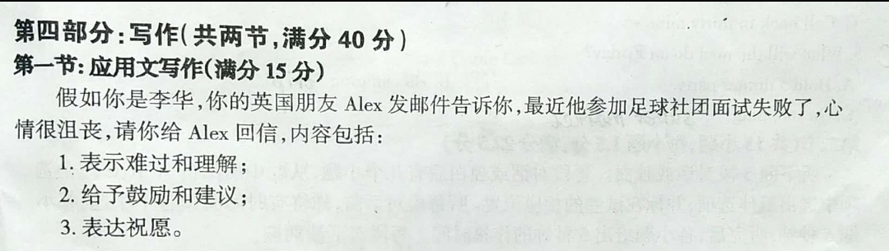
省略在考试中的使用
2019绍兴上虞高二期末测试卷
明确
简练
生动

Slide 28
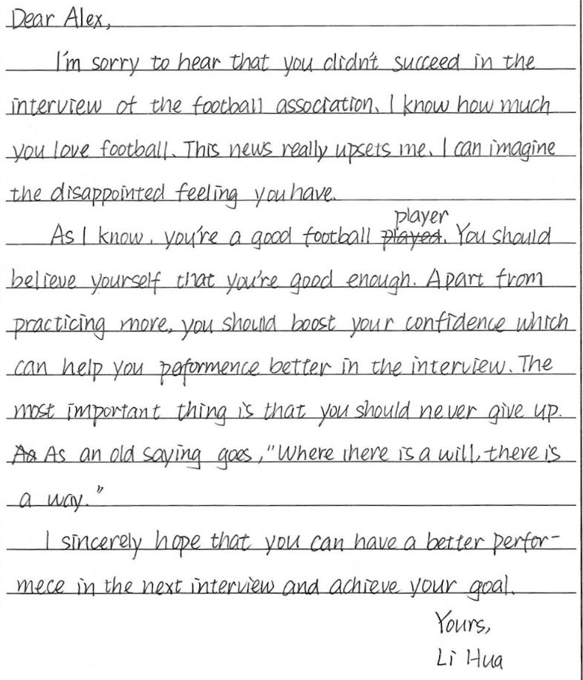
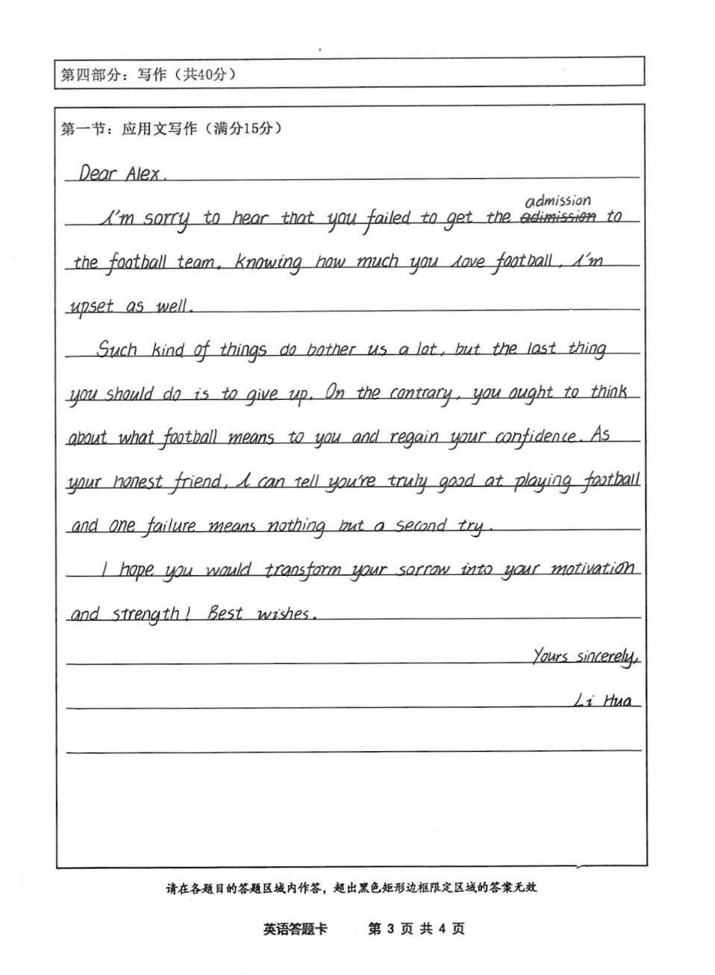
用简化法彰显情感

Slide 29
避免重复,简洁明了；连接紧密,结构紧凑；
强调重点，突出信息。
Functions
功能
简单句中的省略
状语从句中的省略
并列句中的省略
Ellipsis
Types
类型
宾语从句中的省略
复合句中的省略
定语从句中的省略
Application
应用
其他省略
动词不定式的省略
介词的省略
省略在歌曲中的使用
省略在歌曲中的使用
替代此so等的省略
省略在诗歌中的使用
省略在诗歌中的使用
省略在新闻中的使用
用简化法彰显情感
省略在考试中的使用
用补全法看清观点

Slide 30
Homework
1. Go over the types of ellipsis.
2. Finish the given exercise.

