Slide 1

感恩遇见，相互成就，本课件资料仅供您个人参考、教学使用，严禁自行在网络传播，违者依知识产权法追究法律责任。
更多教学资源请关注
公众号：溯恩高中英语
知识产权声明

Slide 2



Reading & Writing

Slide 3

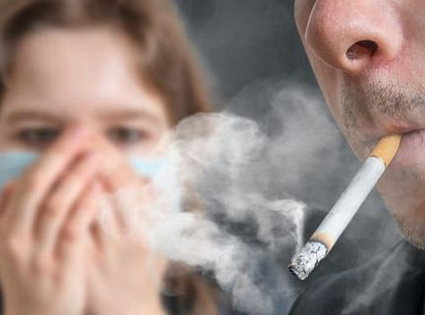
Lead in
How can we persuade them to quit smoking?

Slide 4
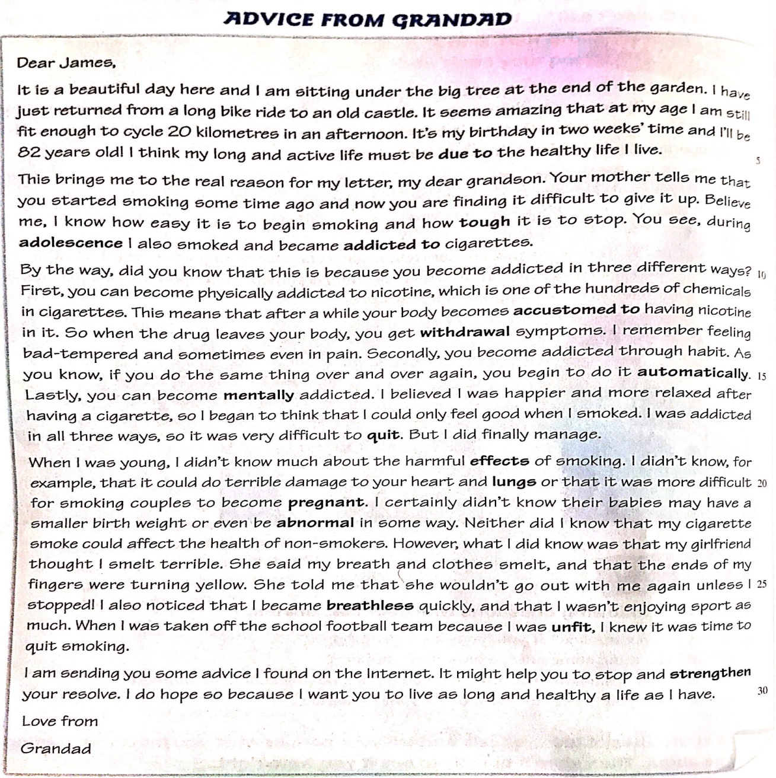
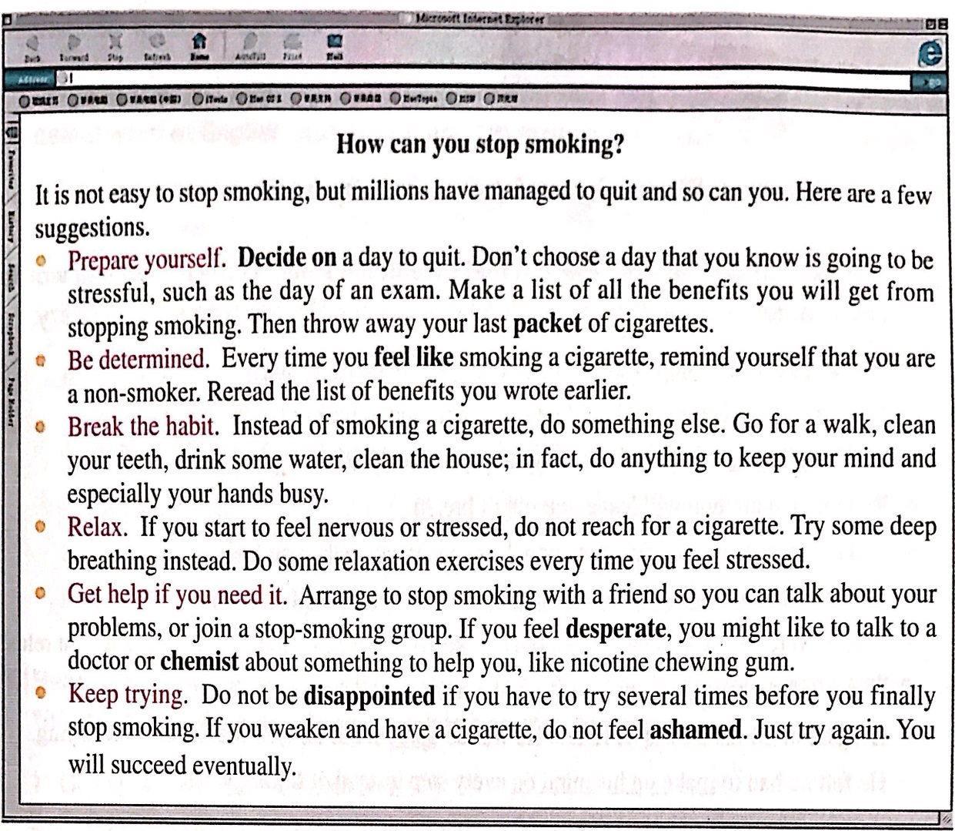
Pre-reading
an internet page
a letter
an attachment

Slide 5
Reading：Read for structure
Read the text quickly and summarize the main idea of each paragraph.
The letter | Para.1
 | Para.2
 | Para.3
 | Para.4
 | Para.5
The Internet page | Para.6
the writer’s recent life
the writing purpose
the ways of becoming addicted
the harmful effects of smoking
the writer’s hopes and wishes
the suggestions of quitting smoking

Slide 6
Reading：Read for structure
Read the text quickly and summarize the main idea of each paragraph.
The letter | Para.1
 | Para.2
 | Para.3
 | Para.4
 | Para.5
The Internet page | Para.6
the writer’s recent life
the writing purpose
a persuasive writing：
a letter of advice
the ways of becoming addicted
the harmful effects of smoking
the writer’s hopes and wishes
the suggestions of quitting smoking

Slide 7
Reading：Read for content
Para. 1 & 2
It is a beautiful day here and I am sitting under the big tree at the end of the garden. I have just returned from a long bike ride to an old castle. It seems amazing that at my age I am still fit enough to cycle 20 kilometers in an afternoon. It’s my birthday in two weeks’ time and I’ll be 82 years old. I think my long and active life must be due to the healthy life I live.
This brings me to the real reason for my letter, my dear grandson. Your mother tells me that you started smoking some time ago and now you are finding it difficult to give it up. Believe me, I know how easy it is to begin smoking and how tough it is to stop. You see, during adolescence, I also smoked and became addicted to cigarettes.

Slide 8

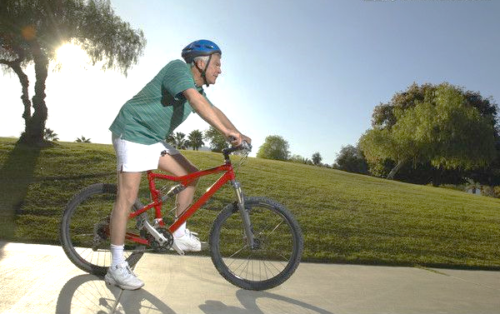
Reading：Read for content
Para. 1 & 2
It is a beautiful day here and I am sitting under the big tree at the end of the garden. I have just returned from a long bike ride to an old castle. It seems amazing that at my age I am still fit enough to cycle 20 kilometers in an afternoon. It’s my birthday in two weeks’ time and I’ll be 82 years old. I think my long and active life must be due to the healthy life I live.
This brings me to the real reason for my letter, my dear grandson. Your mother tells me that you started smoking some time ago and now you are finding it difficult to give it up. Believe me, I know how easy it is to begin smoking and how tough it is to stop. You see, during adolescence, I also smoked and became addicted to cigarettes.

Slide 9
Reading：Read for content
Para. 1 & 2
It is a beautiful day here and I am sitting under the big tree at the end of the garden. I have just returned from a long bike ride to an old castle. It seems amazing that at my age I am still fit enough to cycle 20 kilometers in an afternoon. It’s my birthday in two weeks’ time and I’ll be 82 years old. I think my long and active life must be due to the healthy life I live.
This brings me to the real reason for my letter, my dear grandson. Your mother tells me that you started smoking some time ago and now you are finding it difficult to give it up. Believe me, I know how easy it is to begin smoking and how tough it is to stop. You see, during adolescence, I also smoked and became addicted to cigarettes.
because of

Slide 10
Reading：Read for content
Para. 1 & 2
It is a beautiful day here and I am sitting under the big tree at the end of the garden. I have just returned from a long bike ride to an old castle. It seems amazing that at my age I am still fit enough to cycle 20 kilometers in an afternoon. It’s my birthday in two weeks’ time and I’ll be 82 years old. I think my long and active life must be due to the healthy life I live.
This brings me to the real reason for my letter, my dear grandson. Your mother tells me that you started smoking some time ago and now you are finding it difficult to give it up. Believe me, I know how easy it is to begin smoking and how tough it is to stop. You see, during adolescence, I also smoked and became addicted to cigarettes.

Slide 11
Reading：Read for content
Para. 1 & 2
It is a beautiful day here and I am sitting under the big tree at the end of the garden. I have just returned from a long bike ride to an old castle. It seems amazing that at my age I am still fit enough to cycle 20 kilometers in an afternoon. It’s my birthday in two weeks’ time and I’ll be 82 years old. I think my long and active life must be due to the healthy life I live.
This brings me to the real reason for my letter, my dear grandson. Your mother tells me that you started smoking some time ago and now you are finding it difficult to give it up. Believe me, I know how easy it is to begin smoking and how tough it is to stop. You see, during adolescence, I also smoked and became addicted to cigarettes.
Tip 1：
Put yourself in the reader’s position. You're just making convincing statements to let him/her accept your advice naturally.
difficult
When I was a teenager,

Slide 12
Reading：Read for content
Para. 3
By the way, did you know that this is because you become addicted in three different ways? First, you can become physically addicted to nicotine, which is one of the hundreds of chemicals in cigarettes. This means that after a while your body becomes accustomed to having nicotine in it. So when the drug leaves your body, you get withdrawal symptoms. I remember feeling bad-tempered and sometimes even in pain. Secondly, you become addicted through habit. As you know, if you do the same thing over and over again, you begin to do it automatically. Lastly, you can become mentally addicted. I believed I was happier and more relaxed after having a cigarette, so I began to think that I could only feel good when I smoked. I was addicted in all three ways, so it was very difficult to quit. But I did finally manage.

Slide 13

Reading：Read for content
Para. 3
By the way, did you know that this is because you become addicted in three different ways? First, you can become physically addicted to nicotine, which is one of the hundreds of chemicals in cigarettes. This means that after a while your body becomes accustomed to having nicotine in it. So when the drug leaves your body, you get withdrawal symptoms. I remember feeling bad-tempered and sometimes even in pain. Secondly, you become addicted through habit. As you know, if you do the same thing over and over again, you begin to do it automatically. Lastly, you can become mentally addicted. I believed I was happier and more relaxed after having a cigarette, so I began to think that I could only feel good when I smoked. I was addicted in all three ways, so it was very difficult to quit. But I did finally manage.

Slide 14
Reading：Read for content
Para. 3
By the way, did you know that this is because you become addicted in three different ways? First, you can become physically addicted to nicotine, which is one of the hundreds of chemicals in cigarettes. This means that after a while your body becomes accustomed to having nicotine in it. So when the drug leaves your body, you get withdrawal symptoms. I remember feeling bad-tempered and sometimes even in pain. Secondly, you become addicted through habit. As you know, if you do the same thing over and over again, you begin to do it automatically. Lastly, you can become mentally addicted. I believed I was happier and more relaxed after having a cigarette, so I began to think that I could only feel good when I smoked. I was addicted in all three ways, so it was very difficult to quit. But I did finally manage.
is used to

Slide 15
Reading：Read for content
Para. 3
By the way, did you know that this is because you become addicted in three different ways? First, you can become physically addicted to nicotine, which is one of the hundreds of chemicals in cigarettes. This means that after a while your body becomes accustomed to having nicotine in it. So when the drug leaves your body, you get withdrawal symptoms. I remember feeling bad-tempered and sometimes even in pain. Secondly, you become addicted through habit. As you know, if you do the same thing over and over again, you begin to do it automatically. Lastly, you can become mentally addicted. I believed I was happier and more relaxed after having a cigarette, so I began to think that I could only feel good when I smoked. I was addicted in all three ways, so it was very difficult to quit. But I did finally manage.

Slide 16
Reading：Read for content
Para. 3
By the way, did you know that this is because you become addicted in three different ways? First, you can become physically addicted to nicotine, which is one of the hundreds of chemicals in cigarettes. This means that after a while your body becomes accustomed to having nicotine in it. So when the drug leaves your body, you get withdrawal symptoms. I remember feeling bad-tempered and sometimes even in pain. Secondly, you become addicted through habit. As you know, if you do the same thing over and over again, you begin to do it automatically. Lastly, you can become mentally addicted. I believed I was happier and more relaxed after having a cigarette, so I began to think that I could only feel good when I smoked. I was addicted in all three ways, so it was very difficult to quit. But I did finally manage.

Slide 17


Reading：Read for content
Para. 3
By the way, did you know that this is because you become addicted in three different ways? First, you can become physically addicted to nicotine, which is one of the hundreds of chemicals in cigarettes. This means that after a while your body becomes accustomed to having nicotine in it. So when the drug leaves your body, you get withdrawal symptoms. I remember feeling bad-tempered and sometimes even in pain. Secondly, you become addicted through habit. As you know, if you do the same thing over and over again, you begin to do it automatically. Lastly, you can become mentally addicted. I believed I was happier and more relaxed after having a cigarette, so I began to think that I could only feel good when I smoked. I was addicted in all three ways, so it was very difficult to quit. But I did finally manage.

Slide 18
Reading：Read for content
Para. 3
By the way, did you know that this is because you become addicted in three different ways? First, you can become physically addicted to nicotine, which is one of the hundreds of chemicals in cigarettes. This means that after a while your body becomes accustomed to having nicotine in it. So when the drug leaves your body, you get withdrawal symptoms. I remember feeling bad-tempered and sometimes even in pain. Secondly, you become addicted through habit. As you know, if you do the same thing over and over again, you begin to do it automatically. Lastly, you can become mentally addicted. I believed I was happier and more relaxed after having a cigarette, so I began to think that I could only feel good when I smoked. I was addicted in all three ways, so it was very difficult to quit. But I did finally manage.

Slide 19
Reading：Read for content
Para. 3
By the way, did you know that this is because you become addicted in three different ways? First, you can become physically addicted to nicotine, which is one of the hundreds of chemicals in cigarettes. This means that after a while your body becomes accustomed to having nicotine in it. So when the drug leaves your body, you get withdrawal symptoms. I remember feeling bad-tempered and sometimes even in pain. Secondly, you become addicted through habit. As you know, if you do the same thing over and over again, you begin to do it automatically. Lastly, you can become mentally addicted. I believed I was happier and more relaxed after having a cigarette, so I began to think that I could only feel good when I smoked. I was addicted in all three ways, so it was very difficult to quit. But I did finally manage.

Slide 20
Reading：Read for content
Para. 4
When I was young, I didn’t know much about the harmful effects of smoking. I didn’t know, for example, that it could do terrible damage to your heart and lungs or that it was more difficult for smoking couples to become pregnant. I certainly didn’t know their babies may have a smaller birth weight or even be abnormal in some way. Neither did I know that my cigarette smoke could affect the health of non-smokers. However, what I did know was that my girlfriend thought I smelt terrible. She said my breath and clothes smelt, and that the ends of my fingers were turning yellow. She told me that she wouldn’t go out with me again unless I stopped! I also noticed that I became breathless quickly, and that I wasn’t enjoying sport as much. When I was taken off the school football team because I was unfit, I knew it was time to quit smoking.

Slide 21

Reading：Read for content
Para. 4
When I was young, I didn’t know much about the harmful effects of smoking. I didn’t know, for example, that it could do terrible damage to your heart and lungs or that it was more difficult for smoking couples to become pregnant. I certainly didn’t know their babies may have a smaller birth weight or even be abnormal in some way. Neither did I know that my cigarette smoke could affect the health of non-smokers. However, what I did know was that my girlfriend thought I smelt terrible. She said my breath and clothes smelt, and that the ends of my fingers were turning yellow. She told me that she wouldn’t go out with me again unless I stopped! I also noticed that I became breathless quickly, and that I wasn’t enjoying sport as much. When I was taken off the school football team because I was unfit, I knew it was time to quit smoking.

Slide 22
Reading：Read for content
Para. 4
When I was young, I didn’t know much about the harmful effects of smoking. I didn’t know, for example, that it could do terrible damage to your heart and lungs or that it was more difficult for smoking couples to become pregnant. I certainly didn’t know their babies may have a smaller birth weight or even be abnormal in some way. Neither did I know that my cigarette smoke could affect the health of non-smokers. However, what I did know was that my girlfriend thought I smelt terrible. She said my breath and clothes smelt, and that the ends of my fingers were turning yellow. She told me that she wouldn’t go out with me again unless I stopped! I also noticed that I became breathless quickly, and that I wasn’t enjoying sport as much. When I was taken off the school football team because I was unfit, I knew it was time to quit smoking.

Slide 23


Reading：Read for content
Para. 4
When I was young, I didn’t know much about the harmful effects of smoking. I didn’t know, for example, that it could do terrible damage to your heart and lungs or that it was more difficult for smoking couples to become pregnant. I certainly didn’t know their babies may have a smaller birth weight or even be abnormal in some way. Neither did I know that my cigarette smoke could affect the health of non-smokers. However, what I did know was that my girlfriend thought I smelt terrible. She said my breath and clothes smelt, and that the ends of my fingers were turning yellow. She told me that she wouldn’t go out with me again unless I stopped! I also noticed that I became breathless quickly, and that I wasn’t enjoying sport as much. When I was taken off the school football team because I was unfit, I knew it was time to quit smoking.

Slide 24
Reading：Read for content
Para. 4
When I was young, I didn’t know much about the harmful effects of smoking. I didn’t know, for example, that it could do terrible damage to your heart and lungs or that it was more difficult for smoking couples to become pregnant. I certainly didn’t know their babies may have a smaller birth weight or even be abnormal in some way. Neither did I know that my cigarette smoke could affect the health of non-smokers. However, what I did know was that my girlfriend thought I smelt terrible. She said my breath and clothes smelt, and that the ends of my fingers were turning yellow. She told me that she wouldn’t go out with me again unless I stopped! I also noticed that I became breathless quickly, and that I wasn’t enjoying sport as much. When I was taken off the school football team because I was unfit, I knew it was time to quit smoking.
Tip 2：
Get to know your reader. Figure out the concerns of the reader and this can make it easy for you to write a letter in a convincing style.

Slide 25
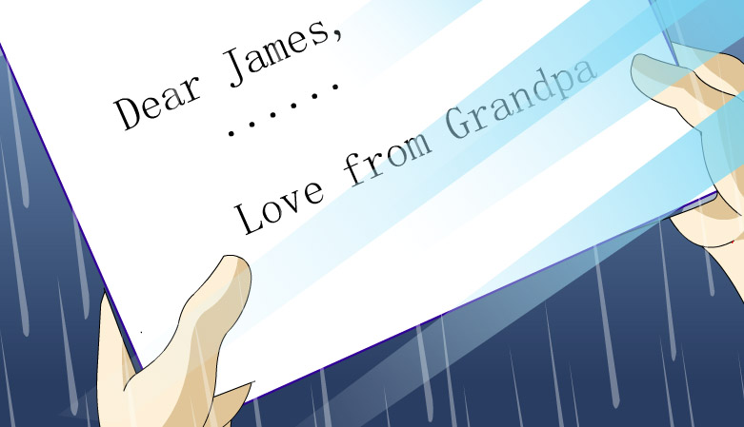
Reading：Read for content
Para. 5
I am sending you some advice I found on the internet. It might help you to stop and strengthen your resolve. I do hope so because I want you to live as long and healthy a life as I have.

Slide 26
Reading：Read for content
Para. 5
I am sending you some advice I found on the internet. It might help you to stop and strengthen your resolve. I do hope so because I want you to live as long and healthy a life as I have.
Tip 3：
End the letter with a final appeal in a polite and kindly tone so that the reader can give a second thought to your advice.

Slide 27
Pre-writing
Have a try!
Write a letter to persuade a smoker to quit smoking with around 80 words.
1. writer’s recent life
2. writing purpose
3. the ways of becoming addicted
4. harmful effects of smoking
5. writer’s hopes and wishes

Slide 28
Writing
evaluation criterion：
Structure | Content | Language
1. writing purpose 2. harmful effects 3. hopes and wishes | Put yourself in the reader’s position. Get to know your reader. Figure out the concerns of the reader. End the letter with a final appeal in a polite and kindly tone. | I don’t know … I certainly don’t know … Neither do I know that … However, what I do know is that … I totally understand that… I do hope that… …
tones

Slide 29
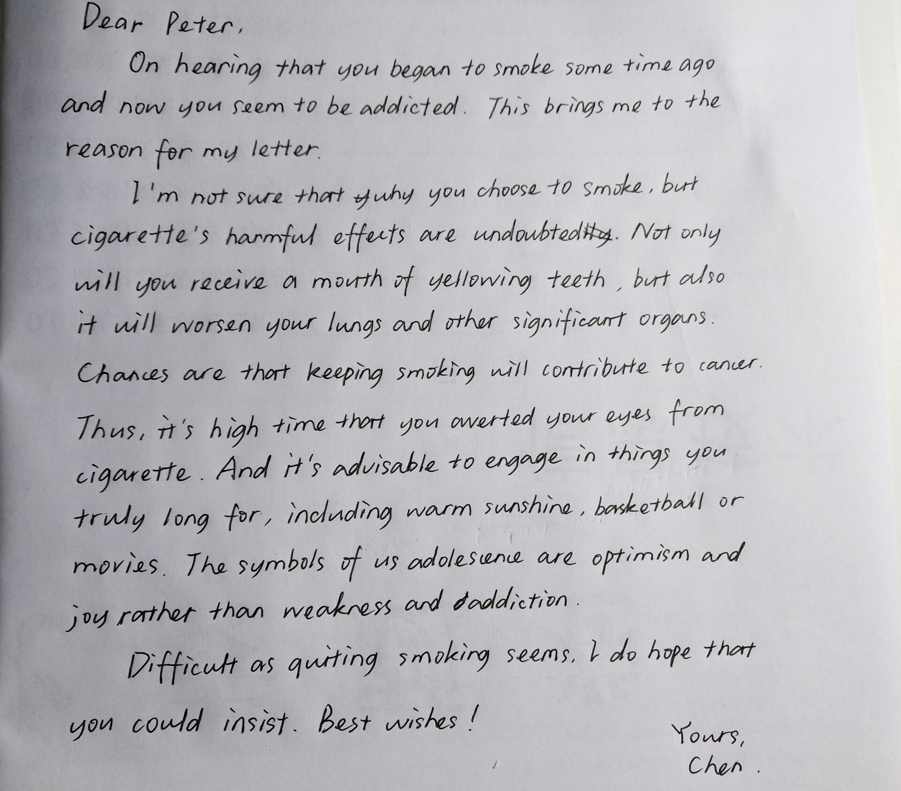
Post -writing

Slide 30
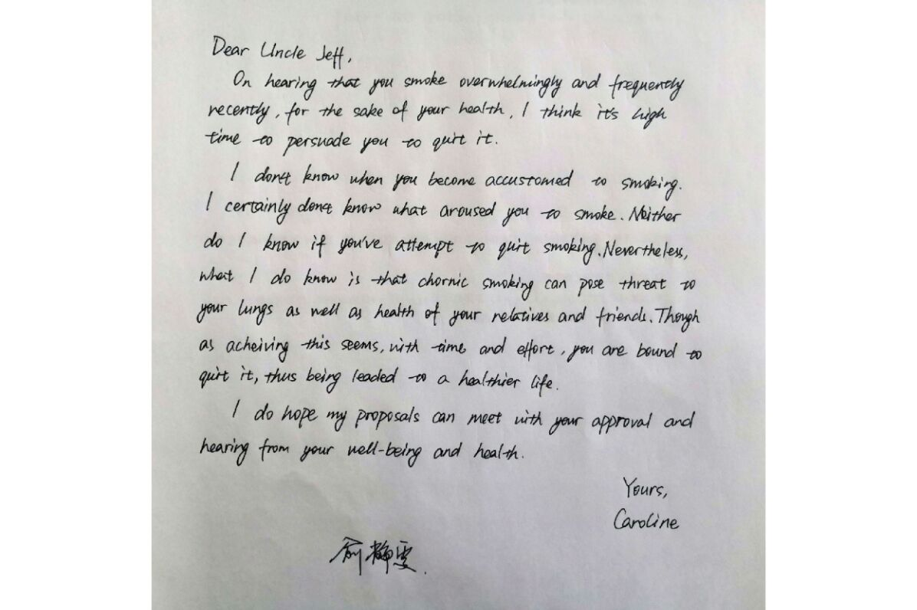
Post -writing

Slide 31
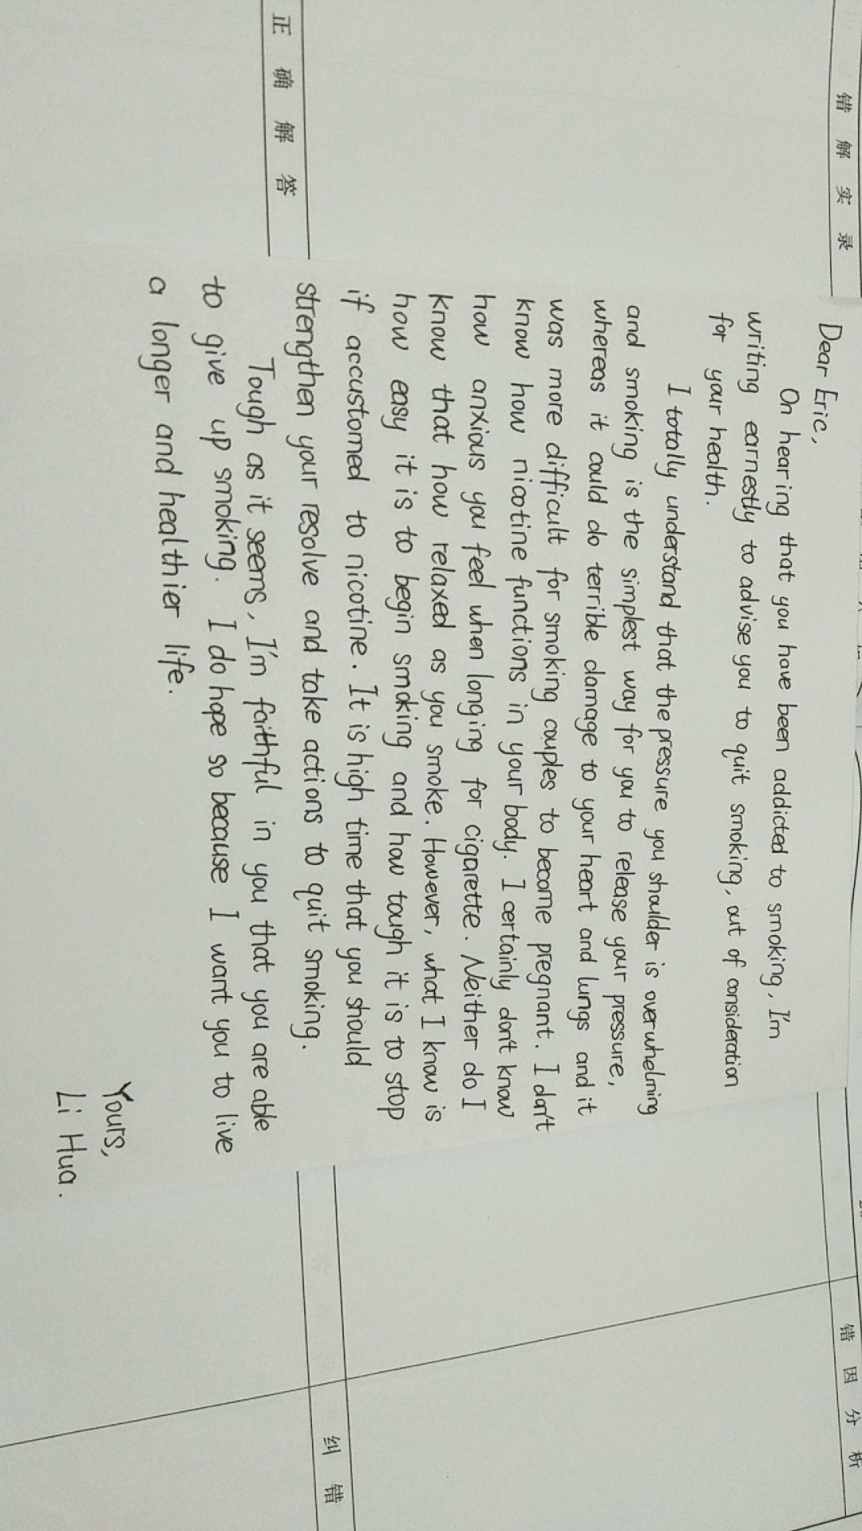
Post -writing

Slide 32
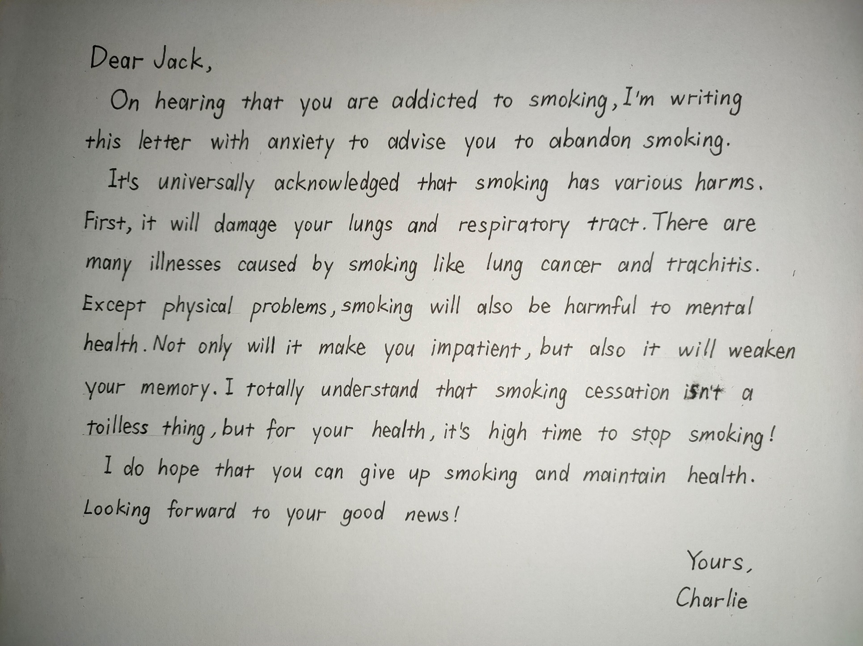
Post -writing

Slide 33
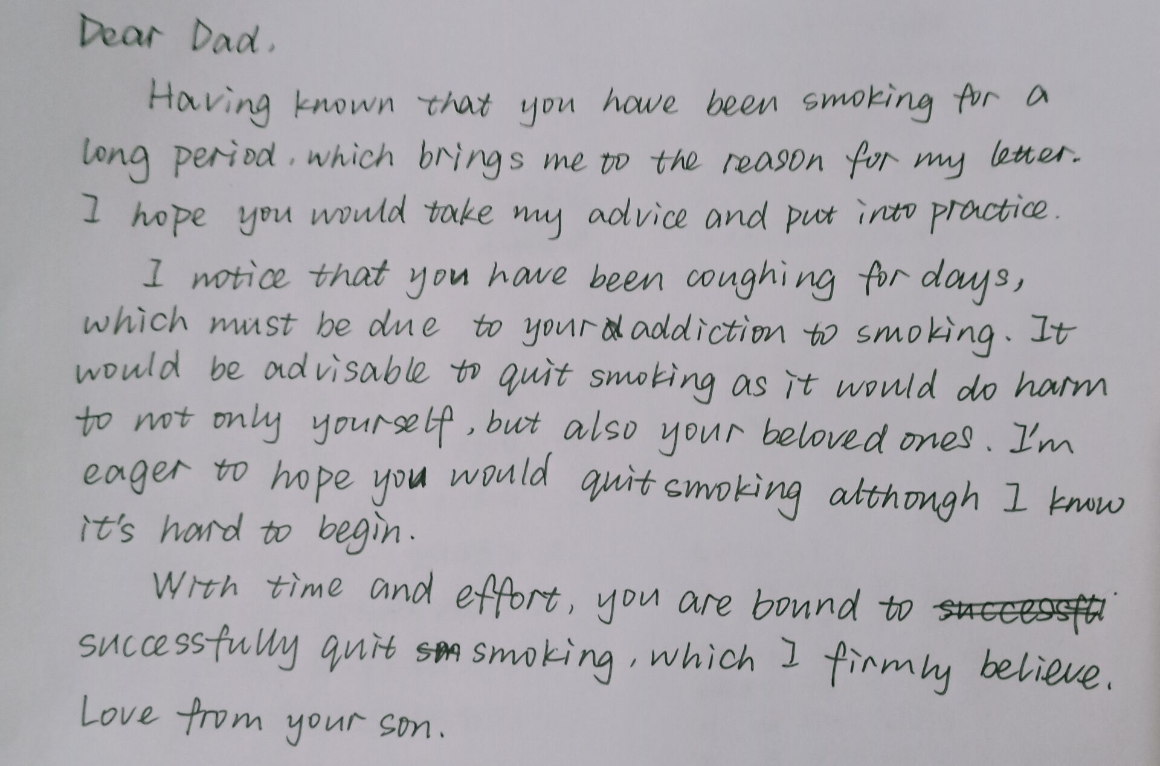
Post -writing

