Slide 1

感恩遇见，相互成就，本课件资料仅供您个人参考、教学使用，严禁自行在网络传播，违者依知识产权法追究法律责任。
更多教学资源请关注
公众号：溯恩高中英语
知识产权声明

Slide 2
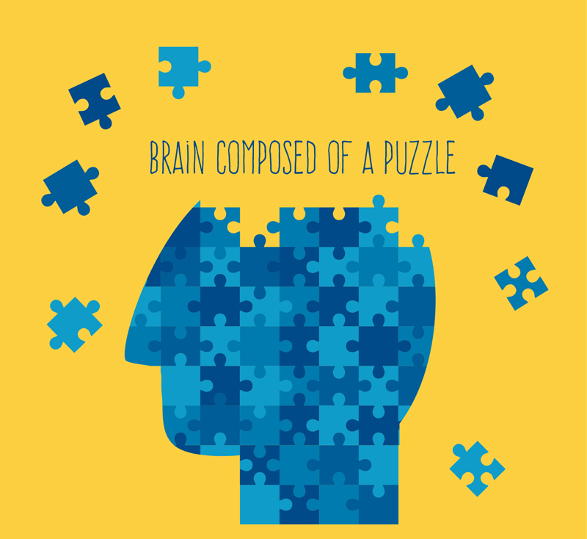
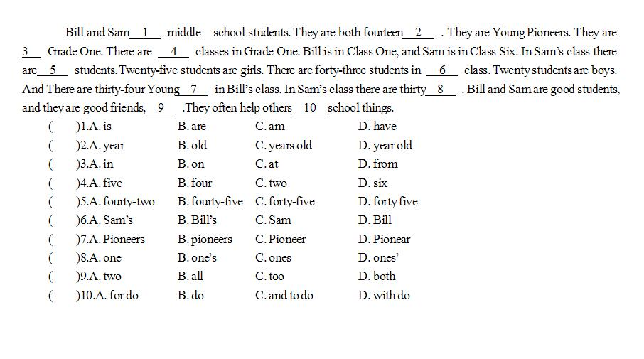

a cloze test

Slide 3

Pre-reading
basic steps
Step 1: main idea
Step 2: matching
Step 3: checking

Slide 4
The First, Second & Third Reading
After the First World War, some soldiers returned to their village. Most of them managed to live well, but one — Barton, who had been wounded and never recovered his __1__ — was unable to work regularly. In time he became penniless. Yet he was too proud to accept help from others.
Once each year the soldiers held a get-together dinner. On one of these __2__ they met in the home of Clinton, who had made __3__ money and grown self-important. Clinton showed them a large gold coin, about __4__ age and value he kept talking for long. Each man examined it with interest __5__ it passed around the long table. Later, however, when Clinton wanted to get it back, the coin was missing.
__6__ there arouse questions and denials. Finally, the village lawyer suggested everyone __7__ searched, to which all agreed — except Barton. His companions looked at him with surprise.
“You refuse, then?” asked Clinton, frowning.
Barton turned red. “Yes,” he said, “I can’t allow it.”
“Do you realize,” Clinton stepped forward, asking with displeasure, “what your refusal __8__?”
“I did not steal the gold piece, and I will not __9__ to such a search.” Barton answered firmly.
One by one, the rest of the group turned __10__ their pockets. When the coin failed to appear, __11__ was focused on Barton again.
From that day on, people turned their eyes away when they met him. He grew poorer, and when his wife died not long afterward, no one knew and cared whether __12__ was from poverty or shame.
A few years later, Clinton made some changes in his house.

Slide 5
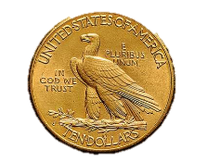
The First, Second & Third Reading
After the First World War, some soldiers returned to their village. Most of them managed to live well, but one — Barton, who had been wounded and never recovered his __1__ — was unable to work regularly. In time he became penniless. Yet he was too proud to accept help from others.
Once each year the soldiers held a get-together dinner. On one of these __2__ they met in the home of Clinton, who had made __3__ money and grown self-important. Clinton showed them a large gold coin, about __4__ age and value he kept talking for long. Each man examined it with interest __5__ it passed around the long table. Later, however, when Clinton wanted to get it back, the coin was missing.
1. | strength | B. courage | C. hope | D. confidence
the quality of being physically strong

Slide 6
The First, Second & Third Reading
After the First World War, some soldiers returned to their village. Most of them managed to live well, but one — Barton, who had been wounded and never recovered his __1__ — was unable to work regularly. In time he became penniless. Yet he was too proud to accept help from others.
Once each year the soldiers held a get-together dinner. On one of these __2__ they met in the home of Clinton, who had made __3__ money and grown self-important. Clinton showed them a large gold coin, about __4__ age and value he kept talking for long. Each man examined it with interest __5__ it passed around the long table. Later, however, when Clinton wanted to get it back, the coin was missing.
1. | strength | B. courage | C. hope | D. confidence
the quality of being physically strong

Slide 7
The First, Second & Third Reading
After the First World War, some soldiers returned to their village. Most of them managed to live well, but one — Barton, who had been wounded and never recovered his __1__ — was unable to work regularly. In time he became penniless. Yet he was too proud to accept help from others.
Once each year the soldiers held a get-together dinner. On one of these __2__ they met in the home of Clinton, who had made __3__ money and grown self-important. Clinton showed them a large gold coin, about __4__ age and value he kept talking for long. Each man examined it with interest __5__ it passed around the long table. Later, however, when Clinton wanted to get it back, the coin was missing.
strength
2. | collections | B. occasions | C. situations | D. communication
a special event, ceremony or celebration

Slide 8
The First, Second & Third Reading
After the First World War, some soldiers returned to their village. Most of them managed to live well, but one — Barton, who had been wounded and never recovered his __1__ — was unable to work regularly. In time he became penniless. Yet he was too proud to accept help from others.
Once each year the soldiers held a get-together dinner. On one of these __2__ they met in the home of Clinton, who had made __3__ money and grown self-important. Clinton showed them a large gold coin, about __4__ age and value he kept talking for long. Each man examined it with interest __5__ it passed around the long table. Later, however, when Clinton wanted to get it back, the coin was missing.
strength
2. | collections | B. occasions | C. situations | D. communication
a special event, ceremony or celebration

Slide 9
The First, Second & Third Reading
After the First World War, some soldiers returned to their village. Most of them managed to live well, but one — Barton, who had been wounded and never recovered his __1__ — was unable to work regularly. In time he became penniless. Yet he was too proud to accept help from others.
Once each year the soldiers held a get-together dinner. On one of these __2__ they met in the home of Clinton, who had made __3__ money and grown self-important. Clinton showed them a large gold coin, about __4__ age and value he kept talking for long. Each man examined it with interest __5__ it passed around the long table. Later, however, when Clinton wanted to get it back, the coin was missing.
strength
2. | collections | B. occasions | C. situations | D. communication
a special event, ceremony or celebration

Slide 10
The First, Second & Third Reading
In a couple of years I hope to go live with them there.
After the First World War, some soldiers returned to their village. Most of them managed to live well, but one — Barton, who had been wounded and never recovered his __1__ — was unable to work regularly. In time he became penniless. Yet he was too proud to accept help from others.
Once each year the soldiers held a get-together dinner. On one of these __2__ they met in the home of Clinton, who had made __3__ money and grown self-important. Clinton showed them a large gold coin, about __4__ age and value he kept talking for long. Each man examined it with interest __5__ it passed around the long table. Later, however, when Clinton wanted to get it back, the coin was missing.
strength
occasions
3. | A. a great many | B. a couple of | C. a great deal of | D. a great number of
e.g.
I have met a great many people in my life.
e.g.
In a couple of years, I hope to make it.
e.g.
He gave me a great deal of information.
e.g.
There are a great number of options.

Slide 11
The First, Second & Third Reading
In a couple of years I hope to go live with them there.
After the First World War, some soldiers returned to their village. Most of them managed to live well, but one — Barton, who had been wounded and never recovered his __1__ — was unable to work regularly. In time he became penniless. Yet he was too proud to accept help from others.
Once each year the soldiers held a get-together dinner. On one of these __2__ they met in the home of Clinton, who had made __3__ money and grown self-important. Clinton showed them a large gold coin, about __4__ age and value he kept talking for long. Each man examined it with interest __5__ it passed around the long table. Later, however, when Clinton wanted to get it back, the coin was missing.
strength
occasions
3. | A. a great many | B. a couple of | C. a great deal of | D. a great number of
e.g.
I have met a great many people in my life.
e.g.
In a couple of years, I hope to make it.
e.g.
He gave me a great deal of information.
e.g.
There are a great number of options.

Slide 12
The First, Second & Third Reading
In a couple of years I hope to go live with them there.
After the First World War, some soldiers returned to their village. Most of them managed to live well, but one — Barton, who had been wounded and never recovered his __1__ — was unable to work regularly. In time he became penniless. Yet he was too proud to accept help from others.
Once each year the soldiers held a get-together dinner. On one of these __2__ they met in the home of Clinton, who had made __3__ money and grown self-important. Clinton showed them a large gold coin, about __4__ age and value he kept talking for long. Each man examined it with interest __5__ it passed around the long table. Later, however, when Clinton wanted to get it back, the coin was missing.
strength
occasions
a great deal of
4. | A. what | B. which | C. whose | D. how
5. | A. as | B. and | C. but | D. because

Slide 13
The First, Second & Third Reading
In a couple of years I hope to go live with them there.
After the First World War, some soldiers returned to their village. Most of them managed to live well, but one — Barton, who had been wounded and never recovered his __1__ — was unable to work regularly. In time he became penniless. Yet he was too proud to accept help from others.
Once each year the soldiers held a get-together dinner. On one of these __2__ they met in the home of Clinton, who had made __3__ money and grown self-important. Clinton showed them a large gold coin, about __4__ age and value he kept talking for long. Each man examined it with interest __5__ it passed around the long table. Later, however, when Clinton wanted to get it back, the coin was missing.
strength
occasions
a great deal of
4. | A. what | B. which | C. whose | D. how
5. | A. as | B. and | C. but | D. because

Slide 14
The First, Second & Third Reading
In a couple of years I hope to go live with them there.
After the First World War, some soldiers returned to their village. Most of them managed to live well, but one — Barton, who had been wounded and never recovered his __1__ — was unable to work regularly. In time he became penniless. Yet he was too proud to accept help from others.
Once each year the soldiers held a get-together dinner. On one of these __2__ they met in the home of Clinton, who had made __3__ money and grown self-important. Clinton showed them a large gold coin, about __4__ age and value he kept talking for long. Each man examined it with interest __5__ it passed around the long table. Later, however, when Clinton wanted to get it back, the coin was missing.
strength
occasions
a great deal of
whose
4. | A. what | B. which | C. whose | D. how
5. | A. as | B. and | C. but | D. because

Slide 15
The First, Second & Third Reading
In a couple of years I hope to go live with them there.
After the First World War, some soldiers returned to their village. Most of them managed to live well, but one — Barton, who had been wounded and never recovered his __1__ — was unable to work regularly. In time he became penniless. Yet he was too proud to accept help from others.
Once each year the soldiers held a get-together dinner. On one of these __2__ they met in the home of Clinton, who had made __3__ money and grown self-important. Clinton showed them a large gold coin, about __4__ age and value he kept talking for long. Each man examined it with interest __5__ it passed around the long table. Later, however, when Clinton wanted to get it back, the coin was missing.
strength
occasions
a great deal of
whose
as
4. | A. what | B. which | C. whose | D. how
5. | A. as | B. and | C. but | D. because
while sth else is happening

Slide 16
The First, Second & Third Reading
__6__ there arouse questions and denials. Finally the village lawyer suggested everyone __7__ searched, to which all agreed — except Barton. His companions looked at him with surprise.
“You refuse, then?” asked Clinton, frowning.
Barton turned red. “Yes,” he said, “I can’t allow it.”
“Do you realize,” Clinton stepped forward, asking with displeasure, “what your refusal __8__?”
“I did not steal the gold piece, and I will not __9__ to such a search.” Barton answered firmly.
6. | A. Fortunately | B. Instantly | C. Gradually | D. Unexpectedly
Immediately

Slide 17
The First, Second & Third Reading
__6__ there arouse questions and denials. Finally the village lawyer suggested everyone __7__ searched, to which all agreed — except Barton. His companions looked at him with surprise.
“You refuse, then?” asked Clinton, frowning.
Barton turned red. “Yes,” he said, “I can’t allow it.”
“Do you realize,” Clinton stepped forward, asking with displeasure, “what your refusal __8__?”
“I did not steal the gold piece, and I will not __9__ to such a search.” Barton answered firmly.
6. | A. Fortunately | B. Instantly | C. Gradually | D. Unexpectedly
Immediately

Slide 18
The First, Second & Third Reading
Instantly
__6__ there arouse questions and denials. Finally the village lawyer suggested everyone __7__ searched, to which all agreed — except Barton. His companions looked at him with surprise.
“You refuse, then?” asked Clinton, frowning.
Barton turned red. “Yes,” he said, “I can’t allow it.”
“Do you realize,” Clinton stepped forward, asking with displeasure, “what your refusal __8__?”
“I did not steal the gold piece, and I will not __9__ to such a search.” Barton answered firmly.
7. | A. was | B. would be | C. to be | D. be

Slide 19
The First, Second & Third Reading
Instantly
__6__ there arouse questions and denials. Finally the village lawyer suggested everyone __7__ searched, to which all agreed — except Barton. His companions looked at him with surprise.
“You refuse, then?” asked Clinton, frowning.
Barton turned red. “Yes,” he said, “I can’t allow it.”
“Do you realize,” Clinton stepped forward, asking with displeasure, “what your refusal __8__?”
“I did not steal the gold piece, and I will not __9__ to such a search.” Barton answered firmly.
be
7. | A. was | B. would be | C. to be | D. be
subjunctive mood
May I suggest(that) we (should) go there by train?

Slide 20
The First, Second & Third Reading
Instantly
__6__ there arouse questions and denials. Finally the village lawyer suggested everyone __7__ searched, to which all agreed — except Barton. His companions looked at him with surprise.
“You refuse, then?” asked Clinton, frowning.
Barton turned red. “Yes,” he said, “I can’t allow it.”
“Do you realize,” Clinton stepped forward, asking with displeasure, “what your refusal __8__?”
“I did not steal the gold piece, and I will not __9__ to such a search.” Barton answered firmly.
be
8. | A. informs | B. implies | C. inspires | D. improves
to suggest that sth is true without saying so directly

Slide 21
The First, Second & Third Reading
Instantly
__6__ there arouse questions and denials. Finally the village lawyer suggested everyone __7__ searched, to which all agreed — except Barton. His companions looked at him with surprise.
“You refuse, then?” asked Clinton, frowning.
Barton turned red. “Yes,” he said, “I can’t allow it.”
“Do you realize,” Clinton stepped forward, asking with displeasure, “what your refusal __8__?”
“I did not steal the gold piece, and I will not __9__ to such a search.” Barton answered firmly.
be
implies
9. | A. get | B. turn | C. accept | D. submit
give in to sb/sth

Slide 22
The First, Second & Third Reading
One by one, the rest of the group turned __10__ their pockets. When the coin failed to appear, __11__ was focused on Barton again.
From that day on, people turned their eyes away when they met him. He grew poorer, and when his wife died not long afterward, no one knew and cared whether __12__ was from poverty or shame.
A few years later, Clinton made some changes in his house.
10. | A. out | B. in | C. on | D. up
turn inside out
hand in
to cause sth to operate
show up

Slide 23
The First, Second & Third Reading
out
One by one, the rest of the group turned __10__ their pockets. When the coin failed to appear, __11__ was focused on Barton again.
From that day on, people turned their eyes away when they met him. He grew poorer, and when his wife died not long afterward, no one knew and cared whether __12__ was from poverty or shame.
A few years later, Clinton made some changes in his house.
11. | A. conclusion | B. attention | C. decision | D. impression

Slide 24
The First, Second & Third Reading
out
One by one, the rest of the group turned __10__ their pockets. When the coin failed to appear, __11__ was focused on Barton again.
From that day on, people turned their eyes away when they met him. He grew poorer, and when his wife died not long afterward, no one knew and cared whether __12__ was from poverty or shame.
A few years later, Clinton made some changes in his house.
attention
12. | A. he | B. she | C. it | D. they

Slide 25
The First, Second & Third Reading
out
One by one, the rest of the group turned __10__ their pockets. When the coin failed to appear, __11__ was focused on Barton again.
From that day on, people turned their eyes away when they met him. He grew poorer, and when his wife died not long afterward, no one knew and cared whether __12__ was from poverty or shame.
A few years later, Clinton made some changes in his house.
attention
12. | A. he | B. she | C. it | D. they

Slide 26
The fourth Reading
Read for the contents
What’s the genre of the passage?
Who are the main characters in the story?
When and where did the story happen?
What happened?
How did they try to find the gold coin?
Why was Barton suspected of stealing the gold coin?

Slide 27
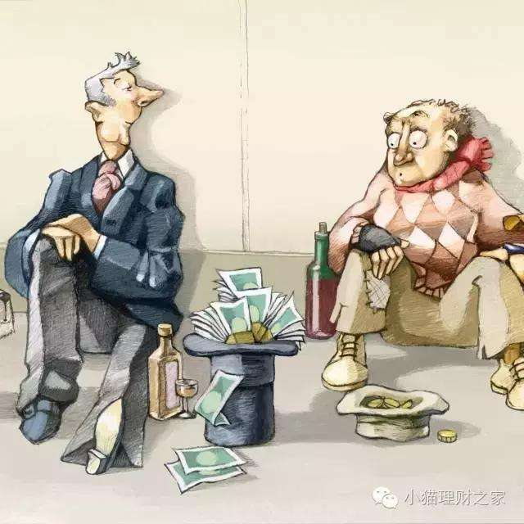
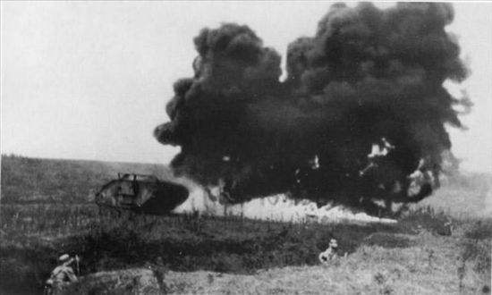
The fourth Reading
Read for the contents
What’s the genre of the passage?
narration story
Who are the main characters in the story?
Clinton & Barton
When did the story happen?
After the first world war
Where did the story happen?
in the home of Clinton

Slide 28
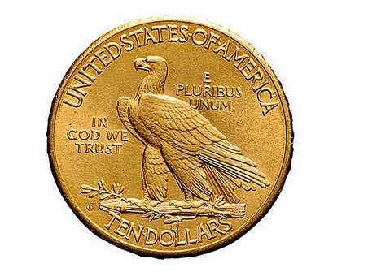
The fourth Reading
Read for the contents
What happened?
Clinton showed other soldiers a large gold coin but it was gone when he wanted to get it back.
How did they try to find the gold coin?
Search the persons on the scene
Why was Barton suspected of stealing the gold coin?
He refused to be searched and he was very poor.

Slide 29
The fourth Reading
Read for the plot
Plot is known as the foundation of a novel or story which the characters and settings are built around.
This is the turning point of the story and is meant to be the moment of highest interest and emotion.
Events and complications begin to resolve and the result of actions of the main characters are put forward.
a series of events build up to the conflict
Climax
plot
Rising Action
Falling Action
Beginning
Ending
characters and setting are established. The conflict or main problem is introduced as well.
It is the end of a story and ends with either a happy or a tragic ending.

Slide 30
The fourth Reading
Read for the plot
Plot is known as the foundation of a novel or story which the characters and settings are built around.
This is the turning point of the story and is meant to be the moment of highest interest and emotion.
Barton was accused of stealing the gold coin, but he denied.
Events and complications begin to resolve and the result of actions of the main characters are put forward.
a series of events build up to the conflict
Climax
A few years later, Clinton made some changes in his house. …
Everyone agreed to be searched except Barton.
plot
Rising Action
Falling Action
Clinton showed other soldiers a large gold coin but it was gone when he wanted to get it back.
?
Beginning
Ending
characters and setting are established. The conflict or main problem is introduced as well.
It is the end of a story and ends with either a happy or a tragic ending.

Slide 31
The Fifth Reading
Read for the language
His companions looked at him with surprise.
“Do you realize,” Clinton stepped forward, asking with displeasure, “what your refusal implies?”
Use “with + n.” to express certain emotion

Slide 32
The Fifth Reading
Read for the language
His companions looked at him with surprise.
“Do you realize,” Clinton stepped forward, asking with displeasure, “what your refusal implies?”
Use “with + n.” to express certain emotion
“Do you realize,” Clinton stepped forward, asking with displeasure, “what your refusal implies?”
“You refuse, then?” asked Clinton, frowning.
Use “V-ing” to describe accompanying actions

Slide 33
The Fifth Reading
Read for the language
His companions looked at him with surprise.
“Do you realize,” Clinton stepped forward, asking with displeasure, “what your refusal implies?”
Use “with + n.” to express certain emotion
“Do you realize,” Clinton stepped forward, asking with displeasure, “what your refusal implies?”
“You refuse, then?” asked Clinton, frowning.
Use “V-ing” to describe accompanying actions
“I did not steal the gold piece, and I will not submit to such a search.” Barton answered firmly.
Use adverbs to express states of mind and mood

Slide 34

Pre-writing
Discussion
Discuss and predict what happened next.
A few years later, Clinton made some changes in his house. …
① What did Clinton find?
② …

Slide 35
Writing
Complete the story
A few years later, Clinton made some changes in his house. …
complete the story with around 80 words
How did Clinton react to the truth? (doing, saying, thinking, feeling)
How did Barton react to Clinton’s apology? (doing, saying, thinking, feeling)
What’s the ending of the story? (theme)
Use “with + n.” to express certain emotion
Use “V-ing” to describe accompanying actions
Use adverbs to express states of mind and mood

Slide 36
Post-writing
Read for the theme
What kind of person was Barton?
proud poor incapable
a realistic figure
self-respecting honest
dignity and honesty

Slide 37
Homework
Read one possible version and revise your writing.

Slide 38
Post-writing
A few years later, Clinton made some changes in his house
He found the gold coin, buried in dirt between pieces of the wood floor in the room where the reunion dinner had been held. Clinton immediately realized that Barton was innocent. Hurrying to Barton’s home, he told him of the amazing discovery of the coin and apologized to him sincerely. “But,” he concluded with confusion, “why did you not allow yourself to be searched then?” Barton looked at Clinton blankly. “For weeks my family and I hadn’t had enough to eat —my pockets were full of leftovers that I had taken from the table to carry home to my wife and children”. In the toughest and darkest time, dignity and honesty might be the only possession for those little people.

