Slide 1

感恩遇见，相互成就，本课件资料仅供您个人参考、教学使用，严禁自行在网络传播，违者依知识产权法追究法律责任。
更多教学资源请关注
公众号：溯恩高中英语
知识产权声明

Slide 2
Continuation writing
Description is a picture of words !
Ma Lijia (Doreen)
Notes:
本PPT模板部分元素使用了幻灯片母版制作。如果需要修改，点击-视图-幻灯片母版-修改；完成后关闭编辑母版即可。

Slide 3
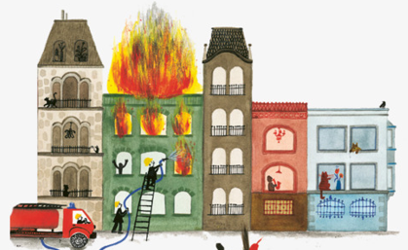
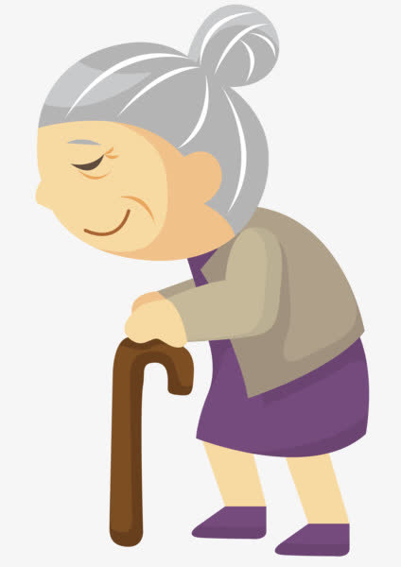
Free talk
Q1: If a fire broke out in your flat, what would you do?
Q2: Would you risk your life to take something
precious with you?

Slide 4
Read for information
when
where
why
A story
who
how
what

Slide 5


elder sister
Jane
Tom
neighbor
neighbor
Makcik

Slide 6
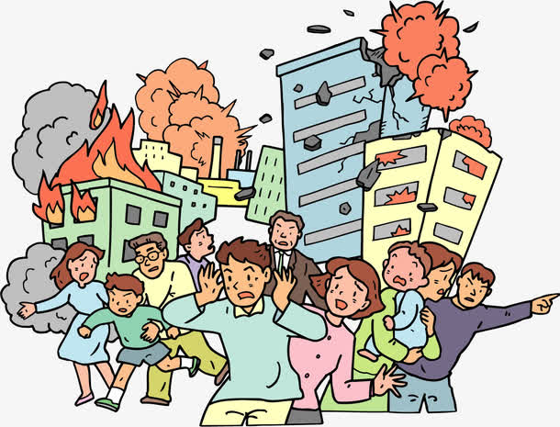

Read for plots
atmosphere
words
“Quick! Quick! ....” someone yelled.
People were running and crying.
Then a thick burning smell filled the air.
When ..., a thick cloud of ... greeted him.
actions
surroundings
a figure of speech 修辞
personification拟人

Slide 7

rushed out
headed towards
A /An________ girl
heroic
Theme(主题)?
stopped
turned around
actions
actions
had no idea
but followed
Help & love
between people
interactions
(互动)
headed back
mental state
words
actions
feared
“...”Tom cried.
began banging
but no answer
actions
refused to
pounded against
contrast
Tom's imagery
timid
nervous,
Jane's imagery
（意象）
heroic
brave,
selfless,
timid (胆小的),
determined,
heroic ...
selfish...

Slide 8
Plot deduction(推理)
Para.1:Tom noticed the flame was reaching up.
Para.2:Luckily, some neighbors passing by stopped and offered help.
trouble
Main idea: Tom and Jane pounded against the door but in vain.
solution
Main idea: With the help of their neighbors,
they managed to save the old lady.
Theme:
Help & love between people

Slide 9
Para.1: Tom noticed the flame was reaching up.
Jane and Tom pounded against the door but in vain.
timid Tom
asked Jane to leave
frightened
terrified
begged, “...”
shook head
kept pounding
was overcome by her resolve
insisted, “...”
heroic Jane
surroundings
atmosphere
character's reaction

Slide 10
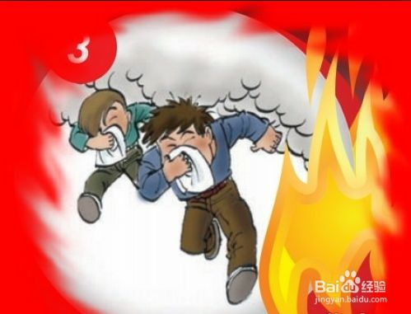
atmosphere
I.Surroundings
The dark, rainy evening, the wind, the thundering clouds held me entirely in their power. — Book1 “Anne’s Best Friend”
1. __________________,_________,___________________ held Jane and Tom entirely in their power.
The big, terrifying fire
the smoke
the running people
There was no stopping the fires. There was no way to organize or communicate. — Book1 “The Story of An Eyewitness”
2. There was no stopping the fires. There was no way to ______the door or _________the old lady.
open
awaken
Learn more,recite more, use more!

Slide 11
II.Character's reaction
They were coughing.
physical reaction
They were choked to death.
They were sweating at every pore (毛孔).
Their eyes were stinging (刺痛) .
mental reaction
1. Frozen with fear, he stood rooted to the spot.
2. A burst of horror held him totally in its power, and he was unable to move an inch.
3. He felt that the blood in his body froze rapidly because of the terrible sight.
4. Time seemed to stand still.

Slide 12
Para.1: Tom noticed the flame was reaching up.
Jane and Tom pounded against the door but in vain.
timid Tom
asked Jane to leave
frightened
terrified
begged, “...”
shook head
kept pounding
was overcome by her resolve
insisted, “...”
heroic Jane
1. surroundings
...held sb. entirely in their power.
There was no ... There was no ...
atmosphere
2. character's reaction (physical and mental)
were coughing/ sweating at every pore...
Time seemed to stand still.
Frozen with fear, he stood rooted to the spot.
Notes:
Para1做的这个分析挺好的，para2也可以做类似的分析，比如neighbors和Jane and Tom的动作行为，心理等

Slide 13
Peer assessment
Items | Levels
Coherence
Content
Language
Handwriting
Suggestions & Comments :
☆ ☆ ☆ ☆ ☆
☆ ☆ ☆ ☆ ☆
☆ ☆ ☆ ☆ ☆
☆ ☆ ☆ ☆ ☆

Slide 14
Homework
Description is a picture of words !
1. Polish your writing with your partners.
2. Use what we have learned in this class to continue the rest part of the story.

Slide 15
One possible version
story effect
Tom noticed the flame was reaching up.There was no stopping the fires. There was no way to open the door or awaken the old lady. Choked by the thick smoke,both of them were coughing and were sweating at every pore. Frozen with fear, Tom stood rooted to the spot. He held Jane’s hand tightly and begged Jane to run for safety as quickly as possible. Jane tried to shield her nose from the choking smoke and shook her head. She kept pounding against the door while Tom burst out crying.
interactions

Slide 16
Luckily, some neighbors passing by stopped and offered help. At the sight of the neighbors offering help, a sense of strength immediately replaced the mounting fear and anxiety in Jane’s mind. She told them Makcik, an old lady, must be still in the room. Hearing the words, they forced the door open with all their might. Sure enough, Makcik was lying in bed, unconscious. Without delay, she was carried downstairs and then rushed to the hospital, where she finally came to herself. People in the neighborhood felt relieved and Jane and Tom’s joy was especially immense.
Notes:
Jane 拼错了。这个possible version语言还不错，但是连贯性不太好。

Slide 17

Thanks!
Notes:
本PPT模板部分元素使用了幻灯片母版制作。如果需要修改，点击-视图-幻灯片母版-修改；完成后关闭编辑母版即可。

