Slide 1


感恩遇见，相互成就，本课件资料仅供您个人参考、教学使用，严禁自行在网络传播，违者依知识产权法追究法律责任。
更多教学资源请关注
公众号：溯恩高中英语
知识产权声明

Slide 2
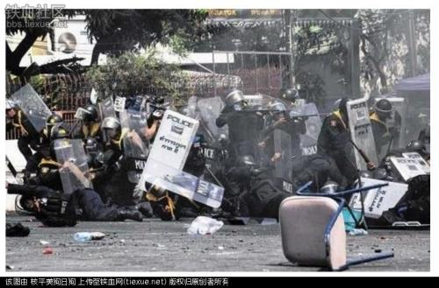
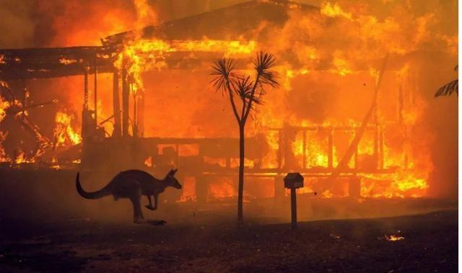
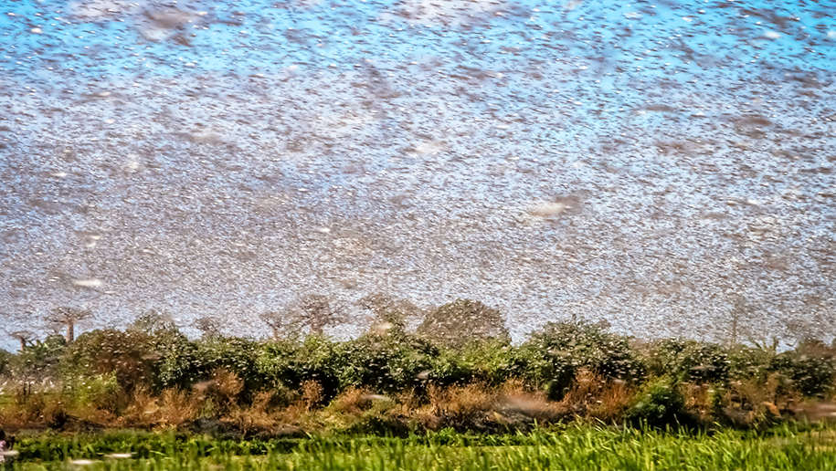
What has happened at the beginning of 2020?

Slide 3
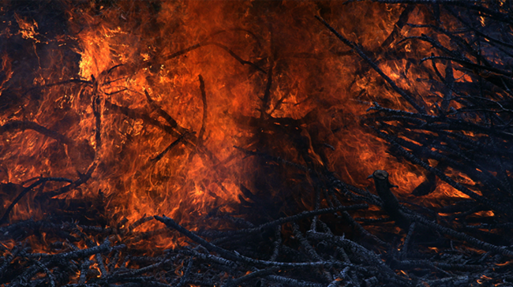
Australians urged to "leave early" in face of new bushfire threat
Authorities confirmed that a ____________(four) firefighter had died while ___________(battle) the blazes, bringing the overall ________(die) toll to 26 people. More than 2,000 homes have ________________(destroy) since the crisis began in September and some eight million hectares has been burned , _________ area the size of Ireland of South Carolina. University of Sydney scientists estimated one billion ____________(animal) have been killed in the fires. The figure includes mammals, birds _________ reptiles, but not frogs, insects or invertebrates(无脊椎动物).
fourth
battling
death
been destroyed
an
animals
and

Slide 4
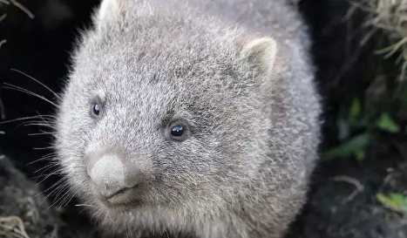
The hero in the Australian bushfires：wombats(袋熊)
Quite generously, wombats have ___________________(report) been allowing other animals to take refuge in their homes, as they hide from the blazes that ______________(threat) their own habitats. Complex underground tunnels, ___________(create) by wombats, have served _________ safehouses for other species like wallabies and echidnas, allowing them ______________(survive) an otherwise fatal situation.
reportedly
threaten
created
as
to survive

Slide 5
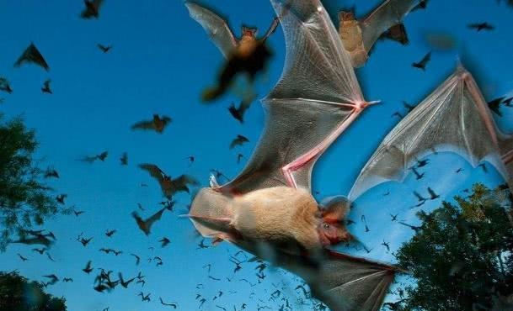
But unfortunately, many annimals lost their habitats, including the bats.
Bats can be a little scary-looking, but the diverse flying mammals are broadly beneficial to the ecosystems where they — and we — live. 1__________________
Bats account for about 20% of all mammal species.
With more than 1,200 species included in the order Chiroptera, bats represent one of the largest orders of mammals. They are surpassed only by the order Rodentia, which boasts a whopping 2,277 species — 40% of all mammalian species.
2____________________
As with birds, flight has allowed bats to travel and settle in all corners of the Earth, with the exception of the Arctic and Antarctic. Bats generally roost in caves, crevices, foliage and man-made structures like attics or under bridges.
Microbats use echolocation to hunt prey.
Although microbats are not blind, their true perceptive strength lies in their ability to use echolocation, also known as biosonar.
Bats 'waggle' their heads to hear better.
You know how a dog cocks its head as if to better understand what a human is saying? 3.____________Their motion is similar to what dogs, cats and even humans do, but bats do it for a different reason: to fine tune the location of prey as they're echolocating.
C
A
B

Slide 6
Fears More Than 2000 Koalas Killed In Devastating Nsw Bushfires
Female bats can control when they get pregnant and give birth.
To ensure that external conditions are optimal for a newborn bat, mother bats are equipped with a variety of biological tactics that allow them to put off fertilization, implantation or development of the fetus.
4_______________ But females will store sperm in their reproductive tract before finally fertilizing their eggs when spring arrives. In other species, the egg is fertilized immediately after mating, but instead of implanting to the wall of the uterus, it floats around until favorable conditions arrive.
Bats hang upside-down to conserve energy.
If humans hung upside-down from a tree for several hours, it wouldn't take long before they passed out. So how do bats manage it? 5___________ Because our blood pumps in the direction of our brain, the stress of gravity transfers even more blood to the head when upside-down. A bat's circulatory systems pumps the opposite way — away from its head.
A. Bats are found across the planet.
B. Well, bats do the same thing, only they do it while flying.
C. Below are 6 facts about these under appreciated creatures.
D. In some species, mating will occur in the fall.
E. Another type of bat, the common big-eared bat, makes use of a natural tool to catch difficult prey.
F.For starters, human and bat circulatory systems are fundamentally different.
G. All these adaptations ensure blood is evenly distributed throughout the bat’s body!
D
F

Slide 7
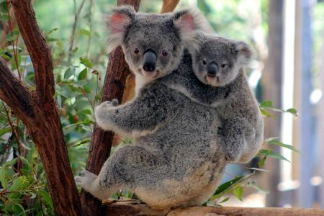
What’s worse, more than 2000 Koalas killed in Devastating NSW bushfires.
An inquiry into koala populations and habitat in NSW 1__________(expect) to hear evidence that more than 2000 of the 2___________(nation) Australian marsupials may 3_________(die) on the state's north coast in recent bushfires. The state parliament's upper house inquiry will hold 4___ urgent hearing on Monday to discuss the extent of damage 5____ the koala population from bushfires. Thousands of hectares of koala habitat across northern NSW and southeast Queensland have been destroyed in the recent bushfires. Koalas 6__________(list) as vulnerable in Queensland, NSW and the ACT, 7________(large) as a result of habitat clearing.
is expceted
native
have died
an
to
are listed
largely

Slide 8
What’s worse, more than 2000 Koalas killed in Devastating NSW bushfires.
On Sunday evening, the Rural Fire Service said there were 91 bush and grass 8____________(fire) in NSW, 48 of 9__________ were not contained. North East Forest Alliance president and ecologist Dailan Pugh is expected to give evidence on Monday that more than 2000 koalas may have died 10________ up to one third of koala habitat on the state's north coast may have been lost in the fires.
fires
which
and

Slide 9
East Africa is reeling from an invasion of locusts
“Let my people go, so that they may worship me. If you refuse 1______(let) them go, I will bring locusts into your country tomorrow.” So said God, rather vengefully, according to Mose and Aaron. But 2_______________ the locust infestation(大量滋生) wreaking havoc on east Africa is of biblical proportions, it is not a portent of end times, said experts at press conference in Nairobi this month. Still, the finer-length bugs spell big trouble for the countries most 3__________(affect).
to let
through
afftcted

Slide 10
East Africa is reeling from an invasion of locusts
It is the 4____________(bad) invasion in decades for Kenya, Ethiopia and Somalia. One enormous swarm, 5____________(recent) over north-eastern Kenya, contains nearly 200 billion of the creatures and 6____________(occupy) a space in the sky three times 7_________ size of New York City. There are dozens 8__________ swarms in Kenya alone. 9_____________(kill) the bugs early is vital. They can 10______________(damage) with surveillance(监测) and spraying, particularly if they are doused when still young and hopping, and before the population booms.
worst
recently
occupies
the
of
Killing
be damaged

Slide 11
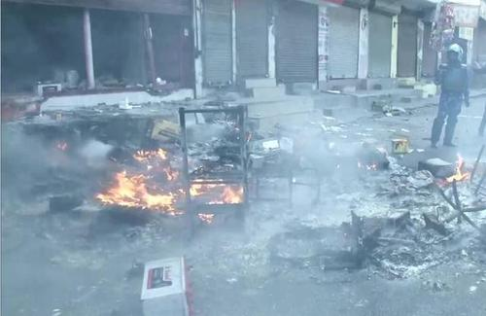
India Police Issues Shoot-At-Sight Orders As Death Toll Reaches 13 In Citizenship Law-Related Violence
Indian police on Tuesday evening issued shoot-at-sight orders in the affected areas in New Delhi, as communal 1__________(violent) over the controversial citizenship law intensifies in the capital, officials said.
"Police deployment 2_________________(make) in affected areas and order of shoot at sight have been issued to calm the tempers," a local government official said. Meanwhile, the death toll in the violence over the citizenship law has risen 3_____ 13. Over 180 people 4___________(include) policemen were injured in the violence.A ruling Bharatiya Janata Party (BJP) official also wrote on twitter 5_________ shoot at sight orders have been issued.
violence
has been made
to
including
that

Slide 12
India Police Issues Shoot-At-Sight Orders As Death Toll Reaches 13 In Citizenship Law-Related Violence
The clashes 6_______(break) out between pro- and anti-Citizenship Amendment Act (CAA) groups in the northeastern part of the city on Sunday and took 7_____ ugly turn on Monday.
Delhi Chief Minister Arvind Kejriwal in his third appeal during the day asked people to maintain peace and stop the "8_________(mad)." "Everyone has received injuries whether it is Hindus, Muslims 9___ police personnel. No one will benefit from it and this madness must 10_________(stop)," Kejriwal told reporters.
broke
an
madness
or
be stopped

Slide 13
useful expressions and sentence structures:
1. bring the overall death toll to 2. take refuge
3. be broadly beneficial to 4. account for
5. with more than 1,200 species included 6. with the exception of
7. lie in 8. as if to better understand
9. be equipped with 10. the extend of damage to
11. wreak havoc on 12. of biblical proportions
13. three times the size of 14. rise to
15. take an ugly turn 16. whether...or...
17.If humans hung upside-down from a tree for several hours, it wouldn’t take long before they passed out.

Slide 14
translate the following sentences using the expressions above.
1. 权威表明，到目前为止，已有20多医务人员死亡，这使得死亡总人数达到了1900多。
2. 因为包含了20几名医务人员，死亡总人数达到了1900多，这约占受感染人数的3.6%。
3. 尽管受新冠肺炎感染人数上升至8万多，但是由于采取的措施及时有效，疫情已经有了很大的好转。我们相信，再过不久我们就可以去上学啦。
4. 无论是老师还是学生，配备了现代化技术，都从中收益很大。
5. 一群人围着我，他跑过来似乎想看看到底发生了什么事。

Slide 15
1. 权威表明，到目前为止，已有20多医务人员死亡，这使得死亡总人数达到了1900多。
Authorities confirmed that so far more than 20 medical staff _____________, _____________________________over 2,900.
2. 因为包含了20几名医务人员，死亡总人数达到了1900多，这约占受感染人数的3.6%。
__________________________, the total number of deaths has reached 2,900, ___________________3.6% of all _____________.
bringing the overall death toll to
have died
which brings the overall death toll to
With 20 medical staff included
which accounts for
the infected

Slide 16
3. 尽管受新冠肺炎感染人数上升至8万多，但是由于采取的措施及时有效，疫情已经有了很大的好转。我们相信，再过不久我们就可以去上学啦。
Although the number of people ___________________ Covid-19 _______________ more then 80,000, the epidemic situation _______________________ thanks to immediate and effective measures. we hold the firm belief that _________________________________.
(who are) infected with
has risen to
has taken a good turn
it won't take long before we attend school

Slide 17
4. 无论是老师还是学生，配备了现代化技术，都从中收益很大。
a._____________ modern technoligies, _____________________ the students ____________________.
b. Equipped with modern technoligies, it ___________________
____________________________.
5. 许多人围着我，他跑过来似乎想看看到底发生了什么事。
___________________________, he came _____________ _____________________ what had happened.
Equipped with
whether the teachers or
have benefit a lot from it
is boradly beneficial to
is of great benefit to
whether the teachers or the students
With crowds of people surrounding me
running
as if to see

