Slide 1

感恩遇见，相互成就，本课件资料仅供您个人参考、教学使用，严禁自行在网络传播，违者依知识产权法追究法律责任。
更多教学资源请关注
公众号：溯恩高中英语
知识产权声明

Slide 2


B3U1 A Sad Love Story
Moon Lai
March 11, 2020

Slide 3
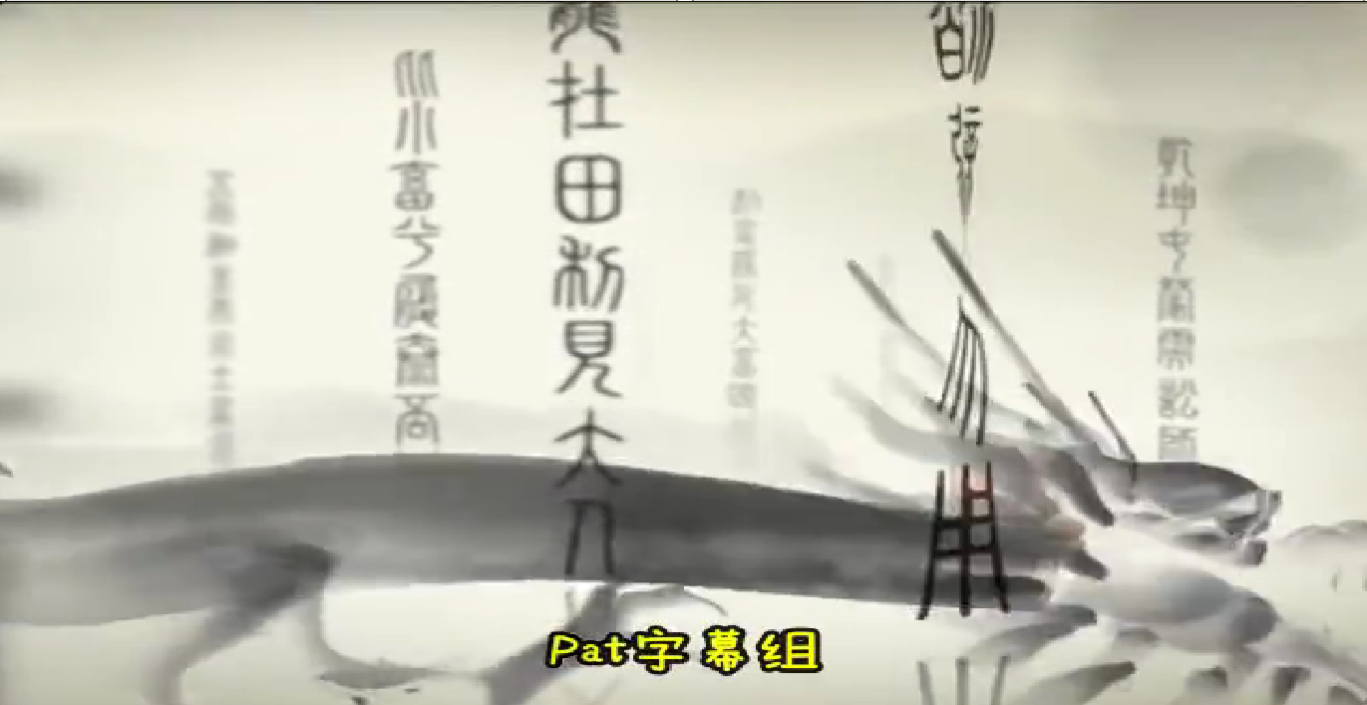

Slide 4
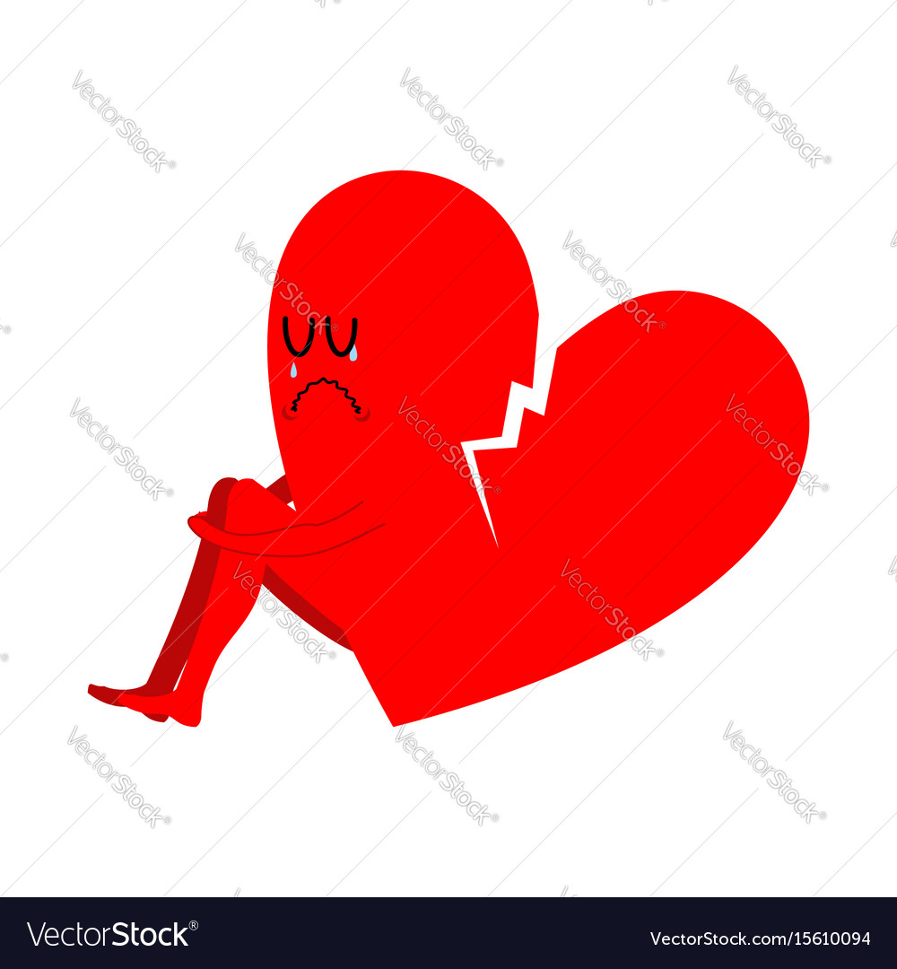

Slide 5
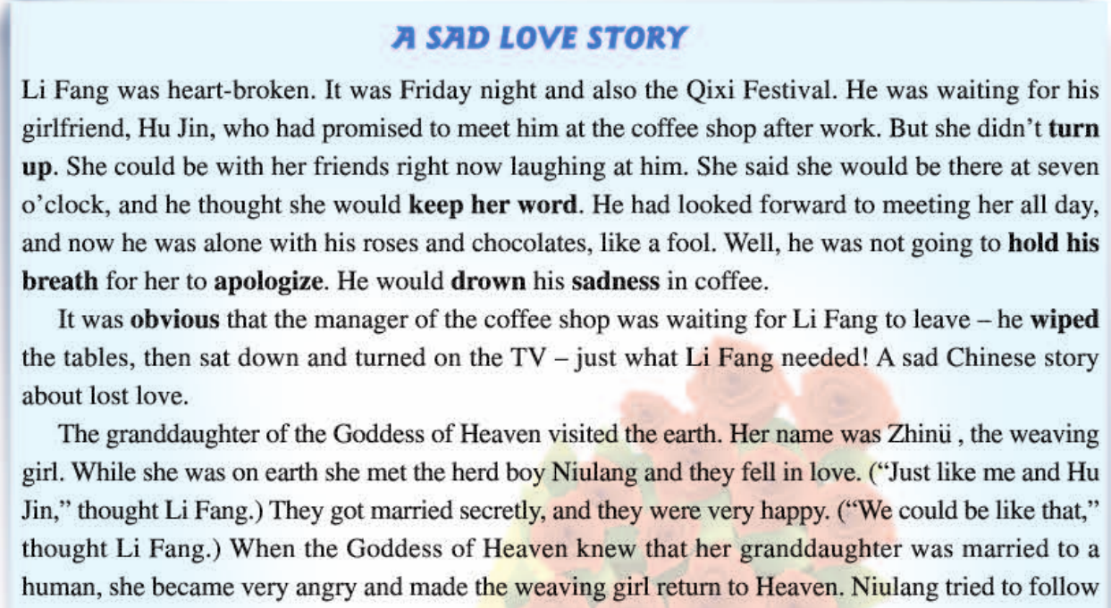
Q1: Why sad? Not romantic instead?

Slide 6
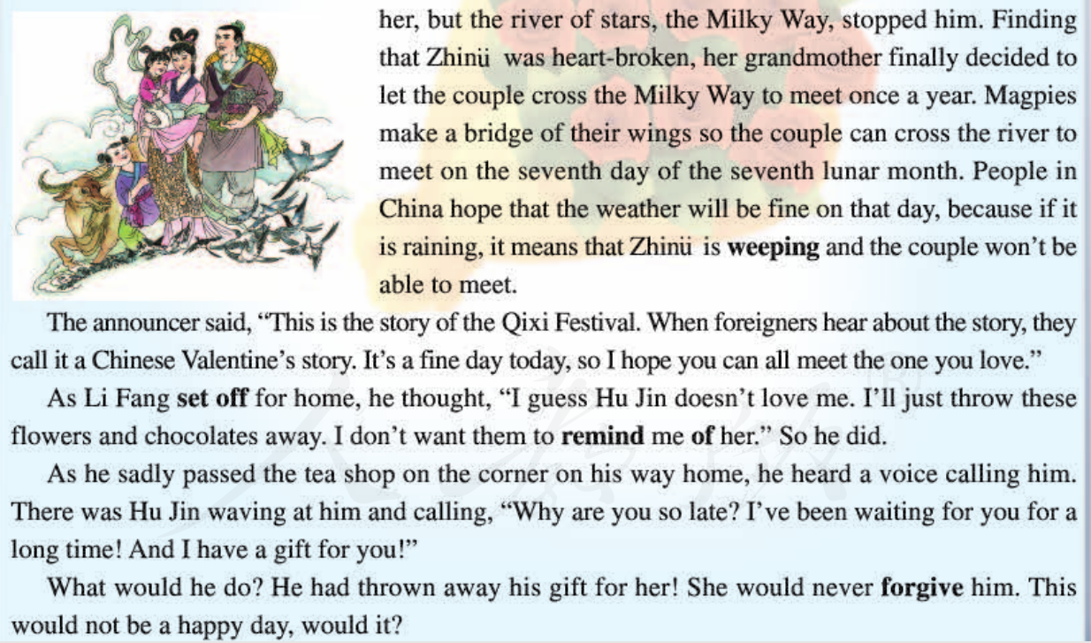

Slide 7
Q2: Which words and expressions can convey LF’s feelings?

Slide 8
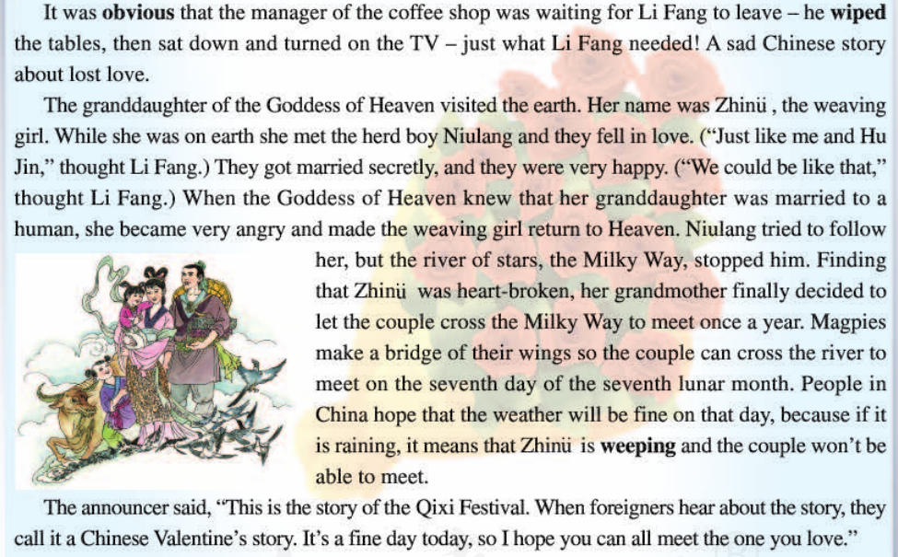

Q3: Why “shop manager” is mentioned here?
Manager suggested LF should leave, which was to intensify the sadness of LF.
Q4: Why “a sad love story ” is mentioned here?
Niulang & Zhinv
V.S.
Li Fang & Hu Jing
environ-ment
emotion

Slide 9


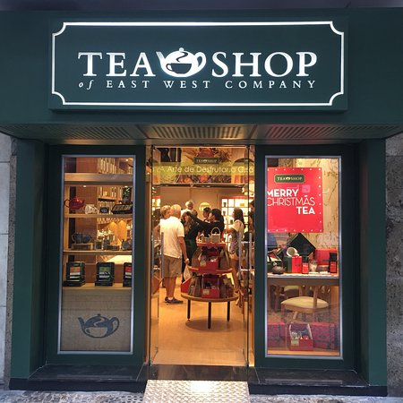
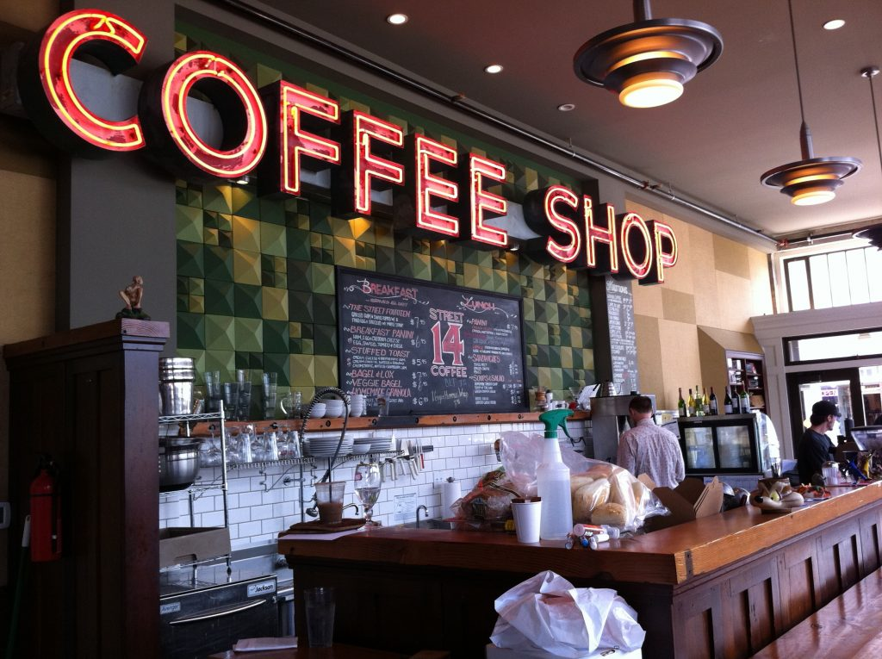
contrast 对比
Why are you so late? I’ve been waiting for you for a long time! And I have a gift for you!”
I guess Hu Jin doesn’t love me.
I’ll just throw these flowers and chocolates away.
I don’t want them to remind me of her.
…?

Slide 10



Q5: What words can be used to describe LF’s feelings?
Complicated; there are ups and downs.

Slide 11
记叙文阅读理解能力:浅层的信息定位能力
who
when
Qixi Festival,Friday night
where
LF came across HJ on his way home. He had thrown away the flowers and chocolates while HJ still kept her gifts for LF.
how
what
why
Li Fang, Hu Jing, manager, Niulang, Zhinv, Goddess of Heaven, announcer
coffee shop, tea shop
LF and HJ made an appointment but didn’t meet each other until the last moment.
LF was waiting for HJ at the coffee shop while HJ at the tea shop.

Slide 12
记叙文阅读理解能力:深层的文本分析能力
1.厘清故事的发展线索(clues)
2.明确文本的主要矛盾(conflict)
3.关注故事的语言风格(style)

Slide 13
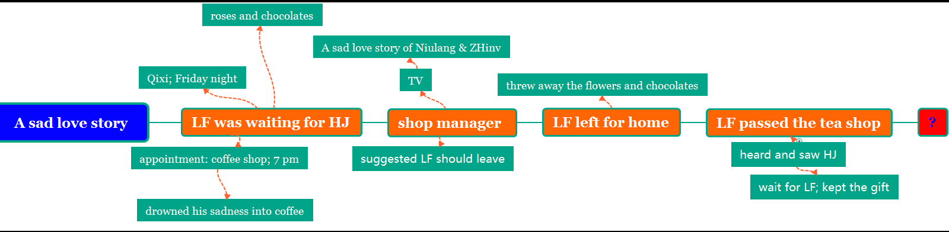
Development of the story

Slide 14

Plot of the story
Climax
?
saw HJ
(tea shop)
set off for home
negative
watch a sad love story
sad
drown in coffee
sad
wait alone
foolish
waiting
heart-broken
appointment
excited
(coffee shop)
Beginning
Ending

Slide 15

Reading comprehension
1. Why didn't Li Fang meet Hu Jin?
A．Hu Jin broke her word.
B．Li Fang didn't wait long enough.
C．They waited for each other at different places.
D．Li Fang watched TV and forgot the appointment.
2. From what perspective was the story mainly narrated?
A. From the 1st person’s perspective.
B. From the 2nd person’s perspective.
C. From the 3rd person’s perspective.

Slide 16
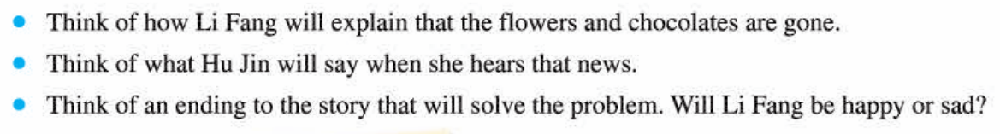
Deeper Discussion:
What’s going on with Li Fang and Hu Jin?
In the story, not a single word did Li Fang say.
So, how can we understand the feelings of him?

Slide 17
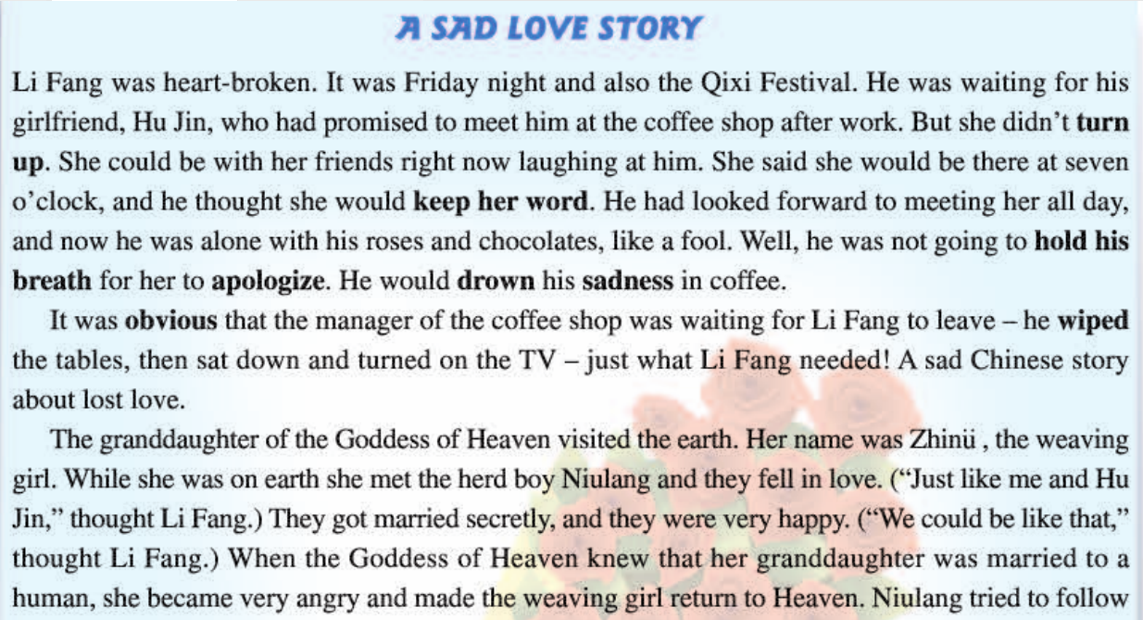

Slide 18
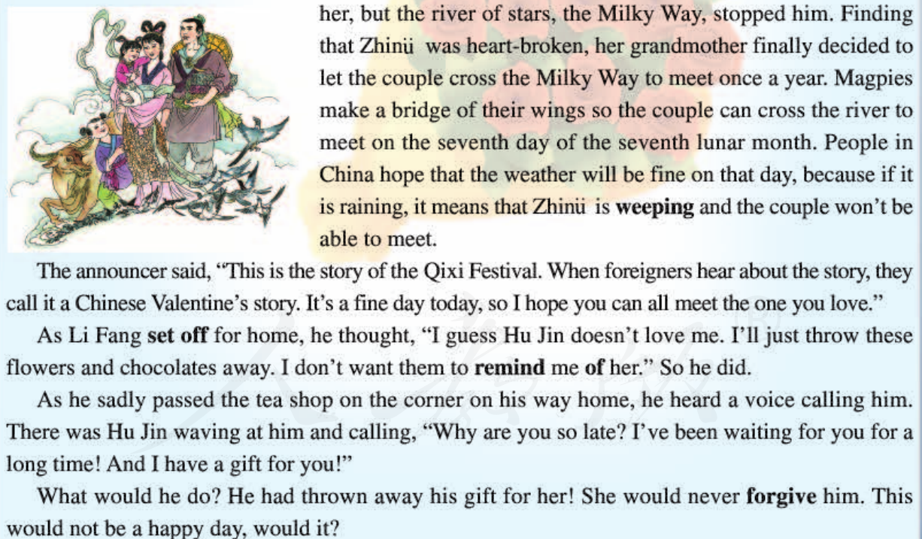

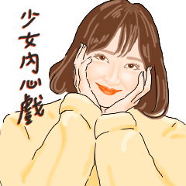

Slide 19
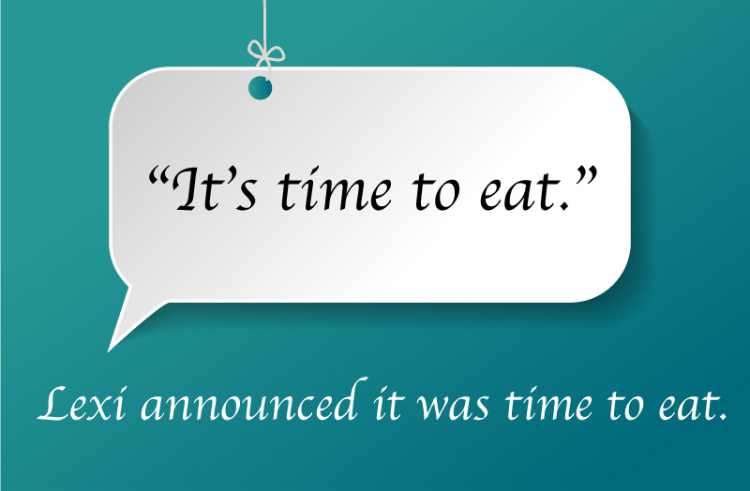
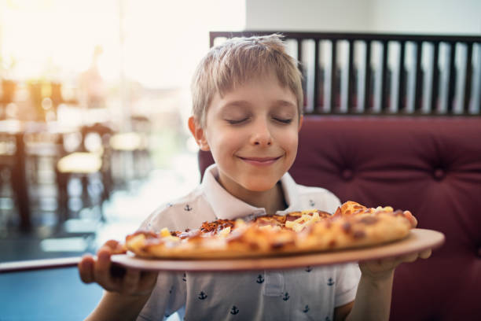
How to describe a character’s inner thought?
direct thought
indirect thought
“It’s time to eat.”
He thought that
it was time to eat.

Slide 20
direct thought
indirect thought
“Just like me and Hu Jin, ” thought Li Fang.
“We could be like that, ”
thought Li Fang.
③ As Li Fang set off for home, he thought, “I guess Hu Jin doesn’t love me. I’ll just throw these flowers and chocolates away. I don’t want them to remind me of her.’’
She could be with her friends right now laughing at him.
…and he thought she would keep her word.
Well, he was not going to hold his breath for her apologise. He would drown his sadness in coffee.
What would he do? He had thrown away her Valentine gifts! She would never forgive him. This would not be a happy Valentine’s Day!

Slide 21
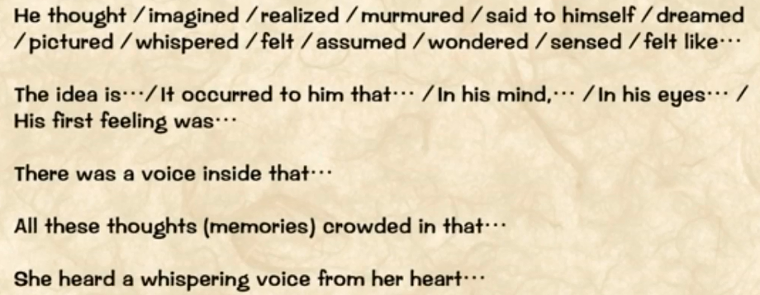
tag words (标志词) for writing character’s inner thought

Slide 22
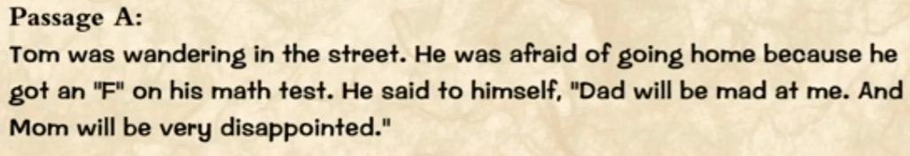
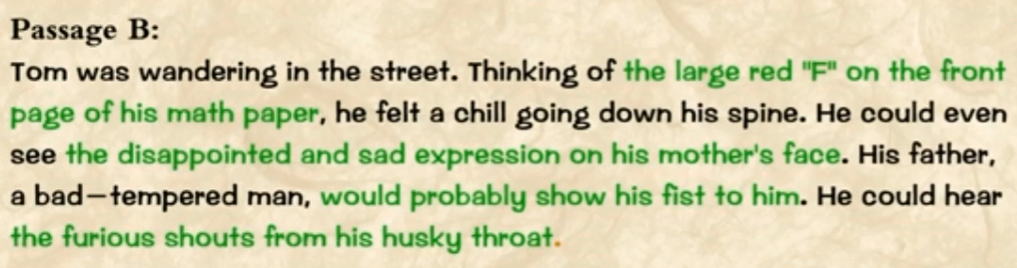
How to write a character’s inner thought?

Slide 23
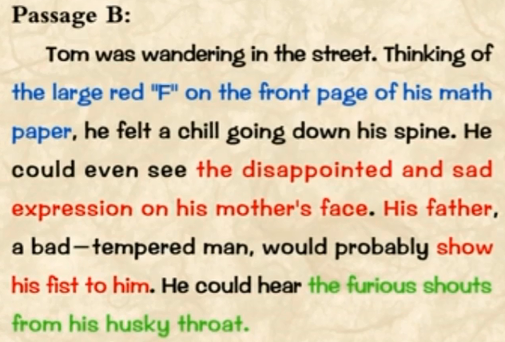

A specific scene from his memory
(头脑印象描写)
What he will probably see?
What other people will probably do?
(本人可能所见/他人所做)
What he probably hear?
What other people will probably say?
(本人可能所听/他人所说)
For more information, please go to https://www.sunedu.com/sysConfigItem/selectDetail/659488?pId=8588

Slide 24

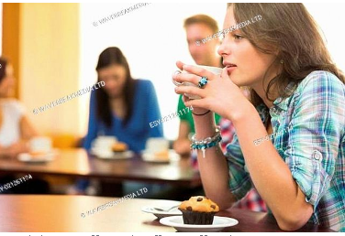
Writing task 1:
The story was mainly narrated from the perspective of Li Fang.
So, we also wonder how Hu Jin was feeling while waiting for Li Fang.
Please write a paragraph (about 100 words) of Hu Jin’s inner thoughts.

Slide 25

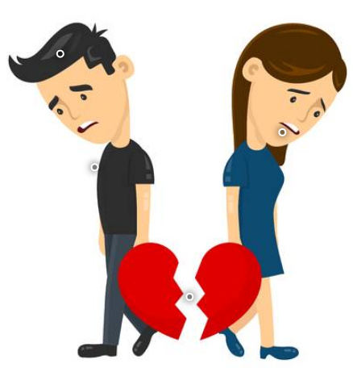
Writing task 2:
We are all curious about what would happen to them coming next.
Please write a logical ending of the story (about 100 words).
A romantic love story or a sad one must be reasonable.

