Slide 1

感恩遇见，相互成就，本课件资料仅供您个人参考、教学使用，严禁自行在网络传播，违者依知识产权法追究法律责任。
更多教学资源请关注
公众号：溯恩高中英语
知识产权声明

Slide 2
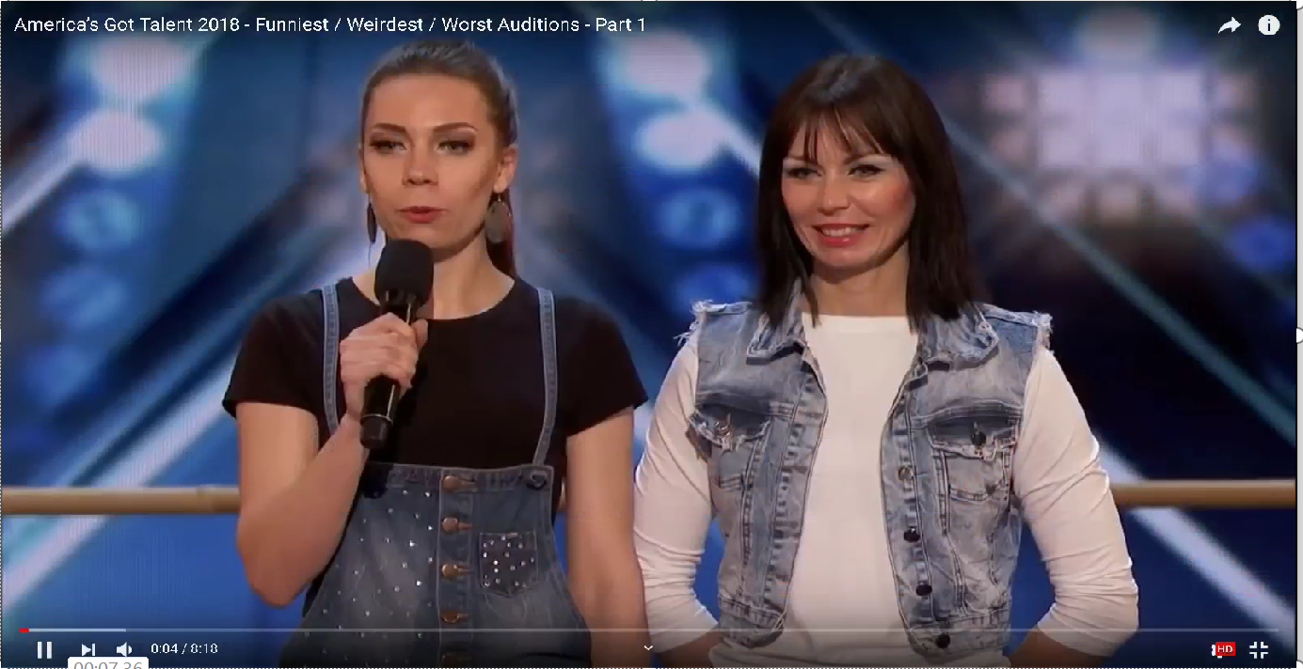

Slide 3
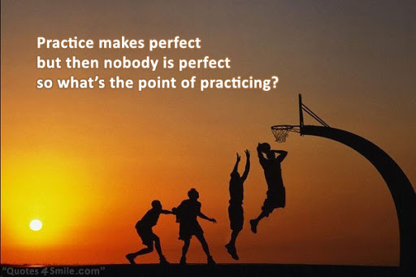
Practice makes perfect!
没人能随随便便成功！

Slide 4
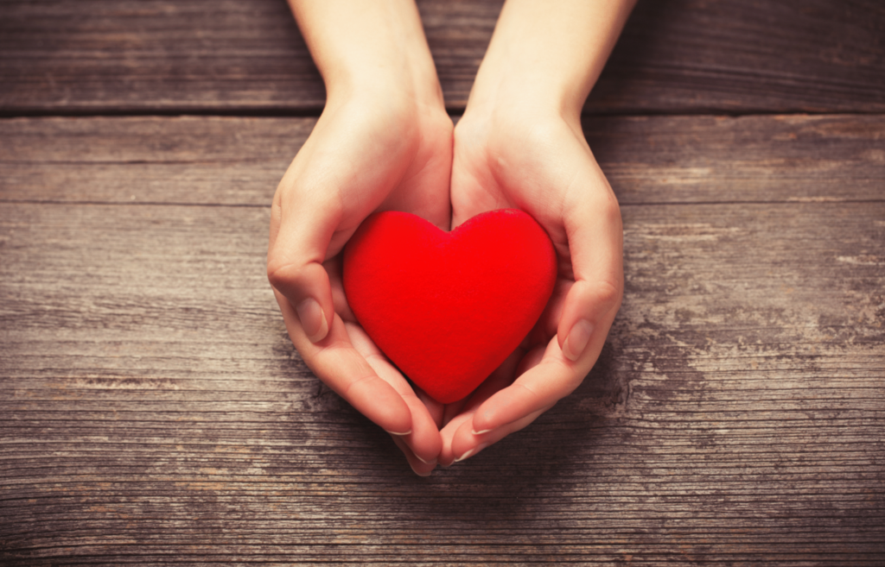

Slide 5
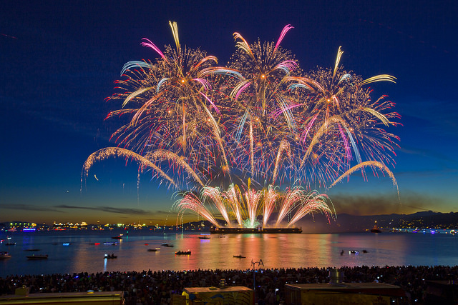
B3U1 Festivals around the world
（Reading）
By Lai Huidi (Moon Lai)

Slide 6
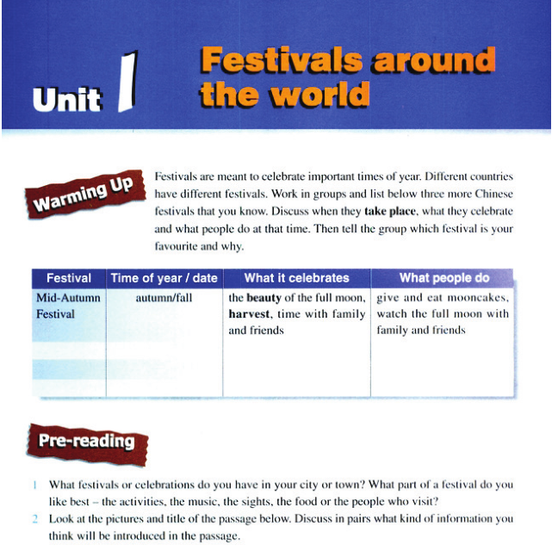

Slide 7
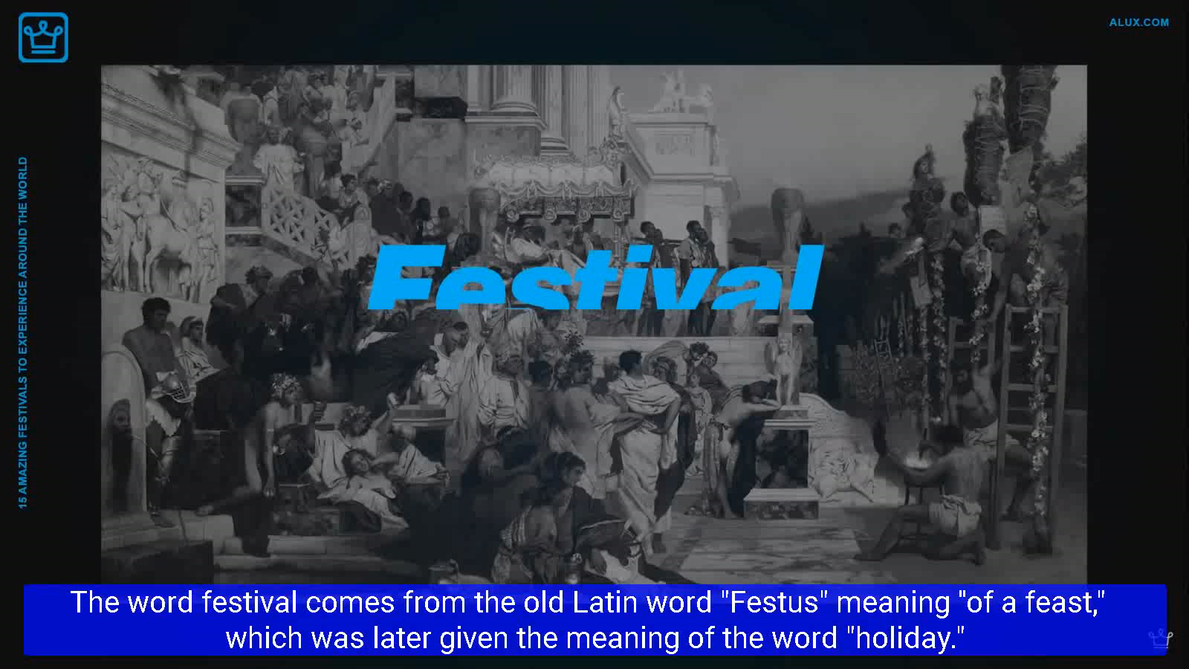

Slide 8
be meant to do sth:
本应该；打算
Come on, Ellen, you’re meant to be helping me.
I thought the police were meant to protect people.
The diagram is meant to show the different stages of the process.
take place=fall on 发生
The next meeting will take place on Thursday.
The wedding will take place at St Andrew's church.

Slide 9
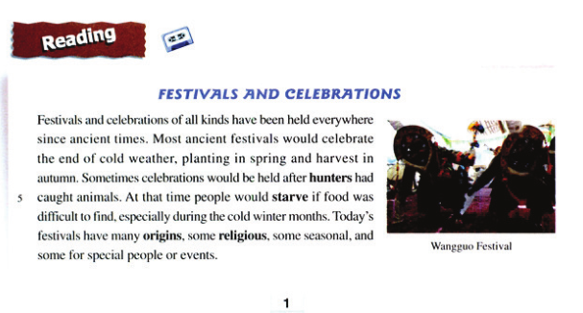
title 大标题
1

Slide 10
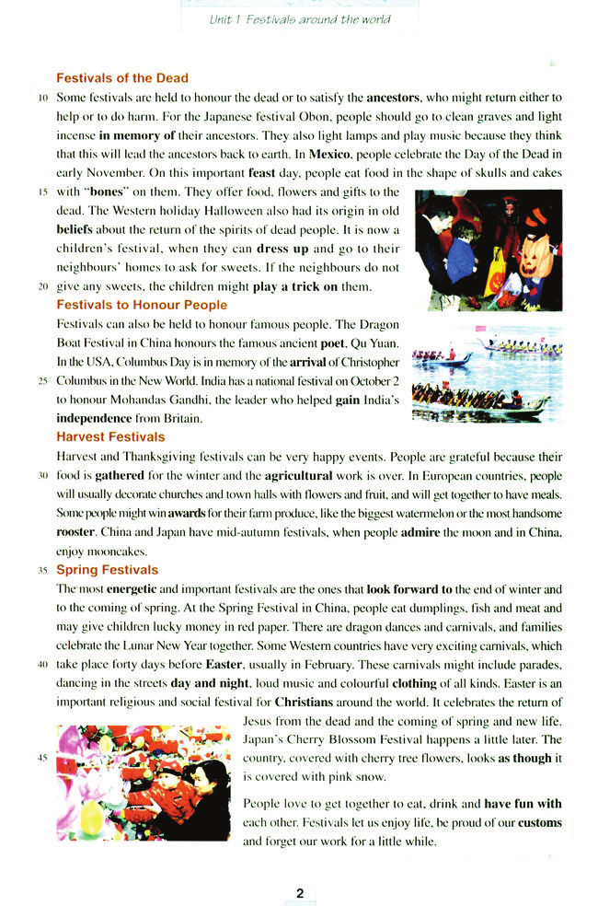
Festivals and Celebrations
2
subtitle
小标题
What？Different kinds of festivals
3
When？
Where ?
4
How ?
Why ?
5
pictures as illustration 配图
6

Slide 11
Read for Style
1. What is the writing style of this passage?
A. An argumentation B. An exposition C. A narration
议论文 说明文 记叙文
2. How does the author introduce the topic of festivals?
By classification.
Festivals of the Dead
Festivals to Honour People
Harvest Festivals
Spring Festivals
subtitles

Slide 12
Read for Structure
？
Para.1
Para. 2
Para.3
Para.4
Para.5
Festivals of the Dead
Festivals to Honor People
Harvest Festivals
Spring Festivals
Para.6
？

Slide 13
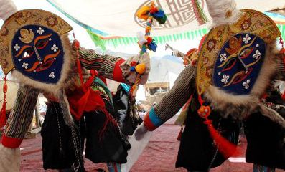
Para. 1
Festivals and celebrations of all kinds have been held everywhere since ancient times. Most ancient festivals would celebrate the end of cold weather, planting in spring and harvest in autumn. Sometimes celebrations would be held after hunters had caught animals. At that time people would starve if food was difficult to find, especially during the cold winter months. Today’s festivals have many origins, some religious, some seasonal, and some for special people or events.
Wangguo festival 望果节
藏族农民欢庆丰收的节日
藏戏、射箭、游行、祭祀
藏历七、八月间举行

Slide 14
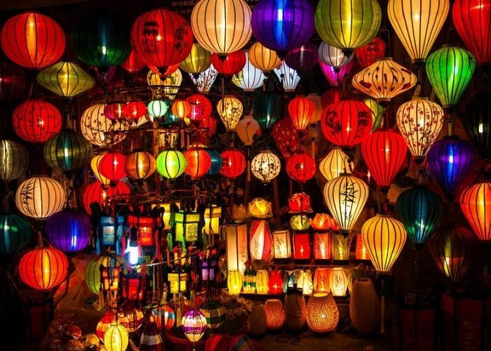
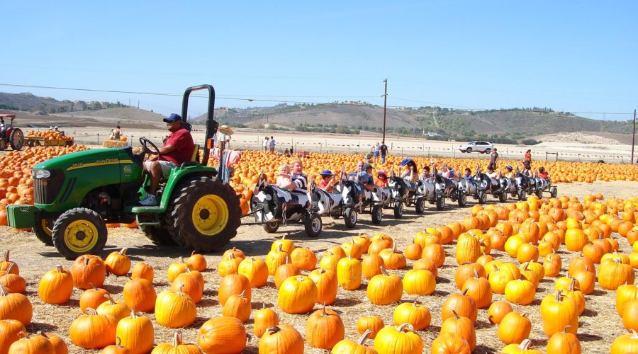
Para. 1
Origins of festivals
Festivals and celebrations of all kinds have been held everywhere since ancient times.
Festivals and celebrations of all kinds have been held everywhere since ancient times. Most ancient festivals would celebrate the end of cold weather, planting in spring and harvest in autumn. Sometimes celebration would be held after hunters had caught animals. At that time people would starve if food was difficult to find, especially during the cold winter months. Today’s festivals have many origins ,some religious, some seasonal, and some for special people or events.
ancient festivals
To suffer or die because you have not enough food to eat
starve
if food was difficult to find
Today's festivals
Today’s festivals have many
origins ,some religious, some seasonal, and some for special people or events.

Slide 15
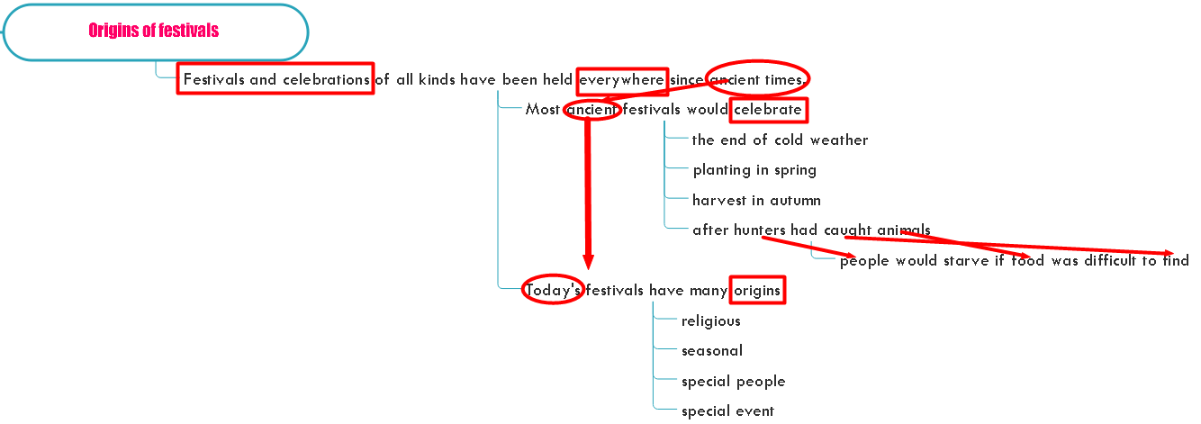
Mind-map of para.1
What is the sequence in developing paragraph 1 ?
In the order of time.
What is the use of last sentence in paragraph 1?
2 Festivals of the Dead
3 Festivals to Honour People
4 Harvest Festivals
5 Spring Festivals
As a transition. （过渡句）

Slide 16
Read for Structure
Origins of festivals
？
Para1
Para 2
Para3
Para4
Para5
Festivals of the Dead
religious
Festivals to Honor People
special people
Harvest Festivals
seasonal
Spring Festivals
special event
Para6
？

Slide 17
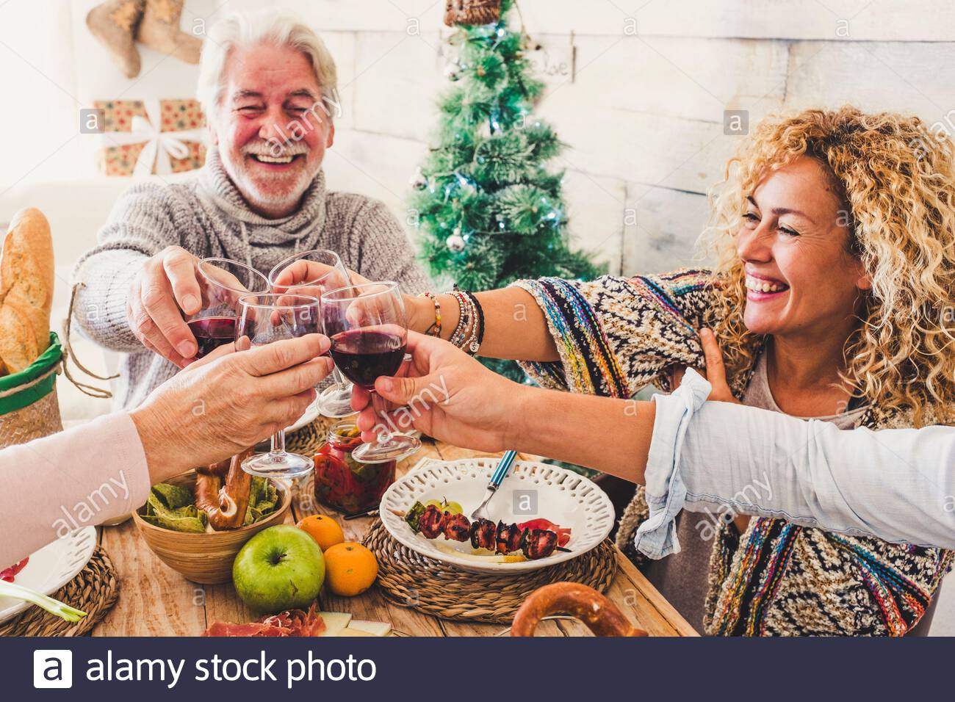
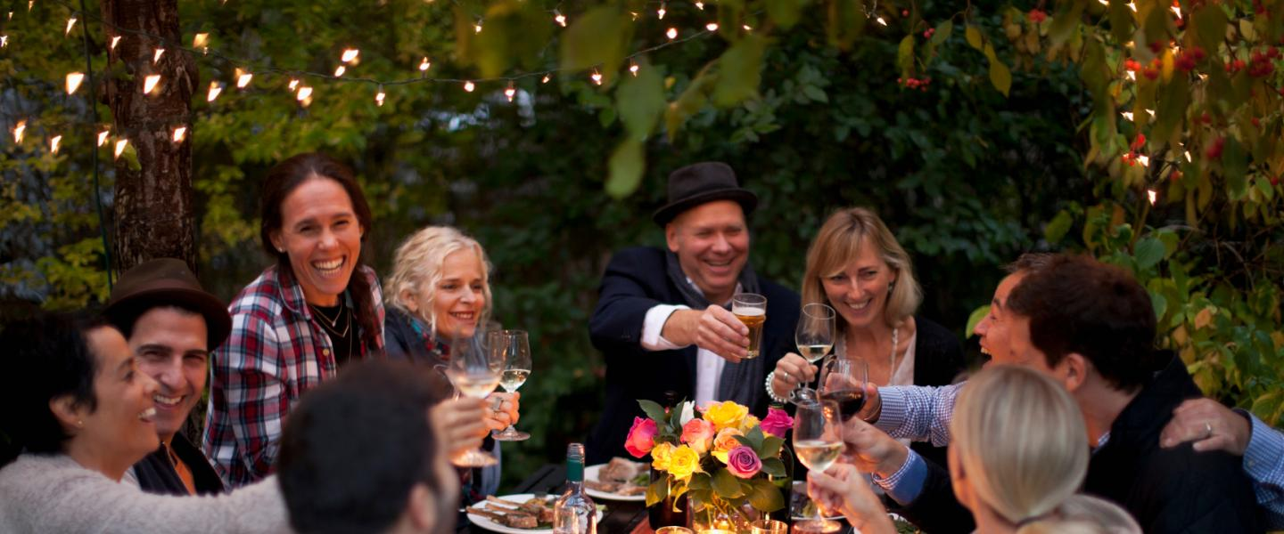
Para. 6
values of festivals
People love to get together to eat, drink and have fun with each other. Festivals let us enjoy life, be proud of our customs and forget our work for a little while.
People love to get together to eat, drink and have fun with each other. Festivals let us enjoy life, be proud of our customs and forget our work for a little while.

Slide 18
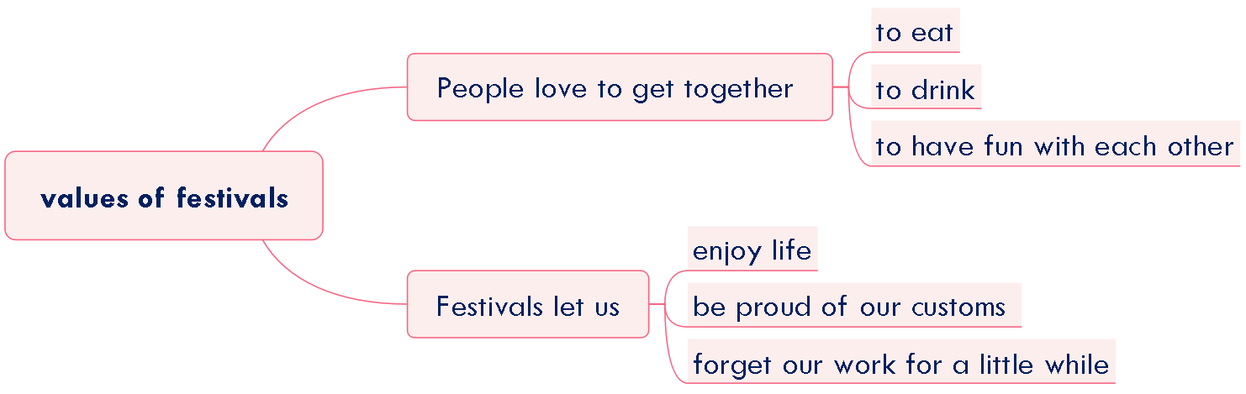
Mind-map of para.6

Slide 19
Read for Structure
Origins of festivals
？
Para1
Para 2
Para3
Para4
Para5
Festivals of the Dead
religious
Festivals to Honor People
special people
Harvest Festivals
seasonal
Spring Festivals
special event
Para6
values of festivals
？

Slide 20
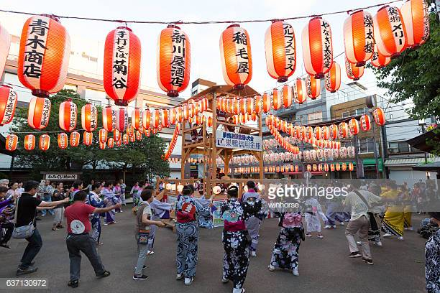
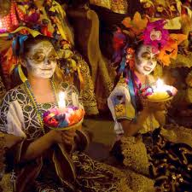
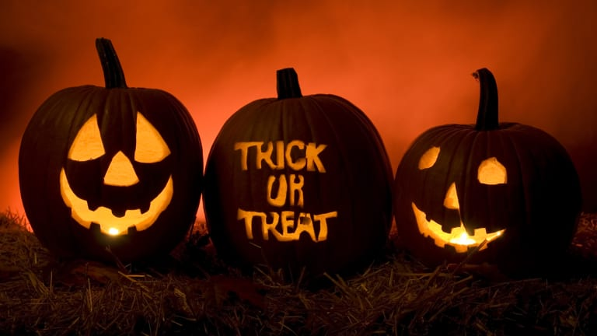
Festivals of the Dead--Para. 2
Topic sentence？
Examples？
Some festivals are held to honour the dead or to satisfy the ancestors, who might return either to help or to do harm.
Some festivals are held to honour the dead or to satisfy the ancestors, who might return either to help or to do harm. For the Japanese festival. Obon, people should go to clean graves and light incense in memory of their ancestors. They also light lamps and play music because they think that this will lead the ancestors back to earth. In Mexico, people celebrate the Day of the Dead in early November. On this important feast day, people eat food in the shape of skulls and cakes with “bones” on them. They offer food, flowers and gifts to the dead. The Western holiday Halloween also had its origin in old beliefs about the return of the spirits of dead people. It is now a children’s festival, when they can dress up and to their neighbours’ homes to ask for sweets. If the neighbours do not give any sweets, the children might play a trick on them.
Japanese festival, Obon
Mexico the Day of the Dead
Western
Halloween

Slide 21
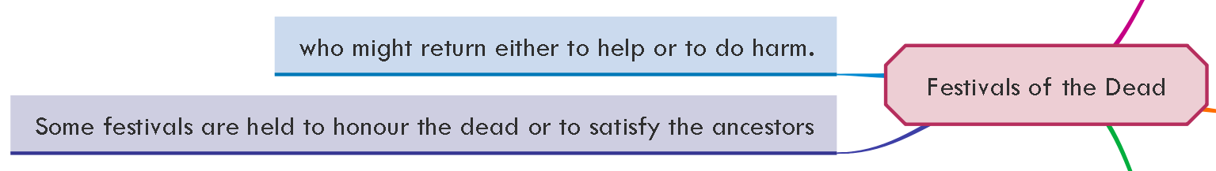
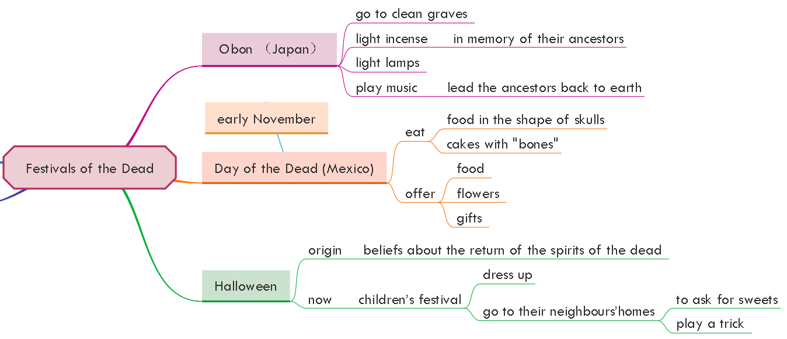
Mind-map of para.2
Topic sentence
Examples
Details

Slide 22
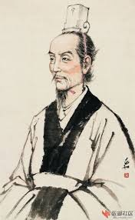
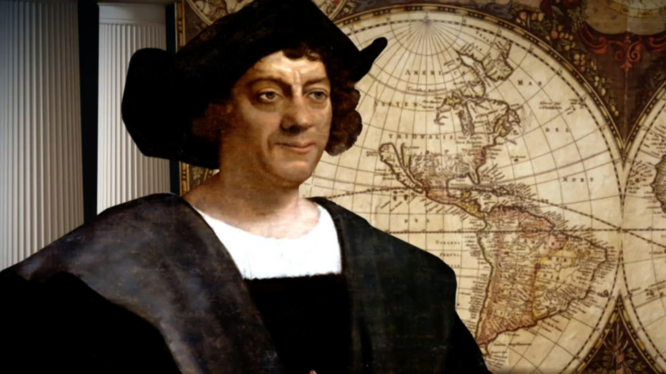
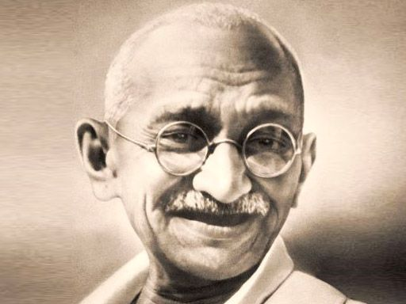
Festivals to Honour People--Para. 3
?
famous people
Festivals can also be held to honour famous people .
Festivals can also be held to honour famous people . The Dragon Boat Festival in China honours the famous ancient poet, Qu Yuan. In the USA Columbus Day is in memory of the arrival of Christopher Columbus in New World. India has a national festival on October 2 to honour Mohandas Gandhi, the leader who helped gain India’s independence from Britain.
Dragon Boat Festival in
China
In the USA Columbus Day
Qu Yuan is a patriotic poet who was admired and loved by the people.
National leaders, heroes, famous historical figures.
These festivals are used to strengthen national pride.
India
national festival on October 2
Qu Yuan
a famous poet
Christopher Columbus
the first arrival in the New World
Mohandas Gandhi
Leader of Indian’s Independence Movement
Is Qu Yuan honored only becuase he was a famous poet?
What kind of people to honor? Shall they be famous? How famous?

Slide 23
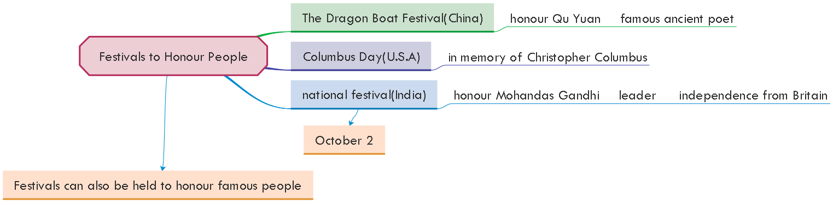
Mind-map of para.3
Topic sentence
Examples
Details

Slide 24
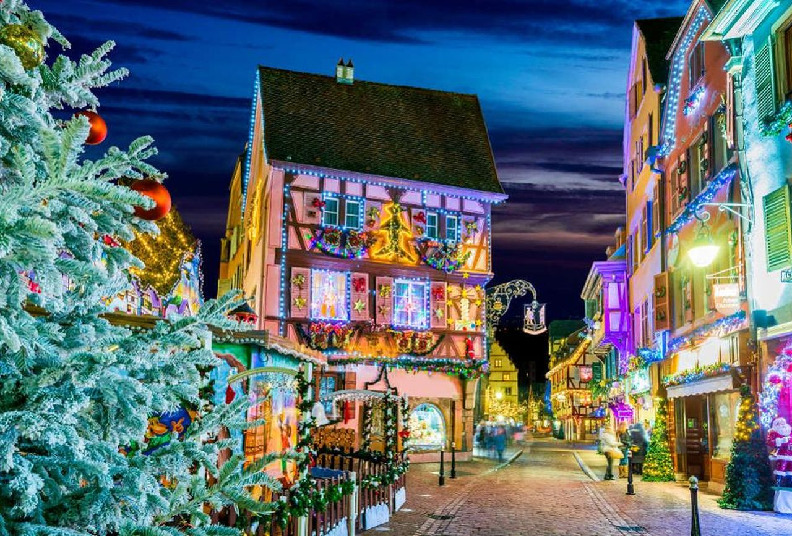
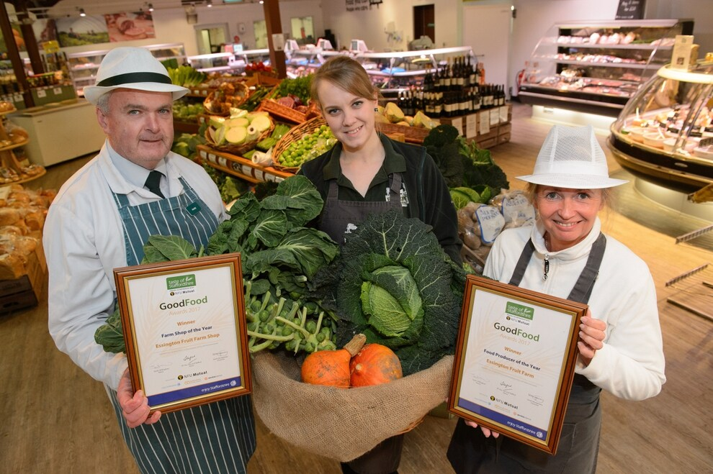
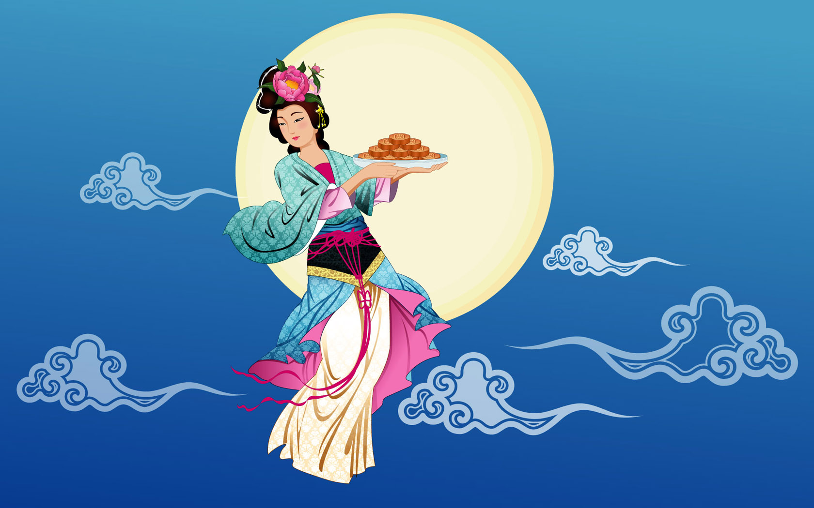
Harvest Festivals--Para. 4
Why?
People are grateful because their food is gathered for the winter and the agricultural work is over.
Harvest and Thanksgiving festivals can be very happy events. People are grateful because their food is gathered for the winter and the agricultural work is over. In European countries, people will usually decorate churches and town halls with flowers and fruit, and will get together to have meals. Some people might win awards for their farm produce, like the biggest watermelon or the most handsome rooster. China and Japan have mid-autumn festivals, when people admire the moon and in China, enjoy mooncakes.
(noun) things that have been made or grown, especially things connected with farming
Sometimes we can guess the meaning of a new word by giving examples
produce
watermelon
rooster
Festival
Festival
How to celebrate
Where
Countries
How
Festival
Origin
Place
Evidence

Slide 25
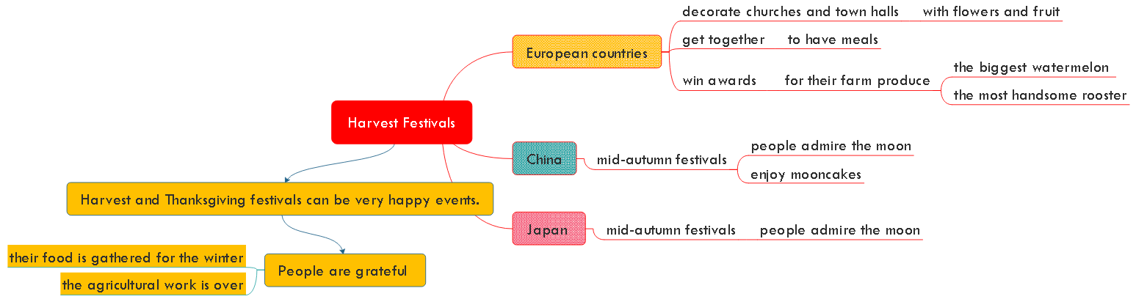
Mind-map of para.4
Details
Examples
Topic sentence

Slide 26
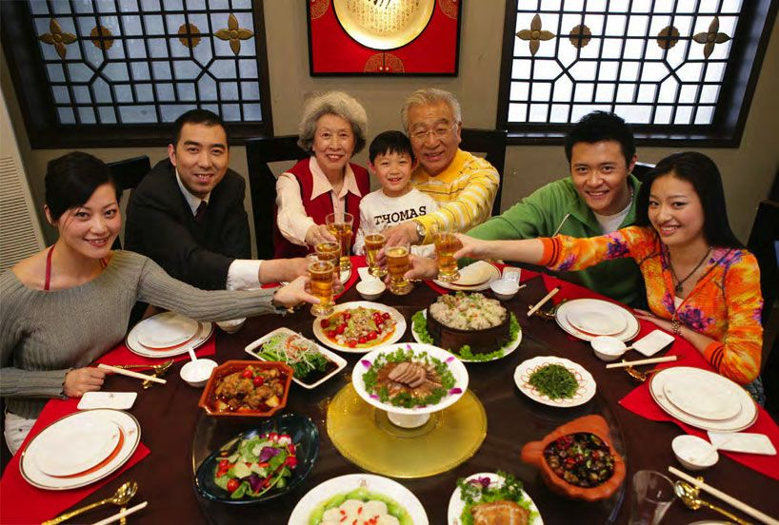
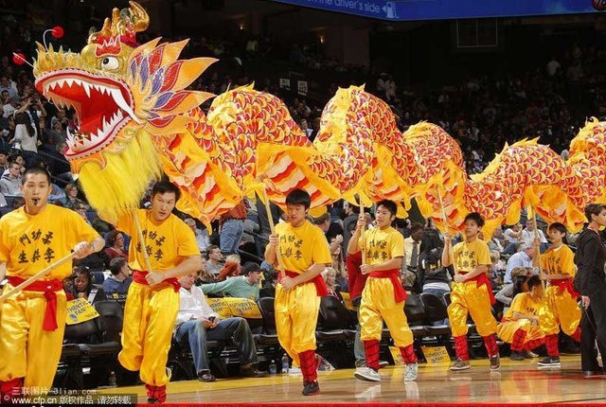
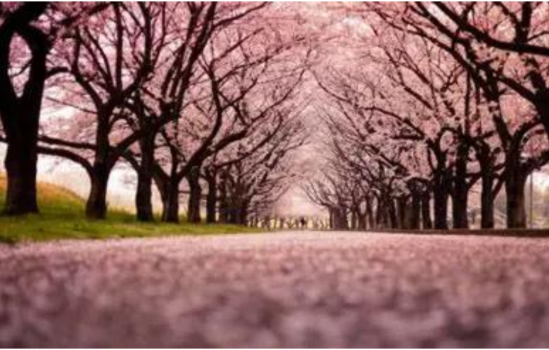
Spring Festivals--Para. 5
?
The most energetic and important festivals are the ones that look forward to the end of winter and to the coming of spring. At the Spring Festival in China, people eat dumplings, fish and meat and may give children lucky money in red paper. There are dragon dances and carnivals, and families celebrate the Lunar New Year together. Some Western countries have very exciting carnivals, which take place forty days before Easter, usually in February. These carnivals might include parades, dancing in the streets day and night, loud music and colourful clothing of all kinds. Easter is an important religious and social festival for Christians around the world. It celebrates the return of Jesus from the dead and the coming of spring and new life. Japan’s Cherry Blossom Festival happens a little later. The country, covered with cherry tree flowers, looks as though it is covered with pink snow.
The most energetic and important festivals
The country, covered with cherry tree flowers, looks as though it is covered with pink snow.
How
Origin
Festival
How to celebrate
Festival
Countries
How

Slide 27
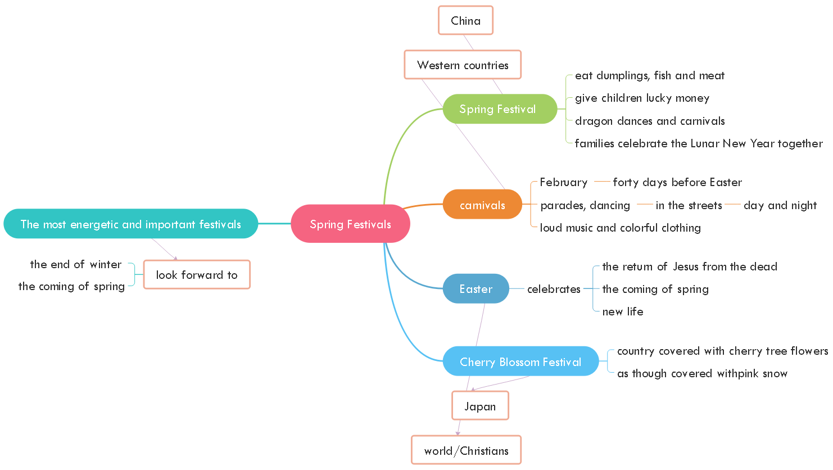
Mind-map of para.5
Details
Examples
Topic sentence

Slide 28
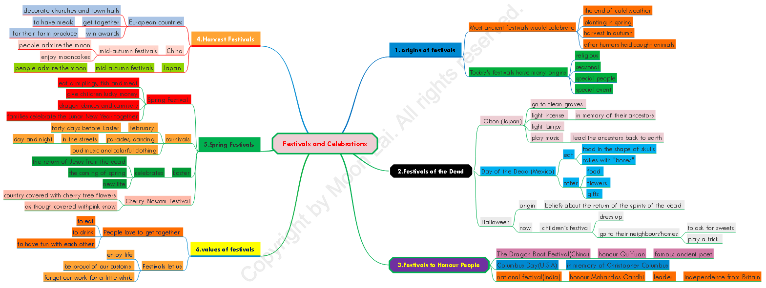

Slide 29

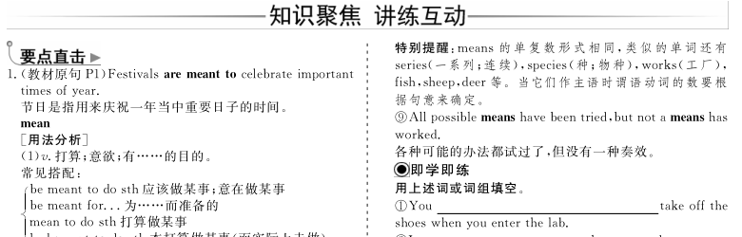
1. Draw a mind-map of Reading 1,U1.
2. Language points.

Slide 30
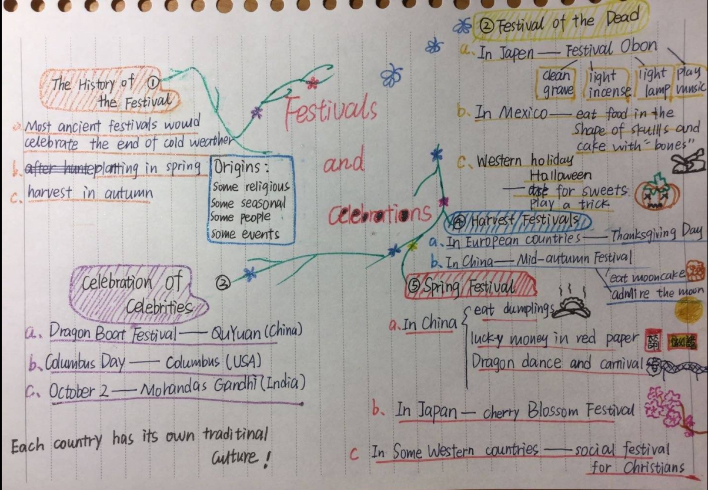
附: 学生的思维导图欣赏

Slide 31
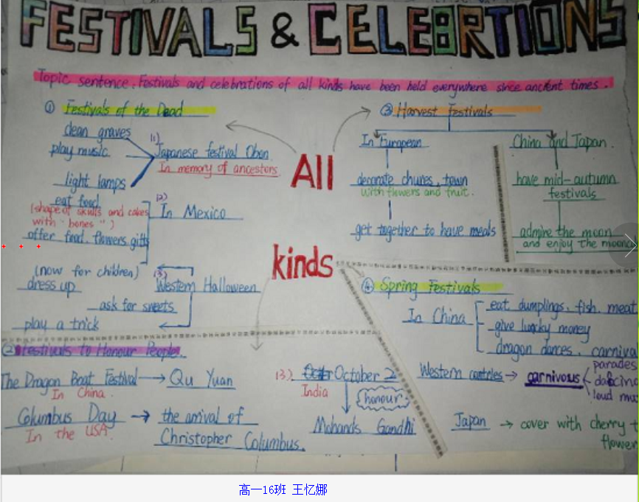
附: 学生的思维导图欣赏

Slide 32
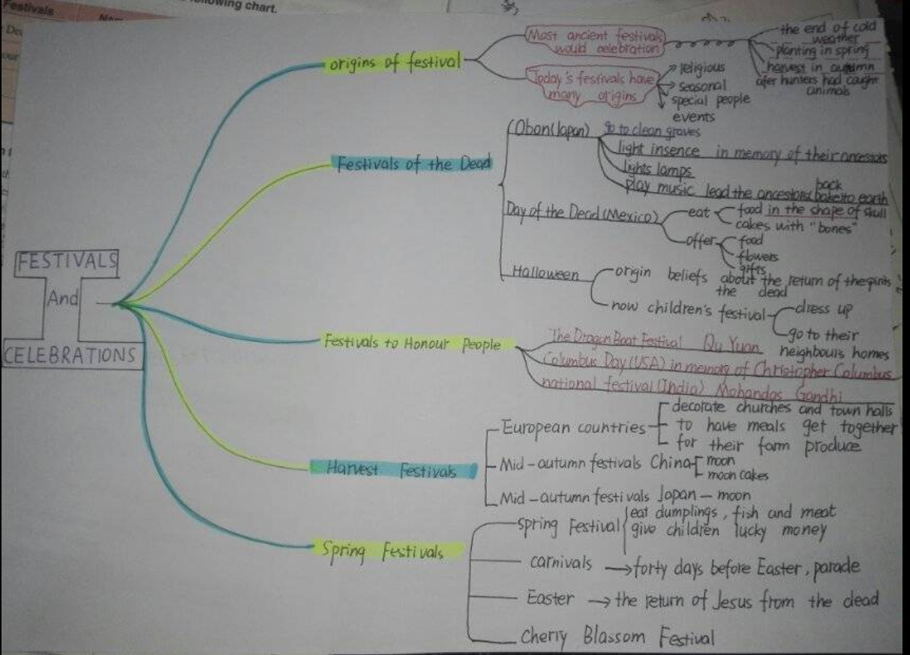
附: 学生的思维导图欣赏

Slide 33
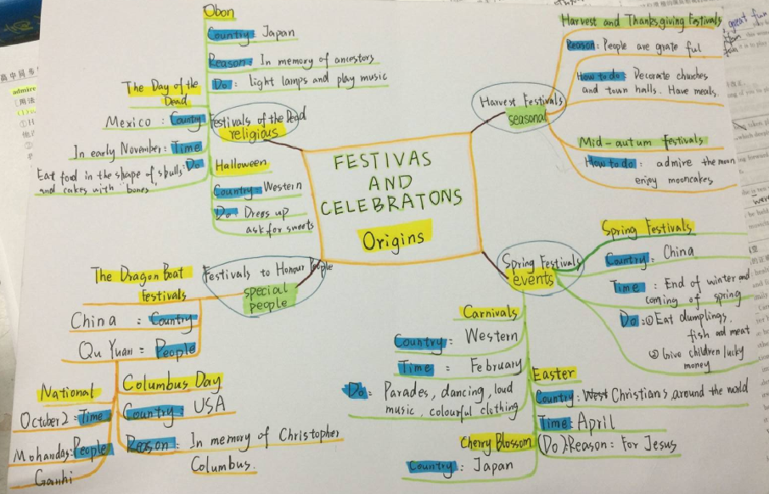
附: 学生的思维导图欣赏

Slide 34
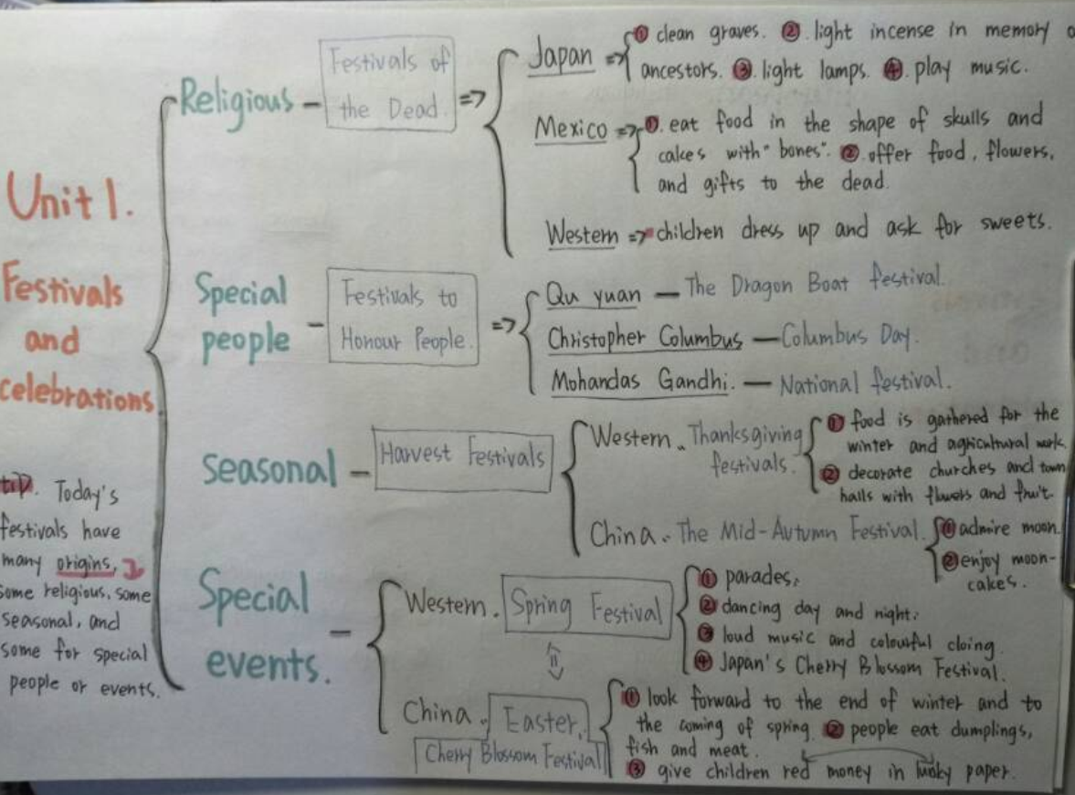
附: 学生的思维导图欣赏

Slide 35
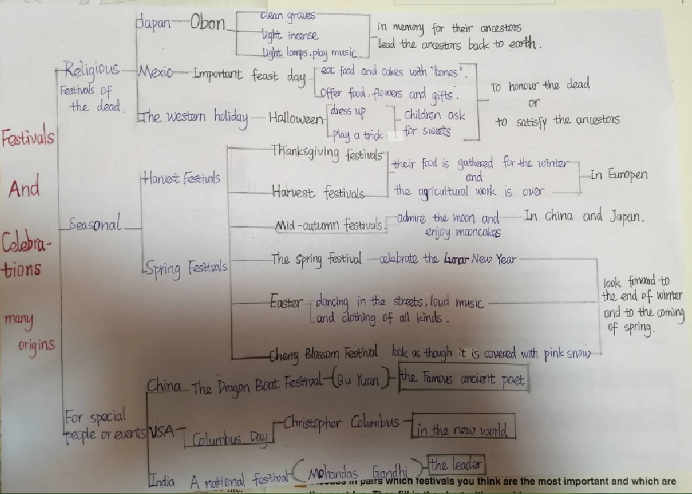
附: 学生的思维导图欣赏

