Slide 1

感恩遇见，相互成就，本课件资料仅供您个人参考、教学使用，严禁自行在网络传播，违者依知识产权法追究法律责任。
更多教学资源请关注
公众号：溯恩高中英语
知识产权声明

Slide 2
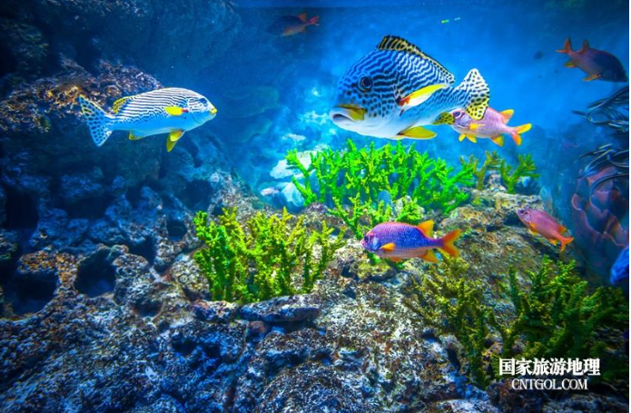
Unit 3
Under the Sea
Harriet
Match 9th

Slide 3
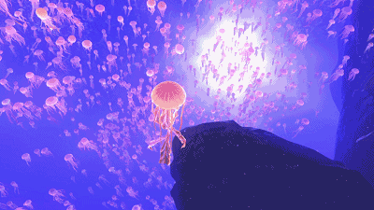
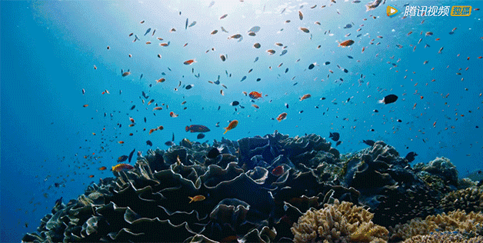
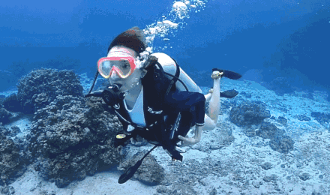
jellyfish 水母
Let's go snorkeling under the sea......

Slide 4
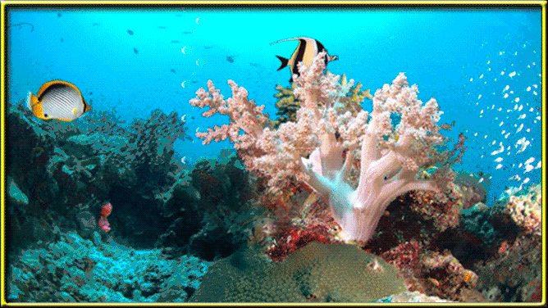
What do you think of these creatures?
amazing
wonderful
miraculous
A New Dimension of Life
(一个新的生命维度)

Slide 5
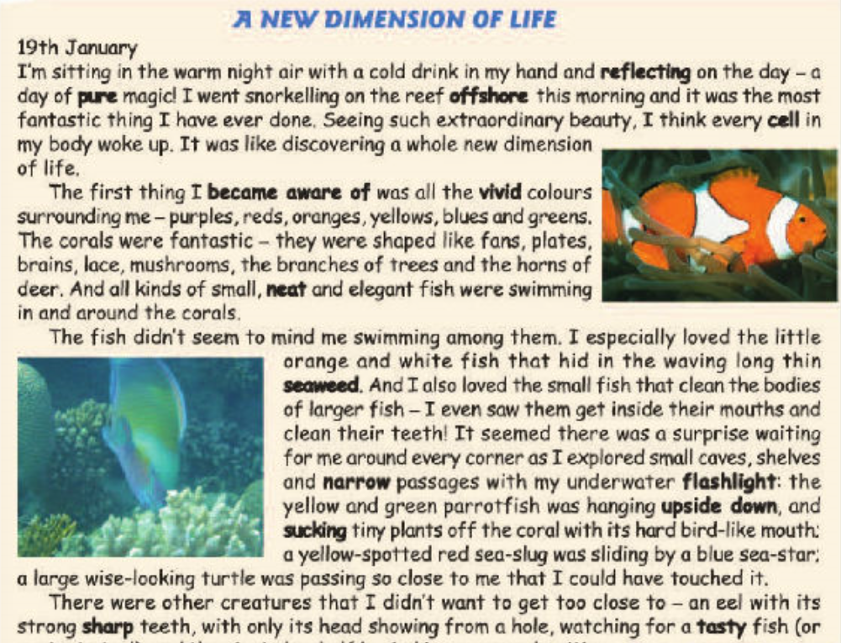
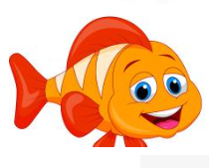
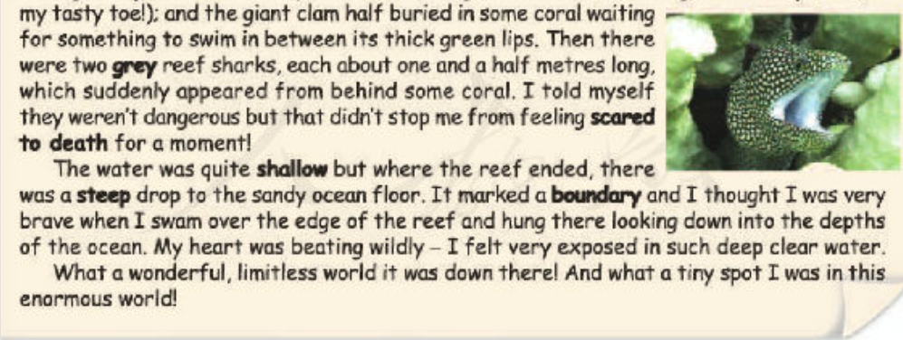
What kind of passage is it?
A. an advertisement
B. a piece of news
C. a diary entry
D. a book review
a daily written record of (usually personal) experiences and observations
snorkeling；pure magic；
the most fantastic

Slide 6




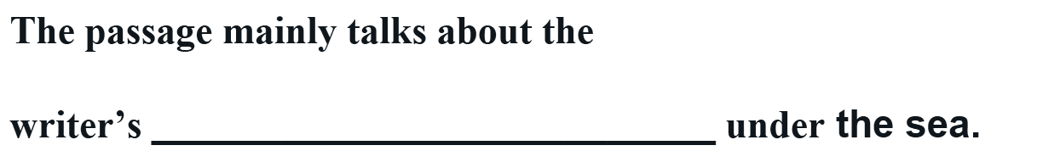




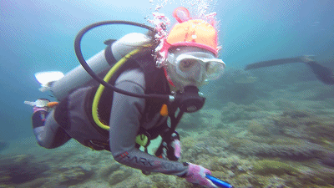


Slide 7




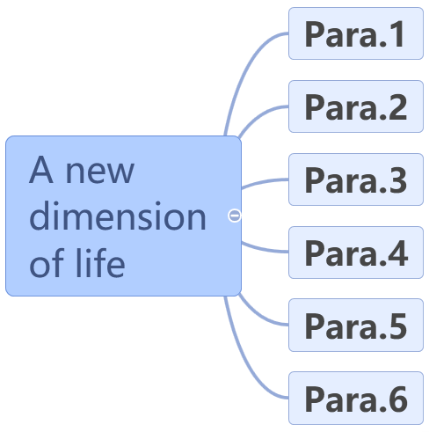







Slide 8


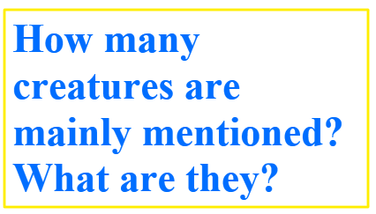
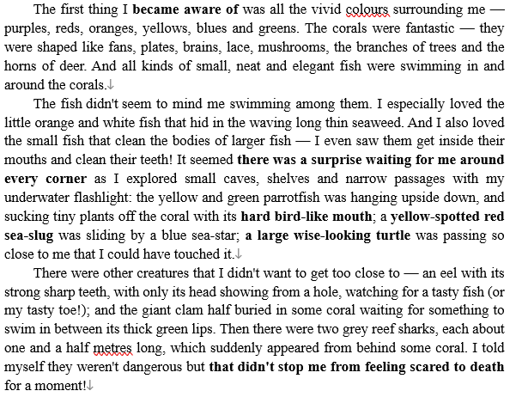

v
2
3
anemone fish
双锯鱼
4
鳗鱼
海参
蚌

Slide 9

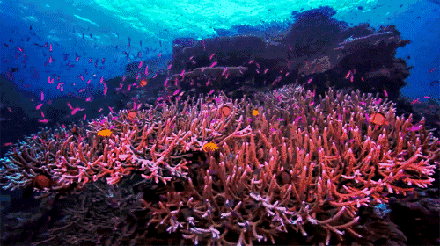


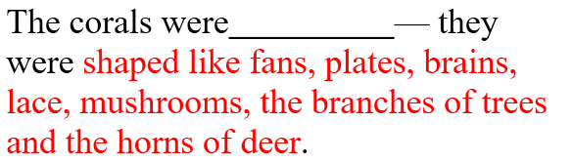



Descriptive techniques
To make the language more influential?
Tip 1: Simile 明喻
Notes:
从这张ppt开始，可以理论化总结一些描写的手法及修辞手法，比如这个：tip1: simile

Slide 10
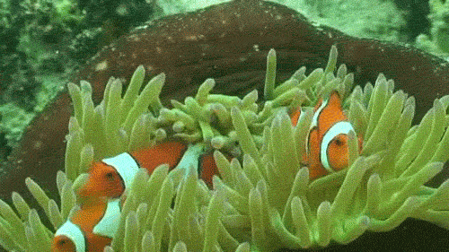


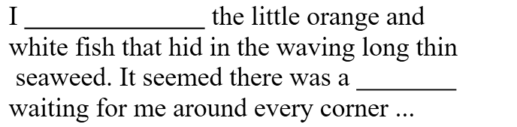


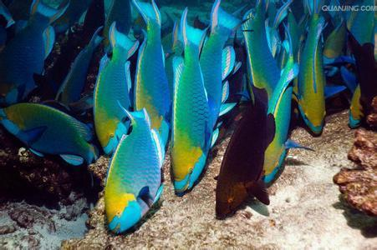

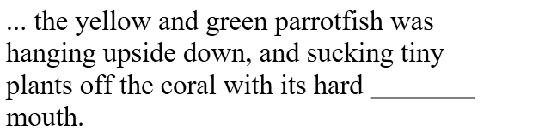


Tip 2: Non-finite verbs serve as attributives.
Tip 3: Compound words serve as adjectives.
Notes:
Tip2: by using non-finite verb as attributive
Tip3: compound words serve as adj（类似意思，老师再组织下语言）

Slide 11
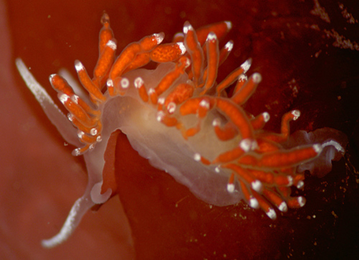



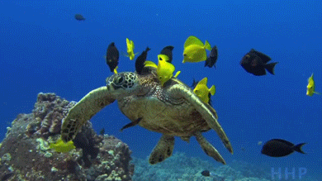




Tip 4: Use subjunctive mood.

Slide 12
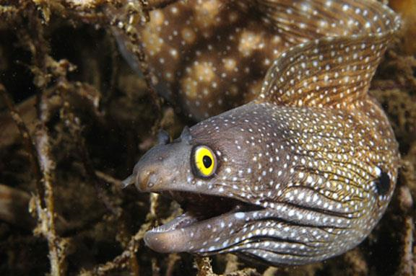
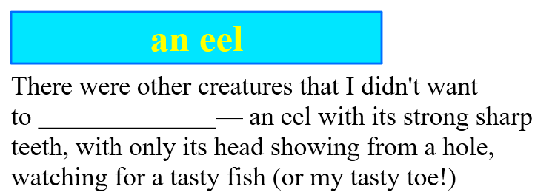

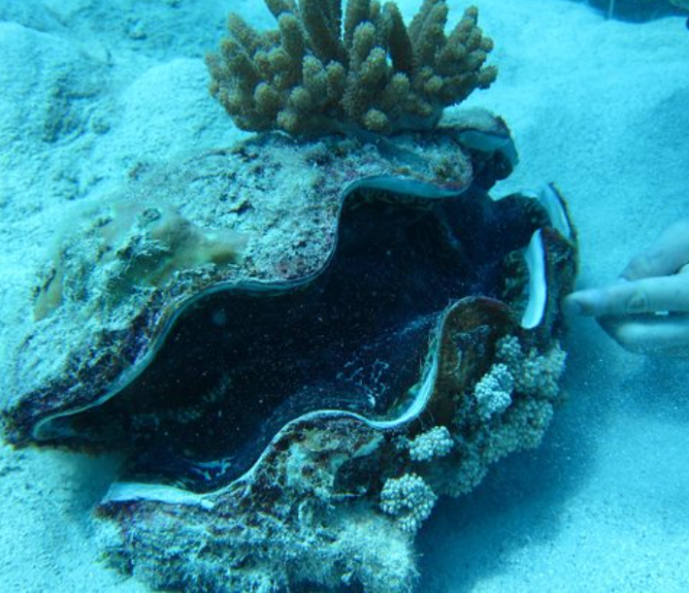
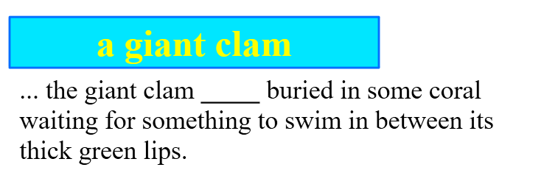

Tip 5: With-structure serves as adverbial.
Tip 6: Non-finite verbs serve as adverbials.

Slide 13
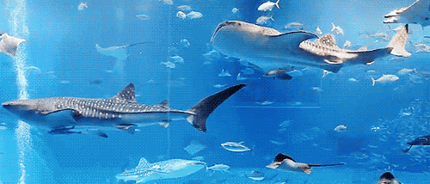
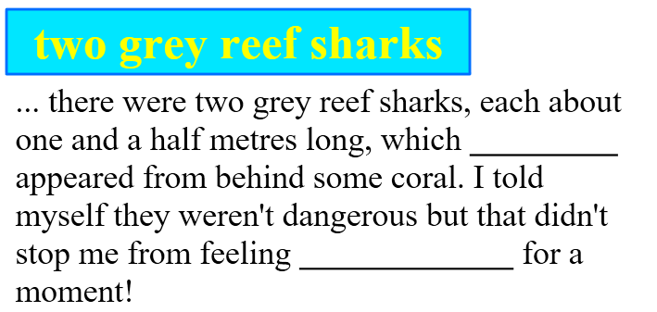


Tip 7: Use exaggerations.
Notes:
exaggeration

Slide 14

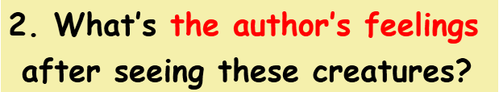

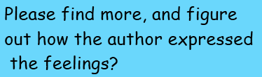

More tips to express one’s feelings: By using
adjectives,
adverbs,
the superlative of adjectives, exaggeration,
negative sentences, etc.

Slide 15
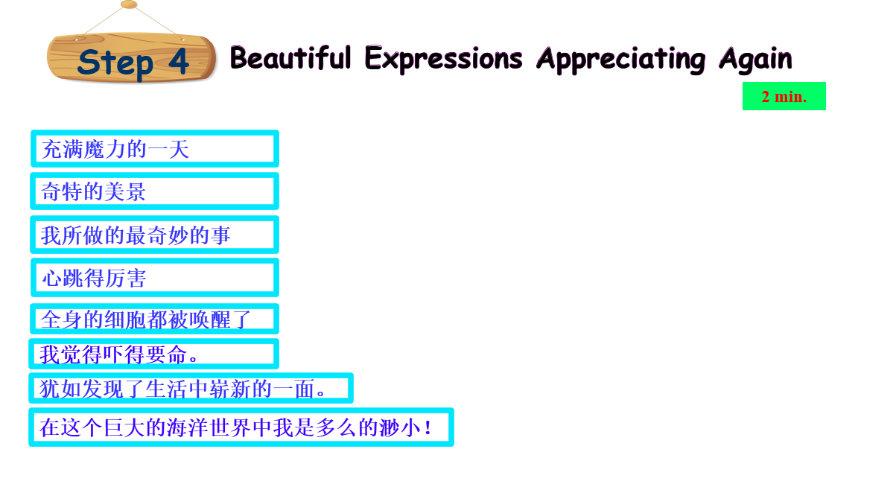

Notes:
除了上一张最后一段是体现作者的心情之外，文中还有哪些表达也是体现作者的心情？用这个问题替换这张和下一张的直接呈现，让学生自己去找一找，没找到的老师可以给出补充。

Slide 16
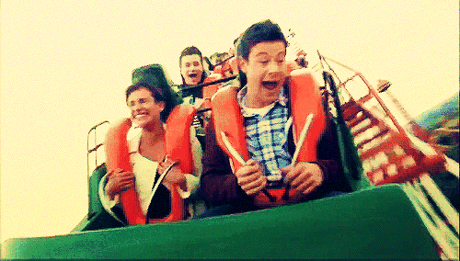



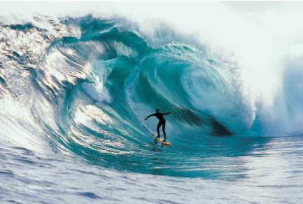





Slide 17
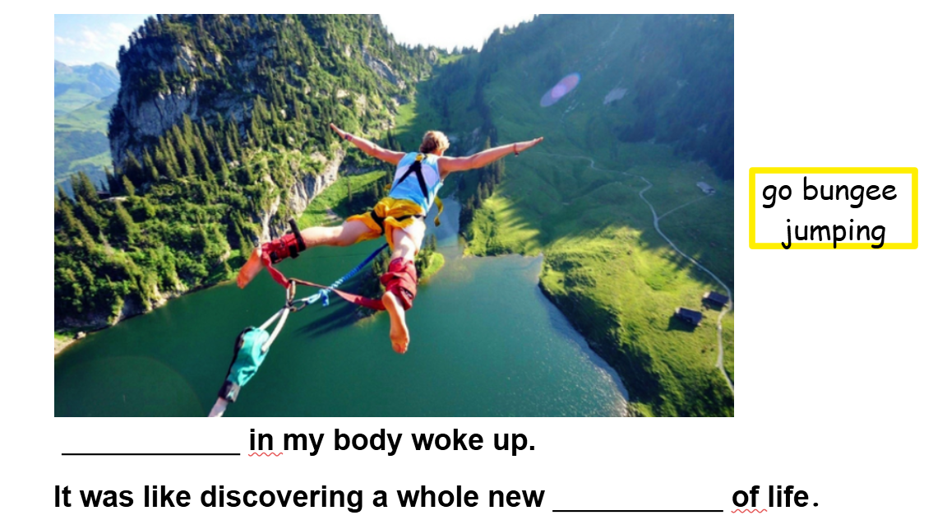



Slide 18
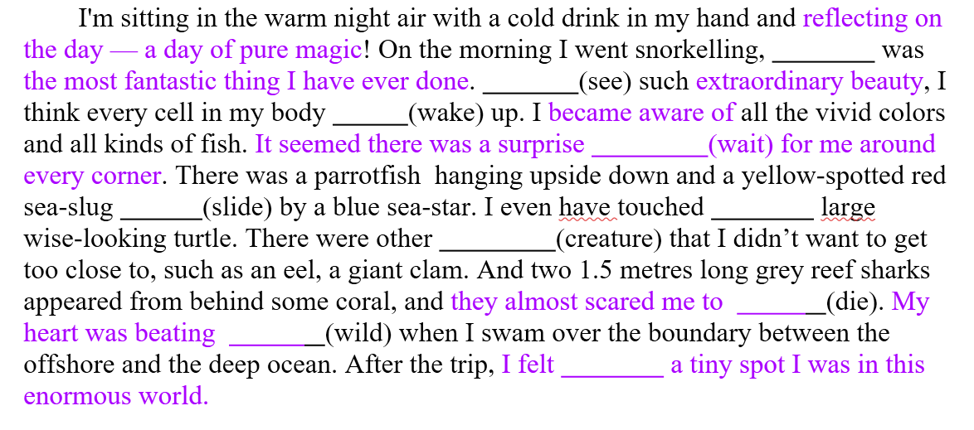
which
Seeing
woke
waiting
sliding
a
creatures
death
wildly
what
Notes:
直接设计成高考题型---语法填空，colored parts 当作课后欣赏。

Slide 19
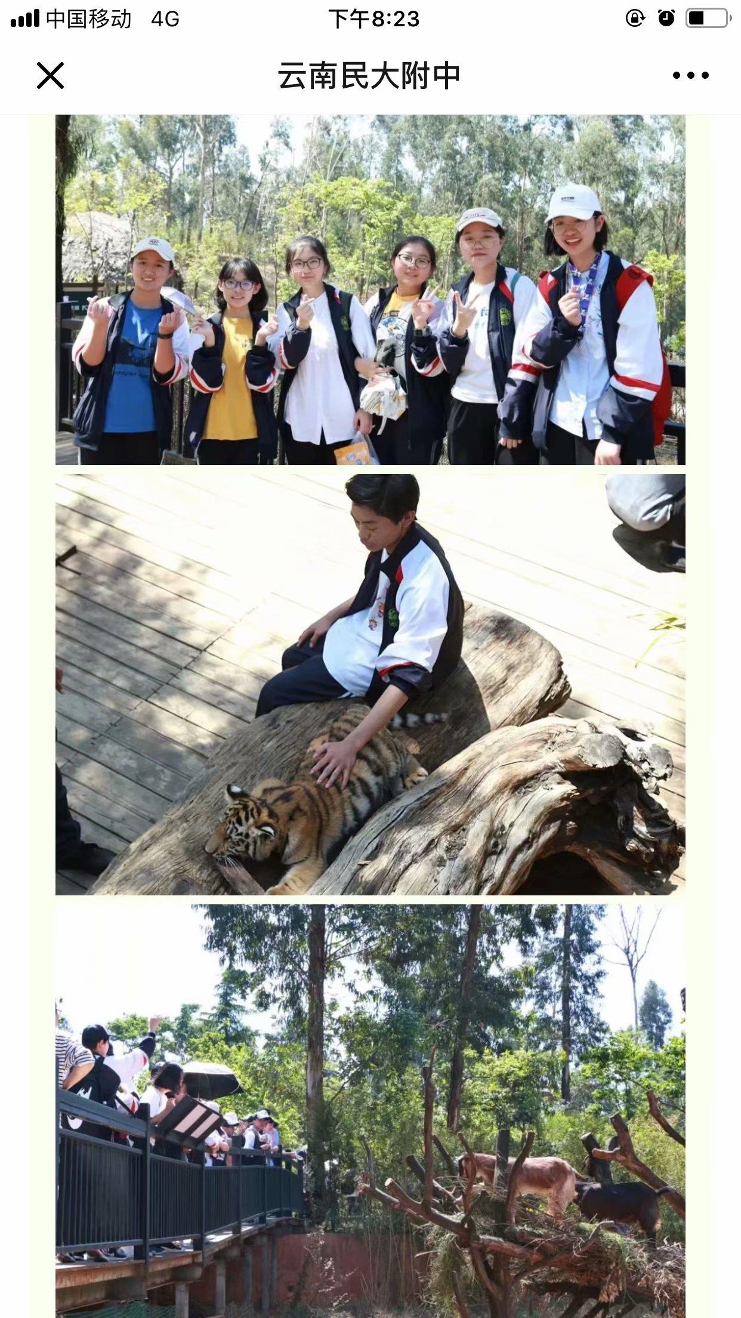
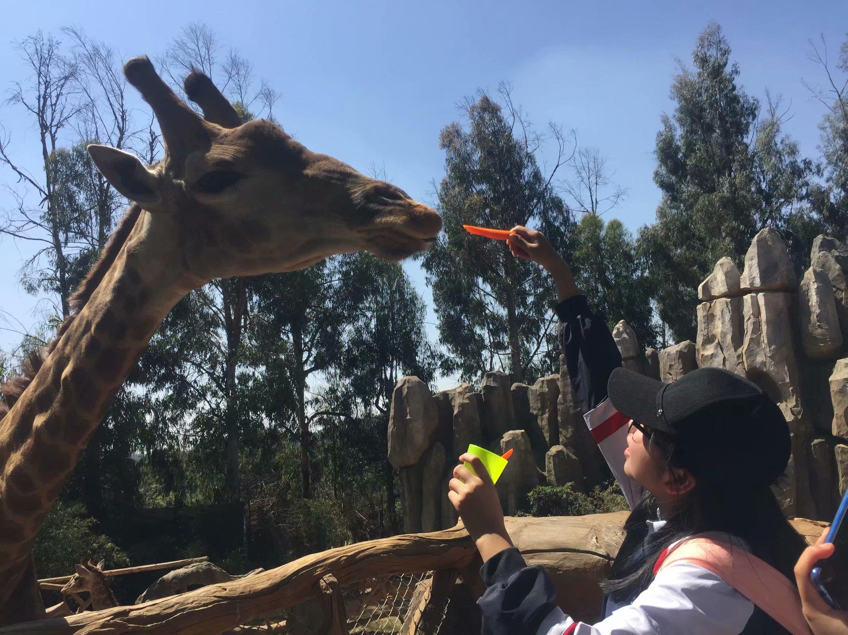
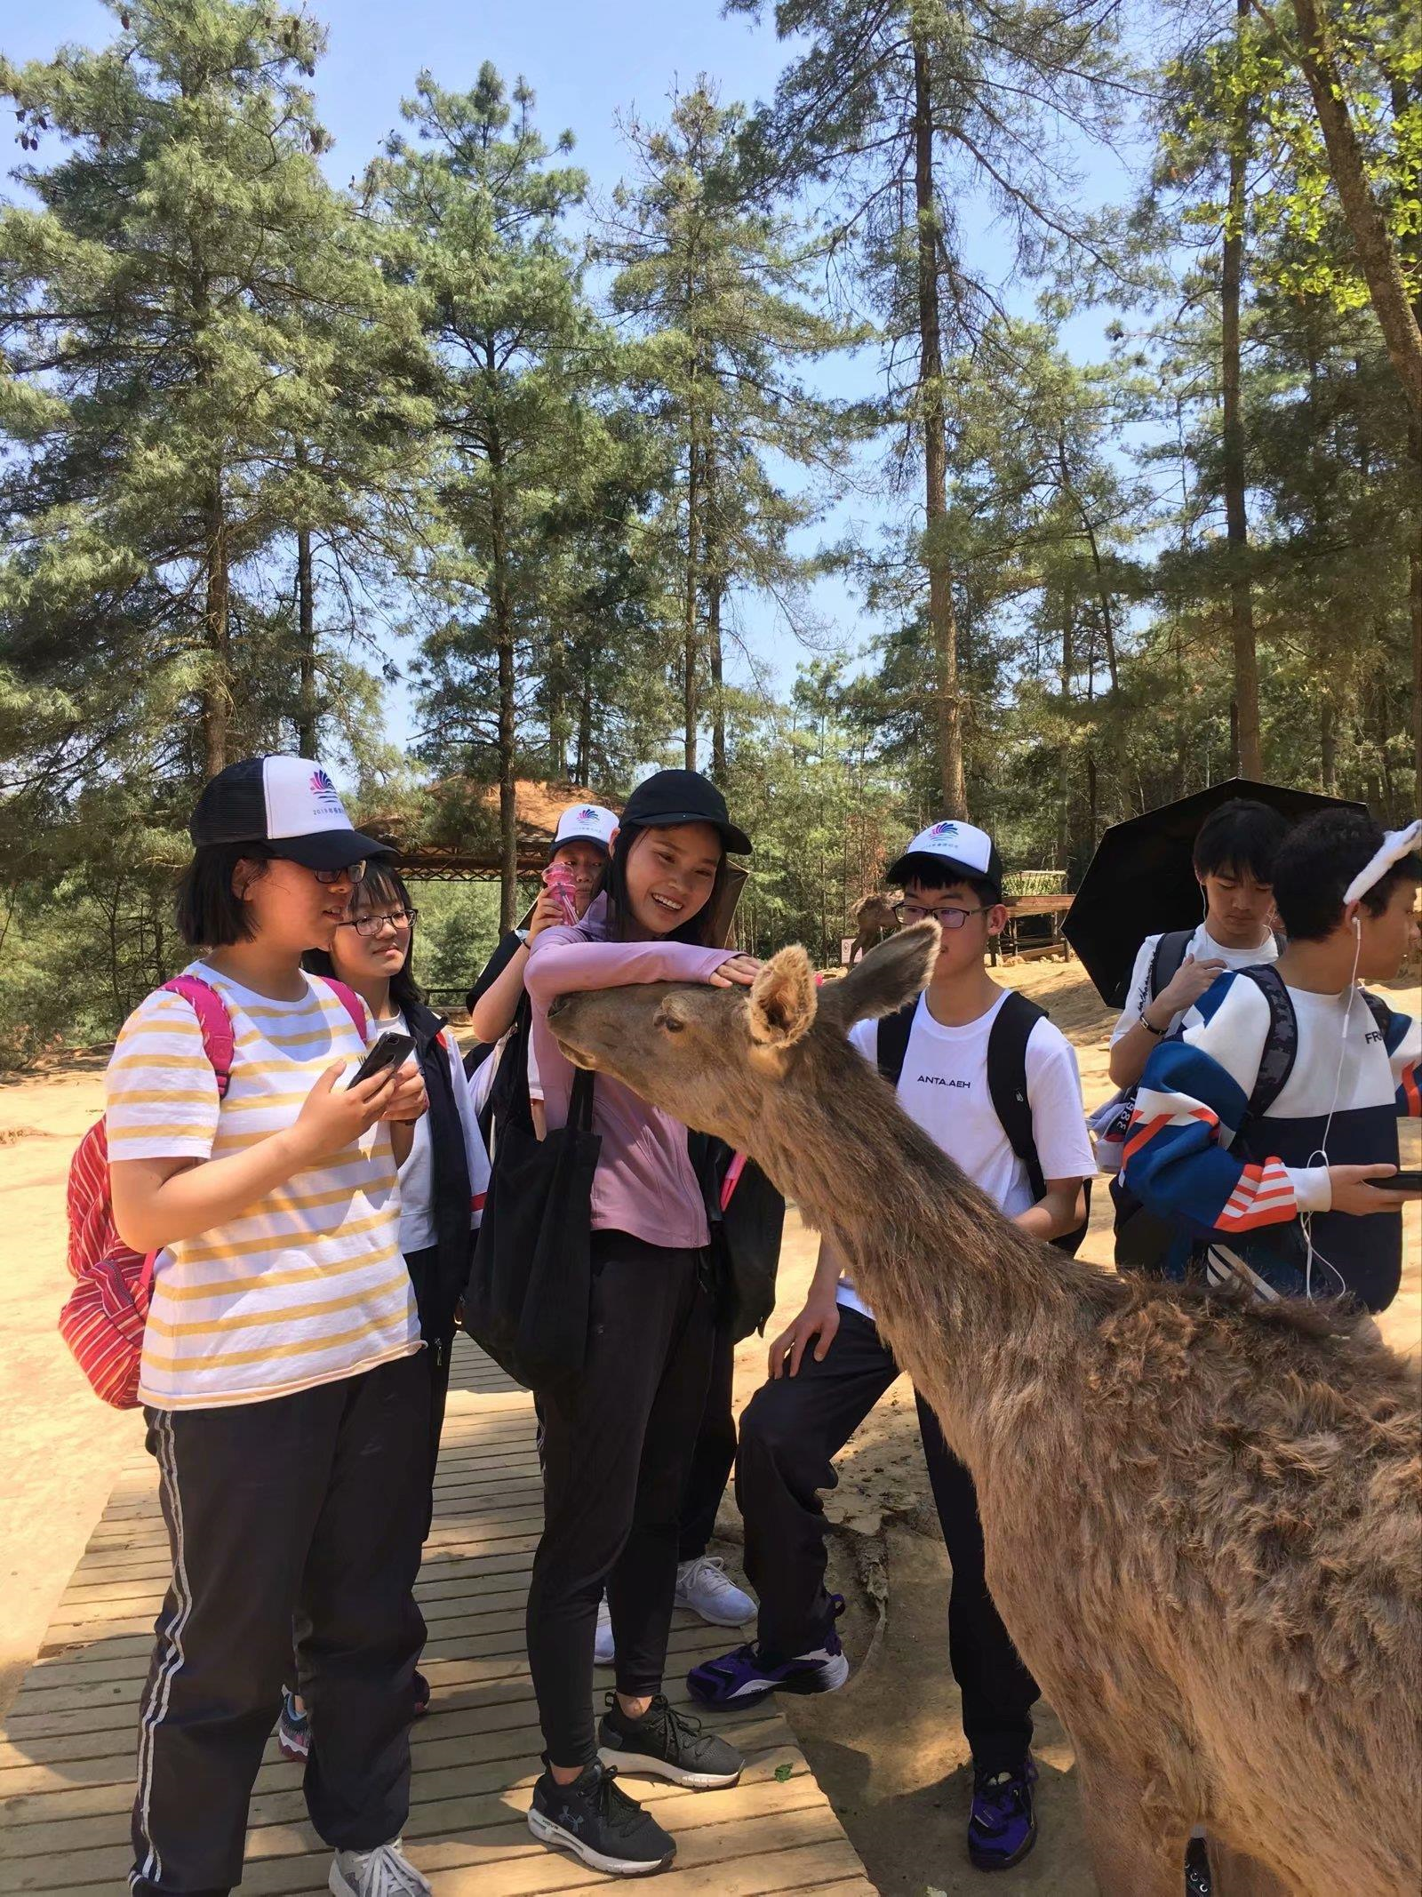
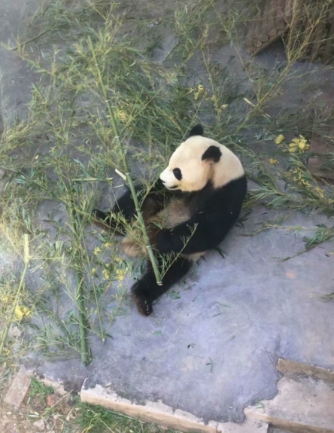


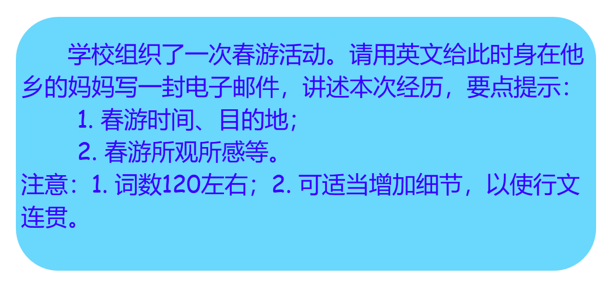
Notes:
设计一个应用文写作任务.比如给外国朋友写信，描述你难忘的一次旅行。或者校报英语报道一次全校出游活动。
老师，您好，鉴于这是一次真实的活动，是大家共同的难忘的记忆，为了保证作文在真实语境里发生，所以，我想请教一下您，可否用上面这个作文题目来使学生真实而自热地呈现自己的经历和感受？谢谢您，请您指点！

Slide 20
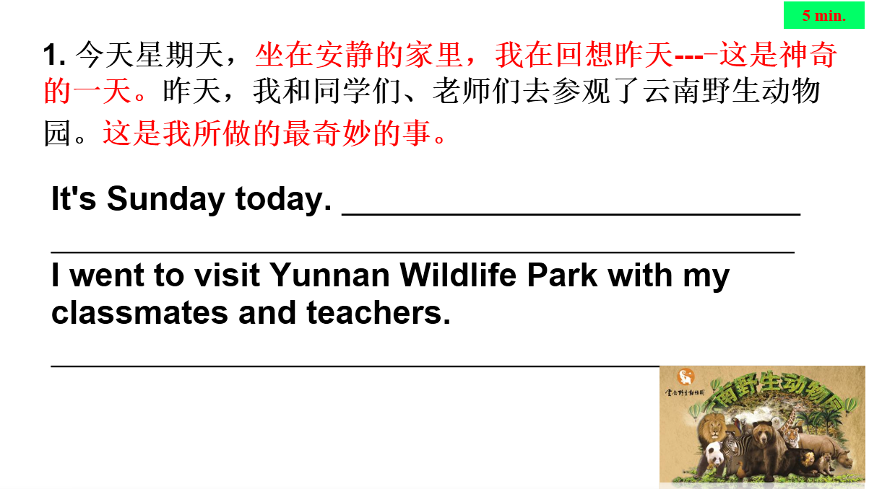
Sitting at my quiet home, I’m reflecting yesterday--- a day of pure magic!
It was the most fantastic thing I have ever done.

Slide 21
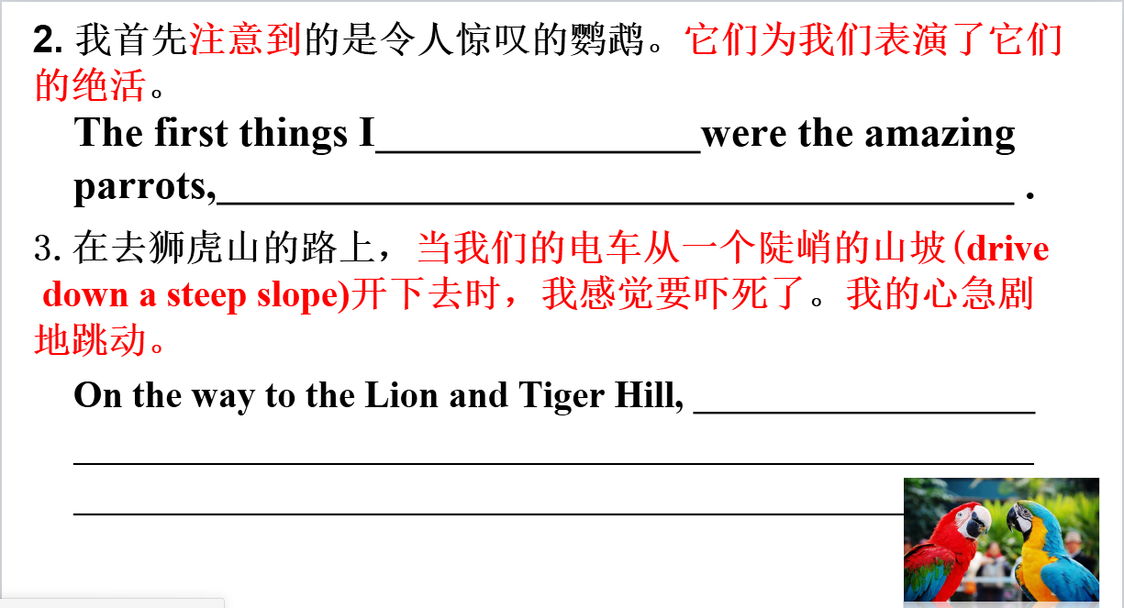
became aware of
which performed their unique skills for us
I felt scared to death when our electric bus drove down such a steep slope. My heart beat wildly.

Slide 22
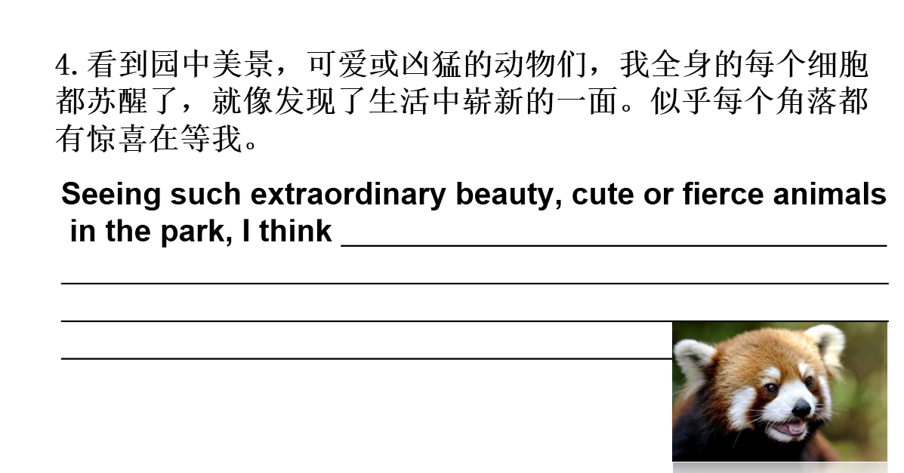
every cell in my body woke up. It was like discovering a new dimension of life. It seemed there was a surprise waiting for me around every corner.

Slide 23
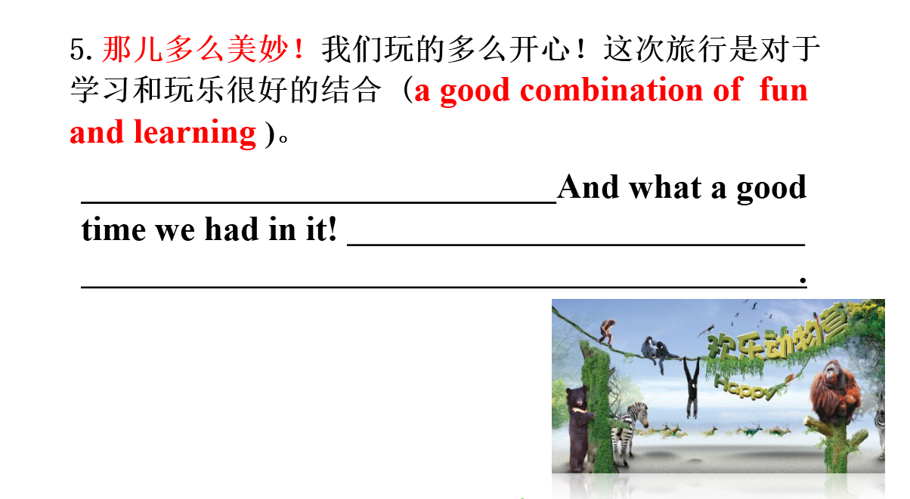
What a wonderful world it is!
The trip was really a good
combination of fun and learning!
What a wonderful world it is!

Slide 24

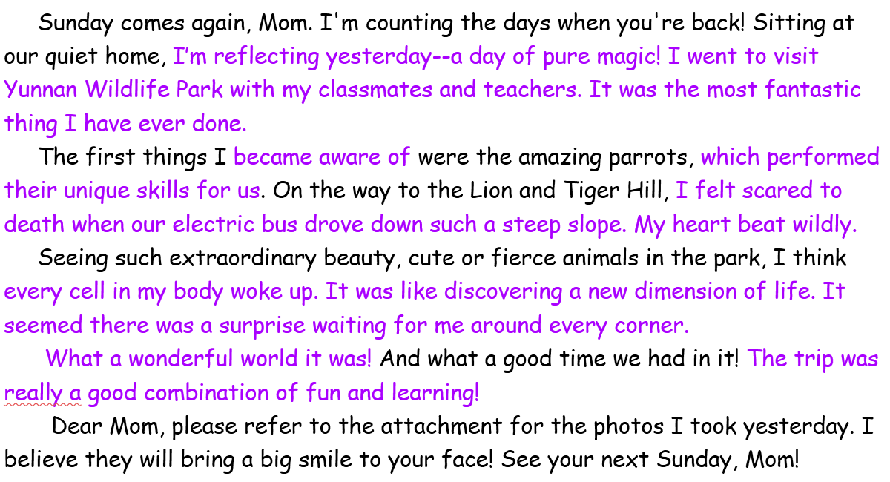

连句成篇
Can’t wait to appreciate yours!

Slide 25

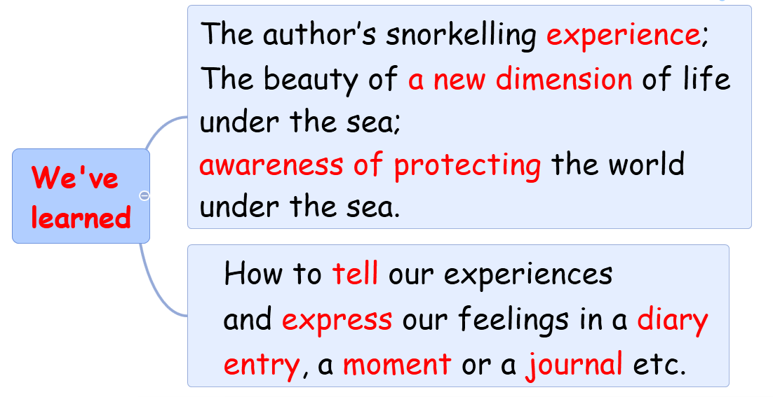

Slide 26
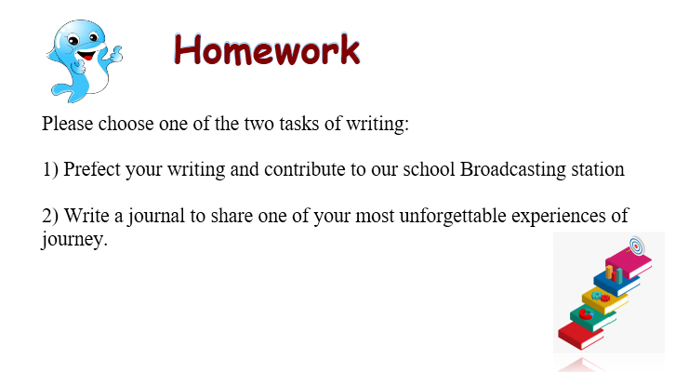

Slide 27
