Slide 1
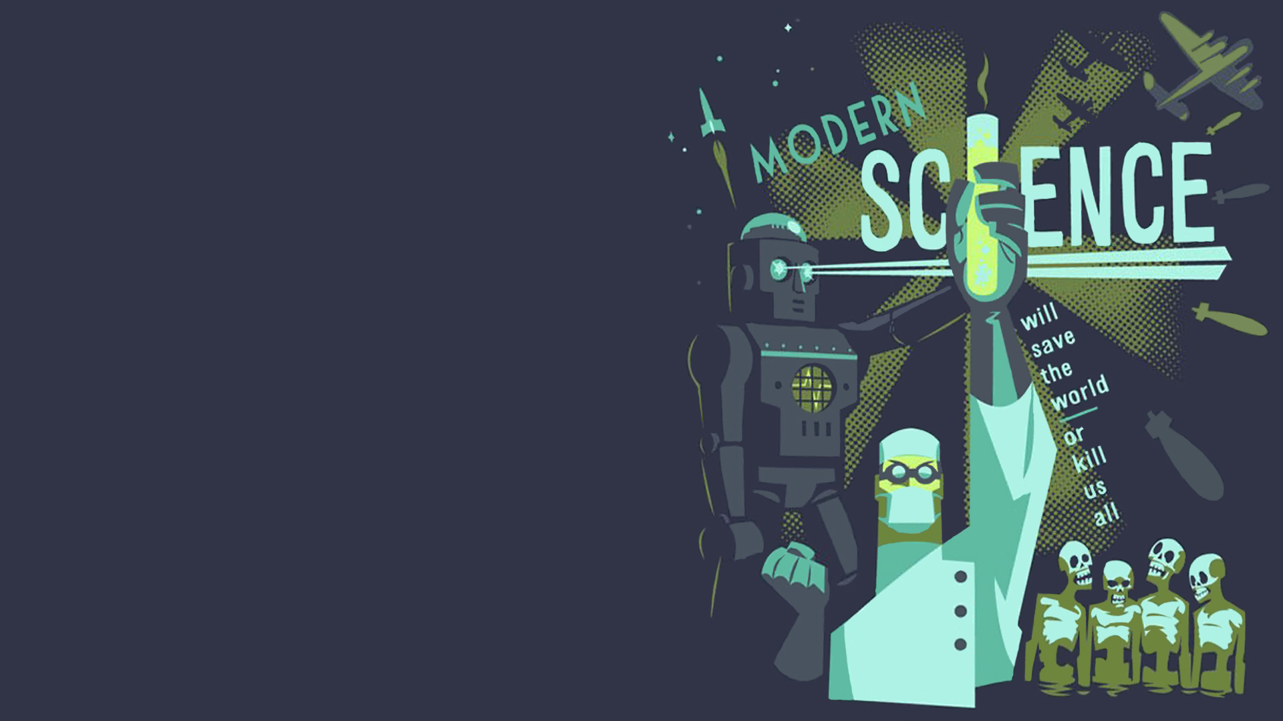
Reading: How Life Began on the Earth
Teaching Objects: During the class, students should be able to
1.Understand the meaning of the reading passage.
2.Practice the following reading skills: skimming and scanning
3.Get the detailed information about how life developed on the earth
4.Practice skills of analyzing things in scientific mind
5.Retell the story by completing the summary
Focal points& Difficult points:
1. Get the detailed information about how life developed on the earth
2. Practice skills of analyzing things in scientific mind

Slide 2
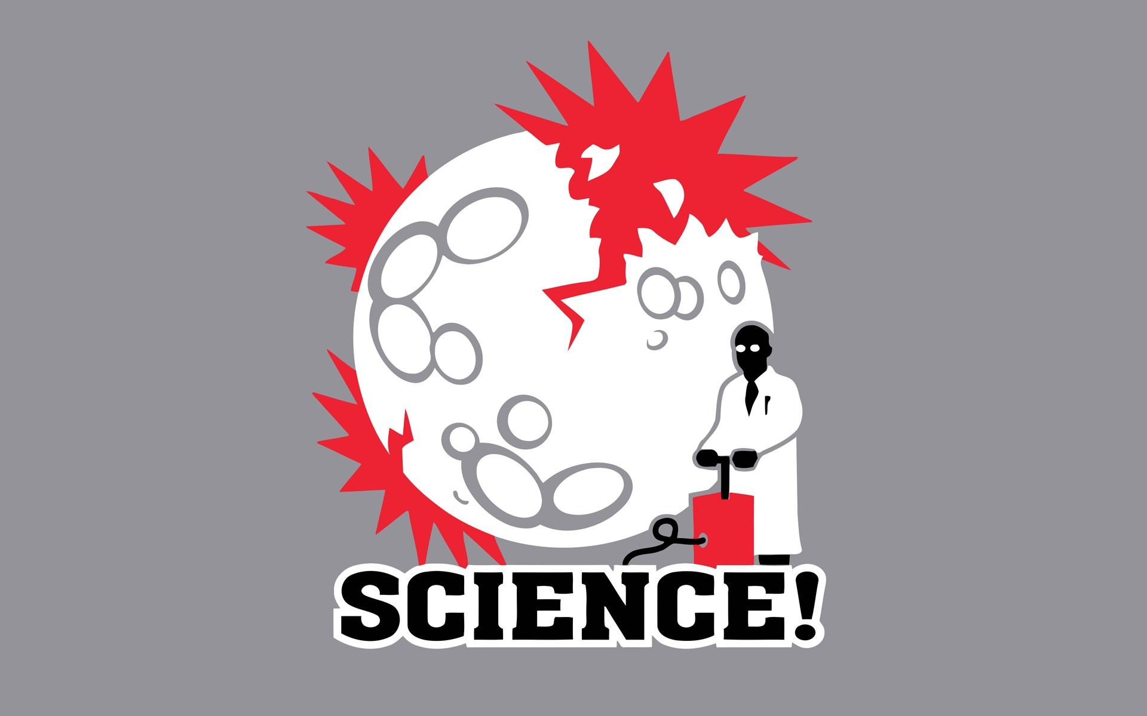
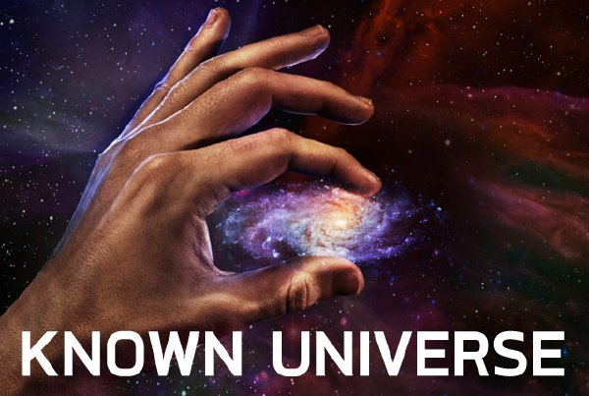
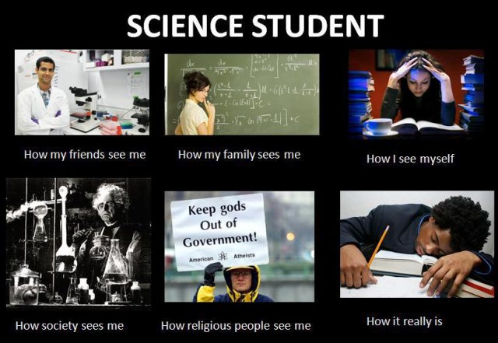

Slide 3
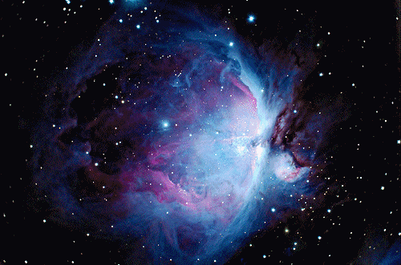
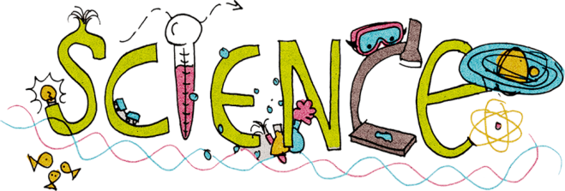
Unit4 Astronomy
The of the stars

Slide 4
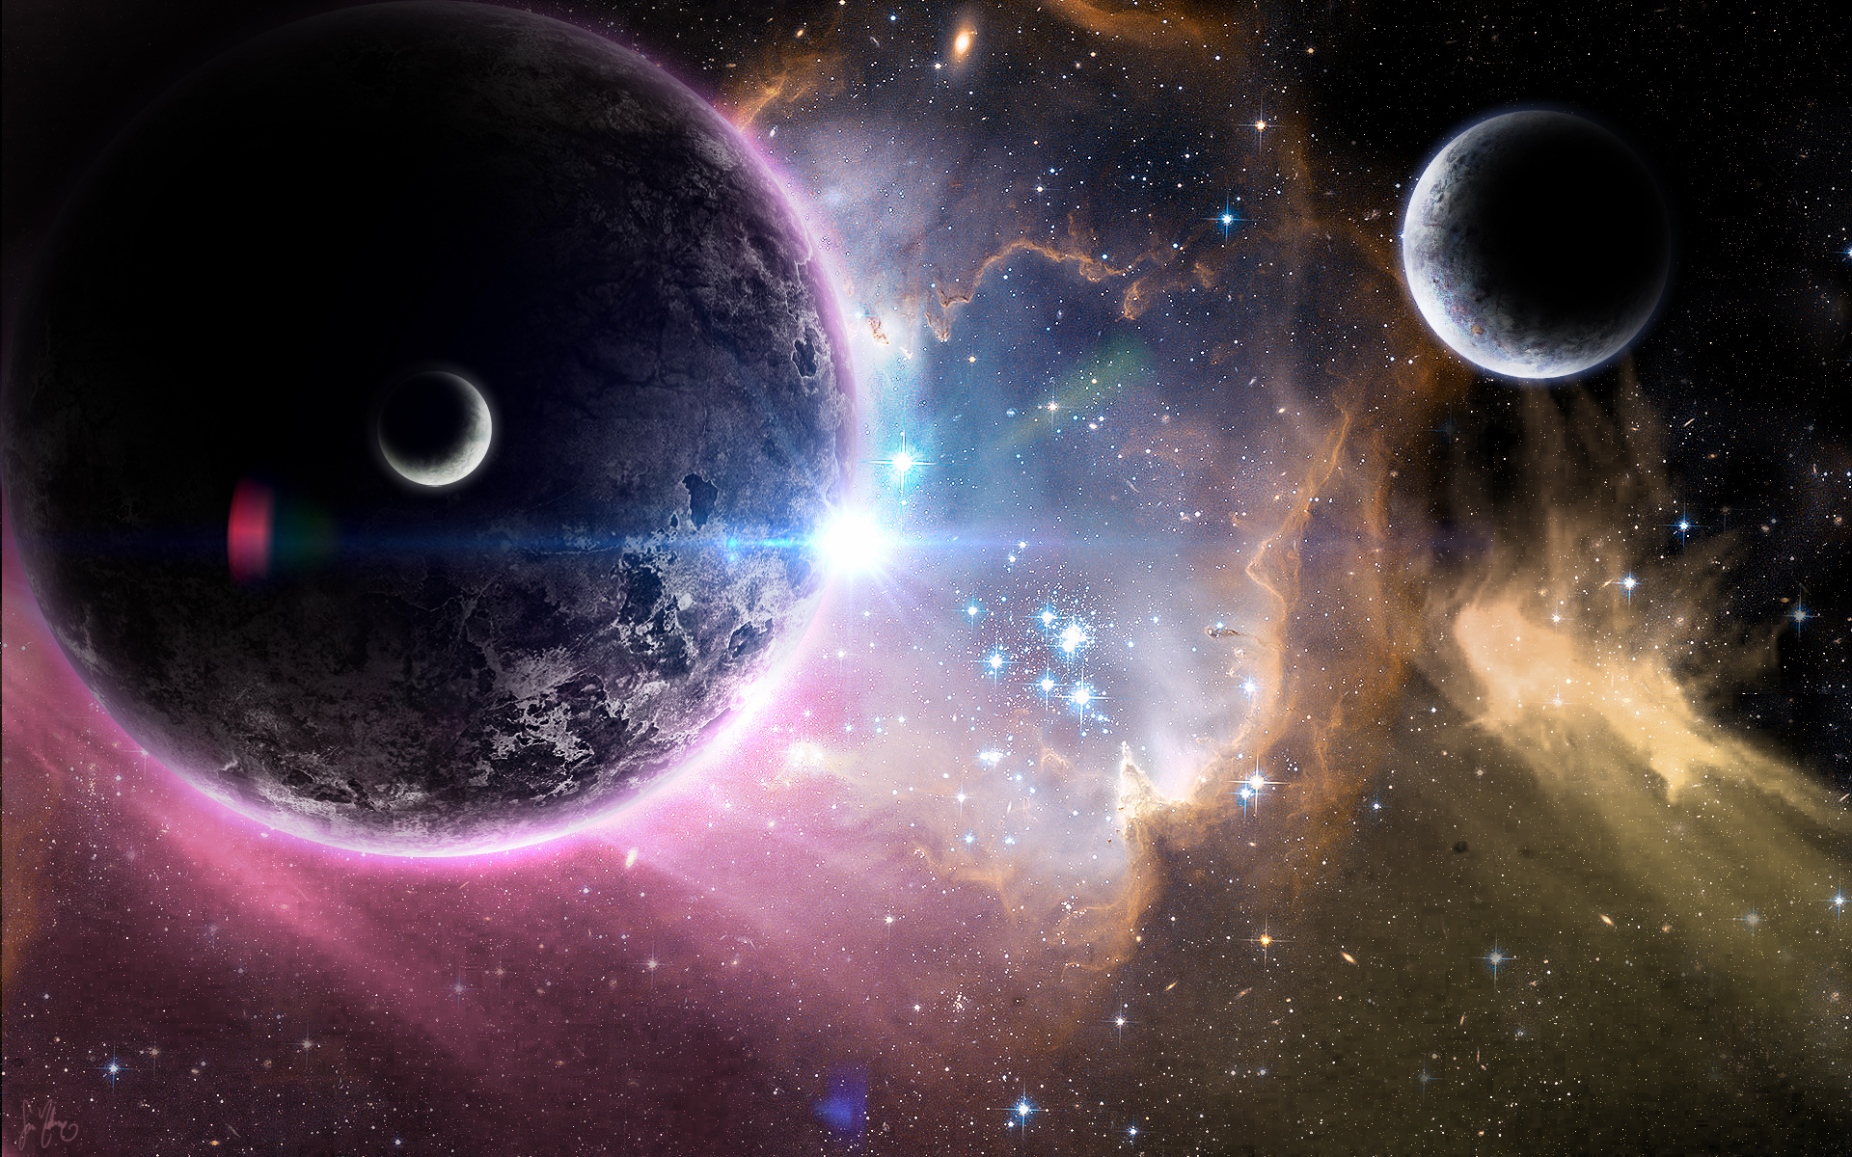




Quiz
The earth moves around the sun.
2. It takes the earth one day to move around the sun.
year
3. The earth is the only planet moving around the sun.
one of the 8 planets
4. There is water on the moon now.
is no water on the
5. The earth is the only planet in the solar system which has living creatures.

Slide 5
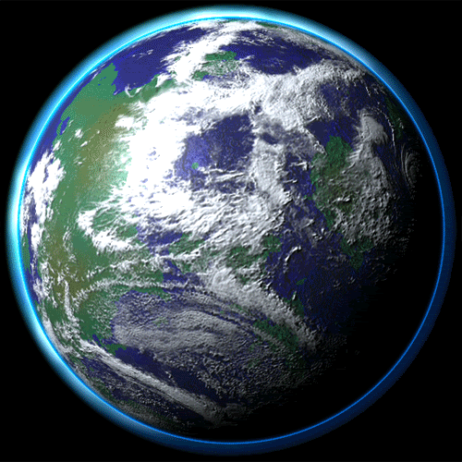

The earth is the only planet in the solar system which has living creatures.

Slide 6
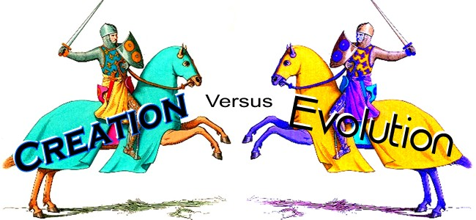
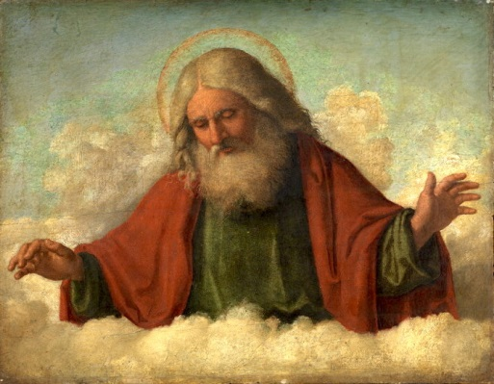
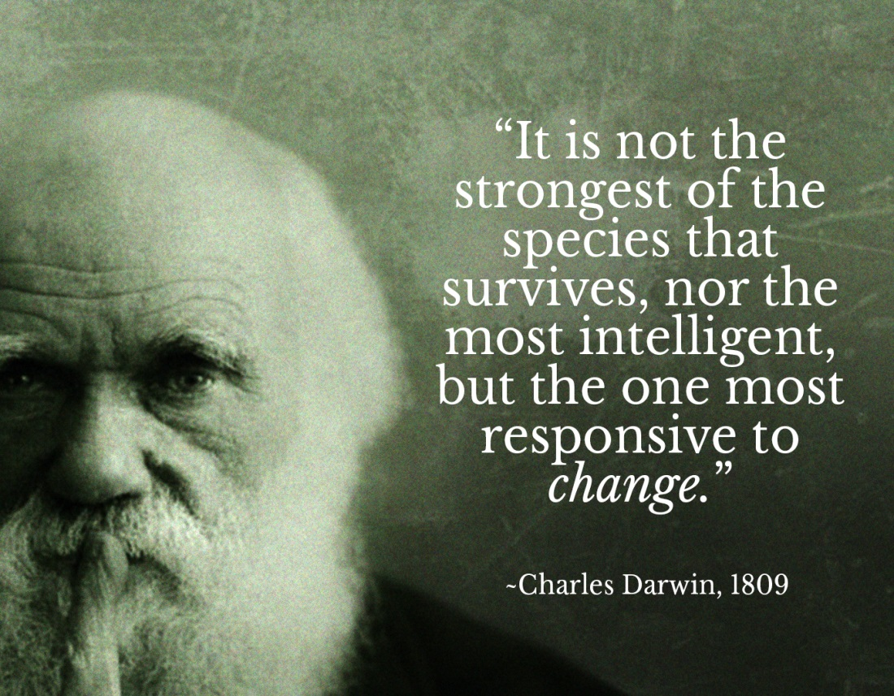
HOW LIFE BEGAN ON THE ERTH
VS
进化论
神创论

Slide 7
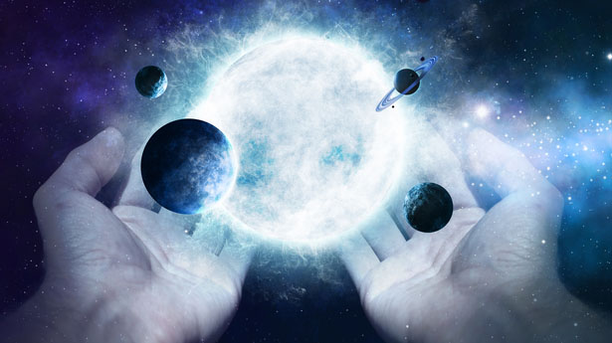
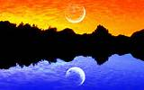
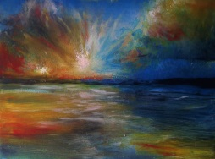
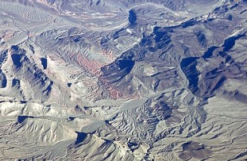

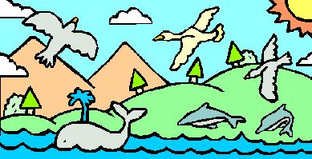
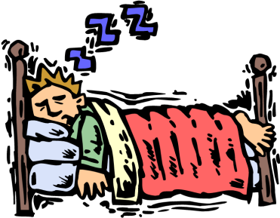
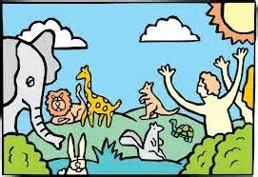
God created the world in 7 days
Day1:God created day and night
Day2:Sky and ocean
Day3:Dry land
Day4:The sun, moon and stars
Day5:Creatures in the air and sea
Day6:Land animals and man
Day7:God had a rest

Slide 8
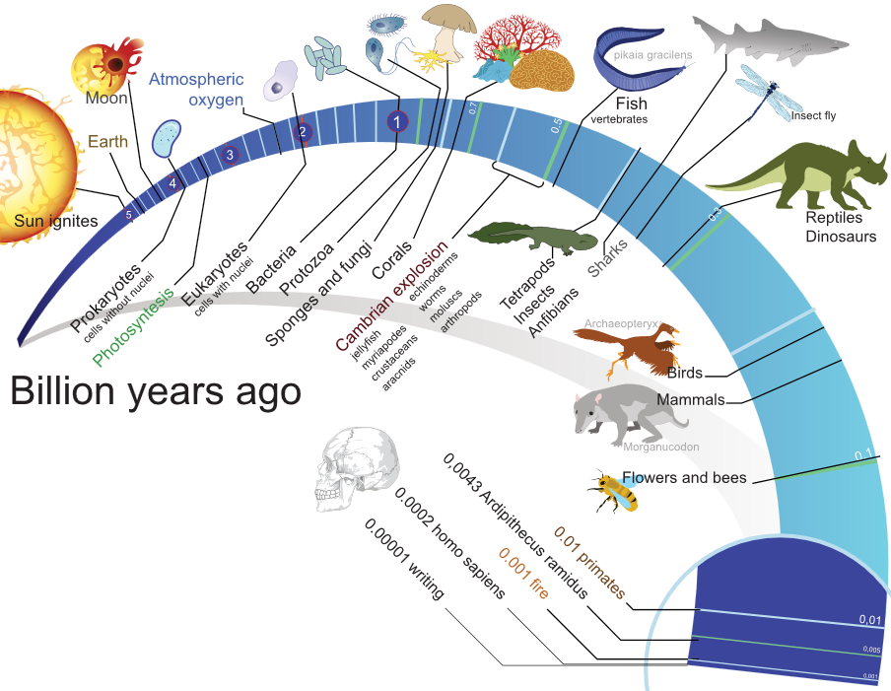
Reading
How Life Began on the Earth

Slide 9
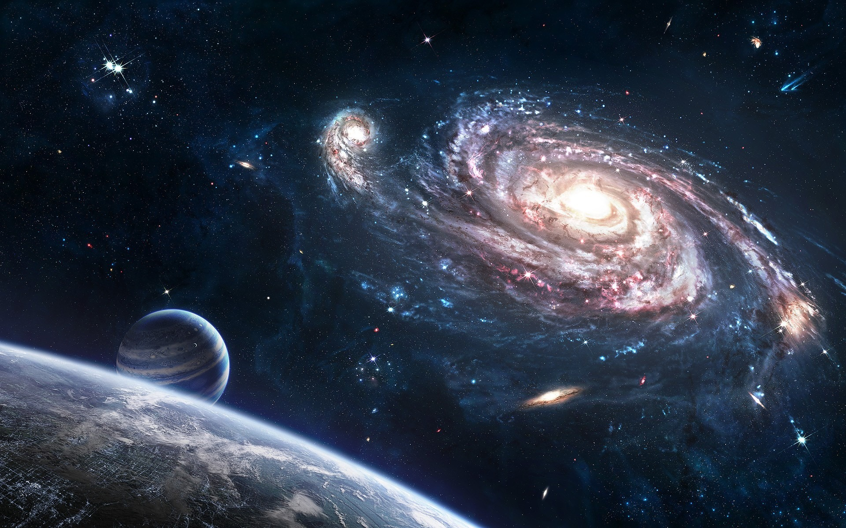
Match the main idea with each paragraph.
Para. 1
A. The formation(形成) of the earth.
Para. 2
B. The importance of water for life.
C. A widely accepted theory about the formation of the universe.
Para. 3
D. The arrival of a kind of clever animals and their impacts on the earth.
Para. 4
Fast Reading
Para. 5
E. The development of plants and animals on the earth.

Slide 10



Careful Reading
Task 1 (para.1)
What is the widely accepted theory in Para 1?
The universe began with a “Big Bang” that threw matters…

Slide 11
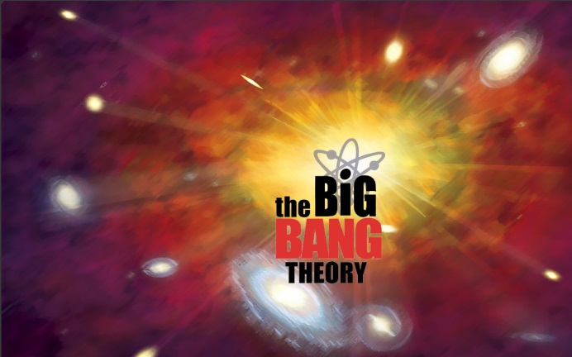
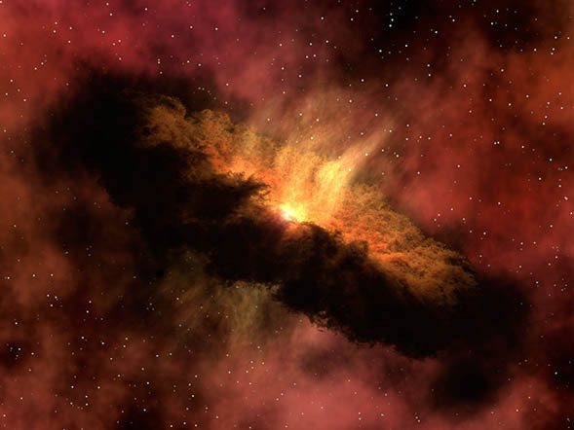
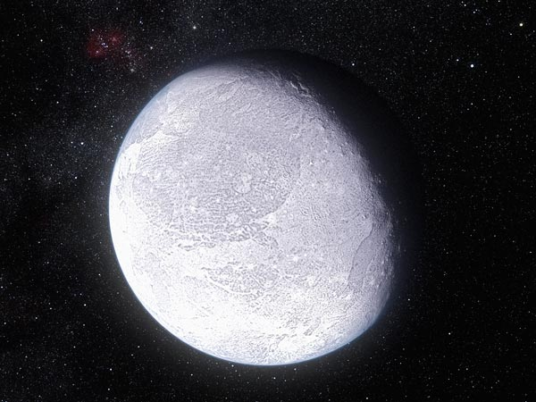
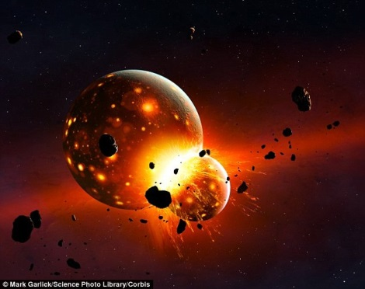
Task 2 (para.2)
How did the earth come into being(产生）?
Big Bang
a cloud of ____
dust
slowly combine
a solid ____
globe

Slide 12
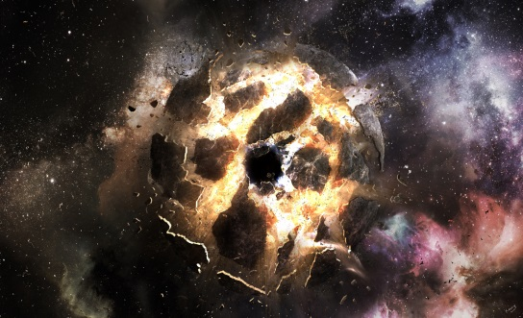
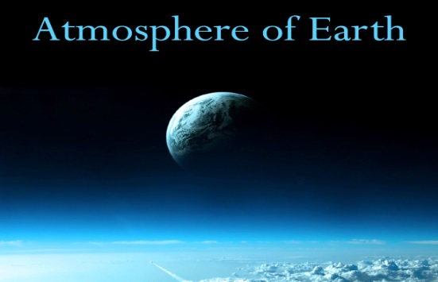
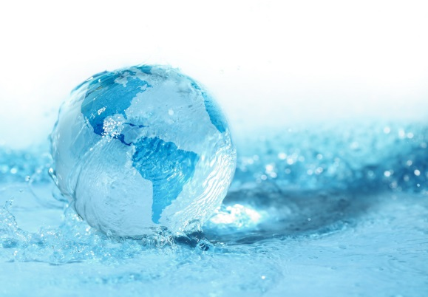
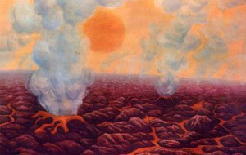
Task 2 (para.2)
it exploded loudly with _____ and _____
rock
fire
the earth’s ___________
atmosphere
the earth ______ down
___appeared
cooled
water

Slide 13


Task 3 (para.3)
Why was the earth different from other planets?
A It produced a lot of heat B The water remained
C Water disappeared D It was the oldest planet
2. Why was life able to develop on the earth but not
on other planets?
A The earth had a solid shape
B The earth didn’t have harmful gases in its atmosphere
C The water stayed on the earth but not on other planets
D The earth was not too hot or not too cold

Slide 14

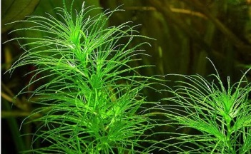
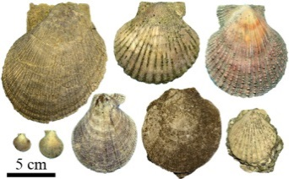
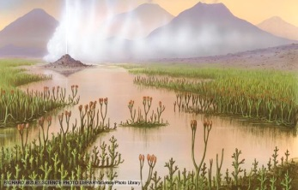
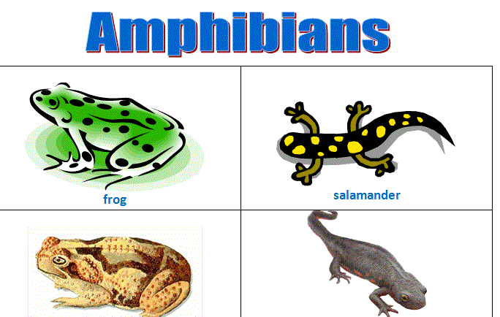
Task 4
(para.4)
  How did life develop after water appeared?
extremely small plants
The first__________________ on the surface of the water produced O2 .
shellfish
Early _______ and all sorts of fish appeared.
Green plants
________ began to grow on land.
Followed by land animals , some were _______. Others, called_________
insects
amphibians

Slide 15

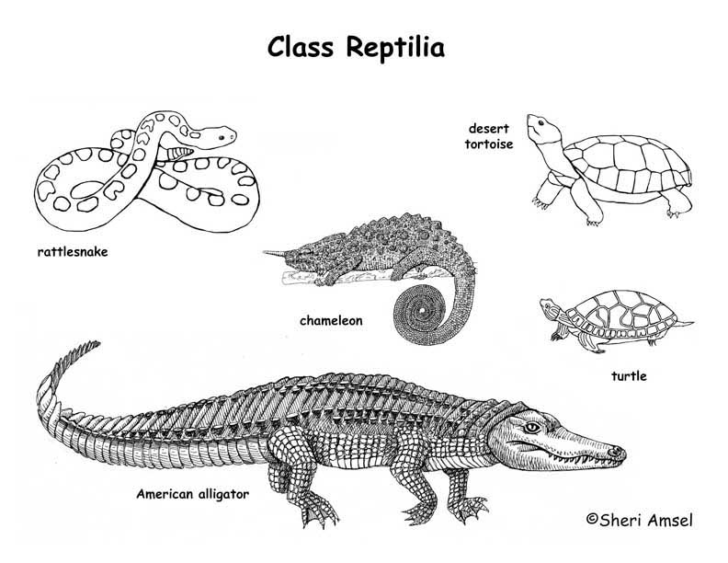
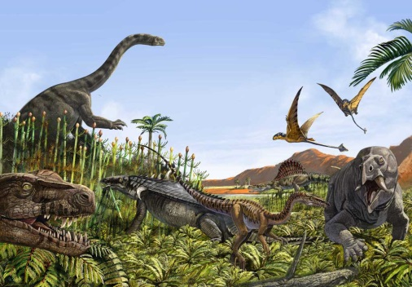
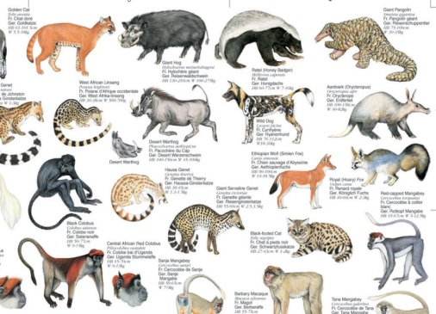
When the plants grew into forests, _______appeared.
reptiles
After that, some huge animals
called _________developed.
dinosaurs
The disappearance of dinosaurs made possible the rise of _______ on the
earth.
mammals

Slide 16
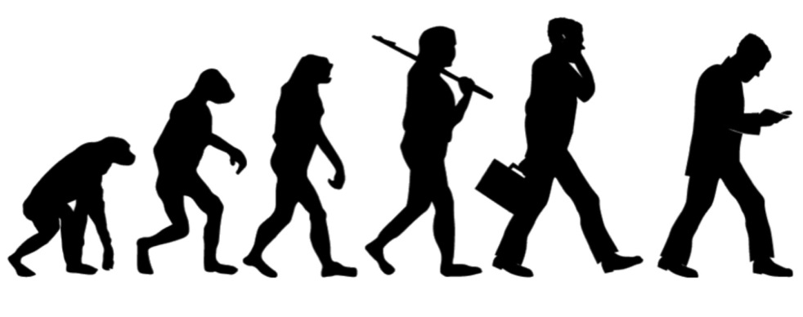
Task 5 (para.5) Q&A
1. What were those clever animals with hands and feet?
2. What have they done to the earth?
What problem are humans causing?
Human beings
They are not looking after the earth very well.

Slide 17
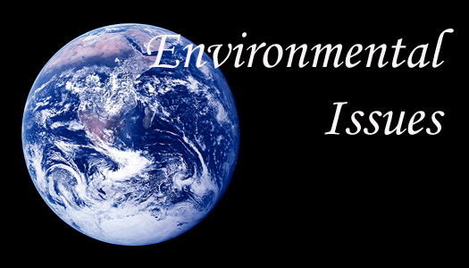
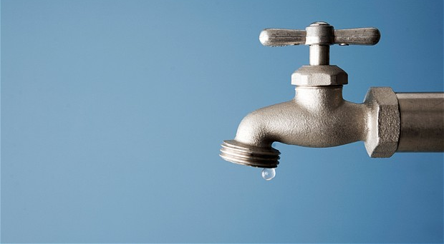
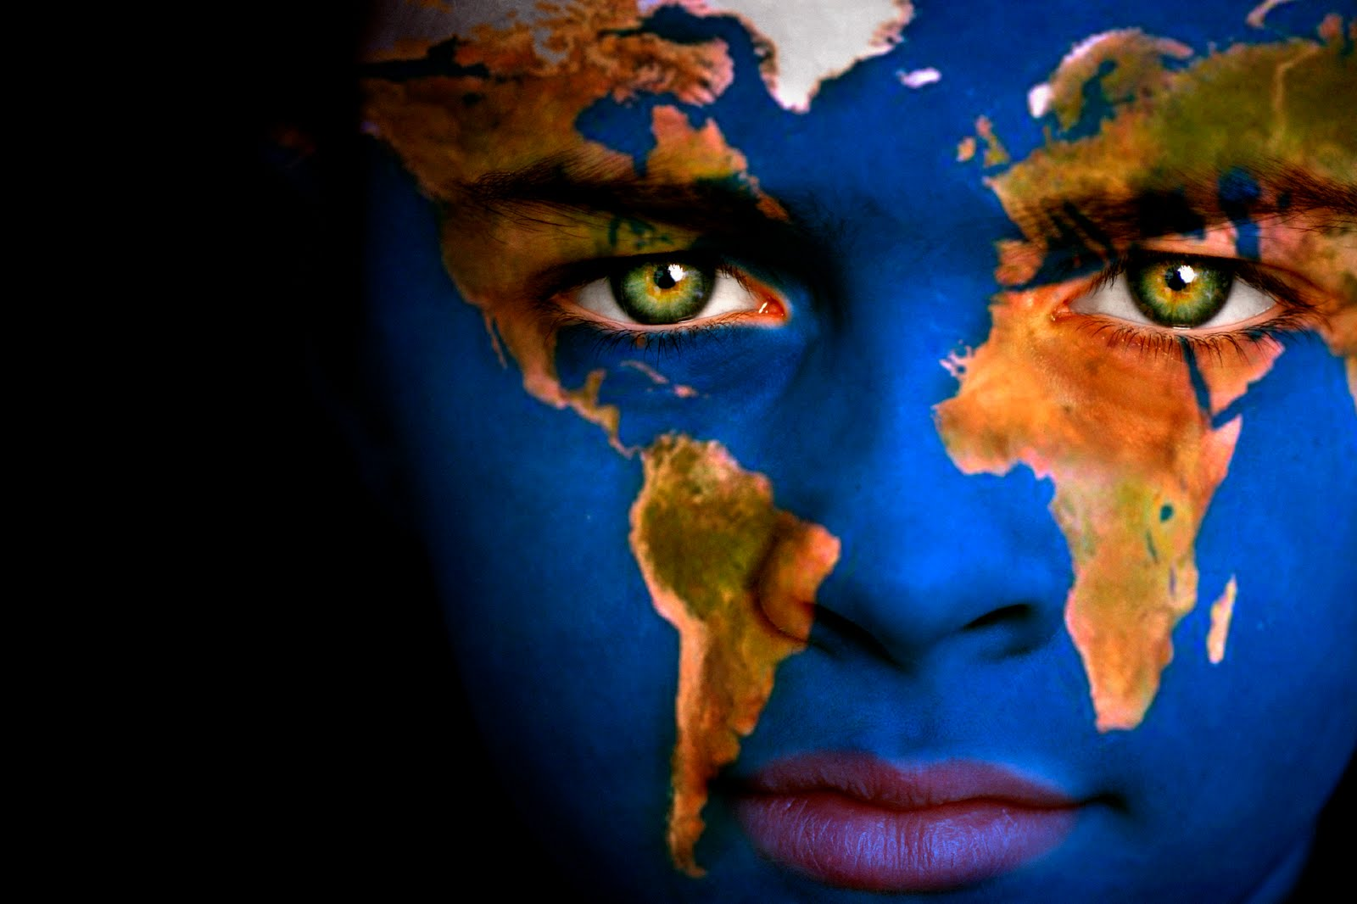
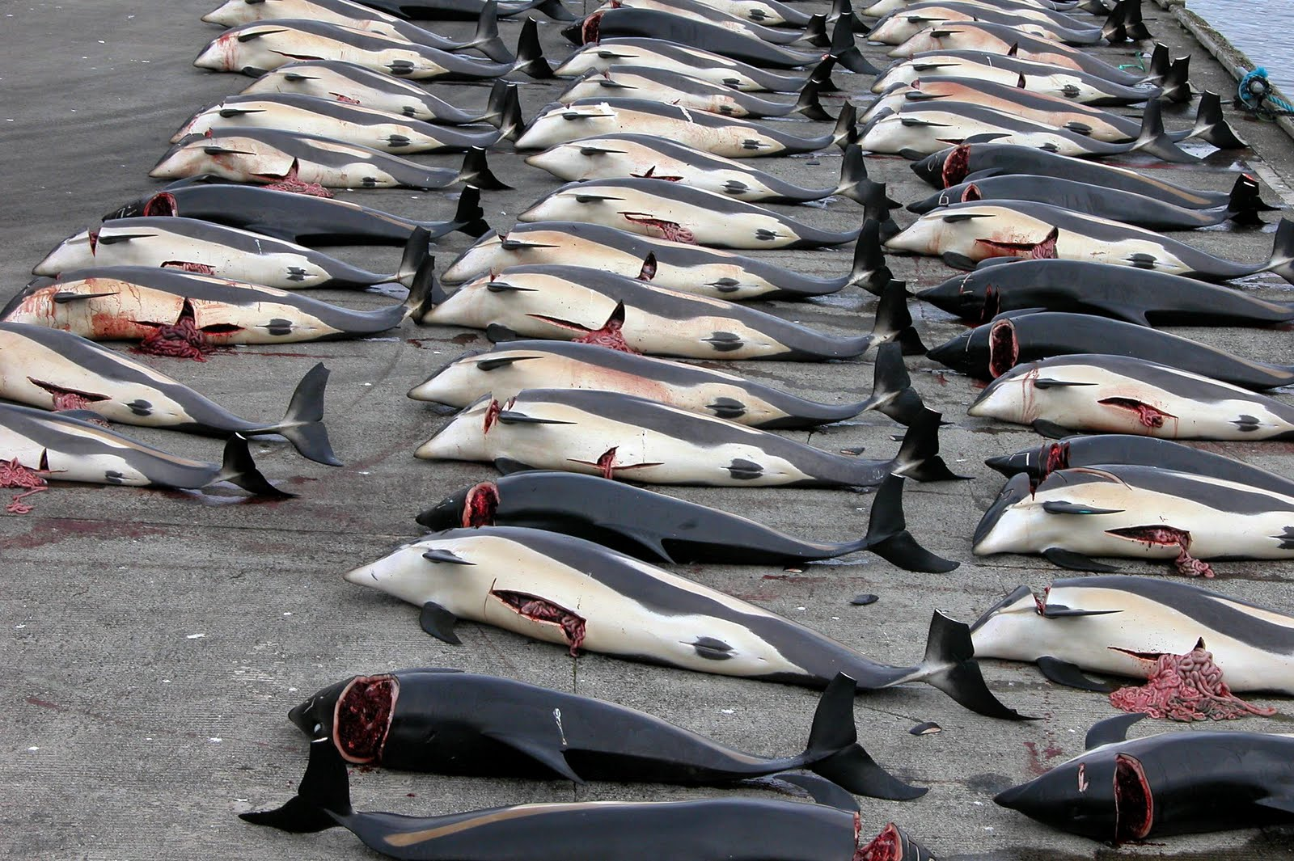
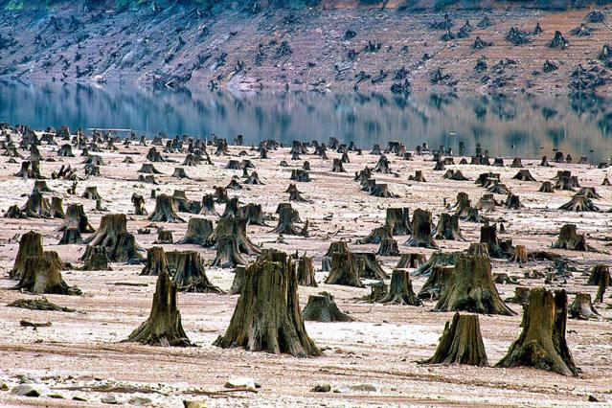
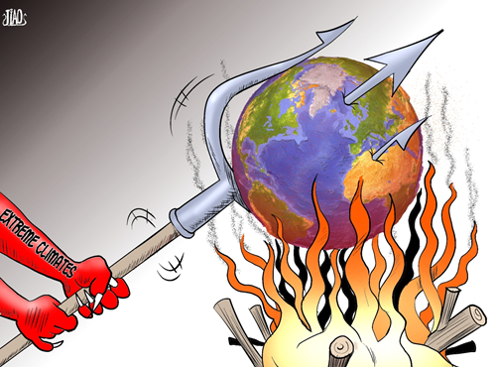
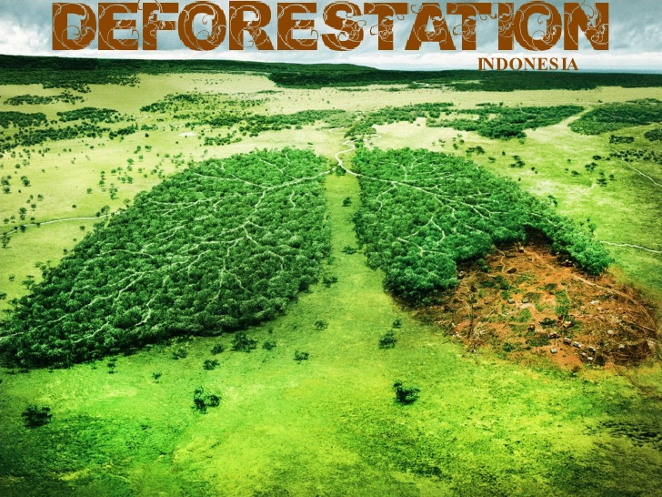
Global Warming
Deforestation
Water Shortage
What little things can we do for our Mother Earth?
Over hunting

Slide 18
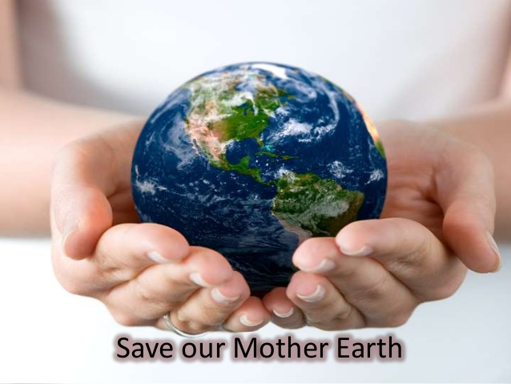

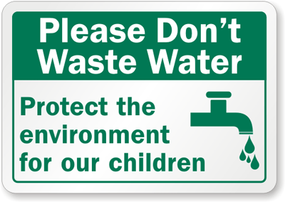


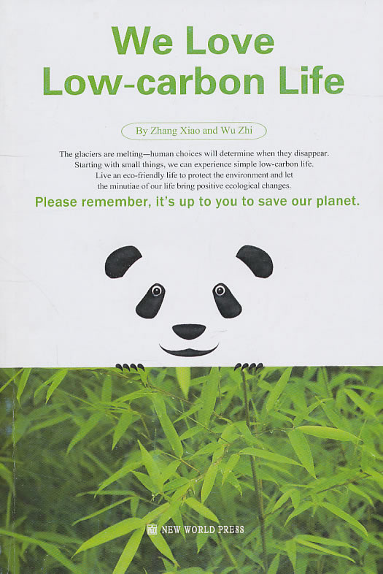



Slide 19

Summary
After the “big bang”, the earth was still just a cloud of _____,it _______loudly with fire and rock, which were _____ to produce the_________, water vapour and other gases. Then ________ began to appeared on the earth. ____________ in water are considered
to be the earliest lives on the earth. The O₂ they supplied encouraged the lives of______________. Slowly green plants grew on land, which were followed by __________like insects & ________. When the plants grew into______, ______ appeared. Then _______ developed but disappeared later, which made the rise of a totally different animal,______, possible, and finally _____ spread all over the world.
dust
exploded
in time
carbon
water
The small plants
shell-fish and fish
land animals
amphibians
forests
reptiles
dinosaurs
mammal
humans

Slide 20
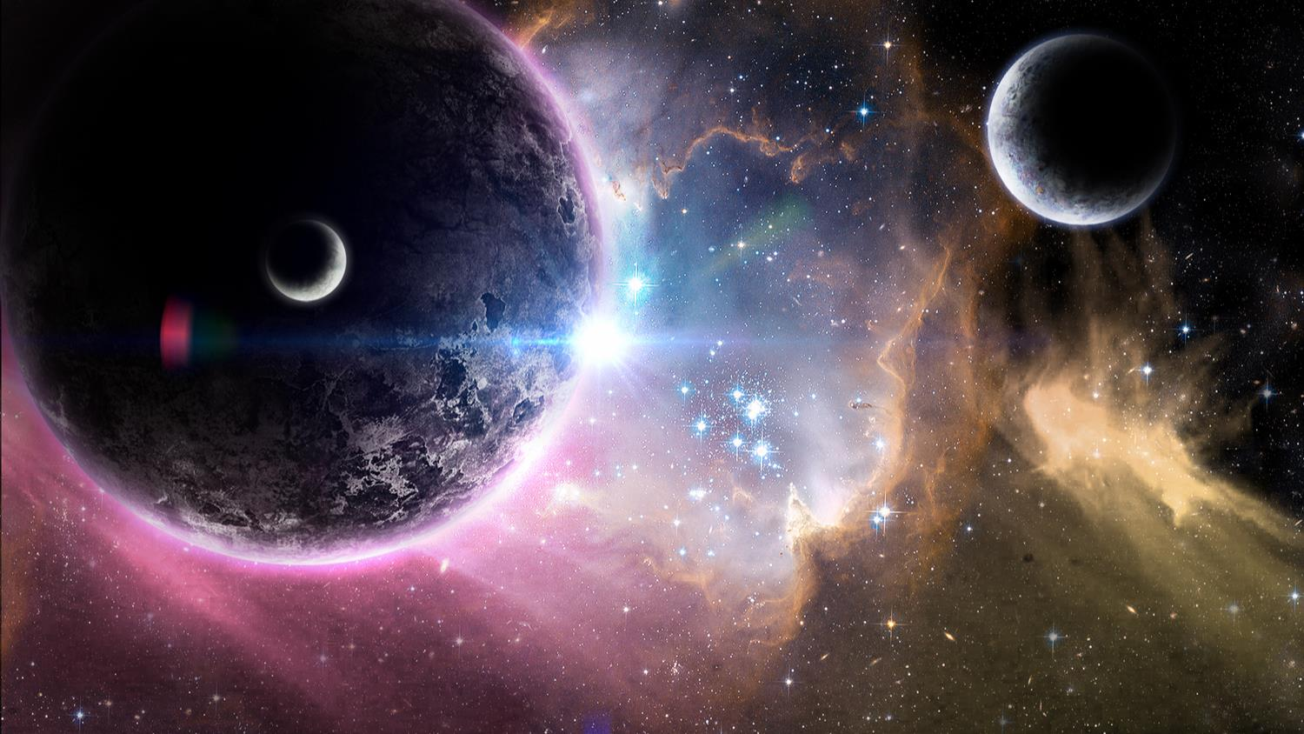

The History of the earth
Video

Slide 21
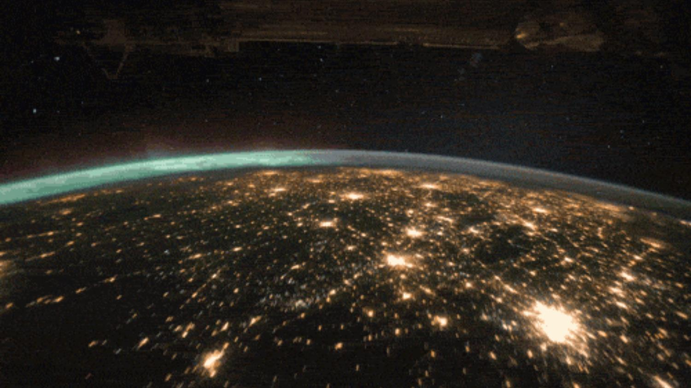
Homework
What message can you get from “As a result of this, many scientists believe the earth may become too hot to live on. So whether life will continue on the earth for millions of years to come will depend on whether this problem can be solved? ”
Can you write something to solve this problem?

Slide 22
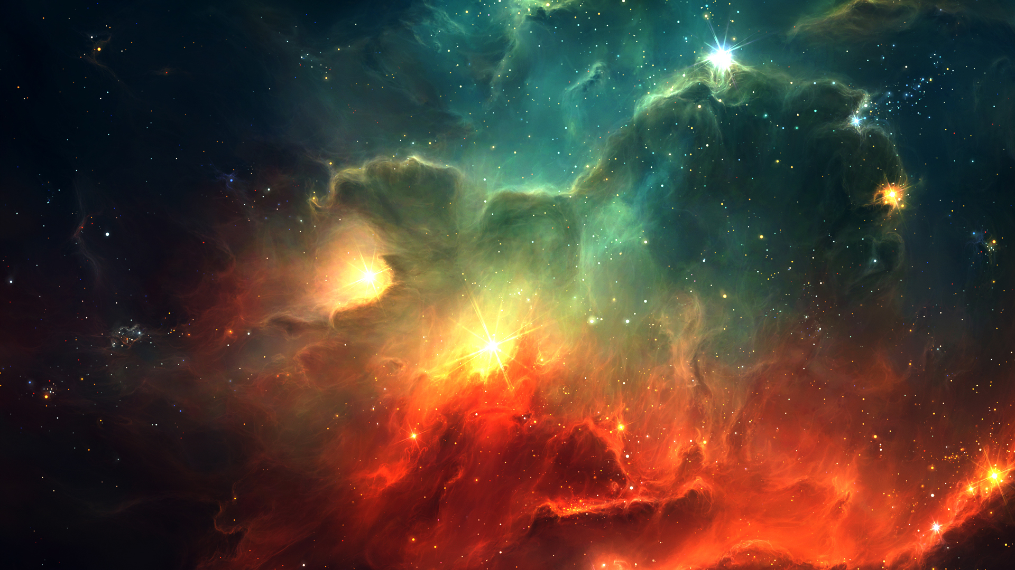

T H A N K S

Slide 23
The End
右键点击结束放映

Slide 24
The End
右键点击结束放映

Slide 25

作者简介
陈德荣，男，党员。英语专业8级。2004年以来连续多次获市优质课比赛一等奖，主编40多套优秀教辅丛书及资料，主持多个省级课题和在国家级刊物上发表论文多篇，教学业绩突出。

Slide 26

感恩遇见，相互成就，本课件资料仅供您个人参考、教学使用，严禁自行在网络传播，违者依知识产权法追究法律责任。
更多教学资源请关注
公众号：溯恩高中英语
知识产权声明

