Slide 1

感恩遇见，相互成就，本课件资料仅供您个人参考、教学使用，严禁自行在网络传播，违者依知识产权法追究法律责任。
更多教学资源请关注
公众号：溯恩高中英语
知识产权声明

Slide 2





苛求完美
抗疫暖心金句
写作高分素材
aim for perfection
常山一中
吴俊峰
Loading http://www.sunedu.com

Slide 3
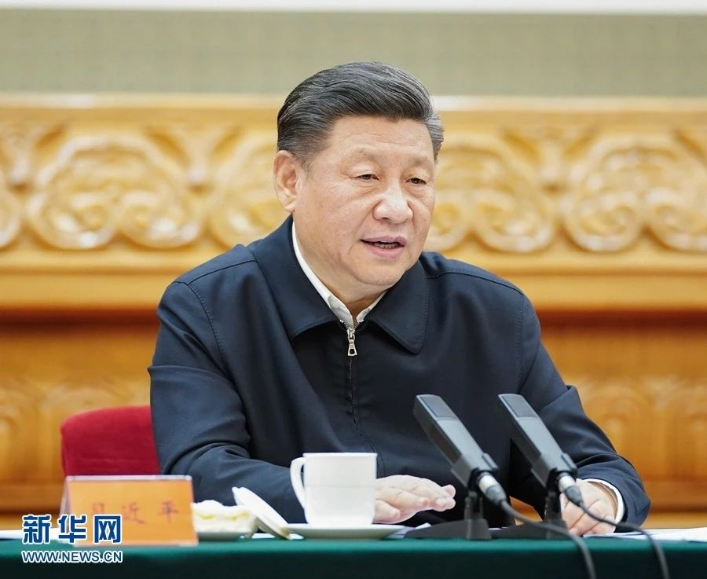
1

Slide 4
1
The Chinese nation has experienced many ordeals in its history, but it has never been overwhelmed.
中华民族历史上经历过很多磨难，但从来没有被压垮过。
---2020年2月23日，习近平在统筹推进新冠肺炎疫情防控和
经济社会发展工作部署上的重要讲话。
ordeal /ɔːˈdiːl/ n. 折磨；严酷的考验；痛苦的经验
overwhelm /ˌəʊvəˈwelm/ vt. 淹没；压倒；受打击；覆盖；压垮
The Chinese nation has experienced many ordeals in its history, but it has never been overwhelmed. Instead, it has become more and more courageous, growing up and rising up from the hardships.
中华民族历史上经历过很多磨难，但从来没有被压垮过，而是愈挫愈勇，不断在磨难中成长、从磨难中奋起。

Slide 5
1
The Chinese nation has been through all kinds of trials and tribulations in its history, which forged a national character of perseverance and resilience. Fighting this epidemic will be no exception. It will only make us stronger and more tenacious. Our country will march on in more determined strides to usher in moderate prosperity in all respects, to eradicate absolute poverty, and to realize the rejuvenation of the Chinese nation.
中华民族历史上曾经历过各种艰难困苦，这恰恰培育了我们百折不挠的民族精神。这场疫情同样将强健我们的筋骨，磨炼我们的意志，让中国以更坚实的步伐，实现全面小康，摆脱绝对贫困，迈向中华民族的伟大复兴。---2020年2月15日，王毅在第56届慕尼黑全会议上的演讲。
tribulation /ˌtrɪbjuˈleɪʃn/n. 苦难；磨难；忧患 resilience /rɪˈzɪliəns/ n. 恢复力；弹力；顺应力
tenacious /təˈneɪʃəs/adj. 顽强的；坚韧的 stride /straɪd/ n. 大步；步幅；进展
usher /ˈʌʃə(r)/ vt. 引导，招待；迎接；开辟 prosperity /prɒˈsperəti/ n. 繁荣，成功
eradicate /ɪˈrædɪkeɪt/ vt. 根除，根绝；消灭 rejuvenation /rɪˌdʒuːvəˈneɪʃn/ n.复兴，恢复活力

Slide 6
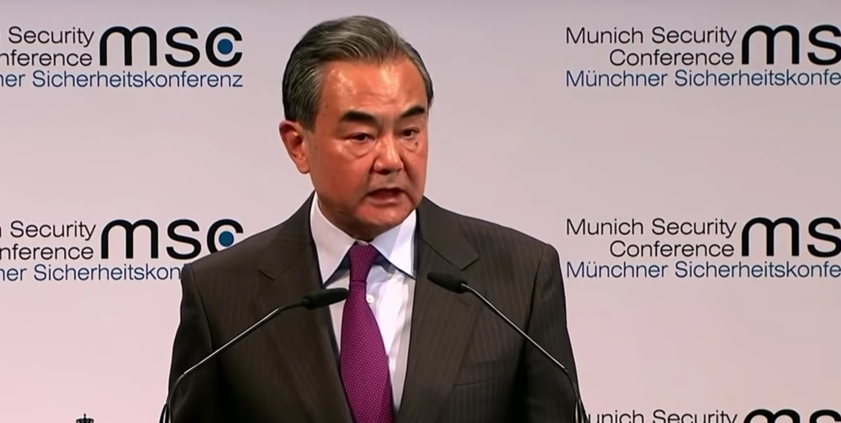
2
We resolve to protect the city of Wuhan, protect Hubei province, and protect every fellow countryman who is struggling with the virus.
我们决心守护武汉，守护湖北，守护与病毒抗争的每一位骨肉同胞。
---2020年2月15日，王毅在第56届慕尼黑全会议上的演讲。
resolve /rɪˈzɒlv/ v. 决定; 解决
countryman n. 同胞
fellow countryman
同胞; 同乡; 手足同胞;

Slide 7
2
The Chinese government is engaged in a vigorous effort to combat the sudden outbreak of a novel virus. The 1.4 billion Chinese people are united as one in fighting this “war without smoke”. We resolve to protect the city of Wuhan, protect Hubei province, and protect every fellow countryman who is struggling with the virus. And we are determined to fight and win this battle.
中国政府正全力抗击一场突如其来的新型疫情. 14亿中国人民团结一心，投身到这场没有硝烟的战争之中。我们决心守护武汉，守护湖北，守护与病毒抗争的每一位骨肉同胞，坚决打赢这场疫情阻击战。
--- 王毅在第56届慕尼黑全会议上的演讲。
vigorous /ˈvɪɡərəs/ adj. 有力的；精力充沛的
combat /ˈkɒmbæt/ n. 战斗；搏斗

Slide 8
3
A race against time, leave no one behind.
应收尽收，刻不容缓！
As many world leaders noted, it is admirable that the Chinese government and people have shown firm resolve in dealing with the epidemic. The high speed and massive scale of China's response are rarely seen in the world. China's speed, scale and efficiency all demonstrate the strengths of China's system.
正如许多国家领导人所说，中国人民战胜疫情的决心令人惊叹，中方行动速度之快、规模之大，世所罕见，展示出的中国速度、中国规模、中国效率显示了中国制度的优势。--- 王毅在第56届慕尼黑全会议上的演讲。
epidemic /ˌepɪˈdemɪk/ adj. 流行的；传染性的 n. 传染病；流行病
scale /skeɪl/ n. 规模；比例

Slide 9

4
Wuhan is not an isolated island and is not fighting alone.
武汉不是“孤岛”，武汉不是孤军作战。
---中央指导组成员，国务院副秘书长丁向阳。
isolate /ˈaɪsəleɪt/ v. 使...隔离，孤立，脱离

Slide 10
4
Another group of people working around the clock were several thousand engineers and construction workers, who built the two specialized hospitals equipped with 2,500 beds in less than 15 days. Braving freezing weather, community workers leave no stone unturned in checking on every block to make sure that no family in need is left unattended to. Tens of thousands of volunteers are working non-stop to help deliver supplies and assistance to the affected regions. Overseas Chinese around the globe rushed to make donations in cash and kind to help battle the outbreak.
数千名工程人员通宵达旦，在不到15天时间里建成2500张床位的两所专业化医院。基层社区人员在风雪中深入每一个街巷，为防控疫情不放弃任何一个家庭，不遗漏任何一个角落。千千万万志愿者日夜兼程为疫区运输物资、提供帮助。遍布海外的华人华侨感同身受，自觉为抗击疫情捐钱捐物。--- 王毅在慕尼黑全会议演讲。
leave no stone unturned 彻底;千方百计 in cash and kind 以现金和物资

Slide 11
4
Wuhan may be the front line in this battle, yet Wuhan is not fighting alone. We Chinese across the country stand firmly with our brothers and sisters in Wuhan and Hubei.
That said, China is not fighting alone. The international community has given us valuable moral and material support. This joint fight is strengthening the friendship between the Chinese people and peoples across the world.
防范疫情的重点地区在武汉，但武汉并不孤单，因为全中国人民都同武汉和湖北的兄弟姐妹坚定地站在一起。
同时，中国并不是孤军作战，国际社会也给予了我们宝贵的精神支持和物质援助。各国人民同中国人民的友情在共同抗击疫情中得到了升华。--- 王毅在第56届慕尼黑全会议上的演讲。
with our brothers and sisters 和我们的兄弟姐妹（比喻）
joint /dʒɔɪnt/ adj. 联合的，合办的；共同拥有的

Slide 12
5
Virus knows no borders, but the worst of times reveals the best in people.
疫情无国界，人间有真情。
---2020年2月24日，外交部发言人耿爽答网上例行记者会。
英文中很多都是“无灵名词”做主语，这样会让整个句子更生动形象。这句话选择“疫情”和“特殊时期”作主语让整个句子更出彩。“无灵名词”做主语后，动词可以灵活选择。常见动词有witness / show / experience等。政府工作报告中常会使用这种翻译方法来解放动词。
reveal /rɪˈviːl/ vt. 显示；透露；揭露

Slide 13
6
Fear not the want of armor, for mine is also yours to wear.
岂曰无衣，与子同裳。
armor /ˈɑːmə/ n. 盔甲；装甲；（动植物的）保护外层
本句也可译为“Together we stand, my armors thine.”出于《诗经·国风》中的一首《秦风·无衣》：
岂曰无衣？与子同袍。
王于兴师，修我戈矛。与子同仇！
岂曰无衣？与子同泽。
王于兴师，修我矛戟。与子偕作！
岂曰无衣？与子同裳。
王于兴师，修我甲兵。与子偕行！

Slide 14
6
闭上眼睛，我们似乎能听到一声远古的呐喊——“岂曰无衣”！
这一声喝问，激起了千万人的豪情，志气与决心如山雷的呼啸席卷而来：
“与子同袍！”
“与子同泽！”
“与子同裳！”
《秦风·无衣》为后世留下了“袍泽”这个情谊深厚的称谓，也留下了“同仇敌忾”这个团结的成语。更留下了礼乐文治之外，英勇无畏的民族精神。
血与火的时代距离我们已经遥远，但勇敢的面对、热忱的信任，却是任何时代都不应遗忘的。

Slide 15
6
In the toughest times of the fight, people around the world are standing firmly by our side. Japanese groups sent assistance supplies to China, attached with ancient Chinese poetic lines: “Fear not the want of armor, for mine is also yours to wear”, conveying a touching message of empathy from a close neighbor.
在我们抗击疫情最艰苦的日子里，各国人民也和我们坚定站在一起。日本友好团体在送往中国的物资上写了一句中国古诗：“岂曰无衣，与子同裳”，表达一衣带水邻邦与中国人民的感同身受。
---2020年2月15日，王毅在第56届慕尼黑全会议上的演讲。
stand by one's side 支持；站在某人身边
poetic /pəʊˈetɪk/ adj. 诗的，诗歌的；诗意的；诗人的
empathy /ˈempəθi/n. 移情作用；同理心；感同身受；共鸣

Slide 16
6
In other parts of the world, Americans from all walks of life donated medical items and supplies; an Indonesian policeman sang the song “Go, Wuhan!”; UK pupils performed a Chinese song “Fill the World with Love”; the Burj Khalifa Tower in the UAE was lit up in red in solidarity with China; and from this city, Bayern Munich sent its best wishes to China.
美国社会各界踊跃捐赠医疗物资。印尼警察演唱“武汉加油歌”，英国小学生合唱“让世界充满爱”，阿联酋哈利法塔亮起中国红，德国拜仁慕尼黑足球俱乐部也专门为中国加油打气。---2020年2月15日，王毅在第56届慕尼黑全会议上的演讲。
all walks of life 各行各业；各界人士
in solidarity with...与…团结一致

Slide 17
6
In the face of danger, Philippe Klein, a French doctor working in Wuhan, did not hesitate to stay and fought alongside the Chinese people. He said he kept a bottle of champagne to be popped open for celebrating the end of the epidemic. Munyaradzi Gurure, a Zimbabwean student who lived in Wuhan for three years, also chose to stay and signed up to be a volunteer.
菲利普·克莱因，是一位在武汉工作的法国医生，在危难面前毅然留下，和中国人民并肩战斗。他还说已经准备好一瓶香槟，等疫情结束后再打开共同庆祝。一名叫蒙亚的津巴布韦留学生，在武汉学习生活了3年，疫情爆发后，他也选择留了下来，并且主动报名成了一名抗疫志愿者。--- 王毅在第56届慕尼黑全会议上的演讲。
pop/pɒp/ v. 突然出现；突然地行动；爆开；射击
sign up 报名; 注册; 签雇用合约

Slide 18
7
Lands apart, sky shared.
山川异域，风月同天。
佛教在唐朝是鼎盛时期，一直吸引着周边国家。日本特意派遣僧人出使大唐，以求寻访佛法高深、德高望重的高僧到日本弘法和主持僧人受戒。公元742年，高僧鉴真不顾他人的劝阻，执意东渡日本弘法，而触动鉴真高僧的正是日本向唐朝僧侣赠送的袈裟上的四句偈子：“山川异域，风月同天；寄诸佛子，共结来缘。”
鉴真在日本享有极高的声誉，为中日搭起文化交流的桥梁。当我们看到日本支援武汉物资上的“山川异域，风月同天”，震撼良久，这段跨越近1500年的文化交流，依然在今天散发光芒。本句也有译为“Although hills' n rills set us apart, the moon and wind share our kind heart.”或 ”Rivers low, mountains high, the same moon in the sky.”

Slide 19
8
You throw a peach to me, I give you a white jade for friendship.
投我以木桃，报之以琼瑶。
---2020年2月24日，耿爽回应日本政府和人民援助中方
“投我以木桃，报之以琼瑶”原文来自《诗经·国风·卫风·木瓜》。而《诗经·大雅·抑》中也有类似古文：“投我以桃，报之以李。”两句诗句式和含义都一样：你向我赠送木桃，我就回报琼瑶（美玉）；你赠给我一筐桃，我回敬你一篮李。都强调了“礼尚往来”，我们接受了别人的好意，应该以同样的态度或做法回应对方。
这句古诗采取直译方式，"jade"就是“玉簪”的意思。

Slide 20
8
The Chinese people are also following the spread of the virus in Japan with care and concern. We completely relate to what they are going through.
当前日本国内疫情也牵动中国人民的心，我们感同身受。
---耿爽回应近期中日双方围绕抗击疫情的互动
中文表达一般都比较抽象，我们在翻译的时候需要做到抓住核心意。如“牵动中国人民的心”，这表明中国人民深切关注和关心日本疫情情况。因此，译文翻译为“with care and concern”更直接指出核心含义。
感同身受：completely relate to what they are going through

Slide 21
8
When lending each other a helping hand, we gain friendship and mutual trust.
中日两国互帮互助，传递的是友谊，收获的是互信。
---耿爽回应近期中日双方围绕抗击疫情的互动
原文中的“传递的是友谊，收获的是互信”，并列两个动词搭配其实表达的是一个意思，因此不要翻译成两个并列动词，可以合并成一个动词，共同搭配“友谊”和“互信”。
互帮互助：lend each other a helping hand
互信：mutual trust

Slide 22
8
This is the very epitome of how China and the whole international community have been dealing with global challenges altogether.
这也是中国与整个国际社会共同应对全球性挑战的一个缩影。
---耿爽回应近期中日双方围绕抗击疫情的互动
这句话翻译时候一定要注意时态。此次全球性挑战早已开始，但仍存在，尚未消除，因此，时态使用现在完成进行时更准确。
epitome /ɪˈpɪtəmi/ n. 缩影；摘要；象征; 典型
The iPhone is now the epitome of what a smartphone should be in many consumers eyes, and for good reason.
iPhone现在已经成为许多消费者眼中智能手机的缩影。

Slide 23
8
China will remain in close communication, coordination and cooperation with Japan to jointly protect the lives and health of the two peoples and make positive contributions to upholding regional and global public health security.
中方愿同日方继续保持密切沟通，加强协调合作，共同维护两国人民的生命安全和身体健康，为维护地区和世界的公共卫生安全作出积极贡献。---耿爽回应近期中日双方围绕抗击疫情的互动
这句较长，翻译时候需要弄清楚句子内部逻辑关系，确定好主从关系，采用恰当的方式进行连接。这句话可分成四个小短句,（1）和（2）为句子主体，中方主要执行的事情，而（3）和（4）则是旨在达成的目标，用to do结构来连接（3）和（4）。
密切沟通：close communication
协调合作：coordination and cooperation /kəʊˌɔːdɪˈneɪʃn/
支撑；鼓励：uphold
公共卫生安全：public health security

Slide 24
9
This is the time for facts, not fear.
This is the time for science, not rumors.
This is the time for solidarity, not stigma.
要事实，不要恐慌。要科学，不要谣言。要团结，不要污名。
---世界卫生组织总干事谭德塞
solidarity /ˌsɒlɪˈdærəti/ n. 团结，团结一致
stigma /ˈstɪɡmə/ n. 柱头；耻辱；污名；烙印
We would have seen many more cases outside China by now – and probably deaths – if it were not for the government's efforts, and the progress they have made to protect their own people and the people of the world.
如果不是中国政府的努力，以及中国在保护本国人民和世界人民方面取得的进展，我们现在将会在中国以外的地方看到更多病患，甚至更多死亡病例。---世界卫生组织总干事谭德塞

Slide 25
9
The speed with which China detected the outbreak, isolated the virus, sequenced the genome and shared it with WHO and the world are very impressive, and beyond words. So is China's commitment to transparency and to supporting other countries.
中国发现疫情，分离病毒，进行基因测序并与世卫组织及全世界分享信息的速度令人钦佩，难以言表。中国对信息透明的承诺和对其他国家的支持亦是如此。---世界卫生组织总干事谭德塞。
sequence/ˈsiːkwəns/ vt. 按顺序排好
genome /ˈdʒiːnəʊm/ n. 基因组；染色体组
commitment /kəˈmɪtmənt/ n. 承诺，保证
transparency /trænsˈpærənsi/ n. 透明，透明度

Slide 26
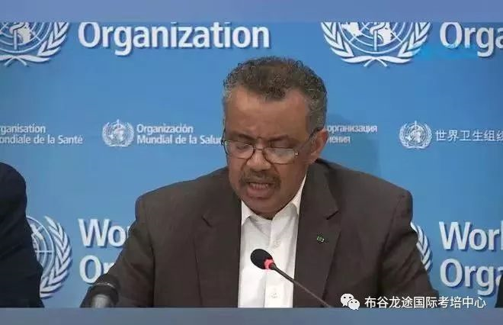
1
0
China's measures are not only protecting its people, but also protecting the people in the whole world.
中国采取的措施不仅是在保护中国人民，也是在保护世界人民。
--世界卫生组织总干事谭德塞。

Slide 27
1
0
The history of civilization is a history of struggle against disease. Virus respects no borders. That is why we have attached great importance to international health cooperation from the start of the outbreak. In the spirit of openness and transparency, we promptly notified the world about the outbreak and shared the genetic sequence of the virus. We have been working closely with WHO, invited international experts to join our ranks, and provided assistance and facilitation to foreign nationals in China.
人类文明史就是一场与疾病的抗争史。病毒没有国界，中方从一开始就高度重视国际卫生合作，本着公开透明原则，及时向各方通报疫情信息，分享病毒基因序列，与世卫组织密切合作，邀请国际专家并肩工作，积极为在华外国公民提供协助和便利。
respect vt. 遵守 notify /ˈnəʊtɪfaɪ/ vt. 通告，通知；公布
join one's ranks 加入...队伍/行列 facilitation /fəˌsɪlɪˈteɪʃn/ n. 简易化

Slide 28
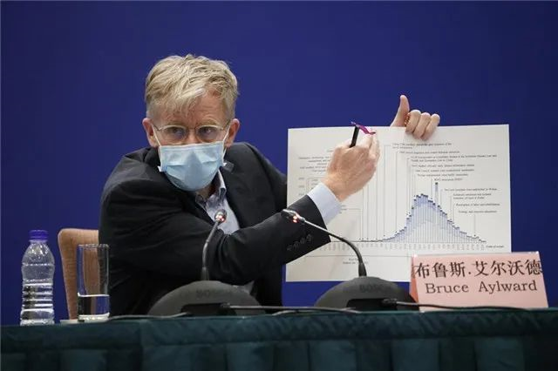
1
1
To the people of Wuhan, it is recognized the world is in your debt.
武汉人民，世界欠你们一句感谢。
---2月24日晚，世界卫生组织总干事高级顾问布鲁斯·艾尔沃德在北京新闻发布会发言
And behind every window of these skyscrapers we drove past, there were people. There were 15 million people who were staying put in one place for weeks at a time to stop this disease.
我们途经一座座高楼大厦，窗户后面，有1500万武汉人，他们几个星期都待在屋里，这一切只是为了阻止病毒的传播。

Slide 29
1
1
And I just thought it's so important that we recognize that to the people of Wuhan, it is recognized, the world is in your debt. And when this disease finishes, hopefully, we will have a chance to thank the people in Wuhan for the role that they played in it, because many of us, many of the people here have suffered but the people of that city have gone through an extraordinary period.
我想这一点很重要，我们必须认识到，对武汉人民而言，世界欠你们一份情。当疫情结束时，希望我们有机会能够感谢武汉人民，为他们的付出和行动，这里的很多人都经受了苦难，但那座城市的人民所经历的是异常的磨难。
in one's debt 受……的恩惠；欠...... 一份情

Slide 30
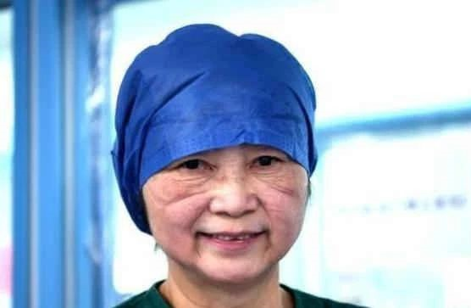
1
2
Heroes in harm's way.
最美逆行者。
When she took off her protective goggles, there were two deep furrows on her haggard face. People cannot help bursting into tears at the sight of this photo.
goggle /ˈɡɒɡl/
n. 护目镜；眼镜
furrow /ˈfʌrəʊ/
n. 皱纹；犁沟；车辙
haggard /ˈhæɡəd/
adj. 憔悴的
in harm's way 处于危险之中
One of the heroes in harm's way: LI Lanjuan

Slide 31

1
2
On January 22, LI arrived in Wuhan and proposed that the central government should impose a lockdown in Wuhan after learning about the spread of the epidemic. On January 23, Wuhan was officially placed under lockdown. LI said，“The purpose of this lockdown is to rigorously contain the further spread of the epidemic.“
impose/ɪmˈpəʊz/ v. 强加; 强制实行
rigorously /ˈrɪɡərəsli/ adv. 严厉地
One of the heroes in harm's way: LI Lanjuan

Slide 32
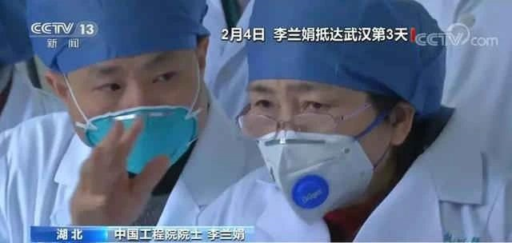
1
2
On February 1, LI and her emergency medical team from Shulan Hospital were geared up for their aid to Wuhan. She said,“We can bring our experience to Wuhan and we hope that critically ill patients can be treated in a timely manner.”
gear/ɡɪə(r)/
v. 开始工作; 开动
be geared up
准备就绪
critically/ˈkrɪtɪkli/
adv. 危急地；严重地
One of the heroes in harm's way: LI Lanjuan

Slide 33
1
2
Scientists and researchers, who have been working day and night, isolated the first virus strain and developed the test reagent in less than seven days. Hailed as heroes in harm's way, over 20,000 healthcare workers in 100 plus medical teams converged in Hubei, the hardest hit province, from across the nation to support epidemic control. Exemplifying professional dedication, all medical workers are saving and protecting lives around the clock despite the risk of infection and exhaustion from overwork.
科技人员不眠不休投入工作，不到7天就成功分离病毒毒株并研制出检测试剂。一百多支医疗队、两万多名医护人员从全国各地向湖北重灾区集结，被誉为当代“最美逆行者”。所有医护人员以高度的职业素养，夜以继日奋斗在救治一线，冒着被感染的危险拯救病人的生命，透支自己的健康守护他人的安宁。---王毅在慕尼黑全会议 exhaustion/ɪɡˈzɔːstʃən/n. 枯竭；精疲力竭
reagent /riˈeɪdʒənt/ n. 试剂；反应物 hail /heɪl/ vt. 致敬；招呼；向...欢呼
converge/kənˈvɜːdʒ/ v. 聚集；靠拢 exemplify /ɪɡˈzemplɪfaɪ/ vt. 例证；例示

Slide 34
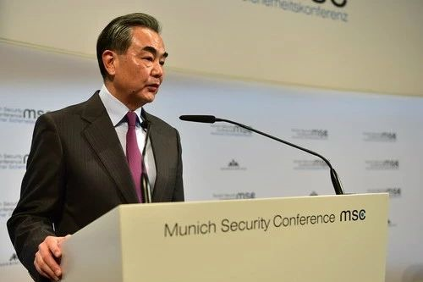
1
3
Adversity reveals true friendship. True gold can stand the test of fire.
患难见真情，烈火炼真金。---2020年2月 王毅接受路透社专访。
中国有句话，“烈火炼真金”。我们相信，经过这场疫情考验，中国人民将会更加坚强团结，中国经济将更加稳健可持续，全体中国人民会以更坚实步伐，实现全面小康，迈向现代化进程。中国还有一句话叫做“患难见真情”。在共同抗击疫情的斗争中，中国同各国之间的友谊和信任将得到加强和深化。各国都会意识到，我们身处一个地球村，国与国的命运已经紧密地联系在一起。 ---2020年2月14日，王毅接受路透社专访。

Slide 35
1
3
As an old saying goes in China, “real gold can endure the burning fire.” We believe, through the test of the outbreak, with more stability and sustainability of China's economy, all Chinese people will be stronger and more united to advance China into a moderately prosperous country and march for the modernization in more solid steps. There is another old saying going that “the trouble unveils the true friendship.” In the fight against outbreak, the friendship and mutual trust between China and other countries will be strengthened and deepened. Every country will come to realize that we are in one global village where the destinies of all countries are closely interwoven.
sustainability /səˌsteɪnəˈbɪləti/ n. 持续性; 可持续发展 unveil /ˌʌnˈveɪl/ v. 揭开；显露
moderately /ˈmɒdərətli/ adv. 适度地；中庸地; 中等地 interwove交织; 交叉
mutual/ˈmjuːtʃuəl/ adj. 共同的；相互的，彼此的 destiny /ˈdestəni/ n. 命运

Slide 36
1
4
Winter will eventually pass, and spring is sure to come.
没有一个冬天不可逾越，没有一个春天不会到来。
---2020年2月15日，王毅在第56届慕尼黑全会议上的演讲。
严格彻底的防控措施正在显现效果。截至2月14日，全国除湖北以外的确诊病例已经连续12天下降，而湖北和武汉的疫情也正在得到更有效管控。这一事实表明，这场疫情总体上是可控的。治愈人数昨天超过了8000人，全国病亡率控制在2.29%，除湖北以外的病亡率则为0.55%。这一事实和数据表明，这场疫情总体上是可治的。正像习近平主席所说，我们完全有信心、有能力、有把握战胜这场疫情。黎明，正在到来；曙光，就在前方。

Slide 37
1
4
China's rigorous and thorough measures are paying off. As of 14 February, the number of confirmed cases outside Hubei has recorded a 12-day consecutive drop, and the situation in Hubei and Wuhan is being put under more effective containment. This shows that overall, the epidemic is controllable. The number of cured cases exceeded 8,000 as of yesterday. The case fatality rate has been kept at around 2.29 percent nationwide, and 0.55 percent outside Hubei. These facts and figures demonstrate that the disease is largely curable. Just as President Xi Jinping said, we have full confidence, capacity and determination to defeat the epidemic. Dawn is breaking and we are seeing light coming through.
consecutive /kənˈsekjətɪv/adj. 连贯的；连续不断的
containment /kənˈteɪnmənt/ n. 控制，抑制；遏制
exceed /ɪkˈsiːd/ v. 超过；胜过--excessive adj. 过多的，极度的
fatality /fəˈtæləti/ n. 死亡；致命性 --fatal/ˈfeɪtl/ adj. 致命的；毁灭性的

Slide 38
1
4
After the storm comes the rainbow. We are confident that China will emerge stronger from the epidemic. Its pent-up consumer demand and growth potential will be quickly unleashed and China will enjoy more sound and sustainable economic and social development.
风雨之后总会有彩虹。相信在疫情得到控制后，中国将会浴火重生，积压的消费和增长潜力将快速释放，中国的经济社会发展将在更加健康和可持续的轨道上阔步前行。---王毅在第56届慕尼黑全会议上的演讲
emerge /ɪˈmɜːdʒ/ vi. 浮现；摆脱；暴露
pent-up /ˌpent ˈʌp/ adj. 被压抑的；幽闭的
unleash /ʌnˈliːʃ/ v. 发泄；解除束缚 --leash n. 皮带；束缚 v. 束缚；皮带绑住
sound adj. 合理的；充足的；彻底的；熟睡的；健全的
sustainable /səˈsteɪnəbl/ adj. 可持续的

Slide 39
1
5
No victory should be lightly announced until there is a complete win.
不获全胜，决不轻言成功。
---2月23日，习近平在统筹推进新冠疫情防控和经济社会
发展工作部署会议上的重要讲话。
At such a time it is even more important to view China's development in a comprehensive, dialectical and long-term perspective, and to strengthen and firm up confidence. In general, the fundamentals of China's long-term sound economic growth remain unchanged.
越是在这个时候，越要用全面、辩证、长远的眼光看待我国发展，越要增强信心、坚定信心。综合起来看，我国经济长期向好的基本面没有改变，疫情的冲击是短期的、总体上是可控的。
dialectical /ˌdaɪəˈlektɪkl/ adj. 辩证的；辩证法的；方言的
fundamental /ˌfʌndəˈmentl/ adj. 基本的，根本的 n. 基本;根本

Slide 40
1
5
The COVID-19 outbreak is a major public health emergency that has spread in the fastest speed, caused the most extensive infection and is the most difficult to contain in the country since the founding of the People's Republic of China. This is both a crisis and a big test for us.
这次新冠肺炎疫情，是新中国成立以来在我国发生的传播速度最快、感染范围最广、防控难度最大的一次重大突发公共卫生事件。对我们来说，这是一次危机，也是一次大考。--- 习近平在统筹推进新冠疫情防控和经济社会 发展工作部署会议上的重要讲话。
extensive /ɪkˈstensɪv/ adj. 广泛的；大量的；广阔的
contain /kənˈteɪn/ v. 控制；包含；容纳
crisis /ˈkraɪsɪs/ n. 危机；危险期；决定性时刻

Slide 41

Thank you!

